Slide 1
GTFS-ride: The First Standard for Transit Ridership Data
Oregon Department of Transportation¹, Oregon State University², COGITO Partners³
Matthew Barnes¹, Josh Roll¹
Dr. J. David Porter², Phillip Carleton², Sylvan Hoover², Ben Fields²
Chris Watchie³

Slide 2
Meeting Outline
Project and Attendee Introductions
Meeting 2 Protocol
Project Updates and Discussion
Industry Stakeholder Presentations
moovel
Remix
TIDES
Trillium
Plans for Progress and Future Meetings
Group Interaction, Feedback, and Insights

Slide 3
Project and Consortium Group Members
10/10/2018

Slide 4
Introductions
Oregon Department of Transportation (ODOT)
Matthew Barnes, Transit Network Coordinator
Josh Roll, Research Coordinator
Oregon State University (OSU)
Dr. J. David Porter, Professor
Phillip Carleton, Graduate Student
Sylvan Hoover, Graduate Student
Ben Fields, Graduate Student
COGITO Partners
Chris Watchie, Principal (Meeting Facilitator)
Notes:
“aaron@trilliumtransit.com'" <aaron@trilliumtransit.com>, "'Andrew.Martin@ltd.org'" <Andrew.Martin@ltd.org>, BARNES Matthew M <Matthew.M.BARNES@odot.state.or.us>, "'carletop@oregonstate.edu'" <carletop@oregonstate.edu>, "'charlie@remix.com'" <charlie@remix.com>, "'chris@cogitopartners.com'" <chris@cogitopartners.com>, "'cpangilinan@transitcenter.org'" <cpangilinan@transitcenter.org>, "'David.Porter@oregonstate.edu'" <David.Porter@oregonstate.edu>, "'DBarker@mbta.com'" <DBarker@mbta.com>, "'DPilant@tillamookbus.com'" <DPilant@tillamookbus.com>, "'easall@gmail.com'" <easall@gmail.com>, "'fieldsbe@oregonstate.edu'" <fieldsbe@oregonstate.edu>, "'gabriel@korbato.com'" <gabriel@korbato.com>, "'GilligaM@trimet.org'" <GilligaM@trimet.org>, "'hooversy@oregonstate.edu'" <hooversy@oregonstate.edu>, "'jay@korbato.com'" <jay@korbato.com>, "'john.levin@metrotransit.org'" <john.levin@metrotransit.org>, "'jonny@goswift.ly'" <jonny@goswift.ly>, "'jsullivan@rvtd.org'" <jsullivan@rvtd.org>, "'lreed@conveyal.com'" <lreed@conveyal.com>, "'maddie@goswift.ly'" <maddie@goswift.ly>, "'mike.kowalski@fuse.net'" <mike.kowalski@fuse.net>, "'mike@goswift.ly'" <mike@goswift.ly>, "'mindy.montgomery@moovel.com'" <mindy.montgomery@moovel.com>, "'nick.fischer@utatransit.net'" <nick.fischer@utatransit.net>, "'ritesh.warade@ibigroup.com'" <ritesh.warade@ibigroup.com>, "'satinder.bhalla@transsight.com'" <satinder.bhalla@transsight.com>, "'schancey@co.josephine.or.us'" <schancey@co.josephine.or.us>, "'tkowalski@fuse.net'" <tkowalski@fuse.net>, "'tyler.gislason@tripspark.com'" <tyler.gislason@tripspark.com> “ -CW

Slide 5
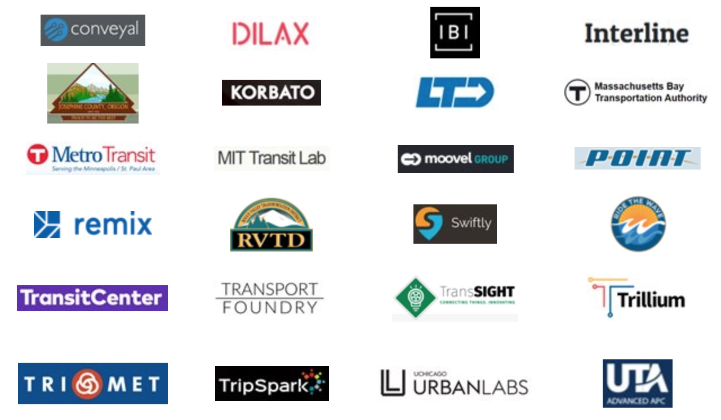
Consortium Group Members

Slide 6
Introductions
Please introduce yourself in the chat box!
Name, Title, Organization, Email Address

Slide 7
Interactive Meeting Protocols
10/10/2018

Slide 8
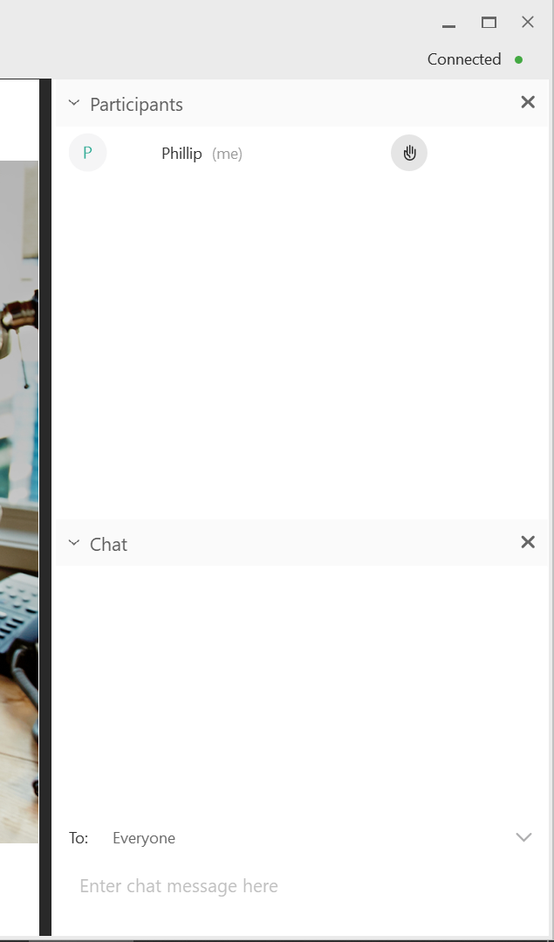
Suggestions for Interaction
A combined Q & A will take place at the end of all presentations
You may submit questions and comments in writing in the chat dialogue box (with option to be seen by “everyone”) during the presentation
Questions and comments will be addressed at the end of the presentation to allow time for all presenters
Notes:
Content from CW version of this slide:
“This will be confirmed during our dry run of presentation.
To make a comment or question,
please use the X function.
All questions and comments will be
addressed during the meeting or in
the summary report.
“
This needs to be updated once we do the dry run - CW

Slide 9
Consortium Group – Roles & Responsibilities
Provide your time and commitment for three meetings to
Suggest adjustments and actions
Steer the development
Review of transit agencies input
Come well prepared to all meetings
Notes:
“From the intro email:
Look at the GTFS-ride data standard and suggest adjustments that will both meet your possible future needs and provide value to other GTFS-ride users.
Suggest actions that will help us move GTFS-ride from a data format to a data standard.
Help steer the development of a simple suite of open source software tools to support use of the data standard.
Review of transit agencies input on pilot use of GTFS-ride and suggested changes to data standard.
Note to group: how much time 10-15 hrs total? “ - CW

Slide 10
Project Updates and Discussion
10/10/2018

Slide 11
GTFS-ride Promotion Activities
Conference Presentations
Past
Institute of Industrial and Systems Engineers Annual Conference
Orlando, FL – May
State Public Transportation Partnership Conference
Minneapolis , MN – August
National Conference on Rural Public and Intercity Bus Transportation
Breckenridge, CO – September
Upcoming
Oregon Public Transportation Conference – Bend, OR (https://oregontransit.com/OPTC_Conference)
CALACT Technology & Shared Mobility Conference – Napa, CA (https://www.calact.org/conferences)
Transportation Research Board Annual Meeting – Washington, D.C. (http://www.trb.org/AnnualMeeting)

Slide 12
GTFS-ride Promotion Activities
Possible upcoming TRR publication
Currently under revision after initial review
Google group GTFS-ride discussion posts
Very limited group involvement and feedback

Slide 13
File Size Comparisons
Agency | Detail Level | Time Range | Raw Ridership File Size | Zipped GTFS File Size | Zipped GTFS-ride File Size
Lane Transit District (LTD) | Daily Stop-Visit | 2.5 months | 49.09 MB (.csv) | 1.22 MB (1 feed) | 11.00 MB (1 feed)
Rogue Valley Transportation District (RVTD) | Daily Stop Visit | 2 months | 31.3 MB (.csv) | 0.27 MB (1 feed) | 2.89 MB (1 feed)
Josephine Community Transit (JCT) | Daily 7 Routes | 2.5 months | 1.2 MB (.xls) | 0.50 MB (5 feeds) | 0.47 MB (5 feeds)
Union County Public Transit (NEOPT) | Daily 1 Route | 10 months | 0.22 MB (.xls) | 0.09 MB (1 feed) | 0.06 MB (1 feed)

Slide 14
LTD and RVTD Data Processing

Slide 15
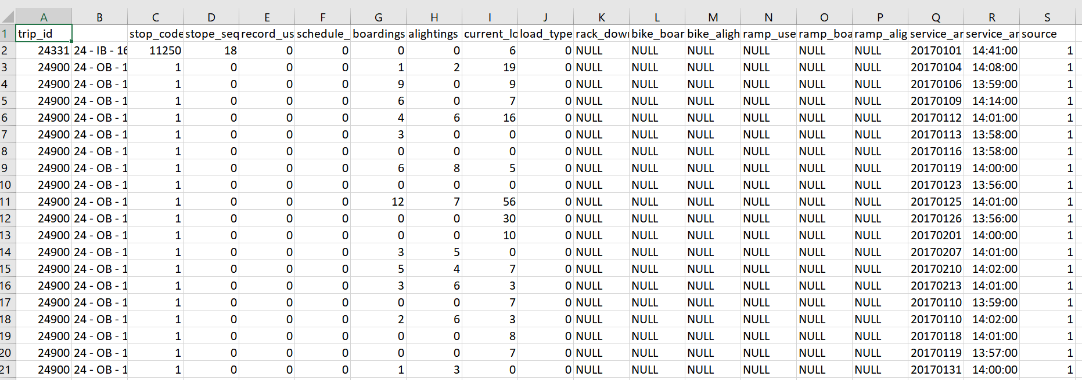
RVTD Provided Data

Slide 16
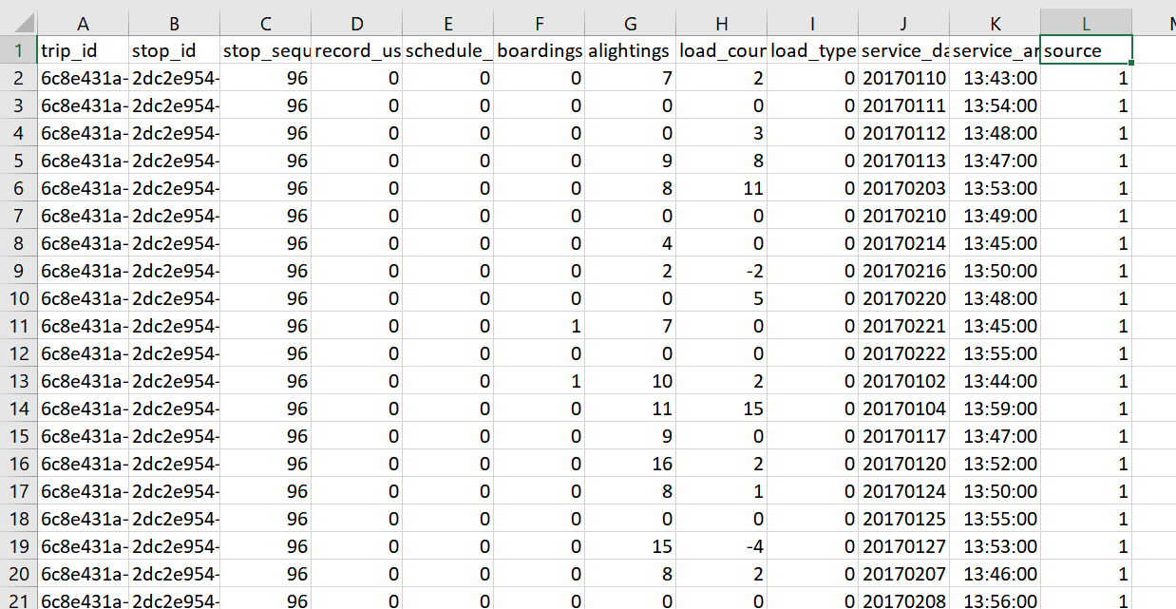
GTFS-ride Representation

Slide 17
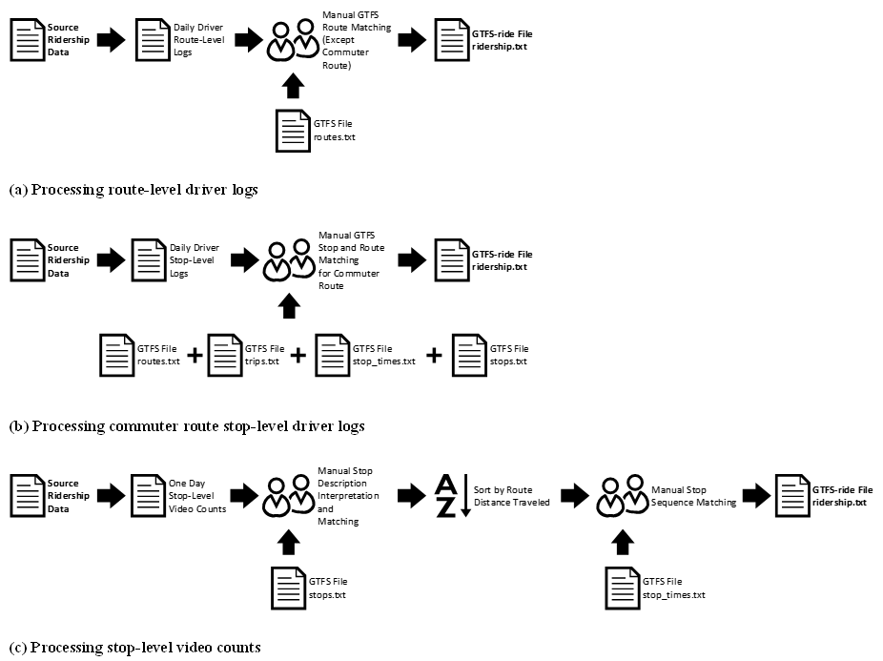
JCT Data Processing

Slide 18
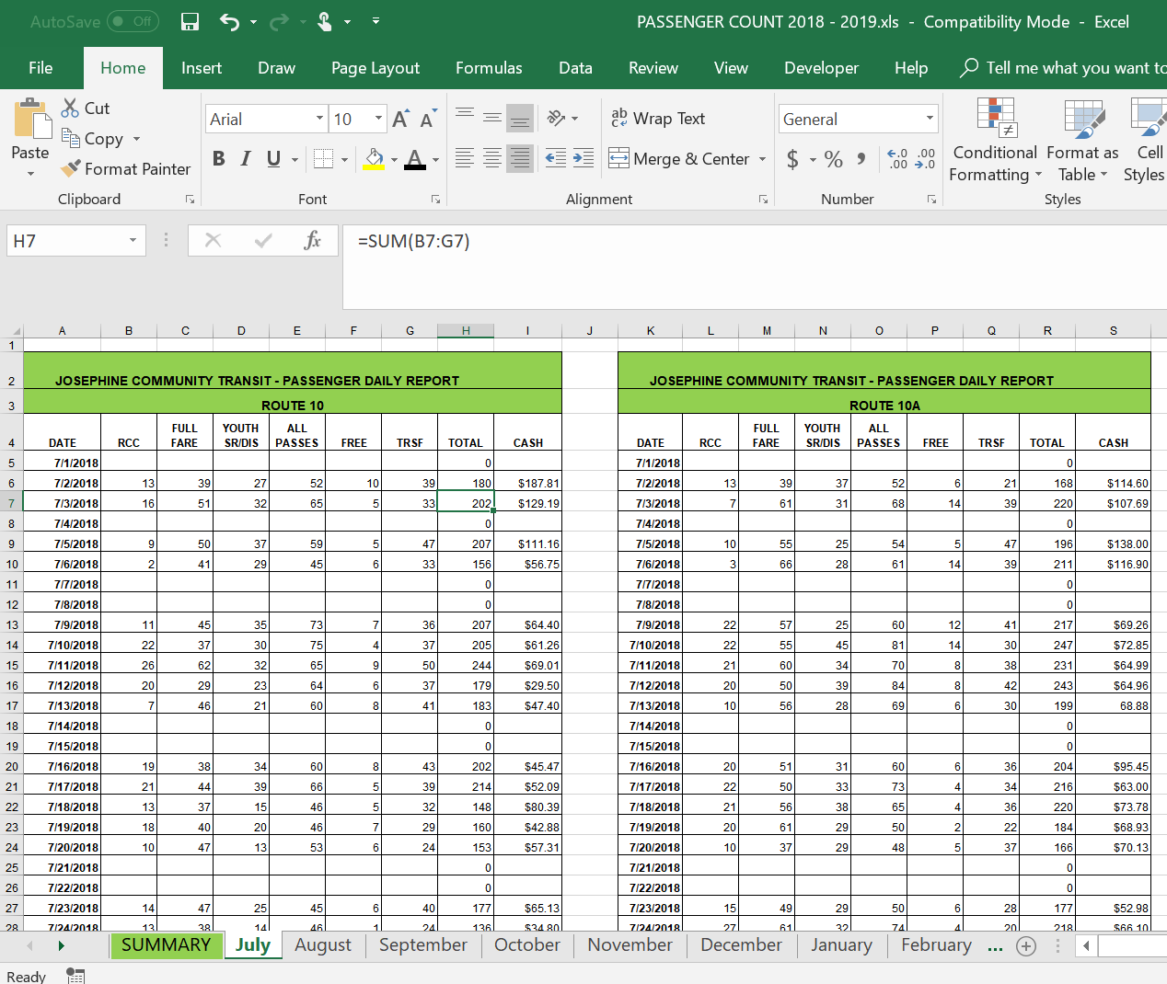
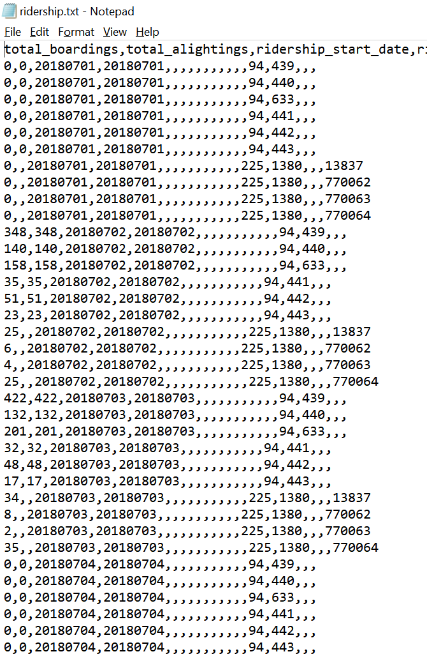
JCT Input vs. Output

Slide 19
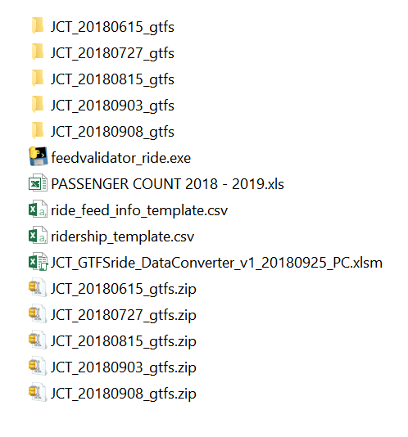
JCT Conversion Tool
Folder Setup Steps
Gather required GTFS feeds
Unzip GTFS feeds
Provide GTFS-ride templates
Provide raw data file
Place converter file in folder
`
`
`

Slide 20
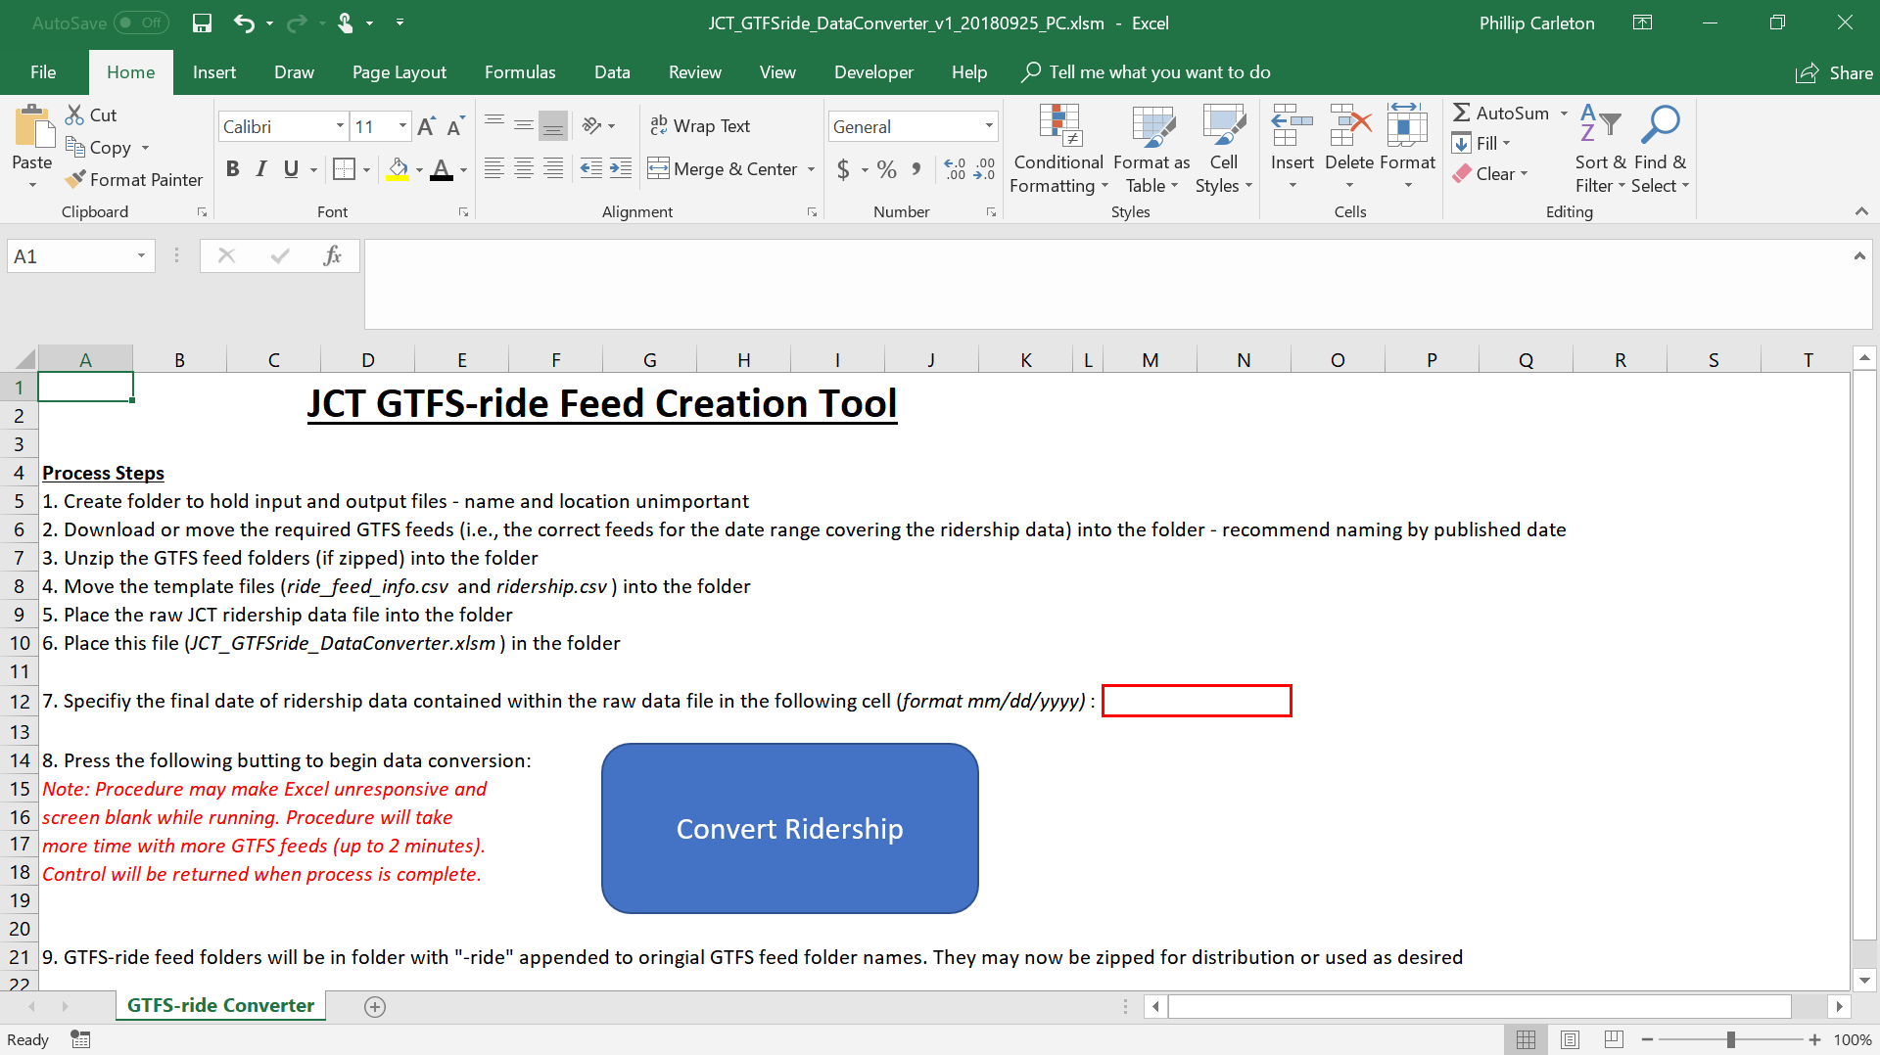
JCT Conversion Tool

Slide 21
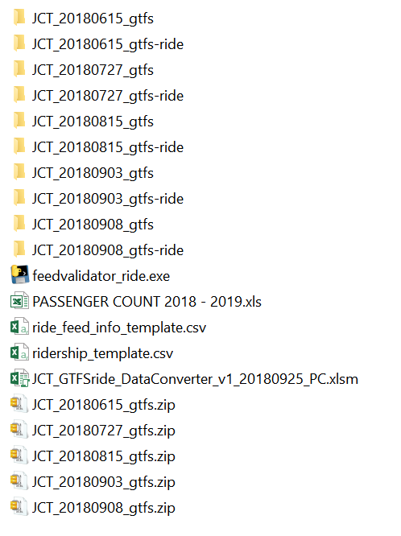
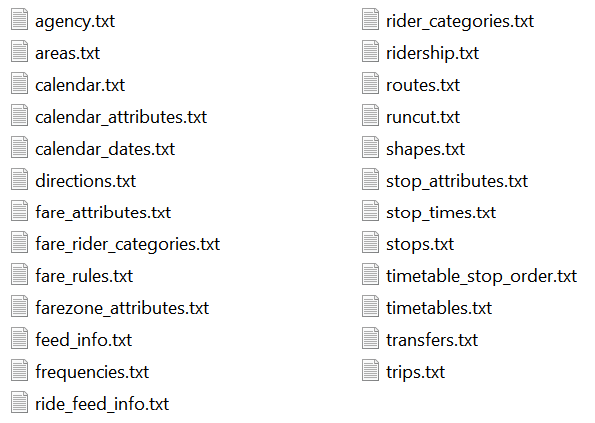
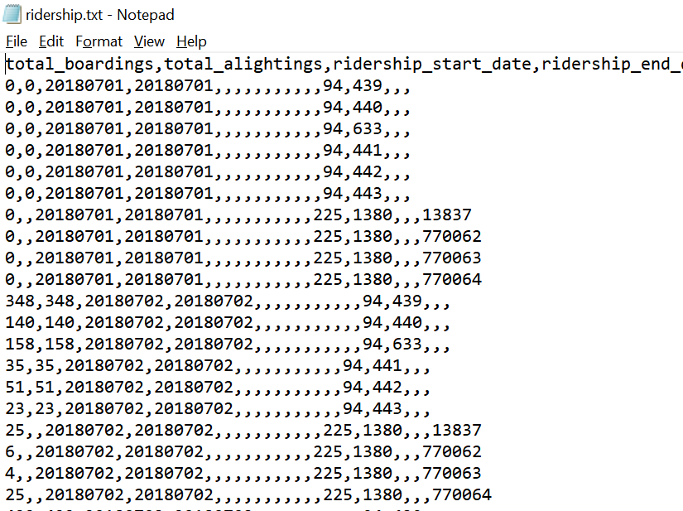
JCT Conversion Tool

Slide 22
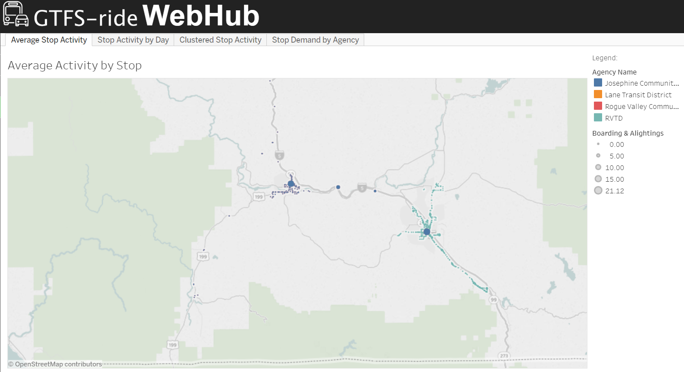
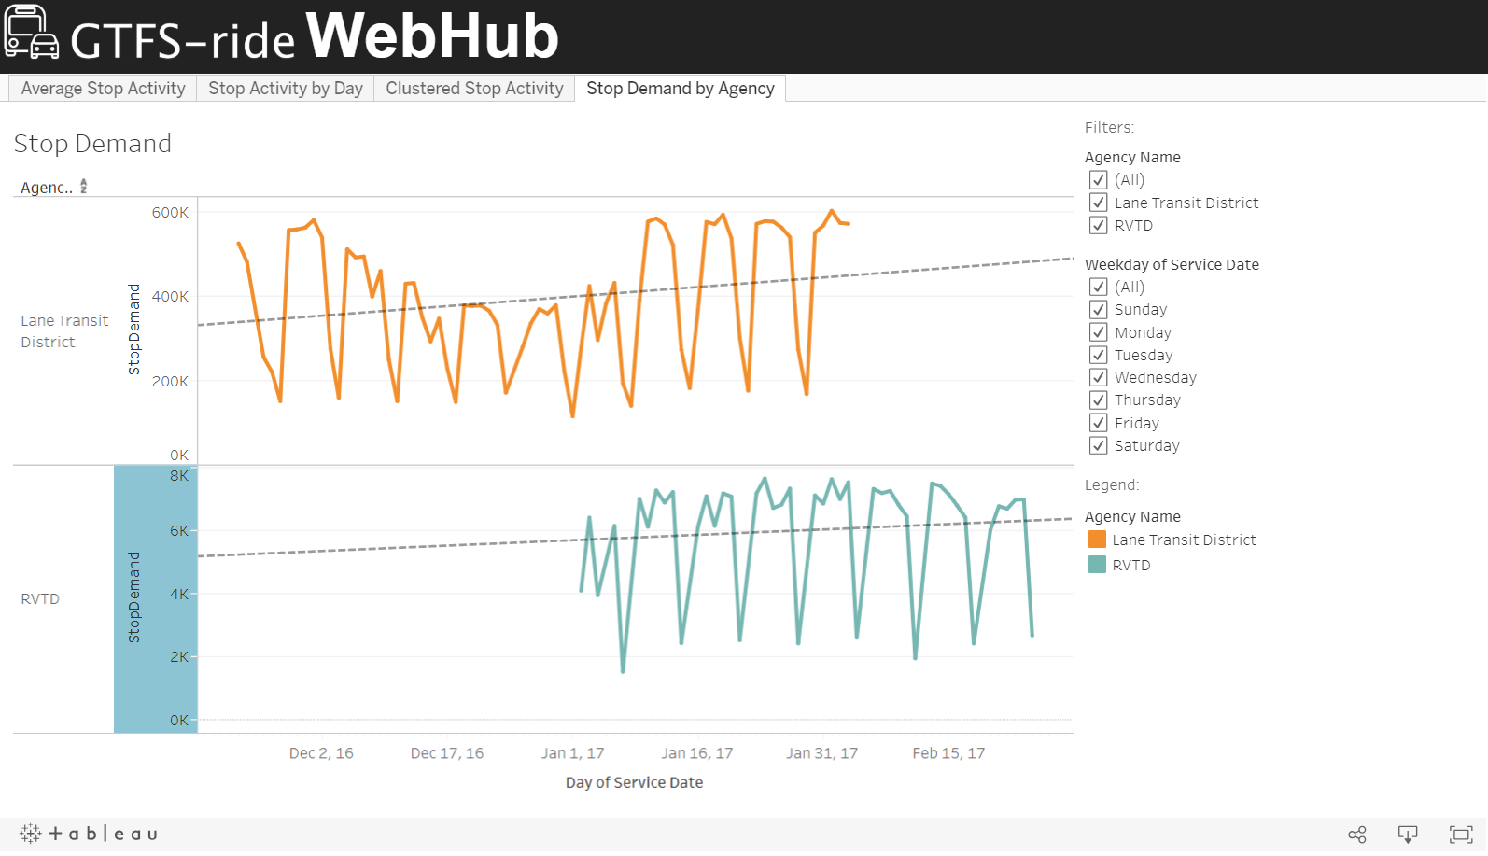
WebHub Visualizations

Slide 23
Industry Stakeholder Conversations

Slide 24
Plans for Progress and Future Meetings
10/10/2018

Slide 25
Project Tasks
Project Timeline
Official completion date
December 31, 2018
Possible extension if additional funding is secured
Remaining Project Tasks
Work with JCT to refine conversion macro
Assist any other agencies to produce GTFS-ride data
Promote GTFS-ride at upcoming conferences
Continue Google groups discussions and dissemination efforts
Refine Tableau outputs
Continue administration and maintenance of standard, including outstanding issues and change requests
Produce final project report

Slide 26
Group Meetings & Tasks
Next Consortium Meeting
January 2019 (tentative)
Doodle poll will be sent out in the next couple of weeks
Consortium Group Tasks
Decide if continued GTFS-ride discussion posts to the Google group is valuable
Renewed efforts to build an interested stakeholder group in GTFS-ride with your contacts
Provide project team with contact list of possible opportunities (e.g., funding, publication, marketing, conferences, developers, organizations, agencies, etc.)
Provide feedback to open GTFS-ride issues on GitHub and Google group

Slide 27
Group Interaction and Feedback
10/10/2018

Slide 28

Thank You!
Additional questions or comments can be directed to:
Dr. J. David Porter
David.Porter@oregonstate.edu
For more information please visit www.gtfs-ride.org

Slide 29
Conversion Program Flow

