Slide 1

Remote Directory Server

Slide 2
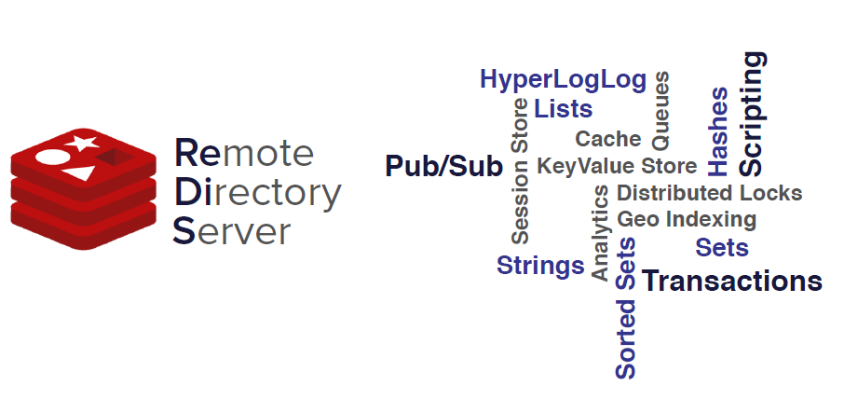
Introduction
Redis - https://www.youtube.com/watch?v=ctfDs7M35Ho&t=2564s

Slide 3
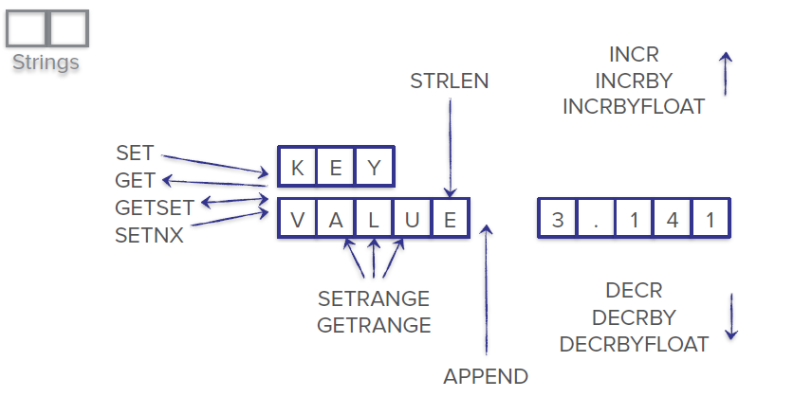
Types – String

Slide 4
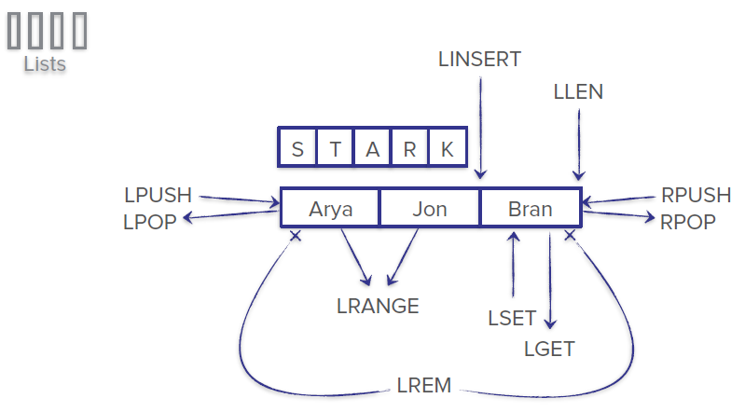
Types – List

Slide 5
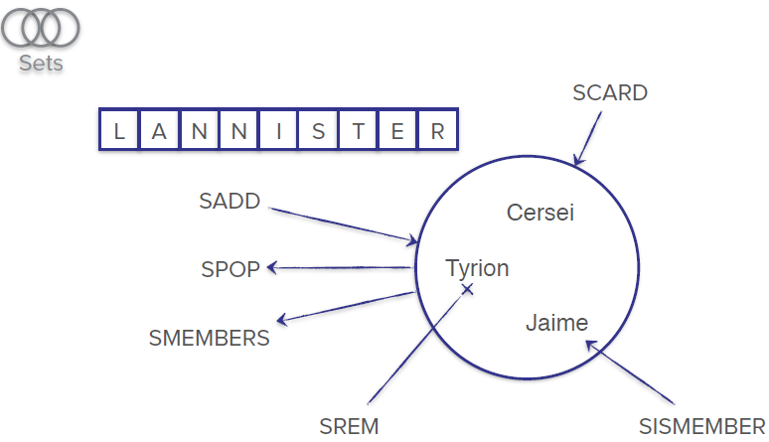
Types – Set

Slide 6
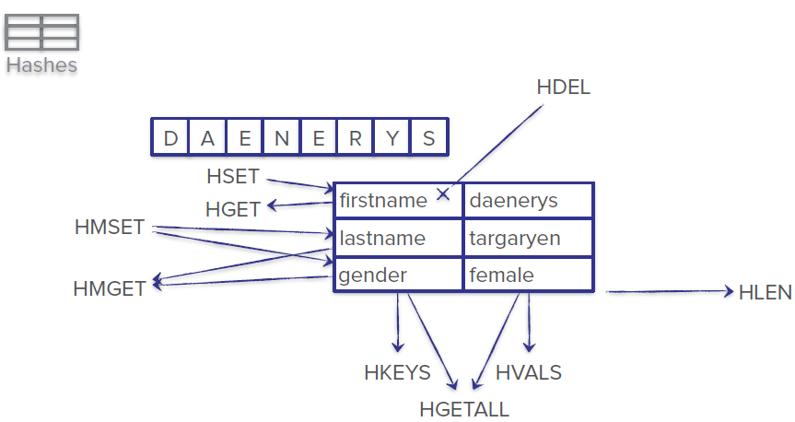
Types – Hash

Slide 7
Demo
KEY
VALUE
P
A
Y
M
E
N
T
I
D
HASH
ENTRY KEY
ENTRY VALUE
ObjRef(dom+refId)
Group ID,
RelationRefID: List
ObjNotes: List
A1
S0
RelationRefID: [1]
ObjNotes: List
B1
S0
RelationRefID: [1]
ObjNotes: List

Slide 8
Demo
KEY
VALUE
R
E
L
A
T
I
O
N
HASH
ENTRY KEY
ENTRY VALUE
ENTRY KEY: LONG
FirstObjRef(dom+refid),
Owner
SecondObjRef(dom+refid)
Trans Ref
timestamp
1
A1
Owner
B1
Trans Ref
timestamp

Slide 9
RDB(Redis Database File)
RDB Makes a snapshot of the dataset at specific intervals.
How does it work?
Whenever Redis create a snapshot, this happens
1.Redis forks. New child process starts In addition to the parent process
2. The child process begins to write the dataset to a temporary RDB file.
3. Once the child process finishes writing to the new RDB file, it replaces the old one.
Commands:
--SAVE: block all the other clients, while saving the DB
--BGSAVE: Save the DB in background process.(preferred in production env, you don’t want to block Redis until it completes the snapshot)
In Redis.config file: save 30 100 means take a snapshot every 30 seconds if there are 100 keys changed.

Slide 10
RDB(Redis Database File)
Advantages:
A straightforward approach to backup and restore your data, enabled by default in redis.config file.
RDB is very good for disaster recovery, being a single compact file can be transferred to remote data centers (possibly encrypted).
RDB maximizes Redis performances since the only work the Redis parent process needs to do in order to persist is forking a child that will do all the rest. The parent instance will never perform disk I/O or alike.
Disadvantages:
Using RDB There is a possibility that you will lose data that stored in memory after RDB’s last snapshot.
When RDB frequently forks a child process to persist on disk, the fork can be time-consuming if the dataset is big.

Slide 11
AOF(Append Only File)
How does it work?
AOF logs each write operation received by the server, that will be played again at server startup, restoring the original dataset.
Advantages:
Durability, no data lost. (you can have 3 fsync policies:no fsync at all, fsync every second(default), fsync at every query).
Append only prevent data corruption.
Redis can automatically rewrite the AOF in the background when it gets too big
Disadvantages:
AOF writes to disk for every operation, an expensive task.
Size of AOF file is larger than RDB file. Also, AOF might be slower than RDB(it depends on fsync policies)

Slide 12
Hybrid Approach(RDB & AOF)
Recommended approach in Redis documentation. AOF provides data safety, and RDB delivers snapshots backups for disaster recovery.
Combining both AOF and RDB in the same instance is possible. In this case, when Redis restarts, the AOF file will be utilized to reproduce the original dataset since it is assured to be the most complete.
Recommended Read:
https://redis.io/topics/persistence

