Slide 1
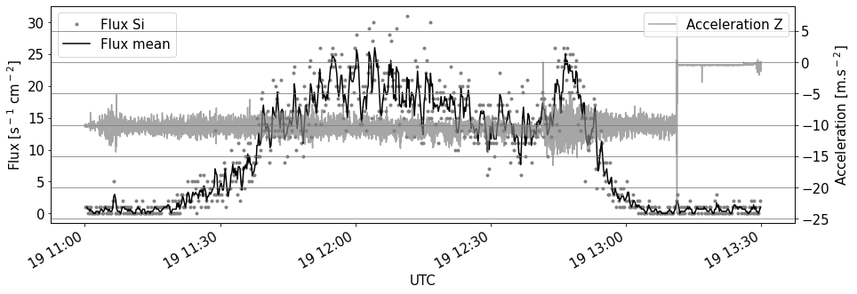
take off
burst
landing

