Slide 1
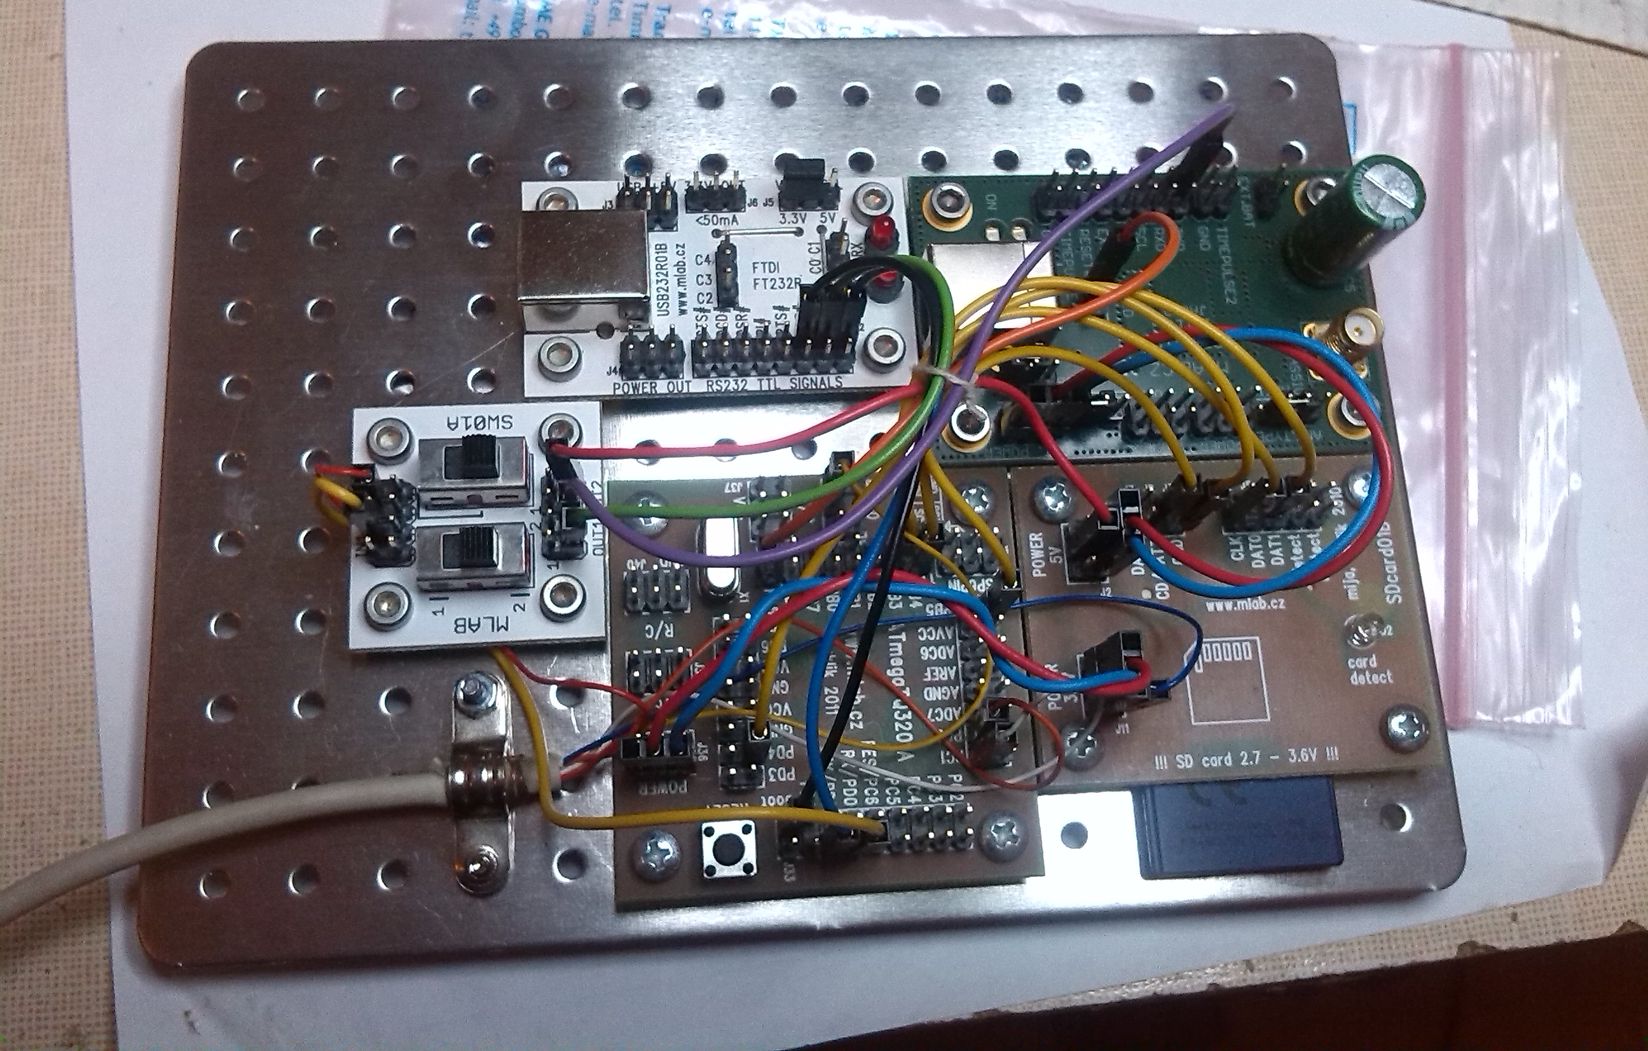
USB
to
PC
GPS
Antenna
Power
ON/OFF
Firmware
Update /
Log Output
SD
Card
MB 3201

