Slide 1
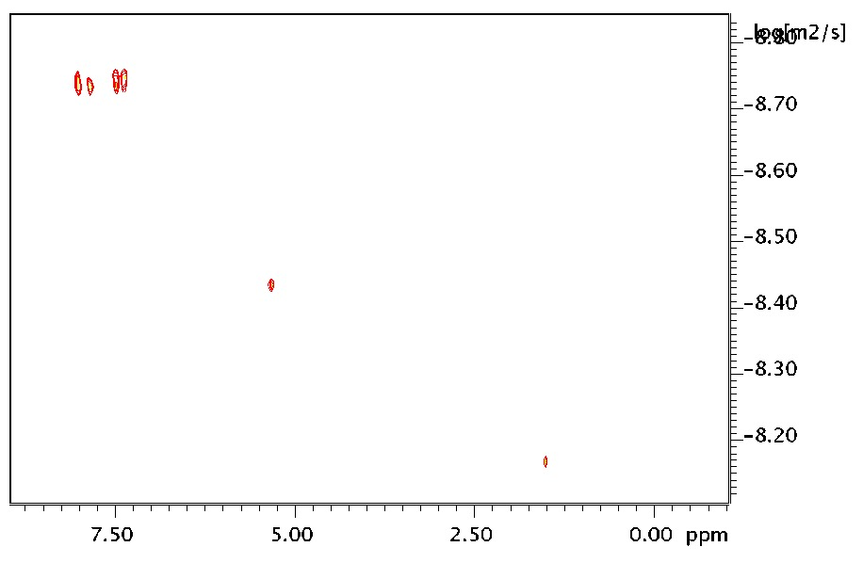
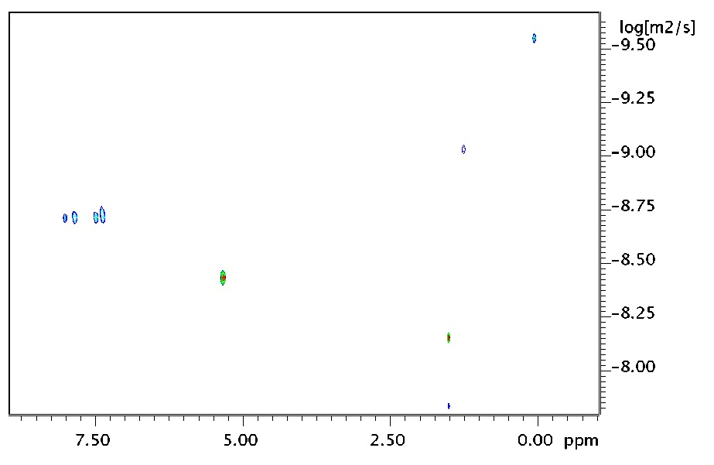
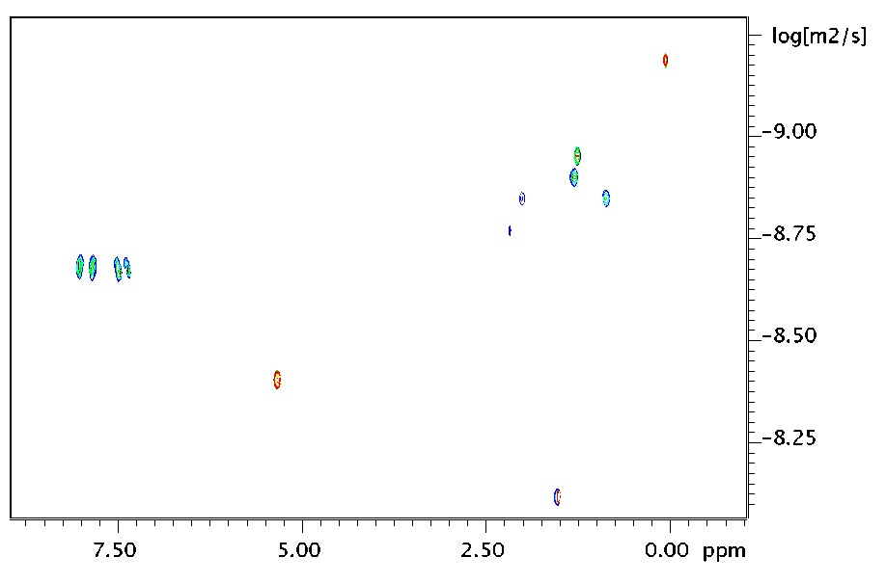
a
b
CD₂Cl₂ – 8.9 mg/ml
CD₂Cl₂ – 0.89 mg/ml
Chemical shift
Chemical shift
c
d
CD₂Cl₂ – 0.089 mg/ml
Material | Diffusion constant [m² s⁻¹]
 | 8.9 mg/ml | 0.89 mg/ml | 0.089 mg/ml
D (BSBS) | 1.8 x 10⁻⁹ | 1.9 10⁻⁹ | 2.1 10⁻⁹
D (CD₂Cl₂) | 3.6 10⁻⁹ | 3.7 10⁻⁹ | 4.0 10⁻⁹
D (H₂O) | 6.8 10⁻⁹ | 7.1 10⁻⁹ | 7.6 10⁻⁹
Chemical shift

