Slide 1
Numerical Simulations: Laser Annealed InZnO on Plastic
John Armitage
Cavendish Laboratory: Optoelectronics Group

Slide 2
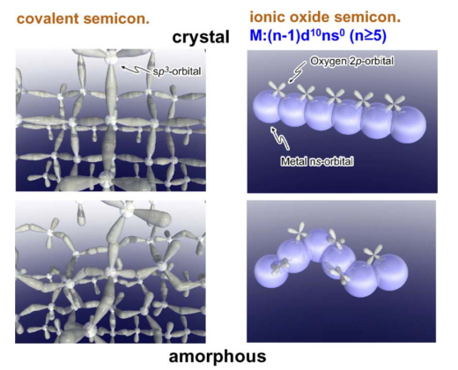
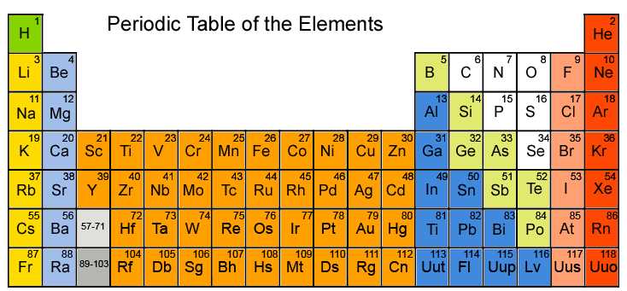
Amorphous Oxides: New Student Review
InGaZnO, ZnO, InO, ITO, TiO
Oxides semiconductors are inherently N-type
Possible high mobilities (100 cm2/Vs)
Hosono et. al. – Nature 2004
Notes:
I do not know how familiar everyone is with Amorphous Oxides. So, I feel like a brief review is in order. Oxide Semiconductors are a bit odd. Oxides like in most inorganic devices are a insulator. This group of elements with a large delocalized orbitals, end up with overlap between atoms.
Transport it non-band like. Just like organics. Cause of n-type is a little controversial. Oxygen vacancies act as hole traps. Hopping transport. Large delocalized orbitals
How to keep oxide amorphous from becoming crystalline – use different ratios of Zn:Ga:In

Slide 3

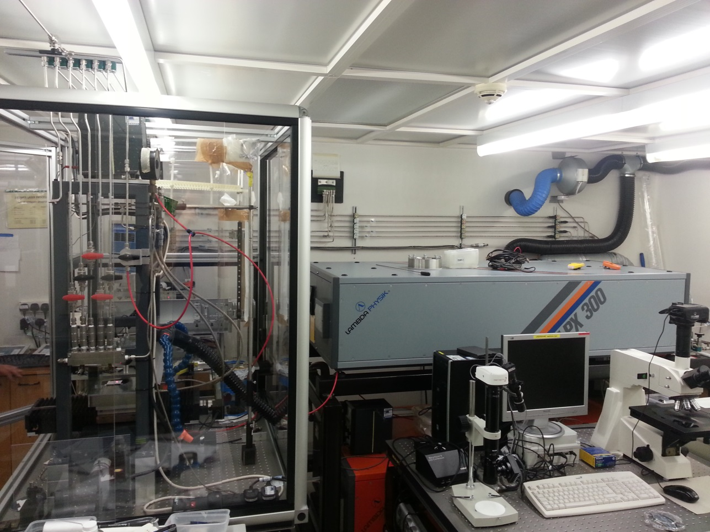
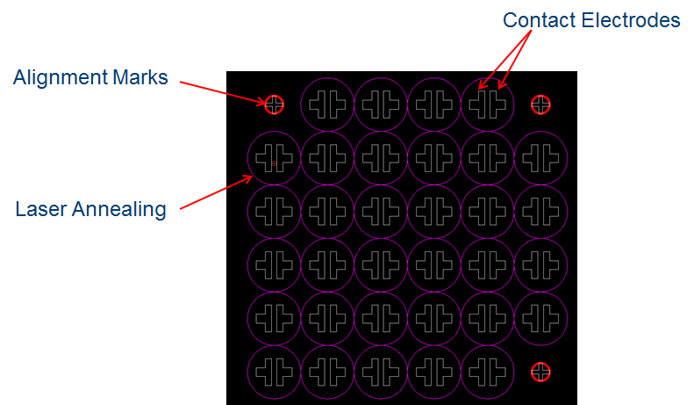
KrF Excimer Laser
248 nm laser
25 ns pulse width

Slide 4
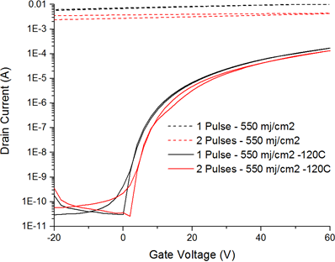
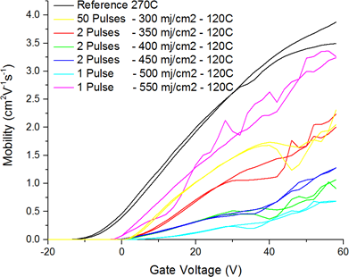
Results: Laser Annealed Oxides on Silicon
- How is this process occurring? - Can we transfer this process to plastic?
Low Temp Anneal
Al Electrodes
IZO
SiO2
N-Doped Si

Slide 5
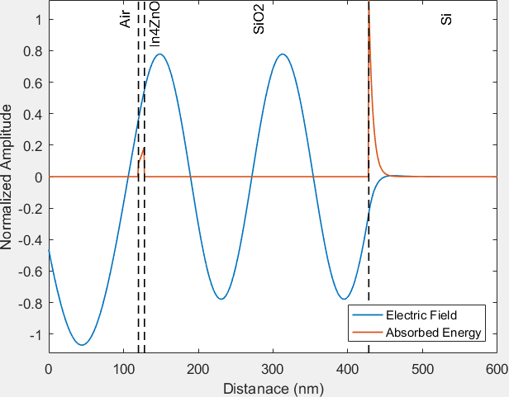
Simulating Laser Annealing
Step (1): Boundary Conditions
1: E_{nL}+ E_{nR} = E_{(n+1)L}+ E_{(n+1)}
2: d(E_{nL}+ E_{nR})/dx = d(E_{(n+1)L}+ E_{(n+1)R})/dx
Step (2): D, H, B
1: D = εE 2: VxE = -dB/dt 3: H = B/μ
Step (3): Absorption rate
1: U = ½ (E·D + E·H) 2: S = E x H
3: dA/dt = -dU/dt - V·S
Step (4): Finite Element – Heat Transfer
1: ϱ*Cp*dT/dt - V·(kVT) = dQ/dt
Air
In4ZnO
SiO2
Si
E_{1L}
E_{2L}
E_{3L}
E_{4L}
E_{1R}
E_{2R}
E_{3R}

Slide 6
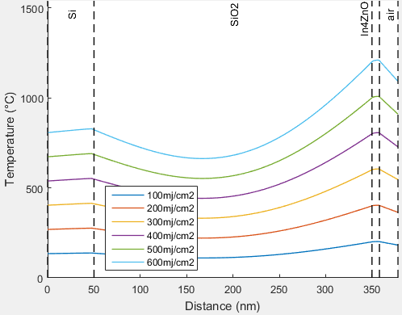
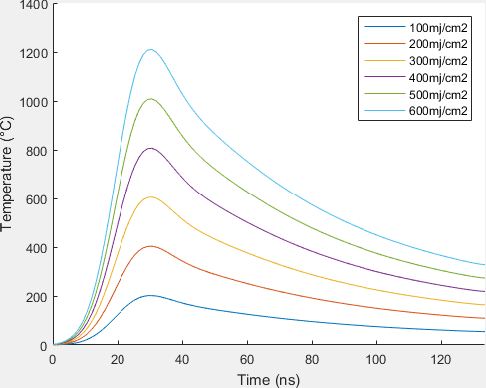
Comparison of Simulation to Experimental work
Devices work between 350 mj/cm2 to 550 mj/cm2
Temperature cross section of sample at maximum temperature of the IZO layer
Maximum temperature of IZO layer
Possible Process Window
1) Byskov-Nielsen, et. al. Ultra-short pulse laser ablation of metals: Threshold fluence, incubation coefficient and ablation rates. Appl. Phys. A Mater. Sci. Process. 101, 97–101 (2010).

Slide 7
Can we cover this process to glass or PEN?
Determine rough estimate of processing window
Laser
Glass or PEN
Complete Fabrication
Al Gate
Cytop
Amorphous Oxide
Electrodes
Glass or PEN
7

Slide 8
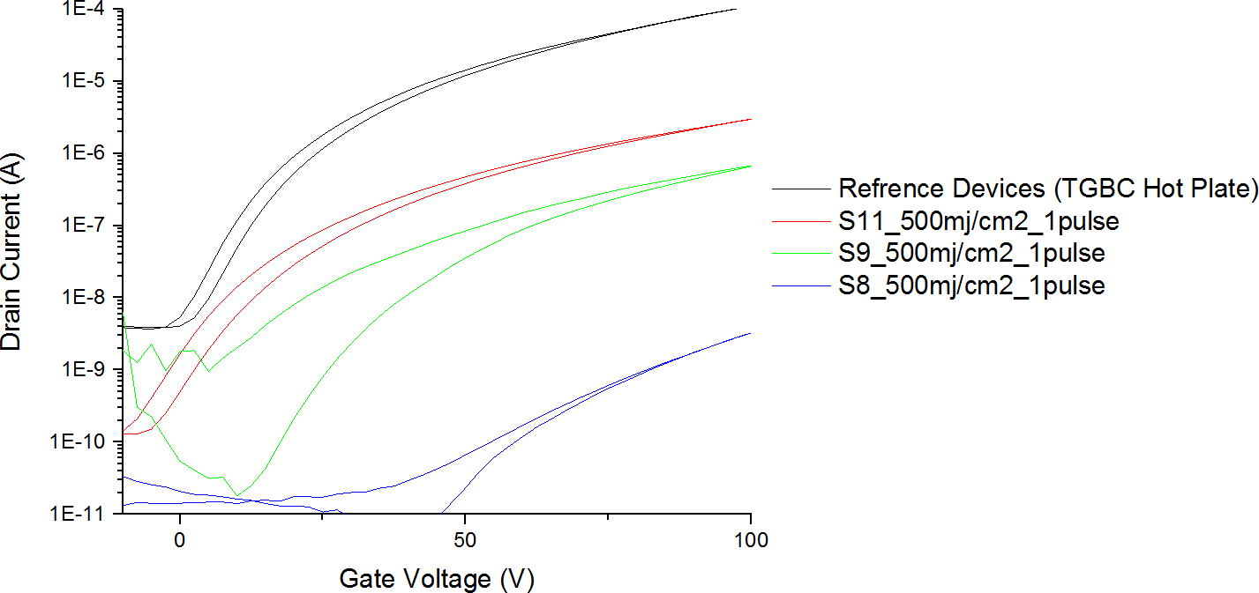
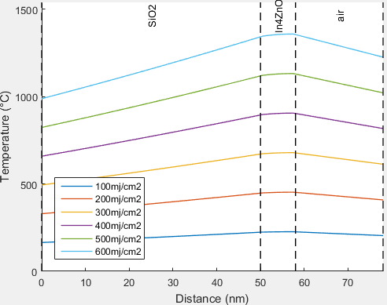
Top Gate Top Contact Glass
Device properties exhibited between 350 mj/cm2 to 550 mj/cm2
Al Gate
Possible Process Window
Cytop
Amorphous Oxide
Al Electrodes
Glass

Slide 9
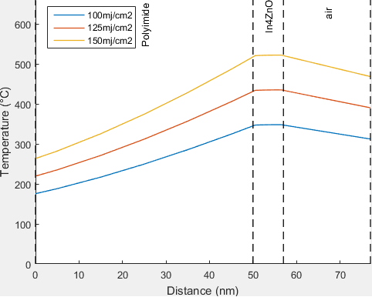
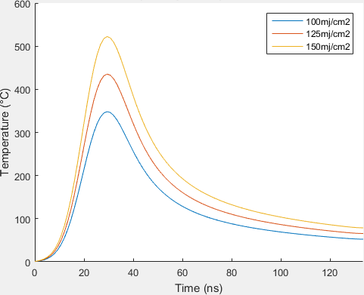
Top Gate Top Contact PEN
No working Devices PEN: Max Fluence 100 mj/cm2 – PEN Obliterated at 150 mj/cm2
Al Gate
Cytop
Amorphous Oxide
Al Electrodes
PEN

Slide 10
Top Gate Bottom Contact
Electrodes on PEN and Glass Obliterated
Processing Window on Glass: 350 mj/cm2 to 550 mj/cm2
Processing Window on PEN: > 100 mj/cm2
Gold, Tungsten and ITO electrodes
Al Gate
Electrode | Substrate | Electrode Obliteration | Simulated Max Temperature
Au | Glass | 100 mj/cm2 | > 1000C
Au | PEN | 55 mj/cm2 | > 1000C
W | Glass | 45 mj/cm2 | Not Simulated*
W | PEN | 25 mj/cm2 | Not Simulated*
ITO | Glass | 140 mj/cm2 | > 1500C
ITO | PEN | 60 mj/cm2 | > 1000C
Cytop
Amorphous Oxide
Electrodes
Glass
Cytop
Al Gate
Amorphous Oxide
Electrodes
Glass
*Tungsten oxidises at 300C.

Slide 11
Summary
Laser Annealing Amorphous Oxides
Thermally Insulate the PEN from the IZO layer
Electrically Insulating UV Absorbent Layer
Stability of N-type Polymers

Slide 12
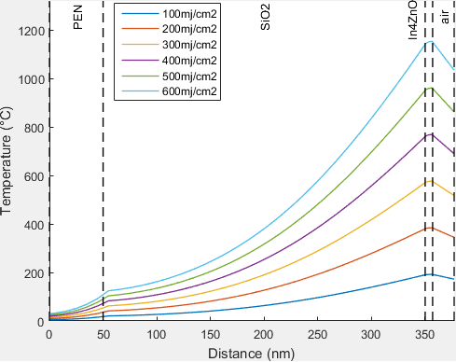
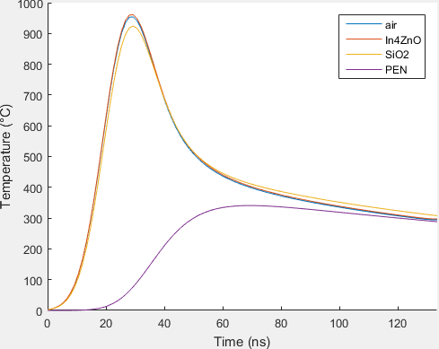
Thermally Insulate the PEN
- SiO2 thermally protects PEN
Al Gate
Cytop
Amorphous Oxide
SiO2
Al Electrodes
PEN

Slide 13
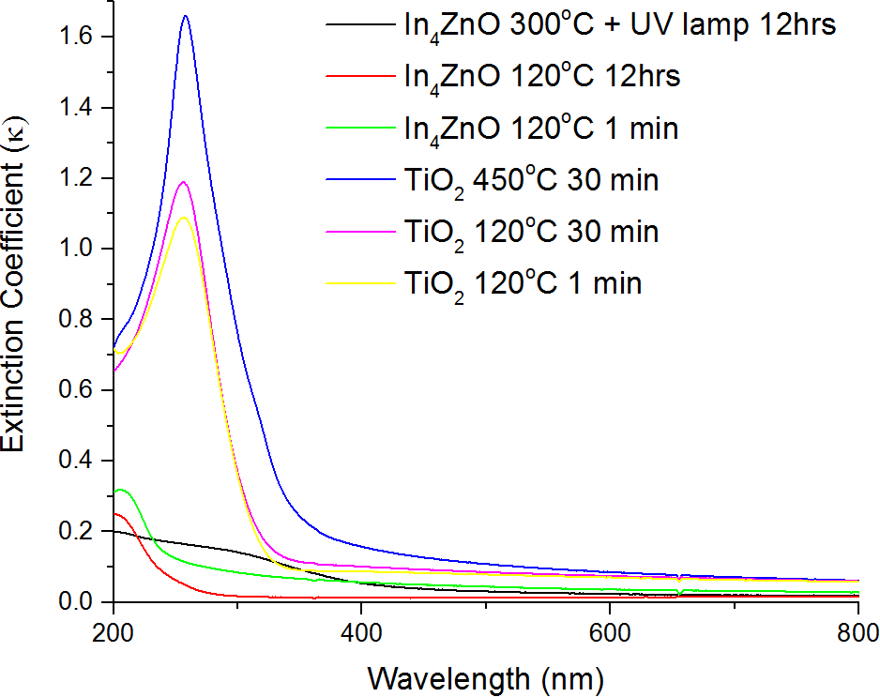
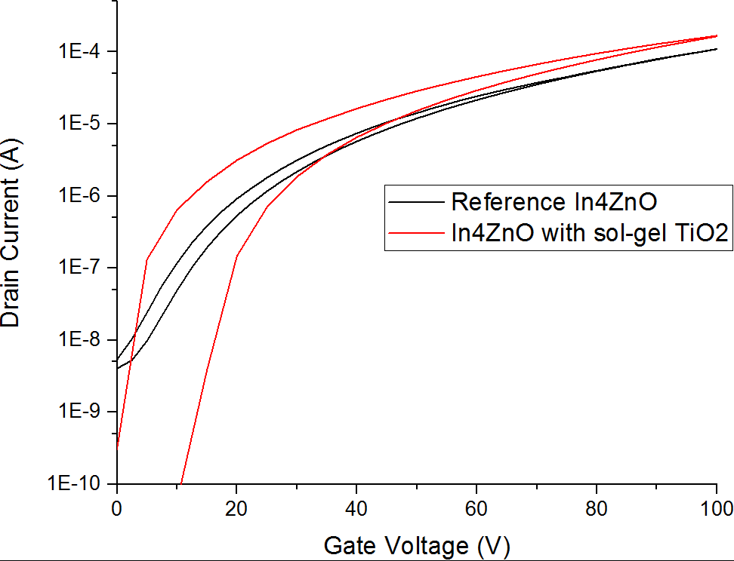
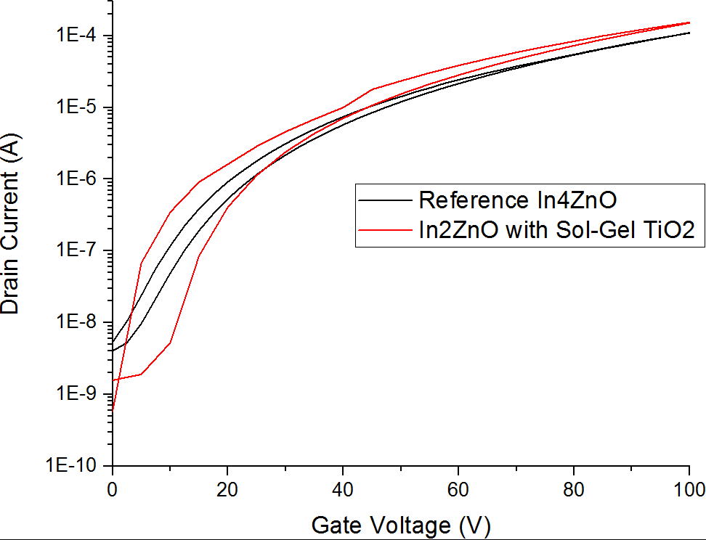
Electrically Neutral UV Absorbent Layer
Cytop
Al Gate
Amorphous Oxide
Electrodes
TiO2
SiO2
PEN

Slide 14
End
Extra Slides below

Slide 15
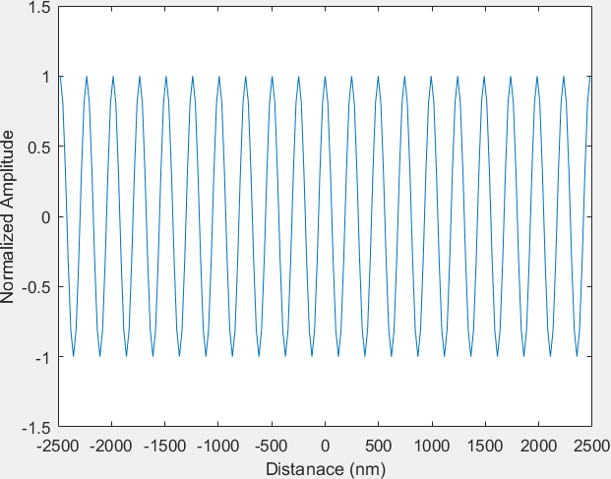
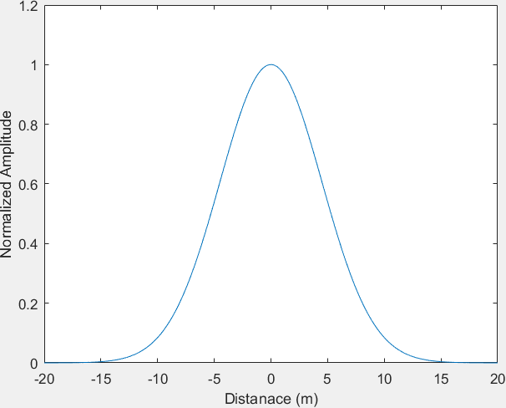
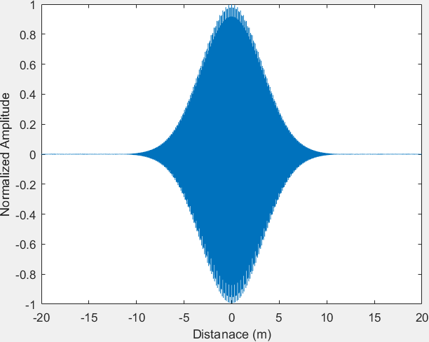
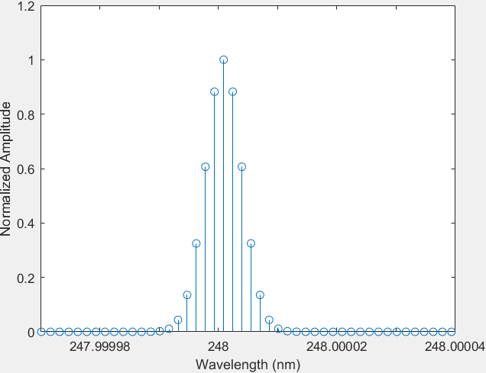
Generating Laser Pulse
X
=
FFT
A few important coefficients

Slide 16
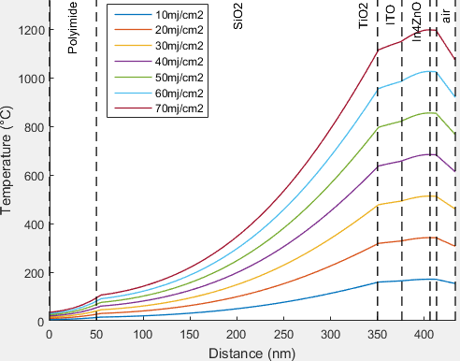
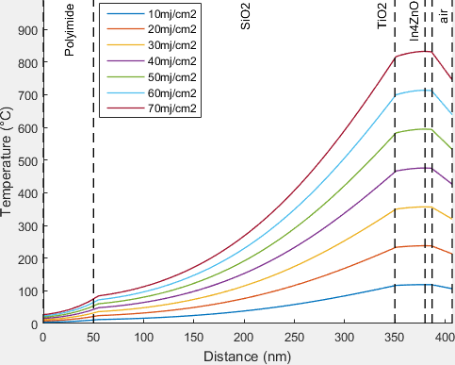
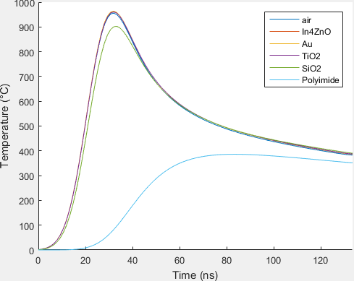
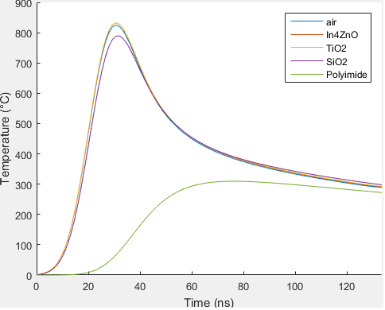
Simulations of a TiO2 Absorbent Layer
Temperature of Each Layer at 70mj/cm2
With ITO Electrodes
With out ITO Electrodes

Slide 17
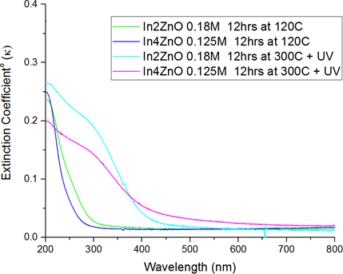
Simulation Parameters
Most parameters can be found online (Er, K, Cp, p, k…)
Extinction Coefficient from UV Vis
Index of refraction from Ellipsometry (n ~= 1.5 )

Slide 18
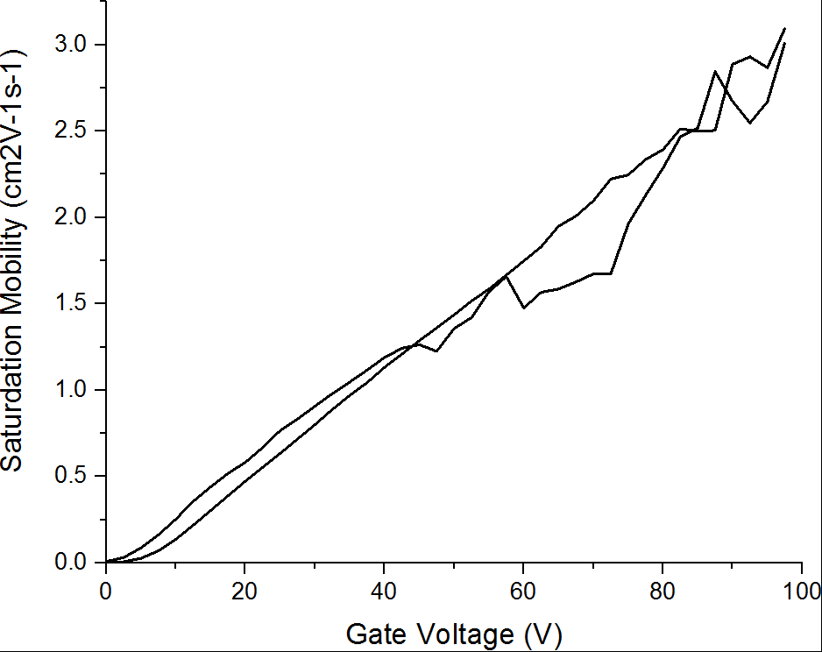
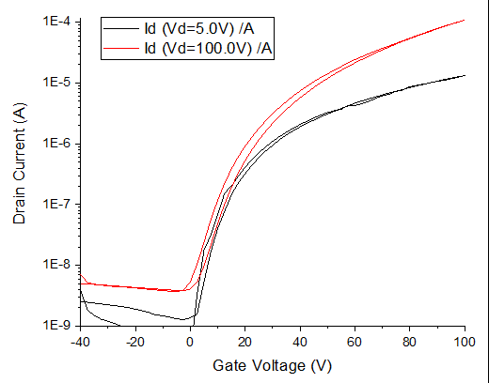
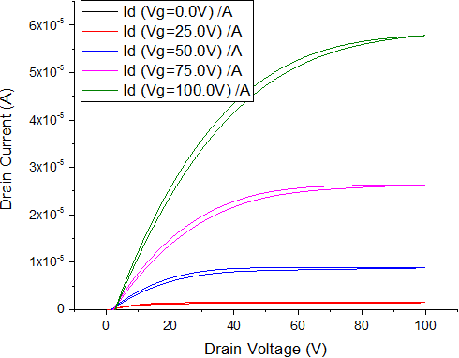
ITO Electrodes: TGBC on Glass (Hot Plate)
Al Gate
Cytop
Amorphous Oxide
ITO Electrodes
Glass

Slide 19
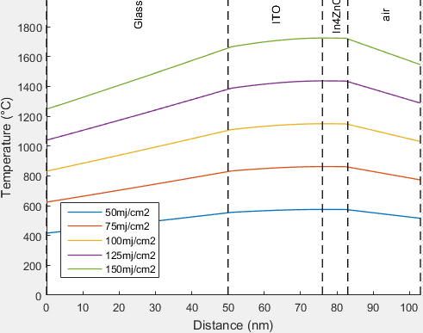
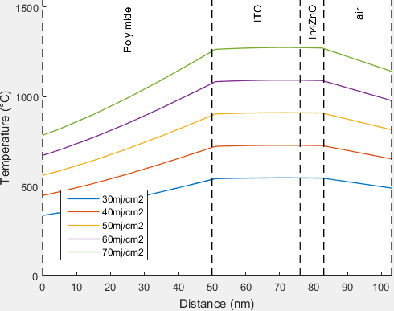
ITO Electrodes: TGBC on Glass and PEN
No working Devices Glass: Max Fluence 125 mj/cm2 – ITO Electrodes Obliterated at 140 mj/cm2 PEN: Max Fluence 55 mj/cm2 – ITO Electrodes Obliterated at 60 mj/cm2
ITO on Glass
ITO on ‘PEN’

Slide 20
How to Validate the Simulation?
Photo Deflection Spectroscopy built into laser annealing
Laser obliteration typically occurs at melting point of material¹.
Melting Point IZO ~= 1900C, Max Temp is 1200C?
Possible Extinction Coefficient Increase During Laser Annealing
1) Byskov-Nielsen, et. al. Ultra-short pulse laser ablation of metals: Threshold fluence, incubation coefficient and ablation rates. Appl. Phys. A Mater. Sci. Process. 101, 97–101 (2010).

