Slide 1
IE451 Data Analytics and Optimization
Validation & Classification I

Slide 2

This week…
What is next?
Validation of Classifiers
Metrics for classifier evaluation
Costs in data mining
Methods for classifier evaluation
Introduction to Classification
1R
Decision Trees
Random Trees
Random Forest

Slide 3
Types of Scales
Scale is defined as a set of numbers, amounts, etc. used to measure or compare the level of something (Cambridge Dictionary)
There is a hierarchy based on the information level provided by the type of the scale. From the simplest to the most informative:
Nominal Scale
Ordinal Scale
Interval Scale
Ratio Scale
Categorical Data
Numerical Data
Notes:
You cannot say Brown is "greater than" Blue.

Slide 4
Types of Scales
Nominal Scale
Ordinal Scale
Interval Scale
Ratio Scale
Labels only. No order. Brown is ”…. than" Blue ?
Order matters. Intervals between the values are not known. 3rd – 2nd vs 2nd - 1st ?
Difference between values is consistent. But no true zero point. 0°C no temperature?
e.g., height, weight, age
Notes:
You cannot say Brown is "greater than" Blue.

Slide 5
Simplified KDD Process
Extracting meaningful, previously unknown patterns or knowledge from large databases
The knowledge discovery process:
Define
Objective
Prepare
Data
Mine
Knowledge
Interpret
Results
Business/scientific objective
Data mining objective
Data cleaning
Data selection
Feature selection
Visualization
Supervised Learning
Unsupervised Learning
Association Rules
Predictive models
Structural insights

Slide 6
Supervised Learning
Data Set: Both the input features and the output(s) are available.
The question that is addressed is "For which values of input features, we obtain a particular output value?", so that we can infer/deduce for an unseen case and/or future (i.e., population).
The goal is to determine the hidden relationships between the input features and the outputs.
Supervised Learning has a central role in the context of Predictive Analytics.
Output(s) might be numerical data (in this case we refer to the problem as Regression) or categorical, i.e., nominal or ordinal (in this case we refer to the problem as Classification)

Slide 7
Data: Supervised Learning
m
1
k
y
X
n

Slide 8
Validation of the Models: Motivation
It is important to evaluate methods’ (i.e., classifiers and regression algorithms’) generalization performance in order to:
Determine whether to employ the method:
(For example: when learning the effectiveness of medical treatments from a limited-size data, it is important to estimate the accuracy of the classifiers.)
Fine-tune/optimize the method:
(For example: when post-pruning decision trees we must evaluate the accuracy of the decision trees on each pruning step.)

Slide 9
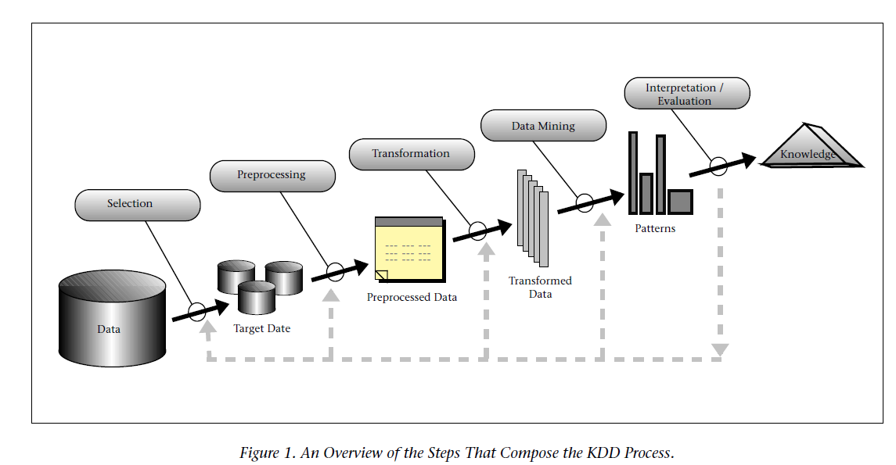
Knowledge Discovery in Databases (KDD)
Source: (Fayyad et al., 1996)

Slide 10
Performance of the Methods
In practice there are two major criteria that we can use to choose the methods:
Predictive Performance
Descriptiveness / Explainability / Transparency
Particularly for security, health management etc., the explainability, i.e. the transparency of the method is highly desirable.
One can sacrifice from the predictive performance and prefer methods that are descriptive in such applications.
How can we measure the predictive performance of the methods?
What are the metrics and the methods that we can use to assess these metrics?

Slide 11
SMART Metrics
In general one should prefer SMART metrics as Key Performance Indicator (KPIs).
Specific – Measurable – Attainable – Relevant - Timely
Vague Goal: "I want to improve sales."
SMART Goal: "Increase monthly software subscription sales by 10% (Specific/Measurable) through targeted email campaigns (Relevant) to existing leads (Achievable/Attainable) by the end of Q2 (Time-bound)."

Slide 12
SMART Metrics
This is also the case in the context of Data Analytics.
Metrics that align with the business objective should be preferred.
For Predictive Performance widely used metrics are as follows:
Regression: MSE, RMSE, MAE & MAPE
Classification: Accuracy

Slide 13
Background Information on Classifiers
Binary: The input is to be classified into one, and only one, of two non-overlapping classes (C1, C2).
Binary classification is the most popular classification task. Assigned categories can be objective, independent of manual evaluation (e.g., Republican or Democrat in the votes data of the UCI repository (Asuncion & Newman, 2007)) or subjective, dependent on manual evaluation (e.g., positive or negative reviews in Amazon.com (Blitzer et al., 2007)).
Classes can be well-defined (e.g., the votes labels), ambiguous (e.g., the review opinion labels), or both (e.g., medical vs. other texts in the Newsgroups collection).
Taken from Sokolova, M., & Lapalme, G. (2009). A systematic analysis of performance measures for classification tasks. Information Processing & Management, 45(4), 427-437.

Slide 14
Background Information on Classifiers
Multi-class: The input is to be classified into one, and only one, of multiple (l) non-overlapping classes.
Multiclass problems include the identification of the Iris type in a three-class data set popular in pattern recognition (Duda & Hart, 1973), in the learning the original 135 categories in the benchmark Reuters collection, or in tagging utterances as objective, subjective, or neutral (Wilson, Wiebe, & Hwa, 2006).
As for the binary case, multi-class categorization can be objective or subjective, well-defined or ambiguous.
Taken from Sokolova, M., & Lapalme, G. (2009). A systematic analysis of performance measures for classification tasks. Information Processing & Management, 45(4), 427-437.

Slide 15
Background Information on Classifiers
Multi-labeled: the input is to be classified into several of multiple non-overlapping classes.
Examples include classification of functions of yeast genes (Mewes, Albermann, Heumann, Lieb, & Pfeiffer, 1997), identifying scenes from image data (Li, Zhang, & Zhu, 2006) or text-database alignment and word alignment in machine translation (Snyder & Barzilay, 2007). In text mining of medical information, multi-label classification methods are often evaluated on OHSUMED, a collection of medical references (Hersh, Buckley, Leone, & Hickam, 1997).
When the learning task is document topic classification, multi-labeling is often referred as multi-topic classification such as for clinical texts that are assigned multiple disease codes from ICD-9-CM (Sasaki, Rea, & Ananiadou, 2007).
Taken from Sokolova, M., & Lapalme, G. (2009). A systematic analysis of performance measures for classification tasks. Information Processing & Management, 45(4), 427-437.

Slide 16
Background Information on Classifiers
Binary, multi-class, and multi-labeled problems form flat classification (Yang, 1999), in which categories are isolated and their relations are not considered important.
In flat classification, every category is treated as an equal, independent island. The model doesn't care if "Cat" and "Dog" are both types of "Mammals." It treats "Cat," "Dog," "Table," and "Chair" as four completely separate, unrelated labels.
The next, hierarchical, problem addresses relations among categories and includes their structure into learning targets.
Think of flat classification as a simple "checkbox" exercise, while hierarchical classification is like navigating a "family tree" or a directory.
Taken from Sokolova, M., & Lapalme, G. (2009). A systematic analysis of performance measures for classification tasks. Information Processing & Management, 45(4), 427-437.

Slide 17
Background Information on Classifiers
Hierarchical: the input is to be classified into one and only one class which are divided into subclasses or grouped into superclasses.
Here, the relationships between categories matter. The system understands that certain classes are "parents" (superclasses) to others (subclasses). It uses the structure of the data to help make better predictions.
The hierarchy is defined and cannot be changed during classification.
Text classification and bioinformatics supply many examples, e.g., protein function prediction (Eisner, Poulin, Szafron, Lu, & Greiner, 2005). Hierarchical classification can be transformed into flat classification. For example, the Reuters collection classification can be multiclass (Bobicev & Sokolova, 2008), multi-labeled (Tikk & Biró, 2003), and hierarchical (Sun, Lim, & Ng, 2003).
Taken from Sokolova, M., & Lapalme, G. (2009). A systematic analysis of performance measures for classification tasks. Information Processing & Management, 45(4), 427-437.

Slide 18
Confusion Matrix – Binary Classifier
Assume that we test a binary classifier on some test set (each data instance has "+" or "-" as the output value).
The classifier will yield either "Positive" or "Negative" as the output.
Thus we will obtain the following confusion matrix at the end:
EXAMPLE |  | Predicted Class
Actual Class |  | Positive | Negative
 | + | 60 | 20
 | - | 30 | 90
 |  | Predicted Class
Actual Class |  | Positive | Negative
 | + | TP | FN
 | - | FP | TN
P
Accuracy = (TP+TN)/(P+N)
Accuracy = (60+90)/(80+120) = 75%
N

Slide 19
Accuracy Might Not Be Enough…
Consider a binary classifier which has 99% accuracy.
Is this a good classifier in terms of the predictive performance?

Slide 20
Accuracy Might Not Be Enough…
Consider a binary classifier which has 99% accuracy.
Is this a good classifier in terms of the predictive performance?
The only correct answer to this question is "IT DEPENDS!".

Slide 21
Accuracy Might Not Be Enough…
Consider a binary classifier which has 99% accuracy.
Is this a good classifier in terms of the predictive performance?
The only correct answer to this question is "IT DEPENDS!".
Suppose that 99% of the whole data is "+" and only 1% is "-".
In that case a simple classifier that yields "Everyone is Positive" would also have accuracy of 99%!
Thus when the data is imbalanced in that case accuracy doesn’t say much about the predictive performance!
EXAMPLE |  | Predicted Class
Actual Class |  | Positive | Negative
 | + | 99 | -
 | - | 1 | -

Slide 22
Accuracy Might Not Be Enough…
Consider two binary classifiers. One has 99% accuracy and the other one has 1% accuracy.
Which one is a better classifier, i.e., should be preferred in practice?

Slide 23
Accuracy Might Not Be Enough…
Consider two binary classifiers. One has 99% accuracy and the other one has 1% accuracy.
Which one is a better classifier, i.e., should be preferred in practice?
The only correct answer to this question is "IT DEPENDS!".

Slide 24
Accuracy Might Not Be Enough…
Consider two binary classifiers. One has 99% accuracy and the other one has 1% accuracy.
Which one is a better classifier, i.e., should be preferred in practice?
The only correct answer to this question is "IT DEPENDS!".
Suppose that 99% of the whole data is "+" (indicating healthy) and only 1% is "-" (indicating sick).
Furthermore, suppose that you will start a treatment for the instances who are predicted to be "Positive" and do nothing who are predicted to be "Negative".
Suppose that the side effect of the treatment is "Headache" and in case you don’t treat a person who is sick "Dies".

Slide 25
Accuracy Might Not Be Enough…
Consider two binary classifiers. One has 99% accuracy and the other one has 1% accuracy.
Which one is a better classifier, i.e., should be preferred in practice?
The only correct answer to this question is "IT DEPENDS!".
Suppose that 99% of the whole data is "+" (indicating healthy) and only 1% is "-" (indicating sick).
Furthermore, suppose that you will start a treatment for the instances who are predicted to be "Positive" and do nothing who are predicted to be "Negative".
Suppose that the side effect of the treatment is "Headache" and in case you don’t treat a person who is sick "Dies".
Classifier A: "All is Positive" (99% Accurate) → 1 Dead!
Classifier B: "All is Negative" (1% Accurate) → 99 Headache!
CLASSIFIER A: 99% Accuracy
EXAMPLE |  | Predicted Class
Actual Class |  | Positive | Negative
 | + | 99 | -
 | - | 1 (Dead) | -
CLASSIFIER B: 1% Accuracy
EXAMPLE |  | Predicted Class
Actual Class |  | Positive | Negative
 | + | - | 99 (Headache)
 | - | - | 1
WHEN THERE IS COST, ACCURACY MIGHT NOT BE ENOUGH!

Slide 26
Shortcomings of Accuracy
Accuracy is a relative measure
Should be compared with "base accuracy" of always predicting the majority class (or compared with a very simple classifier!)
base accuracy in table = max{P,N} / T
Accuracy ignores possibility of different misclassification costs
Not treating an ill patient vs. treating a healthy patient
Refusing credit to client who would have paid back vs. assigning credit to client who won't pay back
Need to distinguish probability of making different types of errors.
Note that cost metrics are mostly assumed to be SYMMETRIC (e.g., RMSE, MSE, etc.) in Regression as well, which is disputable!

Slide 27
Misclassification Costs
Distinguish “predictive accuracy” for different classes
Accuracy: probability that some instance is classified correctly
Decomposed into
TPR: “true positive rate", (estimated) probability that a positive instance is classified correctly, TP/P=TP/(TP+FN)
TNR: “true negative rate", (estimated) probability that a negative instance is classified correctly, TN/N=TN/(TN+FP)
We also define
FPR = 1-TNR: “false positive rate”: estimated probability that a negative is classified as positive (FP/N = FP/(FP+TN))
analogously FNR = 1-TPR

Slide 28
Misclassification Costs (2)
Consider costs C_{FP} and C_{FN}
= cost of false positive and false negative
Expected cost of a single prediction:
C = C_{FP} P(pos|-) P(-) + C_{FN} P(neg|+) P(+)
estimated by C = C_{FP} FPR T₋/T + C_{FN} FNR T₊ /T
Note :
Accuracy is weighted average of TPR and TNR
Accuracy = TPR*T₊/T + TNR*T₋/T
C is not computable from Accuracy alone

Slide 29
Metrics for Binary Classifier’s Evaluation
EXAMPLE |  | Predicted Class
Actual Class |  | Positive | Negative
 | + | 60 | 20
 | - | 30 | 90
Accuracy = (TP+TN)/(P+N)
Error = (FP+FN)/(P+N)
Sensitivity / Recall / TP Rate = TP/P = TP/(TP+FN)
Specificity / TN Rate = TN/N = TN/(FP+TN)
Precision / Positive Predicted Value (PPV) = TP/(TP+FP)
Negative Predicted Value (NPV) = TN/(FN+TN)
FP Rate = FP/N = FP/(FP+TN) = 1-Specificity
F-Score = 2*(Precision*Recall/Precision+Recall)
 |  | Predicted Class
Actual Class |  | Positive | Negative
 | + | TP | FN
 | - | FP | TN

Slide 30
Metrics for Binary Classifier’s Evaluation
The point of the F-score (or F-measure) is to provide a single, balanced metric to evaluate a classification model when simple "accuracy" gives a misleading picture.
It is particularly essential when you have a class imbalance, meaning one category (the "positive" case) is much rarer than the other.
The F-score is the harmonic mean of Precision and Recall. It penalizes extreme values: if either Precision or Recall is very low, the F-score drops significantly.

Slide 31
Metrics for Binary Classifier’s Evaluation
EXAMPLE |  | Predicted Class
Actual Class |  | Positive | Negative
 | + | 60 | 20
 | - | 30 | 90
Accuracy = (TP+TN)/(P+N) = (60+90)/(80+120) = 75%
Error = (FP+FN)/(P+N) = (30+20)/(80+120) = 25%
Precision / Positive Predicted Value (PPV) = TP/(TP+FP) = 60/(60+30) = 67%
Negative Predicted Value (NPV) = TN/(FN+TN) = 90/(90+20) = 82%
Sensitivity / Recall / TP Rate = TP/P = TP/(TP+FN) = 60/(60+20) = 75%
Specificity / TN Rate = TN/N = TN/(FP+TN) = 90/(90+30) = 75%
FP Rate = FP/N = FP/(FP+TN) = 1- SPC = 30/(30+90) = 25%
F-Score = 2*(PPV*Recall/ PPV+Recall)
F-Score = (2* 0.67*0.75)/ (0.67+0.75) = 0.71
 |  | Predicted Class
Actual Class |  | Positive | Negative
 | + | TP | FN
 | - | FP | TN

Slide 32
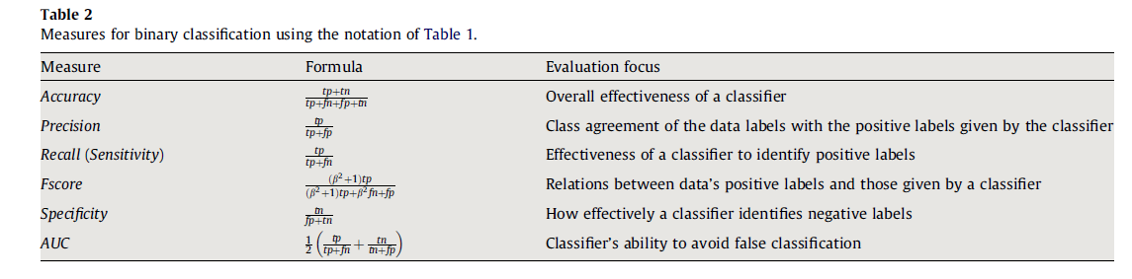
Metrics for Binary Classifier’s Evaluation
AUC is threshold-based across all possible thresholds. The formula above is empirical (point specific): It is Arithmetic Mean of Precision and Recall.
Taken from Sokolova, M., & Lapalme, G. (2009). A systematic analysis of performance measures for classification tasks. Information Processing & Management, 45(4), 427-437.

Slide 33
Area Under “Curve”
In the world of machine learning, a ROC Curve (Receiver Operating Characteristic) is the gold standard for evaluating how well a binary classifier is actually doing its job.
It’s a visualization of the trade-off between "catching the bad guys" and "falsely accusing the good guys."
True Positive Rate (TPR) / Sensitivity: This is the Y-axis. It measures what fraction of the actual "positives" (e.g., people with a disease) were correctly identified.
False Positive Rate (FPR): This is the X-axis. It measures what fraction of the actual "negatives" (e.g., healthy people) were incorrectly flagged as positive.

Slide 34
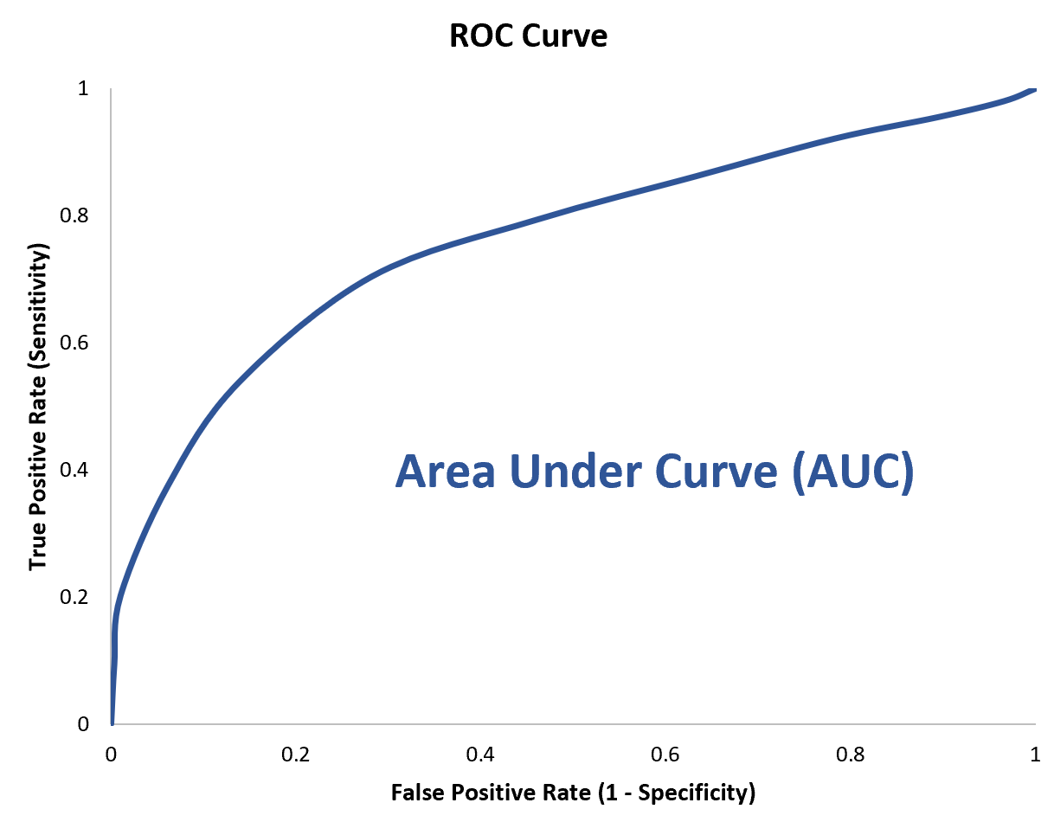
A Sample Area Under “Curve”

Slide 35
Area Under “Curve”
The curve represents the performance of the model across every possible threshold (from 0 to 1).
The "Perfect" Model: The curve would hug the top-left corner (TPR of 1.0 and FPR of 0.0). This means the model identifies all positives without a single false alarm.
AUC (Area Under the Curve): While the curve is great for visualization, we often want a single number to summarize performance. This is the AUC.
AUC = 1.0: Perfect classification. AUC = 0.5: Randomness.

Slide 36
Macro vs. Micro Averaging for Multiclass
If we have more than one class, how do we combine multiple performance measures into one quantity?
Macro-averaging: Compute performance for each class, then average.
Micro-averaging: Collect decisions for all classes, compute contingency table, evaluate.
Macro-averaging treats all classes equally while micro-averaging favors larger classes.

Slide 37
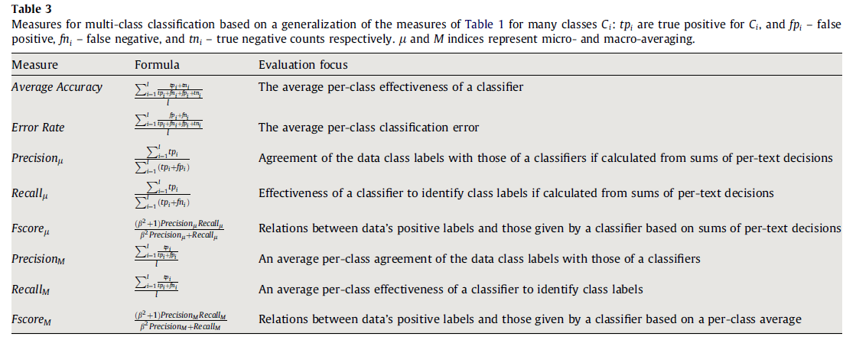
Metrics for Multi-Class Classifier’s Evaluation
Taken from Sokolova, M., & Lapalme, G. (2009). A systematic analysis of performance measures for classification tasks. Information Processing & Management, 45(4), 427-437.

Slide 38
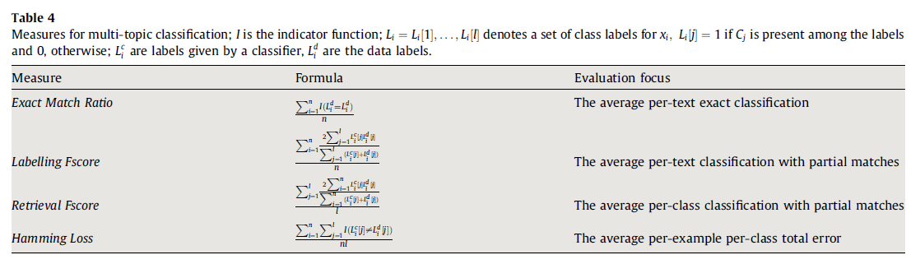
Metrics for Multi-Label Classifier’s Evaluation
Taken from Sokolova, M., & Lapalme, G. (2009). A systematic analysis of performance measures for classification tasks. Information Processing & Management, 45(4), 427-437.

Slide 39
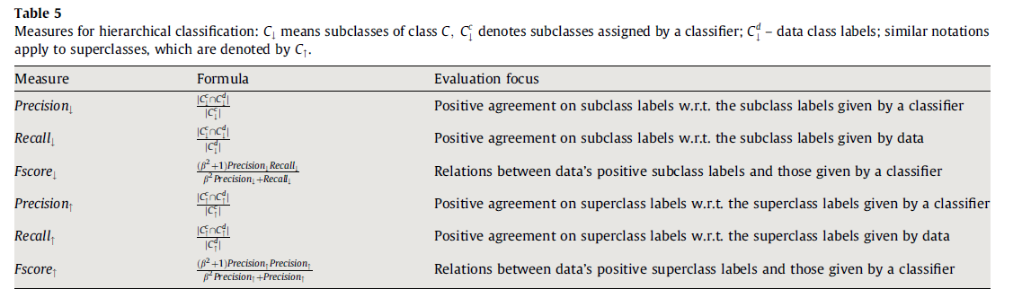
Metrics for Hierarchical Classifier’s Evaluation
Taken from Sokolova, M., & Lapalme, G. (2009). A systematic analysis of performance measures for classification tasks. Information Processing & Management, 45(4), 427-437.

Slide 40
How to Estimate the Metrics?
We will use these metrics to evaluate the predictive performance of our models.
We can use the data that we use to train the model for measuring the predictive performance.
But for various reasons (that we will discuss soon!) we might need other approaches to validate the predictive performance of our models such as:
Independent test data;
Hold-out method;
k-fold cross-validation method;
Leave-one-out method;
Bootstrap method;
And many more…

Slide 41
Estimation with Training Data
The accuracy/error estimates on the training data are not good indicators of performance on future data.
Q: Why?
A: Because new data will probably not have the exact same distribution with the training data!
Classifier
Training set
Training set

Slide 42
Bias-Variance Tradeoff
The bias-variance tradeoff is one of the most fundamental concepts in machine learning.
It describes the tension between two types of errors that prevent a model from generalizing well to new, unseen data.
To understand it, think of your model as a tool trying to understand the true underlying pattern of the data.

Slide 43
Bias-Variance Tradeoff
Bias: This measures how far off your model's predictions are from the actual values on average. A model with high bias is overly simplistic—it makes strong assumptions about the data, often leading to underfitting.
Variance: This measures how much the model's predictions change if you train it on a different subset of the training data. A model with high variance is overly complex—it "memorizes" the noise in the training set rather than learning the pattern, leading to overfitting.
The goal is to find the "sweet spot" where total error is minimized.
When you decrease bias (by adding complexity), variance typically increases.
When you decrease variance (by simplifying the model), bias typically increases.

Slide 44
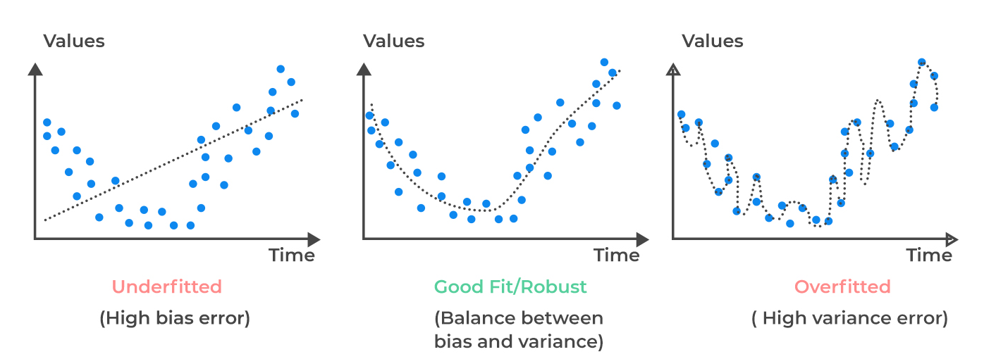
Bias-Variance Tradeoff

Slide 45
Overfitting
Overfitting is defined as the degree to which a classifier performs well on training data but fails to generalize to unseen data.
If you only look at training data, you are essentially giving a student the answers to a test and then asking them to take that same test. A perfect score doesn't mean they understand the subject; it just means they have a good memory.
The "error estimate" on training data is almost always optimistically biased, meaning it makes the model look better than it actually is.

Slide 46
Overfitting
Low Training Error + High Test Error: This is the classic signature of overfitting. The model has essentially "memorized" the noise and specific details of the training set rather than the underlying concept.
Low Training Error + Low Test Error: This is the goal! The model has learned patterns that actually apply to the real world.

Slide 47
Estimation with Independent Test Data
Estimation with independent test data is used when we have plenty of data and there is a natural way to forming training and test data.
For Example: Particularly for time series problems, we can set the current date to a particular date within the data, and use all of the data prior to that date to train the model, and use the rest of the data in order to determine the predictive performance of the trained model.
Classifier
Training set
Test set

Slide 48
Hold-out Method
The hold-out method splits the data into training data and test data (usually 2/3 for train, 1/3 for test). Then we build a classifier using the train data and test it using the test data.
Used with thousands of instances, including plenty from each class.
Classifier
Training set
Test set
Data

Slide 49
Train, Validation, Test Split
Results Known
+
Model
Builder
+
Training set
-
-
Data
+
Evaluate
Classifier Builder
Predictions
+
-
+
-
Y
N
Validation set
+
-
+
-
Final Evaluation
Final Test Set
Classifier
The test data can’t be used for parameter tuning!

Slide 50
Making the Most of the Data
Once evaluation is complete, all the data can be used to build the final classifier.
Generally, the larger the training data the better the classifier (but returns diminish).
The larger the test data the more accurate the error estimate.

Slide 51
Stratification
The holdout method reserves a certain amount for testing and uses the remainder for training.
Usually: one third for testing, the rest for training.
For “imbalanced” datasets, samples might not be representative.
Few or no instances from some classes.
Stratified sampling: advanced version of balancing the data.
Make sure that each class is represented with approximately equal proportions in the subsets.

Slide 52
Stratification
Stratification is the process of dividing a large, heterogeneous population into smaller, distinct subgroups—called strata—that share similar characteristics.
This technique ensures that each subgroup is adequately represented in a sample, which improves the accuracy and reliability of statistical analyses.
Note that, we will later discuss "imbalanced data" and suggest that we need to ensure "approximately balanced" training set!

Slide 53
Repeated Holdout Method
In general, estimates can be made more reliable by repeated sampling
Each iteration, a certain proportion is randomly selected for training (possibly with stratification).
The error rates on the different iterations are averaged to yield an overall error rate.
This is called the repeated holdout method.

Slide 54
Repeated Holdout Method (2)
Random sampling ≠ optimal
the different test sets overlap
we would like all our instances from the data to be tested at least once
Can we prevent overlapping?

Slide 55
k-Fold Cross-Validation
k-fold cross-validation avoids overlapping test sets:
First step: data is split into k subsets of equal size;
Second step: each subset in turn is used for testing and the remainder for training.
The subsets are stratified
before the cross-validation.
The estimates are averaged to
yield an overall estimate.
Classifier
train
train
test
Data
train
test
train
test
train
train

Slide 56
More on Cross-Validation
Standard method for evaluation: stratified 10-fold cross-validation.
Why 10? Extensive experiments have shown that this is the best choice to get an accurate estimate.
Stratification reduces the estimate’s variance.
Even better: repeated stratified cross-validation:
e.g., ten-fold cross-validation is repeated ten times and results are averaged (reduces the variance).

Slide 57
Leave-One-Out Cross-Validation
Leave-One-Out (aka jackknife) is a particular form of cross-validation:
Set number of folds to number of training instances;
i.e., for n training instances, build classifier n times.
Makes best use of the data.
Involves no random sub-sampling.
Computationally expensive.

Slide 58
Leave-One-Out Cross-Validation and Stratification
A disadvantage of Leave-One-Out-CV is that stratification is not possible:
It guarantees a non-stratified sample because there is only one instance in the test set!
Consider an extreme example with a dataset where the binary output is equally likely (i.e., split equally into two classes):
Consider a simple classifier which predicts the larger class.
50% accuracy on entire data.
Leave-One-Out-CV estimate is 100% error!
The class left out for testing is minority during training

Slide 59
Bootstrap Method
Cross validation uses sampling without replacement:
The same instance, once selected, can not be selected again for a particular training/test set
The bootstrap uses sampling with replacement to form the training set:
Sample a dataset of n instances n times with replacement to form a new dataset of n instances;
Use this data as the training set;
Use the instances from the original dataset that don’t occur in the new training set for testing.

Slide 60
Bootstrap Method
The bootstrap method is also called the 0.632 bootstrap:
A particular instance has a probability of 1–1/n of not being picked;
Thus probability of ending up in the test data for each instance is (as n→∞):
Test Data (Out-of-Bag): Approximately 36.8% of the original instances will never be selected for a given bootstrap training set, making them the "out-of-bag" (OOB) samples used for testing.
Approximately 63.2% (1−0.368=0.632) of the unique original instances will appear in the bootstrap training set at least once.

Slide 61
Metric Evaluation Summary:
Use test sets and the hold-out method for “large” data;
Use the cross-validation method for “middle-sized” data;
Use the leave-one-out and bootstrap methods for small data;
Don’t use test data for parameter tuning - use separate validation data.
Comparing two classifiers to each other can use more advanced statistics: t-test, McNemar, …

Slide 62
Classification
Key idea
Known target concept (predict a certain categorical attribute)
Find out how other attributes can be used
Algorithms
Rudimentary Rules (e.g., 0R, 1R)
Divide and Conquer: Decision Trees
Instance-Based Learning
Statistical Modeling (e.g., Naïve Bayes)
Logistic Regression
Support Vector Machines
Neural Networks

Slide 63
The Disease Problem
Suppose that you have a friend who is a doctor.
A laboratory test is required to determine the illness.
If they send someone who is actually healthy for the test, they waste 100 TL (i.e., the cost of the test).
If they fail to send someone who is actually sick for the test, they pay a penalty of 100 TL for the wrong diagnosis.
If they make this decision by tossing a coin, what would be the cost of wrong decisions for the day?
For each "actually healthy" asking a laboratory test is a wrong decision (100 TL waste).
For each "actually sick" not asking a laboratory test is a wrong decision (100 TL penalty).
Can we minimize the cost of wrong decision by using data? (i.e., making informed decisions)

Slide 64
The Disease Problem
Suppose that on that day, 14 people came in for an examination.
Recall:
A laboratory test is required to determine the illness.
If they send someone who is actually healthy for the test, they waste 100 TL (i.e., the cost of the test).
If they fail to send someone who is actually sick for the test, they pay a penalty of 100 TL for the wrong diagnosis.
If they make this decision by tossing a coin, what would be the cost for the day?
# | Disease
1 | Healthy
2 | Healthy
3 | Sick
4 | Sick
5 | Sick
6 | Healthy
7 | Sick
8 | Healthy
9 | Sick
10 | Sick
11 | Sick
12 | Sick
13 | Sick
14 | Healthy

Slide 65
The Disease Problem
Suppose that on that day, 14 people came in for an examination.
Recall:
A laboratory test is required to determine the illness.
If they send someone who is actually healthy for the test, they waste 100 TL (i.e., the cost of the test).
If they fail to send someone who is actually sick for the test, they pay a penalty of 100 TL for the wrong diagnosis.
If they make this decision by tossing a coin, what would be the cost for the day?
There are 9 sick patients. Half of them will make the right decision, and half will make the wrong decision. The expected cost is 450 TL.
There are 5 healthy individuals. Half of them will make the right decision, and half will make the wrong decision. The expected cost is 250 TL.
# | Disease
1 | Healthy
2 | Healthy
3 | Sick
4 | Sick
5 | Sick
6 | Healthy
7 | Sick
8 | Healthy
9 | Sick
10 | Sick
11 | Sick
12 | Sick
13 | Sick
14 | Healthy
TOTAL
450 + 250 = 700 TL!

Slide 66
Creating Value From Data
Healthy
Sick
Suppose that the data suggests that in general population 5 out of 14 is healthy and 9 out of 14 is sick.
What if we used this data and made informed decisions?
If they send everyone for the test, they would waste 500 TL (i.e., the cost of the redundant test for the 5 healthy).
If they don’t send anyone for the test, they would pay a penalty of 900 TL (for the 9 sick).
Best option is sending everyone for the test!
The cost of wrong decisions:
Tossing a coin: 700 TL
Sending everyone for the test: 500 TL
The data on the percentage of sick in population saves us:
700 TL - 500 TL = 200 TL!
Healthy
Sick
Healthy
Sick
Healthy
Sick
Healthy
Sick
Sick
Sick
Sick
Sick

Slide 67
The Disease Problem
# | Age | Body Mass Index | Gender | Intensity of Symptoms | Disease
1 | Young | Under | Male | High | Healthy
2 | Young | Under | Male | Low | Healthy
3 | Middle | Under | Male | High | Sick
4 | Old | Medium | Male | High | Sick
5 | Old | Over | Female | High | Sick
6 | Old | Over | Female | Low | Healthy
7 | Middle | Over | Female | Low | Sick
8 | Young | Medium | Male | High | Healthy
9 | Young | Over | Female | High | Sick
10 | Old | Medium | Female | High | Sick
11 | Young | Medium | Female | Low | Sick
12 | Middle | Medium | Male | Low | Sick
13 | Middle | Under | Female | High | Sick
14 | Old | Medium | Male | Low | Healthy

Slide 68
Rudimentary Rules – 0R
Healthy
Sick
Healthy
Sick
Healthy
Sick
Healthy
Sick
Healthy
Sick
Sick
Sick
Sick
Sick

Slide 69
0-Rule (0R)
Very simple.
Which ever class is most frequent (i.e., the mode of the output) is the prediction for the new test instance.
So we use 0 input features for classification (thus is referred to as 0R).
There are 9 "Sick" & 5 "Healthy" in the training data.
So "Next instance" is predicted to be as "Sick"!
If we use the training data as test:
(Training) Accuracy= 9/14
(Training) Error=5/14

Slide 70
1R: Algorithm
Basically it is a one-level decision tree.
It uses only one of the input features (aka attribute) for classification.
Sometimes performs quite well!
Basic idea:
Create a rule for each feature.
Classify according to the frequency in training data.
Evaluate error rate for each feature.
Choose the best feature and the corresponding rule as the classifier.
Which feature to use?
Let’s check the data…

Slide 71
The Disease Problem
# | Age | Body Mass Index | Gender | Intensity of Symptoms | Disease
1 | Young | Under | Male | High | Healthy
2 | Young | Under | Male | Low | Healthy
3 | Middle | Under | Male | High | Sick
4 | Old | Medium | Male | High | Sick
5 | Old | Over | Female | High | Sick
6 | Old | Over | Female | Low | Healthy
7 | Middle | Over | Female | Low | Sick
8 | Young | Medium | Male | High | Healthy
9 | Young | Over | Female | High | Sick
10 | Old | Medium | Female | High | Sick
11 | Young | Medium | Female | Low | Sick
12 | Middle | Medium | Male | Low | Sick
13 | Middle | Under | Female | High | Sick
14 | Old | Medium | Male | Low | Healthy

Slide 72
1R: Which Feature to Use?
Age
If we use Age:
Rule: "If Young Then Healthy, otherwise Sick" (4 ERRORS)
Young
Old
Middle
Healthy
Sick
Healthy
Healthy
Sick
Healthy
Healthy
Sick
Sick
Sick
Sick
Sick
Sick
Sick

Slide 73
1R: Which Feature to Use?
BMI
If we use BMI:
Rule: "If Under Then Healthy/Sick, if Normal or Over Then Sick" (5 ERRORS)
Under
Over
Normal
Healthy
Sick
Healthy
Healthy
Sick
Sick
Sick
Sick
Sick
Sick
Sick
Sick
Healthy
Healthy

Slide 74
1R: Which Feature to Use?
Gender
If we use Gender:
Rule: "If Male Then Healthy, if Female Then Sick" (4 ERRORS)
Male
Female
Healthy
Sick
Healthy
Sick
Healthy
Sick
Healthy
Sick
Sick
Sick
Sick
Sick
Sick
Healthy

Slide 75
1R: Which Feature to Use?
IoS
Low
High
If we use IoS:
Rule: "If Low Then Healthy/Sick, If High Then Sick" (5 ERRORS)
Healthy
Sick
Healthy
Sick
Healthy
Sick
Sick
Sick
Sick
Sick
Sick
Sick
Healthy
Healthy

Slide 76
1R: Summary of the Analysis
 | Feature | Rules | Errors | Total
1 | Age | Young ⇒ Healthy | 2/5 | 4/14
 |  | Middle ⇒ Sick | 0/4
 |  | Old ⇒ Sick | 2/5
2 | BMI | Under ⇒ Healthy | 2/4 | 5/14
 |  | Normal ⇒ Sick | 2/6
 |  | Over ⇒ Healthy | 1/4
3 | Gender | Male ⇒ Healthy | 3/7 | 4/14
 |  | Female ⇒ Sick | 1/7
4 | IoS | High ⇒ Sick | 2/8 | 5/14
 |  | Low ⇒ Healthy | 3/6
The Rule: Check Age. If young then no need for lab test, otherwise ask for a test!

Slide 77
0R vs. 1R : Value of Information
Recall that 0R training error was = 5/14.
If we use Age training error is 4/14
If we use BMI training error is 5/14
If we use Gender training error is 4/14
If we use IoS training error is 5/14
1R Rule: "Check Age If Young Then Healthy, otherwise Sick" → 4/14 OR "Check Gender If Male Then Healthy, otherwise Sick" → 4/14
Thus, Age or Gender information yield the value of making 1 less error!

Slide 78
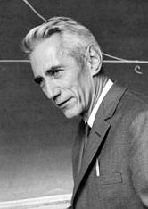
An Alternative Metric - Entropy
Measure of Impurity:
Entropy is a measure of impurity in the training data S
Measured in bits of information needed to encode a member of S
Number of Categories (i.e., Classes)
Proportion of the samples from class i in data set S
Training Data
Claude Shannon
1916-2001
American Mathematician
& Father of Information Theory

Slide 79
An Alternative Metric - Entropy
Measure of Impurity:
Entropy is a measure of impurity in the training data S
Measured in bits of information needed to encode a member of S
Number of Categories (i.e., Classes)
In some specific theoretical contexts, people might choose a base equal to c to normalize the maximum entropy to exactly 1. However, this is just a convenience choice, not a requirement.
In standard Information Theory and Machine Learning (i.e., when calculating Information Gain for decision trees), we almost exclusively stick to base 2 to keep the units consistent as bits.
Proportion of the samples from class i in data set S
Training Data
Claude Shannon
1916-2001
American Mathematician
& Father of Information Theory

Slide 80
An Alternative Metric - Entropy
Measure of Impurity:
Extreme cases
All members have same classification
(1·log1 = 0)
There is no uncertainty; you have zero "surprise" because you know exactly what you will get.
All classifications equally frequent
(-0.5log₂0.5-0.5log₂0.5=1) in binary case
This is the peak of "impurity." You have the highest level of uncertainty, meaning you need the maximum amount of information to accurately guess the class of an item.
Claude Shannon
1916-2001
American Mathematician
& Father of Information Theory

Slide 81
Impurity/Diversity
Age
Young
Old
Middle
Healthy
Sick
Healthy
Healthy
Sick
Healthy
Healthy
Sick
Sick
Sick
Sick
Sick
Sick
Sick
~IMPURE!
PURE!
~IMPURE!

Slide 82
Impurity/Diversity
Gender
Male
Female
Healthy
Sick
Healthy
Sick
Healthy
Sick
Healthy
Sick
Sick
Sick
Sick
Sick
Sick
Healthy
~IMPURE!
~PURE!

Slide 83
Measuring Impurity/Diversity
Assume a binary classification problem (i.e., two classes. Yes/No, True/False, Success/Failure etc.)
Minimum
Gini index/Simpson diversity index
Shannon’s Entropy (measures information in bits)

Slide 84
Measuring Impurity/Diversity
Metric | Origin | Computational Intensity | Typically Used In
Information Gain | Shannon Entropy | Higher (Logarithms) | ID3, C4.5
Gini Impurity | Statistical Variance | Lower (Squared sums) | CART, Random Forest

Slide 85
Expected Information Gain
Gain(S, a) is the amount of expected information gained about the classification by knowing the value of feature a.
Note that Entropy of a feature measures the impurity before the split, on the other hand the information gain measures the change after the split. Therefore, one should prefer to split the feature that either has the smallest entropy or the largest information gain.
All possible values
for feature a

Slide 86
An Alternative Metric - Entropy
Measure of Impurity:
In the Disease Problem, we have 9 Sick and 5 Healthy subjects. Therefore, the beginning entropy of the dataset is:
Number of Categories (i.e., Classes)
Proportion of the samples from class i in data set S
Training Data
Claude Shannon
1916-2001
American Mathematician
& Father of Information Theory
$Entropy\left(Training Data\right)=\sum_{i=1}^{c}{−p_{i}\log_{2}p_{i}}$ = -$\frac{5}{14}\log_{2}\frac{5}{14}−\frac{9}{14}\log_{2}\frac{9}{14}$ = 0.94

Slide 87
An Alternative Metric - Entropy
Age
Old
Young
Middle
Healthy
Sick
Healthy
Healthy
Sick
Healthy
Healthy
Sick
Sick
Sick
Sick
Sick
Sick
Sick
What about the entropy of the state after using Age information?
There are 5 Young (with entropy of 0.97), 4 Middle Aged (with entropy of 0), and 5 Old (with entropy of 0.97).
Total Entropy (Weighted Average) = (5*0.97+4*0+5*0.97)/14 =0.69
$Entropy\left(Young\right)=\sum_{i=1}^{c}{−p_{i}\log_{2}p_{i}}$ = -$\frac{3}{5}\log_{2}\frac{3}{5}−\frac{2}{5}\log_{2}\frac{2}{5}$ = 0.97
$Entropy\left(Middle\right)=\sum_{i=1}^{c}{−p_{i}\log_{2}p_{i}}$ = -$\frac{0}{4}\log_{2}\frac{0}{4}−\frac{4}{4}\log_{2}\frac{4}{4}$ = 0
$Entropy\left(Old\right)=\sum_{i=1}^{c}{−p_{i}\log_{2}p_{i}}$ = -$\frac{2}{5}\log_{2}\frac{2}{5}−\frac{3}{5}\log_{2}\frac{3}{5}$ = 0.97
Claude Shannon
1916-2001
American Mathematician
& Father of Information Theory

Slide 88
An Alternative Metric - Entropy
Beginning Entropy= 0.94
Entropy with Age information
= 0.69 (Information Gain = 0.94-0.69 = 0.25)
Entropy with BMI information
= 0.92 (Information Gain = 0.94-0.92 = 0.02)
Entropy with Gender information
= 0.79 (Information Gain = 0.94-0.79 = 0.15)
Entropy with IoS information
= 0.89 (Information Gain = 0.94-0.89 = 0.05)
Claude Shannon
1916-2001
American Mathematician
& Father of Information Theory

Slide 89
An Alternative Metric - Entropy
Select!
Higher the Gain, better!
Beginning Entropy= 0.94
Entropy with Age information
= 0.69 (Information Gain = 0.94-0.69 = 0.25)
Entropy with BMI information
= 0.92 (Information Gain = 0.94-0.92 = 0.02)
Entropy with Gender information
= 0.79 (Information Gain = 0.94-0.79 = 0.15)
Entropy with IoS information
= 0.89 (Information Gain = 0.94-0.89 = 0.05)
Claude Shannon
1916-2001
American Mathematician
& Father of Information Theory

Slide 90
Decision Trees
Age
Young
Old
Gender
Medium
IoS
Sick
Male
Low
Healthy
Sick
Healthy
Sick

Slide 91
Decision Trees
Divide and Conquer Strategy
The algorithm:
Decide which attribute to split
Create a branch for each value of the attribute for the nominal input features case (and decide where to split for the numeric case)
Repeat recursively at each branch the above routine
Stop if all instances are same class.
Goal: Select a good attribute that reduce impurity sooner so that you get the smallest tree.
Iterative Dichotomiser 3 (ID3) Algorithm of Ross Quinlan (1979) uses entropy, i.e., information gain for this purpose.

Slide 92
The Disease Problem
# | Age | Body Mass Index | Gender | Intensity of Symptoms | Disease
1 | Young | Under | Male | High | Healthy
2 | Young | Under | Male | Low | Healthy
3 | Middle | Under | Male | High | Sick
4 | Old | Medium | Male | High | Sick
5 | Old | Over | Female | High | Sick
6 | Old | Over | Female | Low | Healthy
7 | Middle | Over | Female | Low | Sick
8 | Young | Medium | Male | High | Healthy
9 | Young | Over | Female | High | Sick
10 | Old | Medium | Female | High | Sick
11 | Young | Medium | Female | Low | Sick
12 | Middle | Medium | Male | Low | Sick
13 | Middle | Under | Female | High | Sick
14 | Old | Medium | Male | Low | Healthy

Slide 93
Recall – Select Age For First Branching
Select!
Higher the Gain, better!
Beginning Entropy= 0.94
Entropy with Age information
= 0.69 (Information Gain = 0.94-0.69 = 0.25)
Entropy with BMI information
= 0.92 (Information Gain = 0.94-0.92 = 0.02)
Entropy with Gender information
= 0.79 (Information Gain = 0.94-0.79 = 0.15)
Entropy with IoS information
= 0.89 (Information Gain = 0.94-0.89 = 0.05)
Claude Shannon
1916-2001
American Mathematician
& Father of Information Theory

Slide 94
Next? – Second Level?
Age
Young
Old
Middle
Healthy
Sick
Healthy
For Young State the beginning Entropy is 0.97!
For Old State the beginning Entropy is 0.97!
Healthy
Sick
Healthy
Healthy
Sick
Sick
Sick
Sick
Sick
Sick
Sick

Slide 95
Next Level: After Young, BMI (?)
Age
Young
Old
Medium
BMI (?)
Low
High
Medium
Healthy
Healthy
Sick
Healthy
Sick

Slide 96
Next Level: After Young, BMI (?)
RECALL:
This is the entropy before knowing anything regarding to the patients.
Suppose you know the BMI of the patients. What would be the entropy after this information?
What is the Gain of this extra information? How much uncertainty / impurity would be reduced with this information?

Slide 97
Entropy After Split From BMI

Slide 98
Next Level: After Young, Gender (?)
Age
Young
Old
Medium
Gender
Male
Female
Healthy
Sick
Healthy
Sick
Healthy

Slide 99
Calculating the Gain
Select!

Slide 100
Final Tree
Age
Young
Old
Medium
Gender
IoS
Sick
Male
Female
Low
High
Healthy
Sick
Healthy
Sick

Slide 101
Final Tree – How to Classify?
Age
Young
Old
Medium
Gender
IoS
Sick
Male
Female
Low
High
Healthy
Sick
Healthy
Sick
Consider an old male, who has low BMI and the intensity of symptoms is also low. Healthy or Sick?
How about a middle aged woman, who has low BMI and high intensity of symptoms?

Slide 102
Final Tree – How to Classify?
Age
Young
Old
Medium
Gender
IoS
Sick
Male
Female
Low
High
Healthy
Sick
Healthy
Sick
Consider an old male, who has low BMI and the intensity of symptoms is also low. Healthy or Sick? Healthy
How about a middle aged woman, who has low BMI and high intensity of symptoms? Sick

Slide 103
History of C4.5 (i.e. J48)
ID3 (1979) - (Iterative Dichotomiser 3) - Ross Quinlan
C4.5 (1993) – Improved version of ID3. Again by Quinlan
Improvements: Discrete and continuous attributes, missing attribute values, attributes with differing costs, pruning trees (replacing irrelevant branches with leaf nodes)
Coded in C
C4.8 (1996) -> J48 (WEKA is coded with Java)
J48/C4.5 remains the one most commonly taught in universities – open source
C5.0 (1998) -> Commercial

Slide 104
Randomization: Random Forest
You can randomize the training data or you can randomize the algorithm (or both!).
Say don’t pick the best in terms of the Information Gain, for C4.5 (aka J48 in Weka) classifier but pick one of the best k’s (among a set of promising candidates) randomly and obtain a Random Tree.
Note that the cardinality of the promising candidates set refers to as the numberoffeatures parameter in WEKA.
The idea is very similar to the logic of GRASP metaheuristic.
You can repeat the process randomly and obtain different models and you can use voting and obtain a Forest of Random Trees, i.e., Random Forest

Slide 105
Randomization: Random Forest
Algorithm: Random Forest
Given a training set S
For i = 1 to k do:
Build subset S_{i} by sampling with replacement from S
Learn tree T_{i} from S_{i}
At each node:
Choose best split from random subset of F feature
Each tree grows to the largest extend, and no pruning
Make predictions according to majority vote of the set of k trees.

Slide 106
Features of Random Forests
It is unexcelled in accuracy among current algorithms.
It runs efficiently on large data sets.
It can handle thousands features.
It gives estimates of feature importance in the classification.
It generates an internal unbiased estimate of the generalization error as the forest building progresses.
It has an effective method for estimating missing data and maintains accuracy when a large proportion of the data are missing.
It has methods for balancing error in class population unbalanced data sets

Slide 107
Features of Random Forests
Generated forests can be saved for future use on other data.
Prototypes are computed that give information about the relation between the features and the classification.
It computes proximities between pairs of cases that can be used in clustering, locating outliers, or (by scaling) give interesting views of the data.
The capabilities of the above can be extended to unlabeled data, leading to unsupervised clustering, data views and outlier detection.
It offers an experimental method for detecting feature interactions.

Slide 108
Suggested Videos
Watch this fancy (but not super-informative) video first: https://youtu.be/gkXX4h3qYm4?si=S-PWIqVVxcrjdHIw
Make sure you also watch this super-informative (but not as fancy) video: https://youtu.be/J4Wdy0Wc_xQ?si=qV_9-48l7lIzoedX Corrections from the content creator:
3:18 I should have said the same feature (or variable) can be selected multiple times in a tree. Every time we select a subset of features to choose from, we choose from the full list of features, even if we have already used some of those features. Thus, a single feature can appear multiple times in a tree.
9:28 I say "square" when I meant to say "square root".
Pop Quiz: What is bagging?

