Slide 1

Optimization Challenge
Final Round
May 2, 2026

Slide 2
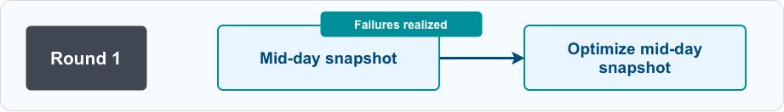
What changes from Round 1?

Slide 3
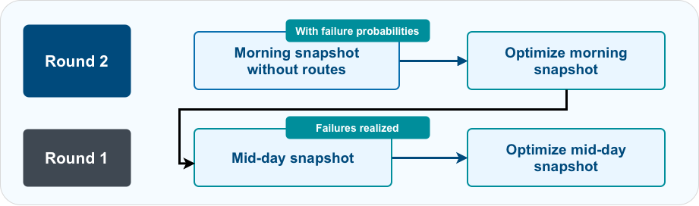
What changes from Round 1?

Slide 4
Probabilistic Failure
What the provided probability means?
failure_probability = 0.23 means there is 23% chance the machine fails by noon.
Time of failure is uniformly distributed for all machines.
Note that, these failures cannot be repaired in the morning plan.
Example:
The machine failed at 10:00am
You might have stopped by that location for replenishment at 11am
We only find out failures by mid-day and report in the mid-day snapshot
Still need to revisit in the afternoon plan for repair

Slide 5
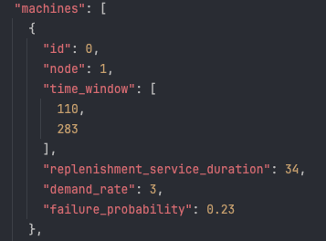
Probabilistic Failure – Update Your Inputs
What the provided probability means?
failure_probability = 0.23 means there is 23% chance the machine fails by noon.
Time of failure is uniformly distributed for all machines.
Note that, these failures cannot be repaired in the morning plan.

Slide 6
Round 2 – Submission I (Due Saturday 21:00)
We expect you to provide a morning plan for 10 instances from the scratch
Only include routes for replenishment for entire day
Similar to your input data for round 1* (do not update mid_day_time=0)

Slide 7
Round 2 – Submission II (Due Sunday 10:00)
We will provide you a set of scenarios aligned with the probabilities for each instance
We will push mid_day_time to middle of the day and include failures
We expect you to provide an afternoon plan for given inputs similar to round 1
You can improve your round 1 algorithms
Submit your final 50 afternoon plans (10 instances x 5 scenarios each)

Slide 8
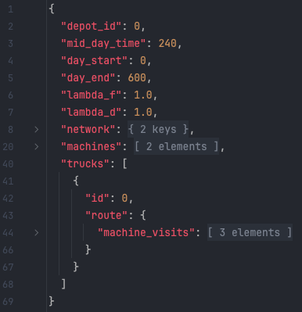
Formatting and input/output expectations
DO
Keep the same snapshot-style JSON structure.
Edit only trucks[*].route.machine_visits.
Keep route timing consistent: arrival, service start, departure.
Optimize/reoptimize only the editable route.
DO NOT
Editable
Change network, machines, truck IDs, root fields, or probabilities.
Schedule Repair operations in Morning Plan.
Submit infeasible plans.
Wait idle after any operation completion (can only wait before)

Slide 9

Good luck!

