Slide 1
IE451 Data Analytics and Optimization
Classification II

Slide 2

This week…
What is next?
Continue with Classification
Naïve Bayes Classifier
Instance Based Learning (kNN)
K*
SVM

Slide 3
Sick or Healthy?
Suppose that there is a disease in your city. 1 out of 1000 is sick. There is a test that is reliable 99% of the time: If 100 healthy person take the test, 99 of them has negative result; if 100 sick person take the test 99 of them test positive. A friend of yours, comes and states that s/he tested positive (indicating sickness). What is the probability that your friend is sick?
For sure (100%)
99%
Less than 99% but definitely more than 50%
Less than 10%
Less than 50% but definitely more than 10%

Slide 4
Sick or Healthy?
1 out of 1000 is sick.

Slide 5
Sick or Healthy?
Test will say "Sick" (99%)

Slide 6
Sick or Healthy?
Among the healthy 999, the test will mistakenly say sick to expectedly 9.99 of them. So altogether about 11 will be tested as "Sick" but only 1 is really sick!

Slide 7
Probability: A Quick Introduction
Let A be a chance event
Probability of A: P(A)
P is a probability function that assigns a number in the range [0, 1] to each event in event space
Prior (a priori) probability of A, P(A): with no new information about A or related events (e.g., no patient information)
Posterior (a posteriori) probability of A: P(A) given certain (usually relevant) information (e.g., laboratory tests)
P(A ∪ B) = ?
P(A ∩ B) = ?

Slide 8
Probability: A Quick Introduction
P( ) = P( ) = P (Red) = P (Blue) =
P (Blue ∩ ) = P ( ) =
P (Blue⏐ ) =

Slide 9
Probability: A Quick Introduction
P( ) = 5/10 P( ) = 5/10 P (Red) = 3/10 P (Blue) = 7/10
P (Blue ∩ ) = P ( ) = 3/10
P (Blue⏐ ) = 3/5
P (Blue⏐ ) = P (Blue ∩ ) / P( )
P (Blue ∩ ) = P (Blue⏐ ) * P( )

Slide 10
Probability Calculus
P(not(A)) = P(A^{c}) = 1-P(A)
If A,B are not mutually exclusive
P(A ∪ B) = P(A) + P(B) - P(A ∩ B)
If A, B are mutually exclusive:
P(A ∪ B) = P(A) + P(B)
A
B
A ∩ B
A
B

Slide 11
Probability Calculus
P(A ∩ B) = P(A) * P(B|A)
A, B are independent iff
P(A ∩ B) = P(A) * P(B)
That is, P(A) = P(A|B)
If A,B are not mutually exclusive, but are independent:
P(A ∪ B) = P(A)+P(B)-P(A)*P(B)
A
B
A ∩ B

Slide 12
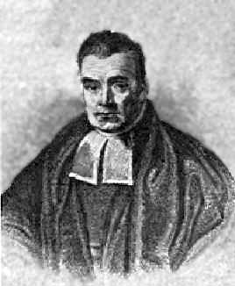
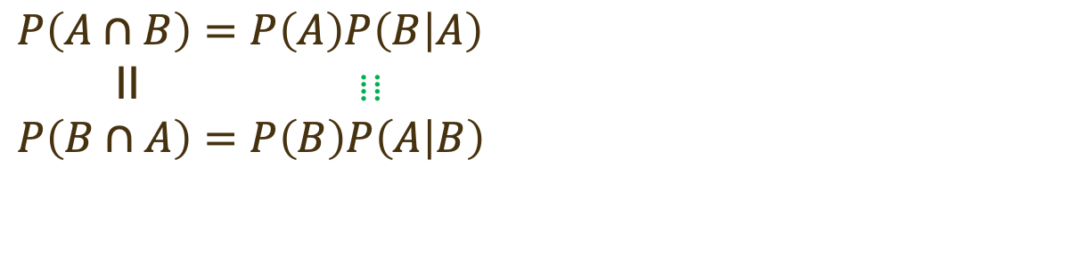
Bayes Theorem
$$P\left(A∩B\right)=P\left(A\right)P\left(B | A\right)$$
II ⦙ ⦙
$$P\left(B∩A\right)=P\left(B\right)P\left(A | B\right)$$
Thomas Bayes
(1701 – 1761)
English
Presbyterian Minister

Slide 13
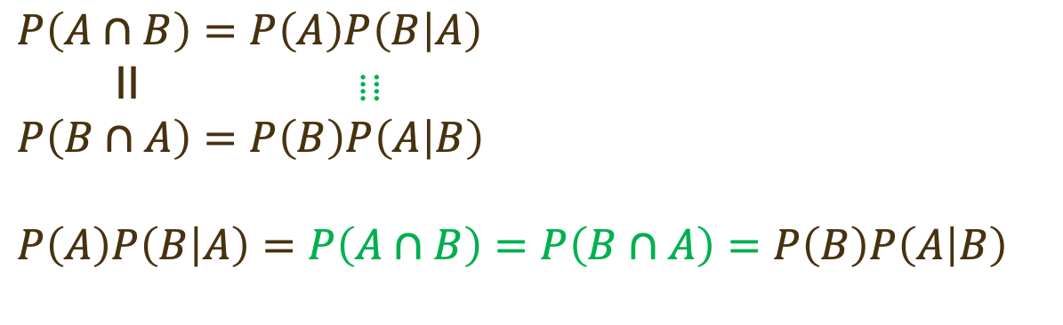
Bayes Theorem
$$P\left(A∩B\right)=P\left(A\right)P\left(B | A\right)$$
II ⦙ ⦙
$$P\left(B∩A\right)=P\left(B\right)P\left(A | B\right)$$
$$P\left(A\right)P\left(B | A\right)=P\left(A∩B\right)=P\left(B∩A\right)=P\left(B\right)P\left(A | B\right)$$
Thomas Bayes
(1701 – 1761)
English
Presbyterian Minister

Slide 14
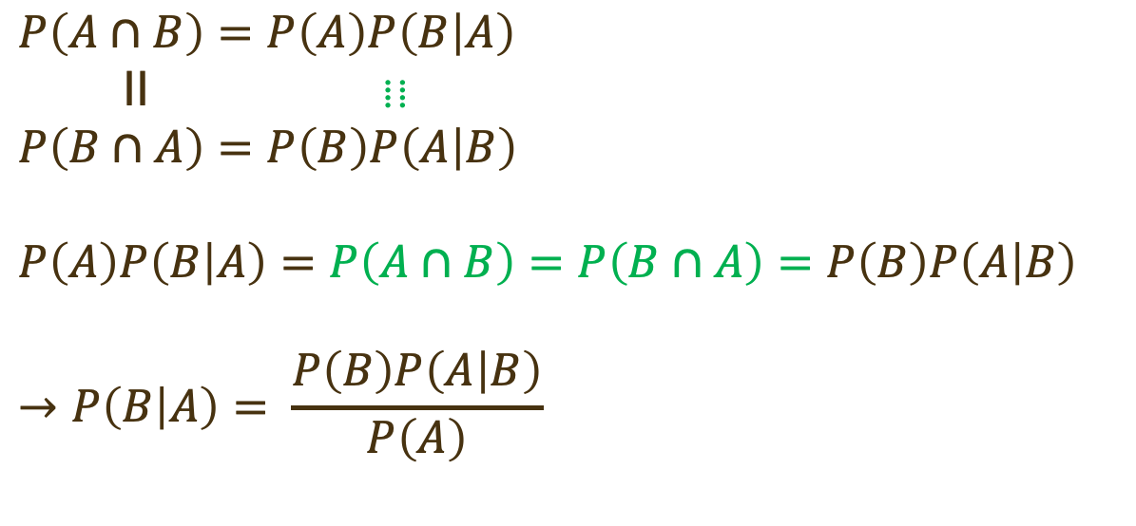
Bayes Theorem
$$P\left(A∩B\right)=P\left(A\right)P\left(B | A\right)$$
II ⦙ ⦙
$$P\left(B∩A\right)=P\left(B\right)P\left(A | B\right)$$
$$P\left(A\right)P\left(B | A\right)=P\left(A∩B\right)=P\left(B∩A\right)=P\left(B\right)P\left(A | B\right)$$
$$→P\left(B | A\right)= \frac{P\left(B\right)P\left(A | B\right)}{P\left(A\right)}$$
Thomas Bayes
(1701 – 1761)
English
Presbyterian Minister

Slide 15
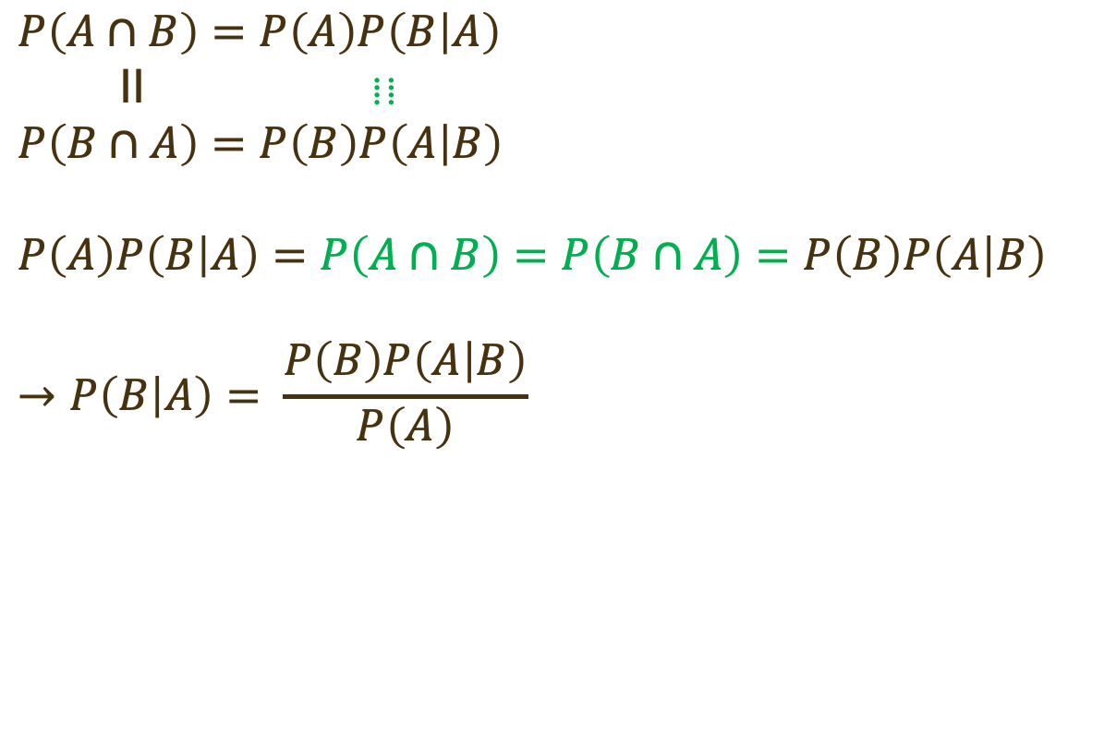
Bayes Theorem
$$P\left(A∩B\right)=P\left(A\right)P\left(B | A\right)$$
II ⦙ ⦙
$$P\left(B∩A\right)=P\left(B\right)P\left(A | B\right)$$
$$P\left(A\right)P\left(B | A\right)=P\left(A∩B\right)=P\left(B∩A\right)=P\left(B\right)P\left(A | B\right)$$
$$→P\left(B | A\right)= \frac{P\left(B\right)P\left(A | B\right)}{P\left(A\right)}$$
Thomas Bayes
(1701 – 1761)
English
Presbyterian Minister

Slide 16
Revising Your Belief With New Data
Thomas Bayes
(1701 – 1761)
English
Presbyterian Minister

Slide 17
Revising Your Belief With New Data
Prior Belief
Thomas Bayes
(1701 – 1761)
English
Presbyterian Minister

Slide 18
Revising Your Belief With New Data
Prior Belief
New Data
Thomas Bayes
(1701 – 1761)
English
Presbyterian Minister

Slide 19
Revising Your Belief With New Data
Prior Belief
Posterior Belief
New Data
Thomas Bayes
(1701 – 1761)
English
Presbyterian Minister

Slide 20
Sick or Healthy?
Suppose that there is a disease in your city. 1 out of 1000 is sick. There is a test that is reliable 99% of the time: If 100 healthy person take the test, 99 of them has negative result; if 100 sick person take the test 99 of them test positive. A friend of yours, comes and states that s/he tested positive (indicating sickness). What is the probability that your friend is sick?
For sure (100%)
99%
Less than 99% but definitely more than 50%
Less than 10%
Less than 50% but definitely more than 10%

Slide 21
Does Your Friend Have the Disease?

Slide 22
Revising Your Belief With New Data
Prior probability of the hypothesis h (i.e., class)
Conditional probability of the data d given the class h
Conditional probability of the class h given the data d
Thomas Bayes
(1701 – 1761)
English
Presbyterian Minister
Probability of the evidence d
(i.e. new data)

Slide 23
The Disease Problem
# | Age | Body Mass Index | Gender | Intensity of Symptoms | Disease
1 | Young | Under | Male | High | Healthy
2 | Young | Under | Male | Low | Healthy
3 | Middle | Under | Male | High | Sick
4 | Old | Medium | Male | High | Sick
5 | Old | Over | Female | High | Sick
6 | Old | Over | Female | Low | Healthy
7 | Middle | Over | Female | Low | Sick
8 | Young | Medium | Male | High | Healthy
9 | Young | Over | Female | High | Sick
10 | Old | Medium | Female | High | Sick
11 | Young | Medium | Female | Low | Sick
12 | Middle | Medium | Male | Low | Sick
13 | Middle | Under | Female | High | Sick
14 | Old | Medium | Male | Low | Healthy

Slide 24
Choosing the Hypothesis (MAP)
Maximum a Posteriori (MAP)
$$h_{MAP}=\underset{h∈H}{arg max}{P\left(h | d\right)}$$
$$=\underset{h∈H}{arg max}{\frac{P\left(d | h\right)·P\left(h\right)}{P\left(d\right)}}$$
$$=\underset{h∈H}{arg max}{P\left(d | h\right)·P\left(h\right)}$$
$$h_{ML}=\underset{h∈H}{arg max}{P\left(d | h\right)}$$
Maximum Likelihood (ML)

Slide 25
Naïve Bayes Classifier - I
Want to classify a new instance (a₁, a₂,…, a_{n}) into finite number of categories from the set H.
Bayesian approach: Assign the most probable category h_{MAP} given (a₁, a₂,…, a_{n}).
Can we estimate the probabilities from the training data?
$$h_{MAP}=\underset{h∈H}{arg max}{P\left(h | a_{1},a_{2},…,a_{n}\right)}$$
$$=\underset{h∈H}{arg max}{\frac{P\left(a_{1},a_{2},…,a_{n} | h\right).P\left(h\right)}{P\left(a_{1},a_{2},…,a_{n}\right)}}$$
$$=\underset{h∈H}{arg max}{P\left(a_{1},a_{2},…,a_{n} | h\right)·P\left(h\right)}$$

Slide 26

Naïve Bayes Classifier - II
$$h_{MAP}=\underset{h∈H}{arg max}{P\left(h | a_{1},a_{2},…,a_{n}\right)}$$
$$=\underset{h∈H}{arg max}{\frac{P\left(a_{1},a_{2},…,a_{n} | h\right)·P\left(h\right)}{P\left(a_{1},a_{2},…,a_{n}\right)}}$$
$$=\underset{h∈H}{arg max}{P\left(a_{1},a_{2},…,a_{n} | h\right)·P\left(h\right)}$$
Second probability easy to estimate (i.e., $P\left(h\right)$)
How?
The first probability difficult to estimate (i.e., $P\left(a_{1},a_{2},…,a_{n} | h\right)$)
Why?
Assume independence (This is the naϊvety assumption!)
$$P\left(d | h\right)=P\left(a_{1},a_{2},…,a_{n} | h\right)=\prod_{i=1,…,n}{P\left(a_{i} | h\right)}$$

Slide 27
Naïve Bayes Classifier - III
Data has multiple features ($a_{1},a_{2},…,a_{n}$), therefore $P\left(a_{1},a_{2},…,a_{n} | h\right)$ is not easy to calculate.
Naïve Bayes assumption: Attributes that describe data instances are conditionally independent given the classification hypothesis
It is a simplifying assumption, obviously it may be violated in reality. In spite of that, in some context it works well in practice.
The Bayesian classifier that uses the Naïve Bayes assumption and computes the MAP hypothesis is called Naïve Bayes classifier.
It has various successful application in Text Classification, Medical Diagnosis, etc. But generally has poor performance.
$$P\left(d | h\right)=P\left(a_{1},a_{2},…,a_{n} | h\right)=\prod_{i=1,…,n}{P\left(a_{i} | h\right)}$$

Slide 28
The Disease Problem
# | Age | Body Mass Index | Gender | Intensity of Symptoms | Disease
1 | Young | Under | Male | High | Healthy
2 | Young | Under | Male | Low | Healthy
3 | Middle | Under | Male | High | Sick
4 | Old | Medium | Male | High | Sick
5 | Old | Over | Female | High | Sick
6 | Old | Over | Female | Low | Healthy
7 | Middle | Over | Female | Low | Sick
8 | Young | Medium | Male | High | Healthy
9 | Young | Over | Female | High | Sick
10 | Old | Medium | Female | High | Sick
11 | Young | Medium | Female | Low | Sick
12 | Middle | Medium | Male | Low | Sick
13 | Middle | Under | Female | High | Sick
14 | Old | Medium | Male | Low | Healthy

Slide 29
The Disease Problem
Age |  |  | BMI |  |  | Gender |  |  | IoS |  |  | Disease
 | Healthy | Sick |  | Healthy | Sick |  | Healthy | Sick |  | Healthy | Sick | Healthy | Sick
Young | 3 | 2 | Under | 2 | 2 | Female | 1 | 6 | High | 2 | 6 | 5 | 9
Middle | - | 4 | Normal | 2 | 4 | Male | 4 | 3 | Low | 3 | 3
Old | 2 | 3 | Over | 1 | 3
$$P\left(\text{Sick} \right)=\frac{9}{14}$$
$$P\left(\text{Healthy} \right)=\frac{5}{14}$$
$$h_{MAP}=\underset{h∈H}{arg max}{P\left(a_{1},a_{2},…,a_{n} | h\right)·P\left(h\right)}$$
$P\left(Young, Over, Male, Low | Sick\right)=?$ $P\left(Young, Over, Male, Low | Healthy\right)=?$
$$P\left(d | h\right)=P\left(a_{1},a_{2},…,a_{n} | h\right)=\prod_{i=1,…,n}{P\left(a_{i} | h\right)}$$
Naϊvety Assumption!

Slide 30
The Disease Problem
Age |  |  | BMI |  |  | Gender |  |  | IoS |  |  | Disease
 | Healthy | Sick |  | Healthy | Sick |  | Healthy | Sick |  | Healthy | Sick | Healthy | Sick
Young | 3 | 2 | Under | 2 | 2 | Female | 1 | 6 | High | 2 | 6 | 5 | 9
Middle | - | 4 | Normal | 2 | 4 | Male | 4 | 3 | Low | 3 | 3
Old | 2 | 3 | Over | 1 | 3
$$P\left(\text{Sick} \right)=\frac{9}{14}$$
$$P\left(\text{Healthy} \right)=\frac{5}{14}$$
$$h_{MAP}=\underset{h∈H}{arg max}{P\left(a_{1},a_{2},…,a_{n} | h\right)·P\left(h\right)}$$
$$P\left(Young, Over, Male, Low | Sick\right)=P\left(Young | Sick\right)·P\left(Over | Sick\right)·P\left(Male | Sick\right)·P\left(Low | Sick\right)$$
$$P\left(Young | Sick\right)=\frac{2}{9}$$
$$P\left(Over | Sick\right)=\frac{3}{9}$$
$$P\left(Male | Sick\right)=\frac{3}{9}$$
$$P\left(Low | Sick\right)=\frac{3}{9}$$

Slide 31
The Disease Problem
Age |  |  | BMI |  |  | Gender |  |  | IoS |  |  | Disease
 | Healthy | Sick |  | Healthy | Sick |  | Healthy | Sick |  | Healthy | Sick | Healthy | Sick
Young | 3 | 2 | Under | 2 | 2 | Female | 1 | 6 | High | 2 | 6 | 5 | 9
Middle | - | 4 | Normal | 2 | 4 | Male | 4 | 3 | Low | 3 | 3
Old | 2 | 3 | Over | 1 | 3
$$P\left(\text{Sick} \right)=\frac{9}{14}$$
$$P\left(\text{Healthy} \right)=\frac{5}{14}$$
$$h_{MAP}=\underset{h∈H}{arg max}{P\left(a_{1},a_{2},…,a_{n} | h\right)·P\left(h\right)}$$
$$P\left(Young, Over, Male, Low | Sick\right)=P\left(Young | Sick\right)·P\left(Over | Sick\right)·P\left(Male | Sick\right)·P\left(Low | Sick\right)$$
$$P\left(Young, Over, Male, Low | Sick\right)·P\left(\text{Sick} \right)=\frac{2}{9}·\frac{3}{9}·\frac{3}{9}·\frac{3}{9}·\frac{9}{14}=0.00530$$

Slide 32
The Disease Problem
Age |  |  | BMI |  |  | Gender |  |  | IoS |  |  | Disease
 | Healthy | Sick |  | Healthy | Sick |  | Healthy | Sick |  | Healthy | Sick | Healthy | Sick
Young | 3 | 2 | Under | 2 | 2 | Female | 1 | 6 | High | 2 | 6 | 5 | 9
Middle | - | 4 | Normal | 2 | 4 | Male | 4 | 3 | Low | 3 | 3
Old | 2 | 3 | Over | 1 | 3
$$P\left(\text{Sick} \right)=\frac{9}{14}$$
$$P\left(\text{Healthy} \right)=\frac{5}{14}$$
$$h_{MAP}=\underset{h∈H}{arg max}{P\left(a_{1},a_{2},…,a_{n} | h\right)·P\left(h\right)}$$
$$P\left(Young, Over, Male, Low | \text{Healthy}\right)=P\left(Young | \text{Healthy}\right)·P\left(Over | \text{Healthy}\right)·P\left(Male | \text{Healthy}\right)·P\left(Low | \text{Healthy}\right)$$
$$P\left(Young | \text{Healthy}\right)=\frac{3}{5}$$
$$P\left(Over | \text{Healthy}\right)=\frac{1}{5}$$
$$P\left(Male | \text{Healthy}\right)=\frac{4}{5}$$
$$P\left(Low | \text{Healthy}\right)=\frac{3}{5}$$

Slide 33
The Disease Problem
Age |  |  | BMI |  |  | Gender |  |  | IoS |  |  | Disease
 | Healthy | Sick |  | Healthy | Sick |  | Healthy | Sick |  | Healthy | Sick | Healthy | Sick
Young | 3 | 2 | Under | 2 | 2 | Female | 1 | 6 | High | 2 | 6 | 5 | 9
Middle | - | 4 | Normal | 2 | 4 | Male | 4 | 3 | Low | 3 | 3
Old | 2 | 3 | Over | 1 | 3
$$P\left(\text{Sick} \right)=\frac{9}{14}$$
$$P\left(\text{Healthy} \right)=\frac{5}{14}$$
$$h_{MAP}=\underset{h∈H}{arg max}{P\left(a_{1},a_{2},…,a_{n} | h\right)·P\left(h\right)}$$
$$P\left(Young, Over, Male, Low | \text{Healthy}\right)=P\left(Young | \text{Healthy}\right)·P\left(Over | \text{Healthy}\right)·P\left(Male | \text{Healthy}\right)·P\left(Low | \text{Healthy}\right)$$
$$P\left(Young, Over, Male, Low | \text{Healthy}\right)·P\left(\text{Healthy}\right)=\frac{3}{5}·\frac{1}{5}·\frac{4}{5}·\frac{3}{5}·\frac{5}{14}=0.00206$$

Slide 34
The Disease Problem
Age |  |  | BMI |  |  | Gender |  |  | IoS |  |  | Disease
 | Healthy | Sick |  | Healthy | Sick |  | Healthy | Sick |  | Healthy | Sick | Healthy | Sick
Young | 3 | 2 | Under | 2 | 2 | Female | 1 | 6 | High | 2 | 6 | 5 | 9
Middle | - | 4 | Normal | 2 | 4 | Male | 4 | 3 | Low | 3 | 3
Old | 2 | 3 | Over | 1 | 3
$$h_{MAP}=\underset{h∈H}{arg max}{P\left(a_{1},a_{2},…,a_{n} | h\right)·P\left(h\right)}$$
$$P\left(Young, Over, Male, Low | Sick\right)·P\left(\text{Sick} \right)=\frac{2}{9}·\frac{3}{9}·\frac{3}{9}·\frac{3}{9}·\frac{9}{14}=0.00530$$
$$P\left(Young, Over, Male, Low | \text{Healthy}\right)·P\left(\text{Healthy}\right)=\frac{3}{5}·\frac{1}{5}·\frac{4}{5}·\frac{3}{5}·\frac{5}{14}=0.00206$$
$$h_{MAP}=\text{Sick}\text{!}$$
Note that $P\left(a_{1},a_{2},…,a_{n} | h\right)·P\left(h\right)$ is not a probability. Thus a summation over the arguments (i.e., h) doesn’t yield 1. However, $\frac{P\left(a_{1},a_{2},…,a_{n} | h\right)·P\left(h\right)}{P\left(a_{1},a_{2},…,a_{n}\right)}$ is a (conditional) probability (i.e., $P\left(h | a_{1},a_{2},…,a_{n}\right)$) and it would sum up to 1!

Slide 35
Naïve Bayes Classifier - Remarks
Naïve Bayes Classifier assumes all attributes equally important.
It also assumes that all of the attributes are independent. But this is not realistic in many cases.
Therefore, selection of attributes (Feature Subset Selection) where only relevant features (those that really matters & those that are not redundant) should be considered in the model.
Also there is an issue regarding the "Zero" entries…
Due to multiplication in the calculations, if only one of the features have no example in the sample, there is a risk for nullifying the whole! → Laplace Correction (Smoothing) (Add +1 To All Bins)
Age |  |  | BMI |  |  | Gender |  |  | IoS |  |  | Disease
 | Healthy | Sick |  | Healthy | Sick |  | Healthy | Sick |  | Healthy | Sick | Healthy | Sick
Young | 3+1 | 2+1 | Under | 2+1 | 2+1 | Female | 1+1 | 6+1 | High | 2+1 | 6+1 | 5+1 | 9+1
Middle | -+1 | 4+1 | Normal | 2+1 | 4+1 | Male | 4+1 | 3+1 | Low | 3+1 | 3+1
Old | 2+1 | 3+1 | Over | 1+1 | 3+1

Slide 36
Instance-Based Learning (IBL)
Lazy Learning – This classifier does not do much!
Recall that the classifiers constructs a model during the training phase in order to classify the new cases.
IBL does not have a training phase. It also does not construct a classifier. Computing is done during the classification.
It basically learns by storing the training data (learning)
Fundamental assumption is "Similar instances will have in similar classes"!
k-Nearest Neighbor (KNN Classifier) is one of the most popular Instance Based Learner. Find most similar k instances and infer based on only these k instances.
How do we assess the "similarity" between the instances?

Slide 37
Similarity Measures – (I)
Each instance is an n-dimensional vector (has n features)
$$\left[a_{1}\left(x\right),a_{2}\left(x\right),…,a_{n}\left(x\right)\right]$$
A commonly used distance metric between numeric features is the Euclidean Distance (ED):
$$d\left(x_{1},x_{2}\right)=\sqrt{\sum_{i=1}^{n}{{\left(a_{i}\left(x_{1}\right)−a_{i}\left(x_{2}\right)\right)}^{2}}}$$
Note that since ED is not scale independent, one needs to normalize the data before using this distance. Otherwise, the features that have higher values would dominate the distance, and change in the units (say, a change in one of the features from kilometers to millimeters would change the results).
Quite effective for low dimensional data, but due to the curse of dimensionality it becomes less useful for high dimensional data.

Slide 38
Similarity Measures – (II)
Each instance is an n-dimensional vector (has n features)
$$\left[a_{1}\left(x\right),a_{2}\left(x\right),…,a_{n}\left(x\right)\right]$$
Another commonly used distance metric between numeric features is the Cosine Similarity (CS):
$$d\left(x_{1},x_{2}\right)=\frac{\left[x_{1}\right]·\left[x_{2}\right]}{\left\|x_{1}\right\|·\left\|x_{2}\right\|}=\frac{\sum_{i=1}^{n}{\left(a_{i}\left(x_{1}\right)·a_{i}\left(x_{2}\right)\right)}}{\sqrt{\sum_{i=1}^{n}{{\left(a_{i}\left(x_{1}\right)\right)}^{2}}}·\sqrt{\sum_{i=1}^{n}{{\left(a_{i}\left(x_{2}\right)\right)}^{2}}}}$$
Note that two data points that have exactly the same orientation would have CS of +1. On the other hand, if they are directly opposing to each other in that case CS of these two would be -1 (e.g., $d_{CS}\left(\left[2,4\right],\left[1,2\right]\right)=1$).
Is useful for high dimensional data and magnitude of the vector is not important but merely the direction of them what really matters (e.g., word counts in different texts, rather than the nominal occurrence of a word, relative frequency might be more useful).

Slide 39
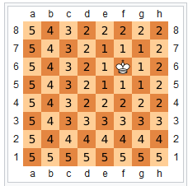
Similarity Measures – (III)
Each instance is an n-dimensional vector (has n features)
$$\left[a_{1}\left(x\right),a_{2}\left(x\right),…,a_{n}\left(x\right)\right]$$
Another distance metric between numeric features is the Manhattan Distance (MD):
$$d\left(x_{1},x_{2}\right)=\sum_{i=1}^{n}{\left|a_{i}\left(x_{1}\right)−a_{i}\left(x_{2}\right)\right|}$$
Sometimes used for high dimensional data. Not as popular as ED.
Another less popular distance metric between numeric features is the Chebyshev Distance (CD) (i.e., $ℒ_{∞}−metric$):
$$d\left(x_{1},x_{2}\right)=\max_{i}\left|a_{i}\left(x_{1}\right)−a_{i}\left(x_{2}\right)\right|$$
It is also known as Chessboard Distance since it corresponds to the minimum number of moves a King in chess has to do in order to move from one square to another.
Only considers the maximum distance among the features.
Source: wikipedia.org

Slide 40
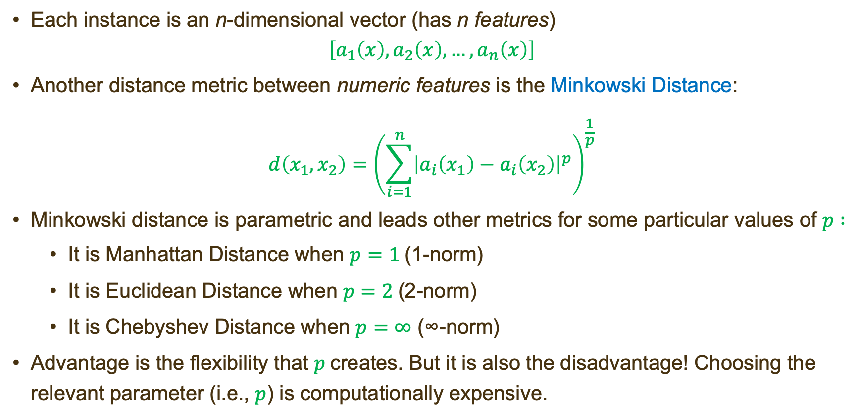
Similarity Measures – (IV)
Each instance is an n-dimensional vector (has n features)
$$\left[a_{1}\left(x\right),a_{2}\left(x\right),…,a_{n}\left(x\right)\right]$$
Another distance metric between numeric features is the Minkowski Distance:
$$d\left(x_{1},x_{2}\right)={\left(\sum_{i=1}^{n}{{\left|a_{i}\left(x_{1}\right)−a_{i}\left(x_{2}\right)\right|}^{p}}\right)}^{\frac{1}{p}}$$
Minkowski distance is parametric and leads other metrics for some particular values of $p :$
It is Manhattan Distance when $p=1$(1-norm)
It is Euclidean Distance when $p=2$(2-norm)
It is Chebyshev Distance when $p=∞$ (∞-norm)
Advantage is the flexibility that $p$creates. But it is also the disadvantage! Choosing the relevant parameter (i.e., $p$) is computationally expensive.

Slide 41
Similarity Measures – (V)
Each instance is an n-dimensional vector (has n features)
$$\left[a_{1}\left(x\right),a_{2}\left(x\right),…,a_{n}\left(x\right)\right]$$
A commonly used distance metric between nominal features is the distance is the Hamming Distance (HD):
$$d\left(x_{1},x_{2}\right)=\sum_{i=1}^{n}{a_{i}\left(x_{1}\right)≠a_{i}\left(x_{2}\right)}$$
This metric is also know as Overlap Distance.
It is basically number of values that are different between two data vectors. That is to say, each match among the nominal attributes yields 0 distance, any mismatch yields +1.
It doesn’t consider the magnitude of the difference between the values (so might be less useful for ordinal attributes (e.g., difference between "very bad" and "very good" is not same with the difference between "good" and "very good").

Slide 42
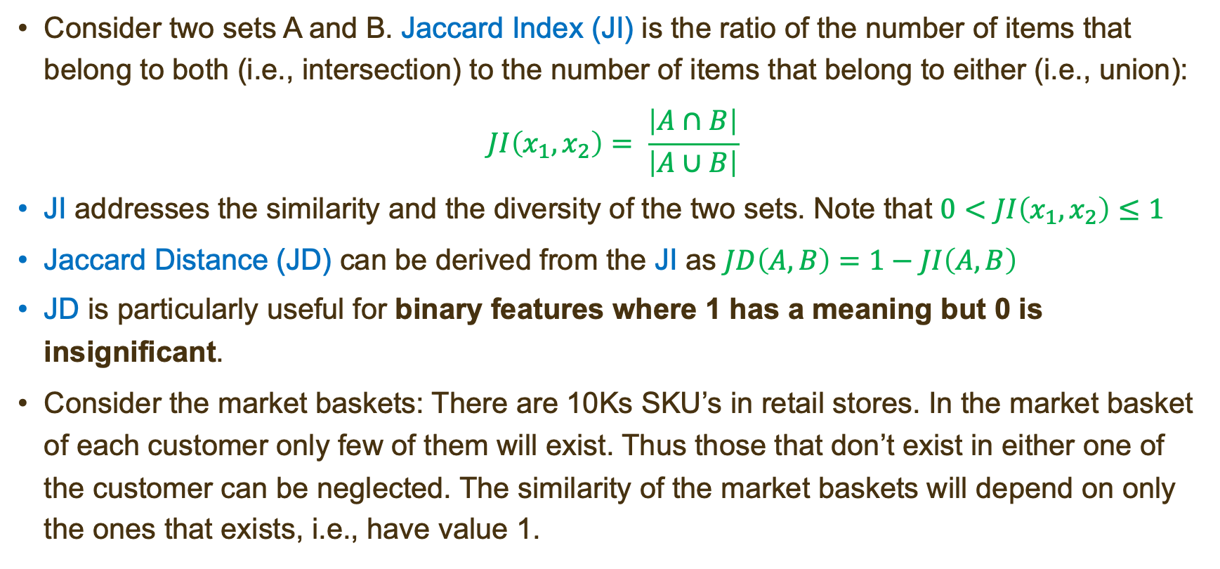
Similarity Measures – (VI)
Consider two sets A and B. Jaccard Index (JI) is the ratio of the number of items that belong to both (i.e., intersection) to the number of items that belong to either (i.e., union):
$$JI\left(x_{1},x_{2}\right)= \frac{\left|A∩B\right|}{\left|A∪B\right|}$$
JI addresses the similarity and the diversity of the two sets. Note that $0<JI\left(x_{1},x_{2}\right)≤1$
Jaccard Distance (JD) can be derived from the JI as $JD\left(A,B\right)=1−JI\left(A,B\right)$
JD is particularly useful for binary features where 1 has a meaning but 0 is insignificant.
Consider the market baskets: There are 10Ks SKU’s in retail stores. In the market basket of each customer only few of them will exist. Thus those that don’t exist in either one of the customer can be neglected. The similarity of the market baskets will depend on only the ones that exists, i.e., have value 1.

Slide 43
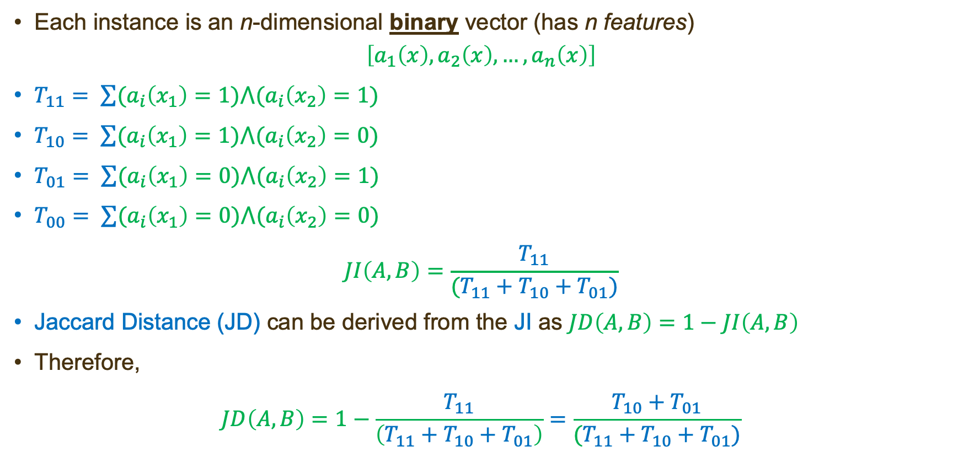
Similarity Measures – (VII)
Each instance is an n-dimensional binary vector (has n features)
$$\left[a_{1}\left(x\right),a_{2}\left(x\right),…,a_{n}\left(x\right)\right]$$
$T_{11}= \sum{{(a}_{i}\left(x_{1}\right)=1)⋀{(a}_{i}\left(x_{2}\right)=1)}$
$T_{10}= \sum{{(a}_{i}\left(x_{1}\right)=1)⋀{(a}_{i}\left(x_{2}\right)=0)}$
$T_{01}= \sum{{(a}_{i}\left(x_{1}\right)=0)⋀{(a}_{i}\left(x_{2}\right)=1)}$
$T_{00}= \sum{{(a}_{i}\left(x_{1}\right)=0)⋀{(a}_{i}\left(x_{2}\right)=0)}$
$$JI\left(A,B\right)=\frac{T_{11}}{(T_{11}+T_{10}+T_{01})}$$
Jaccard Distance (JD) can be derived from the JI as $JD\left(A,B\right)=1−JI\left(A,B\right)$
Therefore,
$$JD\left(A,B\right)=1−\frac{T_{11}}{\left(T_{11}+T_{10}+T_{01}\right)}=\frac{T_{10}+T_{01}}{(T_{11}+T_{10}+T_{01})}$$
$$A$$
$$B$$
$$T_{10}$$
$$T_{11}$$
$$T_{01}$$
$$T_{00}$$

Slide 44
Similarity Measures – (VIII)
Jaccard Distance (JD) can also be used for numerical features.
Each instance is an n-dimensional numerical vector (has n features)
$$\left[a_{1}\left(x\right),a_{2}\left(x\right),…,a_{n}\left(x\right)\right]$$
Jaccard Distance (JD) can be calculated as follows:
$$d\left(x_{1},x_{2}\right)=1−\frac{\sum_{i=1}^{n}{\min\left(a_{i}\left(x_{1}\right),a_{i}\left(x_{2}\right)\right)}}{\sum_{i=1}^{n}{\max\left(a_{i}\left(x_{1}\right),a_{i}\left(x_{2}\right)\right)}}$$
Note that the above calculation would yield the same distance with the formulation that was provided earlier for the binary vector case:
$$JD\left(A,B\right)=1−\frac{T_{11}}{\left(T_{11}+T_{10}+T_{01}\right)}=\frac{T_{10}+T_{01}}{(T_{11}+T_{10}+T_{01})}$$
Therefore, it can be considered as the generalized version of the binary formulation.

Slide 45
The Disease Problem
# | Age | Body Mass Index | Gender | Intensity of Symptoms | Disease | Hamming Distance
1 | Young | Under | Male | High | Healthy | 2
2 | Young | Under | Male | Low | Healthy | 1
3 | Middle | Under | Male | High | Sick | 3
4 | Old | Medium | Male | High | Sick | 4
5 | Old | Over | Female | High | Sick | 3
6 | Old | Over | Female | Low | Healthy | 2
7 | Middle | Over | Female | Low | Sick | 2
8 | Young | Medium | Male | High | Healthy | 2
9 | Young | Over | Female | High | Sick | 2
10 | Old | Medium | Female | High | Sick | 4
11 | Young | Medium | Female | Low | Sick | 2
12 | Middle | Medium | Male | Low | Sick | 2
13 | Middle | Under | Female | High | Sick | 4
14 | Old | Medium | Male | Low | Healthy | 2
$k=1$? What about $k=3$?

Slide 46
Instance-Based Learning – Remarks (I)
Assumes all attributes have the same importance
You can use weighted Euclidean as opposed to regular one where the weights are the weights of the attributes.
For nominal outputs (i.e., classification) one can use majority vote, that is to say assign a cluster that the majority among the k-NN has.
For numeric outputs (i.e., regression) one can use averaging.
Note that one can also consider weighting the outputs of the k-NN instances based on their inverse distance (or inverse square distance) to the test data. For nominal output, one can sum the total weight for each label and choose the one that has the highest total weight.

Slide 47
Instance-Based Learning – Remarks (II)
Theoretically, as n→ ∞, k→ ∞ and k/n→ 0 error approaches to 0!
There are various extended versions of IBk
For each instance track the performance of the training instances and those that don’t perform well get rid of them!
Dynamically learn and adjust the importance of the attribute, that is to say, as the class is incorrect you reduce the weight (and vice versa).
What about k?
Use cross-validation in the training data and choose the k that maximizes the prediction accuracy.

Slide 48
Locally Weighted Numeric Prediction
Locally weighted regression is an alternative to regression trees where the regression is computed at testing time rather than training time – Hence Lazy algorithm!
Allows one to compute a regression for only instances that are close to the testing instance
Use Instance Based Learning together with a base classifier – almost like a wrapper
Learn a model within a neighborhood
Basic idea: approximate non-linear function learning with simple linear algorithms

Slide 49
K* (aka K-Star) Classifier
K* is another lazy learning algorithm available in WEKA.
Developed by Cleary and Trigg (1995) from University of Waikato.
Uses an entropy based distance metric rather than Euclidean distance
The intuition is that the distance between instances is defined as the complexity of transforming one instance into another.
Much slower than KNN Classifier due to the algorithm required to calculate the "entropy based metric"!
Allows you to choose what to do with missing values.

Slide 50
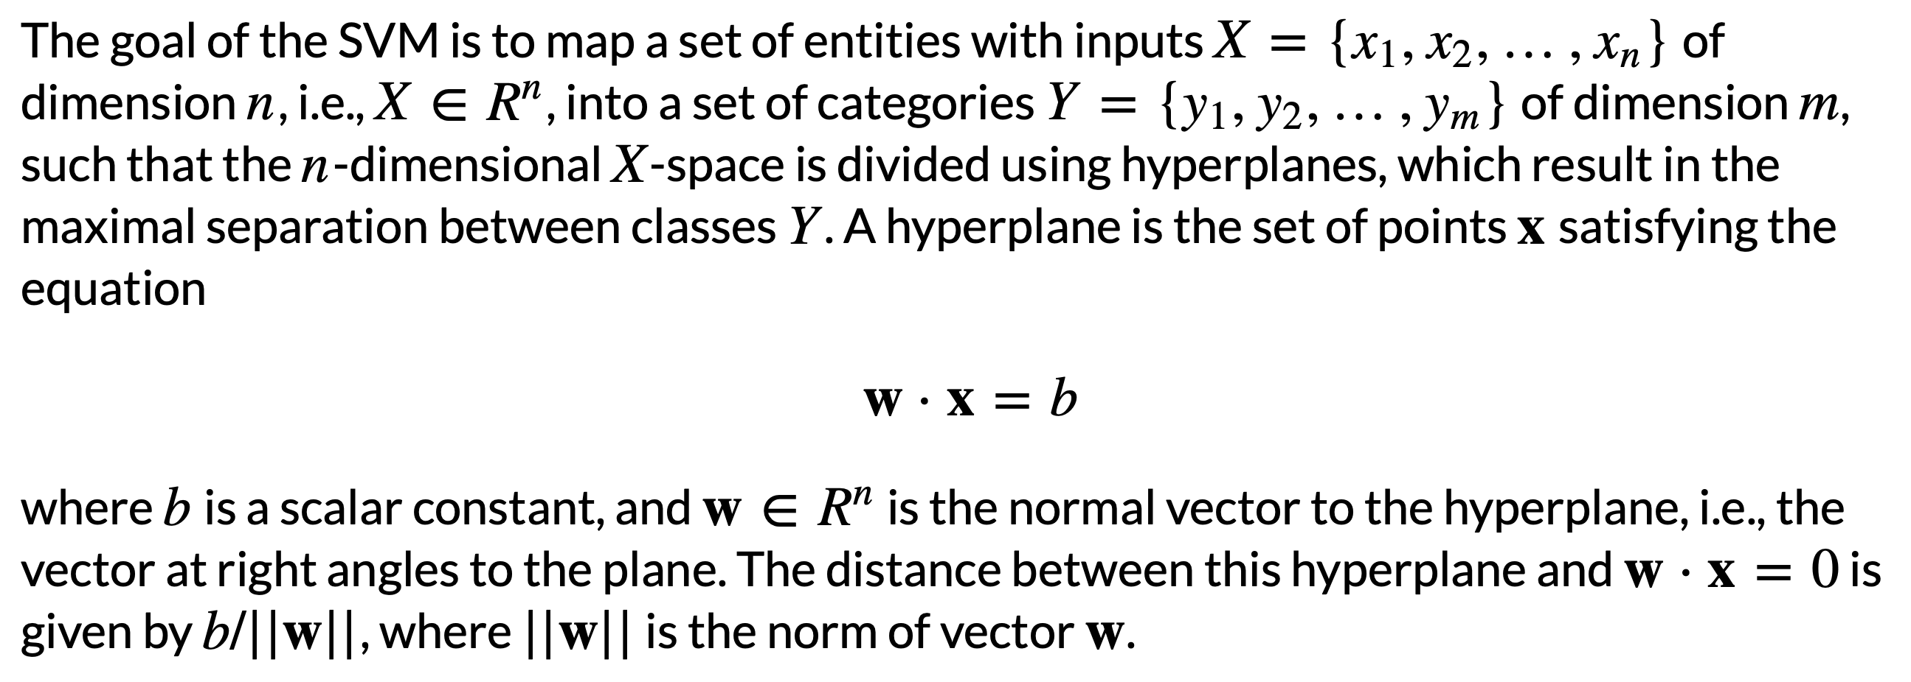
Support Vector Machines

Slide 51
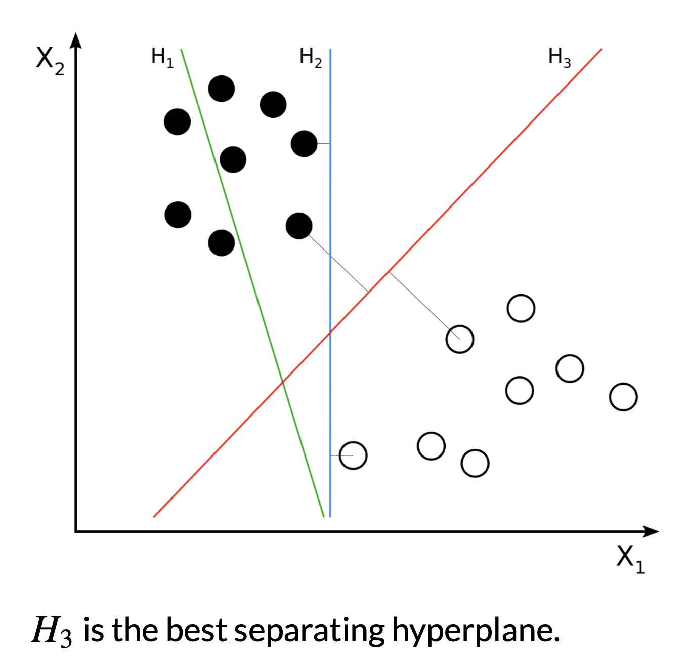
Support Vector Machines

Slide 52
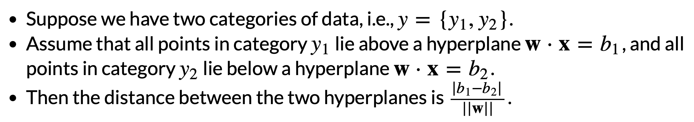
Support Vector Machines

Slide 53
Support Vector Machines

Slide 54
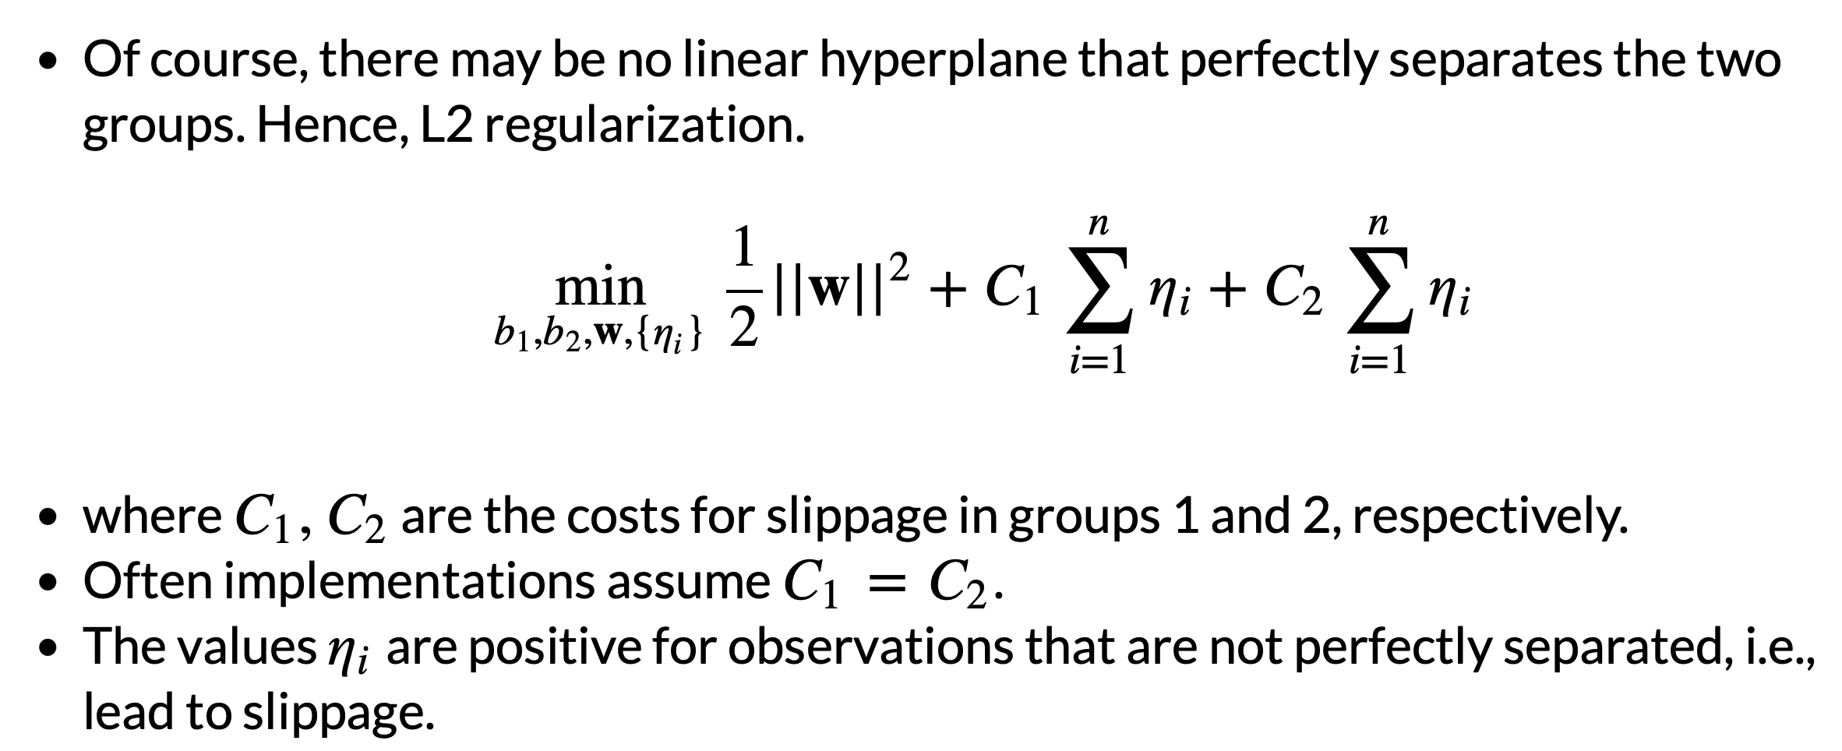
Support Vector Machines

