Slide 1
資料探勘 第八組
B103040012 謝承翰
B103040001 孫世諭
B103040003 魯喆元
B103040008 許廷豪
B103040051 黃嘉彥

Slide 2
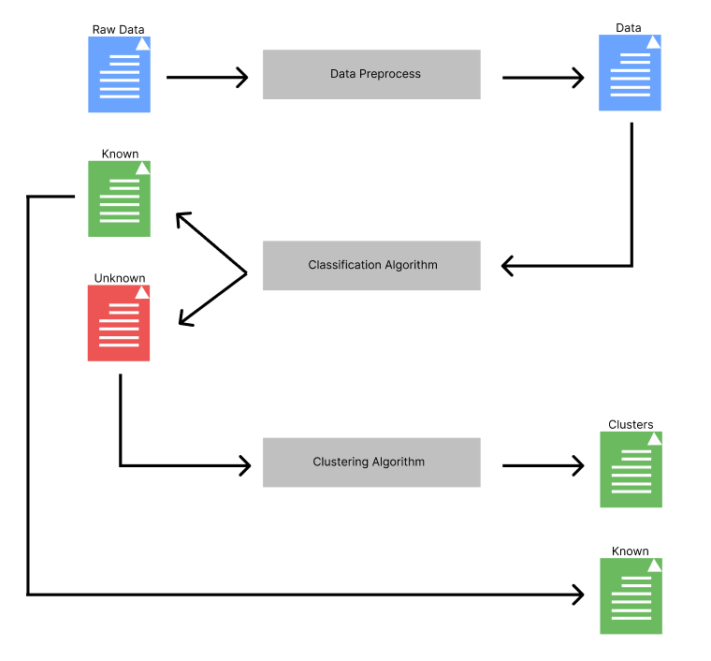
Main Algorithm

Slide 3
Data Preprocess
PCA, Autoencoder, Normalize

Slide 4
PCA
Reduce the dimension to 30 in arrhythmia dataset.
Reduce the dimension to 32 in gene expression cancer RNA-Seq dataset.

Slide 5
Autoencoder
For fairness, reduce the dimension to 30 in arrhythmia dataset.
Reduce the dimension to 32 in gene expression cancer RNA-Seq dataset.

Slide 6
Classification Algorithm
KNN, SVM, SVDD + NN, Naïve Bayes classifier

Slide 7
KNN
How to know a data point doesn’t belong to known type?
Distance and probability.

Slide 8
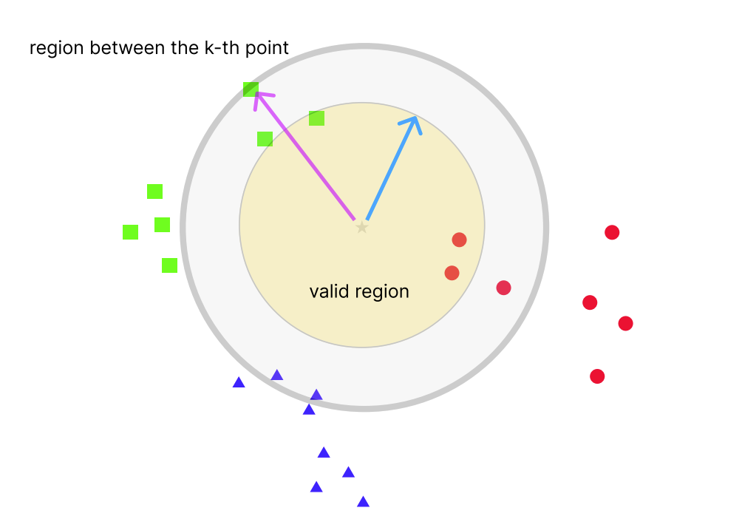
KNN
Probability that belong to red:
2/(1+2+0)=2/3
Probability that belong to green:
1/(1+2+0)=1/3
Probability that belong to blue:
0/(1+2+0)=1/3

Slide 9
KNN
Probability that belong to red:
2/(1+2+0)=2/3
Probability that belong to green:
1/(1+2+0)=1/3
Probability that belong to blue:
0/(1+2+0)=1/3
Determine whether it’s unknown type if
highest probability < prob_threhold

Slide 10
Multi-Classification SVMs
Since SVM is meant to be a binary classifier, multi-classification must use a sequence of SVMs.

Slide 11
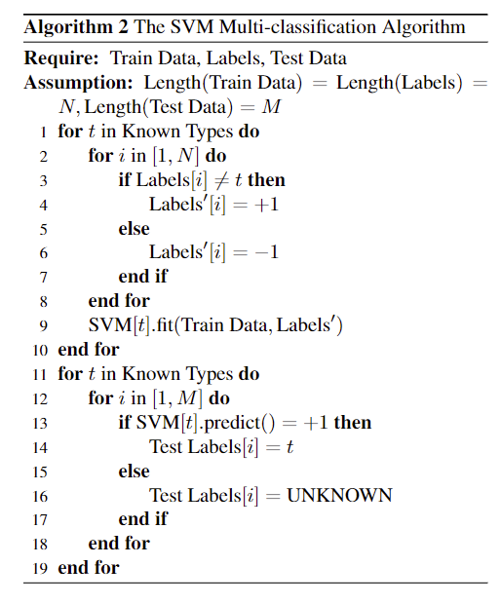
Multi-Classification SVMs

Slide 12
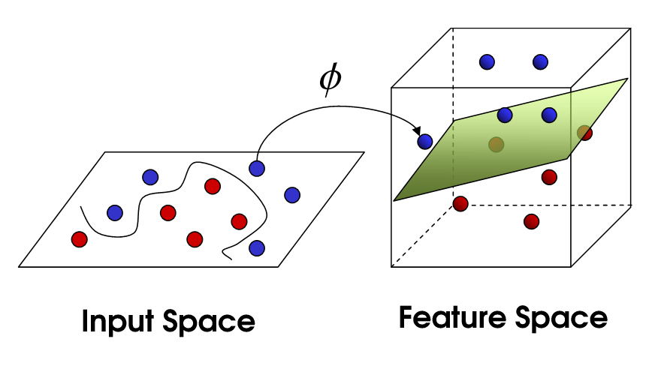
SVM – kernel trick

Slide 13
SVM – kernel trick
There are multiple kernels,
Linear
Polynomial
RBF
sigmoid

Slide 14
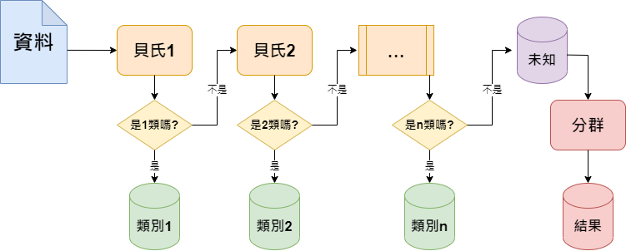
Naïve Bayes classifier

Slide 15
SVDD + NN
Use SVDD to separate unknown types and known types first.
Then apply pre-trained neural network to classify known types.

Slide 16
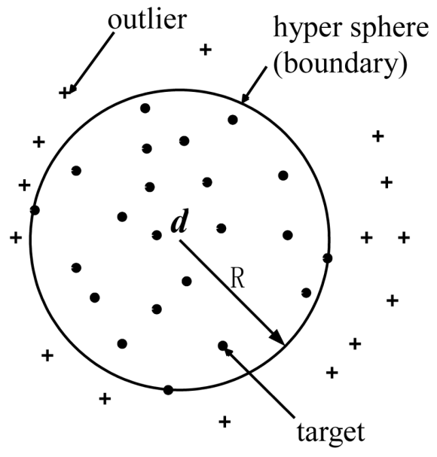
SVDD

Slide 17
Clustering Algorithm
DBSCAN, k-means, NN-chain

Slide 18
DBSCAN
This clustering algorithm generate noisy points.
So after clustering, a noisy point will be marked as the type whose mass center is the closet to this noisy point.

Slide 19
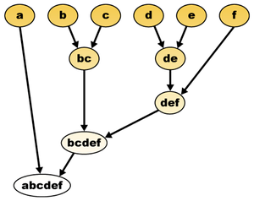
NN-chain

Slide 20
Within the framework of Main algorithm, we compare multiple combinations of those techniques.

Slide 21
But there’s one more thing.

Slide 22
Hyperparameters fine-tune
Take SVM + DBSCAN as example, with the 4 selectable kernels, the total number of hyperparameters is 8.
For each experiments, the total number of hyperparameter is 48 in both datasets.
Manually fine-tune? Not a chance!

Slide 23
Hyperparameters fine-tune
So simulated annealing algorithm is used here.

Slide 24
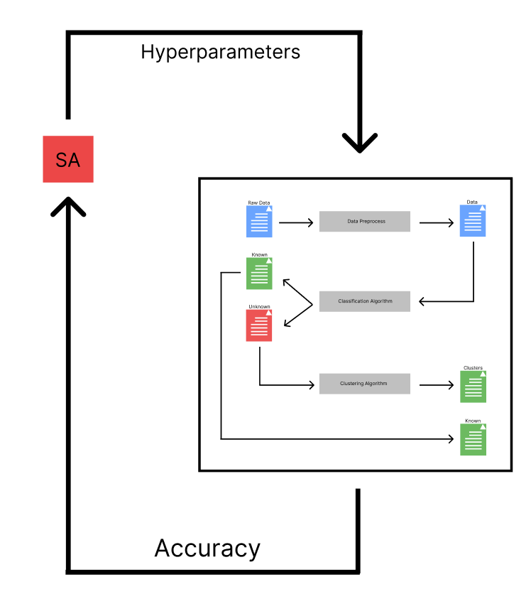
Hyperparameters fine-tune

Slide 25
Final results

Slide 26
KNN + DBSCAN, arrhythmia
Repeat 10 times | Accuracy (%) | Time (s)
Raw | 47.4684% ± 0% | 0.0285
Normalized | 46.8354% ± 0% | 0.0254
PCA-32 | 38.6076% ± 0% | 0.0070
PCA-32 (normalized) | 42.4051% ± 0% | 0.0071
AE-32 | 37.9747% ± 0% | 0.0071
AE-32 (normalized) | 44.3038% ± 0% | 0.0071

Slide 27
KNN + k-means, arrhythmia
Repeat 10 times | Accuracy (%) | Time (s)
Raw | 53.1646% ± 0% | 0.0236
Normalized | 50.6329% ± 0% | 0.0343
PCA-32 | 43.0380% ± 0% | 0.0068
PCA-32 (normalized) | 43.0380% ± 0% | 0.0069
AE-32 | 36.0759% ± 0% | 0.0069
AE-32 (normalized) | 41.7722% ± 0% | 0.0080

Slide 28
SVM (sigmoid) + k-means, arrhythmia
Repeat 10 times | Accuracy (%) | Time (s)
Raw | 28.4810% ± 0% | 3.5272
Normalized | 20.2532% ± 0% | 6.4731
PCA-32 | 30.3797% ± 0% | 1.5779
PCA-32 (normalized) | 36.0759% ± 0% | 0.9797
AE-32 | 22.1519 % ± 0% | 0.5284
AE-32 (normalized) | 24.6835% ± 0% | 0.8430

Slide 29
Naive Bayes classifier (GA) + k-means, arrhythmia
Repeat 10 times | Accuracy (%) | Time (s)
Raw | 13.2911% ± 0% | 0.1342
Normalized | Not converge | -
PCA-32 | 13.2911% ± 0% | 0.0296
PCA-32 (normalized) | 31.6455% ± 0% | 0.0400
AE-32 | 11.8607% ± 0% | 0.0300
AE-32 (normalized) | 31.6455% ± 0% | 0.0398

Slide 30
NN + NN Chain, arrhythmia
Repeat 10 times | Accuracy (%) | Time (s)
Raw | 31.6456 ± 0% | 0.6338
Normalized | 29.7468± 0% | 0.633
PCA-32 | 31.6456% ± 0% | 0.9358
PCA-32 (normalized) | 30.3797% ± 0% | 0.8370
AE-32 | 29.7468% ± 0% | 1.0540
AE-32 (normalized) | 29.7468% ± 0% | 1.0540

Slide 31
KNN + DBSCAN, Cancer RNA-Seq
Repeat 10 times | Accuracy (%) | Time (s)
Raw | 59.0361% ± 0% | 14.5101
Normalized | 66.5663% ± 0% | 10.3013
PCA-30 | 94.5783% ± 0% | 0.0224
PCA-30 (normalized) | 78.3133% ± 0% | 0.0237
AE-30 | 64.4578% ± 0% | 0.0258
AE-30 (normalized) | 59.3373% ± 0% | 0.0235

Slide 32
KNN + k-means, Cancer RNA-Seq
Repeat 10 times | Accuracy (%) | Time (s)
Raw | 74.0964% ± 0% | 22.754
Normalized | 53.6145% ± 0% | 6.3558
PCA-30 | 94.8795% ± 0% | 0.0212
PCA-30 (normalized) | 84.9398% ± 0% | 0.0214
AE-30 | 42.1687% ± 0% | 0.0214
AE-30 (normalized) | 65.9639% ± 0% | 0.0220

Slide 33
SVM (poly) + k-means, Cancer RNA-Seq
Repeat 10 times | Accuracy (%) | Time (s)
Raw | 61.7470% ± 0% | 81.6495
Normalized | 1.2048% ± 0% | 86.6406
PCA-30 | 64.4578% ± 0% | 0.2585
PCA-30 (normalized) | 61.1446% ± 0% | 0.3012
AE-30 | 63.2530 % ± 0% | 0.2013
AE-30 (normalized) | 50.3012% ± 0% | 0.2056

Slide 34
Naive Bayes classifier (GA) + k-means, Cancer RNA-Seq
Repeat 10 times | Accuracy (%) | Time (s)
Raw | 43.3674% ± 0% | 2.2308
Normalized | Not converge | -
PCA-30 | 34.0436% ± 0% | 0.0327
PCA-30 (normalized) | 16.8674% ± 0% | 0.0364
AE-30 | 21.9879% ± 0% | 0.0317
AE-30 (normalized) | 16.8674% ± 0% | 0.0426

Slide 35
NN + NN Chain, Cancer RNA-Seq
Repeat 10 times | Accuracy (%) | Time (s)
Raw | 40.96% ± 0% | 163.359
Normalized | 41.2651 ± 0% | 169.031
PCA-30 | 35.5421% ± 0% | 1.1779
PCA-30 (normalized) | 40.96% ± 0% | 1.1170
AE-30 | 16.4634% ± 0% | 0.9979
AE-30 (normalized) | 41.2651% ± 0% | 1.0220

Slide 36
Just now, we found that …

Slide 37
With PCA-100, SVDD + NN with DBSCAN in Cancer RNA-Seq dataset
 | Accuracy (%)
PCA-100 | 97.8916%

Slide 38
With PCA-100, SVDD + NN with k-means in Cancer RNA-Seq dataset
 | Accuracy (%)
PCA-100 | 98.4940%

Slide 39
Conclusion
The results of Multi-classification SVMs are not as good as KNN, because it’s hard to separate.

Slide 40
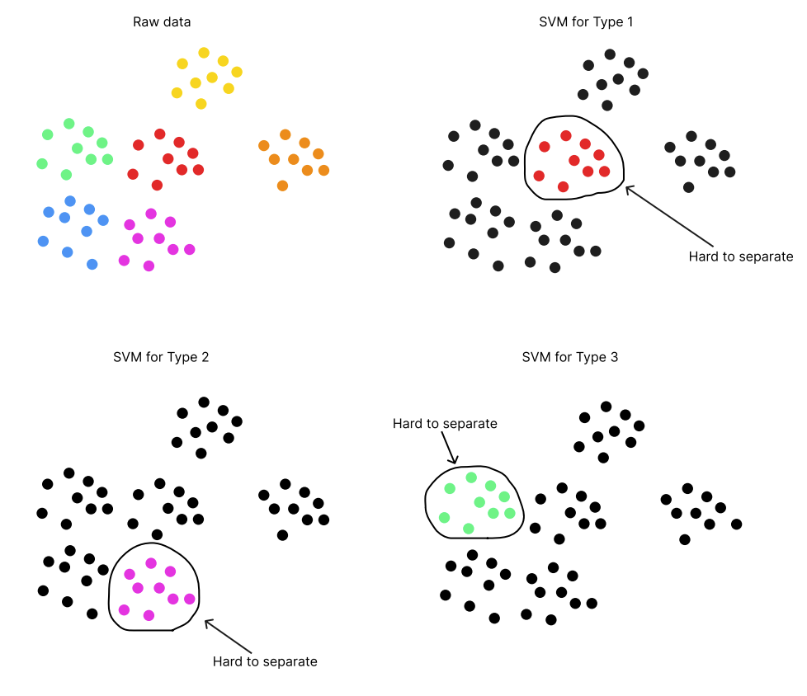

Slide 41
Conclusion
Maybe for each SVM, the kernel shall be different.
Then the pain may ease.

Slide 42
Conclusion
SVDD can’t separate known and unknown types.
This maybe is because the distance in low dimension between data points is too close.
By reducing the dimension to a relatively higher dimension can solve the problem.

Slide 43

All source code in Thanks.

Slide 44
工作分配
B103040012 謝承翰: KNN, SVM, DBSCAN, paper, ppt
B103040001 孫世諭: SVM, k-means, paper
B103040003 魯喆元: naive Bayes classifier
B103040008 許廷豪: NN, SVDD, NN-Chain, paper, ppt
B103040051 黃嘉彥: naive Bayes classifier, paper, poster

