Slide 1
資料探勘 第八組
B103040012 謝承翰
B103040001 孫世諭
B103040003 魯喆元
B103040008 許廷豪
B103040051 黃嘉彥

Slide 2
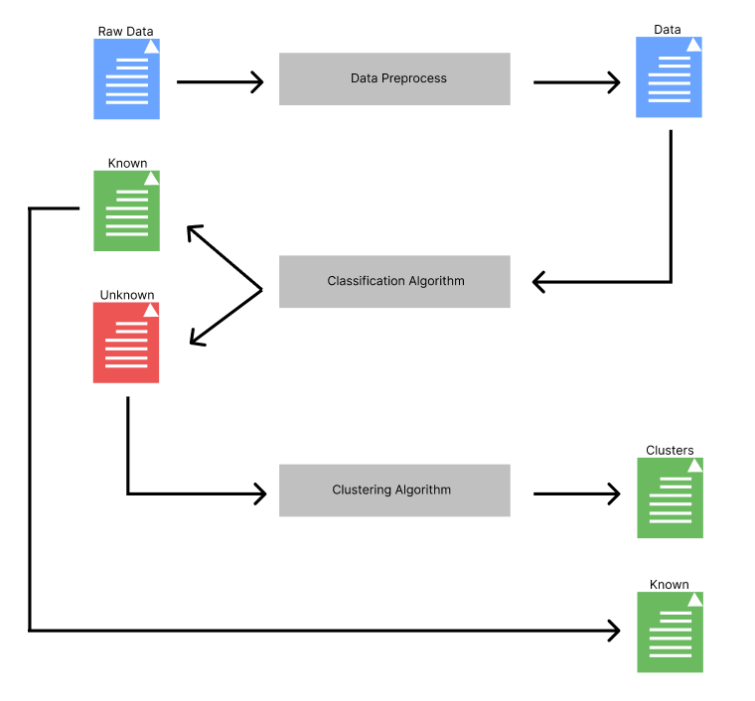
Main Algorithm

Slide 3
Data Preprocess
PCA, Autoencoder, Normalize

Slide 4
PCA
Reduce the dimension to 30 in arrhythmia dataset.
Reduce the dimension to 32 in gene expression cancer RNA-Seq dataset.

Slide 5
Autoencoder
For fairness, reduce the dimension to 30 in arrhythmia dataset.
Reduce the dimension to 32 in gene expression cancer RNA-Seq dataset.

Slide 6
Classification Algorithm
KNN, SVM, SVDD + NN

Slide 7
KNN
How to know a data point doesn’t belong to known type?
Distance and probability.

Slide 8
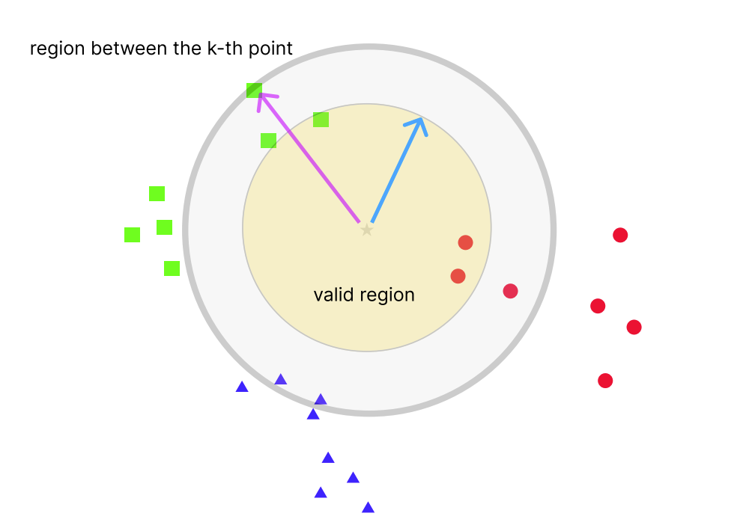
KNN
Probability that belong to red:
2/(1+2+0)=2/3
Probability that belong to green:
1/(1+2+0)=1/3
Probability that belong to blue:
0/(1+2+0)=1/3

Slide 9
Multi-Classification SVMs
Since SVM is meant to be a binary classifier, multi-classification must use a sequence of SVMs.

Slide 10
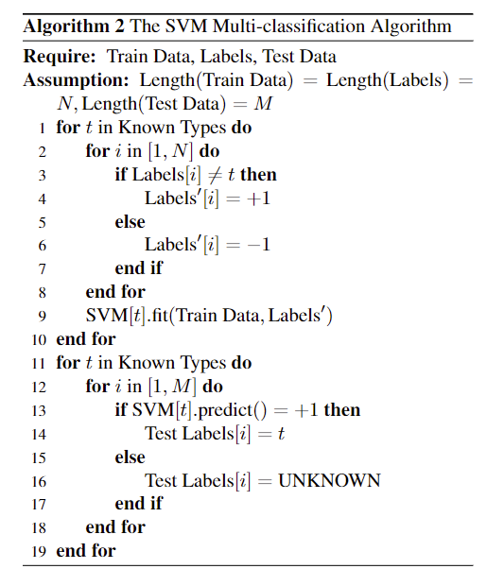
Multi-Classification SVMs

Slide 11
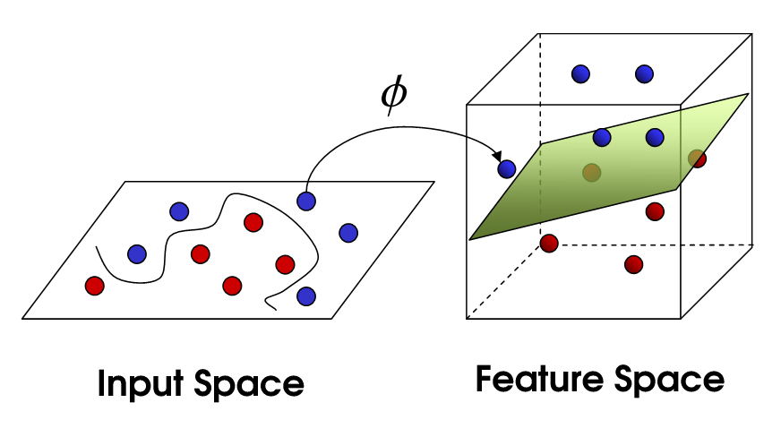
SVM – kernel trick

Slide 12
SVM – kernel trick
There are multiple kernels,
Linear
Polynomial
RBF
sigmoid

Slide 13
SVDD
在對資料集進行前處理之後，這裡使用SVDD(Support Vector Data Description)來將資料做「知道」和「不知道」的分類，由於訓練資料集和測試資料集的類別數不同，因此需要將「要分群」的資料從「要分類」的資料區分出來。而SVDD是one-class classification，代表訓練集只需要1個class的資料，符合此階段的需求。

Slide 14
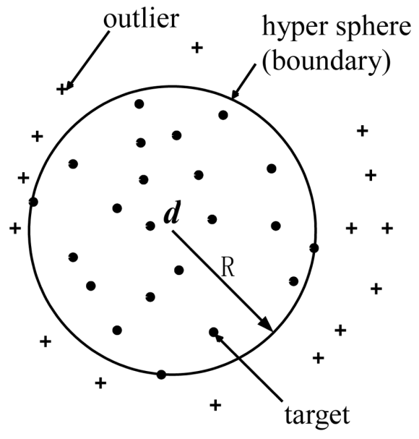
SVDD
SVDD的目標是使訓練集的資料靠近其定義的超球體的圓心，因此其loss function是計算每個點到圓心的距離。在訓練完SVDD之後，能得到超球體的半徑，只要在超球體內，就將其分類為「知道」，後續做分類；在超球體外，就將其分類為「不知道」，後續做分群。

Slide 15
NN
在得到了知道的資料之後，使用類神經網路來分類資料。這裡使用深度為24層的神經網路，最後準確度可以在基因資料集達到100%。

Slide 16
Clustering Algorithm
DBSCAN, k-means, NN-chain

Slide 17
DBSCAN
This clustering algorithm generate noisy points.
So after clustering, a noisy point will be marked as the type whose mass center is the closet to this noisy point.

Slide 18
NN-chain
在分群部分，這裡使用Nearest neighbor chain。
演算法如下：
1.隨機挑一個點推入stack
2.挑離stack頂端的點最近的點，並推入stack
3.挑離stack頂端的點最近的點，如果點在stack內，將頂點和該點從stack中挑出並Merge。
4.重復1到3，直到分群目標達到為止。

Slide 19
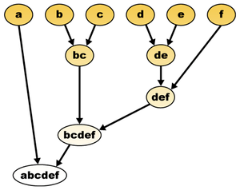
NN-chain
NN-Chain是樹狀分群演算法的一種，如右圖，當兩點merge後，會再次變成圖中的一點，可繼續merge直至所有點被分類到同一群為止。

Slide 20
NN-chain
右圖為NN-Chain的演算法示意圖，最近鄰為有向圖（A是B的最近鄰不一定代表B是A的最近鄰），因此會持續進行搜尋，直到搜尋回到自己為止，此時代表兩點互為彼此的最近鄰，進行merge後從stack pop出，再繼續對stack頂點進行搜尋。

Slide 21
Within the framework of Main algorithm, we compare multiple combinations of those techniques.

Slide 22
KNN + DBSCAN, arrhythmia
Repeat 10 times | Accuracy (%) | Time (s)
Raw | 47.4684% ± 0% | 0.0285
Normalized | 46.8354% ± 0% | 0.0254
PCA-32 | 38.6076% ± 0% | 0.0070
PCA-32 (normalized) | 42.4051% ± 0% | 0.0071
AE-32 | 37.9747% ± 0% | 0.0071
AE-32 (normalized) | 44.3038% ± 0% | 0.0071

Slide 23
KNN + k-means, arrhythmia
Repeat 10 times | Accuracy (%) | Time (s)
Raw | 53.1646% ± 0% | 0.0236
Normalized | 50.6329% ± 0% | 0.0343
PCA-32 | 43.0380% ± 0% | 0.0068
PCA-32 (normalized) | 43.0380% ± 0% | 0.0069
AE-32 | 36.0759% ± 0% | 0.0069
AE-32 (normalized) | 41.7722% ± 0% | 0.0080

Slide 24
SVM (sigmoid) + k-means, arrhythmia
Repeat 10 times | Accuracy (%) | Time (s)
Raw | 28.4810% ± 0% | 3.5272
Normalized | 20.2532% ± 0% | 6.4731
PCA-32 | 30.3797% ± 0% | 1.5779
PCA-32 (normalized) | 36.0759% ± 0% | 0.9797
AE-32 | 22.1519 % ± 0% | 0.5284
AE-32 (normalized) | 24.6835% ± 0% | 0.8430

Slide 25
KNN + DBSCAN, Cancer RNA-Seq
Repeat 10 times | Accuracy (%) | Time (s)
Raw | 59.0361% ± 0% | 14.5101
Normalized | 66.5663% ± 0% | 10.3013
PCA-32 | 94.5783% ± 0% | 0.0224
PCA-32 (normalized) | 78.3133% ± 0% | 0.0237
AE-32 | 64.4578% ± 0% | 0.0258
AE-32 (normalized) | 59.3373% ± 0% | 0.0235

Slide 26
KNN + k-means, Cancer RNA-Seq
Repeat 10 times | Accuracy (%) | Time (s)
Raw | 74.0964% ± 0% | 22.754
Normalized | 53.6145% ± 0% | 6.3558
PCA-32 | 94.8795% ± 0% | 0.0212
PCA-32 (normalized) | 84.9398% ± 0% | 0.0214
AE-32 | 42.1687% ± 0% | 0.0214
AE-32 (normalized) | 65.9639% ± 0% | 0.0220

Slide 27
SVM (sigmoid) + k-means, Cancer RNA-Seq
Repeat 10 times | Accuracy (%) | Time (s)
Raw | 28.4810% ± 0% | 3.5272
Normalized | 20.2532% ± 0% | 6.4731
PCA-32 | 30.3797% ± 0% | 1.5779
PCA-32 (normalized) | 36.0759% ± 0% | 0.9797
AE-32 | 22.1519 % ± 0% | 0.5284
AE-32 (normalized) | 24.6835% ± 0% | 0.8430

Slide 28
Multi-classification SVMs perform bad in these two datasets. Why?

Slide 29
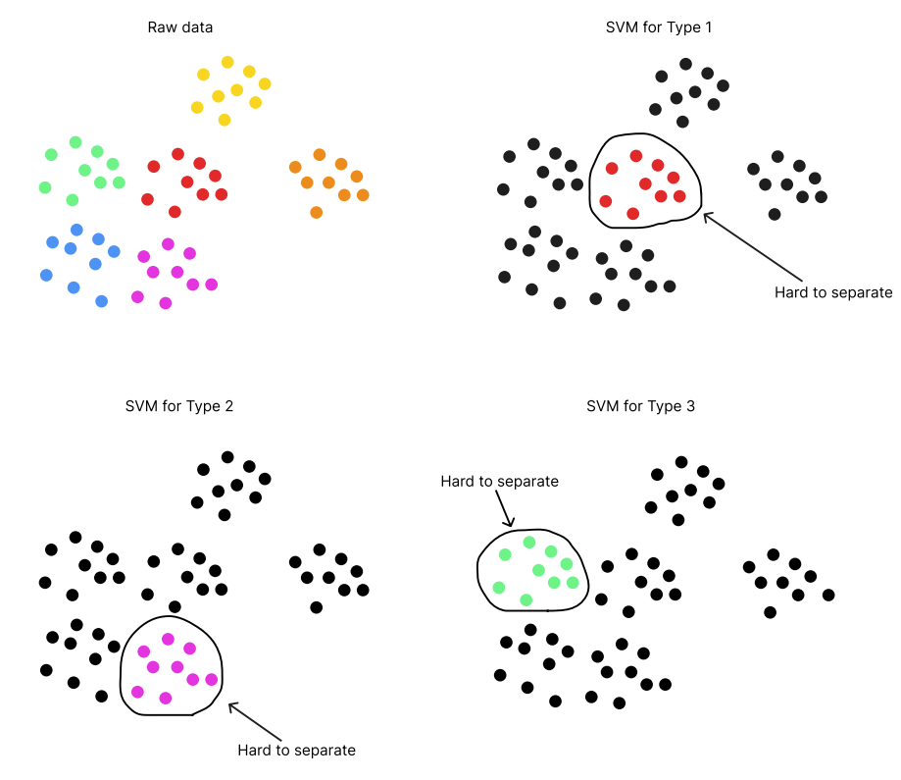

Slide 30
One solution to ease the pain
Apply different kernels on each SVMs.
Then use metaheuristic algorithms, e.g. gene , to auto-tune the parameters, including the proper kernel for each SVM.
But I haven’t done that yet.

Slide 31
工作分配
B103040012 謝承翰: KNN, SVM, DBSCAN, paper, ppt
B103040001 孫世諭: SVM, k-means, paper
B103040003 魯喆元:
B103040008 許廷豪:
B103040051 黃嘉彥: naive Bayes classifier, paper, poster

