Slide 1
資料探勘 第八組

Slide 2
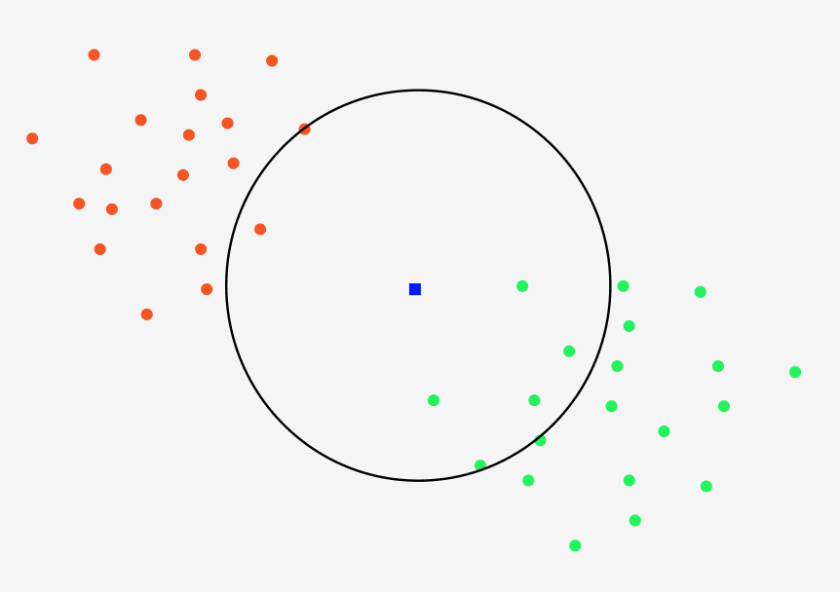
KNN

Slide 3
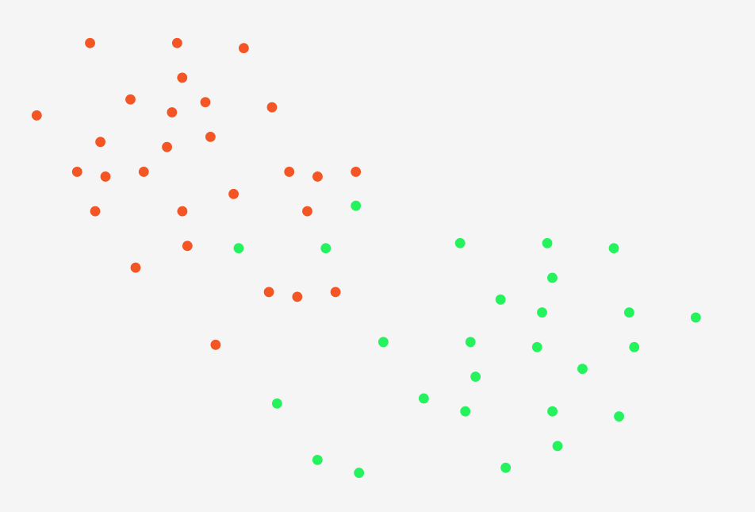
Approximate Nearest Neighbors Oh Yeah (ANNOY)

Slide 4
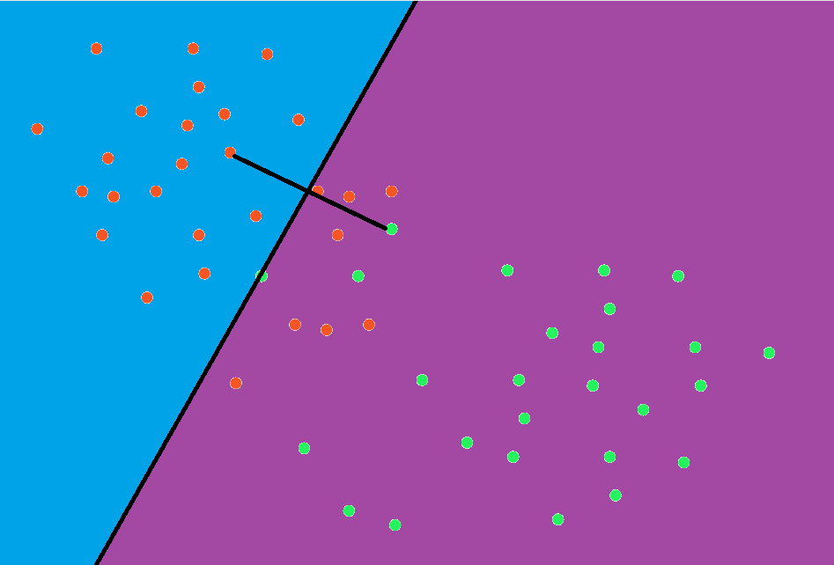
Approximate Nearest Neighbors Oh Yeah (ANNOY)

Slide 5
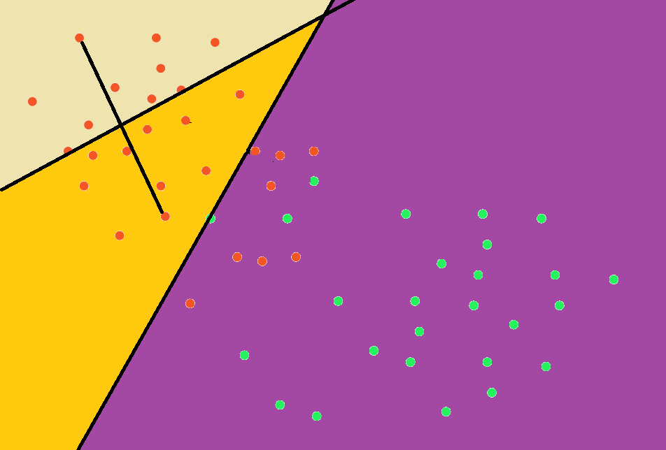
Approximate Nearest Neighbors Oh Yeah (ANNOY)

Slide 6
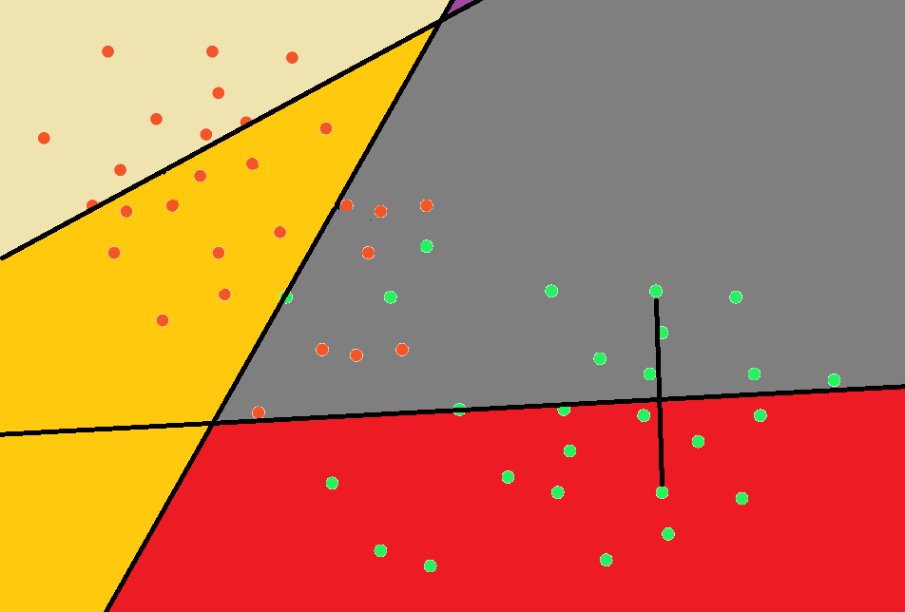
Approximate Nearest Neighbors Oh Yeah (ANNOY)

Slide 7
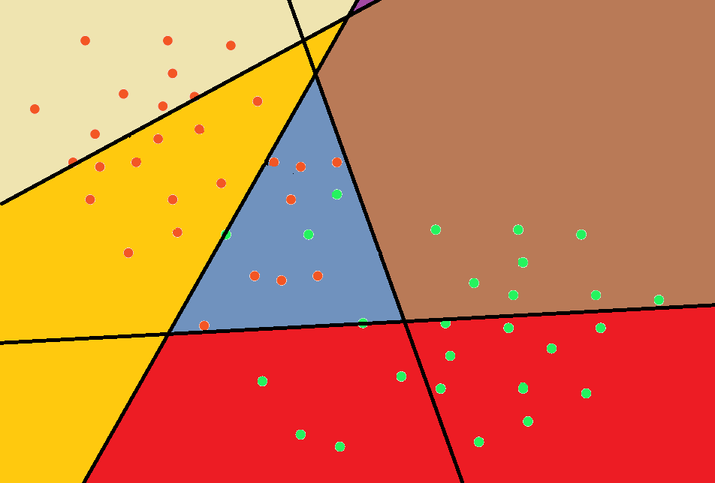
Approximate Nearest Neighbors Oh Yeah (ANNOY)

Slide 8
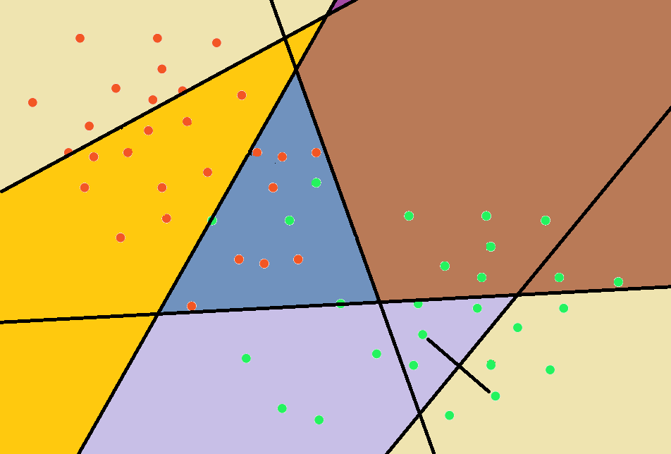
Approximate Nearest Neighbors Oh Yeah (ANNOY)

Slide 9
Approximate Nearest Neighbors Oh Yeah (ANNOY)

Slide 10
Approximate Nearest Neighbors Oh Yeah (ANNOY)

Slide 11
Approximate Nearest Neighbors Oh Yeah (ANNOY)

Slide 12
Approximate Nearest Neighbors Oh Yeah (ANNOY)

Slide 13
Approximate Nearest Neighbors Oh Yeah (ANNOY)
return points in this region

Slide 14
Approximate Nearest Neighbors Oh Yeah (ANNOY)
return points in this region
but there’re some points are
at the other side

Slide 15
Approximate Nearest Neighbors Oh Yeah (ANNOY)
Too close to the hyperplane

Slide 16
Approximate Nearest Neighbors Oh Yeah (ANNOY)

Slide 17
Approximate Nearest Neighbors Oh Yeah (ANNOY)
return points in those region

Slide 18
Approximate Nearest Neighbors Oh Yeah (ANNOY)
Time complexity: O(log n)
Space complexity: O(n)

Slide 19
KNN – Brute Force
Repeat 50 times | Max Accuracy (%) | Time (s)
testA | 78.6965% ± 1.751% | 0.003
testA (normalized) | 78.5373% ± 1.452% | 0.004
testB | 77.98% ± 2.083% | 0.006
testB (normalized) | 77.5% ± 2.516% | 0.005

Slide 20
KNN – ANNOY w.t. DFS
Repeat 50 times | Max Accuracy (%) | Time (s)
testA | 78.6965% ± 1.751% | 0.003
testA (normalized) | 78.5373% ± 1.452% | 0.004
testB | 77.98% ± 2.083% | 0.006
testB (normalized) | 77.5% ± 2.516% | 0.005

Slide 21
KNN – ANNOY w.t. BFS
Repeat 50 times | Max Accuracy (%) | Time (s)
testA | 78.6965% ± 1.751% | 0.003
testA (normalized) | 78.5373% ± 1.452% | 0.004
testB | 77.98% ± 2.083% | 0.006
testB (normalized) | 77.5% ± 2.516% | 0.005

Slide 22
Decision tree
if
if x <= k
if x > k
if
Class 0
if x <= m
if x > m
Class 1
Class 0

Slide 23
Decision tree
因為數據是連續數值，所以採用C4.5。
A | B | C | D | E | class
1 | 5.4 | 7.0 | 0 | 7 | 1
2.5 | 2.0 | 7.9 | 1 | 2 | 1
3.6 | 25.4 | 7.6 | 0 | 3 | 1
1.2 | 5.6 | 7.8 | 1 | 5 | 0
3.1 | 2.7 | 7.9 | 1 | 3 | 0
1.3 | 5.3 | 7.1 | 1 | 11 | 0
5.1 | 5.6 | 7.6 | 0 | 0.4 | 0

Slide 24
Decision tree
先選定一個屬性，例如: A
A | B | C | D | E | class
1 | 5.4 | 7.0 | 0 | 7 | 1
2.5 | 2.0 | 7.9 | 1 | 2 | 1
3.6 | 25.4 | 7.6 | 0 | 3 | 1
1.2 | 5.6 | 7.8 | 1 | 5 | 0
3.1 | 2.7 | 7.9 | 1 | 3 | 0
1.3 | 5.3 | 7.1 | 1 | 11 | 0
5.1 | 5.6 | 7.6 | 0 | 0.4 | 0

Slide 25
Decision tree
由小到大排序
A | B | C | D | E | class
1 | 5.4 | 7.0 | 0 | 7 | 1
1.2 | 5.6 | 7.8 | 1 | 5 | 0
1.3 | 5.3 | 7.1 | 1 | 11 | 0
2.5 | 2.0 | 7.9 | 1 | 2 | 1
3.1 | 2.7 | 7.9 | 1 | 3 | 0
3.6 | 25.4 | 7.6 | 0 | 3 | 1
5.1 | 5.6 | 7.6 | 0 | 0.4 | 0

Slide 26
Decision tree
利用兩數據間平均(A_{i}+A_{i+1})/2得到6個分割點
A | B | C | D | E | class
1 | 5.4 | 7.0 | 0 | 7 | 1
1.2 | 5.6 | 7.8 | 1 | 5 | 0
1.3 | 5.3 | 7.1 | 1 | 11 | 0
2.5 | 2.0 | 7.9 | 1 | 2 | 1
3.1 | 2.7 | 7.9 | 1 | 3 | 0
3.6 | 25.4 | 7.6 | 0 | 3 | 1
5.1 | 5.6 | 7.6 | 0 | 0.4 | 0
1.1
1.25
1.9
2.8
3.35
4.35

Slide 27
Decision tree
計算每個劃分點的information gain，接著換成其他屬性，直到找到最大的information gain，如此就可以知道最好的決策。
A | B | C | D | E | class
1 | 5.4 | 7.0 | 0 | 7 | 1
1.2 | 5.6 | 7.8 | 1 | 5 | 0
1.3 | 5.3 | 7.1 | 1 | 11 | 0
2.5 | 2.0 | 7.9 | 1 | 2 | 1
3.1 | 2.7 | 7.9 | 1 | 3 | 0
3.6 | 25.4 | 7.6 | 0 | 3 | 1
5.1 | 5.6 | 7.6 | 0 | 0.4 | 0
1.1
1.25
1.9
2.8
3.35
4.35

Slide 28
Decision tree
Repeat 50 times | Accuracy (%) | Time (s)
testA | 74.1294% ± 0% | 0.016
testA (normalized) | 74.1294% ± 0% | 0.016
testB | 76% ± 0% | 0.02
testB (normalized) | 77% ± 0% | 0.02

Slide 29
Random forest
很多顆decision tree，由隨機選取的dataset子集建構。
可以有效減緩單顆decision tree over-fitting的問題。

Slide 30
Random forest
Repeat 50 times | Max Accuracy (%) | Time (s)
testA | 78.6965% ± 1.751% | 0.003
testA (normalized) | 78.5373% ± 1.452% | 0.004
testB | 77.98% ± 2.083% | 0.006
testB (normalized) | 77.5% ± 2.516% | 0.005
n=40
n=40
n=19
n=28

Slide 31

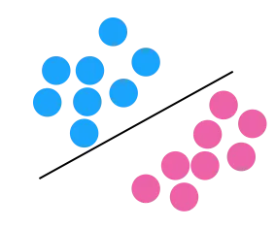
Support Vector Machine
→

Slide 32
Support Vector Machine
找出這條線之後，之後的資料用
帶入即可

Slide 33
Support Vector Machine
但是這麼做有個條件：必須要是線性可分（硬間隔）

Slide 34

Support Vector Machine
非線性可分：

Slide 35
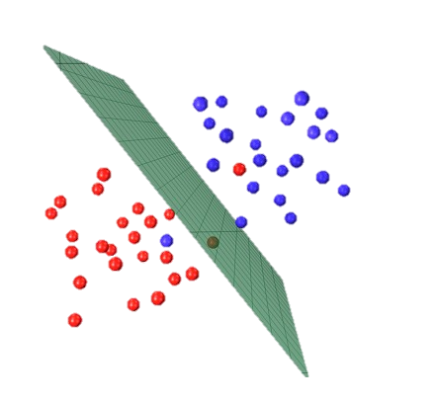
Support Vector Machine
解決方案：
→
kernel

Slide 36
Support Vector Machine
找出 kernel：
→
kernel
其實沒有一個正規的找法，就是某些paper實驗出來某些 kernel 分得還不錯就這樣用了

Slide 37
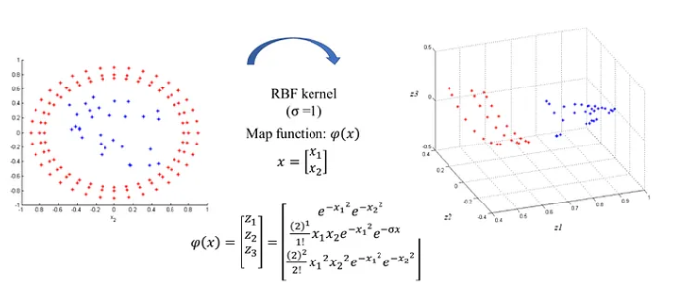
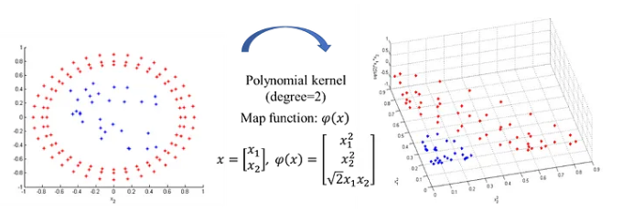
Support Vector Machine
找出 kernel：
RBF kernel
Polynomial kernel

Slide 38
Support Vector Machine
簡而言之：
選擇 kernel
投射到 n+1 維的超平面
找出一個可以切分兩種數據的超平面

Slide 39
Support Vector Machine
簡而言之：
Kernel 選擇：
選擇 kernel
投射到 n+1 維的超平面
找出一個可以切分兩種數據的超平面
Polynomial kernel
尋找方式：
基因演算法（Genetic Algorithm）
程式語言：
C++

Slide 40
Support Vector Machine
基因演算法（超啟發）：
隨機找出 250 個超平面（也就是向量 w）
選擇表現最好的 25 個（菁英）
讓這 25 個最好的菁英交配（數據交換，有 5% 機率突變）
交配直到擁有 250 個超平面
回到步驟 2 （重複 300 次）

Slide 41
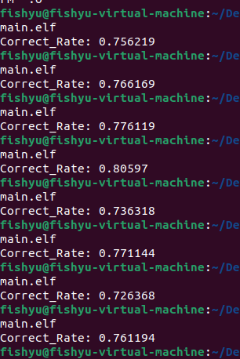
Support Vector Machine
結果呈現：
準確率約落在 73% ~ 80% 左右
可能改善方式：
換個 kernel （因為是自己想的）
修理 training data 少資料的問題
改變參數
標準化

