Slide 1
資料探勘 第八組

Slide 2
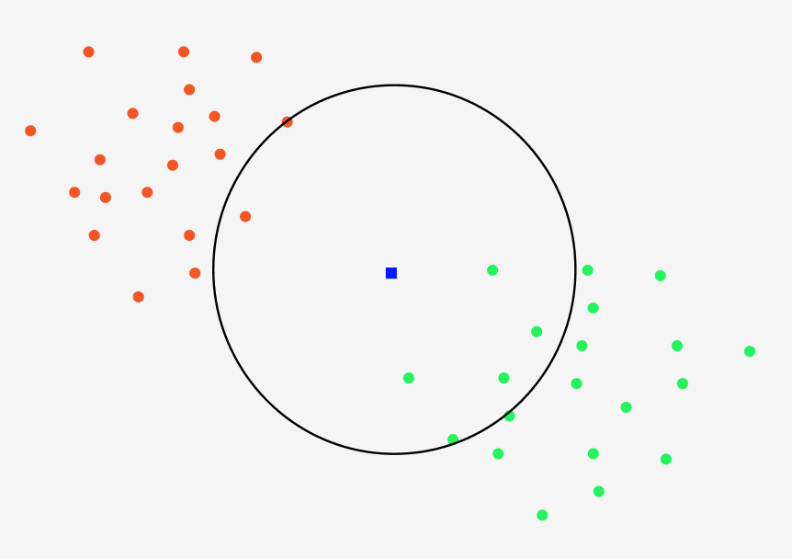
KNN

Slide 3
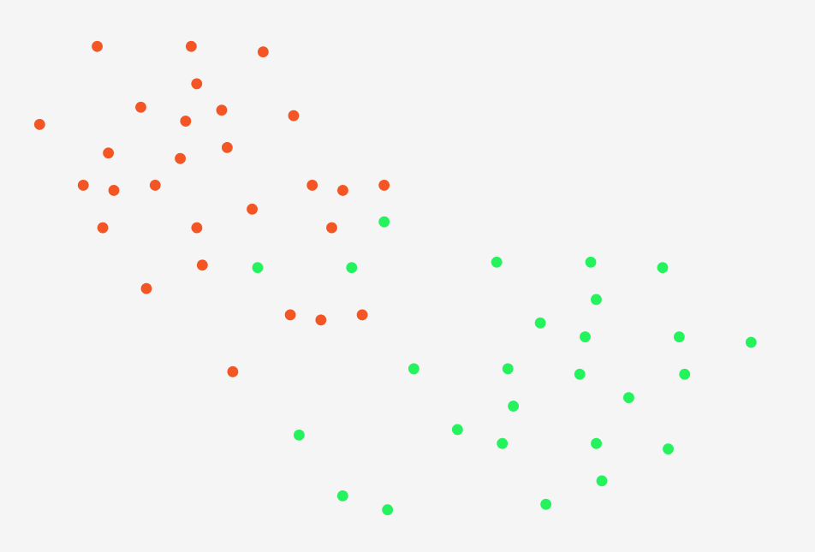
Approximate Nearest Neighbors Oh Yeah (ANNOY)

Slide 4
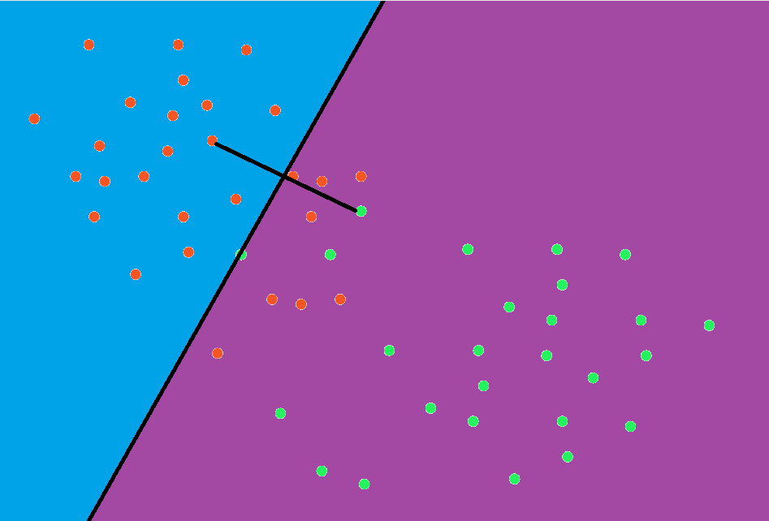
Approximate Nearest Neighbors Oh Yeah (ANNOY)

Slide 5
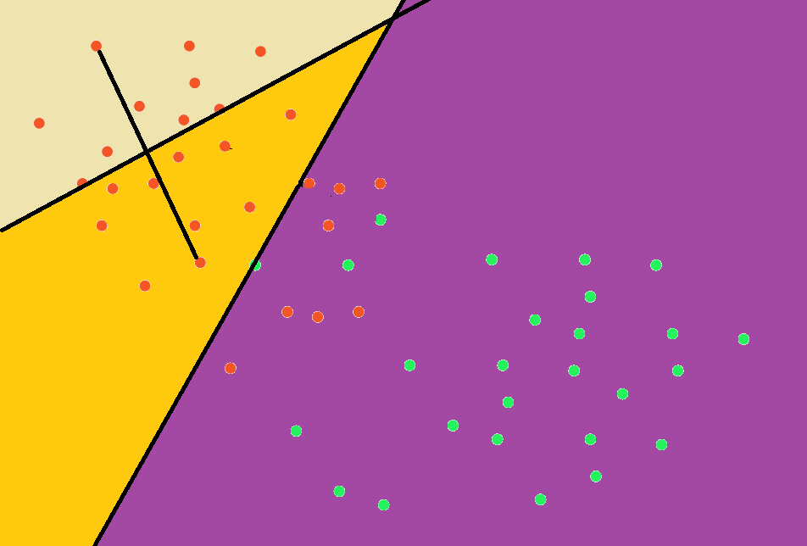
Approximate Nearest Neighbors Oh Yeah (ANNOY)

Slide 6
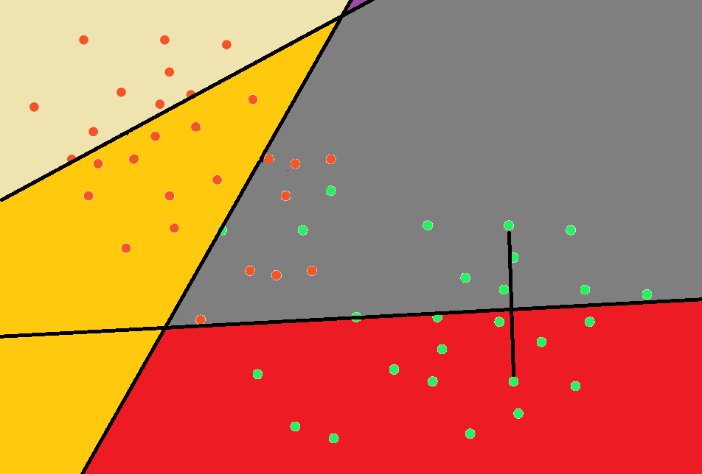
Approximate Nearest Neighbors Oh Yeah (ANNOY)

Slide 7
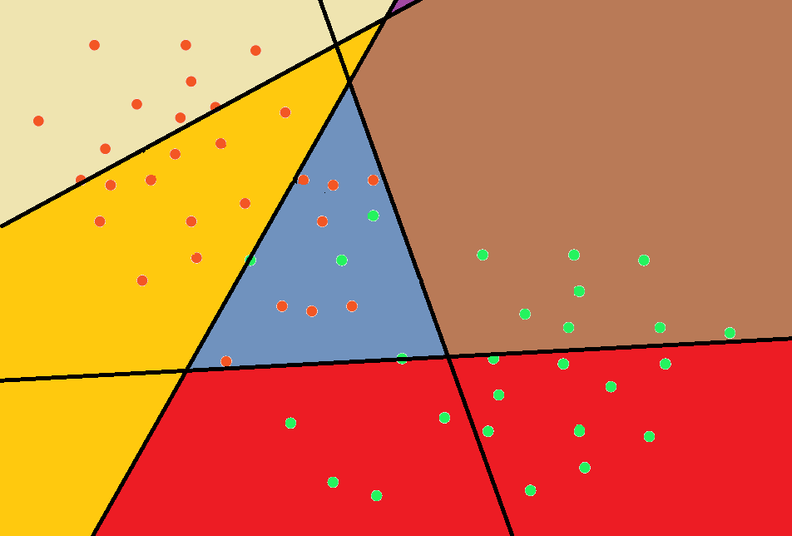
Approximate Nearest Neighbors Oh Yeah (ANNOY)

Slide 8
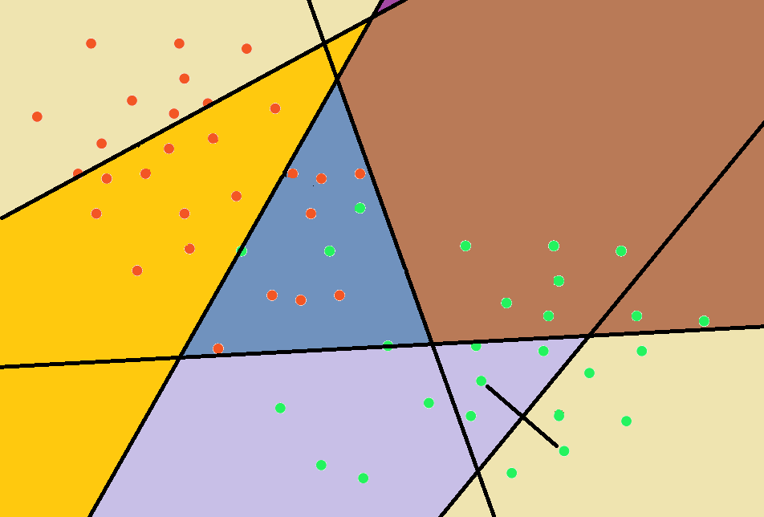
Approximate Nearest Neighbors Oh Yeah (ANNOY)

Slide 9
Approximate Nearest Neighbors Oh Yeah (ANNOY)

Slide 10
Approximate Nearest Neighbors Oh Yeah (ANNOY)

Slide 11
Approximate Nearest Neighbors Oh Yeah (ANNOY)

Slide 12
Approximate Nearest Neighbors Oh Yeah (ANNOY)

Slide 13
Approximate Nearest Neighbors Oh Yeah (ANNOY)
return points in this region

Slide 14
Approximate Nearest Neighbors Oh Yeah (ANNOY)
return points in this region
but there’re some points are
at the other side

Slide 15
Approximate Nearest Neighbors Oh Yeah (ANNOY)
Too close to the hyperplane

Slide 16
Approximate Nearest Neighbors Oh Yeah (ANNOY)

Slide 17
Approximate Nearest Neighbors Oh Yeah (ANNOY)
return points in those region

Slide 18
Approximate Nearest Neighbors Oh Yeah (ANNOY)
Time complexity: O(log n)
Space complexity: O(n)

Slide 19
Decision tree
if
if x <= k
if x > k
if
Class 0
if x <= m
if x > m
Class 1
Class 0

Slide 20
Decision tree
因為數據是連續數值，所以採用C4.5。
A | B | C | D | E | class
1 | 5.4 | 7.0 | 0 | 7 | 1
2.5 | 2.0 | 7.9 | 1 | 2 | 1
3.6 | 25.4 | 7.6 | 0 | 3 | 1
1.2 | 5.6 | 7.8 | 1 | 5 | 0
3.1 | 2.7 | 7.9 | 1 | 3 | 0
1.3 | 5.3 | 7.1 | 1 | 11 | 0
5.1 | 5.6 | 7.6 | 0 | 0.4 | 0

Slide 21
Decision tree
先選定一個屬性，例如: A
A | B | C | D | E | class
1 | 5.4 | 7.0 | 0 | 7 | 1
2.5 | 2.0 | 7.9 | 1 | 2 | 1
3.6 | 25.4 | 7.6 | 0 | 3 | 1
1.2 | 5.6 | 7.8 | 1 | 5 | 0
3.1 | 2.7 | 7.9 | 1 | 3 | 0
1.3 | 5.3 | 7.1 | 1 | 11 | 0
5.1 | 5.6 | 7.6 | 0 | 0.4 | 0

Slide 22
Decision tree
由小到大排序
A | B | C | D | E | class
1 | 5.4 | 7.0 | 0 | 7 | 1
1.2 | 5.6 | 7.8 | 1 | 5 | 0
1.3 | 5.3 | 7.1 | 1 | 11 | 0
2.5 | 2.0 | 7.9 | 1 | 2 | 1
3.1 | 2.7 | 7.9 | 1 | 3 | 0
3.6 | 25.4 | 7.6 | 0 | 3 | 1
5.1 | 5.6 | 7.6 | 0 | 0.4 | 0

Slide 23
Decision tree
利用兩數據間平均(A_{i}+A_{i+1})/2得到6個分割點
A | B | C | D | E | class
1 | 5.4 | 7.0 | 0 | 7 | 1
1.2 | 5.6 | 7.8 | 1 | 5 | 0
1.3 | 5.3 | 7.1 | 1 | 11 | 0
2.5 | 2.0 | 7.9 | 1 | 2 | 1
3.1 | 2.7 | 7.9 | 1 | 3 | 0
3.6 | 25.4 | 7.6 | 0 | 3 | 1
5.1 | 5.6 | 7.6 | 0 | 0.4 | 0
1.1
1.25
1.9
2.8
3.35
4.35

Slide 24
Decision tree
計算每個劃分點的information gain，接著換成其他屬性，直到找到最大的information gain，如此就可以知道最好的決策。
A | B | C | D | E | class
1 | 5.4 | 7.0 | 0 | 7 | 1
1.2 | 5.6 | 7.8 | 1 | 5 | 0
1.3 | 5.3 | 7.1 | 1 | 11 | 0
2.5 | 2.0 | 7.9 | 1 | 2 | 1
3.1 | 2.7 | 7.9 | 1 | 3 | 0
3.6 | 25.4 | 7.6 | 0 | 3 | 1
5.1 | 5.6 | 7.6 | 0 | 0.4 | 0
1.1
1.25
1.9
2.8
3.35
4.35

Slide 25
Decision tree
Repeat 50 times | Accuracy (%) | Time (s)
testA | 74.1294% ± 0% | 0.016
testA (normalized) | 74.1294% ± 0% | 0.016
testB | 76% ± 0% | 0.02
testB (normalized) | 77% ± 0% | 0.02

Slide 26
Random forest
很多顆decision tree，由隨機選取的dataset子集建構。
可以有效減緩單顆decision tree over-fitting的問題。

Slide 27
Random forest
Repeat 50 times | Max Accuracy (%) | Time (s)
testA | 78.6965% ± 1.751% | 0.003
testA (normalized) | 78.5373% ± 1.452% | 0.004
testB | 77.98% ± 2.083% | 0.006
testB (normalized) | 77.5% ± 2.516% | 0.005
n=40
n=40
n=19
n=28

