Slide 1
資料探勘 第八組
B103040012 謝承翰
B103040001 孫世諭
B103040003 魯喆元
B103040008 許廷豪
B103040051 黃嘉彥

Slide 2
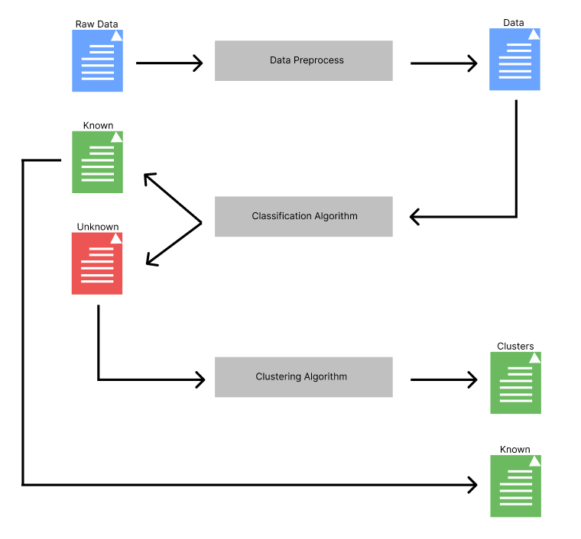
Main Algorithm

Slide 3
Data Preprocess
PCA, Autoencoder, Normalize

Slide 4
PCA
Reduce the dimension to 30 in arrhythmia dataset.
Reduce the dimension to 32 in gene expression cancer RNA-Seq dataset.

Slide 5
Autoencoder
For fairness, reduce the dimension to 30 in arrhythmia dataset.
Reduce the dimension to 32 in gene expression cancer RNA-Seq dataset.

Slide 6
Classification Algorithm
KNN, SVM, SVDD + NN, Naïve Bayes classifier

Slide 7
KNN
How to know a data point doesn’t belong to known type?
Distance and probability.

Slide 8
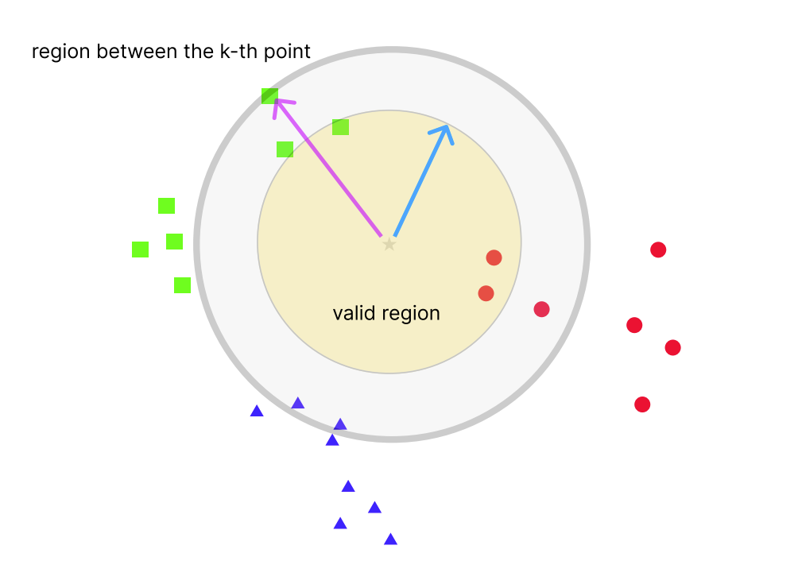
KNN
Probability that belong to red:
2/(1+2+0)=2/3
Probability that belong to green:
1/(1+2+0)=1/3
Probability that belong to blue:
0/(1+2+0)=1/3

Slide 9
Multi-Classification SVMs
Since SVM is meant to be a binary classifier, multi-classification must use a sequence of SVMs.

Slide 10
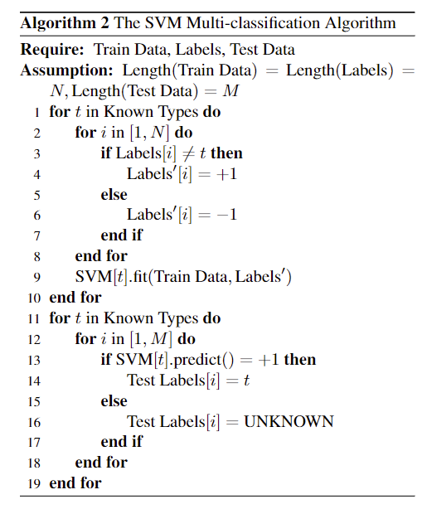
Multi-Classification SVMs

Slide 11
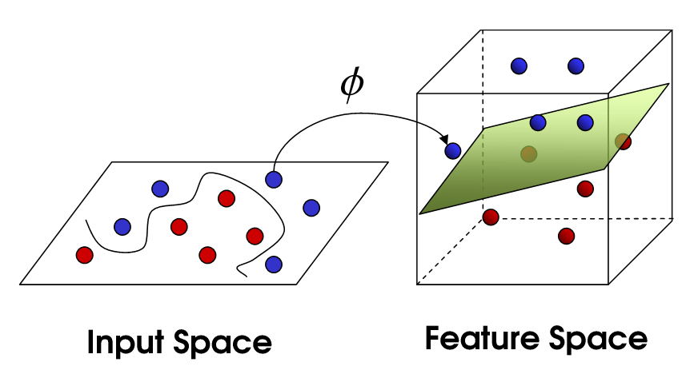
SVM – kernel trick

Slide 12
SVM – kernel trick
There are multiple kernels,
Linear
Polynomial
RBF
sigmoid

Slide 13
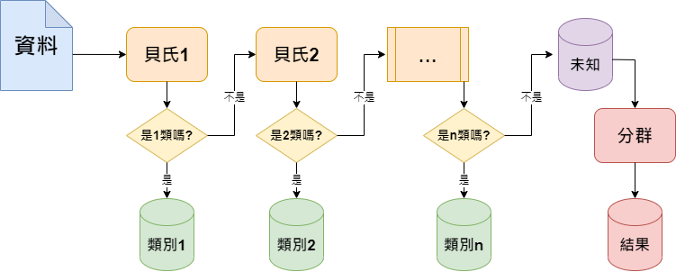
Naïve Bayes classifier

Slide 14
SVDD + NN
Use SVDD to separate unknown types and known types first.
Then apply pre-trained neural network to classify known types.

Slide 15
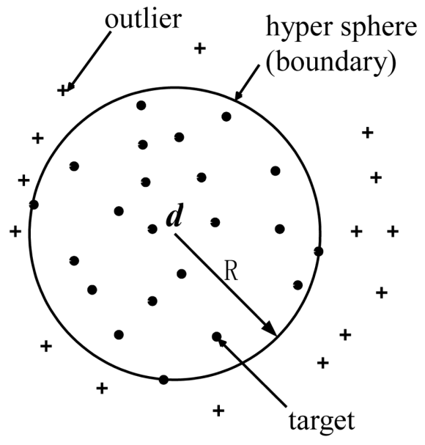
SVDD

Slide 16
Clustering Algorithm
DBSCAN, k-means, NN-chain

Slide 17
DBSCAN
This clustering algorithm generate noisy points.
So after clustering, a noisy point will be marked as the type whose mass center is the closet to this noisy point.

Slide 18
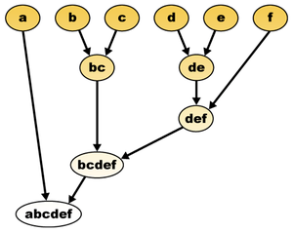
NN-chain

Slide 19
Within the framework of Main algorithm, we compare multiple combinations of those techniques.

Slide 20
But there’s one more thing.

Slide 21
Hyperparameters fine-tune
Take SVM + DBSCAN as example, with the 4 selectable kernels, the total number of hyperparameters is 8.
For each experiments, the total number of hyperparameter is 48 in both datasets.
Manually fine-tune? Not a chance!

Slide 22
Hyperparameters fine-tune
So simulated annealing algorithm is used here.

Slide 23
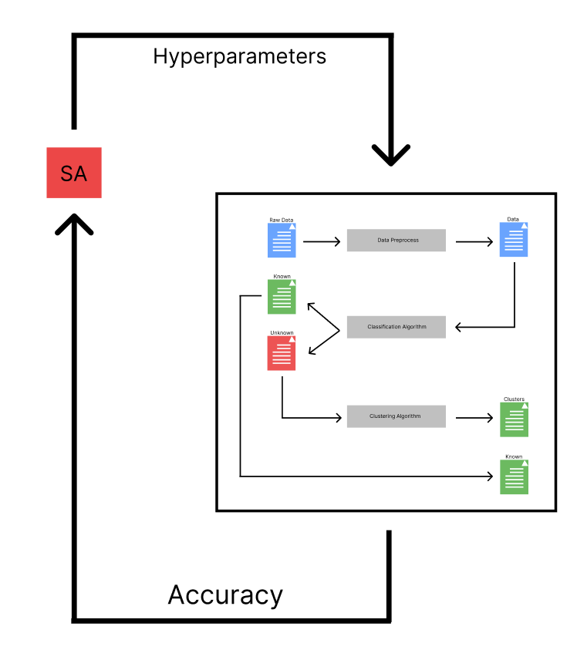
Hyperparameters fine-tune

Slide 24
Final results

Slide 25
KNN + DBSCAN, arrhythmia
Repeat 10 times | Accuracy (%) | Time (s)
Raw | 47.4684% ± 0% | 0.0285
Normalized | 46.8354% ± 0% | 0.0254
PCA-32 | 38.6076% ± 0% | 0.0070
PCA-32 (normalized) | 42.4051% ± 0% | 0.0071
AE-32 | 37.9747% ± 0% | 0.0071
AE-32 (normalized) | 44.3038% ± 0% | 0.0071

Slide 26
KNN + k-means, arrhythmia
Repeat 10 times | Accuracy (%) | Time (s)
Raw | 53.1646% ± 0% | 0.0236
Normalized | 50.6329% ± 0% | 0.0343
PCA-32 | 43.0380% ± 0% | 0.0068
PCA-32 (normalized) | 43.0380% ± 0% | 0.0069
AE-32 | 36.0759% ± 0% | 0.0069
AE-32 (normalized) | 41.7722% ± 0% | 0.0080

Slide 27
SVM (sigmoid) + k-means, arrhythmia
Repeat 10 times | Accuracy (%) | Time (s)
Raw | 28.4810% ± 0% | 3.5272
Normalized | 20.2532% ± 0% | 6.4731
PCA-32 | 30.3797% ± 0% | 1.5779
PCA-32 (normalized) | 36.0759% ± 0% | 0.9797
AE-32 | 22.1519 % ± 0% | 0.5284
AE-32 (normalized) | 24.6835% ± 0% | 0.8430

Slide 28
Naive Bayes classifier (GA) + k-means, arrhythmia
Repeat 10 times | Accuracy (%) | Time (s)
Raw | 13.2911% ± 0% | 0.1342
Normalized | - | -
PCA-32 | 13.2911% ± 0% | 0.0296
PCA-32 (normalized) | 31.6455% ± 0% | 0.0400
AE-32 | 11.8607% ± 0% | 0.0300
AE-32 (normalized) | 31.6455% ± 0% | 0.0398

Slide 29
KNN + DBSCAN, Cancer RNA-Seq
Repeat 10 times | Accuracy (%) | Time (s)
Raw | 59.0361% ± 0% | 14.5101
Normalized | 66.5663% ± 0% | 10.3013
PCA-32 | 94.5783% ± 0% | 0.0224
PCA-32 (normalized) | 78.3133% ± 0% | 0.0237
AE-32 | 64.4578% ± 0% | 0.0258
AE-32 (normalized) | 59.3373% ± 0% | 0.0235

Slide 30
KNN + k-means, Cancer RNA-Seq
Repeat 10 times | Accuracy (%) | Time (s)
Raw | 74.0964% ± 0% | 22.754
Normalized | 53.6145% ± 0% | 6.3558
PCA-32 | 94.8795% ± 0% | 0.0212
PCA-32 (normalized) | 84.9398% ± 0% | 0.0214
AE-32 | 42.1687% ± 0% | 0.0214
AE-32 (normalized) | 65.9639% ± 0% | 0.0220

Slide 31
SVM (poly) + k-means, Cancer RNA-Seq
Repeat 10 times | Accuracy (%) | Time (s)
Raw | 61.7470% ± 0% | 81.6495
Normalized | 1.2048% ± 0% | 86.6406
PCA-32 | 64.4578% ± 0% | 0.2585
PCA-32 (normalized) | 61.1446% ± 0% | 0.3012
AE-32 | 63.2530 % ± 0% | 0.2013
AE-32 (normalized) | 50.3012% ± 0% | 0.2056

Slide 32
Naive Bayes classifier (GA) + k-means, Cancer RNA-Seq
Repeat 10 times | Accuracy (%) | Time (s)
Raw | 43.3674% ± 0% | 2.2308
Normalized | - | -
PCA-32 | 34.0436% ± 0% | 0.0327
PCA-32 (normalized) | 16.8674% ± 0% | 0.0364
AE-32 | 21.9879% ± 0% | 0.0317
AE-32 (normalized) | 16.8674% ± 0% | 0.0426

Slide 33
工作分配
B103040012 謝承翰: KNN, SVM, DBSCAN, paper, ppt
B103040001 孫世諭: SVM, k-means, paper
B103040003 魯喆元: naive Bayes classifier
B103040008 許廷豪: NN, SVDD, NN-Chain, paper, ppt
B103040051 黃嘉彥: naive Bayes classifier, paper, poster

