Slide 1
NASCAR for Sharing Link-Sharing as Use-Case for Personal Discovery
XRD : XAuth : WebFinger : Host-Meta : OExchange
“If you liked NASCAR for identity, you’ll love it for sharing!”
IIW10

Slide 2
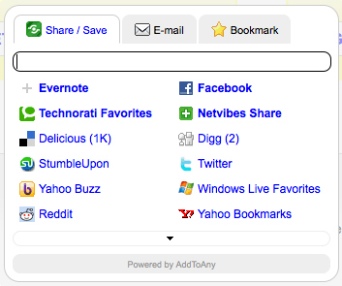
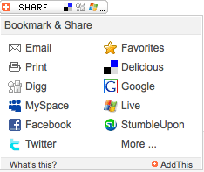

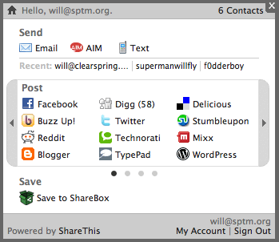


Now

Slide 3
The Use-Case
Present users with personalized options for operating on URL-based content, wherever they encounter it.
Personalization must span machines, browsers, sites, and time
Services will NOT necessarily be known at design time
The user operation:
Share/Post is only one verb; see translate, save-for-later, make-PDF, like, hate, etc.
The action is a basic HTTP-GET-based URL exchange (e.g. facebook/share.php?u=<whatever

Slide 4

A Precursor Problem
Do we have protocol support for the basics?
Need a uniform definition of “a service” to address service personalization
Exchange of Content + Discovery of Availability
For now, let’s say yes, via OExchange (www.oexchange.org)
URL pattern for endpoints, defined flow control, and discovery
I accept URLs at my Offer endpoint:
http://<me>/<whatever>?url=<url>&<etc>
That and some info for humans is in my XRD doc:
http://<me>/<whatever>/target.xrd
You can discover it from my host-meta or in-page Link tags:
rel=“http://oexchange.org/…/related-target”

Slide 5

Implementing Personalization
Now that “service” == URI, we can move on. But how?
http://<service>/<whatever>.xrd
http://<service>/<whatever>.xrd
http://<service>/<whatever>.xrd
http://<service>/<whatever>.xrd
http://<service>/<whatever>.xrd

Slide 6
And Does it Even Matter?
The space of potential services is THE WEB!
Is this a Facebook person or a Twitter person?
That’s the least of it (e.g. AddThis’ new-service request queue is ~1000
The services across the long tail link-back at more impressive rates
Smaller, more tightly-knit online communities == more heavily endorsed content
People I went to high school with vs people who share interests
There are even more interesting use-cases
Send to “mom”, negotiate the service-in-common

Slide 7
Protocol Requirements
The set of services I “probably want to use”:
>= “the set I am currently logged in to”
!= “the set that I’ve used before on this machine”
>= the set of services known at design time
Minimal user friction in this lookup
e.g. a clickable chiclet would be good, if it was the right chiclet
Express the services in the form of something discoverable
“facebook” or “twitter” strings aren’t
Hostnames aren’t necessarily

Slide 8
Some Current Anti-NASCAR Techniques
Start with a reasonable default set (based on something)
Factor in observed behavior
Behavior the tools facilitate
Behavior the tools don’t facilitate
Some employed techniques for handling the unfacilitated
CSS visited hackery
Publisher-cooperative signals
View-analytics
All stored in cross-domain storage of some sort (3rd party cookies, HTML storage)

Slide 9
Discussion topics…

Slide 10
Using XAuth (the spec’d version)?
What it is
Central-serve JS as a means to x-domain HTML5 storage
Callers set a string against their hostname, make avail to other hosts
Retrievers look it up for a given hostname, if allowed
How it helps
Possible to know if a user interacted with the service on a given host
No user friction at all
How it helps less
Tokens undefined, really just boolean existence checks
Information not shared across browsers, machines, possibly time
No mechanism for discovery of new services
Model is somewhat unusual (less a protocol and more a shared serving infrastructure + code)

Slide 11
Using XAuth (a reimagined version)?
What it is
Add some meaning to the tokens – potentially JSON, expressing interfaces available at specific URLs
Allow service-oriented rather than host-oriented lookup
How it helps
Now possible to get “all implementations of this interface this user uses”
Could allow “get all implementations of this interface that this user uses”
How it helps less
Still fundamentally the same single-browser, shared-server solution
May be better thought of as a cache (of WebFinger perhaps?)

Slide 12

Using WebFinger?
What it is
Ability to look up an XRD for a user, using an email address (for all intents and purposes), and get endpoints for specific protocols
How it helps
Services can look up instances of a specific interface for a user using their email address only
Shared across the web, user agents, etc
How it helps less
Deployment challenges (esp. for provisioning)
Potential caching challenges (how recent is the preference data?)
Presents a “enter your email address” user friction point

Slide 13
Other Items?
End goal is to allow a user to express the services they prefer to use to operate on URLs they encounter. How?
Getting services at auth-time? (“Connect”)
Is it more seamless for the user than an email?
Does this need to be authenticated?
Can you get it for other people?
Protocol state of the state
XAuth
WebFinger
Using discovery for even more – negotiated-service intermediaries (“send to mom” use-case)
Browser-based, shared storage of prefs

