Slide 1
OExchange
Duh.

Slide 2
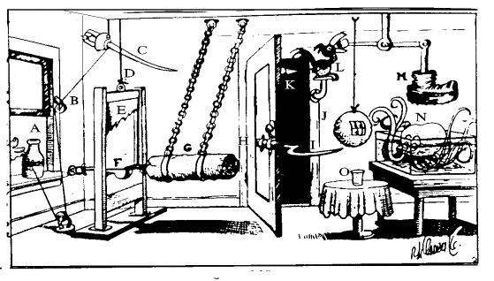
How cross-site sharing (mostly) works today…

Slide 3
A User…

Slide 4


Slide 5
Is browsing the web…

Slide 6
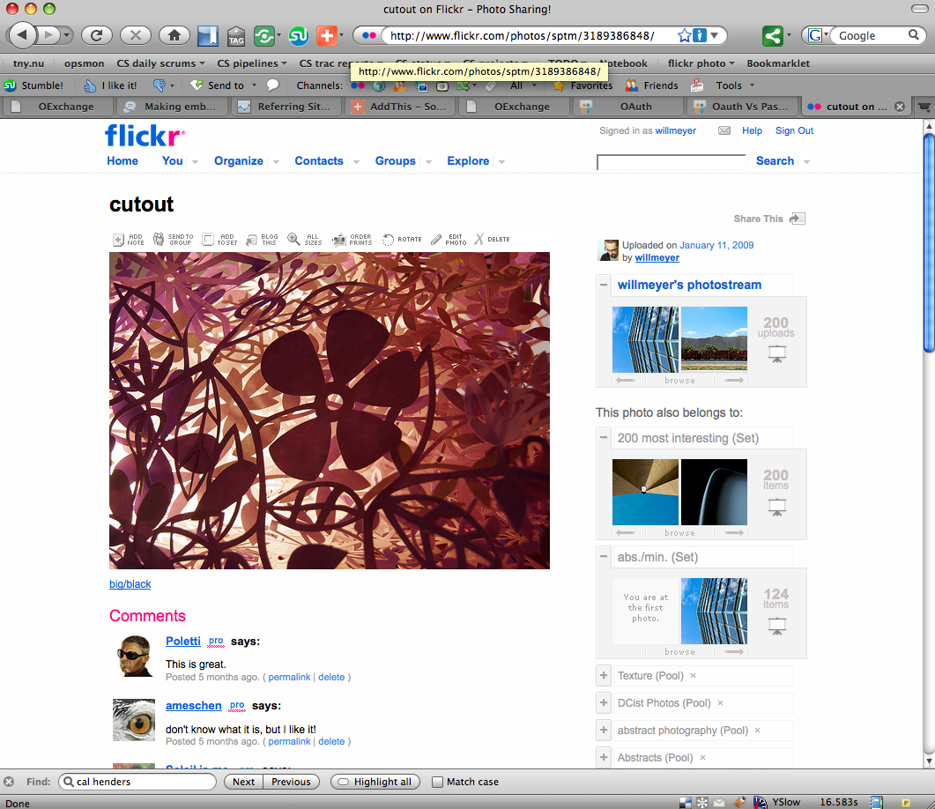
Is browsing the web…

Slide 7
Is browsing the web…
And decides to share something….

Slide 8
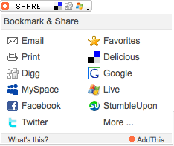
Is browsing the web…
And decides to share something….so they click a link, button, or a menu like this:

Slide 9
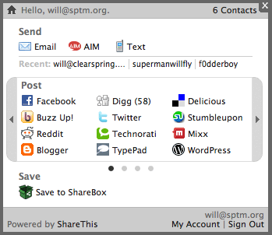
Or this:

Slide 10
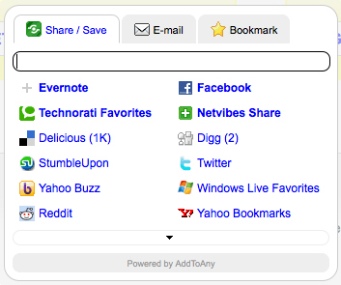
Or this:

Slide 11

Or even just a row of impersonal service links (though they might be pretty):

Slide 12
To do the share, we take the URL of the current page:

Slide 13
To do the share, we take the URL of the current page:
http://www.example.com/something

Slide 14
To do the share, we take the URL of the current page:
http://www.example.com/something
And the service the user picked…

Slide 15

To do the share, we take the URL of the current page:
http://www.example.com/something
And the service the user picked…

Slide 16
And send the User’s browser to a URL specific to that service…

Slide 17
…like this:
http://www.facebook.com/share.php?u=http://www.example.com

Slide 18
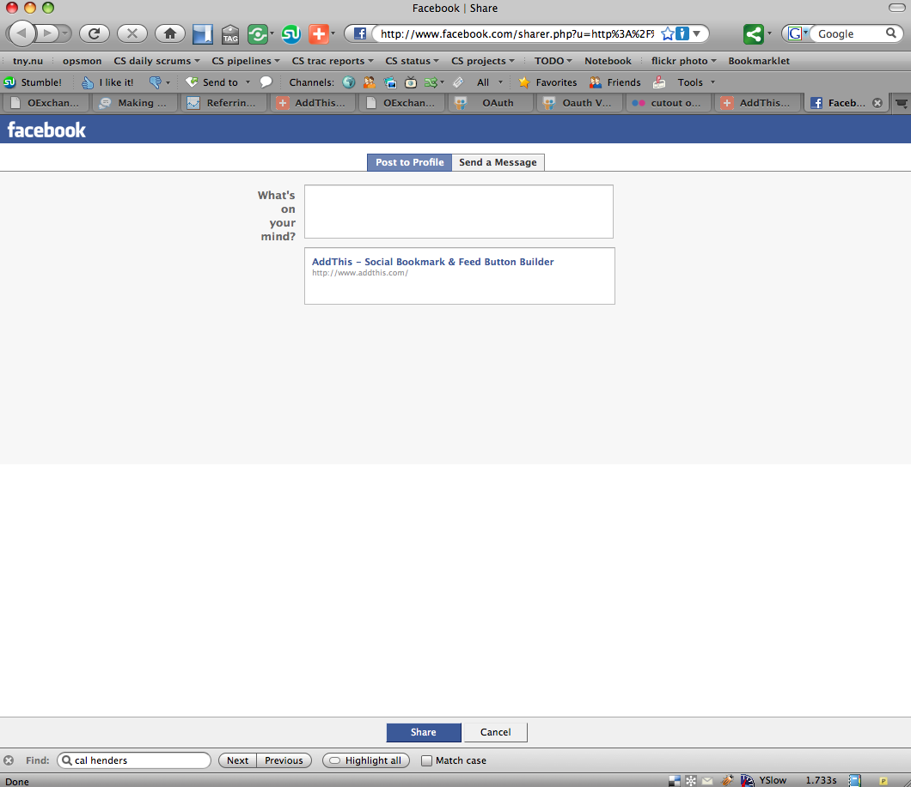
Now the user is just interacting with that site to complete the share…

Slide 19
So basically those buttons just format requests to specific URLs for each site…

Slide 20
So basically those buttons just format requests to specific URLs for each site…
…or the site has to.

Slide 21
So basically those buttons just format requests to specific URLs for each site…
(oh, except for the tools that scrape, or encourage “the password anti-pattern”)

Slide 22
So basically those buttons just format requests to specific URLs for each site…
And it works like this for LOTs and LOTS of different services, which are all pretty close, but different.

Slide 23
http://www.facebook.com/sharer.php?u=http%3A%2F%2Fwww.example.com
/sharer.php?u={the url}

Slide 24

http://www.google.com/bookmarks/mark?op=add&bkmk=http%3A%2F%2Fwww.example.com
/mark?op=add&bkmk={the url}

Slide 25

http://www.stumbleupon.com/submit?url=http%3A%2F%2Fwww.example.com
/submit?url={the url}

Slide 26

http://www.myspace.com/Modules/PostTo/Pages/?u=http%3A%2F%2Fwww.example.com
/PostTo/Pages/?u={the url}

Slide 27
And none of this is really personalized to the user.

Slide 28

This is just silly

Slide 29
URL-sharing links, buttons, and menus proliferate the web.
They are occupied with URL translations.
They should be focused on solving real user problems.

Slide 30
Users shouldn’t have to navigate piles of chiclets (for options they don’t care about).

Slide 31
Users shouldn’t have to navigate piles of chiclets (for options they don’t care about).

Slide 32

Users shouldn’t have to navigate piles of chiclets (for options they don’t care about).
(even really fancy chiclets)

Slide 33
Users would have a better experience if the options were personalized.
And link-sharing tools could be more interesting if the actual exchange was standardized.

Slide 34
A larger sharing network, with more traffic, and happier users.

Slide 35
And, the places a user is sharing to should control the interface/experience

Slide 36
And, the places a user is sharing to should control the interface/experience
Sort of like how the providers control the experience in open authentication flows

Slide 37
Plus, “share this link” is really a combination of many verbs (post/send/share/tweet/save).
Not to mention things like “translate this”.

Slide 38
The Open Stack is coming together…

Slide 39
The Open Stack is coming together…
For identity, access control, service discovery, contact data, application formats, social stream I/O, and more…

Slide 40
The Open Stack is coming together…
For identity, access control, service discovery, contact data, application formats, social stream I/O, and more…
And this can be leveraged to make sharing better. But we still need the simple link-sharing part.

Slide 41
How it should be
The simple process of sharing/posting/sending links (and more) should be standard
Users should have a more targeted experience
Sharing tools should focus on user value, not on proxying URL formats between sites
Sharing increases with targeted and personalized choices for the user, minimal intermediate UI, and tighter browser and page integration

Slide 42
What’s really needed?
Simple agreement on how to exchange (send/share/post) semi-typed “link” content, replacing today’s hodge-podge
A way to discover places to share the content to
A way for users to indicate the services they prefer

Slide 43
What am I sharing? A page? A video? An image?

Slide 44
Where am I sharing it to? A social bookmarking site? A blog?

Slide 45
How close are we?
Defining the content is coming along on its own (well, sorta)
Content “targets” mostly all share a model (e.g. share.php?url=) for simple link sharing
Personal discovery is starting to be real
We just need a few connecting bits

Slide 46
OExchange
http://www.oexchange.org/spec

Slide 47
A super simple protocol for sending content to a site. Where the target site controls the user experience, not an intermediate tool.

Slide 48
This includes:
A common URL syntax for the share operation
Simple agreement on a URL “plus more when you have it” type model
Basic discoverability of endpoints available on a given host
Recommendations on how to leverage WebFinger for personalization

Slide 49
How it works…
Our faithful User…

Slide 51
Is using a site (or other app), and wants to share some content.

Slide 52
That site, either itself or by using an intermediate tool, has a known set of OExchange endpoints
These endpoints are called Targets.

Slide 53
That site, either itself or by using an intermediate tool, has a known set of OExchange endpoints
(the targets can be discovered dynamically, but more on that later)

Slide 54
That site, either itself or by using an intermediate tool, has a known set of OExchange endpoints
The targets have defined metadata, like:
friendly name: my cool bookmarking site
endpoint: http://www.example.com/oexchange/share

Slide 55
The site or tool forms a standard HTTP request to the target, like:
http://www.mcbs.com/oexchange/share?ctype=link
&url=http://www.example.com/thing-to-share

Slide 56
…and just sends the browser there.

Slide 57
The typing thing is simple.
A “ctype” parameter indicates the type of content, and it defaults to “link”.
So bookmarking tools don’t really have to change.

Slide 58
The typing thing is simple.
A “ctype” parameter indicates the type of content, and it defaults to “link”.
So bookmarking tools don’t really have to change.
And there is ALWAYS a browser-appropriate URL in the transaction (no type negotiation required).

Slide 59
There are also other defined types, which improve the user experience when they are present but don’t hurt anything otherwise:
Flash objects
Iframes
Images
(more as appropriate)

Slide 60
That’s it.
It’s basically the way things work today.

Slide 61
That’s it.
It’s basically the way things work today.
Except everyone agrees to use the same URL scheme, and on a common set of types, and makes their UI flow with their own site.
So we can all move on with our day.

Slide 62
Oh wait, how do you find out about these Targets? And where does personalization come in?

Slide 63
Oh wait, how do you find out about these Targets? And where does personalization come in?
There’s also a simple discovery thing.

Slide 64

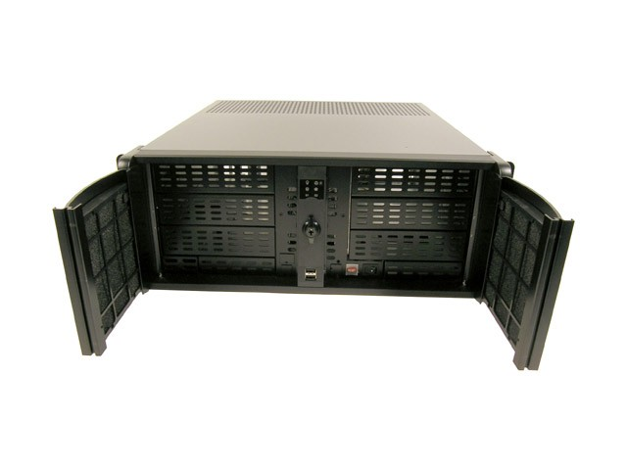
If you are a Target (which means you can accept OExchange shares):
you can always tell people about your endpoint directly
or you can leverage XRD on your host, so tools can find you
http://www.willmeyer.com/.well-known/host-meta

Slide 65
/.well-known/host-meta is becoming a standard location for service discovery info on a host, so we’ve added to it.
<Link
rel="http://oexchange.org/spec/0.8/rel/hosted-service"
type="application/xrd+xml”
href=http://www.willmeyer.com/oexchange/bookmarks/oexchange.xrd >
<Title>Example Bookmarking Service</Title>
</Link>

Slide 66
/.well-known/host-meta is becoming a standard location for service discovery info on a host, so we’ve added to it.
<Link
rel="http://oexchange.org/spec/0.8/rel/hosted-service"
type="application/xrd+xml”
href=http://www.willmeyer.com/oexchange/bookmarks/oexchange.xrd >
<Title>Example Bookmarking Service</Title>
</Link>
(this goes inside the document, along with other Link descriptors like WebFinger’s)

Slide 67
Things that want to facilitate sending links somewhere can dynamically find and interoperate with more targets.

Slide 68
We also think we can add preferred user services to personal XRDs obtained with WebFinger (with a “I want to send links to this service” relation).

Slide 69
We also think we can add preferred user services to personal XRDs obtained with WebFinger (with a “I want to send links to this service” relation).
(which means you as a user can indicate that you use a specific bookmarking service or network, and only see that chiclet)

Slide 70
Hey, what about authentication?

Slide 71
Hey, what about authentication?
The target manages it (hopefully using some nice standard method), since it dictates session lifetime and auth flow for its users already

Slide 72
Hey, what about authentication?
The target manages it (hopefully using some nice standard method), since it dictates session lifetime and auth flow for its users already
Sharing should NOT include scraping or intermediate password input -- in-situ sharing buttons are cool, but ultimately not cool

Slide 73
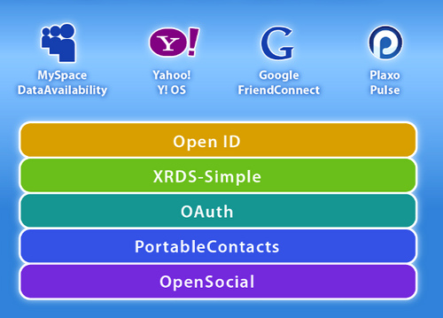
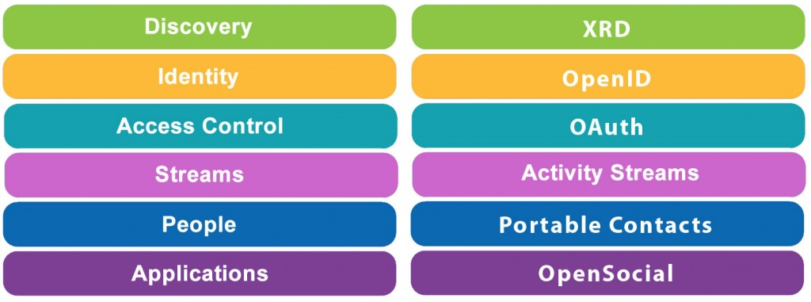
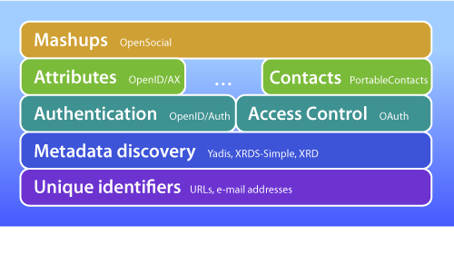
…and the “open stack”?

Slide 74
…and the “open stack”?
The basic URL transaction doesn’t have any relation to the authentication method used (so standards can be leveraged there)
Any tag-soup standards can be supported via specific types, or simply on top of the exchange when a least-common-denominator is not required
OExchange Discovery plays nice with XRD and Webfinger
Activity Streams/Atom Publishing, and other application-domain-specific read/write standards represent a deeper level of integration; no need for OExchange to interfere there.

Slide 75
What happens now?

Slide 76
The network of sharing destinations can grow dramatically, while user experience improves…

Slide 77
The network of sharing destinations can grow dramatically, while user experience improves…
…and sharing tools can offer more personalized sharing prompts

Slide 78
The network of sharing destinations can grow dramatically, while user experience improves…
…and sharing tools can offer more personalized sharing prompts.
…with more long-tail services.

Slide 79
The network of sharing destinations can grow dramatically, while user experience improves…
…and sharing tools can offer more personalized sharing prompts.
…with more long-tail services.
…and more appropriate/targeted services (like language-specific services).

Slide 80
And as a bonus, the middlemen are optional.

Slide 81
…so?
An increase in user sharing rate means increased link-back lift for publishers
A standardized sharing interface increases the network effect of the destination
Life gets better for users

Slide 82

OK, then.
http://www.oexchange.org/spec
http://groups.google.com/group/oexchange

