Slide 1



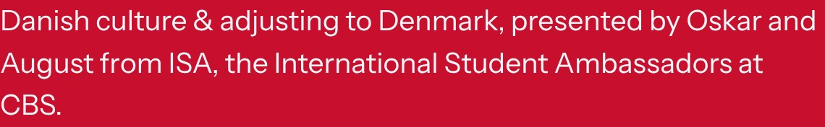

Notes:
Welcome everyone! “Velkommen til Danmark” means “Welcome to Denmark”. We have about 20 minutes: what’s helpful to know about Danes, the challenges, the surprises, how to find your footing, and then your questions. Keep it relaxed, this is students talking to students.

Slide 2

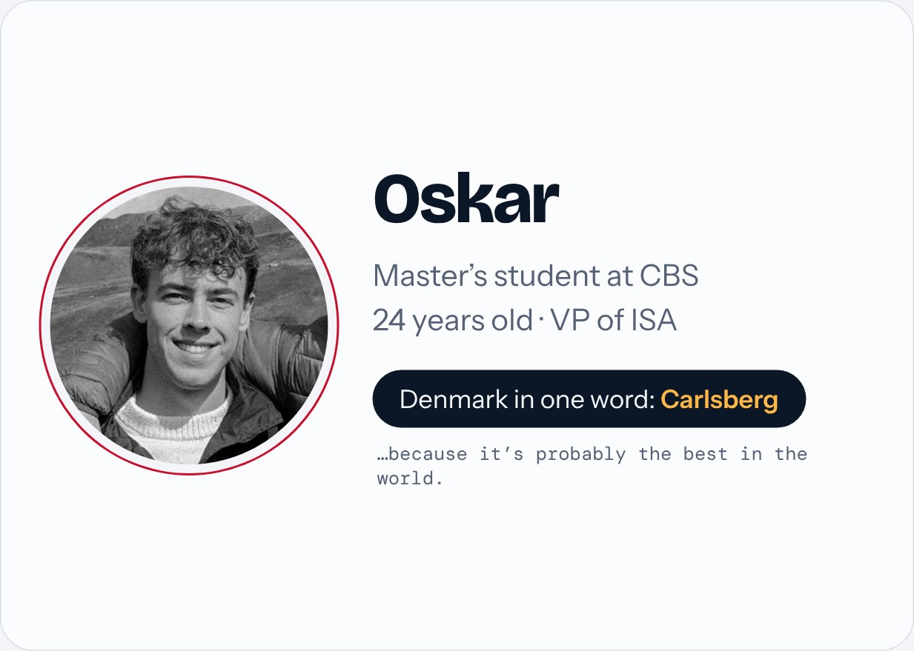
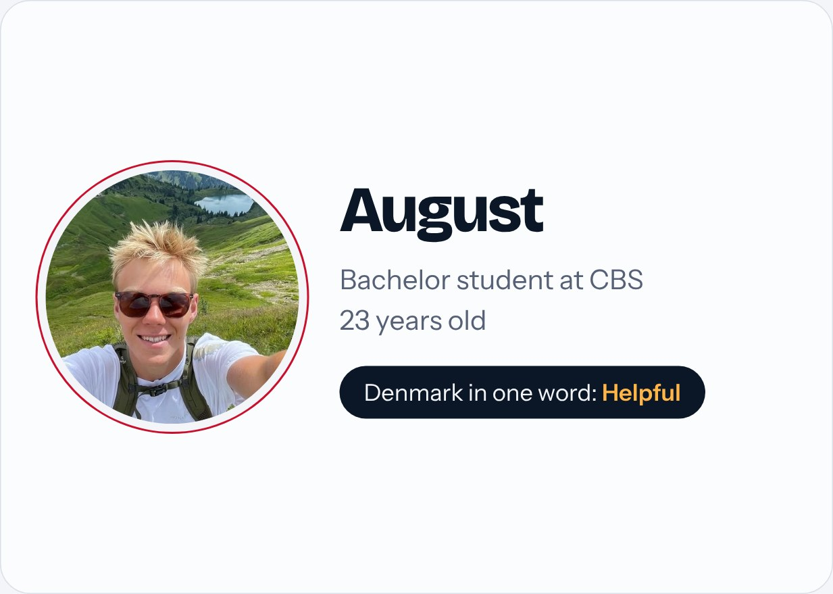
Notes:
About 30 seconds. I’m Oskar, 24, doing my master’s at CBS and VP of ISA. My one word for Denmark is Carlsberg, because it’s probably the best in the world. Then August introduces himself: 23, bachelor student at CBS, and his one word is “helpful”. Then: today we’ll share what’s helpful to know, what’s hard, what surprises people, and how to find your footing.

Slide 3

Notes:
A quick, relatable warm-up. Read a couple of the lines out loud. The point: everyone goes through the same things in their first weeks. The clocks went back on Sunday 25 October, so the evenings just got a lot darker.

Slide 4

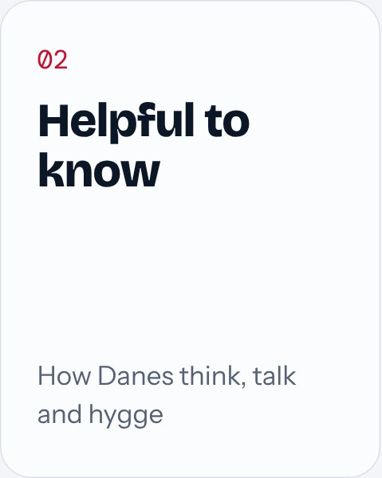
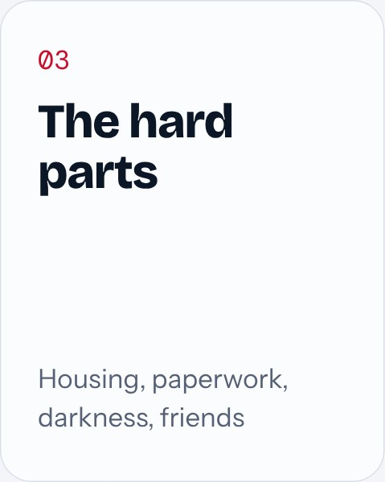
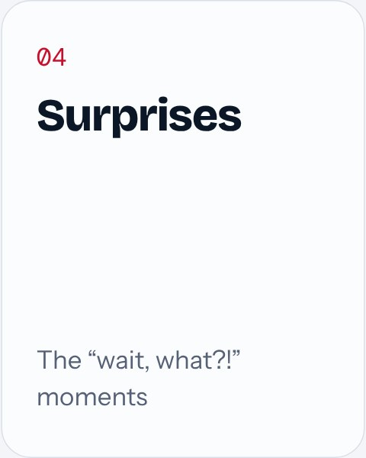
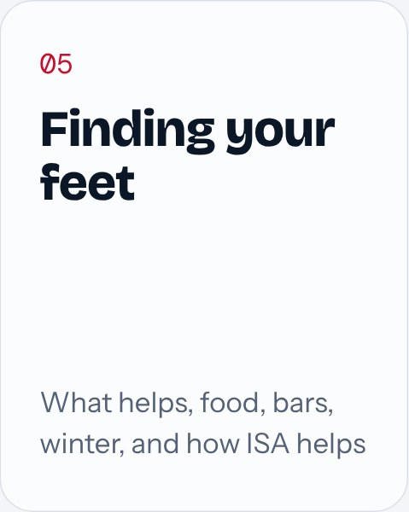
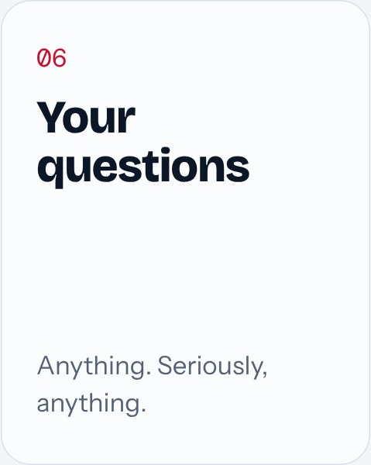
Notes:
Quick overview. You can click a card to jump to that part.

Slide 5

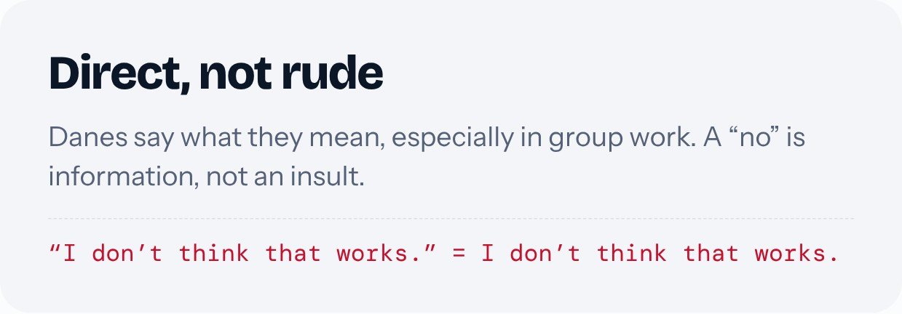
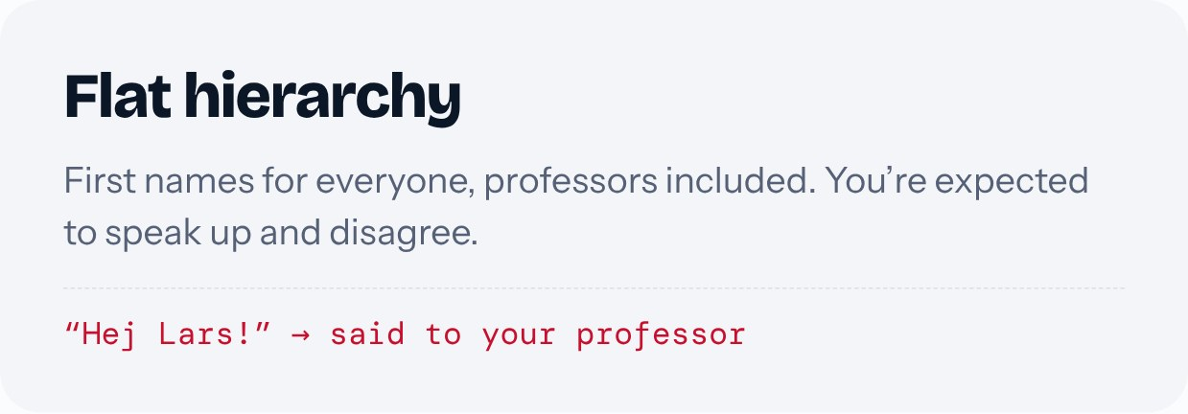
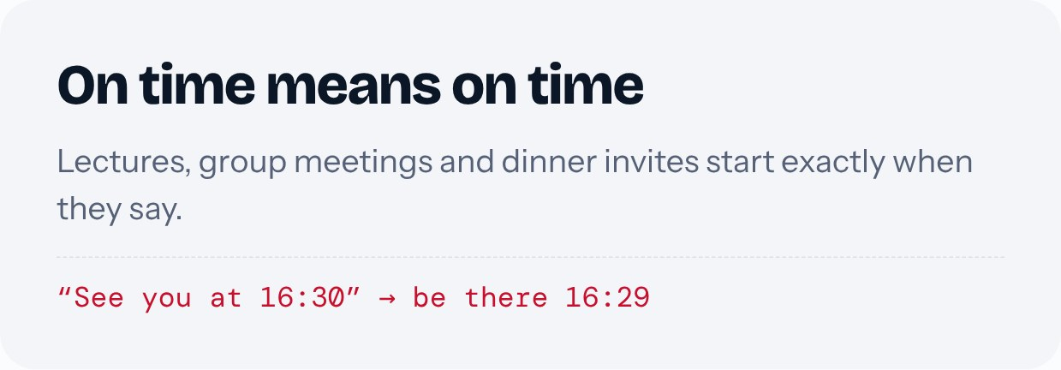
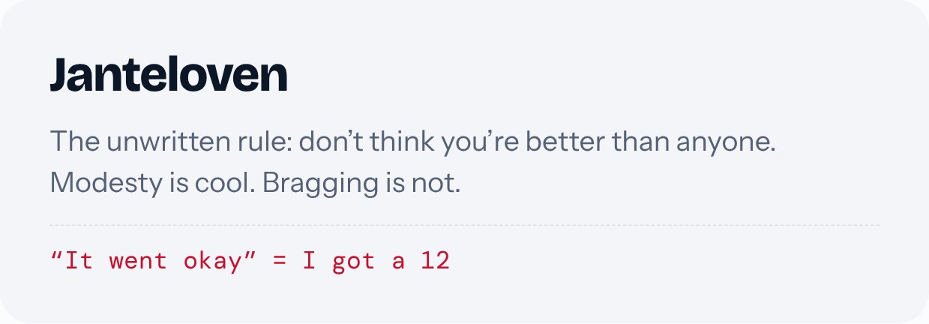
Notes:
Directness: feedback like “I don’t think that works” is about the work, not about you. Flat hierarchy: first names for teachers, everyone’s opinion counts. Punctuality: being late to a group meeting gets noticed. Janteloven: don’t show off about money or grades. 12 is the top grade on the Danish scale, so “it went okay” can mean you aced it. Add one personal example.

Slide 6

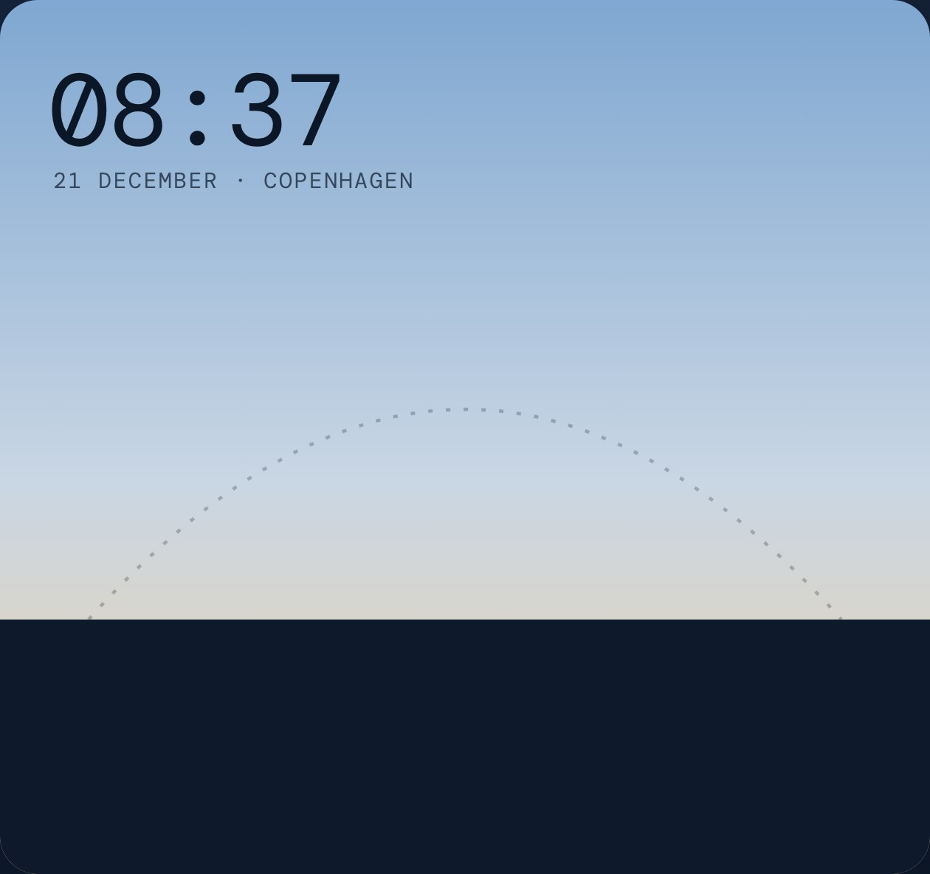
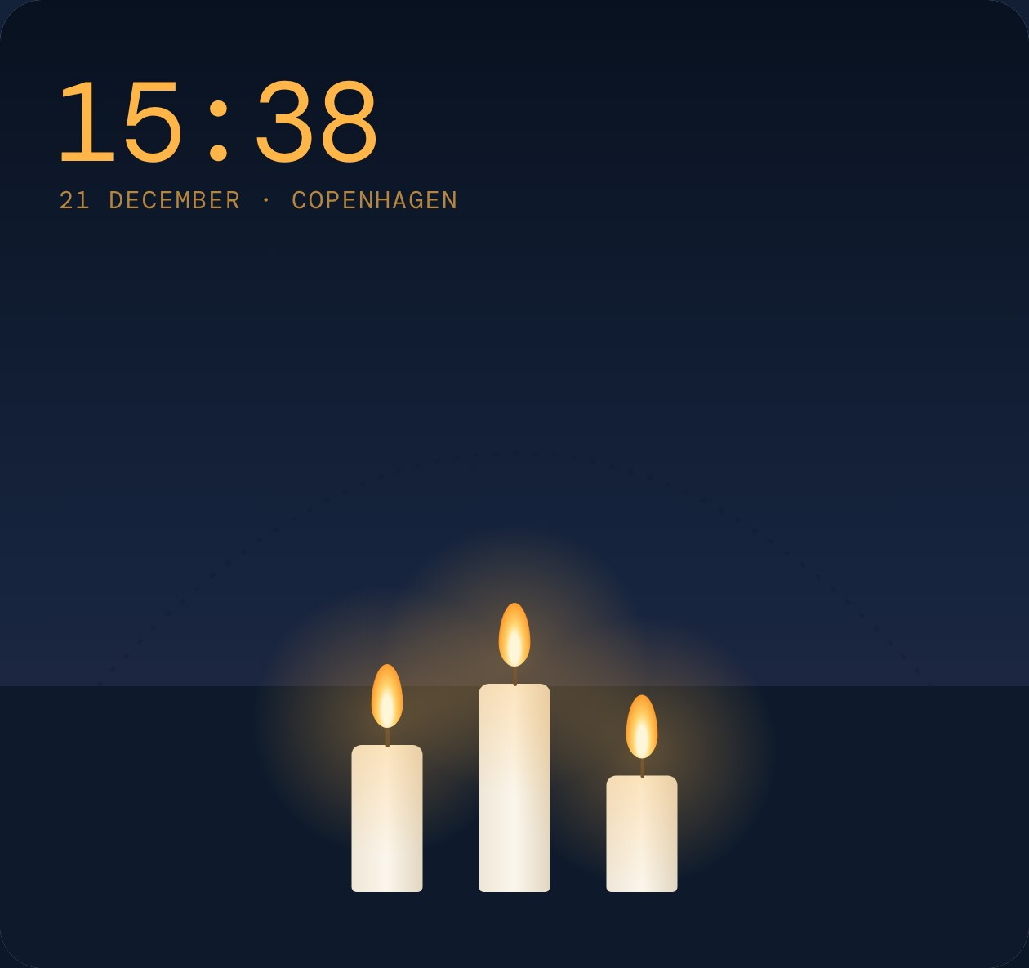

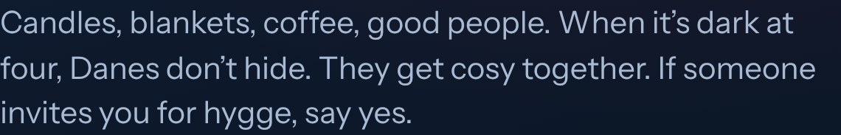

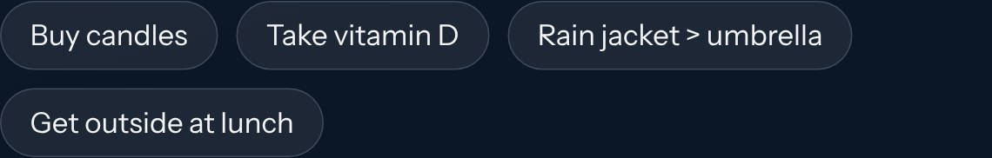
Notes:
Watch the sun: on the shortest day it rises around 08:37 and sets around 15:38. Many internationals find November–February the hardest months. Hygge is how Danes cope: small cosy gatherings, candles, coffee and cake. Tips: get outside in daylight, take vitamin D, stay active, accept invitations. A good rain jacket beats an umbrella because the wind destroys umbrellas.

Slide 7


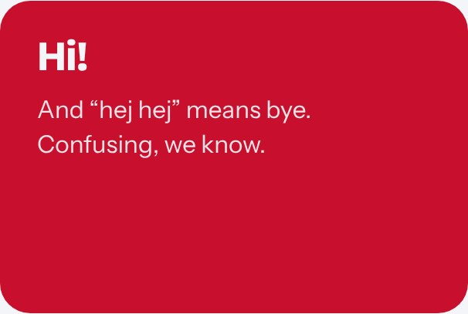


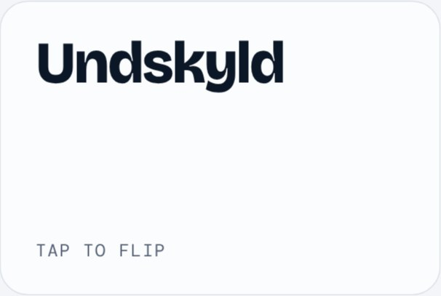
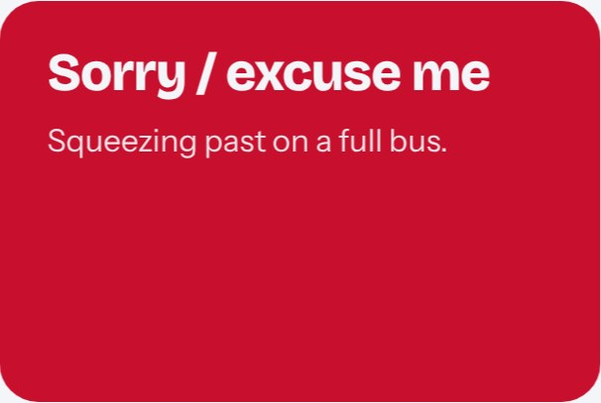
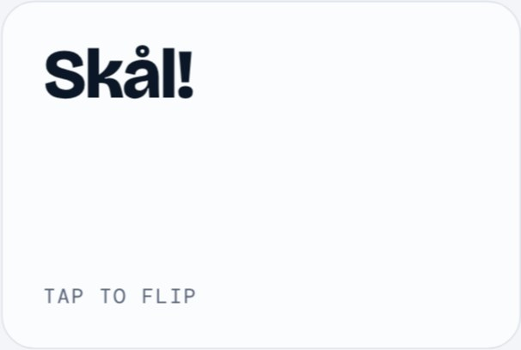
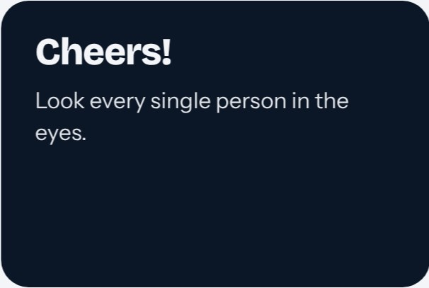

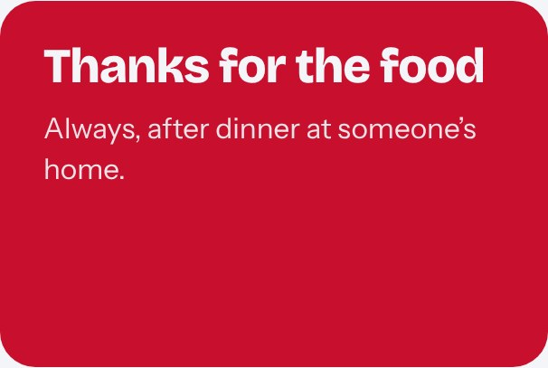

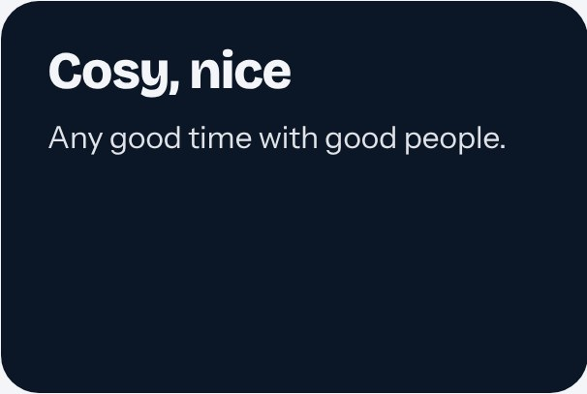
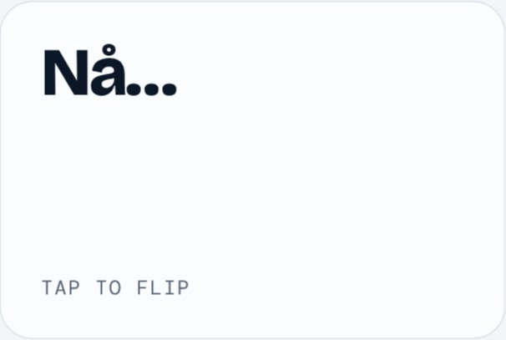
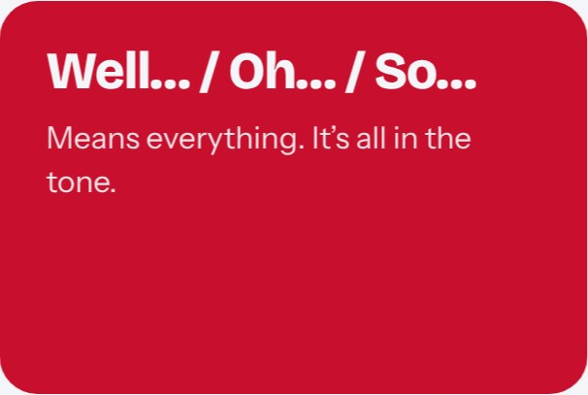
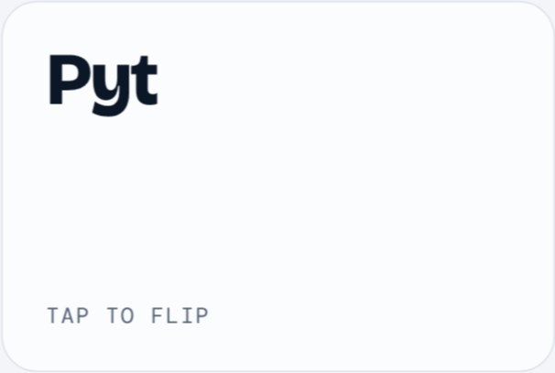
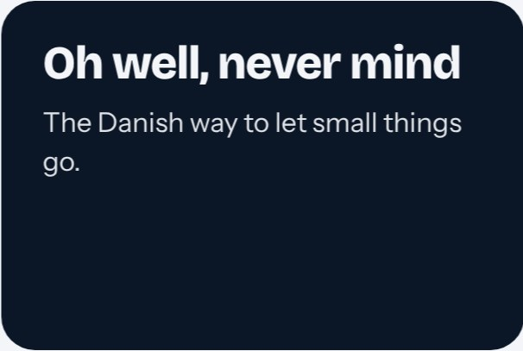
Notes:
August presents this slide. Say each word and let the room guess the meaning before you flip. Press → to flip all cards, or click single cards. Skål: when Danes toast, you look each person in the eyes. “Tak for mad” after dinner at someone’s home is a must. “Pyt” is what you say when the bus leaves without you.

Slide 8

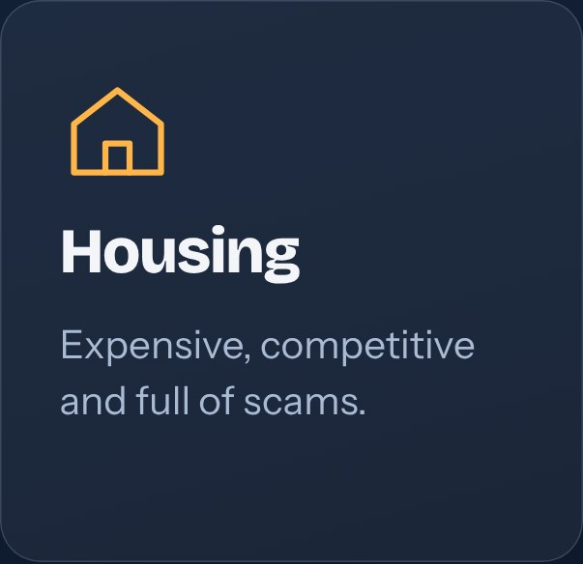

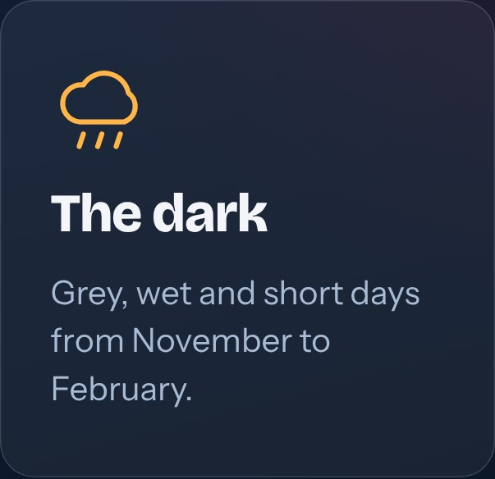
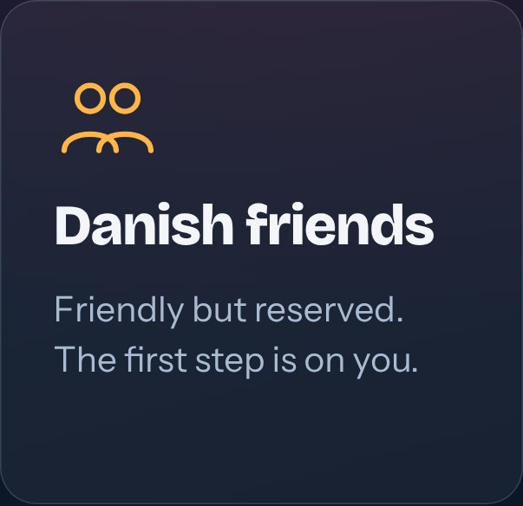
Notes:
August presents this slide. The four big ones. On Danish friends: many Danes have had the same friend group since school, so they aren’t cold, just busy. You meet them through shared activities (student organisations, sports, Friday bars) more than through small talk. Then the reassurance: almost everyone hits at least one of these, and it gets easier.

Slide 9

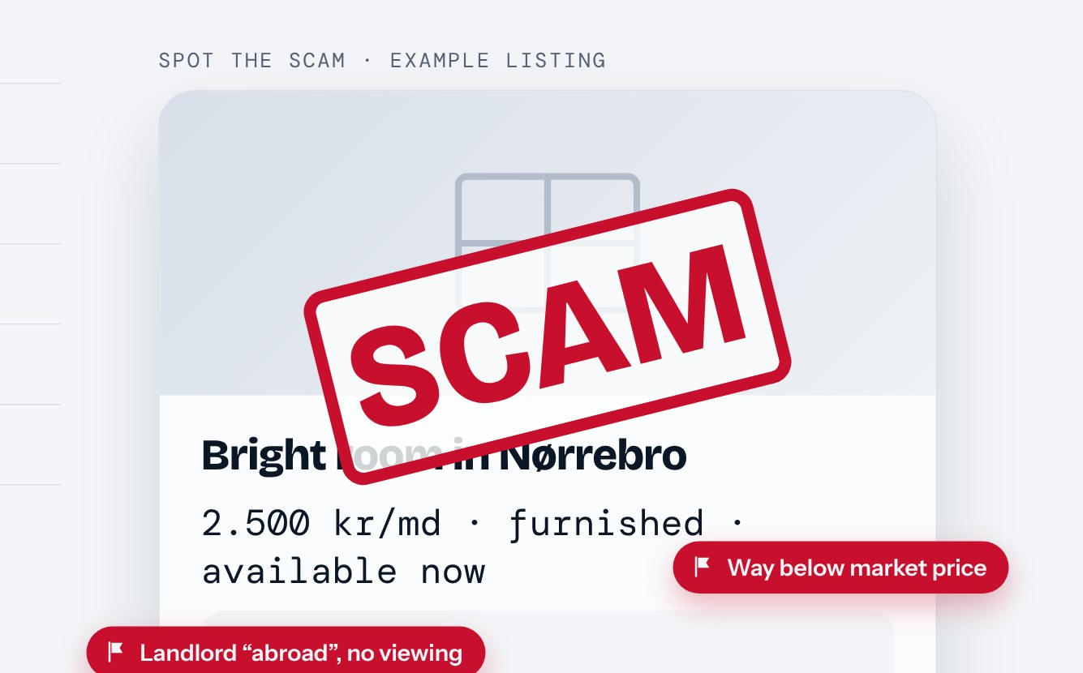
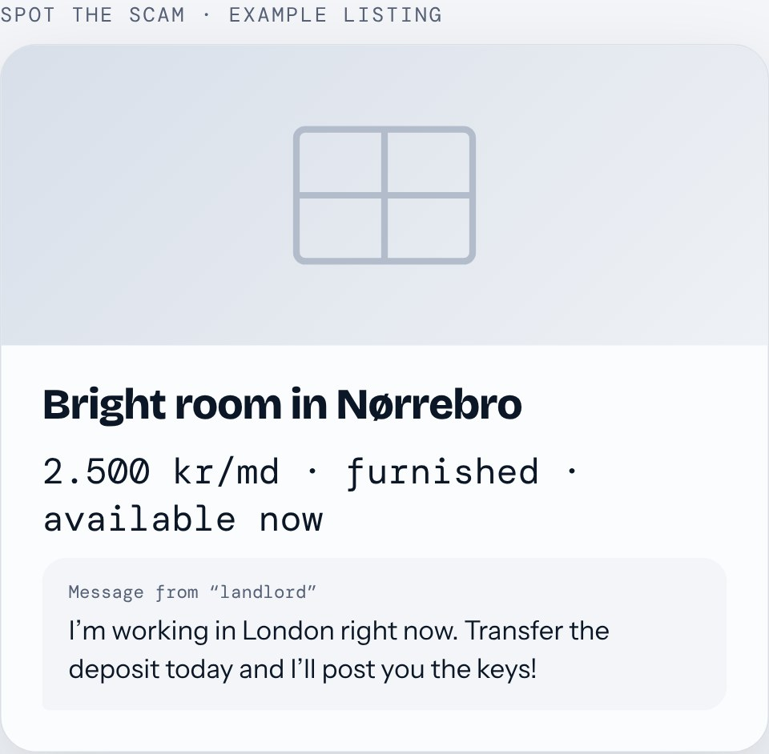
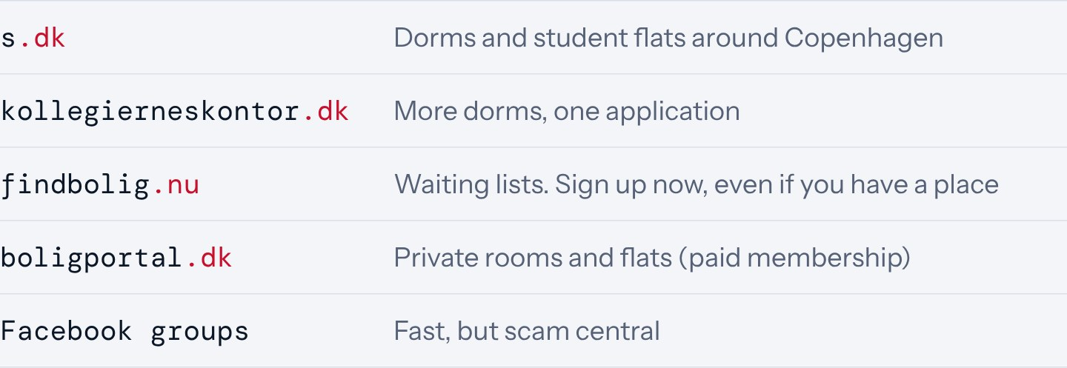



Notes:
August presents this slide. Housing is the number-one stress. S.dk and Kollegiernes Kontor are the two big portals for dorms (kollegier). findbolig.nu runs waiting lists, so sign up early because seniority counts. BoligPortal costs money but has many private listings. Facebook groups are fast but full of scams. Press → to reveal the red flags one by one, then the stamp. Never pay before you’ve seen the place and signed a contract. Danish law caps the deposit at 3 months’ rent (plus up to 3 months prepaid rent). Tell how you found your place, or how people usually find one.

Slide 10
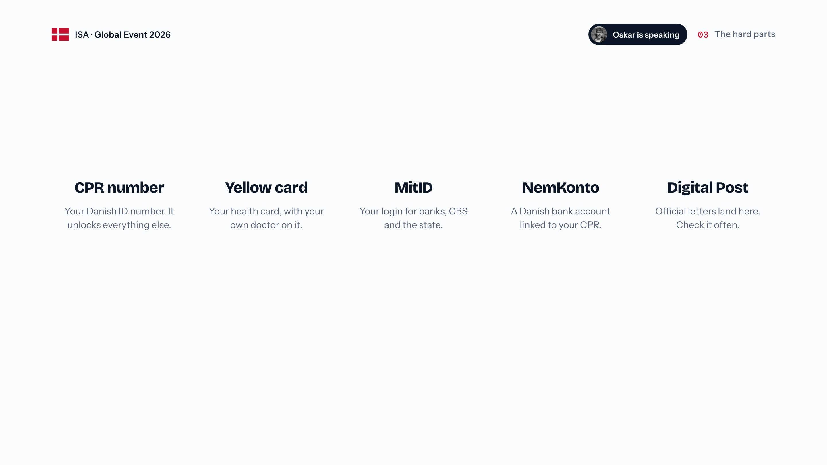






Notes:
Order matters: the CPR number (International House or your municipality) comes first. With it you get the yellow health card with your own GP, and healthcare is free. MitID is the digital ID for almost everything. NemKonto is the account the state and employers pay into. Digital Post is where official letters arrive; missing them can mean fines. Then the quote: the CPR, bank, address loop is something almost everyone hits. It does get sorted, it just takes patience.

Slide 11

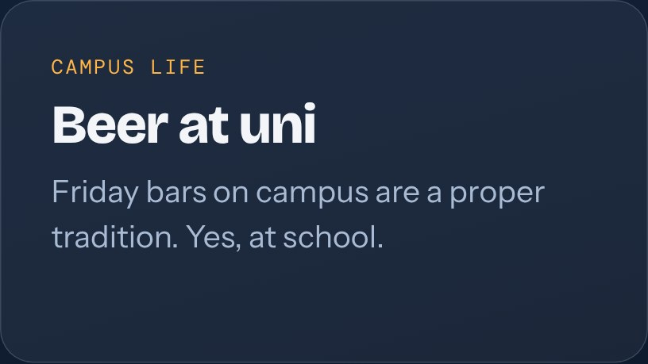

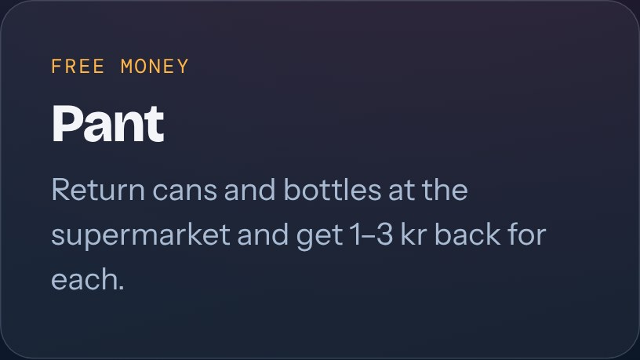
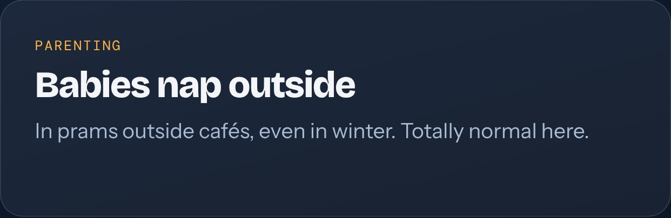
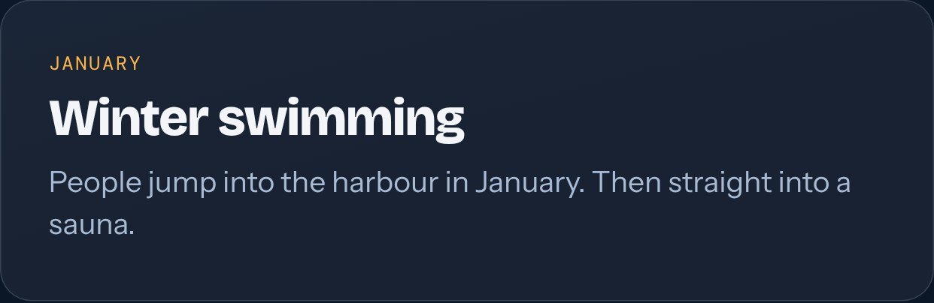
Notes:
Ask: which one surprised you most? Pant: the label on cans and bottles shows the deposit (A = 1 kr, B = 1.50 kr, C = 3 kr); return them in the machines at the supermarket. Add your own biggest surprise.

Slide 12

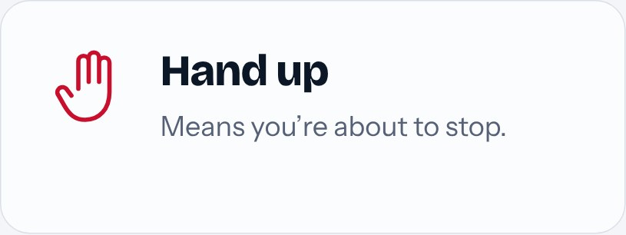
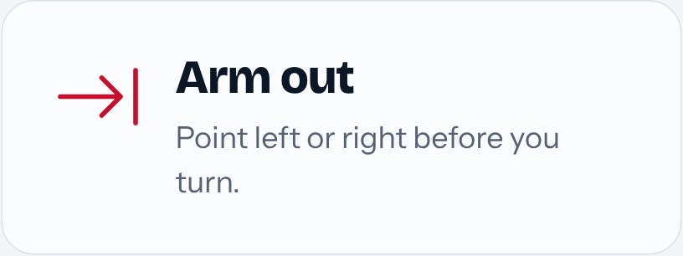
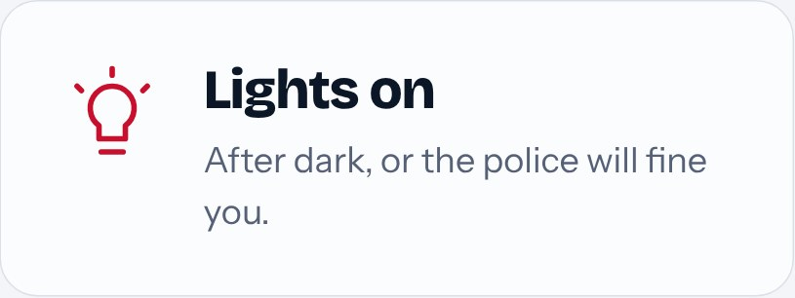
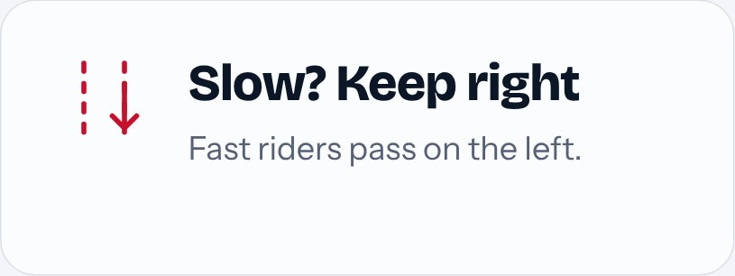
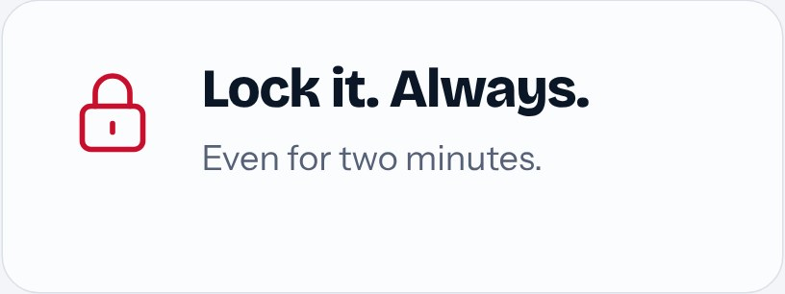
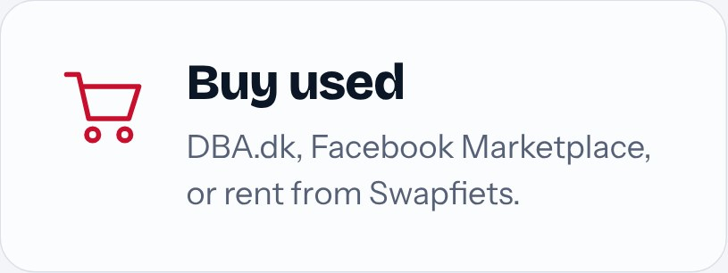




Notes:
August presents this slide. Biking is how Copenhagen moves, and Danish cyclists are fast and strict. Hand up = stopping, arm out = turning. Lights after dark are required and the police do give fines. Slow riders keep right. Never stop suddenly in the bike lane. Bike theft is common, so always lock it. Second-hand: DBA.dk or Facebook Marketplace. Swapfiets is a monthly bike subscription if you want zero hassle.

Slide 13


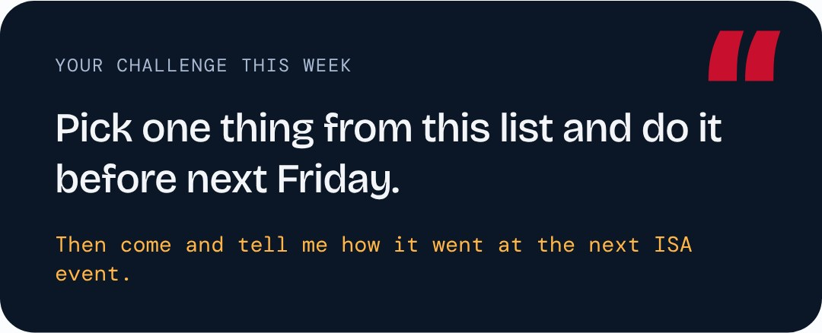
Notes:
Go through the five quickly, then give them the challenge: pick one and do it before next Friday. Danes usually make friends through shared activities: student organisations, sports clubs, volunteering, Friday bars. Showing up again and again is the trick.

Slide 14















Notes:
Join a student organisation, or create one. I created CBS AI, a student organisation for people curious about AI and business. There are already lots of organisations at CBS, like CBS Chess, CBS Extreme Sports and CBS Vikings. But if your thing isn’t there yet, whether it’s basketball, wine, beer, coffee, hiking or running, you can start it yourself. It’s one of the best ways to find your people.

Slide 15

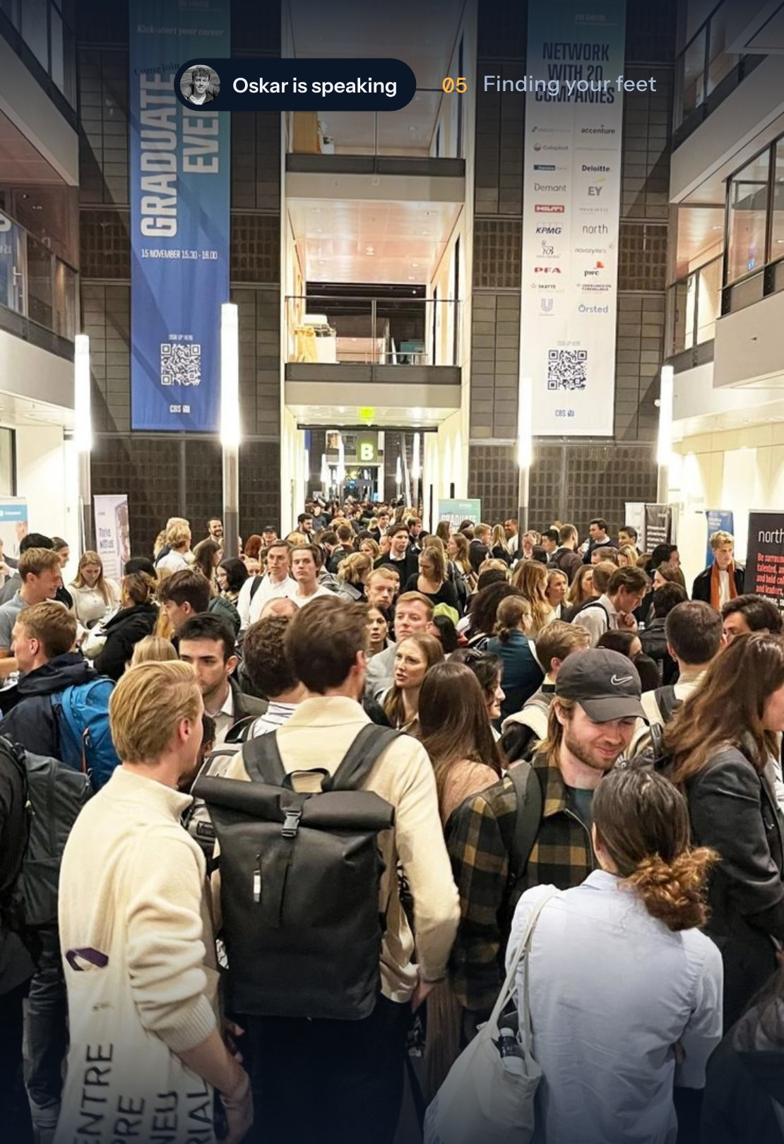


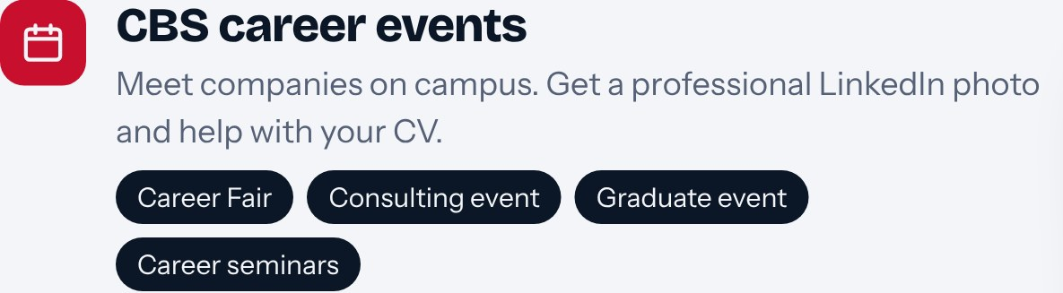


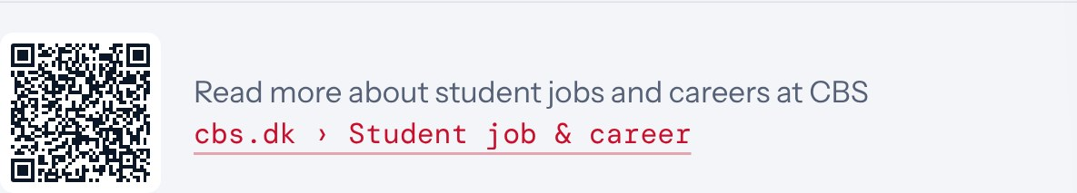
Notes:
How to get a student job in Denmark. LinkedIn is a great way to find opportunities. CBS runs career events on campus, like the Career Fair, the Consulting event, the Graduate event and career seminars, where you can talk to people from the companies. At the career day you can get a professional LinkedIn photo taken and get help with your CV. CBS also has its own job portal, CareerGate, with jobs only for CBS students. Scan the QR code to read more on the CBS student job and career page.

Slide 16

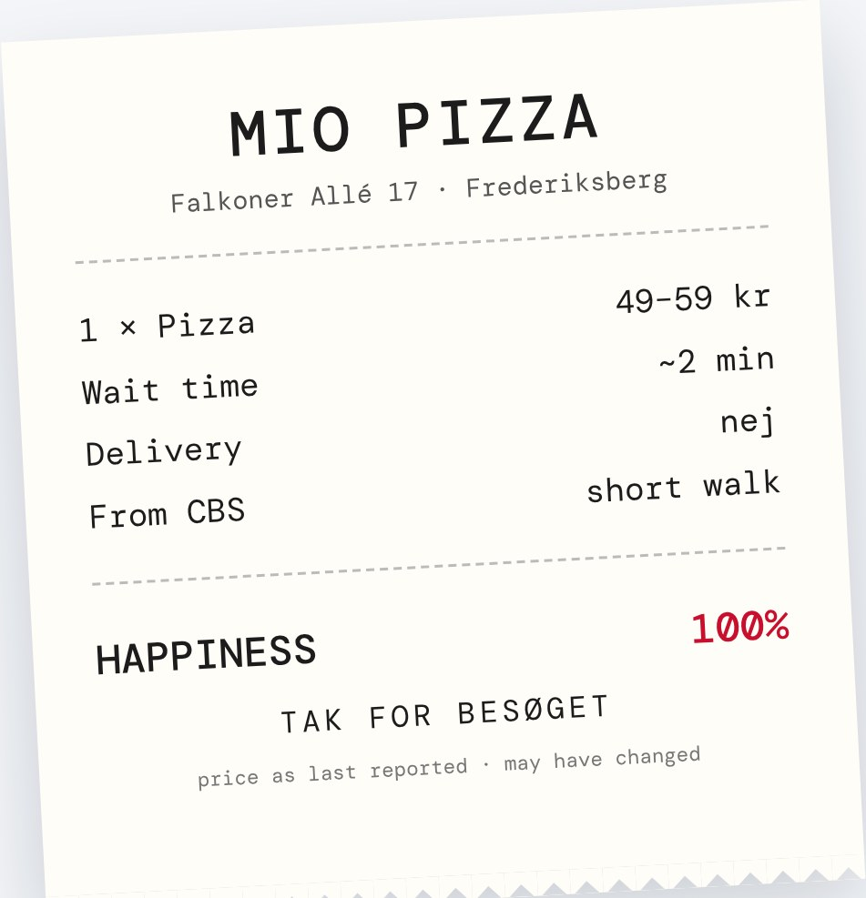

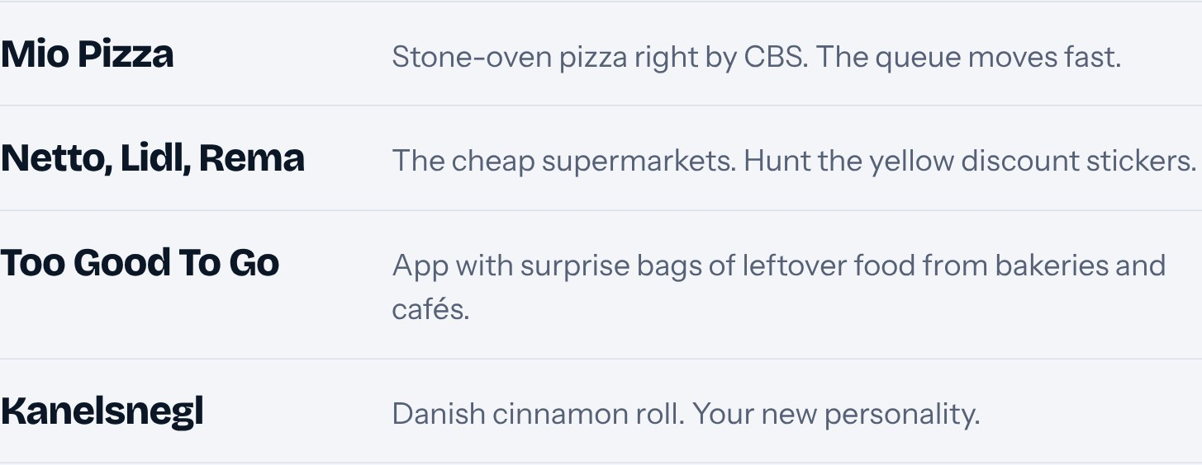
Notes:
Mio Pizza on Falkoner Allé 17, a short walk from Solbjerg Plads, is a CBS favourite: simple stone-oven pizzas around 49–59 kr (last reported price), ready in a couple of minutes, no delivery. Groceries: Netto, Lidl and Rema 1000 are the budget chains. Too Good To Go sells leftover food cheaply at the end of the day. Add your own favourite cheap spot.

Slide 17



Notes:
Café Nexus at Solbjerg Plads is CBS’s student bar with Friday bars; many study programmes run their own Friday bars too. Bodegas are traditional Danish pubs. Studenterhuset is a student-run café and bar with concerts and language cafés. The Black Diamond is a great study spot on the harbour. Also: Frederiksberg Have right next to CBS. Add your own favourite place.

Slide 18









Notes:
A little bonus: my personal favourites, roughly in the order of a perfect night out. Bouillon on Solbjergvej is a French bistro near Frederiksberg Station, very good and not expensive. ÅBEN is a brewery bar in Kødbyen. Det Hvide Lam at Kultorvet is a tiny bodega with live jazz. Det Elektriske Hjørne on Store Regnegade is a classic café bar whose bar was designed by Finn Juhl for Hotel d’Angleterre in 1947. Farfars Bodega on Skindergade has football and a dance floor in the basement (level −1). Ølhaven at Gothersgade 8L is a courtyard beer garden with a big wall of taps. Bodega Danza in Kødbyen is where the night ends. Add a line about why each one is your favourite. Click a card to jump to its slide, or press → to go through them one by one.

Slide 19



Notes:
Bouillon: A Parisian-style bouillon: French classics like onion soup, steak frites and crème brûlée, at prices meant for everyone. Practically next door to CBS.

Slide 20



Notes:
ÅBEN: Brewery bar where the beer is brewed right on site. A good first stop before Kødbyen wakes up.

Slide 21




Notes:
Det Hvide Lam: A tiny old-school bodega with live jazz. Squeeze in, order a beer and stay a while.

Slide 22





Notes:
Det Elektriske Hjørne: A classic café bar with a design story: Finn Juhl drew the bar in 1947 for Hotel d’Angleterre, and it moved here in 1982.

Slide 23



Notes:
Farfars Bodega: Bodega vibes, football on the screens and a dance floor in the basement (level −1). Easy to stay longer than planned.

Slide 24



Notes:
Ølhaven (“the beer garden”) at Gothersgade 8L: A beer garden tucked into a courtyard off Gothersgade, with a wall of 20+ taps under an old timber-framed building.

Slide 25



Notes:
Bodega Danza: The last stop. When the night isn’t over yet, end it on the dance floor in Kødbyen.

Slide 26








Notes:
Something to look forward to in the dark months. J-Dag is the first Friday of November, this year Friday 6 November: Tuborg’s Christmas beer is released at 20:59 and bars get very busy. Tivoli opens its Christmas season around mid-November. If classmates invite you to a julefrokost, go! Danes celebrate Christmas on the evening of the 24th. On New Year’s Eve people watch the King’s speech, eat kransekage, and jump into the new year from a chair. Not going home for Christmas? Ask around, many people invite others in.

Slide 27





Notes:
This is the key message: you don’t have to figure Denmark out alone. ISA is a group of current international students who volunteer to plan events through the whole year and help newcomers settle in. Come to our events, bring a friend, or come alone and leave with new ones. Questions any time: isa@cbs.dk find “CBS International Student Ambassadors” on Facebook, and follow us on Instagram @cbs.isa. Mention any upcoming ISA event dates here.

Slide 28












Notes:
Open the floor. If it’s quiet, pick one of the example questions and answer it yourselves to get things going. End by thanking everyone and pointing them to the quiz, games and the Danish dinner. “Velbekomme” is what Danes say when serving food, roughly “enjoy your meal”.

