Slide 1
Statistical analysis based on data from users of the website StackOverFlow
By
higher school of economics
Students
Dmitriy shagarov
Oleg sidorenkov

Slide 2

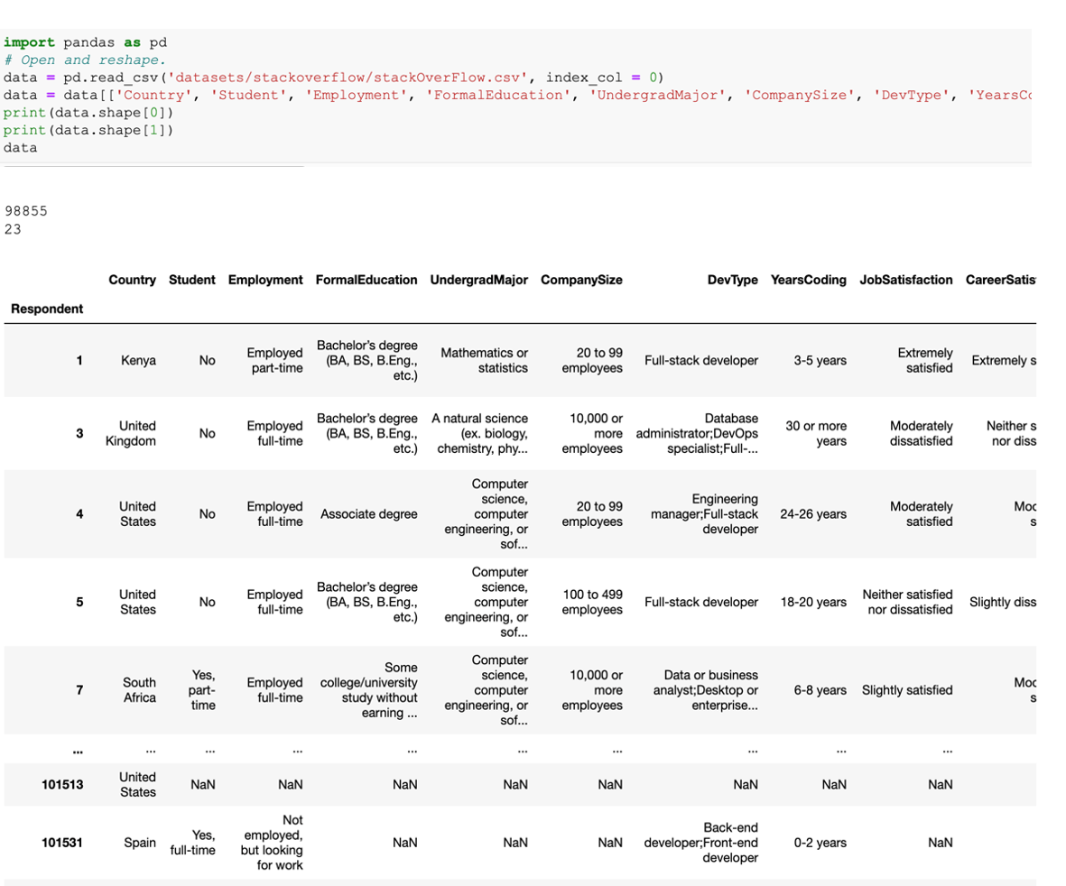



The analysis was carried out on the basis of data from the website kaggle.com
Dataset about statistics of StackOverFlow users

Slide 3

Dataset information
Shape: 98855 rows × 23 columns
Country – categorical, str
Student – binary, bool
Employment – categorical, str
CompanySize – categorical, str
YearsCoding – categorical, str
JobSatisfaction – categorical, str
CareerSatisfaction – categorical, str
JobSearchStatus – categorical, str
Converted salary – numeric, float64
NormalSalary – numeric, int
LanguageWorkedWith – categorical, str
OperatingSystem – categorical, str
NumberMonitors – numeric, float64
StackOverflowRecommend – numeric, float64
StackOverflowRecommend – categorical, string
HoursComputer – categorical, string
Age – categorical, string

Slide 4

Hypotheses
People who are satisfied with their work do not look for new job and vice versa
Students are rarely employed full-time
The more people spend time working the higher salary they get.
Most of programmers are younger than 50
Students are mostly people of age 18-24 years
Most popular programming language is python
Windows is most popular OS for multiple screens

Slide 5
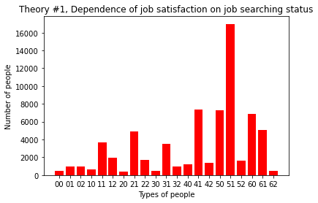

Hypothesis 1: People who are satisfied with their work do not look for new job and vice versa
Job satisfaction 0-6: 0 - extremely dissatisfied, 6 - extremely satisfied
Job searching status 0-2: 0 - not looking, 2 - actively looking
For example extremely satisfied person who is not looking for job is in group 60

Slide 6
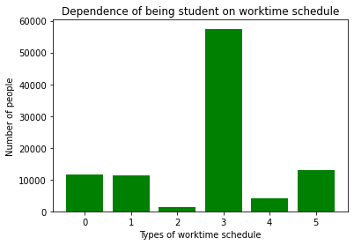
Hypothesis 2: Students are rarely employed full-time
0 means totally free person 1 means no work student 2 means part-time work adult 3 means full-time work adult 4 means part-time work student 5 means full-time work student

Slide 7
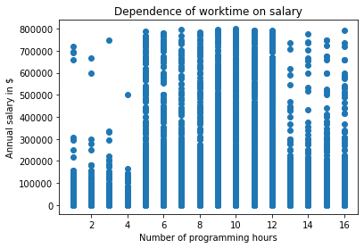
Hypothesis 3: Busier people get higher salary
People who work 8 – 12 hours daily earn all types of salary
Who works less than 5 hours gets less than quarter of maximum salary (800 000$)
As for workaholics, they rarely get maximum salary but still earn more than part-time employees

Slide 8
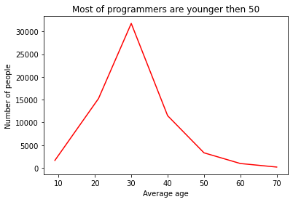

Hypothesis 4: Most of programmers are younger than 50
Number of people who are:
1638: under 18 y.o.
15249: 18 - 24 y.o.
31759: 25 - 34 y.o.
11477: 35 - 44 y.o.
3313: 45 - 54 y.o.
959: 55 – 64 y.o.
179: over 65 y.o.

Slide 9
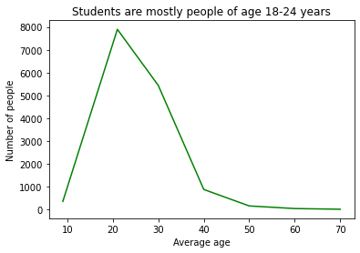
Hypothesis 5: Students are mostly people of age 18-24 years
Number of students who are:
362: under 18 y.o.
7894: 18 - 24 y.o.
5438: 25 - 34 y.o.
885: 35 - 44 y.o.
165: 45 - 54 y.o.
50: 55 – 64 y.o.
20: over 65 y.o.

Slide 10
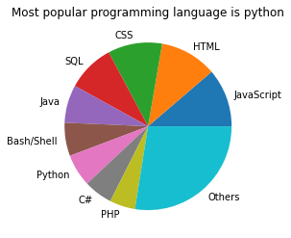
Hypothesis 6: Most popular programming language is python
Top five most popular languages:
JavaScript, 54686 users
HTML, 53628 users
CSS, 50979 users
SQL, 44670 users
Java, 35521 users
And Python got 7th place with audience of 30359 users
* To see whole list of languages and number of user check PythonProject/OldCodePhotos/Langs.rtf

Slide 11
Hypothesis 7: Windows is the most popular OS for multiple screens
 | Windows | MacOS | Linux | Unix | Average
1 | 10644 | 7106 | 6419 | 49 | 8072
2 | 20034 | 9976 | 8788 | 70 | 12956
3 | 6051 | 2881 | 1983 | 16 | 3643
4 | 548 | 156 | 186 | 3 | 297
os
Num of mons
Windows is not only the most popular OS for multiple screens but also the most popular OS overall

Slide 12

Additional information
Average number of monitors in companies of different sizes
StackOverFlow rating depending on frequency of visiting
Extended table for 3rd theory
Correlational analysis between variables
Second part of the project: web-scrapping on speedrun.com

Slide 13
Average number of monitors in each type of company
CompanySize | Student | BSD/Unix | Linux-based | MacOS | Windows
Enthusiasts | FALSE | 3 | 1,77 | 1,79 | 1,96
 | TRUE | 2 | 1,76 | 1,77 | 1,9
Medium Group | FALSE | 1,83 | 1,83 | 1,84 | 2,04
 | TRUE | 1,5 | 1,79 | 1,75 | 1,95
Small Company | FALSE | 1,64 | 1,88 | 1,85 | 2,06
 | TRUE | 1,33 | 1,83 | 1,85 | 1,91
Standart Company | FALSE | 2 | 1,91 | 1,89 | 2,08
 | TRUE | 2 | 1,85 | 1,88 | 1,93
Large Company | FALSE | 1,75 | 2,02 | 1,95 | 2,12
 | TRUE | 2,5 | 1,95 | 1,92 | 1,92
Minor Corporation | FALSE | 2 | 1,95 | 1,96 | 2,13
 | TRUE | 5 | 1,87 | 1,86 | 2,03
Average Corporation | FALSE | 2,8 | 1,98 | 1,98 | 2,12
 | TRUE | 2,33 | 1,9 | 1,78 | 2,05
Global Corporation | FALSE | 1,89 | 2,01 | 1,97 | 2,11
 | TRUE | 3 | 2,01 | 1,87 | 2
The additional argument is workers’ category: student or not
* To see .xlsx table check PythonProject/datamons.xlsx
*Average number of monitors

Slide 14
StackOverFlow rating depending on frequency of visiting
HoursComputer | I have never visited Stack Overflow (before today) | Less than once per month or monthly | A few times per month or weekly | A few times per week | Daily or almost daily
Less than 1 hour | 5,97 | 5,83 | 8,55 | 8,31 | 8,81
1 - 4 hours | 6,97 | 7,69 | 8,5 | 8,97 | 9,3
5 - 8 hours | 6,31 | 7,41 | 8,59 | 9,1 | 9,47
9 - 12 hours | 6,8 | 7,31 | 8,6 | 9,14 | 9,46
Over 12 hours | 6,06 | 7,31 | 8,39 | 9,07 | 9,42
The additional argument is amount of time working in front of computer
* To see .xlsx table check PythonProject/datarecvis.xlsx
*Average rating in ten-point scale

Slide 15
Extended table for 3rd theory
The additional argument is years of coding experience
YearsCoding | Less than 1 hour | 1 - 4 hours | 5 - 8 hours | 9 - 12 hours | Over 12 hours
0-2 years | 65298,82 | 52611,77 | 51317,28 | 55691,68 | 35597,81
3-5 years | 25364,43 | 46211,1 | 79297,18 | 64130,01 | 54584,39
6-8 years | 51430 | 47847,95 | 91207,43 | 84080,06 | 71530,75
9-11 years | 65074,67 | 120757,3 | 103243,8 | 92470,22 | 81312,79
12-14 years | 1006360 | 92138,37 | 114927,5 | 107736,2 | 101893
15-17 years | 287587 | 71936,48 | 128855,4 | 122075,7 | 132601,5
18-20 years | 10614 | 134889,8 | 134964 | 126073,3 | 116295,8
21-23 years | 126467,3 | 323480,4 | 134502,1 | 133640,4 | 127661,4
24-26 years | NaN | 245460 | 165364,7 | 140139,6 | 114991,9
27-29 years | NaN | 126822 | 147785,5 | 152997,8 | 164685,7
30 or more years | 203277 | 243482 | 153076 | 153499,2 | 156729,4
* To see .xlsx table check PythonProject/datahoyesalary.xlsx
*Average annual salary

Slide 16
Correlational analysis between variables
 | JobSatisfaction | JobSearchStatus | ConvertedSalary | Normal Salary | NumberMonitors | StackOverflow Recommend
JobSatisfaction | 1 | -0,37281 | 0,01783 | 0,014928 | 0,055138 | 0,047459
JobSearchStatus | -0,37281 | 1 | -0,04534 | -0,02896 | -0,07183 | -0,01265
ConvertedSalary | 0,01783 | -0,04534 | 1 | 0,93487 | 0,074258 | -0,01292
Normal Salary | 0,014928 | -0,02896 | 0,93487 | 1 | 0,045889 | -0,0064
NumberMonitors | 0,055138 | -0,07183 | 0,074258 | 0,045889 | 1 | 0,02
StackOverflow Recommend | 0,047459 | -0,01265 | -0,01292 | -0,0064 | 0,02 | 1
Mostly in every pair the correlation is almost zero so there is no tendency. We can see that only in JobSatisfaction and JobSearchingStatus the correlation is very negative that means that our hypothesis was truly incorrect
* To see .xlsx table check PythonProject/datacorr.xlsx

Slide 17
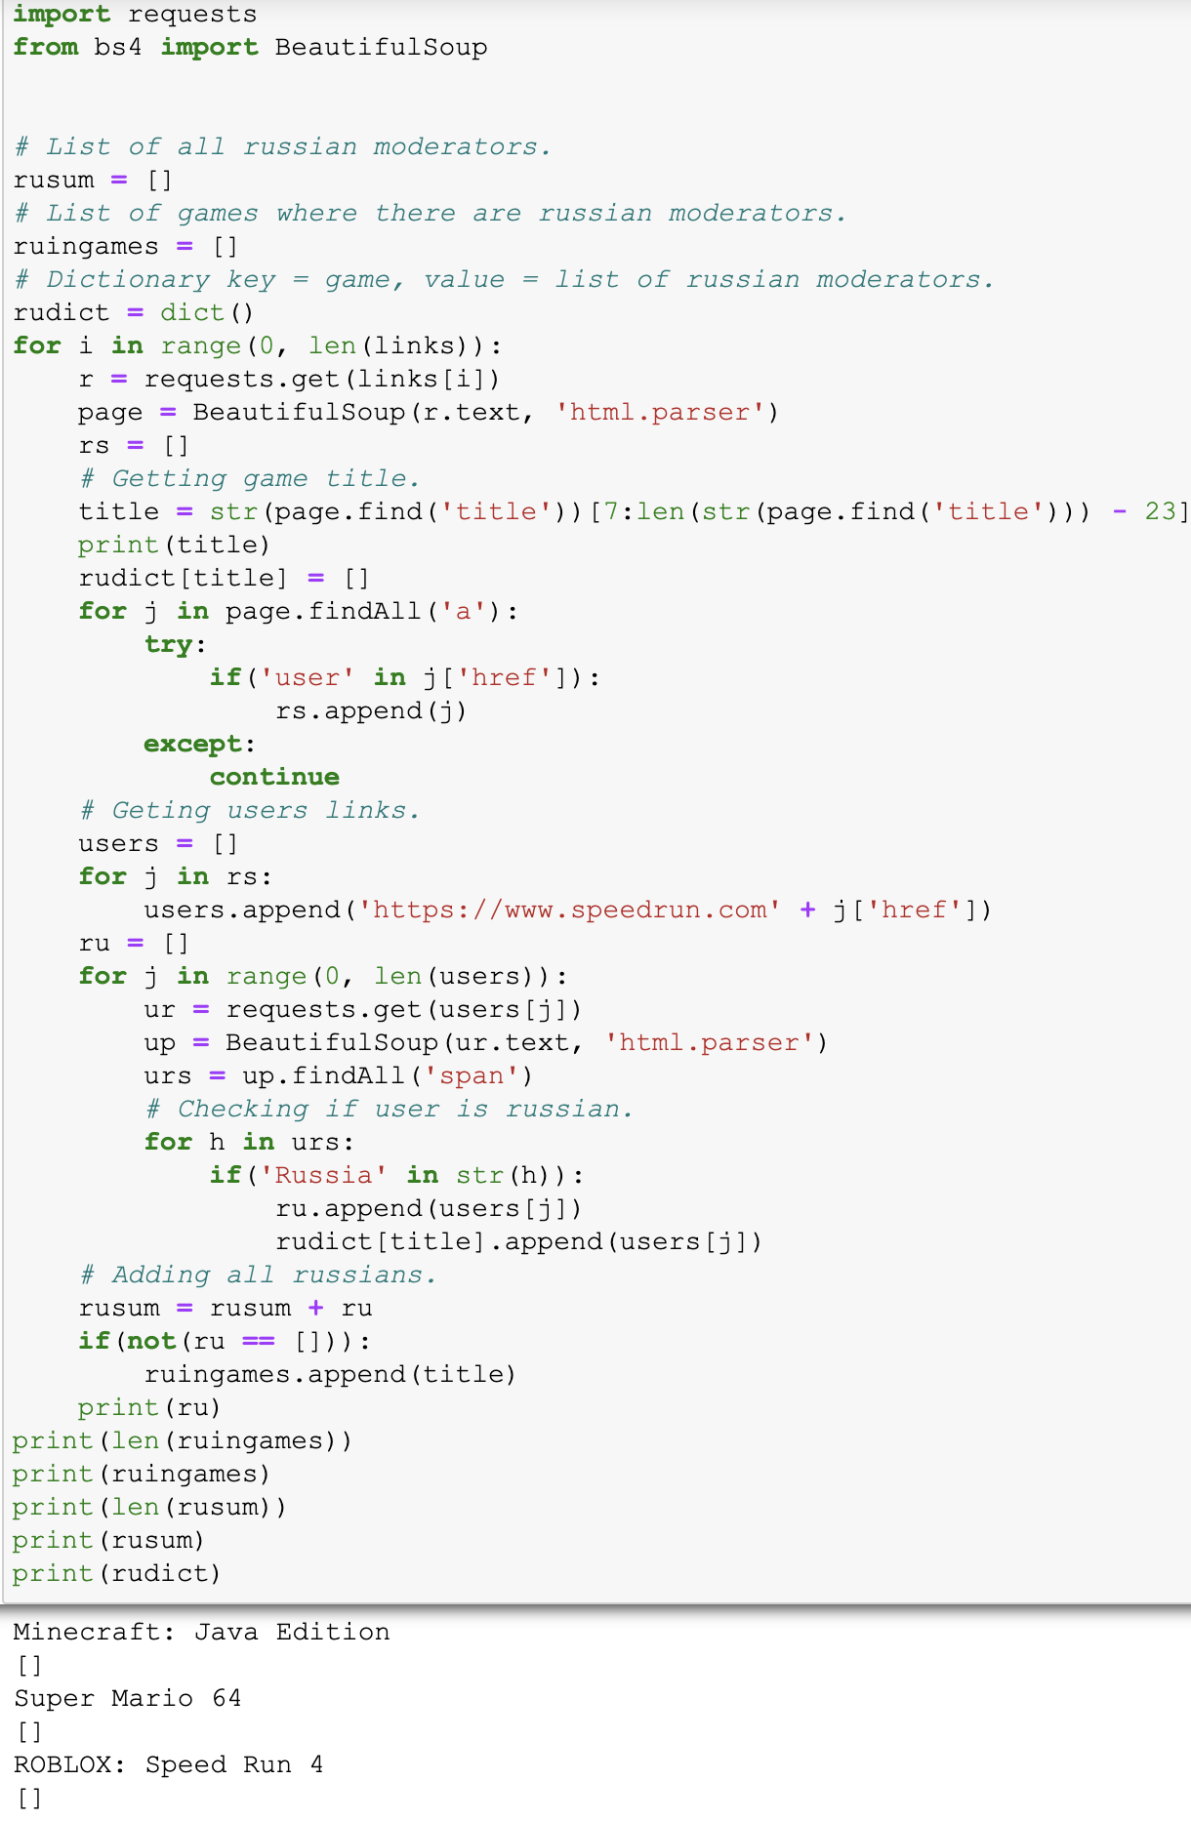
Second part of the project: web-scrapping on speedrun.com
The program visits each of 152 links of speedrun.com each of them leads to game table. On that page we get list of moderators’ profile links. Then we visit this link and check user’s native country. If it is Russia we add this moderator. Totally from 152 links we found only 24 users from 10 games, the program execution process took 7 minutes and 42 seconds total. This is quite surprising information, which means there are not many Russian members of jury.
* To see full .xlsx table with games and Russian moderators check PythonProject/speedrun.xlsx

Slide 18
Conclusion
Only 2 out of 6 hypotheses were proved
It was surprising that many people who dissatisfied with their job don’t look for new opportunities
Students are more often employed full-time than part-time
Both highest and most variable salary get those who work on ordinary schedule
75% programmers are younger than 40
There are as many students aged 18-24 as students of other ages
Most of programmers know web development. Consequently Python is not as popular as we thought
In all OS most people use 2 monitors
There are not enough Russian enthusiasts on speedrun.com. But those who are there usually play and analyze CS:GO and Roblox

Slide 19


