Slide 1
Composition/Resource Events/Policies Layer
Resource Control Operations
(e.g., Compute, FAM, Storage Fabric)
Resource Events
Resource Graph Representation
(e.g., Compute, FAM, Storage Fabric)
Graph Reference Database
Evaluate and Meet Client Requirements
Composition Policies
Graph Reference Database
Authorization Block
Graph Reference Database Entry

Slide 2
Reference Composer Framework Components
Monitoring System Input
Command Component Execution
Interface to Sunfish
Composition Decision and Policies
Janusgraph Database with Apache
Cassandra NoSQL
Database Backend
Restful Queue
Client Interaction
Lexical Analyzer/
Parser

Slide 3
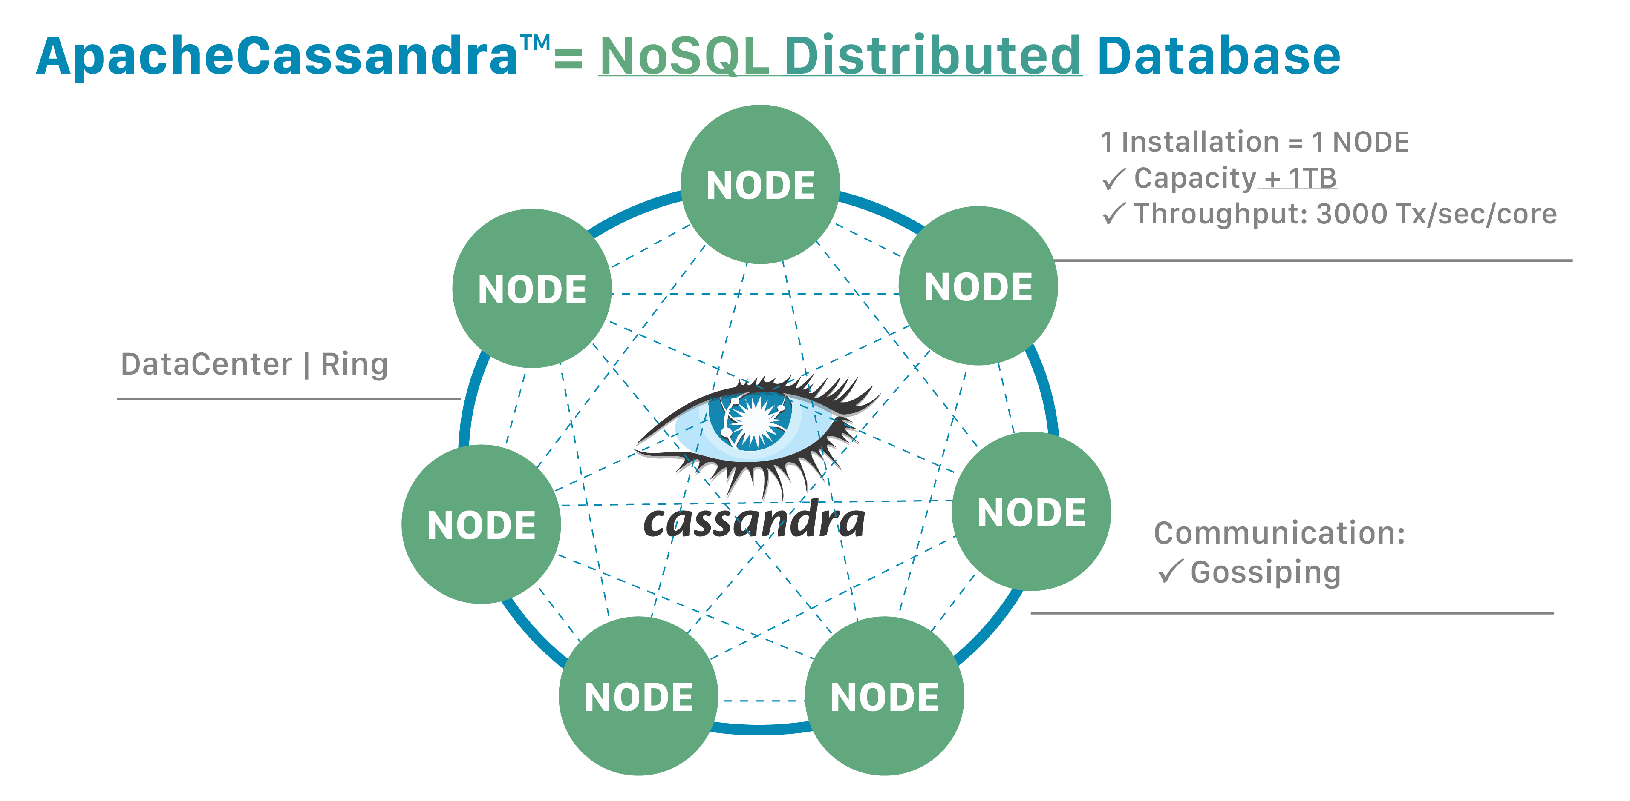
Cassandra Database
Cassandra database back-end
I came to the conclusion that we needed a NoSQL database, as opposed to a relational database when I was imagining out the database transactions. I came to that conclusion due to the fact that the keys needed to point to a next jumping off point. That just smells like a columnar format database instead of a primary key set-up with fixed data lengths. I saw a need to address multiple paths and simultaneous connections, something that a relational database is going to struggle with. I jumped on Cassandra instead of Mongo or HBase because of its column data formatting and peer-to-peer architecture, for scaling.
Janusgraph can do BerkeleyDB, as well, but Cassandra is more ‘robust’ and is scalable.
We can use Lucene for queries.
For my testing, I chose 3.11.0 because that was the version that was verified with Janusgraph.
I configured that back-end janusgraph configuration with cql and Lucene.
For dependencies, I installed Python2 and OpenJDK-8.11-JRE.

Slide 4
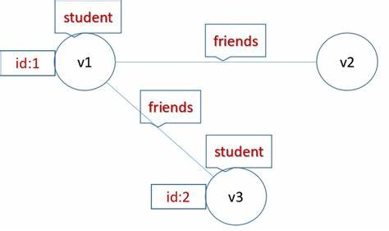
Janusgraph
Janusgraph
Recommended by Christian and Michele
Configurations set to run the Lucene search libraries.
We can create Vertices and Edges that mirror our Sunfish database.
We can fill the Vertices and Edges to match the Redfish entries
The edges can mirror our Redfish connections.
We can leverage Lucene libraries to gather intelligence on the machines and components
We can describe multiple Graphs, simultaneously, for ‘zoom in/zoom out’.
We can write tools that create Redfish/Swordfish associations and simultaneously build and deconstruct database entries and associations.
Do we want to do a start-up comparison of the persistent database entries and in-memory real-time entries? Are we looking for a run-time comparison?
We can run Gremlin code (Turing compatible code for graph database entries and searches) for database changes and Lucene searches
Janusgraph and Gremlin work with Java and Python3 extensions. So, we can code up Gremlin transactions from a consistent code base.
We can leverage the Gremlin shell and remote connections to provide in-code development and testing.

Slide 5
Resource Events Framework
Command Component Execution
Interface to Composer
Interface to Sunfish
Janusgraph Database with Apache
Cassandra NoSQL
Database Backend
Interface to Client
Restful Queue

Slide 6
Reference Framework for Composition Decisions and Policies
Log-based Input for training and updating ML model? Federation or Reinforcement
Plugins
Command Component Execution
Interface to Composer
Interface to Sunfish
Training Model Storage
Restful Queue
Code type as an input

Slide 7
Composability Example 1: Run-Time Container Dynamic Provisioning Memory Resource Request over Aggregated Fabrics
Container 1
CPU !
Resource Control Operations
(e.g., Compute, FAM, Storage Fabric)
Sunfish Services
Resource Events
Resource Inventory
Resource Graph Representation
(e.g., Compute, FAM, Storage Fabric)
Container Engine
RF tree management
Container 2
CPU !
Resource Configuration
Graph Reference Database
Fabric Configuration
Redfish/Swordfish
Agent
Hardware Manager(s)
Message Queue
RESTful API (RF/SF)
Authentication
Evaluate and Meet Client Requirements
Access Control
…
High Speed Fabric Links
Composition
Policies
Events & Logs
Graph Reference Database
Data Store
Container N
CXL Switch
CXL Switch
CPU !
Authorization Block
Graph Reference Database Entry
CXL Switch
CXL Switch

Slide 8
Composition/Resource Events/Policies Layer Transactions
Resource Control Operations
(e.g., Compute, FAM, Storage Fabric)
Sunfish Services
Resource Inventory
Resource Events
Resource Graph Representation
(e.g., Compute, FAM, Storage Fabric)
Redfish/Swordfish
Tree Management
Graph Reference Database
Transactions
Resource Configuration
Fabric Configuration
RESTful API (RF/SF)
Message Queue
Evaluate Client Requirements
Data
Composition Policies
Authentication
Graph Reference Database
Access Control
Events
Events & Logs
Authorization Block
Graph Reference Database Entry
Redfish/Swordfish

Slide 9
Composition/Resource Events/Policies Layer Transactions
Resource Control Operations
(e.g., Compute, FAM, Storage Fabric)
Sunfish Services
Resource Inventory
Resource Events
Resource Graph Representation
(e.g., Compute, FAM, Storage Fabric)
Redfish/Swordfish
Tree Management
Graph Reference Database
Transactions
Resource Configuration
Fabric Configuration
RESTful API (RF/SF)
Message Queue
Evaluate and Meet Client Requirements
Data
Composition Policies
Authentication
Graph Reference Database
Access Control
Events
Events & Logs
Authorization Block
Graph Reference Database Entry
Redfish/Swordfish

Slide 10
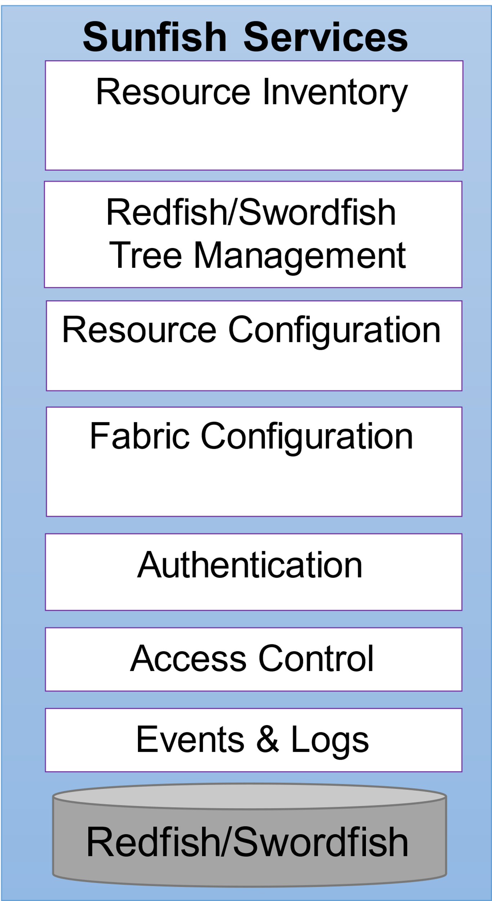
Composability Manager
Resource Control Operations
Register Composer
Client Request Fulfilled
Query Resource Features
Expand a Compute Node
Show Aggregated Resource
Gather Resource Security Information
Query Resource Connections
Create Resource Namespace
Query Inventory
Restful API (RF/SF)
Message Queue
Modify Resource Deta
Request Resource QoS
Query Resource Path
Delete Resource Namespace
Reserve Inventory
Resource Authorization Modification
Gather Resource Failover
Build Resource Path
Create System
Assemble System
Add Resource to Database
Release Resource Failover Option
Modify Resource Path
Delete System
Modify System
Get Request from Client
Choose best Resource Failover Options
Delete Resource Path
Show System

Slide 11
Composability Manager
Resource Control Operations
(Scaled down for SC23)
Register Composer
Client Request Fulfilled
Query Resource Features
Show Aggregated Resource
Query Resource Connections
Create Resource Namespace
Query Inventory
Restful API (RF/SF)
Message Queue
Modify Resource Deta
Query Resource Path
Delete Resource Namespace
Reserve Inventory
Build Resource Path
Create System
Assemble System
Add Resource to Database
Modify Resource Path
Delete System
Modify System
Get Request from Client
Delete Resource Path
Show System

Slide 12
Composability Manager
Evaluate and Meet Client Requirements
For Best Server option
For best Connection option
For best Resource option
Gather Client Request Frequency of Occurrence
Get Server Resource Information
Server Nearest Neighbor Estimate
Resource Pool Nearest Neighbor Estmate
Define Client Request Expected Statistical Requirement Ordering
Correlate Servers with a Reference Variable
Get Server Physical Location
Provide Resource Pool Information
Grab Client Resource Request Numerical Range of Data
Create Server Category Reference
Availability of Network Link
Ger Resource Pool Physical Location
Grab Client Request Similar Resource Items in Transaction Data
Restful API (RF/SF)
Message Queue
Grab Client Resource Request Transaction Trends
Ger Indiiviual Resource Characteristics
Create a Decision Tree for Resource Selection
Resources are missing from Server to Meet Client Request?
Subspace FINDIT clustering of Resources

Slide 13
Reference Framework for Composition Decisions and Policies
Message Queue
RESTful API (RF/SF)
Interface to Sunfish, resources, paths, and locality
Command Component Execution
Interface to Resource Graph Representation
Message Queue
Interface to Composer
RESTful API (RF/SF)
Log-based Input for training and updating ML model
Run time, network congestion, start-up latency, IO performance, memory transaction bandwidth
Federation or Reinforcement
Plugins
Message Queue
RESTful API (RF/SF)
Janusgraph/Cassandra
Training Model Storage
Client transaction commands
Evaluate and Meet Client Requirements
Client Request

Slide 14
Reference Framework for Composition Decisions and Policies
Message Queue
RESTful API (RF/SF)
Interface to Sunfish, resources, paths, and locality
Command Component Execution
Interface to Resource Graph Representation
Message Queue
Interface to Composer
RESTful API (RF/SF)
Log-based Input for training and updating ML model
Run time, network congestion, start-up latency, IO performance, memory transaction bandwidth
Federation or Reinforcement
Plugins
Message Queue
RESTful API (RF/SF)
Janusgraph/Cassandra
Training Model Storage
Client transaction commands
Evaluate and Meet Client Requirements
Client Request

Slide 15
Composability Manager
Decisions and Policies
Query Inventory
Query Resource Path
Query Resource Features
Gather Resource Failover Options
Reserve Inventory
Modify Resource Path
Query Resource Connections
Execute Best Resource Failover Option
Release Inventory
Recommend Resource Path
Modify Resource
Release Resource Failover Options
Restful API (RF/SF)
Message Queue
Create Resource Namespace
Recommend Resource
Understand Resource Issue
Delete Resource Namespace
List Resource QOS Capabilities
Request Resource QOS

Slide 16
Composability Manager
Resource Events
Report New Resource
List Available Events
Report Deleted Resource
Register for Events
Restful API (RF/SF)
Report Resource Issue
Message Queue

Slide 17
Composability Manager
Authorization Block
Tenancy
Restful API (RF/SF)
Security Value
Message Queue
Security Association

Slide 18
Composability Manager
Resource Graph Representation
Search Graph
List Resource Detail
Delete Resource Edge
Create Resource Vertex
Modify Resource Detail
Restful API (RF/SF)
Create Resource Edge
Modify Resource Path
Message Queue
Delete Resource Vertex
Modify Resource Group of Details
Delete Resource Edge
Add Resource Edge

