Slide 1
Composability in the OFMF
Christian Pinto, Michele Gazzetti, Atul Sandur

Slide 2
OFM Interfaces Diagram
Clients
Management Layer
Hardware Layer
App driven system reconfig
Composability Layer
Fabric Resources
Monitoring
Composition
Policies
OFM Services
CXL
Agent
Application Domain
Resource Inventory
Resource
Control
(e.g., Compute, FAM, Storage, Fabric)
RF tree management
Gen-Z
Agent
Resource Configuration
Fabric Configuration
Hardware Manager(s)
RESTful API (RF/SF)
Slingshot
Agent
Authentication
Events & Logs
Access Control
Systems composition
Systems update
Events & Logs
Data Store
Data Store
Administration Domain
IB
Agent
RedFish
Infra management
Events
Vendor Native API
Events
Redfish/Native
Translation

Slide 3
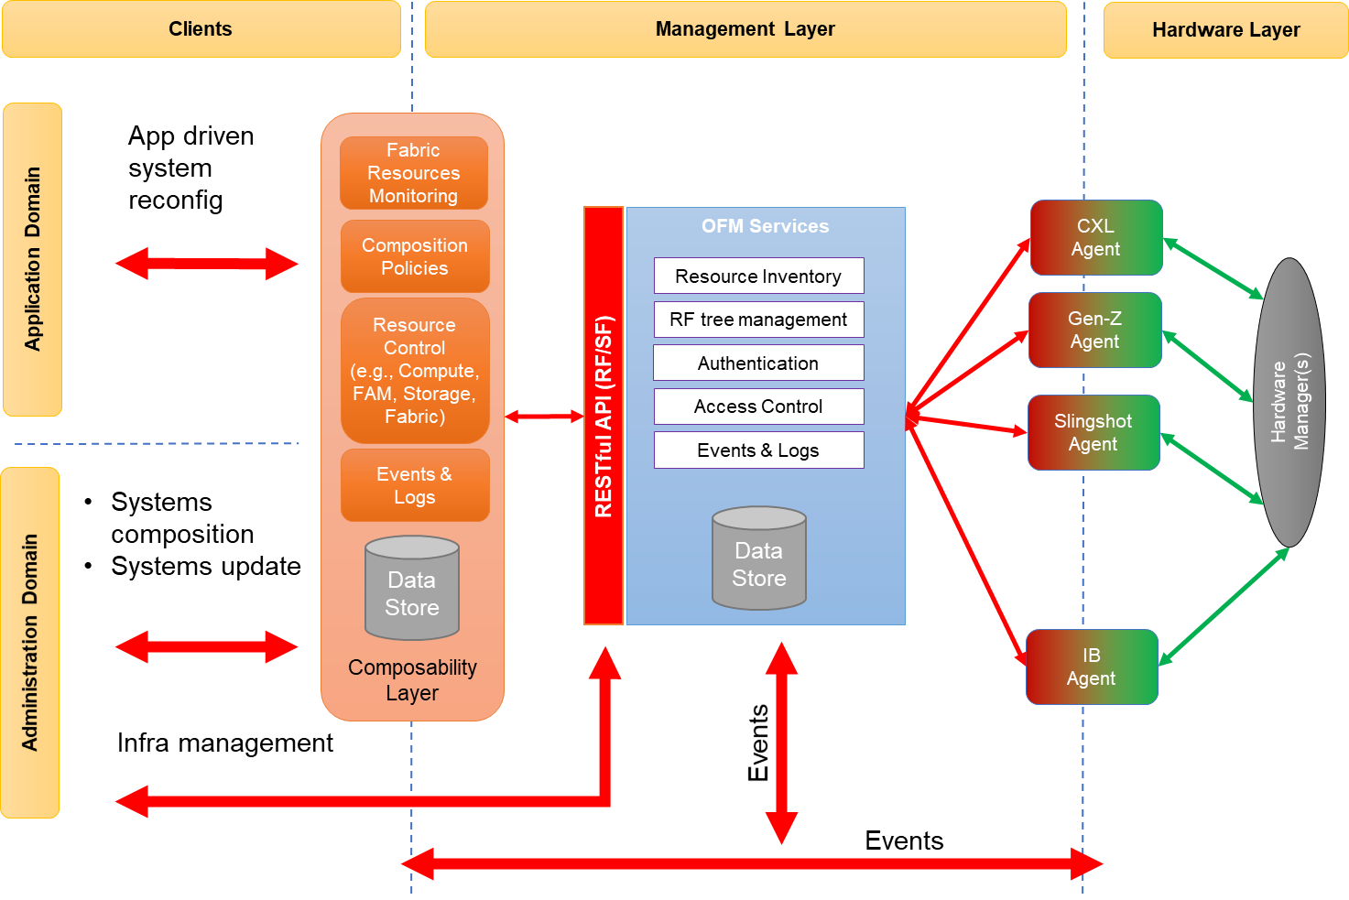
Composability Layer
Composability Layer
Main functionalities exposed to clients
Composition/Deletion of Computer Systems
Dynamic update of Computer Systems resources
Application driven dynamic resources configuration and provisioning
Creation of shared memory region across nodes
On-demand provisioning of accelerators
Virtual network creation
etc.
Management of client permissions/resource ownership
Components
Data store: information on composable resources available, resources bookkeeping, composed/provisioned resources ownership, etc.
Fabric Resources Monitoring: tracks current fabric state and updates local data store based on events.
Composition policies: select resources according to incoming requests constraints and fabric state
Resource control: interacts with OFMF for manipulating RedFish tree to fulfill requests
Fabric Resources
Monitoring
Resource
Control
(e.g., Compute, FAM, Storage, Fabric)
Data Store
Events & Logs
Composition
Policies

Slide 4
Composability Layer
Composability Layer
This layer is composing computer systems and updating them at the ResourceBlock (RB) granularity
RBs are the RedFish unit of Composability
RBs are part of the OFMF RF tree and are created by Agents
Why:
Only agents have enough information on the fabric for figuring out which components are part of a resource block.
RBs are the containers of physical resources and are required from initialization time when no ComputerSystems are available
Fabric Resources
Monitoring
Resource
Control
(e.g., Compute, FAM, Storage, Fabric)
Data Store
Events & Logs
Composition
Policies

Slide 5
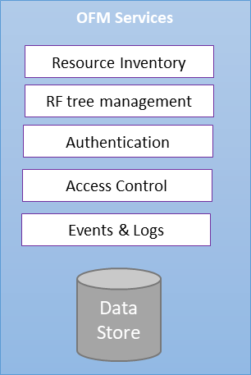
Open Fabric Manager
Data Store: stores the RF tree
Systems
Fabrics
Chassis
ResourceBlocks for composability
Any other redfish object needed for representing a complete infrastructure
RedFish Tree management:
Actions for manipulating the RF tree in response to Client’s requests, including interacting with Agents whenever needed
Events & Logs
PUB/SUB based service
Forwarding Agent events to OFM Services and Clients
Authentication and Access Control
Verify Clients and Agents identity
Restrict access to resources and services depending on identity

Slide 6
Open Fabric Manager
Events & Logs:
Retrieves events from Agents
This could result in changes to the RF tree
Forwards Events from agents to clients

Slide 7
Fabric Agent
Fabric Manager Client
Interacts with FM via fabric specific APIs
RF-FM/FM-RF translation
Command, events and objects translation and forwarding from RF to FM schema (and vice versa)
Expose fabric resources in RF model at initialization time
Trigger events generation to notify changes in the fabric
RF objects annotation with fabric related metadata to support composability policies (e.g., resources latency, maximum bandwidth, TBD, etc.)
Events and Logs
Forward events to OFM
Logs fabric changes history
Events and Logs
Fabric Manager Client
RESTful API (RF/SF)
RF-FM/FM-RF
translation

Slide 8
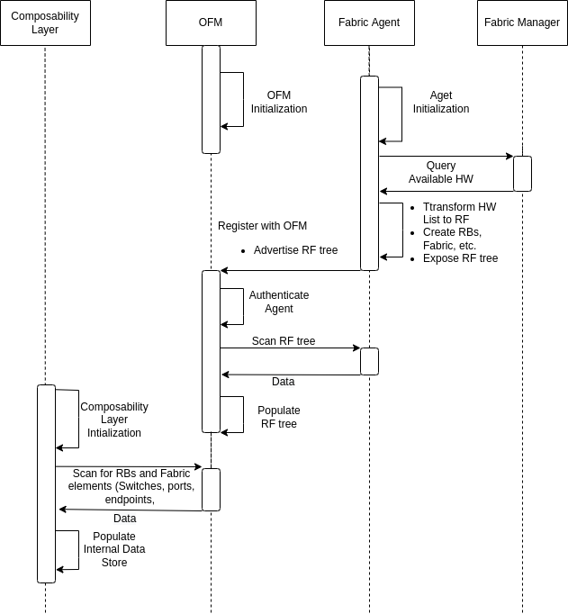
Composability Example System Bring UP

Slide 9
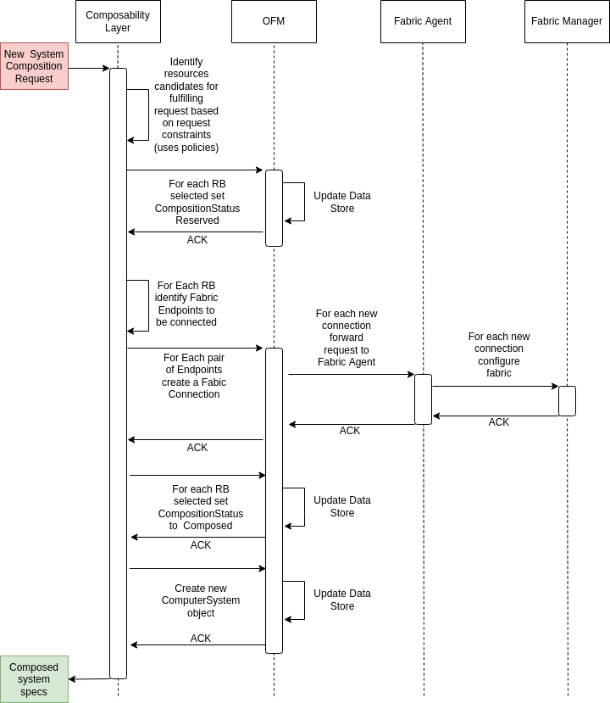
Composability Example System Composition

