Slide 1
Fuzzing POC
Review and check available fuzzing tools

Slide 2
Fuzzing
Fuzzing or fuzz testing is an automated software testing technique that involves providing invalid, unexpected, or random data as inputs to a computer program. The program is then monitored for exceptions such as crashes, failing built-in code assertions, or potential memory leaks. Typically, fuzzers are used to test programs that take structured inputs. This structure is specified, e.g., in a file format or protocol and distinguishes valid from invalid input. An effective fuzzer generates semi-valid inputs that are "valid enough" in that they are not directly rejected by the parser, but do create unexpected behaviors deeper in the program and are "invalid enough" to expose corner cases that have not been properly dealt with.
Wikipedia

Slide 3
Fuzzing – target
Let’s illustrate and fuzz with simple code:
bool fuzz(const uint8_t* data, size_t size)
{
return (size >= 3 && data[0] == 'F' && data[1] == 'U' && data[2] == 'Z' && data[3] == 'Z');
}
It’s deterministic and has simple problem to test;
It’s fast;
It can get any input;
It has no state to incapsulate/carry;
More criteria for good fuzzing test cases

Slide 4
Fuzzing – LibFuzzer
LibFuzzer is in-process, coverage-guided, evolutionary fuzzing engine.
LibFuzzer is linked with the library under test, and feeds fuzzed inputs to the library via a specific fuzzing entrypoint (aka “target function”); the fuzzer then tracks which areas of the code are reached, and generates mutations on the corpus of input data in order to maximize the code coverage.
extern "C" int LLVMFuzzerTestOneInput(const uint8_t* data, size_t size)
{
fuzz(data, size);
return 0;
}
clang++ -g -O1 -fsanitize=fuzzer fuzztest.cpp -o fuzzer

Slide 5
Fuzzing – LibFuzzer. Impact on test
./fuzzer -jobs=4 -max_total_time=600 -max_len=4 -dict=fuzz.dict -artifact_prefix=errors/ corpus/ seeds/
When a LibFuzzer-based fuzzer is executed with one more directory as arguments, it will first read files from every directory recursively and execute the target function on all of them. Then, any input that triggers a new coverage path will be written back into the first corpus directory.
LibFuzzer supports user-supplied dictionaries compatible with AFL.
Structure-Aware Fuzzing with libFuzzer (custom mutators for:
compression, protobufs(libprotobuf-mutator), gRPC API, etc)

Slide 6
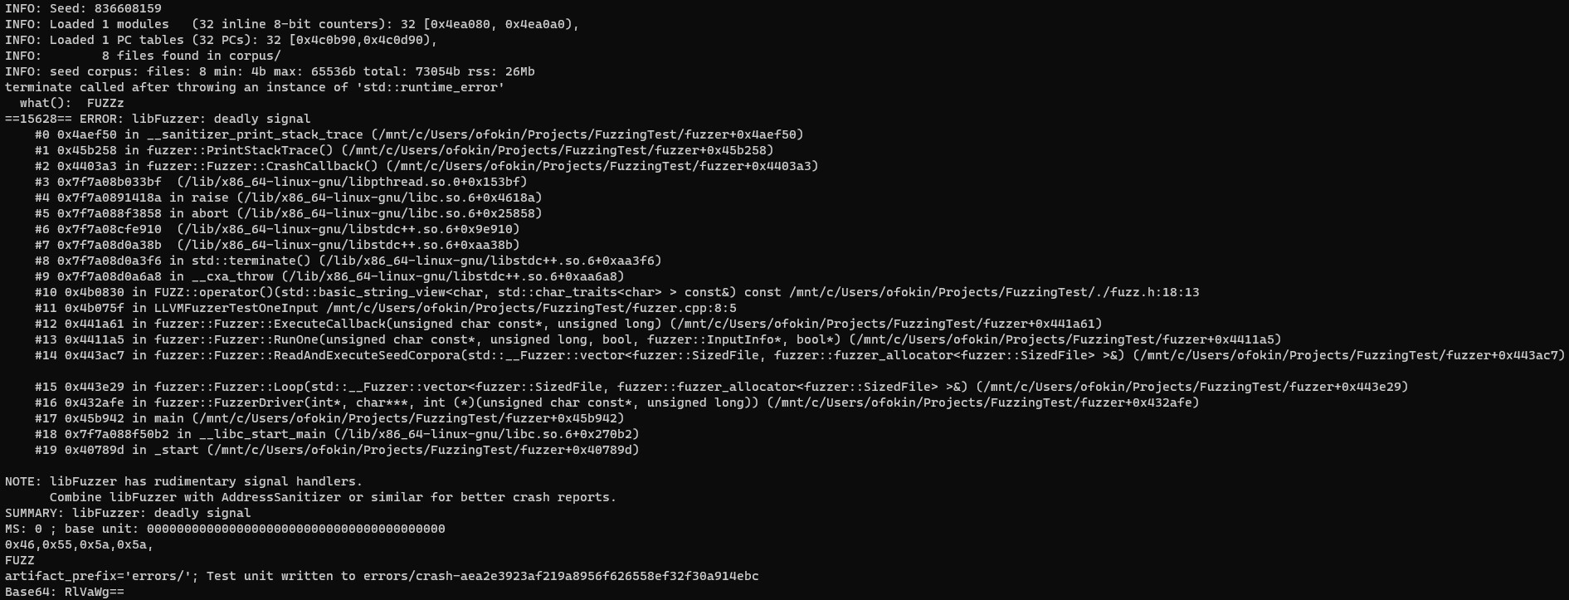
Fuzzing – LibFuzzer. Result

Slide 7
Fuzzing – AFL++
AFL++ is the daughter of the American Fuzzy Lop fuzzer by Michał “lcamtuf” Zalewski and was created initially to incorporate all the best features developed in the years for the fuzzers in the AFL family and not merged in AFL cause it is not updated since November 2017.
Significant pros is an automatic test cases creation (this also brings more cons - makes it unmodifiable, less relevant and relatively slow)

Slide 8
Fuzzing – AFL++. Preparation and run
Install AFL++:
git clone https://github.com/AFLplusplus/AFLplusplus && cd AFLplusplus
make all
sudo make install
export PATH=$PATH:</path/to/AFLplusplus>
Build our code with afl-compiler:
afl-g++-fast main.cpp -o afl-app
And run fuzzing:
afl-fuzz -x fuzz.dict -i seeds/ -o corpus/ -D -V 600 -- afl-app

Slide 9
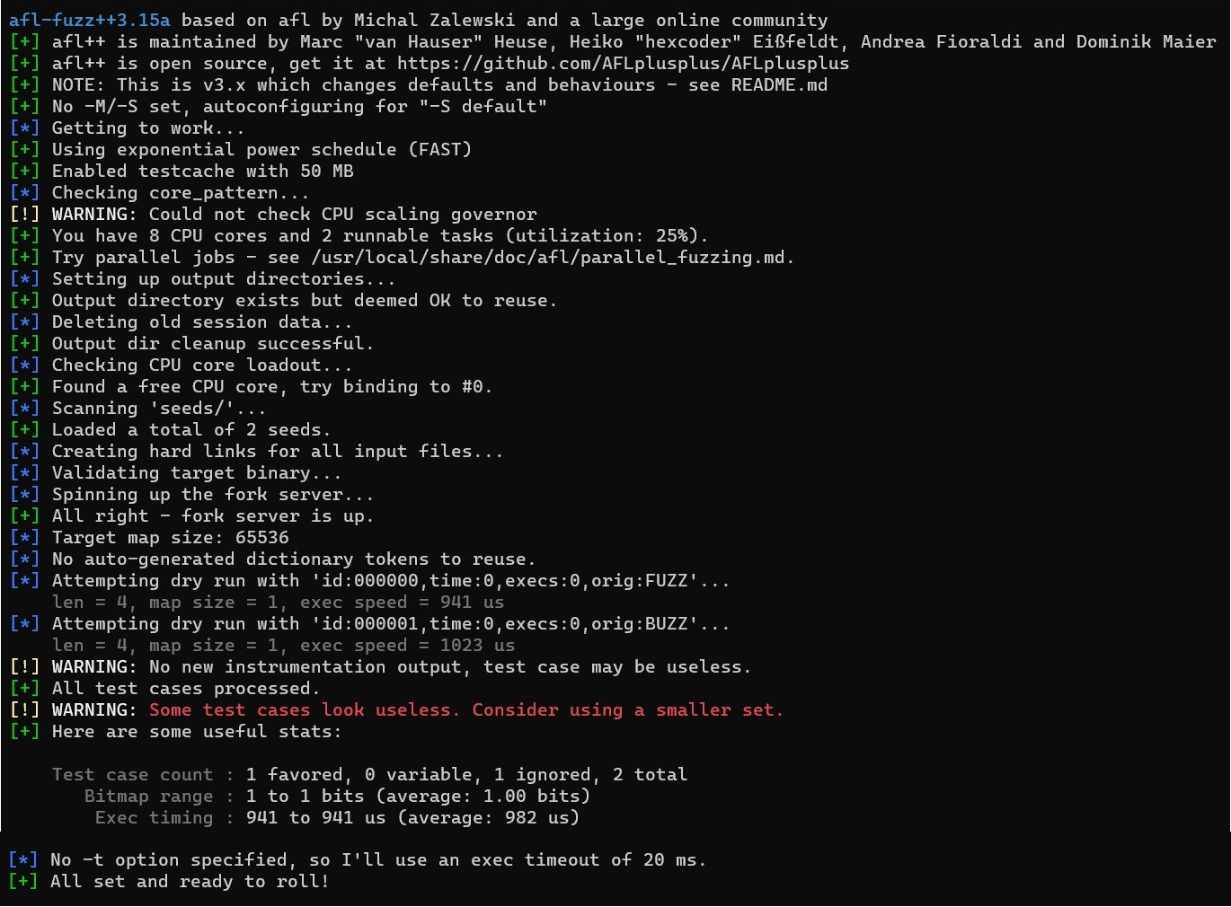
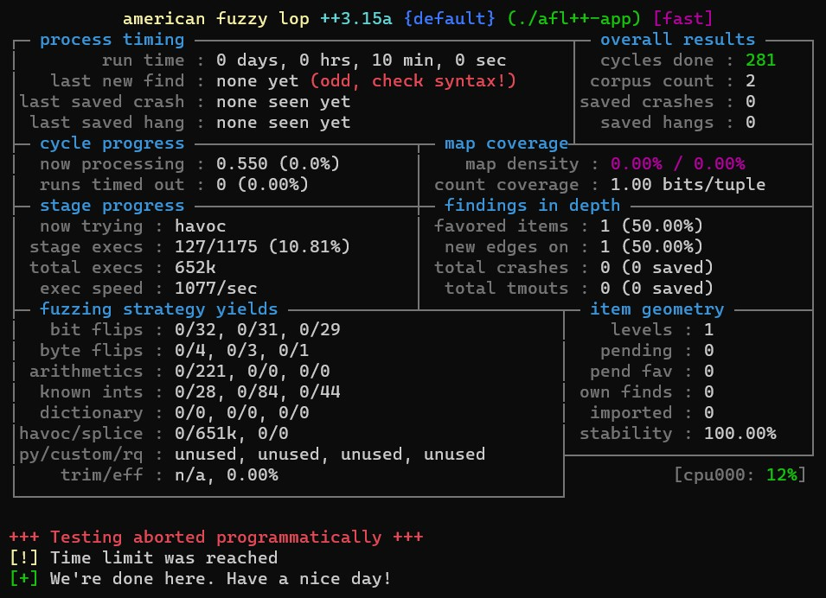
Fuzzing – AFL++. Result

Slide 10
Fuzzing – another tools & CI/CD
AFL based
Hoggfuzz
Microsoft OneFuzz
Radamsa
OSS-Fuzz – for open-source software only
ClusterFuzz – runs on GCP only
ClusterFuzzLite - supports libFuzzer only
GitLab fuzzing (with libFuzzer)
CI/CD receipt: GitHab Actions / GitLab runner + ClusterFuzzLite + libFuzzer

Slide 11
Fuzzing – more links
Fuzz Testing(Fuzzing) Tutorial: What is, Types, Tools & Example
An informative guide on using AFL and libFuzzer
Awesome-Fuzzing Collection
Google fuzzing tutorials and examples
Google SE experience

Slide 12
Fuzzing – comparison and conclusion
LibFuzzer
needs test cases preparation
integrated into LLVM/clang
can be used as a static lib
highly compatible with CI/CD tools
seamlessly paired with other sanitizers
highly flexible with test scenarios
supports custom mutators
AFL compatible test corpus
AFL++
automatically creates test cases
supports both gcc and clang
rich test results and stats
LibFuzzer is an excellent tool for fuzzing - functional, highly customizable, lighting fast and easily integrated with other tools and CI/CD services
https://github.com/OFxGL/FuzzingTest

Slide 13
Thank You

