Slide 1
✚ PHC-Track
Nnewi North PHC Digital Health Platform
A digital health record, follow-up and reporting system for every Primary Health Centre in Nnewi North LGA, Anambra State — built to work fully offline.
Stakeholder overview · June 2026

Slide 2
The challenge our PHCs face today
Paper registers
Missed follow-ups
Patient folders get lost, histories are rewritten from memory, and one patient can have several conflicting records.
Antenatal contacts and child immunizations are missed because there is no reliable recall list — defaulters are only noticed when it is too late.
Unreliable network & power
Reporting burden
Most digital tools assume constant internet. In our facilities, connectivity is the exception, not the rule.
Monthly NHMIS summaries are tallied by hand from registers — slow, error-prone, and hard to verify.
PHC-Track — Nnewi North PHC Digital Health Platform
2

Slide 3
The solution: one offline-first platform
✔ Works fully offline, by design
Every screen reads and writes a secure store on the device itself. No internet is needed for a single clinic day — sync happens whenever a connection appears.
✔ One record per patient, for life
A unique Medical Record Number, full visit history, allergies and chronic conditions — visible the moment the patient is found.
✔ Automatic clinical schedules
Antenatal contact dates (WHO 8-contact) and the full childhood immunization schedule are computed automatically; overdue lists are always one tap away.
✔ NHMIS reports without the tally sheets
Monthly figures are computed from the actual records and exported for DHIS2 in one click.
✔ Data stays in Nigeria, per NDPA 2023
Self-hostable in-country; every action is recorded in a tamper-evident audit trail.
PHC-Track — Nnewi North PHC Digital Health Platform
3

Slide 4
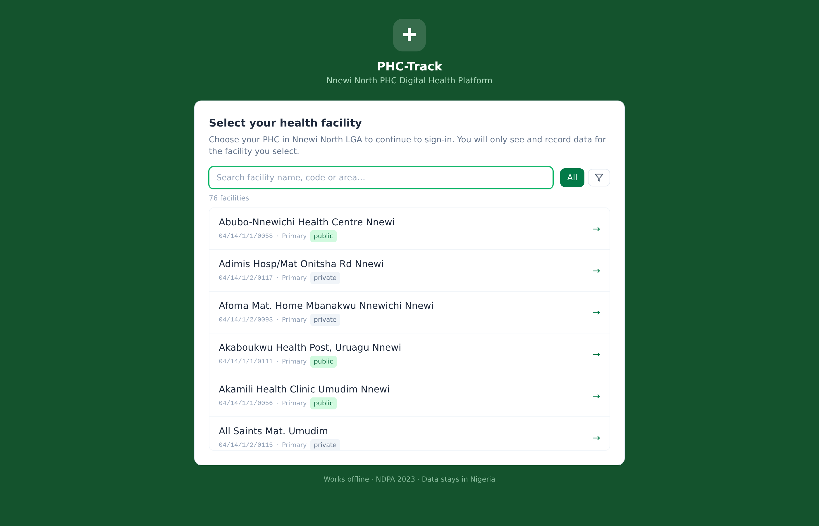
It starts at the facility door
The first screen lists all 76 health facilities in Nnewi North LGA — alphabetical, searchable, filterable.
▪ Every facility in the LGA
All 76 facilities from the official registry, each with its national code (04/14/…).
▪ Pick your PHC, see only your PHC
Staff choose their facility before signing in. Each facility's records are isolated from every other facility.
▪ Search & filter
Find a facility by name, code or area; filter by Public/Private and Primary/Secondary.
PHC-Track — Nnewi North PHC Digital Health Platform
4

Slide 5
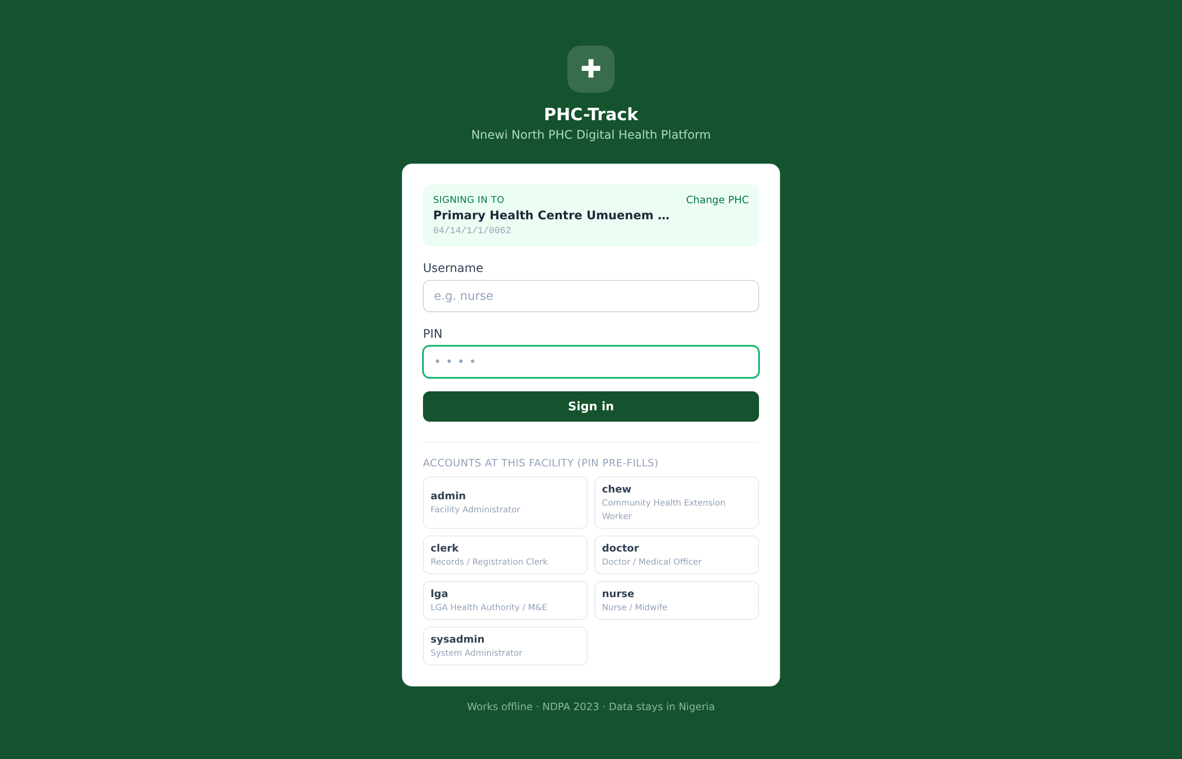
Facility-scoped sign-in
Accounts belong to one facility. A nurse from another PHC cannot sign in here — by design.
▪ Role-based access
Records clerk, nurse/midwife, CHEW, doctor, facility admin, LGA M&E — each sees only what their role permits.
▪ Three layers of isolation
1) sign-in is tied to the selected facility · 2) every read is filtered to that facility · 3) the sync hub will only ever ship a facility its own records.
▪ Offline re-entry
A previously used device can sign in again with no network at all.
PHC-Track — Nnewi North PHC Digital Health Platform
5

Slide 6
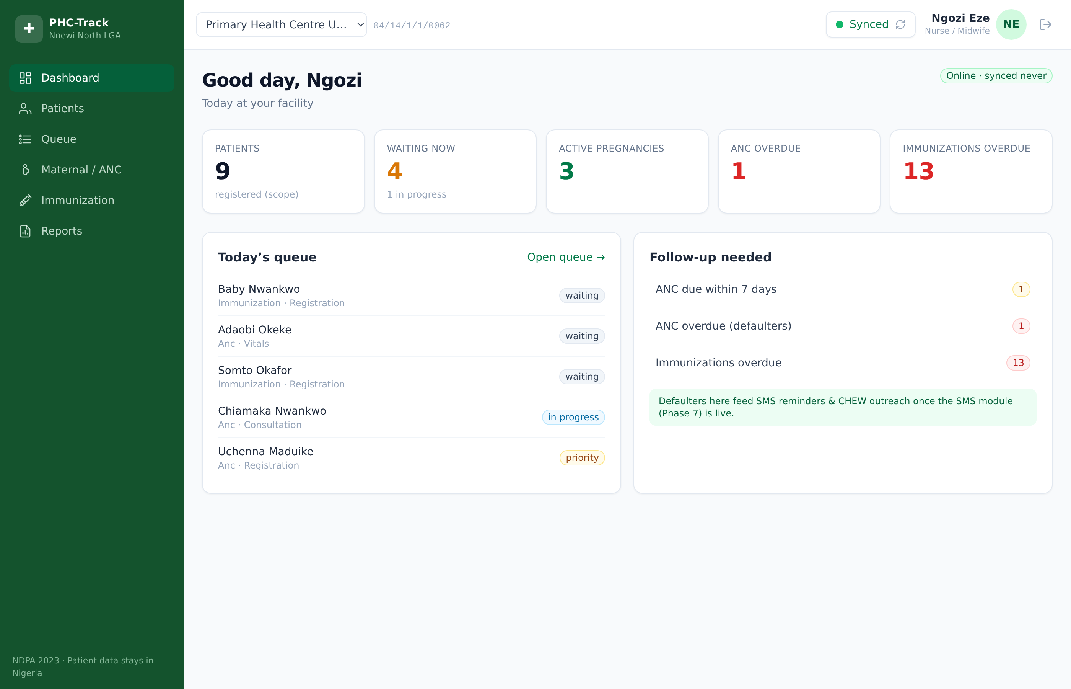
A clinic-day dashboard
The moment a nurse signs in: today's queue, active pregnancies, and who needs follow-up.
▪ Today at a glance
Patients registered, people waiting now, active pregnancies, and overdue ANC/immunizations.
▪ Follow-up panel
ANC defaulters and overdue immunizations surface automatically — these lists will feed SMS reminders.
▪ Sync status, always visible
Offline / Pending / Synced indicator in the header — staff always know where their data stands.
PHC-Track — Nnewi North PHC Digital Health Platform
6

Slide 7
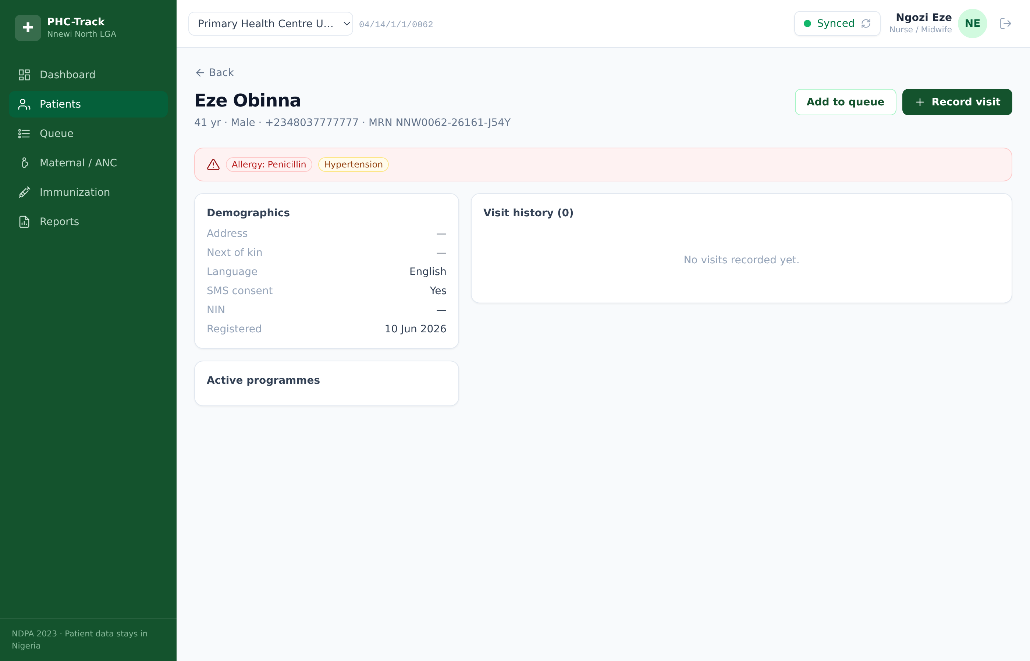
Patient registration & medical records
One lifetime record per patient — searchable by name, phone or MRN in under a second, offline.
▪ Offline-safe identity
A unique MRN is generated on the device (e.g. NNW0062-26161-J54Y) — no network needed to register.
▪ Duplicate protection
Matching phone, name and date of birth are flagged at registration: use the existing record or create anyway.
▪ Safety first
Allergies and chronic conditions appear as a red banner before any care decision is made.
▪ Full visit history
Vitals, diagnoses and treatments build a timeline the next caregiver can trust.
PHC-Track — Nnewi North PHC Digital Health Platform
7

Slide 8
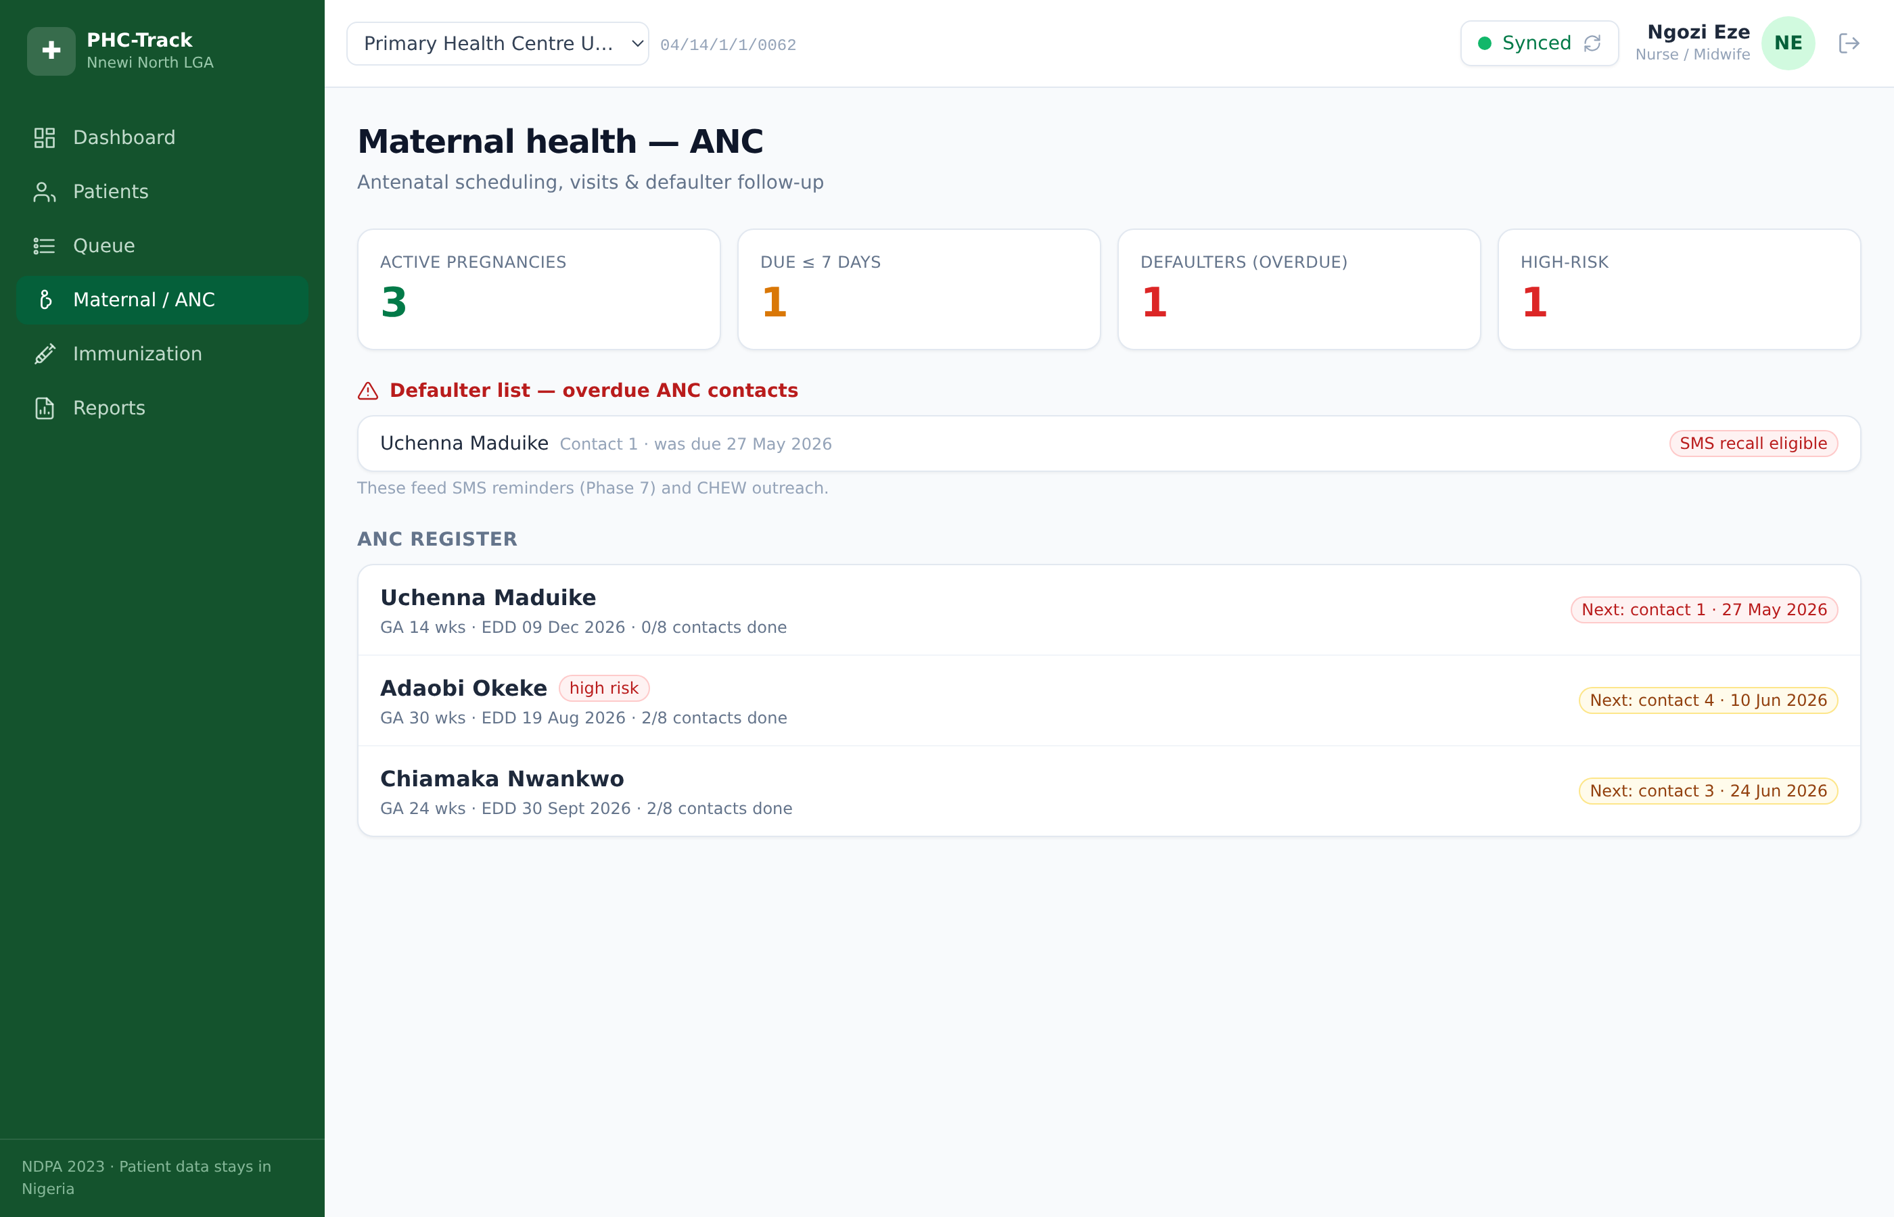
Maternal health (ANC)
Register a pregnancy with the LMP date — the platform does the rest.
▪ Automatic schedule
EDD and all WHO 8-contact ANC dates are computed instantly from the LMP.
▪ Risk flagged early
Age, parity, blood pressure, previous CS and danger signs raise a high-risk flag the whole team can see.
▪ Defaulter list
Women overdue for an ANC contact appear at the top — ready for SMS recall and CHEW outreach.
PHC-Track — Nnewi North PHC Digital Health Platform
8

Slide 9
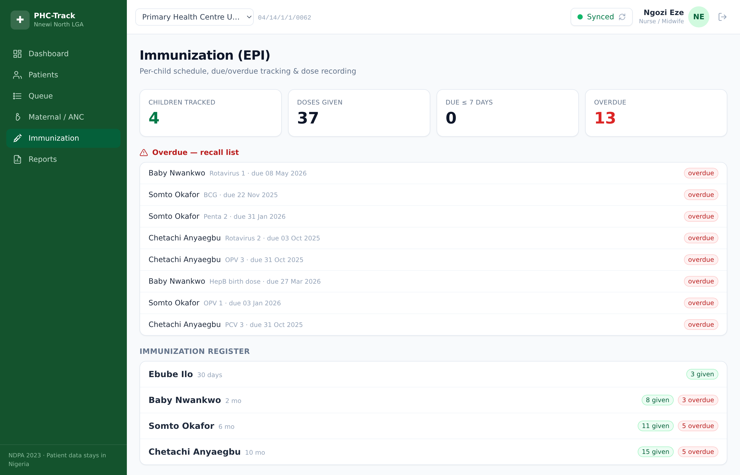
Immunization tracking (EPI)
Every child gets the full national immunization schedule from their date of birth.
▪ Per-child vaccine card
BCG to Measles 2 — every dose due, given or overdue, with batch and lot recorded.
▪ Recall list
Overdue doses across the facility in one list — the starting point for outreach days.
▪ Dropout visible
Penta1 → Measles1 dropout is computed continuously, not discovered at year end.
PHC-Track — Nnewi North PHC Digital Health Platform
9

Slide 10
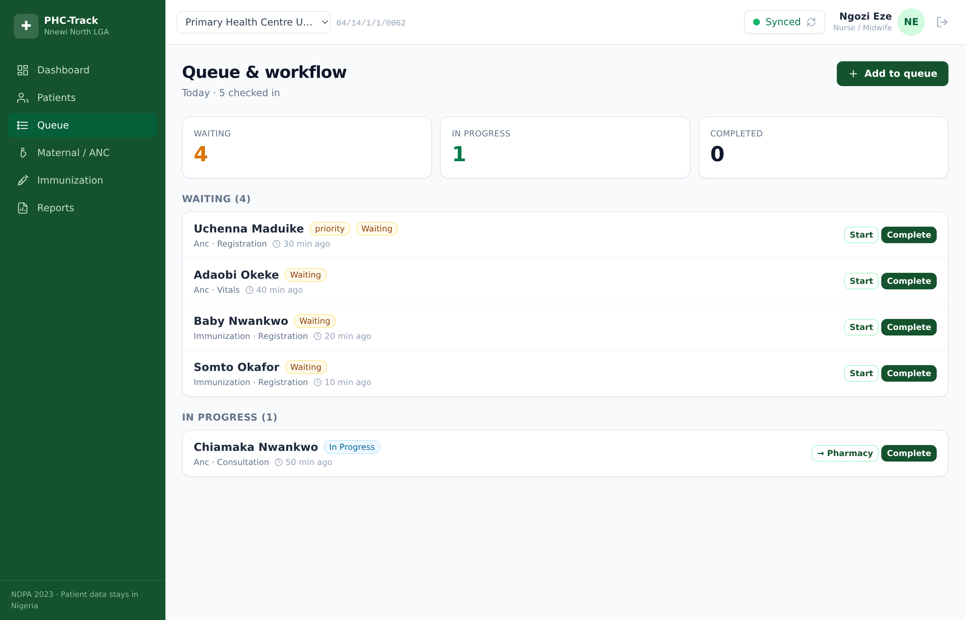
Queue & patient flow
From registration to vitals to consultation — orderly, visible, and fair.
▪ Triage-aware
Emergencies and priority cases move to the front automatically.
▪ Station hand-offs
Registration → vitals → consultation → pharmacy, with waiting counts per station.
▪ Attendance for free
Daily attendance figures fall out of the queue — no separate tally.
PHC-Track — Nnewi North PHC Digital Health Platform
10

Slide 11
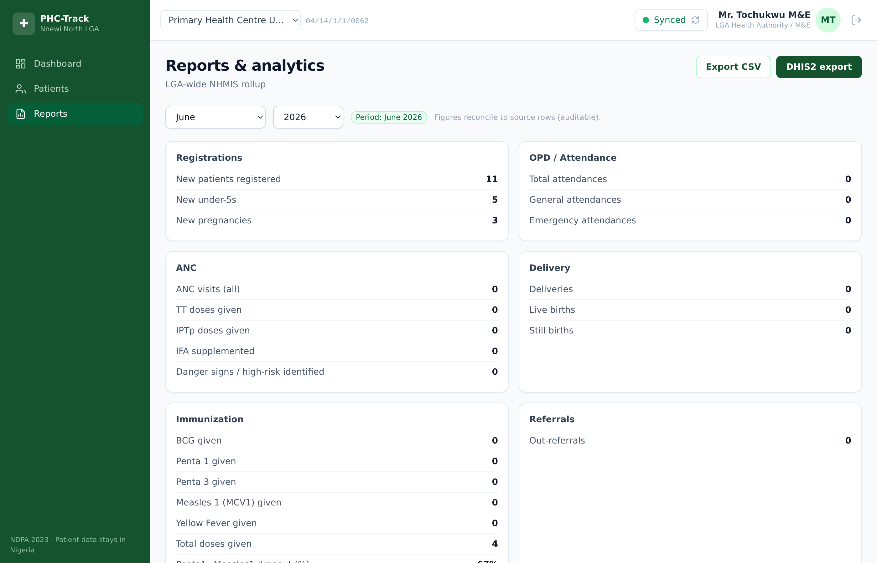
Reporting & analytics
Monthly NHMIS figures computed from the records themselves — auditable down to the source row.
▪ NHMIS-aligned
Registrations, OPD, ANC, deliveries, immunization and referrals in the national format.
▪ DHIS2-ready
One click exports CSV or DHIS2-style JSON for the LGA M&E officer.
▪ LGA-wide view
Authority roles see a roll-up across all facilities; clinic roles see their own.
PHC-Track — Nnewi North PHC Digital Health Platform
11

Slide 12
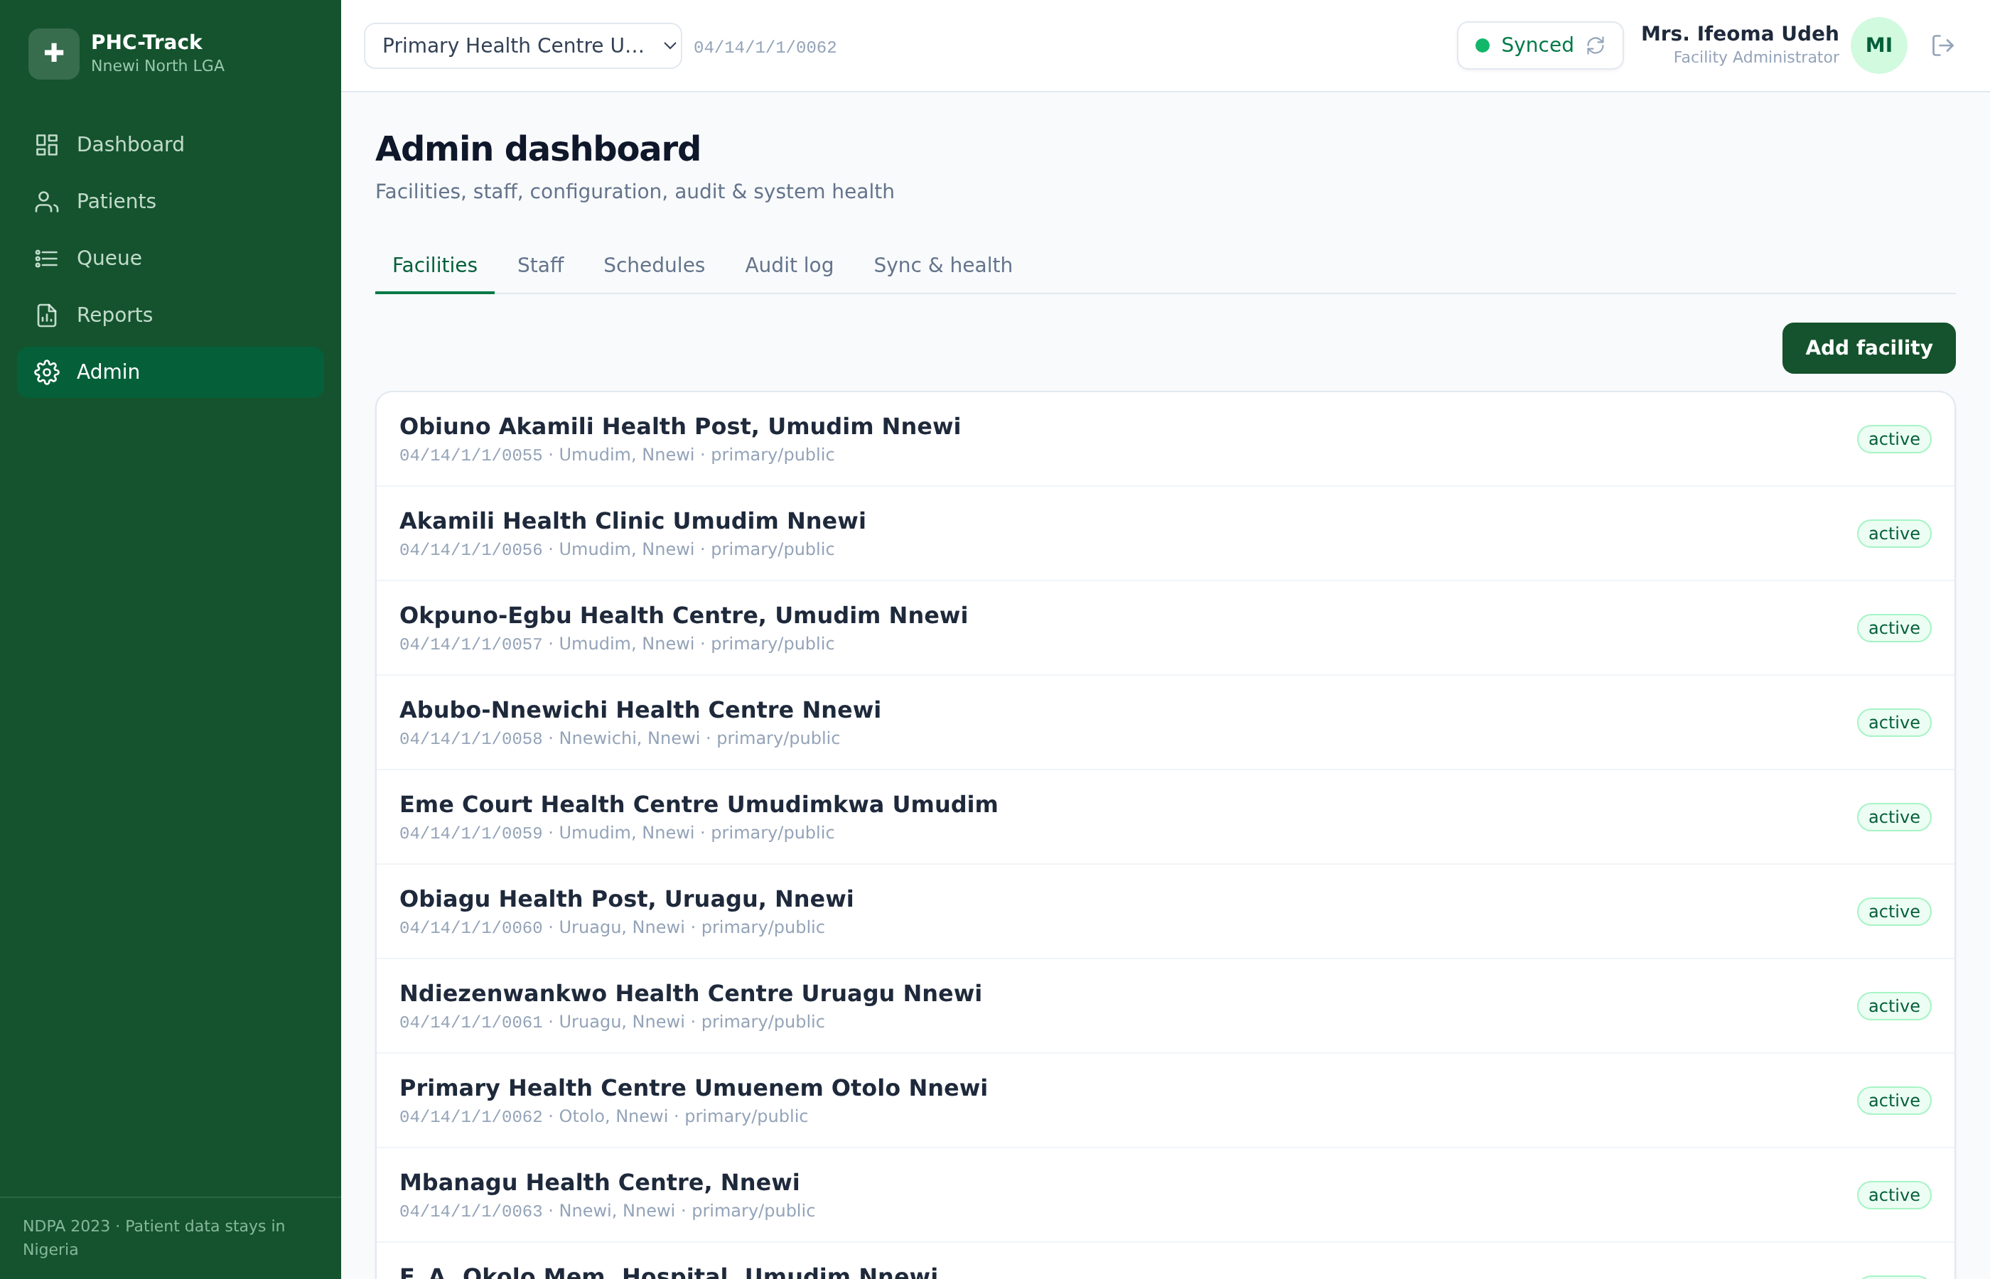
Administration & accountability
Facilities, staff and schedules are managed in the open — and everything leaves a trace.
▪ Full audit trail
Every create, update, delete and login is recorded with who, when, where and from which device.
▪ Staff lifecycle
Accounts are provisioned per facility and can be disabled instantly.
▪ Configurable, not hard-coded
Immunization and ANC schedules are configuration the LGA can verify and update — not buried in code.
PHC-Track — Nnewi North PHC Digital Health Platform
12

Slide 13
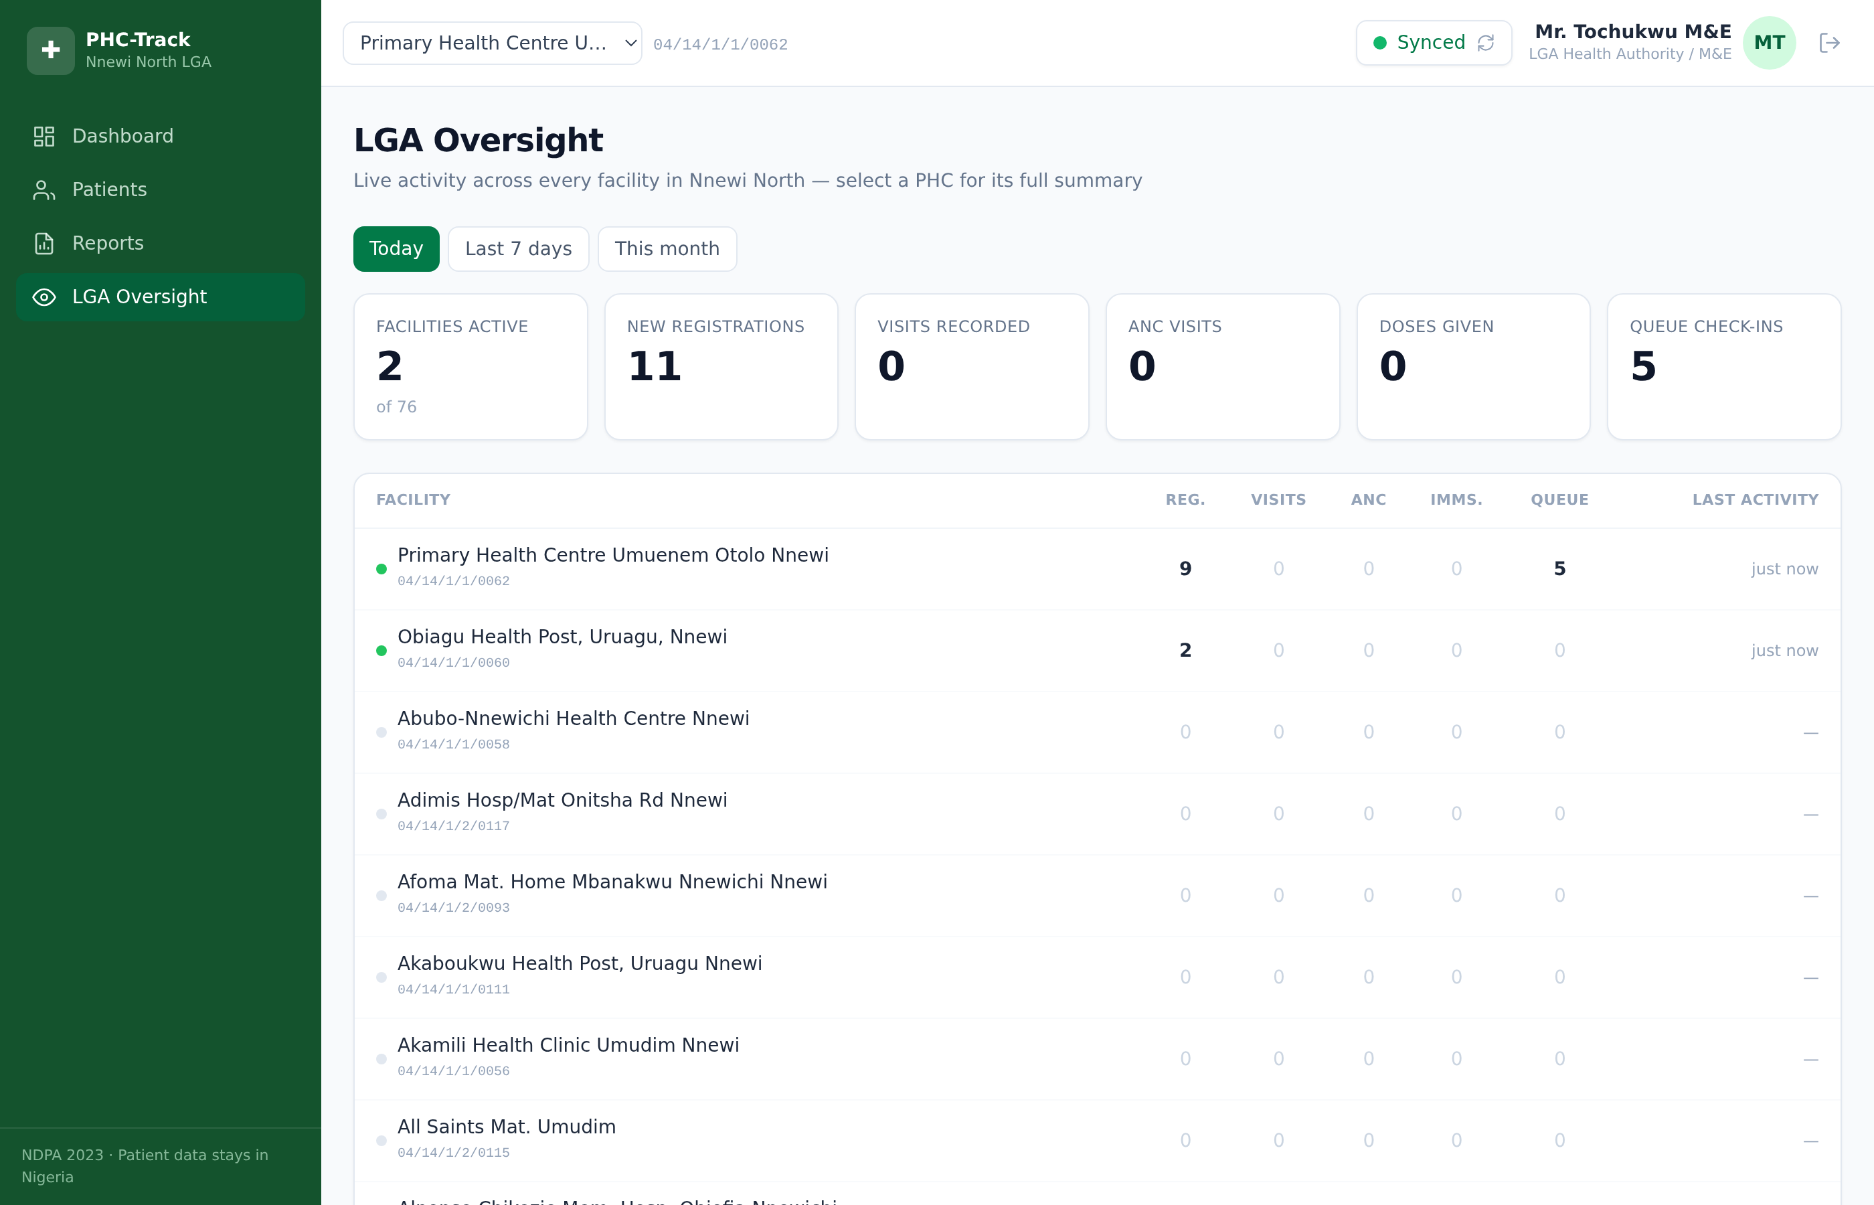
LGA oversight — every facility, one screen
The LGA Health HOD sees what all 76 facilities are doing — without a physical visit.
▪ The whole LGA at a glance
Every facility on one board: today's registrations, visits, ANC, immunizations and queue — most active facilities rise to the top.
▪ Freshness you can trust
A status dot and 'last activity' time per facility — a PHC that hasn't reported in days is visibly different from one active an hour ago.
▪ Today, this week, this month
One toggle switches the whole board between reporting periods.
▪ Restricted by role
Only the LGA Health Authority role sees this page — facility staff never see other facilities' data.
PHC-Track — Nnewi North PHC Digital Health Platform
13

Slide 14
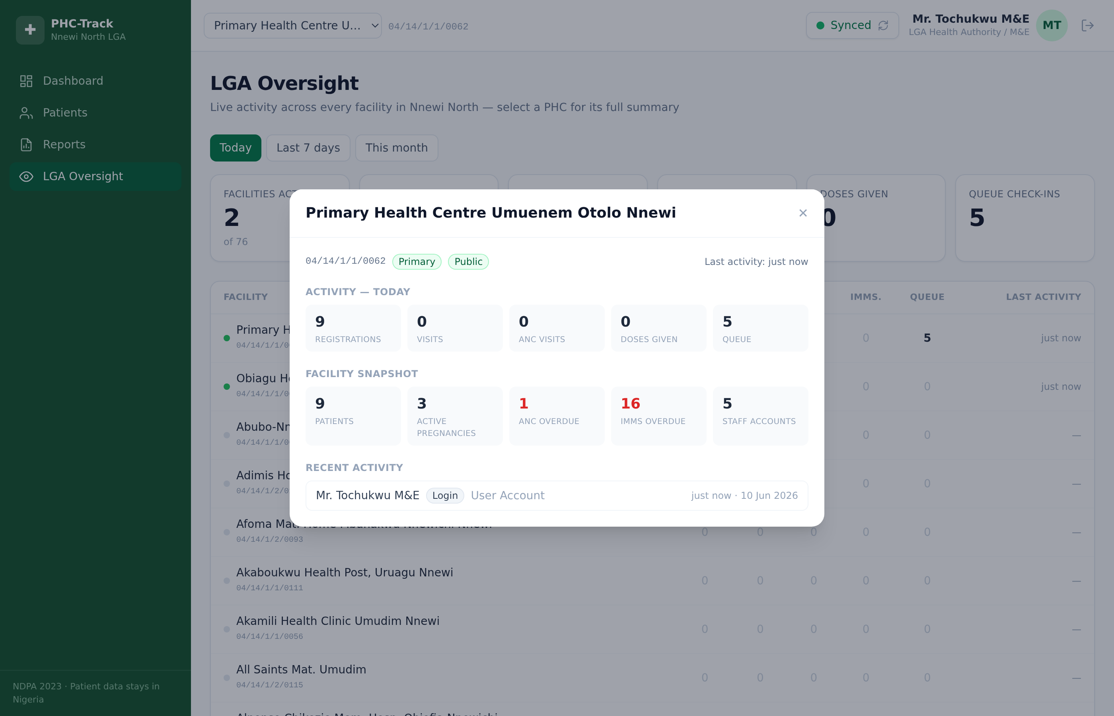
Select a PHC, see its full story
One tap on any facility opens its day: activity, programme snapshot, and who did what.
▪ Period activity
What this facility recorded today (or this week/month): registrations, visits, ANC, doses, queue.
▪ Programme snapshot
Total patients, active pregnancies, and overdue ANC/immunizations highlighted in red — the 'needs attention' signal for supervision visits.
▪ Audited activity feed
The latest actions at the facility with who and when — supervision built on evidence, not recollection.
▪ Live as facilities sync
Each PHC's updates appear the moment its device syncs to the hub.
PHC-Track — Nnewi North PHC Digital Health Platform
14

Slide 15
Built for our reality: offline-first architecture
The network is an optimisation, never a requirement.
1. Clinic device
2. Change journal
3. Sync hub (in Nigeria)
4. LGA view & DHIS2
Tablet / phone / laptop.
All records stored securely on-device. The full clinic day works with zero network.
Every saved record also queues an entry in a local outbox — nothing is ever lost waiting for network.
When connectivity appears, the outbox drains to a central server hosted in-country. Each facility receives only its own records back.
Authorities see live, LGA-wide indicators; NHMIS exports flow to DHIS2.
→
→
→
Status today: the clinic application (steps 1–2) is live and demonstrable. The central sync hub (steps 3–4) is the next build phase; the app was designed around it from day one.
PHC-Track — Nnewi North PHC Digital Health Platform
15

Slide 16
Data protection & compliance
▪ NDPA 2023 as the baseline
Patient data remains in Nigeria — the platform is self-hostable on an in-country server or at the LGA.
▪ Facility data isolation
A facility's records never appear at another facility. Oversight roles (LGA M&E) are the audited exception.
▪ Every action attributable
Tamper-evident audit log: who did what, to which record, when, at which facility, from which device.
▪ No NIN required
Patients are identified by a system MRN; the national ID is optional and never a barrier to care.
▪ Soft delete only
Clinical records are never physically erased — corrections preserve history.
PHC-Track — Nnewi North PHC Digital Health Platform
16

Slide 17
Where we are, and what comes next
NOW — working clinic application
All ten modules usable offline today: registration, EMR, maternal, immunization, queue, reporting, admin, and the LGA oversight board. Demonstrated with two pilot-ready facilities.
NEXT — central sync hub
In-country server so facilities sync automatically and the oversight board fills with live, LGA-wide activity. Production authentication and device enrolment.
THEN — SMS reminders
Automatic ANC and immunization recall messages to mothers (Igbo/English) via Nigerian SMS providers.
PILOT — selected PHCs
Train staff, run paper-parallel for one month, measure: defaulter recovery, reporting time, record completeness.
PHC-Track — Nnewi North PHC Digital Health Platform
17

Slide 18
Better records. Fewer missed children.
Faster, truer reporting.
PHC-Track gives every health worker in Nnewi North a tool that works where they work — with or without network — and gives the LGA numbers it can finally trust.
Thank you — questions & live demo welcome

