Slide 1

Recap & Recall
TIMER 4 MIN
ANSWER IN YOUR BOOK — NO NOTES
1
LESSON 2.2
2
LESSON 2.2
Parents who buy Match of the Day magazine for their children. Primary or secondary audience?
A plumber. Which socio-economic group?
primary · secondary?
C1 · C2 · D/E?
3
LESSON 2.1
4
BRIDGE
You ask your friends what they think of a film. Primary or secondary research?
How could a film company prove its film was a hit?
primary · secondary?
money from tickets · the director's opinion?
Notes:
Q1–2 look back at 2.2, Q3 at 2.1. Q4 bridges into today: take a few ideas, then move on.

Slide 2
Answers
TICK OR FIX IN A DIFFERENT COLOUR
1
LESSON 2.2
2
LESSON 2.2
Parents who buy Match of the Day magazine for their children. Primary or secondary audience?
A plumber. Which socio-economic group?
ANSWER Secondary: it isn't mainly made for them
ANSWER C2: skilled trades
3
LESSON 2.1
4
BRIDGE
You ask your friends what they think of a film. Primary or secondary research?
How could a film company prove its film was a hit?
ANSWER Primary: you collected it yourself
ANSWER Money from tickets: a number that counts the audience. Today.
Notes:
Tick or fix. Q3: primary research matters again in Part 2 today, when they interview a partner. Q4: ticket money is a box office figure, one of six kinds of audience statistic.

Slide 3
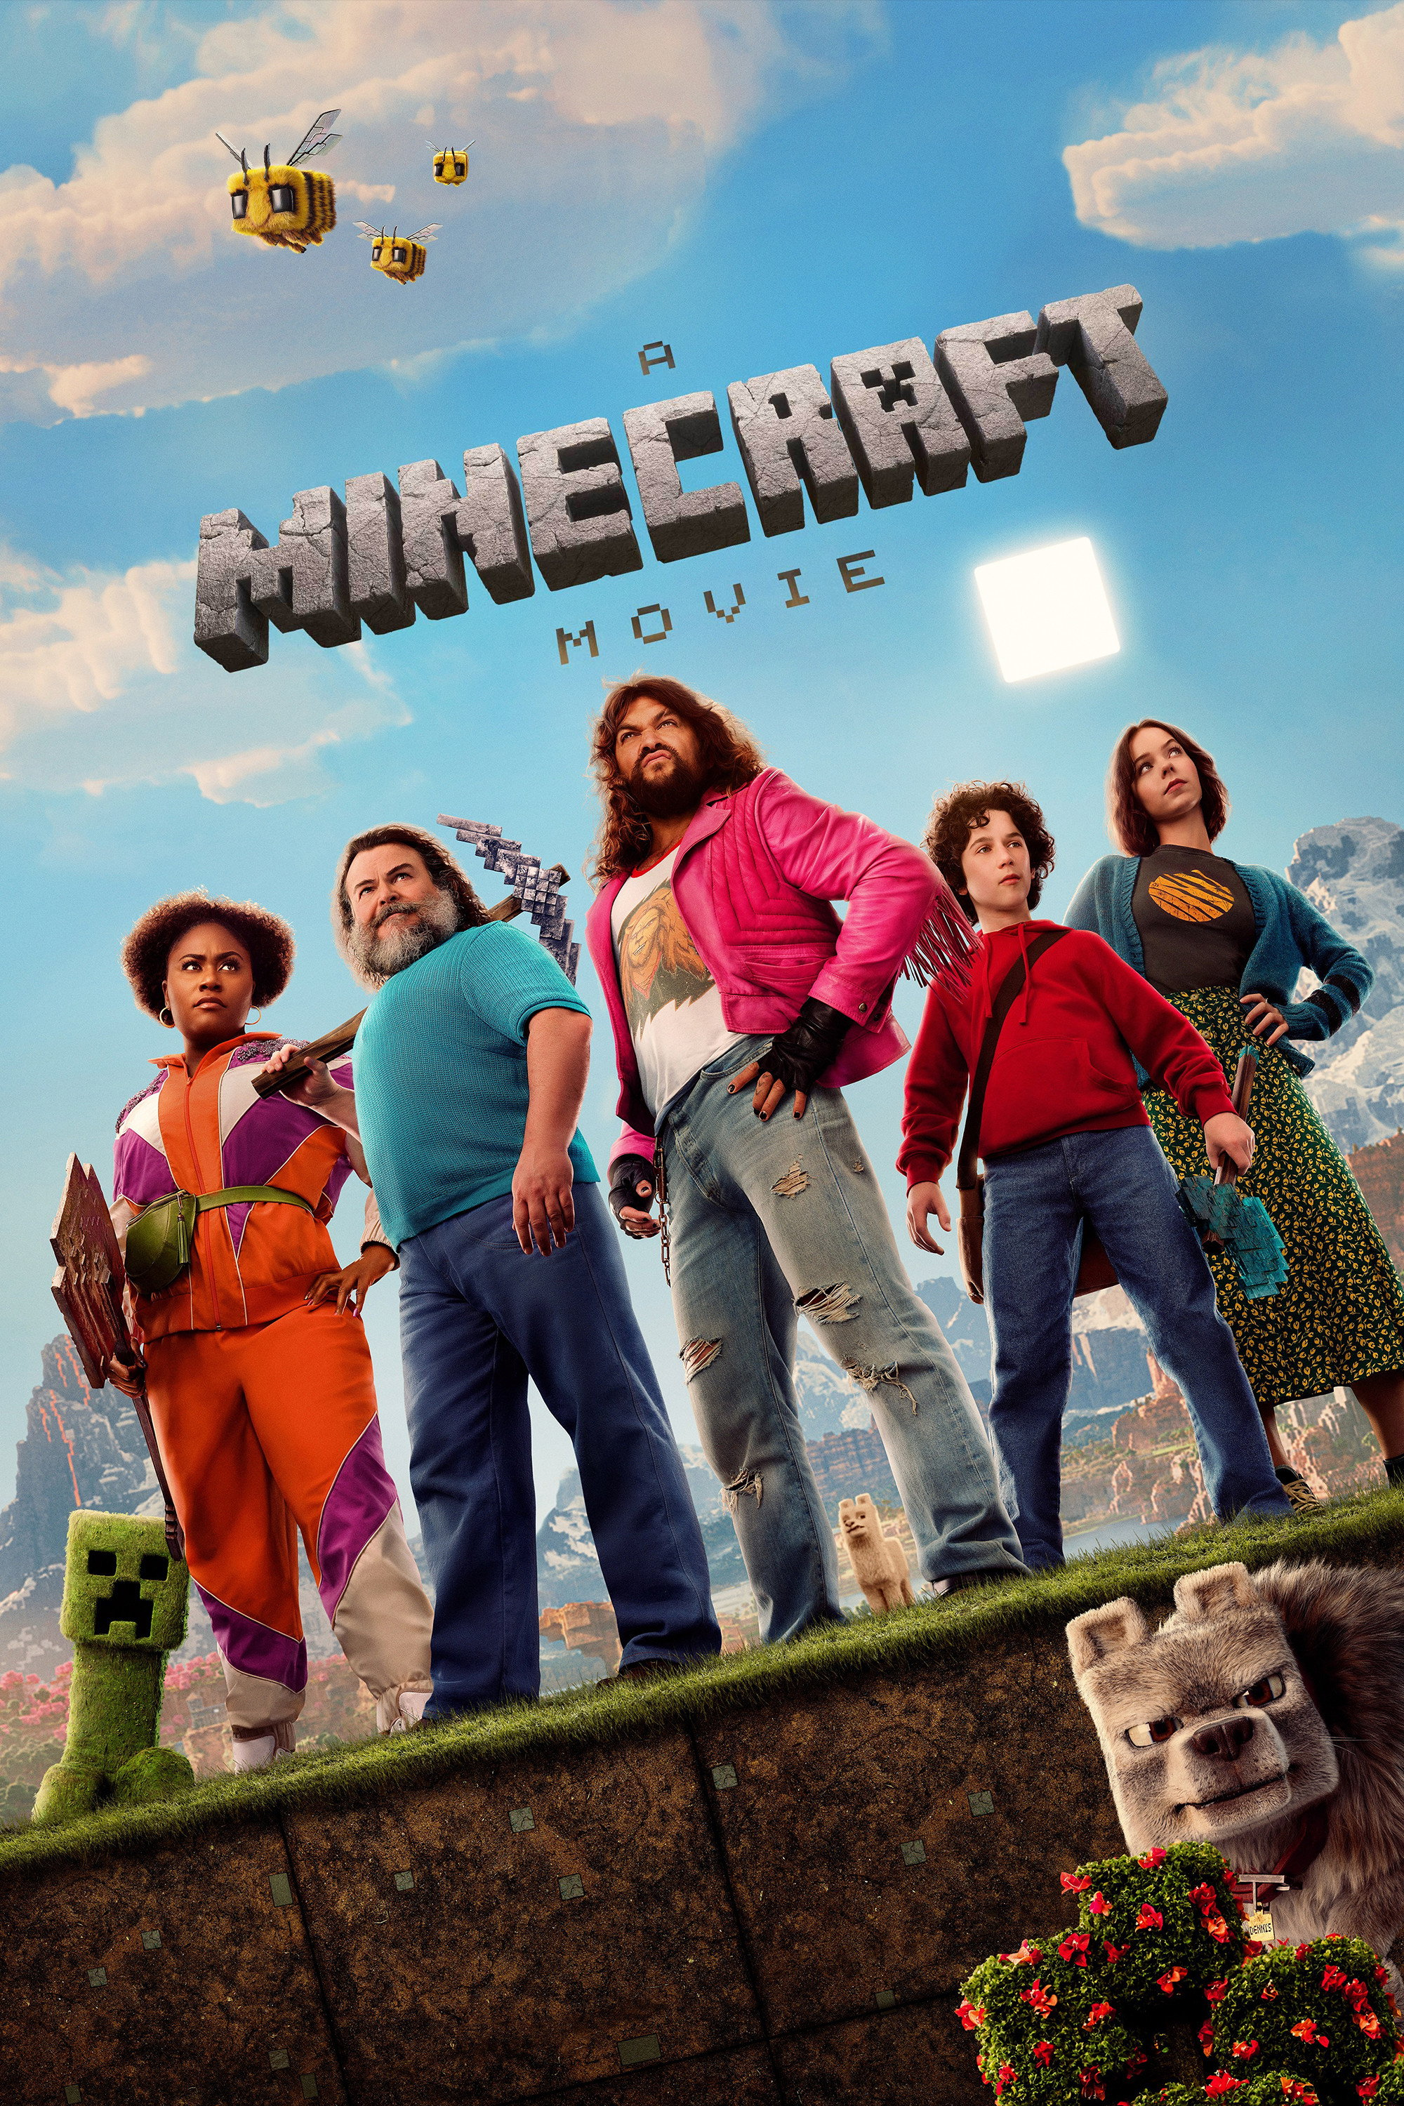
EXPLORING MEDIA
LESSON 2.3 · Y10 BTEC CREATIVE MEDIA
Lesson 2.3
Counting and Asking Audiences
Count an audience with real numbers. Then ask them yourself.
Notes:
Cover: A Minecraft Movie, the UK and Ireland's top film of 2025 at the box office. In the PSA (Task 1) students back up who an audience is with research: statistics they find (secondary) and questions they ask (primary).

Slide 4

The big questions
TOPIC QUESTION — THE WHOLE OF COMPONENT 1
How are media products made to reach and engage their audiences?
TODAY'S QUESTION
How can you find out how big an audience is, and what it thinks?
Notes:
Topic question for the whole of Component 1; today's question comes back in the plenary. Two halves: COUNT the audience (statistics), then ASK them (interviews, focus groups, surveys).

Slide 5

KEY TERM
Audience statistic
A number that counts a product's audience. Producers and advertisers use them to show how big an audience is.
IN THE REAL WORLD
A Minecraft Movie took £56.9 million at UK and Ireland cinemas in 2025: the top film of the year (BFI).
Notes:
Spec A1: audience statistics. Example on click. Why do producers care? A big number sells advertising and persuades people to try it. Each sector counts its audience in its own way: six kinds, over the next two slides.

Slide 6
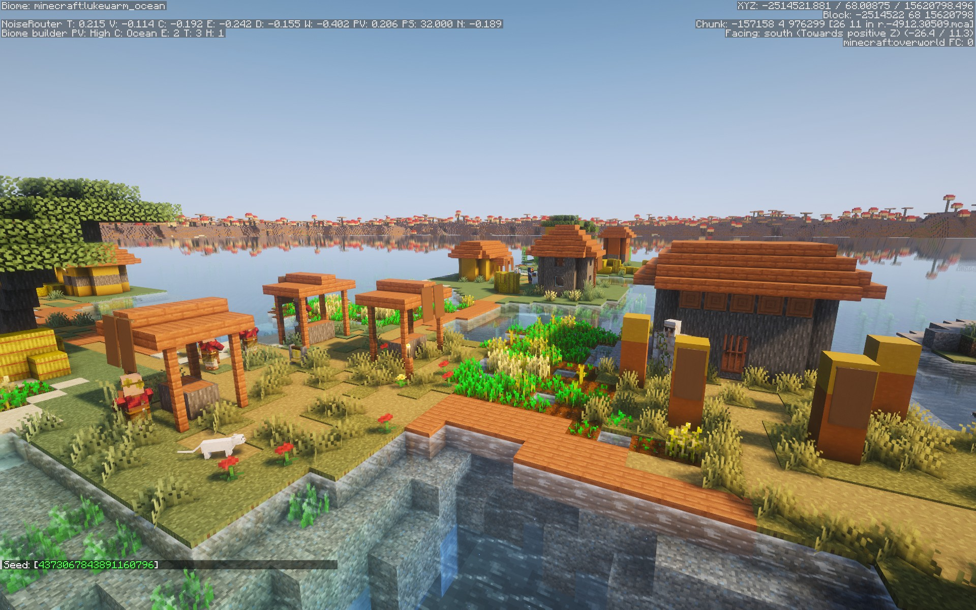
Counting what people pay for
Three statistics for films, print and games.
1
Box office Money taken from cinema tickets for a film.
2
Circulation Copies of a newspaper or magazine sold or given out, such as Metro each weekday.
3
Sales Copies of a game, album or book bought. Minecraft has sold more than 300 million.
Notes:
One per click. Box office is MONEY, the others are COPIES. Circulation counts free papers too (Metro is given out free). Minecraft: Mojang, October 2023.

Slide 7
Counting people online
Three statistics for websites, streaming and social media.
1
Hits Visits to a website or web page, such as BBC News.
2
Subscriptions People signed up to get something regularly: a streaming service or a YouTube channel.
3
Followers People who follow an account on social media, such as Marcus Rashford on Instagram.
Notes:
One per click. A YouTube channel's "subscribers" are subscriptions too, even though they don't pay. The Warm-up on the page has these six meanings open while students sort examples.

Slide 8

Which one?
Spotify wants to show how big its audience is. Which statistic should it use?
A
B
C
D
Box office
Circulation
Subscriptions
Hits
Notes:
Answer C: people sign up to Spotify Premium every month. Follow-up: and for a film? (box office). A magazine? (circulation).

Slide 9
Reading the numbers
Three sums you'll need for real tables.
1
How much more? Take away: Wicked: For Good £47.0m − Zootropolis 2 £30.5m = £16.5m more.
2
Percentages 95% of 8 to 14s use Google Search. In a class of 30: 30 × 95 ÷ 100 = 28.5, so about 29.
3
How many times as many? Divide: £56.9m ÷ £23.4m ≈ 2.4. A Minecraft Movie took about 2.4 times as much as How to Train Your Dragon.
Notes:
One per click; do each sum on the board. Sources: BFI 2025 box office (via the Press Association) and Ofcom Online Nation 2025.
These are the three kinds of sum in Task 2, on different rows. The page's help panel has the same three steps.

Slide 10

Turn & Talk
TIMER 3 MIN
Minecraft has sold more than 300 million copies.
What does that tell you about its audience? What doesn't it tell you?
1
Think on your own: 30 seconds
2
Partner A answers. B listens.
3
B adds one thing or disagrees, with a reason.
Notes:
Tells you: a huge audience, all over the world, for a long time.
Doesn't tell you: how old they are, boys or girls, why they bought it, whether they still play. A statistic counts; it doesn't say WHO or WHY. To find that out you have to ask them: Part 2.
Early finishers do the same thinking for A Minecraft Movie in ★ What numbers don't say.

Slide 11
Count the audience
TIMER 25 MIN
1
The page opens on the Warm-up: which kind of statistic is each card?
SUCCESS LOOKS LIKE
The right statistic for each sector
Sums from the table, not guesses
Every statistic with its number and its source
2
Task 1 · Which number? Task 2 · Read the numbers: three real tables.
3
Task 3 · Find two statistics for products in your research log (it links to Lesson 2.1).
4
Finished? Try ★ What numbers don't say. Tasks 4–6 open later.
FIND IT Hub › Year 10 › Lesson 2.3 › Counting and Asking Audiences
Notes:
Warm-up is optional: its meanings are open on the page. Task 2 takes typed numbers ("£56.9m" and "56.9" both work). Task 3 is live research: each statistic needs a number, a real link (not a search page) and who made the page. The research log link opens 2.1 in a new tab. Tasks 4–6 are locked (Part 2) until the unlock word. A wrong check makes students wait.

Slide 12
Three ways to ask
Primary research: ask the audience yourself.
1
Interview Ask one person questions and listen to their answers in detail.
2
Focus group A small group try the product together, then discuss it while you ask questions.
3
Survey The same questions for lots of people, so you can count the answers.
Notes:
Spec: personal interview, focus group, survey. One per click. Ask: which gives you the most detail? (interview) Which gives numbers for a chart? (survey) Which lets people spark ideas off each other? (focus group)

Slide 13
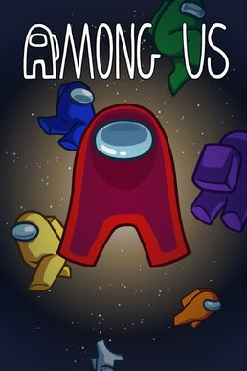
Four kinds of question
Worked model: a survey about Among Us.
1
Multiple choice "Who do you play with? A) Friends B) Family C) Strangers online"
2
Rating scale "How much do you enjoy Among Us, from 1 to 5?"
3
Ranking "Put these in order, favourite first: crewmate, impostor, ghost."
4
Open-ended "What makes a game of Among Us fun?"
Notes:
One per click. The first three give answers you can count; open-ended gives detail and reasons (best in an interview). A good survey mixes them.

Slide 14
Follow-ups and samples
Two more things a good researcher does.
1
Follow-up question Asks for more about the answer someone just gave. "I play it on the bus." "Who with?"
2
Sample The people you choose to ask: enough of them, from the target audience, and different from each other.
Notes:
One per click. Follow-ups are where interviews get interesting: plan "Why do you say that?" in advance. Sample: three best mates who all love the game will all say the same thing.

Slide 15
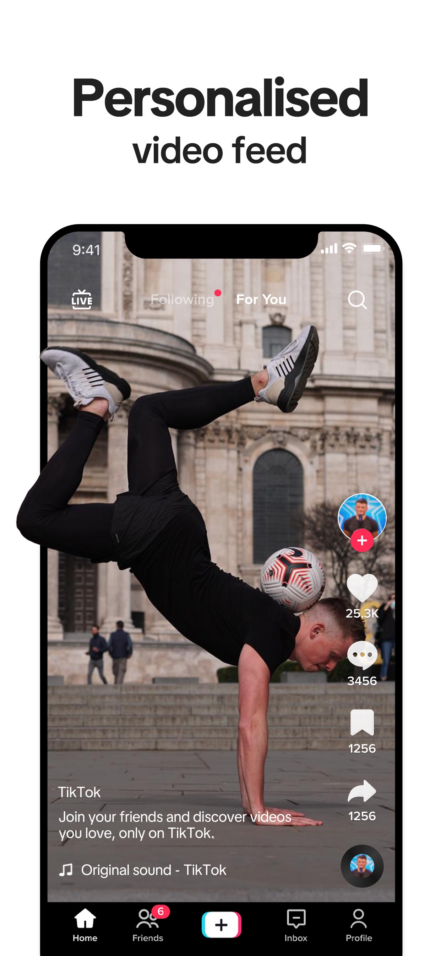
Turn & Talk
TIMER 3 MIN
A survey asks: "Don't you think TikTok is a waste of time?"
What's wrong with this question? How would you fix it?
1
Think on your own: 30 seconds
2
Partner A answers. B listens.
3
B adds one thing or disagrees, with a reason.
Notes:
It pushes people towards an answer ("Don't you think…", "waste of time"). Fairer: "How much time do you spend on TikTok a day?" or "What do you get out of TikTok?"
Task 5 tests a whole survey like this: students see the results come back, click the ones that are no use, then rewrite those questions.

Slide 16
Which one?
You want to know in detail why one friend stopped watching a series. Which method?
A
B
C
Interview
Focus group
Survey
Notes:
Answer A: one person, in detail, with follow-ups. A survey counts many answers; a focus group is a group discussion.

Slide 17
Record your interview
In PowerPoint, with your partner, about 2 minutes each.
1
Record Insert › Audio › Record Audio… Name it, then press the red button.
2
Ask Your four questions, plus a follow-up when an answer is interesting.
3
Save Right-click the speaker icon › Save Media as… Upload it to Classroom.
Notes:
Same steps as Task 6 on the page. Sit side by side, show your partner the product first, then swap so both are interviewed. Headsets with microphones if available; otherwise quiet corners.

Slide 18
Ask the audience
TIMER 30 MIN
1
Task 4 · Which way to ask? Methods, kinds of question, follow-ups and samples.
SUCCESS LOOKS LIKE
The right method for the job
Fair questions: one thing at a time
A follow-up when an answer is interesting
2
Task 5 · Test the survey: run Jay's survey, click the results that are no use, rewrite those questions.
3
Task 6 · Interview a partner: plan, record 2 minutes, upload, then write up what they said.
4
Finished? ★ Build a survey: one question of each kind.
UNLOCK WORD
FOLLOWUP
FIND IT Hub › Year 10 › Lesson 2.3 › Counting and Asking Audiences
Notes:
Unlock word FOLLOWUP (or "follow-up") opens Tasks 4–6 and ★ Build a survey. Teacher mode or "outwood" opens every part. Task 5: a rewrite that still breaks a rule says why under the box and makes them wait. Task 6: the recording goes to this lesson's Classroom assignment; the write-up is saved from the page.

Slide 19
Exit ticket
BACK TO TODAY'S QUESTION
How can you find out how big an audience is, and what it thinks?
Pick a product you use. Name one statistic that counts its audience, and write one question you'd ask them.
START WITH "I could count its audience with its ___. I would ask: ___?"
Notes:
Exit ticket. Listen for the right statistic for the sector, and a fair question (not pushing an answer, one thing at a time).

