Slide 1

Recap & Recall
TIMER 4 MIN
ANSWER IN YOUR BOOK — NO NOTES
1
C3 MOCK
2
C3 MOCK
On your FIZZIKAL cover, the big brand name across the top is the…
The short lines of text around your cover image are…
masthead · cover line · puff?
cover lines · mastheads · captions?
3
C3 MOCK
4
BRIDGE
Who was FIZZIKAL for? Example: 'teenagers who play team sports'.
Your cover was a print product. Which of these is also print?
a billboard · a podcast · a website?
Notes:
Bridge from the Component 3 mock: they made a FIZZIKAL magazine cover, a print product. Q4 previews today: the three sectors. Choices on screen, so no bare recall.

Slide 2
Answers
TICK OR FIX IN A DIFFERENT COLOUR
1
C3 MOCK
2
C3 MOCK
On your FIZZIKAL cover, the big brand name across the top is the…
The short lines of text around your cover image are…
ANSWER Masthead
ANSWER Cover lines: they tell readers what's inside
3
C3 MOCK
4
BRIDGE
Who was FIZZIKAL for? Example: 'teenagers who play team sports'.
Your cover was a print product. Which of these is also print?
ANSWER Its target audience: who every choice was for
ANSWER A billboard (a podcast is audio, a website is interactive)
Notes:
Tick or fix. Q4 is the hook into today: print is one of three media sectors.

Slide 3
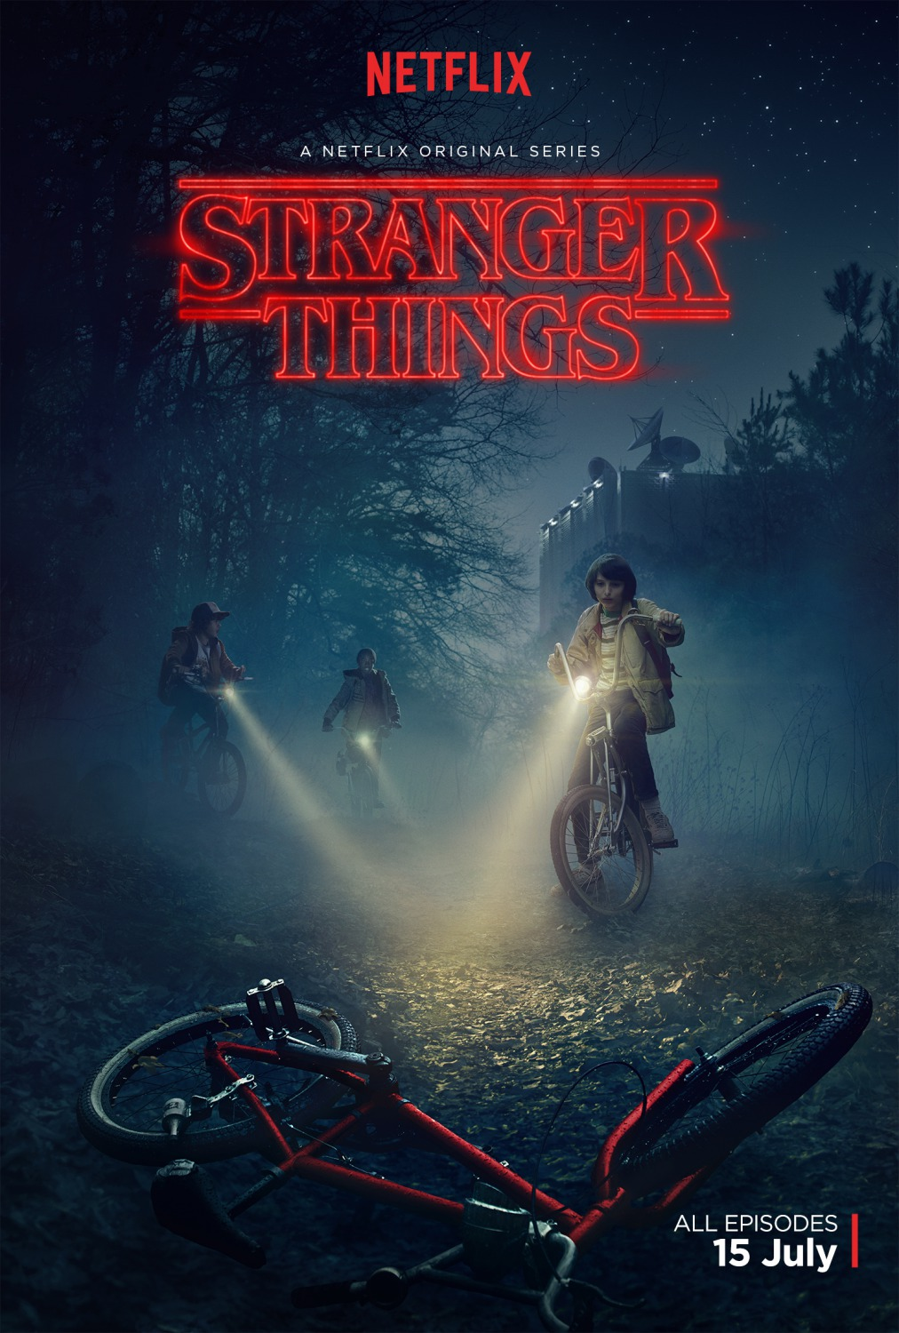
EXPLORING MEDIA
LESSON 1.1 · Y10 BTEC CREATIVE MEDIA
Lesson 1.1
Media Everywhere
Films, games, magazines, apps: what kind of media is each one, and when was it made?
Notes:
Cover: Stranger Things (2016), a contemporary TV series set in the 1980s. Ask: is it historical or contemporary? (Contemporary: it was MADE in 2016, even though it is set in 1983.)

Slide 4

The big questions
TOPIC QUESTION — THE WHOLE OF COMPONENT 1
How are media products made to reach and engage their audiences?
TODAY'S QUESTION
What are the three media sectors, and how has media changed since 2000?
Notes:
Topic question for the whole of Component 1; today's question comes back in the plenary.

Slide 5

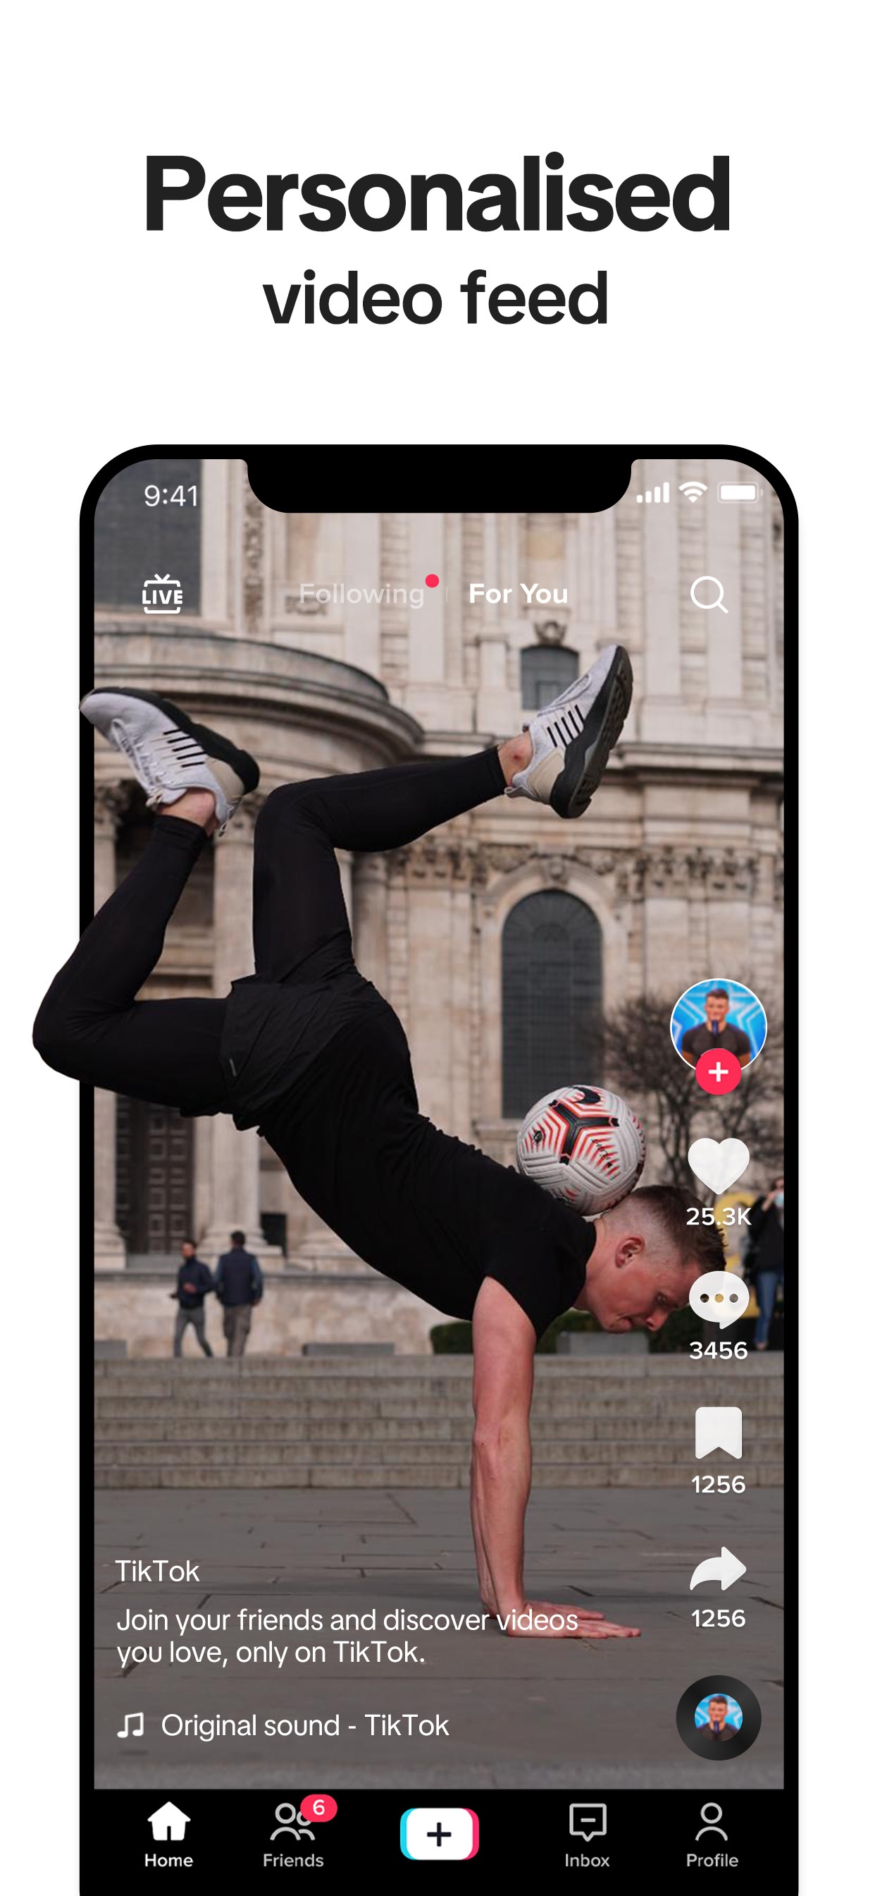
What counts as media?
A media product is anything made to reach an audience through sound, pictures, print or a screen.
1
Audio / moving image You watch or listen: films, TV, music videos, radio, podcasts, YouTube.
2
Print Printed on paper: newspapers, magazines, comics, posters, billboards.
3
Interactive You make choices: games, apps, websites, social media.
4
Then or now? Made before 2000 = historical. Made in 2000 or later = contemporary.
Notes:
The three sectors are Pearson's (spec A1). Contemporary = post-2000, historical = pre-2000 (spec wording). TikTok: interactive, contemporary (2016).

Slide 6
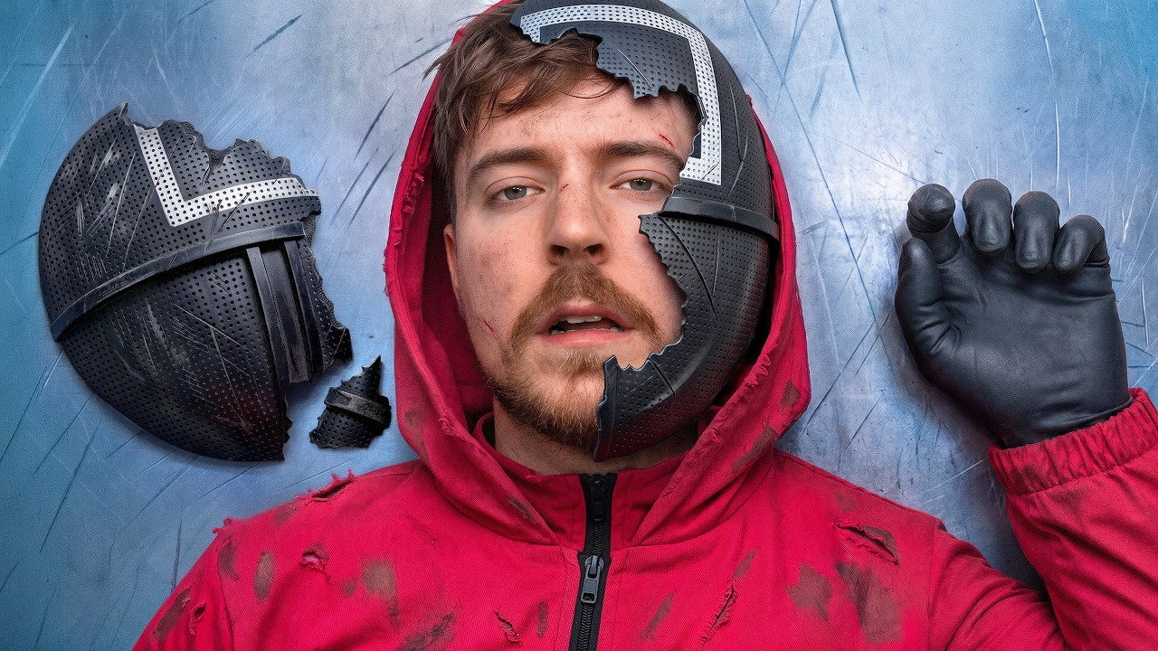
KEY TERM
Audio / moving image
Products you watch or listen to: sound, moving pictures, or both.
IN THE REAL WORLD
A MrBeast YouTube video, Stranger Things on Netflix, a Radio 1 breakfast show.
Notes:
Includes radio and podcasts (sound only) as well as film, TV, music videos, animation and adverts.

Slide 7
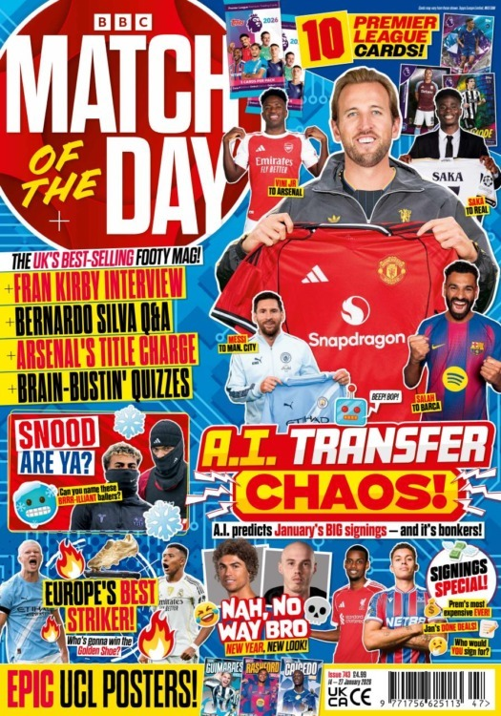
KEY TERM
Print
Products printed on paper: you read and look at them.
IN THE REAL WORLD
Match of the Day magazine, a McDonald's billboard, a newspaper front page.
Notes:
Includes newspapers, magazines, comics, brochures, posters, packaging and print adverts. Their FIZZIKAL cover was print.

Slide 8
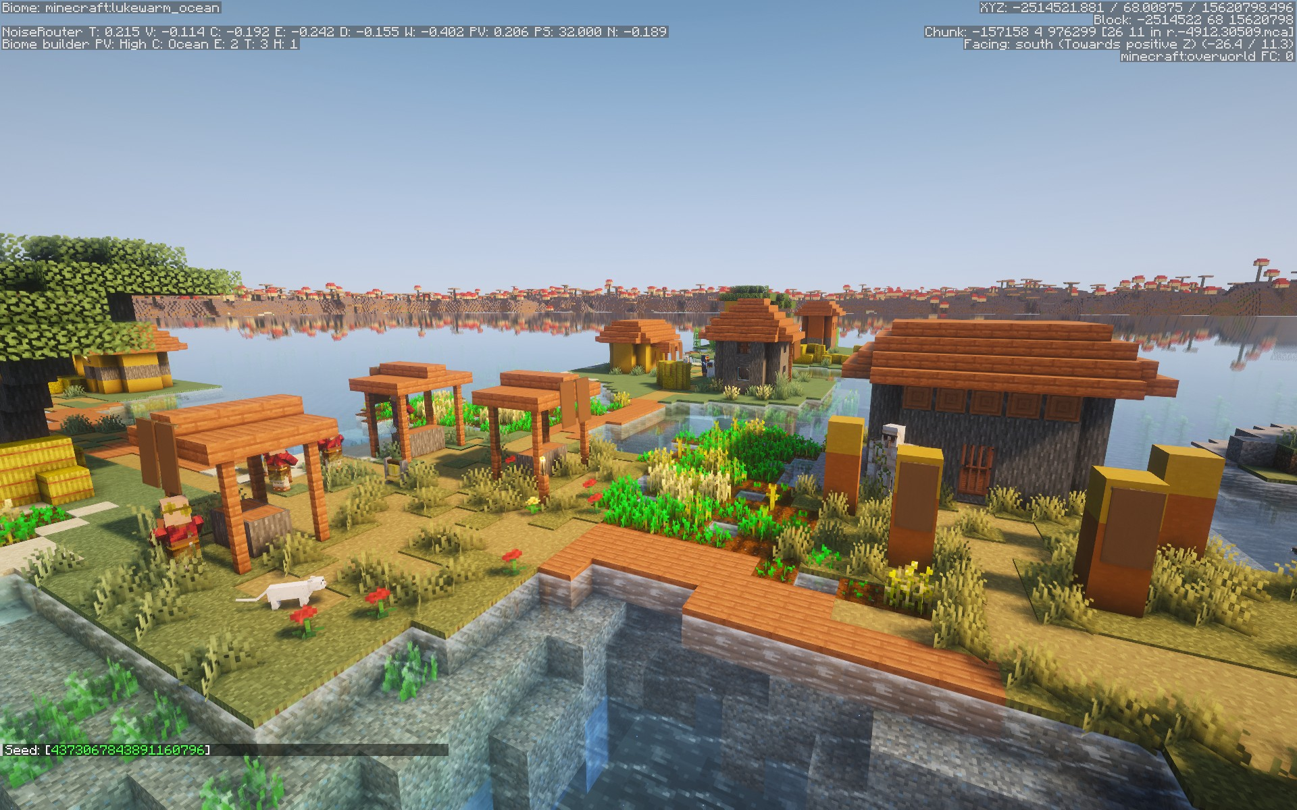
KEY TERM
Interactive
Products where the user makes choices and changes what happens next.
IN THE REAL WORLD
Minecraft, TikTok, a website: nothing happens until you click, tap or play.
Notes:
Includes video, mobile and online games, apps, websites, interactive magazines and adverts.

Slide 9

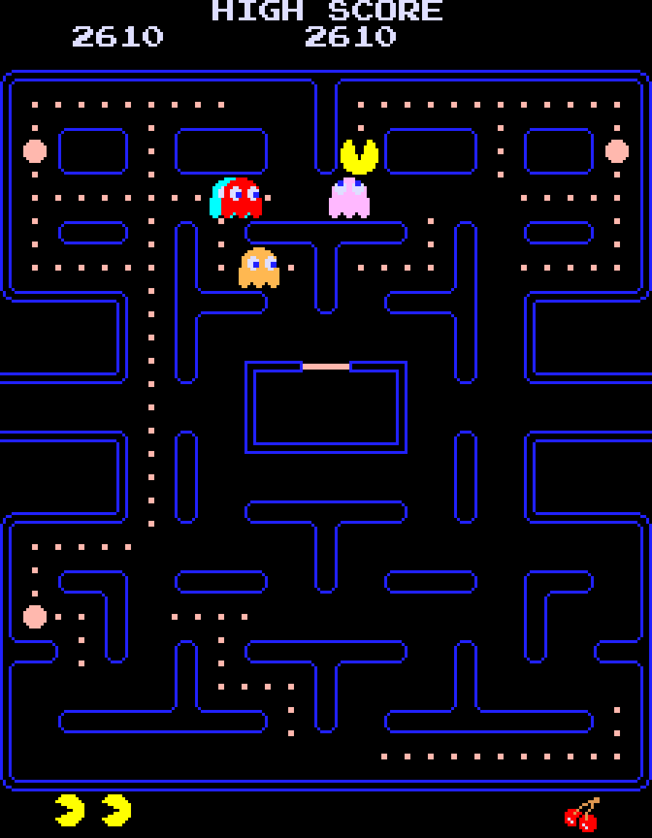
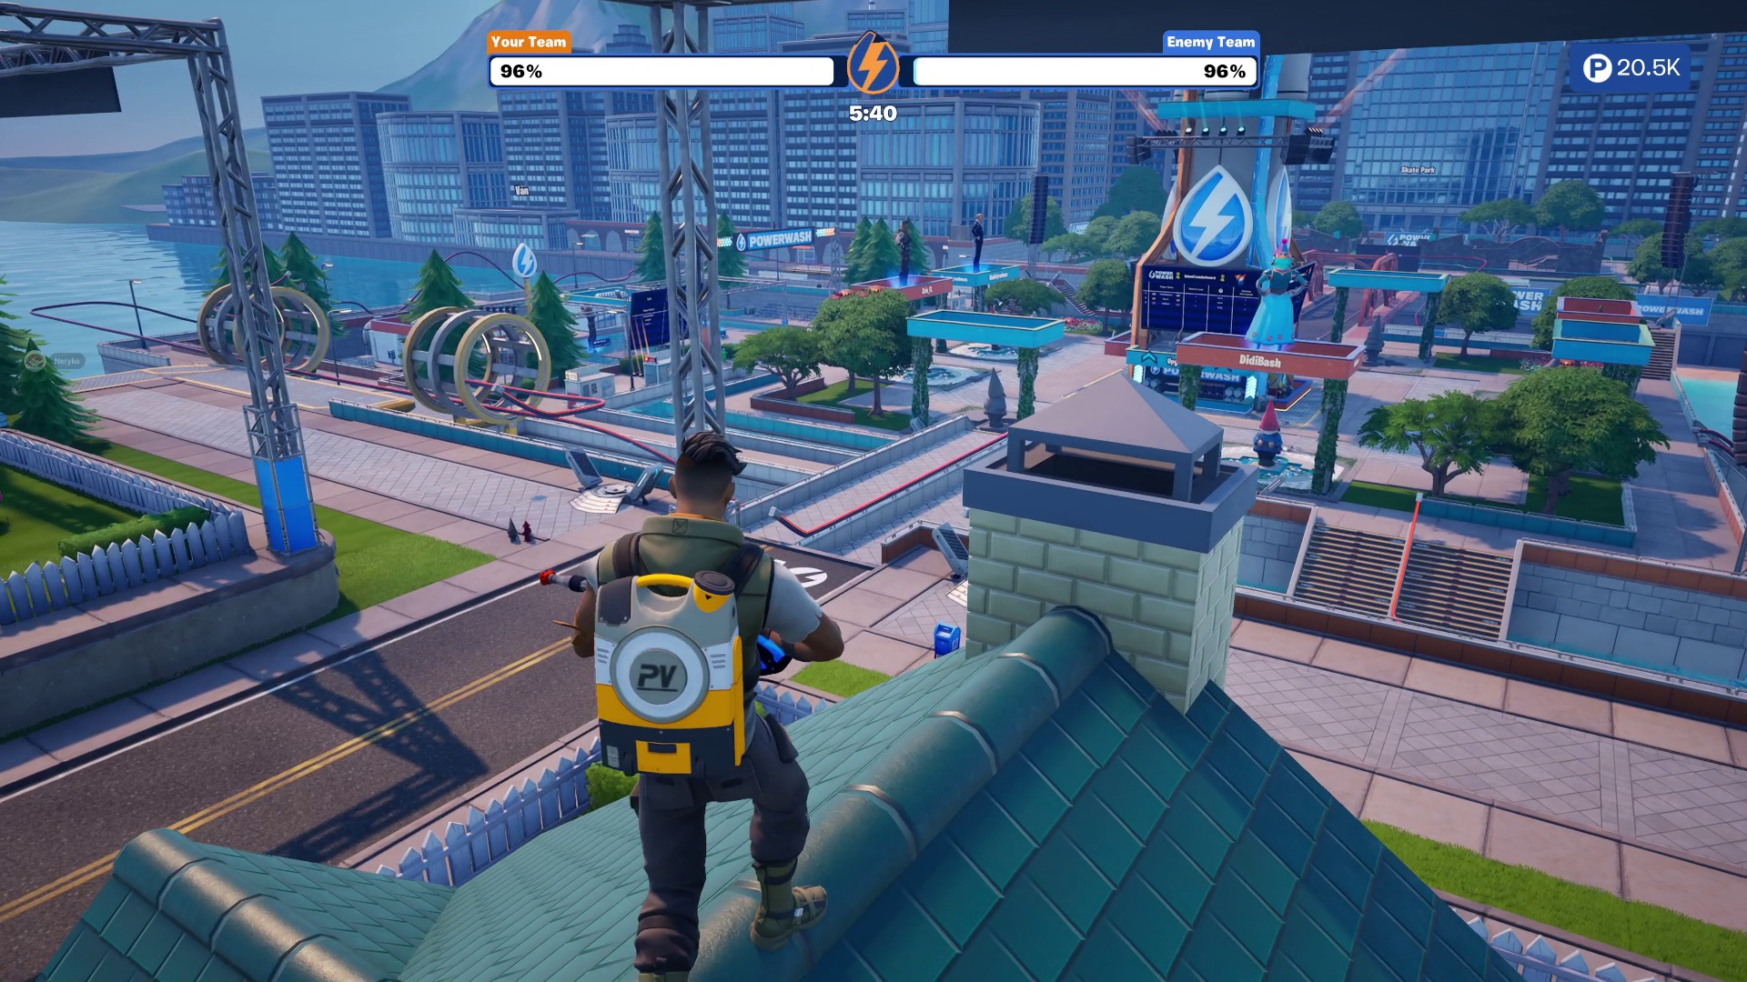
One sector, 37 years apart
Pac-Man · 1980
Fortnite · 2017
SECTOR
Interactive
Interactive
WHERE YOU PLAY
An arcade machine
Console, PC or phone
WHO WITH
HOW IT LOOKS
Notes:
Worked example for the first two rows; students fill in the last two (mini whiteboards). Who with: on your own / up to 100 players online. How it looks: flat pixel maze / 3D world, skins, live events.

Slide 10

Which one?
Pokémon Red came out in the UK in 1999. Which box does it go in?
A
B
C
Interactive · before 2000
Interactive · 2000 onwards
Print · before 2000
Notes:
Hinge. Answer A: a Game Boy game (interactive), released 1996 in Japan and 1999 in the UK, so historical. B = era slip; C = thinks the box art makes it print.

Slide 11
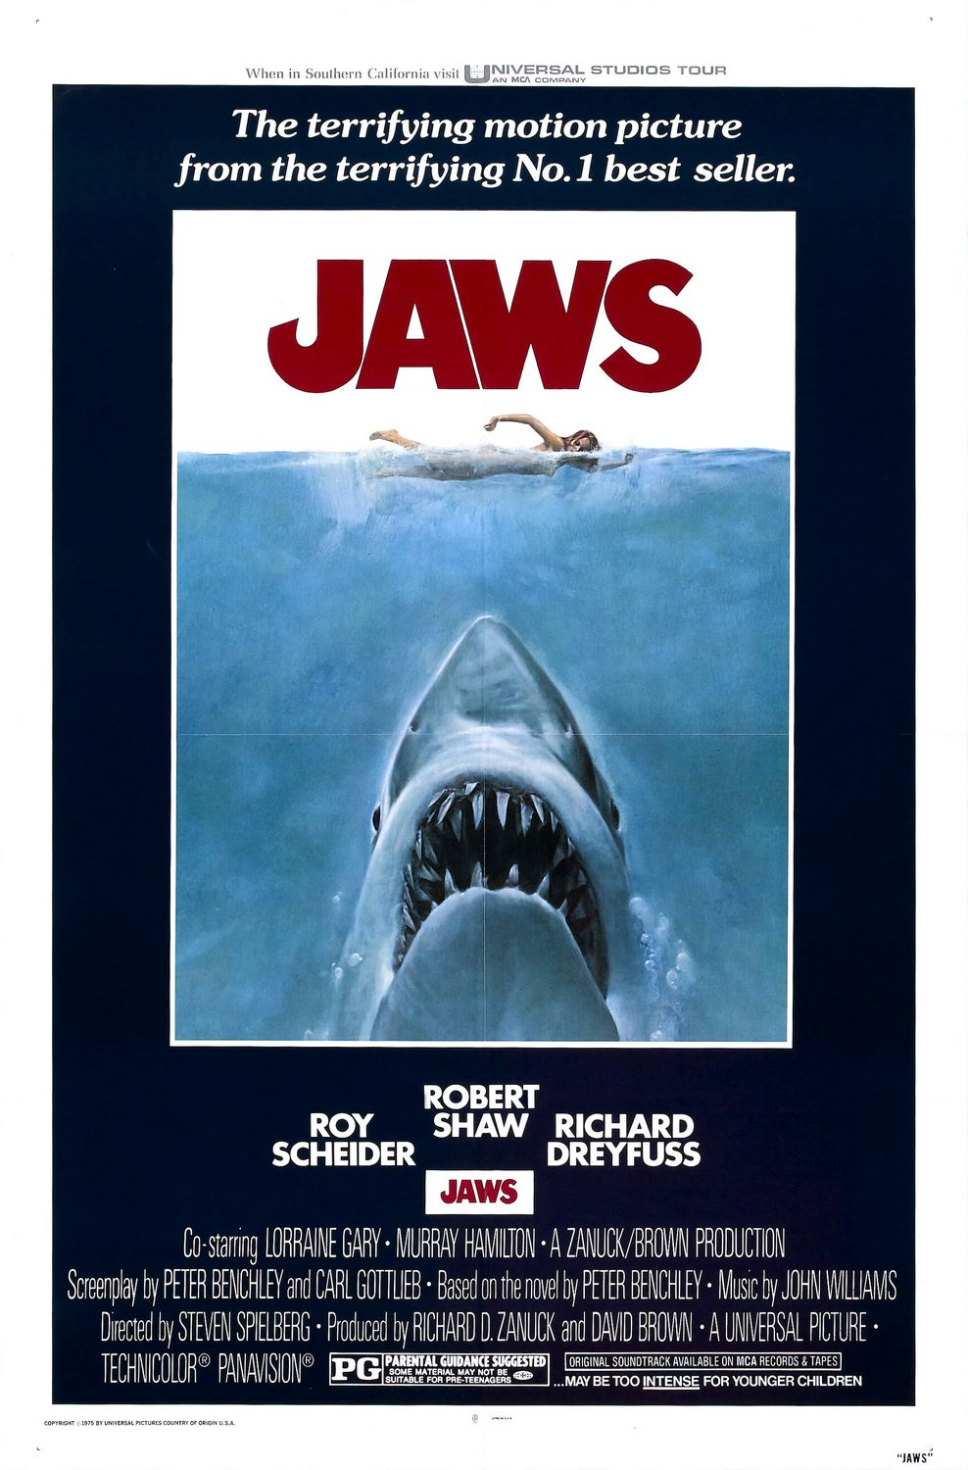
Turn & Talk
TIMER 3 MIN
The Jaws poster is print. Jaws the film is audio / moving image.
Name another product that lives in more than one sector.
1
Think on your own: 30 seconds
2
Partner A answers. B listens.
3
B adds one thing or disagrees, with a reason.
Notes:
Products cross sectors: a film has posters (print) and a website or game (interactive). Good answers: Minecraft (game + film + books), Stranger Things (series + posters + game). On the Media Board, sort the product in the picture.

Slide 12
The Media Board
TIMER 15 MIN
1
Open Media Everywhere. Unsure about sectors? Do the Warm-up tab first.
SUCCESS LOOKS LIKE
Every card in a box
Sector AND era right
Gold if right first time
2
Task 1: put all 21 real products in the right box: sector, then before or after 2000.
3
Check. Red cards are wrong: wait for the timer, then fix them.
4
Finished? Try the ★ Tricky cases tab. Tasks 2–4 open in Part 2.
FIND IT Hub › Year 10 › Lesson 1.1 › Media Everywhere
Notes:
Every card has its real image. Wrong checks cost 10, then 20, then 30 seconds (they survive a refresh). Years appear on the cards once the board is right. Differentiation: Warm-up (Sector snap: 6 products, sectors only, big pictures) and an era-clues hint inside Task 1; early finishers do ★ Tricky cases (set vs made, brand vs issue, remakes, products in two sectors). Tasks 2–4 are locked (Part 2): the unlock word is on the Then and now task slide, so nobody starts them before the clips. Dotted words on the page show their meaning on hover or tap. Optional tabs do not change the grade.

Slide 13
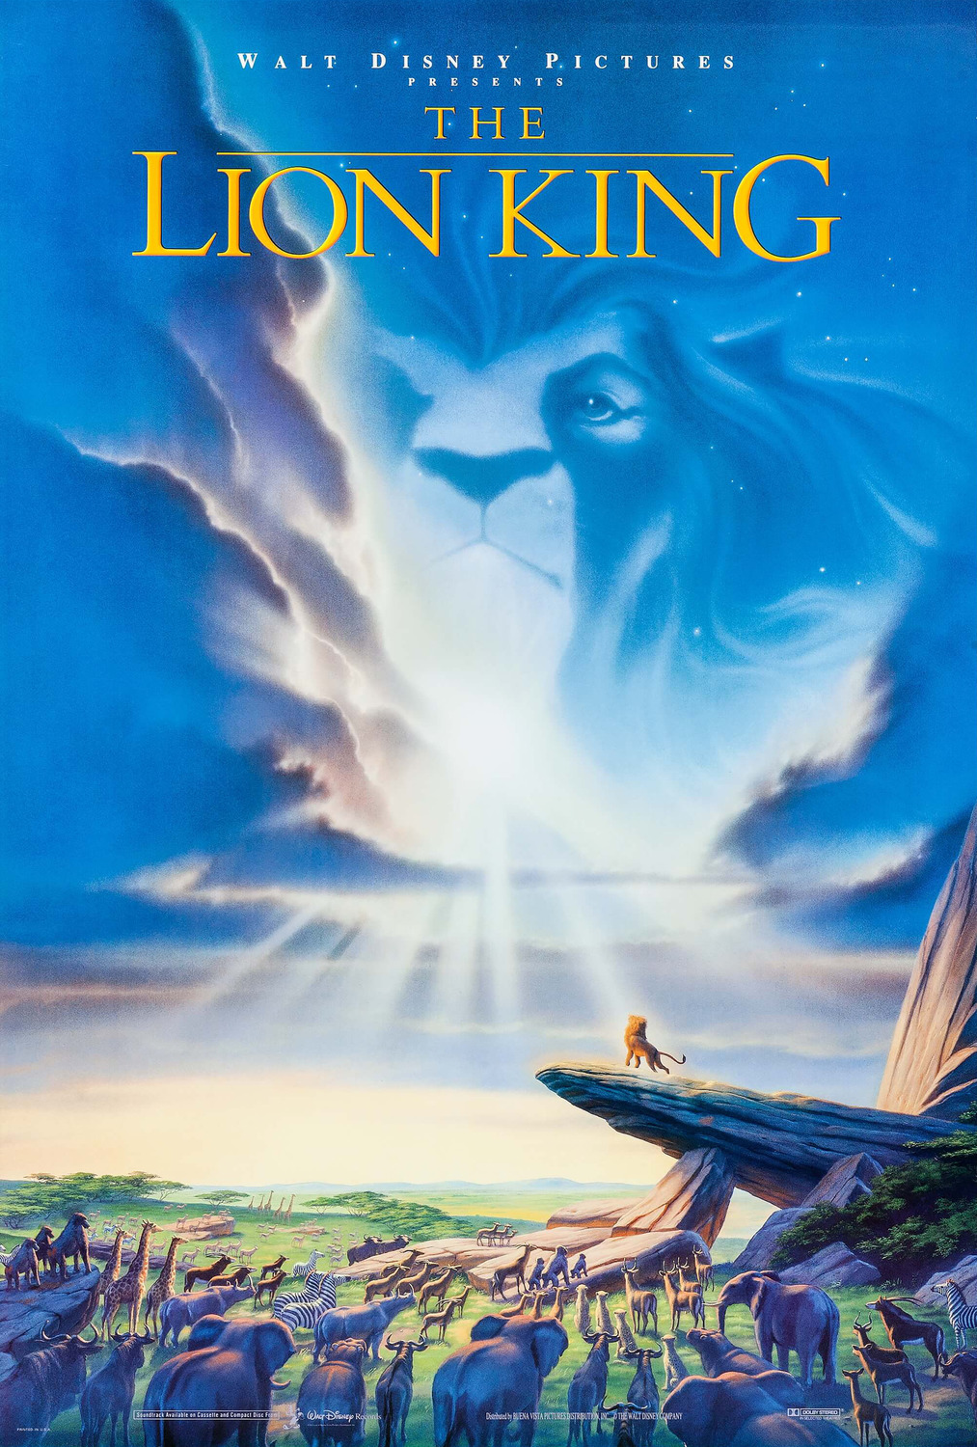
Then: The Lion King, 1994
THEN ANSWER
1
Which sector is it in?
2
How was it made: drawn or filmed?
3
Where would people have seen it in 1994?
WATCH 0:00 – END
Click the poster to play
Notes:
Drive clip "Lion King Cartoon.mp4" (Y10/media.md). Watch the whole clip. Hand-drawn 2D animation: every frame drawn by an artist. Questions after watching.

Slide 14
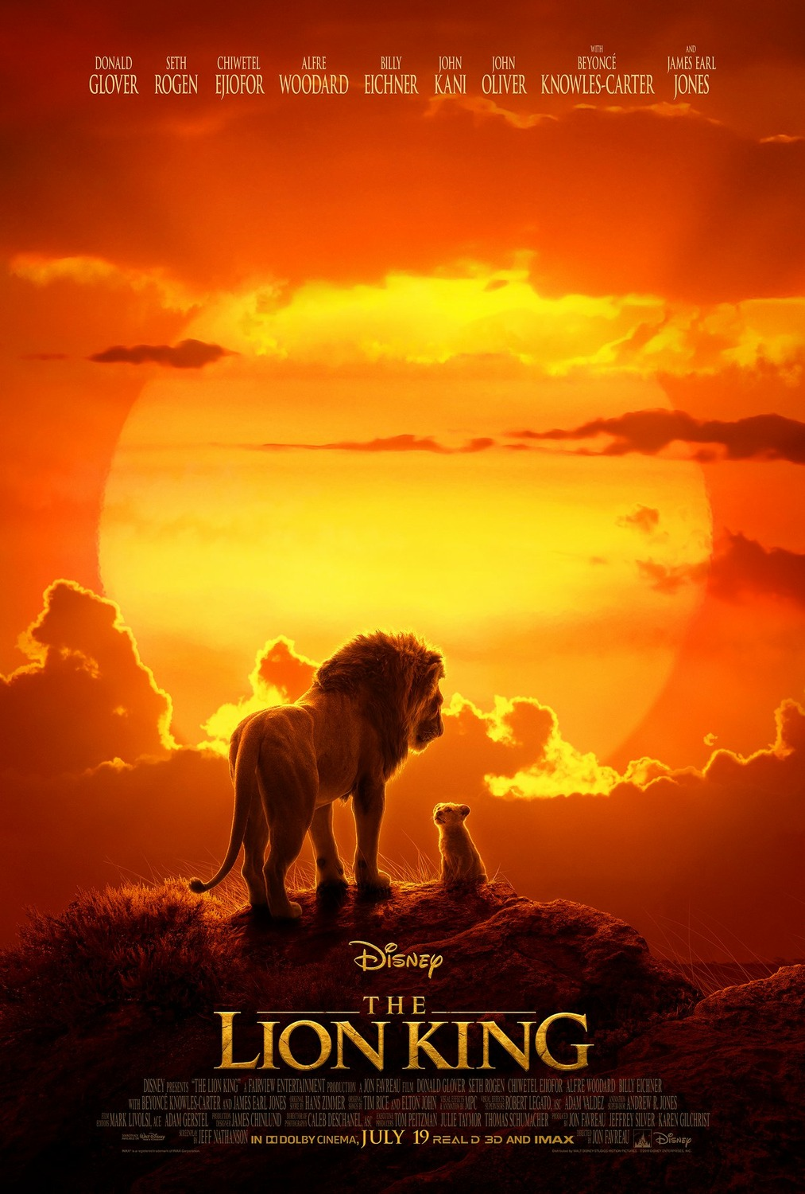
Now: The Lion King, 2019
THEN ANSWER
1
What is the same as 1994?
2
What looks different?
3
Why was it released online first?
WATCH 0:00 – END
Click the poster to play
Notes:
Drive clip "Lion King Digital.mp4", whole clip. Same story, studio and music, 25 years apart, but computer-generated (CGI) to look like real animals. Technology and platforms (YouTube, social media) changed the product; the story did not.

Slide 15
Then and now
TIMER 15 MIN
1
Task 2: watch both trailers, then answer the questions.
SUCCESS LOOKS LIKE
Full sentences in Tasks 3 and 4
Real product names, not "a game"
Says WHY, not just what
2
Task 3: write one difference, and why you think they changed.
3
Task 4: name one product YOU used from each sector.
4
Finished? ★ Remake it, the last tab.
UNLOCK WORD
SIMBA
FIND IT Hub › Lesson 1.1 › Tasks 2–4
Notes:
Unlock word SIMBA: students type it on any locked tab to open Tasks 2–4 and ★ Remake it (it stays open after a refresh). A teacher signed in through Classroom, or anyone typing "outwood", gets every part. Tasks 3–4 are writing: not auto-marked, sent to Classroom as evidence. ★ Remake it is optional extended writing and does not change the grade.

Slide 16
Exit ticket
BACK TO TODAY'S QUESTION
What are the three media sectors, and how has media changed since 2000?
Name the three media sectors, with one product from each. Then give one way The Lion King changed between 1994 and 2019.
START WITH "The three sectors are… One change since 1994 is…"
Notes:
Exit ticket. Next lesson: 1.2 Reading an Image (posters: denotation, connotation, anchorage, polysemy, encoding).

