Slide 1

Recap & Recall
TIMER 4 MIN
ANSWER IN YOUR BOOK — NO NOTES
1
LESSON 1.1
2
LESSON 1.1
Minecraft belongs in which media sector?
The Lion King (1994) was made before 2000, so it is…
interactive · print · audio / moving image?
historical · contemporary?
3
LESSON 1.1
4
BRIDGE
One change from the 1994 to the 2019 Lion King? E.g. 'how it was made'.
On your FIZZIKAL cover, the words around the cover star are…
cover lines · the masthead · the folio?
Notes:
Q1–3 look back at 1.1. Q4 bridges from the Component 3 mock into today: words change what a picture means (anchorage).

Slide 2
Answers
TICK OR FIX IN A DIFFERENT COLOUR
1
LESSON 1.1
2
LESSON 1.1
Minecraft belongs in which media sector?
The Lion King (1994) was made before 2000, so it is…
ANSWER Interactive: the player makes the choices
ANSWER Historical: made before 2000
3
LESSON 1.1
4
BRIDGE
One change from the 1994 to the 2019 Lion King? E.g. 'how it was made'.
On your FIZZIKAL cover, the words around the cover star are…
ANSWER Hand-drawn → computer-generated (CGI)
ANSWER Cover lines: words that steer what the picture means
Notes:
Tick or fix. Q4 is the hook: today we look at how words and pictures work together.

Slide 3
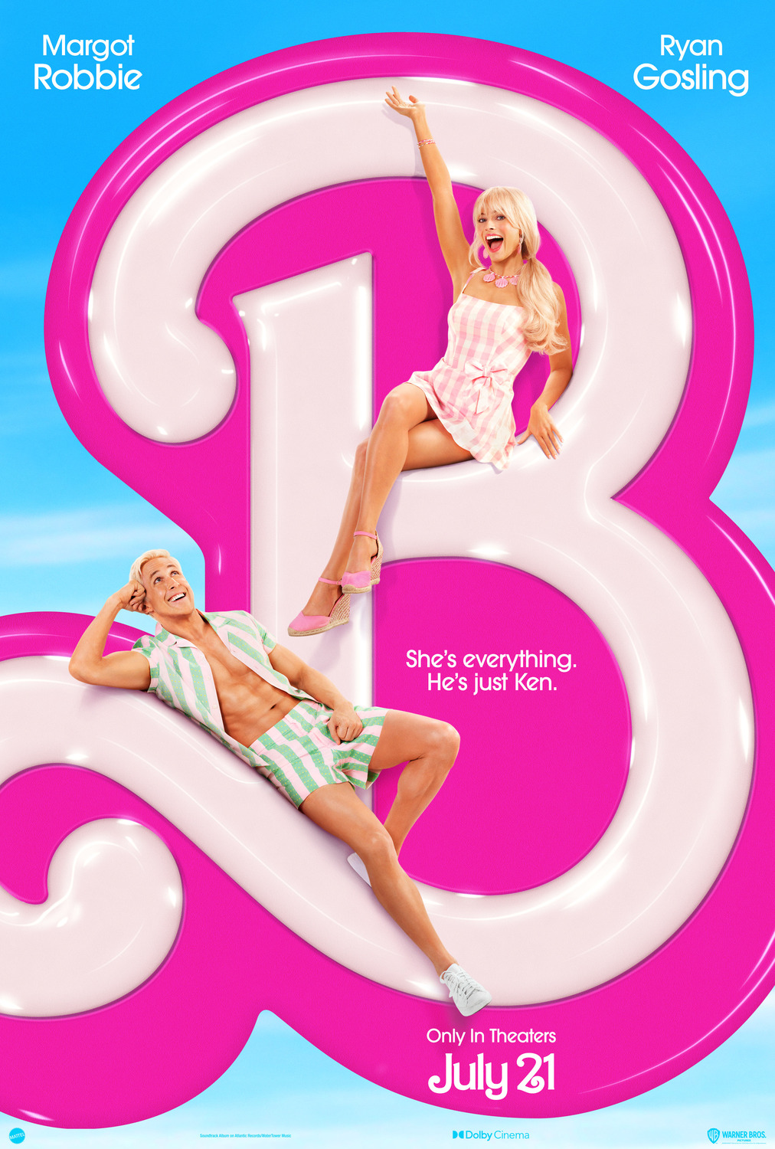
EXPLORING MEDIA
LESSON 1.2 · Y10 BTEC CREATIVE MEDIA
Lesson 1.2
Reading an Image
Every poster is built from choices. Today you learn to read them.
Notes:
Cover: the Barbie poster. Ask: what can you see, and what does it make you think? That is today in one question.

Slide 4

The big questions
TOPIC QUESTION — THE WHOLE OF COMPONENT 1
How are media products made to reach and engage their audiences?
TODAY'S QUESTION
How do images and words work together to make meaning?
Notes:
The topic question stays for the whole of Component 1; today's question comes back in the plenary.

Slide 5

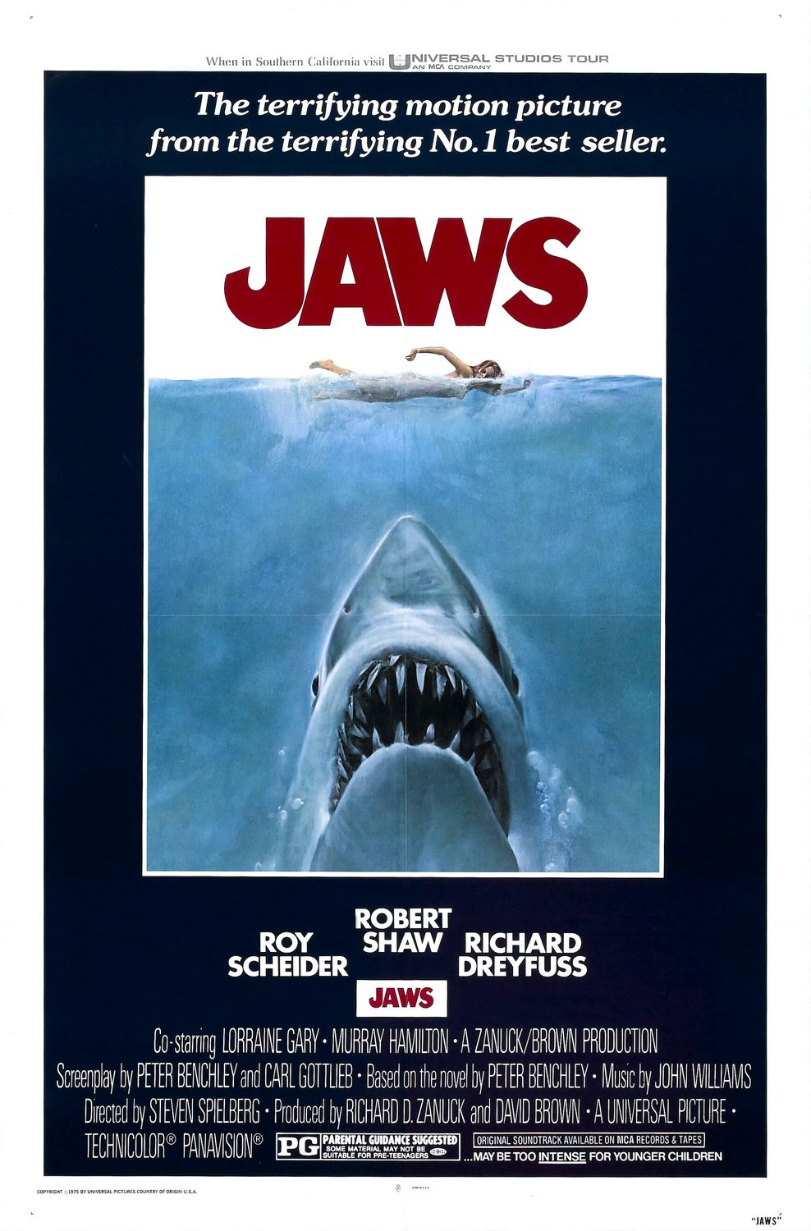
KEY TERM
Denotation
say: dee-noh-TAY-shun
What you can actually see or hear. Just describe it, no opinions.
IN THE REAL WORLD
On the Jaws poster: a woman swims at the top of the sea; a huge shark rises below her, mouth open.
Notes:
Spec textual analysis: denotation and connotation, encoding, anchorage, polysemy. Test: could two people argue about it? If not, it is denotation.

Slide 6
KEY TERM
Connotation
say: con-oh-TAY-shun
What it suggests: the ideas and feelings it gives you.
IN THE REAL WORLD
She has no idea what is below her. Danger is coming, and we know before she does, so we feel tense.
Notes:
Connotations come from denotations: always point to the thing you can see first.

Slide 7
KEY TERM
Anchorage
Words (a caption, title or tagline) that fix the meaning of an image, so we read it the way the producer wants.
IN THE REAL WORLD
"She's everything. He's just Ken." tells us whose film this is: Barbie is the star.
Notes:
Without the caption: two smiling people on a pink B. With it: a joke about who matters.

Slide 8
LESSON 1.2
1
Worked model: the Jaws poster
2
3
1
Tagline
"Terrifying" → this is horror (anchorage)
2
Title
Red capitals → blood, danger
4
3
Swimmer
Small, relaxed → helpless
4
Shark
Rising, mouth open → a killer coming
See it (denotation) → read it (connotation) → fix it (anchorage).
Notes:
Markers sit beside the feature they label. Model aloud: say the denotation, then "this suggests…", then how the words anchor it. Hub Task 1 repeats this model, then students sort 8 new statements.

Slide 9

Which one?
"The swimmer is about to be attacked." Is that denotation, connotation or anchorage?
A
B
C
Denotation: we can see it
Connotation: it is suggested
Anchorage: the words say so
Notes:
Answer B. We never see an attack: we see a shark and a swimmer, and we read danger into it.

Slide 10
KEY TERM
Encoding
say: en-KOH-ding
The producer chooses every detail on purpose to put a meaning in. We decode it when we read it.
IN THE REAL WORLD
Jaws: a red title, a tiny swimmer and a shark she cannot see, all chosen to encode danger.
Notes:
Encoding is the producer's side; connotation is what we read. Ask: why did the designer make the swimmer so small? Nothing on a poster is an accident.

Slide 11
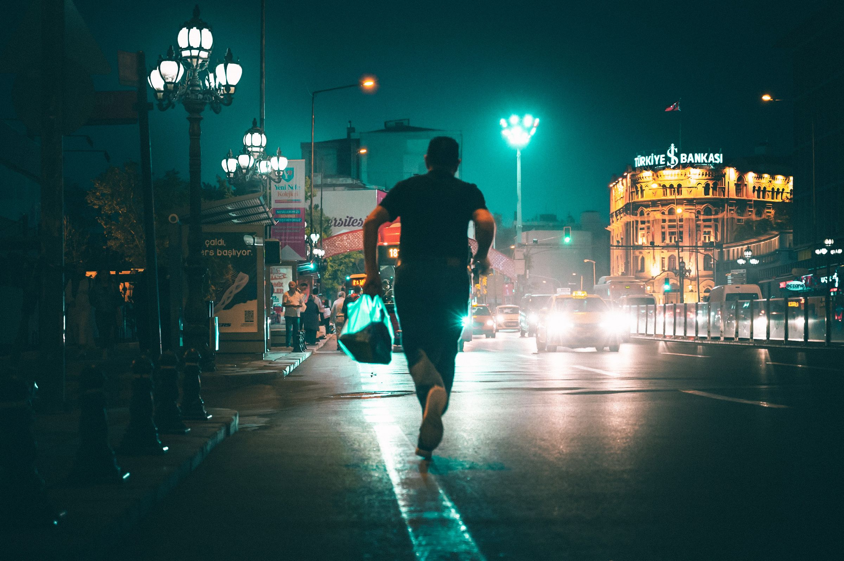
KEY TERM
Polysemy
say: puh-LISS-uh-mee
An image can be read in more than one way. Producers use anchorage to pick one.
IN THE REAL WORLD
Someone running at night: late for the bus, being chased, or out training? A caption decides.
Notes:
This is one of the three photos for the Photoshop task. Ask for three readings before revealing the term.

Slide 12

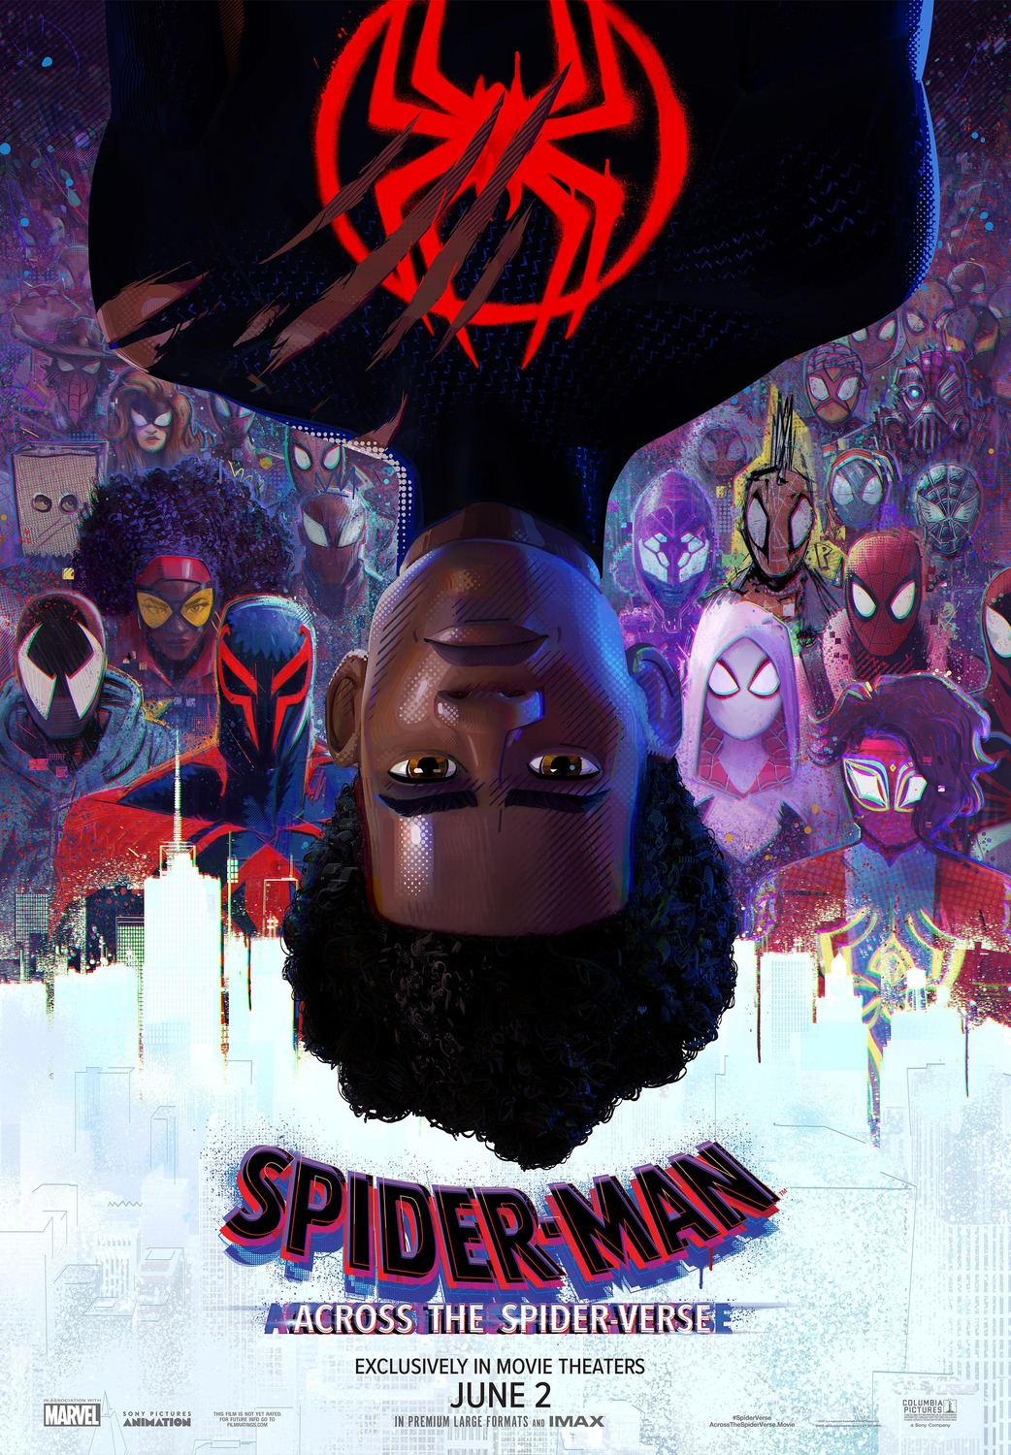
Turn & Talk
TIMER 3 MIN
Spider-Verse: name one thing you can SEE. Then say what it SUGGESTS.
1
Think on your own: 30 seconds
2
Partner A answers. B listens.
3
B adds one thing or disagrees, with a reason.
Notes:
Denotation then connotation, out loud, before writing it in hub Task 3. Look for: Miles upside down (his world is flipped), claw marks on his suit (danger), dozens of Spider-People (many worlds, a crowd hunting him). Push for encoding: why did the designers put him upside down?

Slide 13
What a good analysis sounds like
How does the Jaws poster make the audience feel?
Point
The Jaws poster makes the audience feel that danger is close. A huge shark rises from the dark water towards a swimmer who cannot see it. This connotes that she is helpless and the threat is hidden, so we feel tense, and the word "terrifying" anchors it as a horror film.
Evidence
Explain
Notes:
Point → evidence (denotation) → explain (connotation + anchorage). Students use this shape in hub Task 3 on Spider-Verse.

Slide 14
Read the posters
TIMER 20 MIN
1
New words feel tricky? Warm-up tab first: match each word to its meaning.
SUCCESS LOOKS LIKE
Denotation = only what you see
Connotation points to a detail
Says how the words fix the meaning
2
Task 1: Jaws. Read the worked model, then sort 8 statements.
3
Tasks 2–3: Barbie questions, then Spider-Verse in full sentences, ending with encoding.
4
Finished? ★ Rewrite the meaning: a new genre and tagline for Jaws.
FIND IT Hub › Year 10 › Lesson 1.2 › Reading an Image
Notes:
Tasks 1–2 are auto-marked with cooldowns; Task 3 is writing sent to Classroom. Each task has a 💡 help panel (how to tell denotation from connotation, things to look for, a word bank). Differentiation: Warm-up (Match the words) and ★ Rewrite the meaning (change the anchorage of Jaws; two readings of Spider-Verse). Optional tabs do not change the grade.

Slide 15
One photo, two captions
TIMER 20 MIN
1
Pick a photo on the hub and download it from the Photo Bank.
SUCCESS LOOKS LIKE
Same photo, two opposite meanings
Captions are short, like real ones
Both JPGs attached in Classroom
2
Photoshop: File › Open, then the Type Tool (T): add caption 1.
3
File › Export › Export As… JPG. Change the text to caption 2 and export again.
4
Hub: polysemy (two things it could mean), then each caption and the meaning it anchors.
FIND IT Hub › Lesson 1.2 › Task 4 · photos in Drive › Photo Bank
Notes:
Polysemy + anchorage made practical. The hub previews each caption on the photo as they type. Photos: Pexels (free, no attribution).

Slide 16
Exit ticket
BACK TO TODAY'S QUESTION
How do images and words work together to make meaning?
Pick one poster from today. Write one denotation, one connotation, and one thing the designers chose to encode.
START WITH "On the ___ poster I can see ___, which suggests ___. The designers chose it to…"
Notes:
Exit ticket. Stretch: how do its words anchor the meaning?

