Slide 1

Recap & Recall
TIMER 4 MIN
ANSWER IN YOUR BOOK — NO NOTES
1
C3 MOCK
2
C3 MOCK
The client's instructions for your FIZZIKAL cover are called the…
Which design principle makes the most important thing on a page the biggest?
brief · masthead · mood board?
hierarchy · alignment · white space?
3
C3 MOCK
One thing to improve on your FIZZIKAL cover? E.g. 'clearer cover lines'.
Notes:
Bridge from the Component 3 mock (the FIZZIKAL magazine cover). Choices or an example in each question.

Slide 2
Answers
TICK OR FIX IN A DIFFERENT COLOUR
1
C3 MOCK
2
C3 MOCK
The client's instructions for your FIZZIKAL cover are called the…
Which design principle makes the most important thing on a page the biggest?
ANSWER Brief: what to make, and who it is for
ANSWER Hierarchy
3
C3 MOCK
One thing to improve on your FIZZIKAL cover? E.g. 'clearer cover lines'.
ANSWER Any real improvement, with a reason
Notes:
Tick or fix. Q3: take two or three answers aloud.

Slide 3
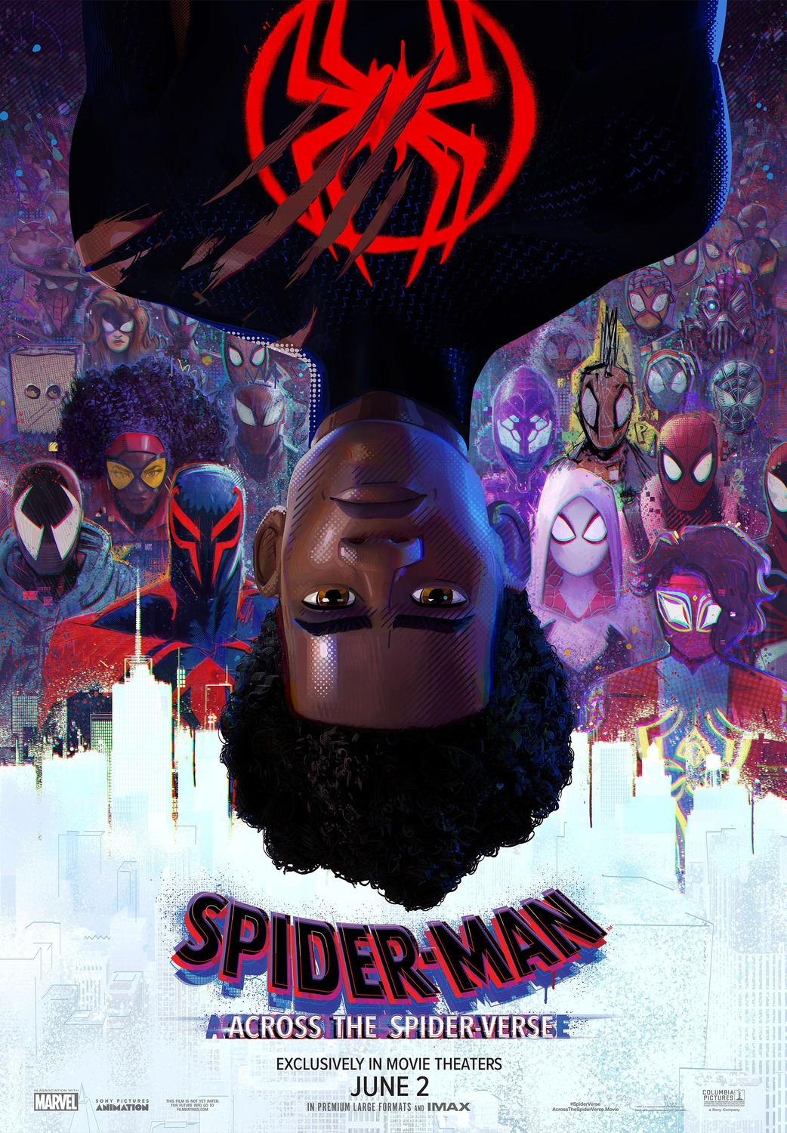
EXPLORING MEDIA
LESSON 1.0 · Y10 BTEC CREATIVE MEDIA
Start here
Welcome to Creative Media
Films, games, magazines, apps: this course is about how they are made, and who for.
Notes:
This class only: the double-first class starts at Lesson 1.1. Next lesson for this class is 1.1 Media Everywhere.

Slide 4

The big questions
TOPIC QUESTION — THE WHOLE OF COMPONENT 1
How are media products made to reach and engage their audiences?
TODAY'S QUESTION
What is this course, and how is Component 1 assessed?
Notes:
The topic question runs through all of Component 1.

Slide 5

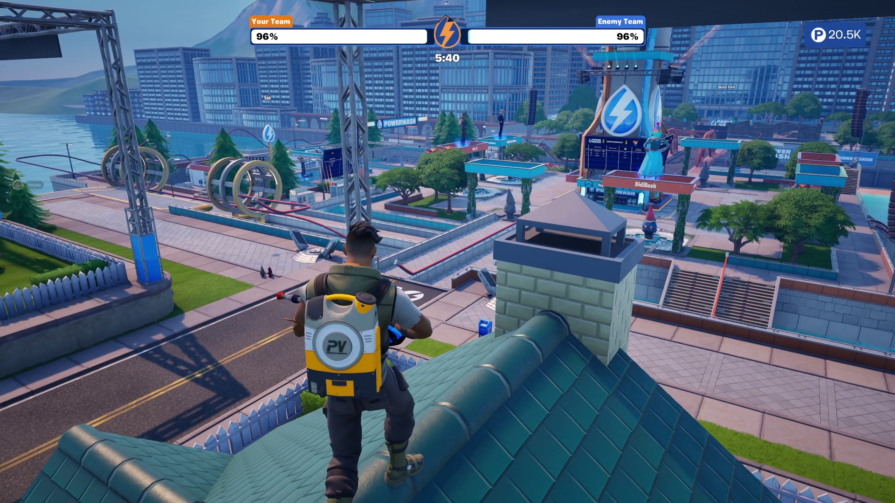
KEY TERM
Media product
Anything made to reach an audience through sound, moving pictures, print or a screen.
IN THE REAL WORLD
A Fortnite season, a Smash Hits cover from 1989, a Radio 1 breakfast show: all media products.
Notes:
Ask for examples from their last 24 hours before revealing the example line.

Slide 6
Three components
The BTEC Tech Award in Creative Media Production has three parts. You need all three.
1
Component 1 · Exploring Media Products How real media products are made for their audiences. Now until the spring.
2
Component 2 · Developing Digital Media Production Skills Hands-on skills in one sector: video, print or interactive.
3
Component 3 · Create a Media Product in Response to a Brief Make your own product for a client. Set and marked by Pearson.
Notes:
From the specification: C1 and C2 are internally assessed (36 guided hours each); C3 is external and synoptic (48 hours). They did a C3-style mock with FIZZIKAL.

Slide 7
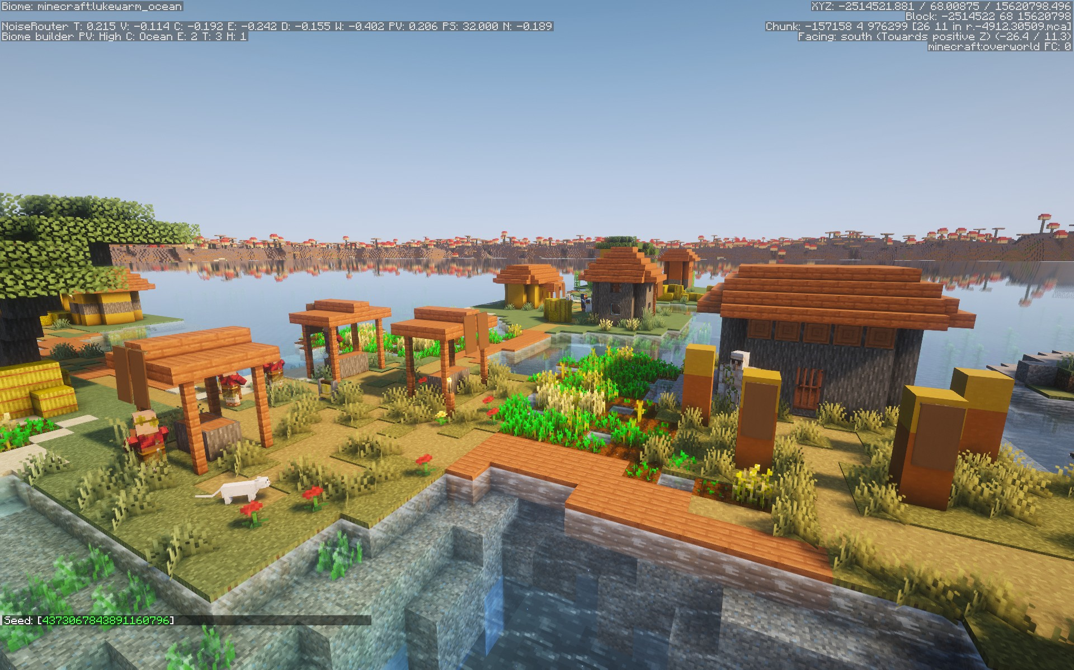
Component 1: what you will learn
Real media products you know, and some made before you were born.
1
Three sectors Audio / moving image, print and interactive.
2
Products, audiences, purposes Who makes media, who it is for, and why.
3
Making meaning Genre, narrative, representation, and the techniques that create them.
4
Then and now Products from before 2000 and from 2000 onwards.
Notes:
Learning outcomes A (investigate media products) and B (how products create meaning and engage audiences).

Slide 8
How Component 1 is assessed
One piece of assessed work, done in lessons, after we have learned everything it needs.
1
A Pearson-set assignment Pearson writes the task. You complete it in class, under supervision, in the spring term.
2
Two tasks Task 1: research media products, their purposes and audiences. Task 2: explain how products create meaning.
3
Your choices, your work You choose your own products. All the work must be yours: no AI tools, no copying.
4
Marked here, checked by Pearson Your teacher marks it, and Pearson checks a sample of the marking.
Notes:
General description only (spec + sample PSA). Do NOT mention the live assignment's theme, client, audience or dates. Practice comes first: every lesson until Christmas builds the knowledge the tasks need.

Slide 9

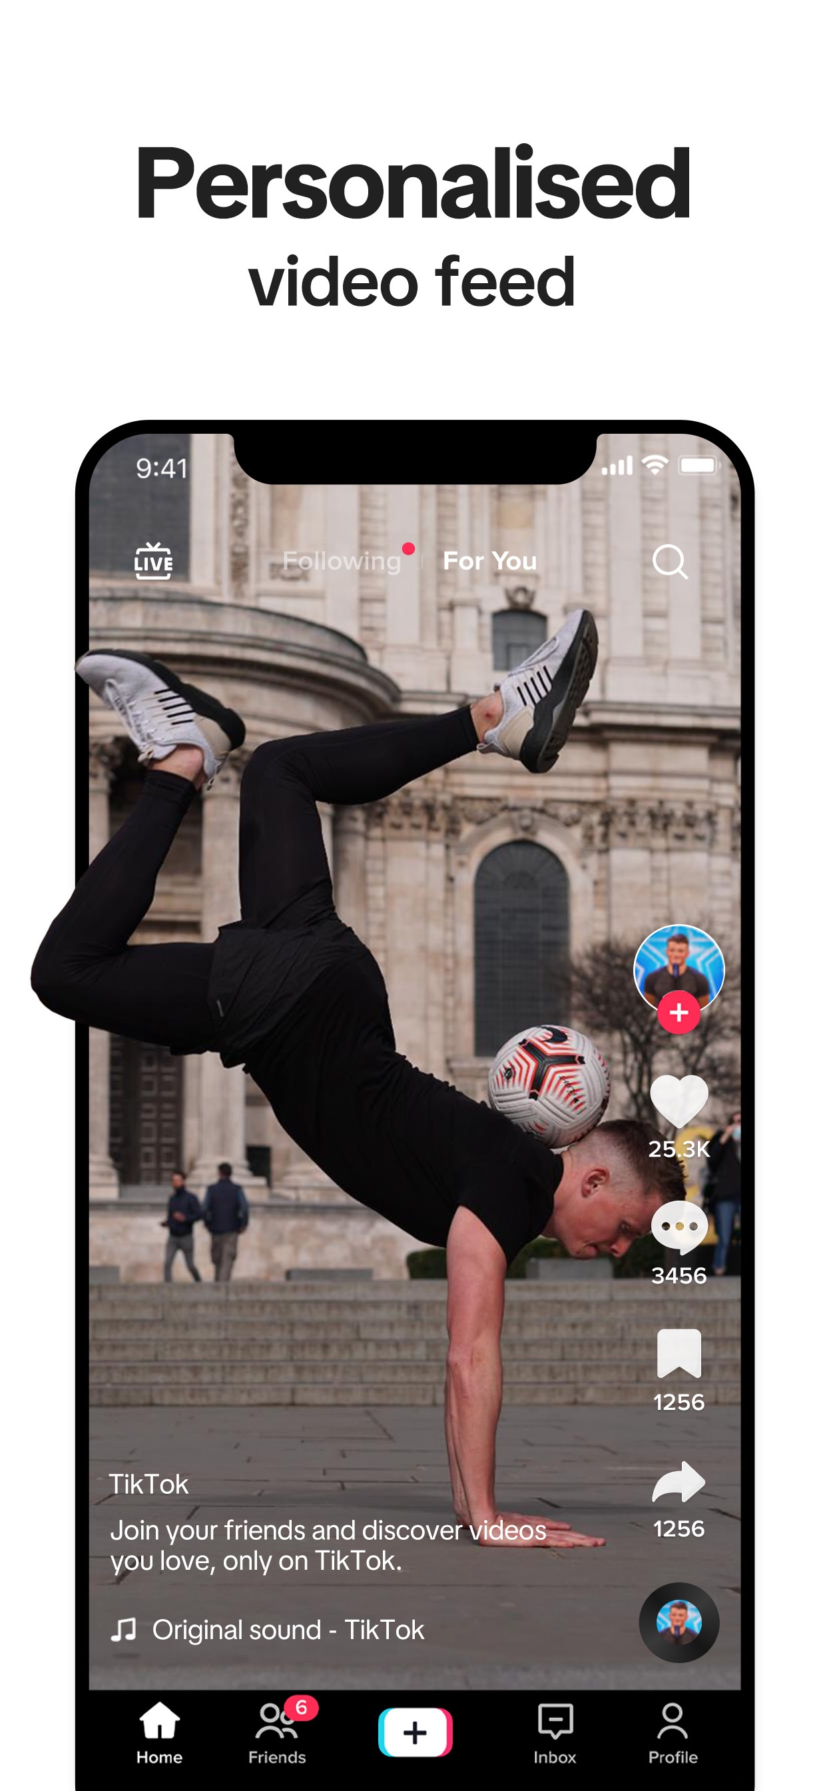
Turn & Talk
TIMER 3 MIN
Which media product could you not live without for a week? Why that one?
1
Think on your own: 30 seconds
2
Partner A answers. B listens.
3
B adds one thing or disagrees, with a reason.
Notes:
Warm-up for the baseline: they will write their favourites on the hub. Listen for the sectors they name.

Slide 10
Baseline: where are you starting?
TIMER 25 MIN
1
Open Welcome to Creative Media on the hub.
SUCCESS LOOKS LIKE
Real product names
Full sentences
Two clues from the poster
2
Task 1: your media: one product of each kind, and what you want to make.
3
Task 2: read the A Minecraft Movie poster: four questions, full sentences.
4
Save: it goes to your teacher. There are no wrong answers.
FIND IT Hub › Year 10 › Lesson 1.0 › Welcome to Creative Media
Notes:
Completion-scored (100% when finished): a baseline, not a test. Compare with their 1.2 and later writing.

Slide 11
Exit ticket
BACK TO TODAY'S QUESTION
What is this course, and how is Component 1 assessed?
Tell your partner one thing Component 1 will make you do, and one question you still have.
START WITH "In Component 1 I will… I still want to know…"
Notes:
Collect two or three questions. Next lesson: 1.1 Media Everywhere.

