Slide 1

Recap & Recall
TIMER 4 MIN
ANSWER IN YOUR BOOK — NO NOTES
1
LESSON 1.2
2
LESSON 1.2
Words that fix what a picture means are called…
"The shark suggests danger." Denotation or connotation?
anchorage · polysemy · denotation?
denotation · connotation?
3
LESSON 1.1
4
BRIDGE
A magazine belongs in which media sector?
Which company made A Minecraft Movie (2025)?
print · interactive · audio / moving image?
Mojang · Warner Bros. · Netflix?
Notes:
Q1–2 look back at 1.2, Q3 at 1.1. Q4 bridges into today: the game and the film have different producers. Who are they, and why do they make things?

Slide 2
Answers
TICK OR FIX IN A DIFFERENT COLOUR
1
LESSON 1.2
2
LESSON 1.2
Words that fix what a picture means are called…
"The shark suggests danger." Denotation or connotation?
ANSWER Anchorage: e.g. "He's just Ken."
ANSWER Connotation: it is suggested, not seen
3
LESSON 1.1
4
BRIDGE
A magazine belongs in which media sector?
Which company made A Minecraft Movie (2025)?
ANSWER Print
ANSWER Warner Bros. Mojang made the game
Notes:
Tick or fix. Q4: Mojang (owned by Microsoft) made the game; Warner Bros. made the film. Today: what kind of company is Warner Bros., and why did it make the film?

Slide 3
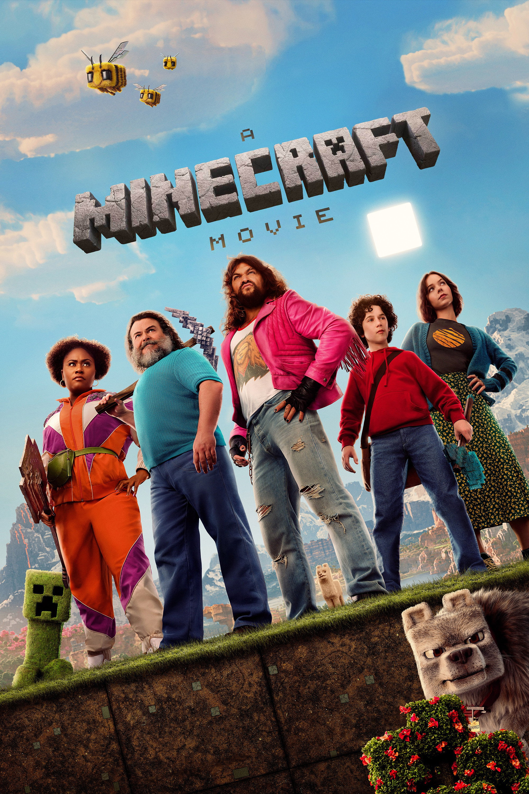
EXPLORING MEDIA
LESSON 1.3 · Y10 BTEC CREATIVE MEDIA
Lesson 1.3
Who Made It and Why?
Every media product has a producer, and a reason.
Notes:
Cover: A Minecraft Movie. Ask: who made it? Why would they make a film of a game? Hold the answers: we come back to Warner Bros. in Sam's paragraph (Task 2).

Slide 4

The big questions
TOPIC QUESTION — THE WHOLE OF COMPONENT 1
How are media products made to reach and engage their audiences?
TODAY'S QUESTION
Who makes media products, and why do they make them?
Notes:
Topic question for the whole of Component 1; today's question comes back in the plenary.

Slide 5

Four kinds of producer
The producer is whoever makes a media product.
1
Media conglomerate A giant company that owns lots of media businesses. Disney, Sony.
2
Public service broadcaster A duty to serve the whole public, not just make money. The BBC, Channel 4.
3
Independent producer A person or small company no media giant owns. ConcernedApe (Stardew Valley).
4
Community media Made by and for a local area or group, not for profit. Hospital radio.
Notes:
Spec A1 producer types. One per click. For each, ask: who owns it, and how is it paid for? Those two questions decide the type.
Conglomerate: Disney owns Pixar, Marvel, Star Wars. Public service broadcaster: paid for by the TV licence (BBC) or adverts but owned by the public (Channel 4), with a duty to inform, educate and entertain. Independent: Toby Fox made Undertale almost alone. Community: often volunteers.

Slide 6

Which one?
BBC Radio 1 is paid for by the TV licence and plays no adverts. Which kind of producer makes it?
A
B
C
D
A media conglomerate
A public service broadcaster
An independent producer
Community media
Notes:
Answer B. The TV licence and the duty to serve everyone make it a public service broadcaster. If anyone says A: the BBC is big, but size alone isn't the test; who pays and who it must serve is.

Slide 7

Name the producer
TIMER 12 MIN
1
The page opens on the Warm-up tab: sort 8 examples, two per kind of producer.
SUCCESS LOOKS LIKE
Ask: who owns it?
Ask: how is it paid for?
All seven rounds solved
2
Task 1 · Mystery producer: each round names a real producer. Read the clue and name its type.
3
Guess on clue 1 for ★★★. A wrong guess shows the next clue, but loses gold and makes you wait.
FIND IT Hub › Year 10 › Lesson 1.3 › Who Made It and Why?
Notes:
Warm-up is optional: its definitions are open on the page. Confident students can go straight to Task 1. Clues go from vague to clear: who owns it, how it is paid for, how big it is. Dotted words on the page show their meaning on hover or tap.

Slide 8
Purpose, motivation, aim
Three questions to ask about every product.
1
Purpose What the product does for the audience.
2
Motivation Why the producer makes it: what they want or get.
3
Aim What the producer wants the product to be like.
Notes:
One per click. The test for purpose versus motivation: who gets it? If the audience gets it (a laugh, facts), it is a purpose. If the producer gets it (money, a message heard), it is a motivation.

Slide 9
The words to use
Purpose for the audience
Motivation for the producer
Aim what it is like
entertain fun, a laugh, a story
inform give facts
educate teach
persuade get you to do or buy
inspire make you feel you could too
challenge question an idea
generate profit make money
raise awareness make people know
benefit a community help an area or group
self-expression show your own ideas
innovation do something new
public service responsibilities a duty to serve everyone
high quality well made, expensive-looking
distinctive stands out
accessible easy for everyone to use
diverse many kinds of people
inclusive everyone feels welcome
impartial fair to every side
Notes:
One column per click. These are the exact spec words: use them, not near-misses ("to make money" is fine in speech, but write "generate profit"). Students have them on the page too: dotted words show their meaning, and Task 3 has a "The words" panel.

Slide 10
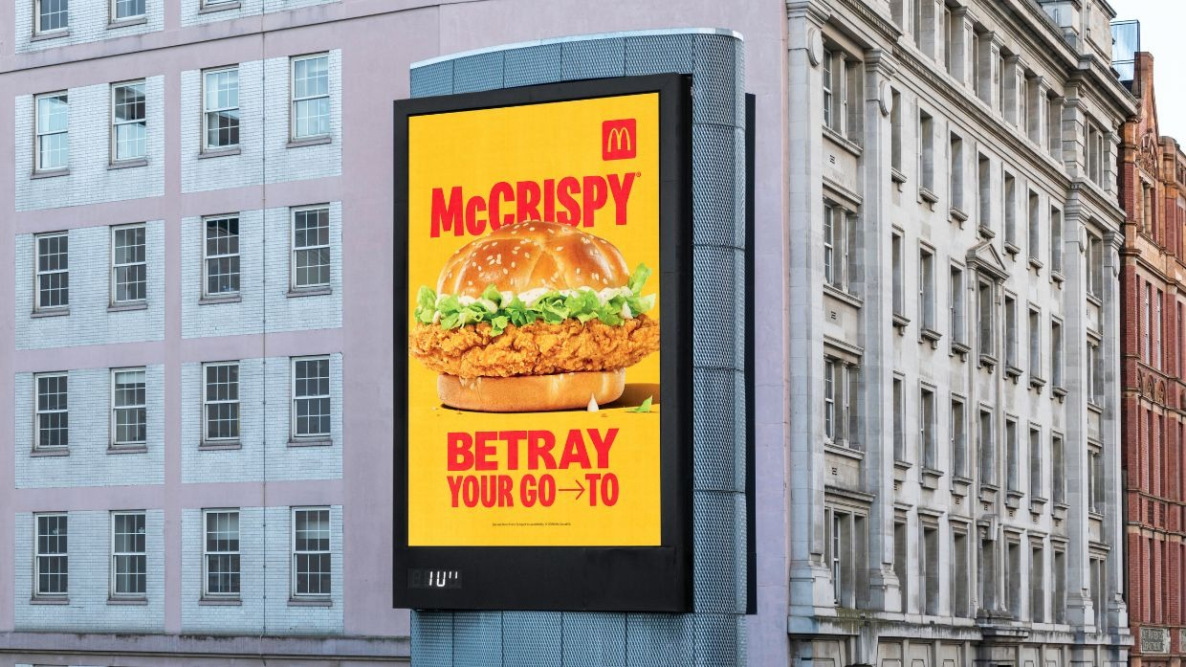
Worked model: the McCrispy billboard
1
Purpose: persuade
"Betray your go-to": swap your usual order
2
2
Motivation: generate profit
Every swap is a burger sold
3
3
Aim: distinctive
Yellow, one burger, three words: it's McDonald's
1
Purpose: the audience gets it. Motivation: the producer gets it.
Notes:
Model aloud, in this order: what does it do to me (purpose), what does McDonald's get (motivation), what did they want it to look like (aim)? Hub Task 2 repeats this model before students spot Sam's slips.

Slide 11
Which one?
Sam writes: "The purpose of the billboard is to make money." What has Sam got wrong?
A
B
C
Making money is a motivation
A billboard has no purpose
Making money is an aim
Notes:
Answer A, and the most common slip moderators see. The audience doesn't get the money; McDonald's does, so it is a motivation. The purpose is to persuade. Task 2 has four slips like this in Sam's paragraph about A Minecraft Movie.

Slide 12
What a good answer sounds like
Who made Stardew Valley, and what is its purpose?
Producer
Stardew Valley was made by ConcernedApe, which is an independent producer. Its purpose is to entertain, because you relax by running your own farm at your own pace.
Purpose
Reason
Notes:
This is the shape for hub Task 4: name the producer and its type, give the purpose in the spec word, then say why with something from the product. Then go deeper on one product: its motivation and one aim.

Slide 13
Turn & Talk
TIMER 3 MIN
Think of a game, show or app you used this week.
Who made it? What kind of producer are they, and why did they make it?
1
Think on your own: 30 seconds
2
Partner A answers. B listens.
3
B adds one thing or disagrees, with a reason.
Notes:
Everyone says one product out loud before writing Task 4. Push for the spec words: "a conglomerate", "to generate profit". If no one knows who made it: search "<name> made by", or check the credits or app store page (the page's help panel says the same).

Slide 14
Spot it, name it, use it
TIMER 25 MIN
1
Task 2 · Spot the slip: click each wrong sentence in Sam's paragraph, check, then pick each fix.
SUCCESS LOOKS LIKE
Purpose = what the audience gets
Motivation = what the producer gets
Uses today's exact words
2
Task 3 · Name the reason: pick the exact word for each real product.
3
Task 4 · Your turn: one product per sector, in full sentences.
4
Finished? ★ Tricky cases, the last tab: MrBeast, Metro and the BBC.
FIND IT Hub › Year 10 › Lesson 1.3 › Who Made It and Why?
Notes:
Tasks 2–3 are auto-marked with cooldowns; Task 4 is writing sent to Classroom. A wrong check in Task 2 marks only the sentences students flagged, so they have to find the missed slips themselves. ★ Tricky cases is optional and doesn't change the grade.

Slide 15
Exit ticket
BACK TO TODAY'S QUESTION
Who makes media products, and why do they make them?
Pick one product from today. Name its producer, the kind of producer, one purpose and one motivation.
START WITH "___ was made by ___, a ___. Its purpose is to ___, and the motivation is to ___."
Notes:
Exit ticket. Check that purpose and motivation are not the same thing in their answer.

