Slide 1

Recap & Recall
● NAV BEACON · SIGNAL WEAK ▂▁▃▁ · RESCUE SHIP: NO REPLY
⏱ 5 MIN
No notes. Answer every question — a guess beats a blank. Then rate your confidence: 1, 2 or 3.
1
LAST LESSON
CHOOSE A, B OR C
2
LAST LESSON
CHOOSE A, B OR C
code holds "4271". Which one is True?
How many times does the loop run?
A code != "4271"
n = 0
A 2
B code == "4271"
while n < 3:
B 3
C code == 4271
n = n + 1
C 4
3
LESSON 2
WRITE IT
4
LAST LESSON
WRITE IT
IndentationError. What is missing on line 2?
What is printed?
if x > 5:
tries = 3
print("Big")
print("Tries: " + str(tries))
Notes:
DO NOW — 5 minutes, silent, no notes. Mini-whiteboards or books.
Q1, 2 and 4 are from last lesson, Locked In: != and ==, a while loop, str(). Q3 (indentation) is from Lesson 2.
Q1–2 are multiple choice (everyone commits to an answer). Q3 is the easy one: everyone can write something. Q4 needs a written answer.
Confidence rating 1–3 next to each answer — confident-but-wrong is the one most worth correcting.

Slide 2
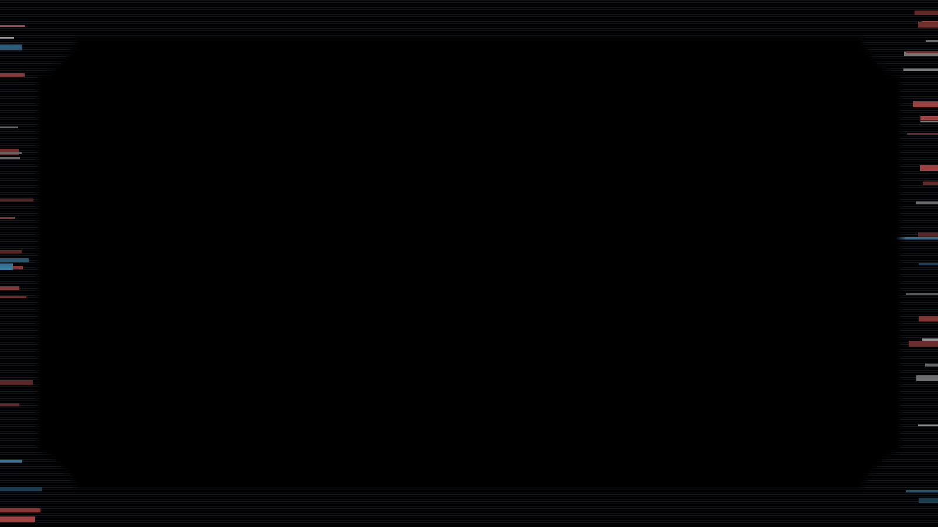
Recap & Recall — answers
● NAV BEACON · SIGNAL WEAK ▂▁▃▁ · RESCUE SHIP: NO REPLY
Mark your own. Confident but wrong? Those are the ones to fix.
1
LAST LESSON
CHOOSE A, B OR C
2
LAST LESSON
CHOOSE A, B OR C
code holds "4271". Which one is True?
How many times does the loop run?
A code != "4271"
the same text, quotes and all
n = 0
A 2
n is 0, 1, 2 inside; at 3 the check is False
B code == "4271"
while n < 3:
B 3
C code == 4271
n = n + 1
C 4
3
LESSON 2
WRITE IT
4
LAST LESSON
WRITE IT
IndentationError. What is missing on line 2?
What is printed?
if x > 5:
tries = 3
print("Big")
print("Tries: " + str(tries))
An indent 4 spaces: the line belongs to the if
Tries: 3 str() made 3 into text
Notes:
Reveal and self-mark. Hands up for "confident and wrong" on each.
Q1: == asks "is it equal?": the same text, so True. != is False here. C compares with the NUMBER 4271, not the text "4271", so it's False.
Q2: n is 0, 1, then 2 when the check is True, so the body runs 3 times. When n reaches 3, 3 < 3 is False and the loop stops. Keep this one in mind: a loop that runs a set number of times needs a counter and a check. Today there's a tidier way.
Q3: the line under an if must be indented (4 spaces), or Python doesn't know it belongs to the if. Today the indent decides which lines REPEAT.
Q4: str() turned 3 into the text "3", so + joins it on: Tries: 3.

Slide 3
● NAV BEACON · SIGNAL WEAK ▂▁▃▁ · RESCUE SHIP: NO REPLY
Y9 PYTHON · LESSON 4 · FOR LOOPS
STATION STATUS
Station Zero
NAVIGATION ..... DARK
BEACON PROGRAM . WIPED
RESCUE SHIP .... NO CONTACT
Chapter 4 — Distress Signal
STORM .......... CLOSING
> _
Notes:
Recap the story out loud — don't put it on screen:
"You got through the airlock. Behind you, the intercom used Hale's voice: 'Let me in. It's me.' The voiceprint said NO MATCH. Now you're in Navigation, and it's dark. The storm has wiped the beacon program — and without the beacon, the rescue ship will never find you."
Today we rewrite the beacon. It flashes shapes out into space, and each shape is a different message. A shape is the same move repeated: that's a loop.
In Slide Show this slide fades in through black and the static creeps in: let it finish before you speak.

Slide 4

What are we learning?
● NAV BEACON · SIGNAL WEAK ▂▁▃▁ · RESCUE SHIP: NO REPLY
TOPIC QUESTION
How do we write programs that make decisions, repeat and reuse code?
LESSON QUESTION
How do we make a program repeat lines a set number of times?
Notes:
Topic question = the whole unit. Last lesson was "repeat while a condition is True". Today is still "repeat", but a SET number of times.
We come back to this question in the plenary.

Slide 5

Meet the turtle
● NAV BEACON · SIGNAL WEAK ▂▁▃▁ · RESCUE SHIP: NO REPLY
I DO
1
import turtle
BEACON DISPLAY
load the turtle
2
t = turtle.Turtle()
make a turtle called t
3
t.forward(100)
move 100, drawing a line
4
t.left(90)
turn left 90°
A turtle is a pen you steer: it draws a line wherever it moves.
Notes:
Some of you met the turtle in Year 8. One line per click.
1 import turtle: load Python's turtle drawing tools. Nothing appears yet.
2 t = turtle.Turtle(): make a turtle and call it t. It appears in the middle, facing right (east).
3 t.forward(100): move forward 100 steps. The pen is down, so it draws a line.
4 t.left(90): turn left 90° on the spot. A turn draws nothing; it only changes where the turtle faces.
Ask: "What would t.forward(100) do now?" (Draw a line upwards.) In the activity, this screen is the station's Beacon display.

Slide 6
A square: the same two lines, 4 times
● NAV BEACON · SIGNAL WEAK ▂▁▃▁ · RESCUE SHIP: NO REPLY
3
t.forward(100)
1
THE SAME SQUARE, WITH A LOOP
4
t.left(90)
5
t.forward(100)
3
for i in range(4):
4 times
2
6
t.left(90)
4
t.forward(100)
7
t.forward(100)
3
8
t.left(90)
5
t.left(90)
9
t.forward(100)
4
10
t.left(90)
The indented lines repeat. Change 4, and they repeat a different number of times.
Notes:
(Lines 1–2, import and make the turtle, are left off here: they don't change.)
Before click 1, ask: "How do you draw a square with the turtle?" Forward, turn, four times over: eight lines.
Click 1: the same two lines, four times. Copying lines is slow, and easy to get wrong: miss one turn and the square breaks.
Click 2: a for loop says it once. for i in range(4): repeats the indented lines 4 times. It's the same colon and the same indent as your while loops last lesson; what's new is that it counts for you.
This is the beacon program from today's activity: lines 3 to 5.

Slide 7
Watch it run
● NAV BEACON · SIGNAL WEAK ▂▁▃▁ · RESCUE SHIP: NO REPLY
I DO
i · int
1
import turtle
0
1
2
3
2
t = turtle.Turtle()
3
for i in range(4):
BEACON DISPLAY
4
t.forward(100)
5
t.left(90)
range(4) gives 0, 1, 2, 3. Four times round: lines 4 and 5 run 4 times.
Notes:
I DO — the whole program, one line per click (15 clicks). Students just watch; you narrate every click in the same words.
Before click 1, point at the shape: for, a name (i), in range(4), a colon; the indented lines are the body, like a while.
1 "import turtle." 2 "Make the turtle t." It appears facing right.
3 "for i in range(4): i gets the first number from range(4): 0." The box shows 0.
4 "t.forward(100): the first side." 5 "t.left(90): turn. End of the body…"
6 The gold arrow: "…so BACK TO THE FOR LINE. i gets the next number: 1." 7–8: side two, turn.
9 "Back up: i is 2." 10–11. 12 "Back up: i is 3." 13–14: the last side and turn.
15 The takeaway. Ask: "Why does i stop at 3, not 4?" range(4) gives four numbers, starting at 0 and stopping BEFORE 4.
Compare with last lesson: no counter to set up, no n = n + 1, no condition to get wrong. for counts for you.

Slide 8

One change: range(3)
● NAV BEACON · SIGNAL WEAK ▂▁▃▁ · RESCUE SHIP: NO REPLY
WE DO
1
How many times round?
3
1
import turtle
2
t = turtle.Turtle()
2
What is in i, the last time round?
2
3
for i in range(3):
Sketch what it draws
3
4
t.forward(100)
5
t.left(90)
On your board: answer 1, then 2, then 3. Boards up after each one.
Notes:
WE DO — the beacon program with ONE change: range(3) instead of range(4) (outlined). Boards up after each question, THEN click.
1 → 3: range(3) means 3 times round.
2 → 2: i is 0, 1, 2. The last time round it's 2, not 3. (The most common slip.)
3 → three sides of the square, with the last side missing: the turtle ends at the top left, facing down.
Ask: "Which lines repeat?" (4 and 5: they're indented.) "What would make it a square again?" (range(4).)

Slide 9
What does it do? Your turn
● NAV BEACON · SIGNAL WEAK ▂▁▃▁ · RESCUE SHIP: NO REPLY
YOU DO
⏱ 3 MIN
1
Sketch it
2
Write what it prints
3
Write what it prints
1
import turtle
1
for i in range(3):
1
for i in range(4):
2
t = turtle.Turtle()
2
print(i)
2
print("Beacon")
3
for i in range(2):
3
print("Sent")
4
t.forward(100)
?
5
t.left(90)
?
?
On your board: sketch 1, write what 2 and 3 print.
Notes:
YOU DO — silent, 3 minutes. Boards up together on 3-2-1.
Card 1 is a drawing: sketch it. Cards 2 and 3 print: write exactly what appears, one line each.

Slide 10

What does it do? — answers
● NAV BEACON · SIGNAL WEAK ▂▁▃▁ · RESCUE SHIP: NO REPLY
1
2 times round: two sides
2
starts at 0, stops before 3
3
Sent isn’t indented: once
1
import turtle
1
for i in range(3):
1
for i in range(4):
2
t = turtle.Turtle()
2
print(i)
2
print("Beacon")
3
for i in range(2):
3
print("Sent")
4
t.forward(100)
OUTPUT
5
t.left(90)
0
OUTPUT
1
Beacon
2
Beacon
Beacon
Beacon
Sent
Notes:
Go through any the class split on.
1: range(2) → only 2 times round: forward, left, forward, left. Two sides of the square: a corner, with the turtle facing left at the end.
2: 0, 1, 2. Not 1, 2, 3 and not 0 to 3: range(3) starts at 0 and stops BEFORE 3. Still 3 numbers.
3: Beacon four times, then Sent ONCE. Only the indented line repeats; Sent is after the loop. In the activity, a turn that isn't indented has the same effect on a drawing.

Slide 11
● NAV BEACON · SIGNAL WEAK ▂▁▃▁ · RESCUE SHIP: NO REPLY
THE STORY SO FAR
Distress Signal
NAVIGATION
You made it through the airlock.
The storm has wiped the beacon program.
Without it, no one can find you.
Notes:
Read it aloud in 20 seconds, then into the chapter card and the activity. The story so far, for anyone who missed Lesson 3.
It leaves out earlier choices (the seals, the power, who's hurt): they differ from student to student, and the activity's own "Previously…" recap covers them.
Link it: the beacon draws shapes, and every shape is a loop.

Slide 12
● NAV BEACON · SIGNAL WEAK ▂▁▃▁ · RESCUE SHIP: NO REPLY
CHAPTER 4
Distress Signal
YOUR TASK
⏱ ≈30 MIN
Open Distress Signal from Google Classroom
NAVIGATION
Navigation is dark.
P
R
I
M
M
Each shape the beacon draws
is a different message.
Predict
Run
Investigate
Modify
Make
Three calls again: in Investigate, Modify and Make. They change the story, not your score.
Something else is aboard.
Notes:
Students open "Distress Signal — For Loops" from Google Classroom (Y9 › Python › Lesson 4).
Predict (4 questions on the beacon program: what it draws, the values of i, which lines repeat, the total turn; the "How for works" card appears after question 2) → Run (three runs, each followed by a question; i is in the Memory box) → Investigate (4 steps: range(8) draws the square twice; a triangle with range(3) and 120°, then turn = 360 ÷ sides; print(i) and range(1, 4); then Break it: the turn moves out of the loop, a straight line and NO error message) → Modify (4 steps: the signal choice, a hexagon or an octagon with the code given; red and pensize(3) with the code given; a pentagon at the bottom; the number of sides from int(input())) → Make (the flare: ask for a colour, draw any regular shape in it, plus the flare call).
The Beacon display draws in step with the code. Black lines show green on it (the page says so). When the code has no print or input, the display takes the output panel's place.
The three calls: Investigate step 1 opens with the CRISIS — the storm is dragging the station down. Hold the orbit (the cryo pods drop to reserve power) or keep the pods powered (the orbit decays). Either way only a FAST ship beats the countdown. Modify 1: MAYDAY (fast, medics) or QUARANTINE (slower, containment). Make: a warning flare or a medical flare — the better call covers what the ship's reply is missing. Don't tell them that.
Circulate. In Investigate step 2, the chain asks for 360 ÷ sides: send stuck students back to the square (4 × 90 = 360).
Stop the class before Modification 4 (next slide).
Fast finishers: the Make extension (a growing starburst: i in the distance).

Slide 13
range() can take a variable
● NAV BEACON · SIGNAL WEAK ▂▁▃▁ · RESCUE SHIP: NO REPLY
⏱ 1 MIN
1
n = int(input("Beeps? "))
THE USER TYPES
2
for i in range(n):
Beeps? 3
3
print("Beep")
On your board: what does it print? Then: what if they type 5?
Notes:
The mid-activity stop: everyone looks up, whatever step they're on.
int(input()) is from Lessons 2 and 3: the user types 3, int() makes it the number 3, and it goes in the box n.
New: range(n). The number of times round doesn't have to be written in the code: it can come from a variable, so the USER decides.
Boards up after a minute.

Slide 14
range(n): n decides how many times
● NAV BEACON · SIGNAL WEAK ▂▁▃▁ · RESCUE SHIP: NO REPLY
1
n = int(input("Beeps? "))
OUTPUT
2
for i in range(n):
Beeps? 3
Beep
3
print("Beep")
Beep
Beep
Type 5 → 5 Beeps
The same code, a different number of times round.
range("3") crashes
range() needs a number: keep the int() round the input().
Notes:
3 Beeps. Type 5 and the same code beeps 5 times: n decides.
Without int(), n holds the TEXT "3", and range(n) stops with a TypeError ('str' object cannot be interpreted as an integer).
Modification 4 uses exactly this: ask how many sides, then the loop runs that many times. Remember what each turn has to be: 360 ÷ the number of sides (Investigate step 2). That's all the help on the slides: the step itself has no code.

Slide 15
● NAV BEACON · SIGNAL WEAK ▂▁▃▁ · RESCUE SHIP: NO REPLY
CHAPTER 4 · BACK IN
Distress Signal
YOUR TASK
⏱ ≈15 MIN
Open Distress Signal from Google Classroom
NAVIGATION
The beacon is sending.
P
R
I
M
M
The ship needs to know
how many sides
Predict
Run
Investigate
Modify
Make
the next signal has.
Carry on from where you were. Modification 4 asks for the number of sides, with int(input()).
Notes:
Back to the activity. Leave this up while students work.
Modification 4 has no code: ask for the sides with int(input()), use it in range(), and turn 360 / sides. It's tested with two numbers, such as 7 then 3.
Make: the flare. Ask for a colour with input(), draw any regular shape in it with a for loop, then make the flare call.
Fast finishers: the extension (a growing starburst).

Slide 16
A bug with no error message
● NAV BEACON · SIGNAL WEAK ▂▁▃▁ · RESCUE SHIP: NO REPLY
1
import turtle
BEACON DISPLAY
2
t = turtle.Turtle()
3
for i in range(4):
4
t.forward(100)
5
t.left(90)
OUTPUT
← not indented
No error. Every line ran.
A logic error: the program runs, but does the wrong thing. The indent decides what repeats.
Notes:
Whole-class feedback after the activity — this was the Break it step in Investigate (there it was the triangle).
Ask: "Which lines repeat?" (Only line 4: line 5 is at the left edge, so it's AFTER the loop.) "So what does the turtle do?" Forward 100, four times: one straight line, 400 long. Then ONE turn, at the end.
This is the first bug this year with no red error message. Python can't know what you MEANT: every line is valid. That's a logic error. The debugging recipe starts from an error message, so here you start from what you expected: compare the drawing with the shape you wanted.
The fix: indent t.left(90) under t.forward(100), so it's back in the loop.

Slide 17

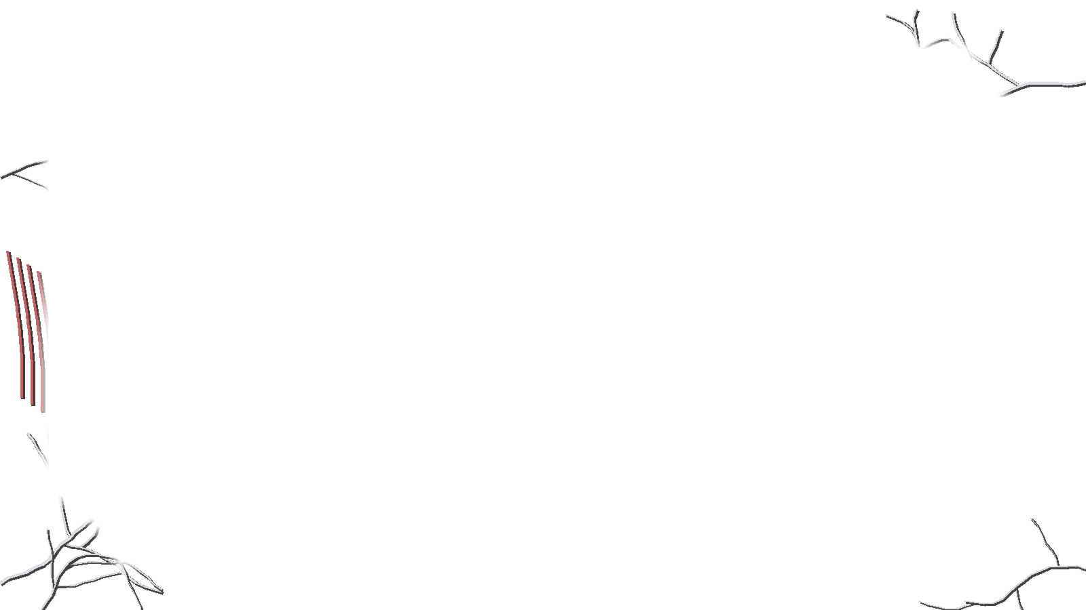
Plenary
● HULL BREACH · DECK 2 · DRONE ONLINE · O2 VENTING
LESSON QUESTION
How do we make a program repeat lines a set number of times?
1
Write a for loop that draws a triangle (3 sides, each turn 120°).
2
while or for? (a) keep asking until the code is right (b) draw 8 sides
RESCUE SHIP: "WE’RE READING TWO LIFE SIGNS MOVING ABOARD."
Notes:
Exit task on whiteboards or a sticky note.
1. for i in range(3): / (indented) t.forward(100) / (indented) t.left(120). Check both lines are indented, and the turn is 120 (360 ÷ 3).
2. (a) while: you don't know how many tries it will take. (b) for: you know it's 8 times. "When you know how many times, for is the tidy way to count."
Close the story: "The rescue ship has your signal. Then it sends one more line: your beacon says one survivor awake, but they're reading TWO life signs moving aboard."
Quick hands-up: "Who sent MAYDAY? Who sent QUARANTINE?" Don't say which was better — later lessons answer that.
In Slide Show this slide fades in through black and the hull cracks creep in by themselves: Chapter 5's state, which Lesson 5's deck opens with.

