Slide 1

Recap & Recall
TIMER 4 MIN
ANSWER IN YOUR BOOK — NO NOTES
1
LESSON 2.1
2
LESSON 2.1
You ask 20 classmates which streaming service they use. Survey or interview?
A Wikipedia page with no references. Trust it, or check it first?
survey · interview?
trust it · check it first?
3
LESSON 1.3
4
BRIDGE
Beano wants to make you laugh. Which purpose is that?
Who do you think Match of the Day magazine is made for?
inform · entertain · persuade?
children · adults · everyone?
Notes:
Q1–2 look back at 2.1, Q3 at 1.3. Q4 bridges into today: don't settle the answer yet, just collect hands for each option.

Slide 2
Answers
TICK OR FIX IN A DIFFERENT COLOUR
1
LESSON 2.1
2
LESSON 2.1
You ask 20 classmates which streaming service they use. Survey or interview?
A Wikipedia page with no references. Trust it, or check it first?
ANSWER Survey: the same questions to lots of people
ANSWER Check it first: fact-check it in a second source
3
LESSON 1.3
4
BRIDGE
Beano wants to make you laugh. Which purpose is that?
Who do you think Match of the Day magazine is made for?
ANSWER To entertain
ANSWER Mostly children who love football. How can we tell? Today.
Notes:
Tick or fix. Q4: ask two students WHY they chose their answer. Whatever they point at (the free cards, the jokes, the price) is evidence about the audience. Today: reading that evidence to say exactly who a product is for.

Slide 3
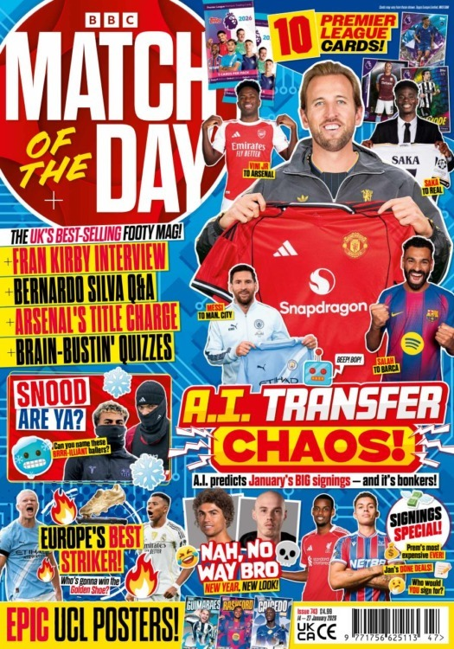
EXPLORING MEDIA
LESSON 2.2 · Y10 BTEC CREATIVE MEDIA
Lesson 2.2
Who Is It For?
Every media product is made for someone. Read the evidence and say exactly who.
Notes:
Cover: Match of the Day magazine, which we take apart in a few slides. In the PSA (Task 1) students define the audience of each product they choose: primary and secondary, with age, gender, socio-economic group and a lifestyle profile. Moderators reward audiences backed by evidence from the product.

Slide 4

The big questions
TOPIC QUESTION — THE WHOLE OF COMPONENT 1
How are media products made to reach and engage their audiences?
TODAY'S QUESTION
Who is a media product made for, and how can you tell?
Notes:
Topic question for the whole of Component 1; today's question comes back in the plenary.

Slide 5

Two audiences
Every product has a main audience, and usually a second one.
1
Primary audience The main group a product is made for. Also called the target audience.
2
Secondary audience Other people it appeals to as well, though it isn't mainly made for them.
Notes:
Spec A1: defining primary and secondary audiences. One per click.
Not the same "primary" as primary research last lesson: here it means MAIN.
Example to say: Match of the Day magazine is made for children who love football (primary). Parents and grandparents who buy it, and flick through it, are a secondary audience. Why do producers care? A secondary audience means more sales, more money.

Slide 6
Describing an audience
Three things to say about any audience.
1
Age An age range: 8 to 12, or 16 to 34. Not just "young".
2
Gender Mostly male, mostly female, or a mix. Say "mostly", not "only".
3
Socio-economic group The kind of jobs they do, and so how much money they have to spend.
Notes:
One per click. Spec: gender, age, socio-economic groupings. Push for ranges and "mostly": very few products have no fans of the other gender. Socio-economic group is the new one: next slide.

Slide 7
Socio-economic groups
People sorted by their job. Advertisers join them into ABC1 and C2DE.
1
A/B Senior managers and professionals: lawyers, head teachers, architects.
2
C1 Office, admin and supervisor jobs: bank clerks, call-centre staff.
3
C2 Skilled trades: plumbers, mechanics, hairdressers.
4
D/E Manual jobs (packing, cleaning), and people on a state pension or not working.
Notes:
The NRS social grades, simplified (A and B, and D and E, are joined). Moderator-praised Component 1 work uses them: "aimed at C1 and above because it is expensive".
ABC1 = A, B and C1 together; C2DE = C2, D and E. Clues to a product's group: what it costs, and what its adverts sell. Free or cheap → all groups.
The same boxes are on hub Task 1, so students can look back.

Slide 8

Which one?
Aisha is a head teacher. Which socio-economic group is she in?
A
B
C
D
A/B: managers, professionals
C1: office and admin
C2: skilled trades
D/E: manual, not working
Notes:
Answer A: a senior professional who runs a school. Quick follow-up: and a plumber? (C2). A receptionist? (C1).

Slide 9
LESSON 2.2
2
1
Read the evidence: who is it for?
1
Masthead
BBC Match of the Day: for people who love football
2
Free gift
10 Premier League cards to collect: children
3
3
Cover lines
"Brain-bustin' quizzes": puzzles for children
4
Language
"Nah, no way bro": talks like a young fan
5
Price
£4.99, in supermarkets: all groups
4
Age · gender · socio-economic group: what does each clue tell you?
5
Notes:
Worked model: each clue is evidence for one part of the audience. One per click; ask "what does this tell us?" before revealing each note.
Put it together: primary audience = children and young teens, boys and girls who love football (the Fran Kirby line shows women's football too), all socio-economic groups. Secondary: parents and grandparents who buy it.
This is exactly what hub Task 2 asks: four real products, clue by clue.

Slide 10

Who's in the audience?
TIMER 15 MIN
1
The page opens on the Warm-up: is each fact about age, gender or socio-economic group?
SUCCESS LOOKS LIKE
Age as a range; "mostly", not "only"
Match the job to its group
Every answer backed by a clue
2
Task 1 · Who's in the audience? Primary or secondary, then which group each job is in.
3
Task 2 · Who's it for? Read each clue and name the audience. Guess early for more stars.
4
Finished? Try ★ Two audiences. Tasks 3–5 open later.
FIND IT Hub › Year 10 › Lesson 2.2 › Who Is It For?
Notes:
Warm-up is optional: its meanings are open on the page. Tasks 3–5 are locked (Part 2) until the unlock word on a later task slide. A wrong check or guess makes students wait. Early finishers do ★ Two audiences: Spider-Verse's primary and secondary audience, and why Sony wants both. Dotted words on the page show their meaning on hover or tap.

Slide 11
KEY TERM
Lifestyle profile
A description of how one typical member of the primary audience lives: their interests, attitudes, values and behaviour.
IN THE REAL WORLD
Jordan, 34, a football fan: goes to every home game, and thinks the manager should be sacked.
Notes:
Spec A1: lifestyle profiles. Age, gender and group say WHO; a lifestyle profile says HOW THEY LIVE. Producers and advertisers use it to decide what to make and where to advertise. Example on click. We'll build Jordan's profile together next: football fans are a neutral audience, so we can focus on the four words.

Slide 12
The four parts: a football fan
Worked model: Jordan, 34, a typical football fan.
1
Interests What they like doing or knowing about: EA FC, football shirts, transfer news.
2
Attitudes What they think or feel about things: thinks their team's manager should be sacked.
3
Values What matters most to them: belonging. The club is like a family.
4
Behaviour What they actually do: goes to every home game, checks scores on the BBC Sport app.
Notes:
One per click. Ask the class for a second example of each before revealing the next.
Tests to say aloud: an interest is a topic or hobby. An attitude is an opinion ("thinks…", "feels…"). A value is a big idea that matters most: loyalty, family, fairness. Behaviour is something you could watch them do, or count.
These four examples are on the page's Task 3 too; the cards students sort there are all new.

Slide 13
Turn & Talk
TIMER 3 MIN
An attitude is an opinion about one thing. A value is the big idea behind it.
"Real fans never leave before the final whistle." Attitude or value? What's the value behind it?
1
Think on your own: 30 seconds
2
Partner A answers. B listens.
3
B adds one thing or disagrees, with a reason.
Notes:
It's an attitude (an opinion about leaving early); the value behind it is loyalty. Attitudes and values are the pair students mix up most: listen for "it's what they think" (attitude) vs "it's what matters most" (value).

Slide 14
Which one?
"Wears the club scarf to school on match days." Which part of the lifestyle profile is this?
A
B
C
D
Interests
Attitudes
Values
Behaviour
Notes:
Answer D: something you could watch them do. If anyone says C (loyalty): that's the value BEHIND the behaviour. Good: say both.

Slide 15
Profile the audience
TIMER 25 MIN
1
Task 3 · A football fan: sort the facts about Jordan into interests, attitudes, values and behaviour.
SUCCESS LOOKS LIKE
Every field backed by the evidence
Interest, attitude, value, behaviour: not mixed up
Each box uses its word
2
Task 4 · Profile the audience: read each evidence file, then build the cards for Radio 1 and Fortnite.
3
Task 5 · Meet the audience: write a lifestyle profile of one typical member, one box per part.
4
Finished? ★ Stranger Things: one more profile, on your own.
UNLOCK WORD
SUPERFAN
FIND IT Hub › Year 10 › Lesson 2.2 › Who Is It For?
Notes:
Unlock word SUPERFAN opens Tasks 3–5 and ★ Stranger Things (it stays open after a refresh). Teacher mode or "outwood" opens every part. Task 4: each lifestyle statement is right in only one field, so a student who mixes up attitude and value goes red there; a wrong field makes them wait. Task 5 is writing for Classroom: each box must use its word (interest, attitude, value, behaviour). The page has a model answer in its help panel.

Slide 16
Exit ticket
BACK TO TODAY'S QUESTION
Who is a media product made for, and how can you tell?
Name a product you use every week. Who is its primary audience, and what is one clue that tells you?
START WITH "The primary audience of ___ is ___, aged ___. I can tell because ___."
Notes:
Exit ticket. Listen for a range, "mostly", a socio-economic group and a real clue from the product, not just "people who like it".

