Slide 1
Fluid breakthrough experiments
Oliver Bond, Meredith Ellis, Nicolas Boullé and Huining Yang

Slide 2
The problem
Suppose we have a small membrane in a container, made of some fibres. Liquid is slowly introduced on top of it until the membrane breaks.
Liquid
Membrane
Air

Slide 3
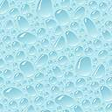
The problem
What is the shape of the meniscus between two fibres?
How does this depend on the physical parameters?
?

Slide 4
Assumptions
Fluid is static and incompressible.
The pressure due to the fluid is hydrostatic.
The upward force is due to the surface tension of the fluid.
The membrane does not bend.
The system is in its steady state.

Slide 5
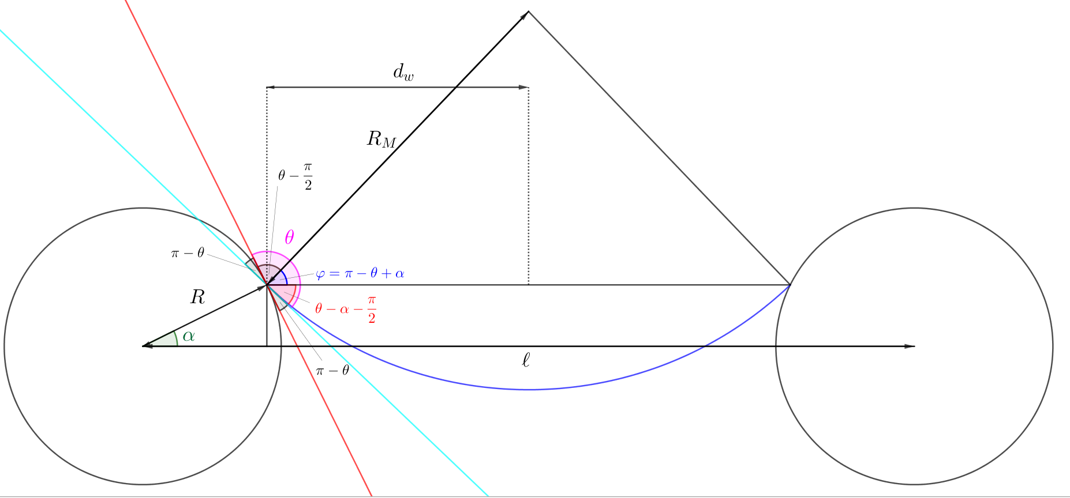


Physical principles
Curvature: $κ=\frac{1}{R_{M}}$
Newton’s second law tells us that forces (and so pressures) are balanced: $ρgH=+ κγ$
Centre of curvature of meniscus
Contact angle
Cross-section of fibre
Cross-section of fibre
meniscus

Slide 6
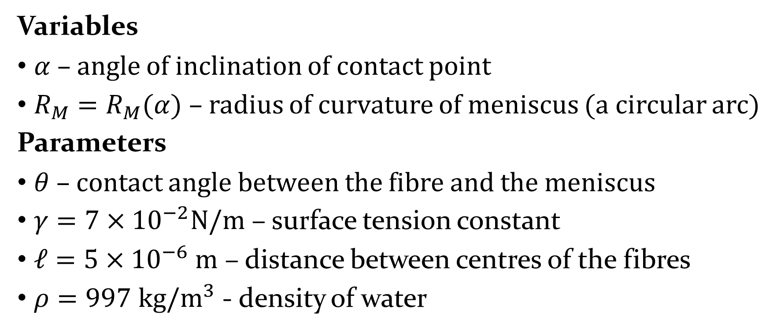
Parameters and variables
Variables
$α$ – angle of inclination of contact point
$R_{M}=R_{M}(α)$ – radius of curvature of meniscus (a circular arc)
Parameters
$θ$ – contact angle between the fibre and the meniscus
$γ=7×{10}^{−2}N/m$ – surface tension constant
$ℓ=5×{10}^{−6} m$ – distance between centres of the fibres
$ρ=997$ $kg/m^{3}$ - density of water

Slide 7
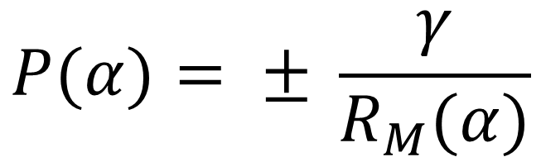

Governing equations
$$R_{M}\left(α\right)= \frac{R cos\left(α\right)− l/2}{cos⁡(θ−α)}$$
$$P(α)= ± \frac{γ}{R_{M}(α)}$$

Slide 8
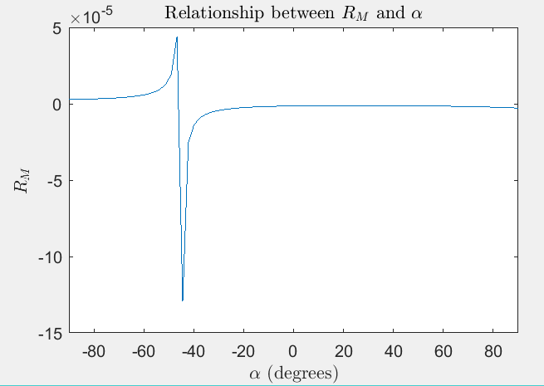
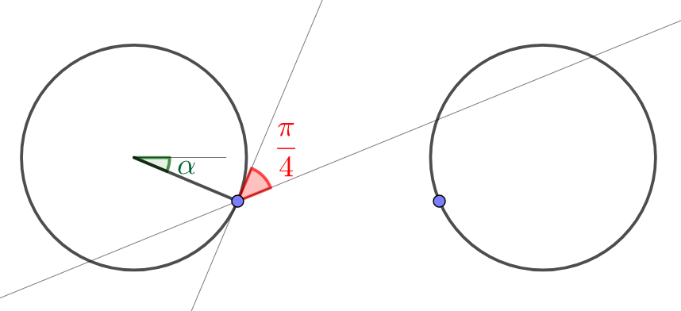
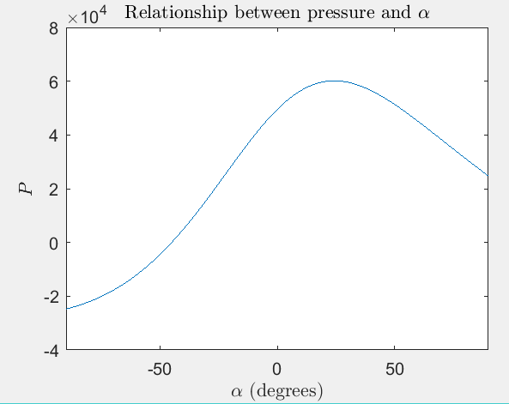


$$θ=\frac{π}{4}$$
$γ=−7×{10}^{−2}$ $N/m$

Slide 9
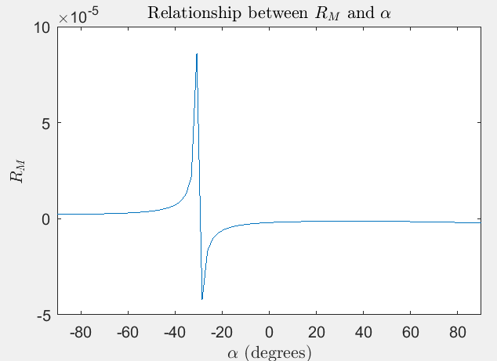
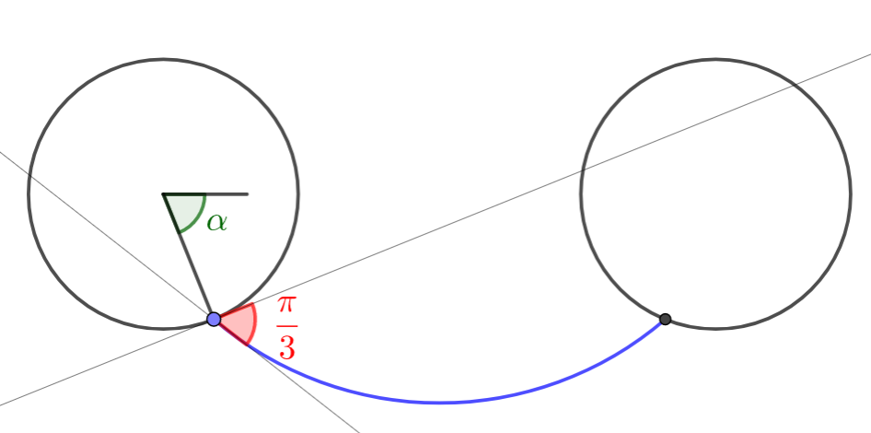
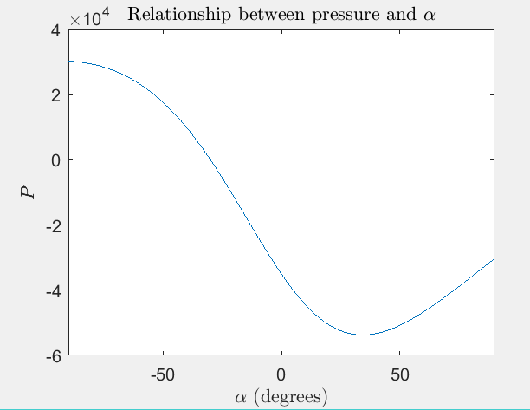
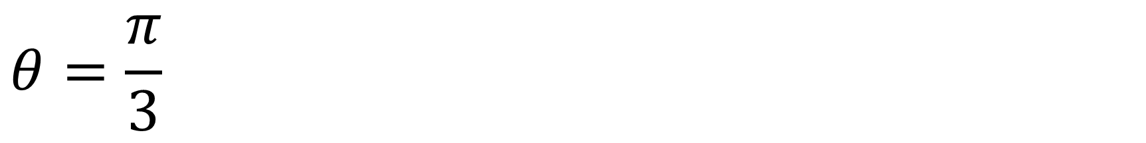

$$θ=\frac{π}{3}$$
$$γ=7×{10}^{−2} N/m$$

Slide 10
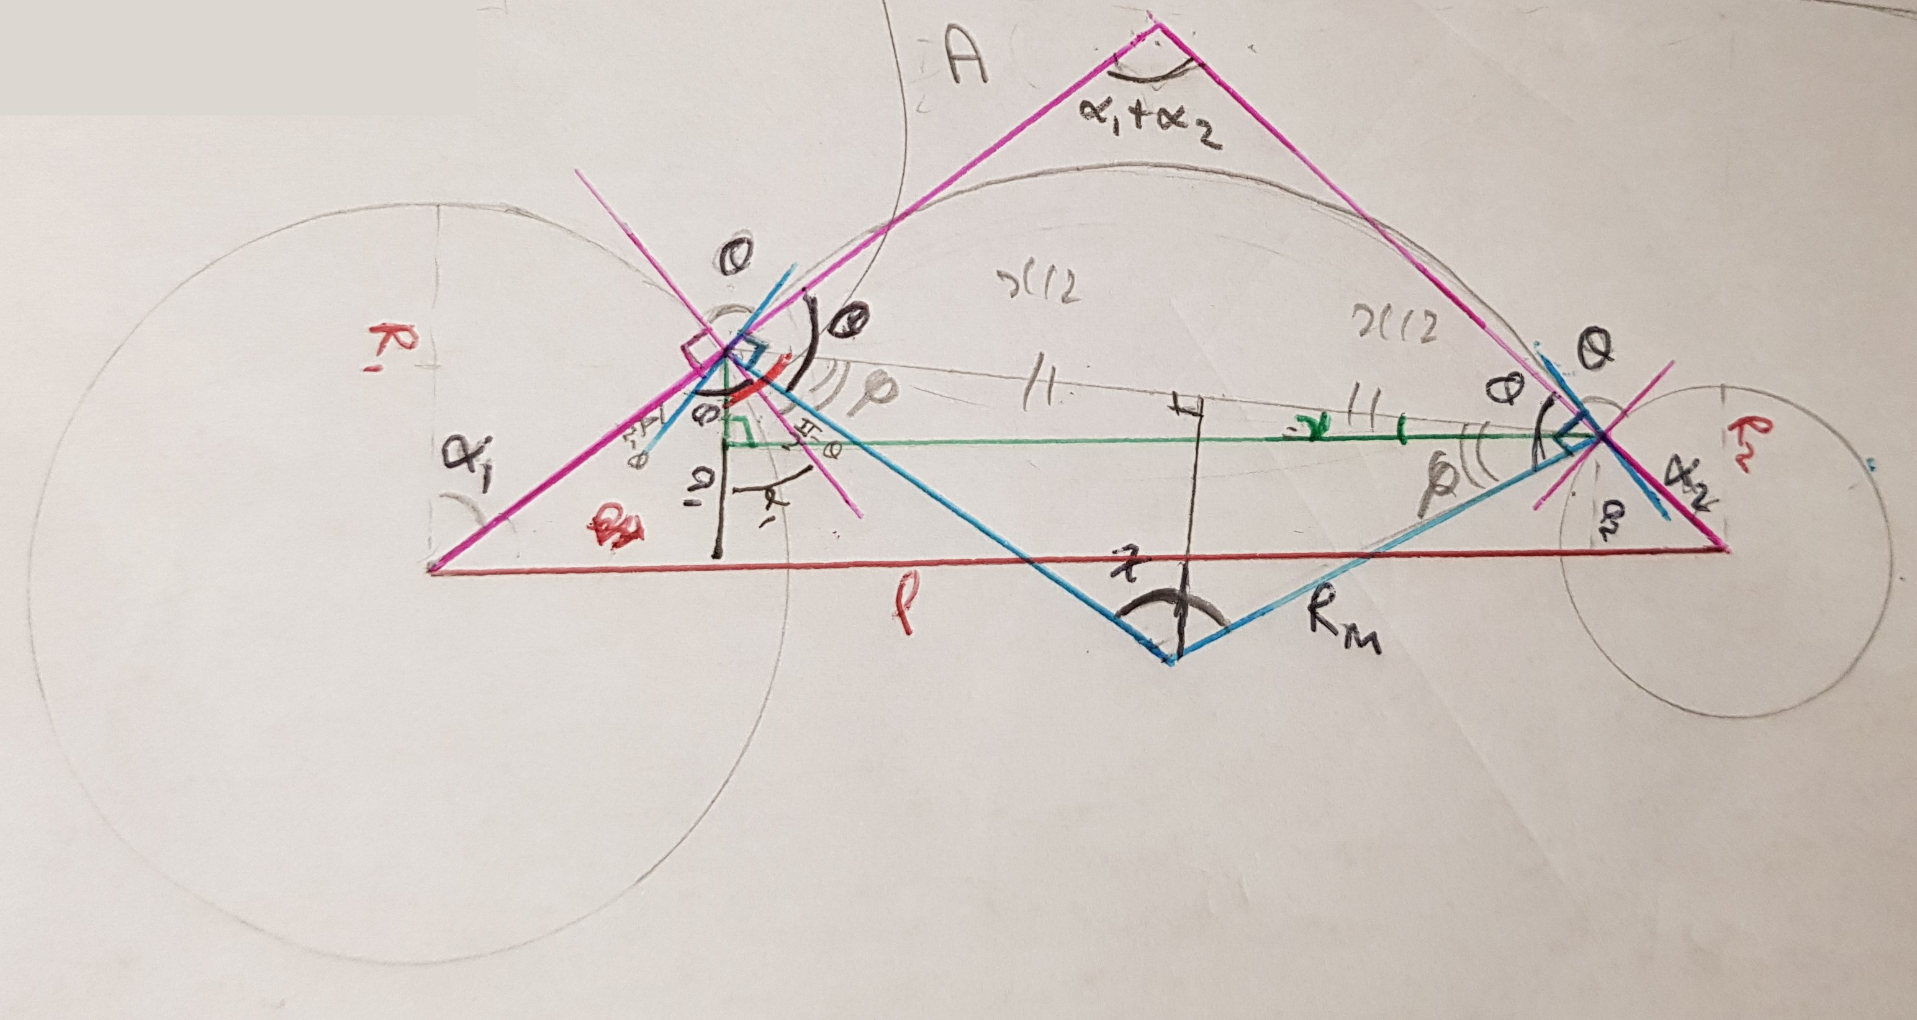
Further work – two circles of different radius?

Slide 11
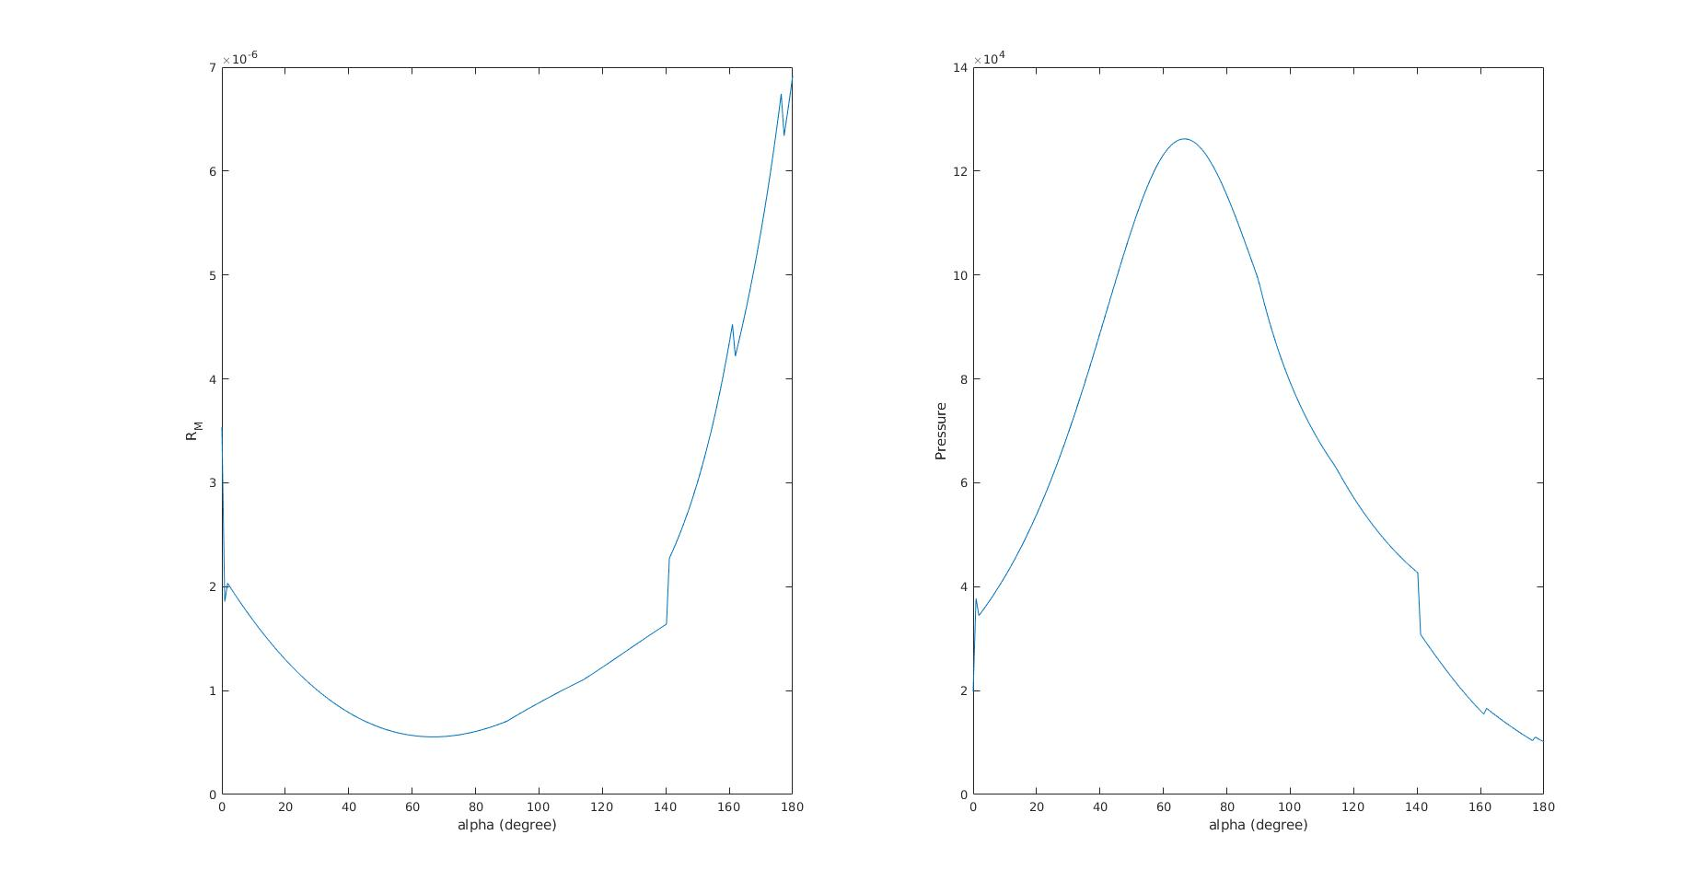
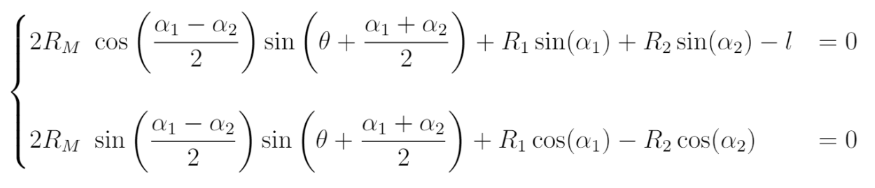
Further work

