Slide 1
Fluid breakthrough experiments
Oliver Bond, Nicolas Boullé, Meredith Ellis and Huining Yang

Slide 2
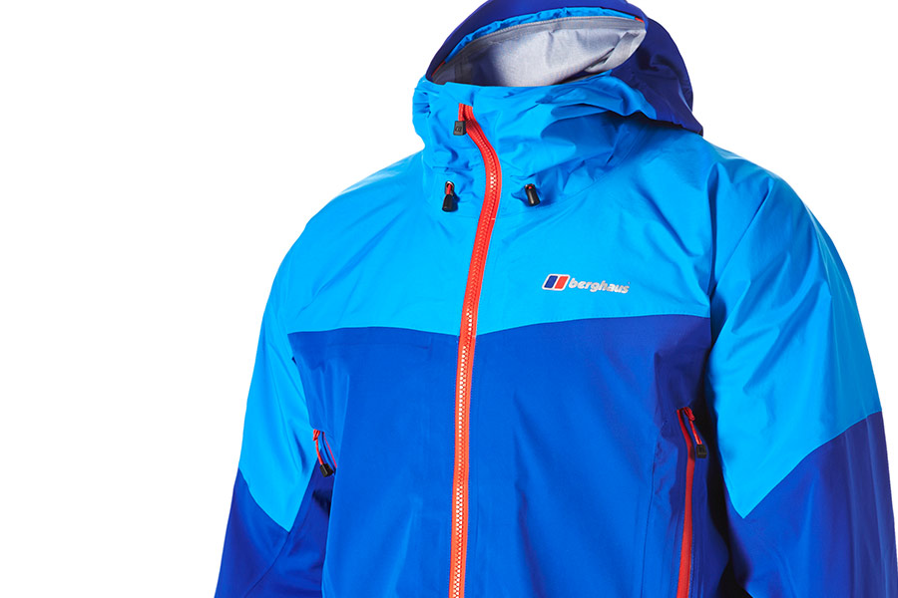
The problem
Waterproof membranes are used extensively in industry, for example in making waterproof coats.
The membranes have a porous structure, comprising a large number of fibres.
There are various choices for the material used to make the fibres, each with different wettability properties.
Liquid
H
Membrane
Air
Notes:
Ollie

Slide 3
The problem
What is the shape of the meniscus between two fibres?
How does this depend on the physical parameters?
?
Notes:
Ollie

Slide 4
Assumptions
Fluid is static and incompressible.
The pressure due to the fluid is hydrostatic.
The upward force is due to the surface tension of the fluid.
The membrane does not bend.
The system is in its steady state.
Notes:
Ollie

Slide 5
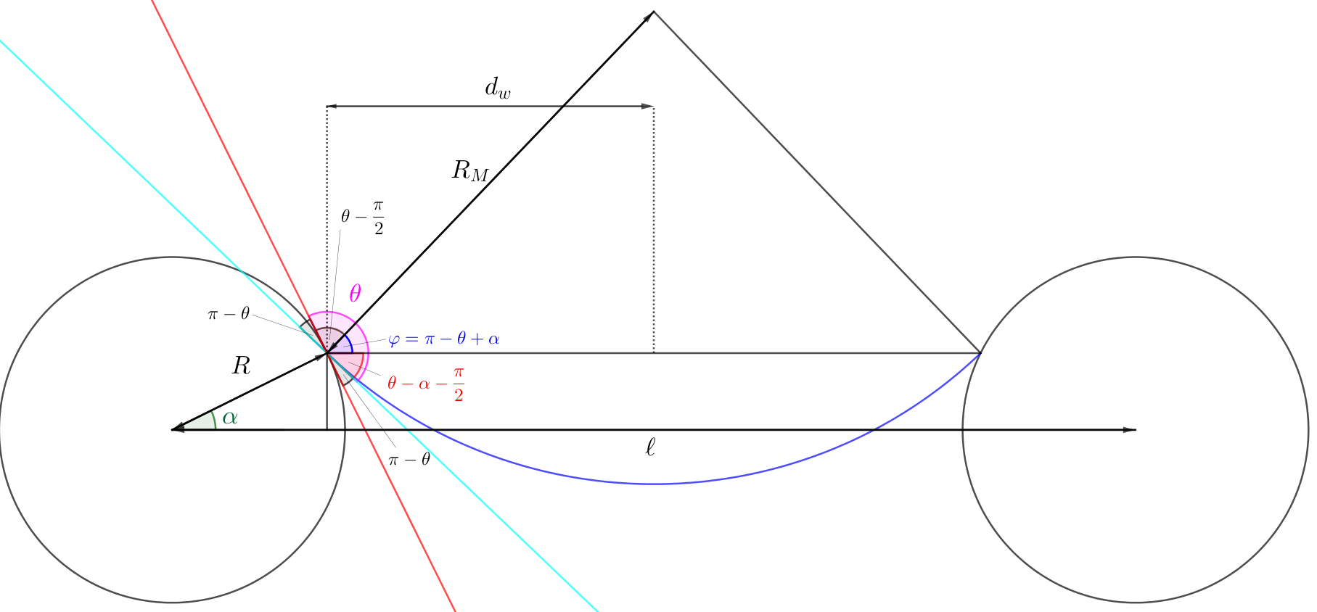

Physical principles
Newton’s second law
Curvature
$κ=\frac{1}{R_{M}}$
Variables
$α$ position angle
$R_{M}$ radius of curvature of the meniscus
water
air
fibre
fibre
Notes:
Nicolas

Slide 6
Governing equations
Notes:
Nicolas

Slide 7
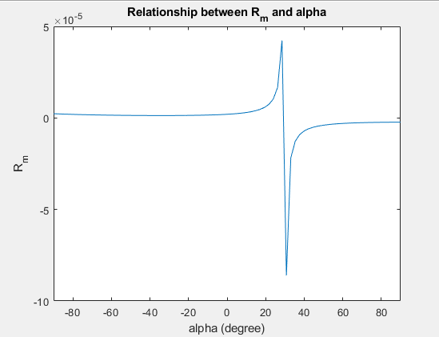
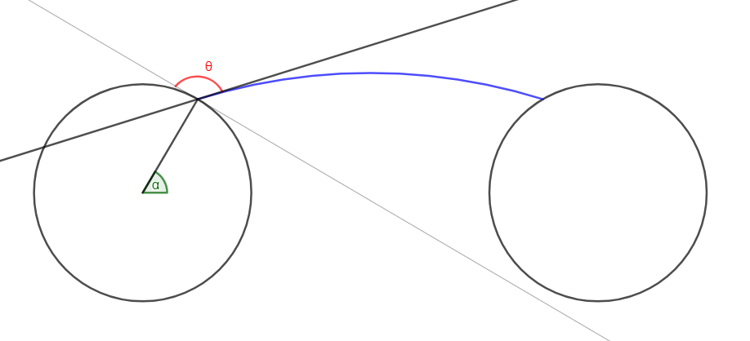
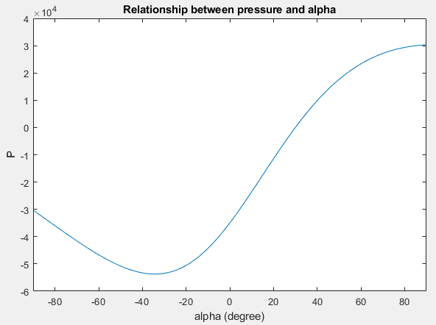
Contact angle:
Hydrophobic
Notes:
Huining

Slide 8
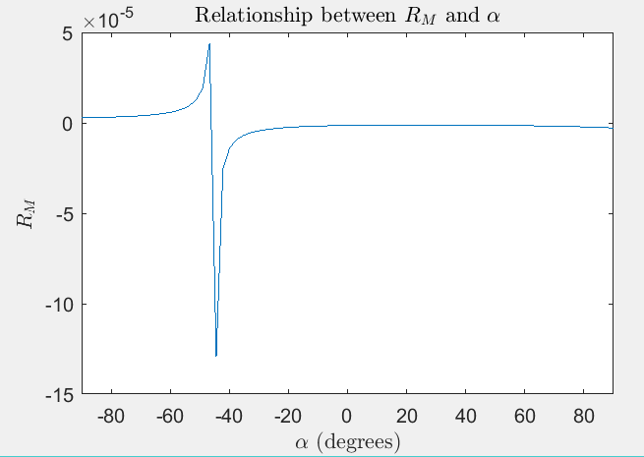
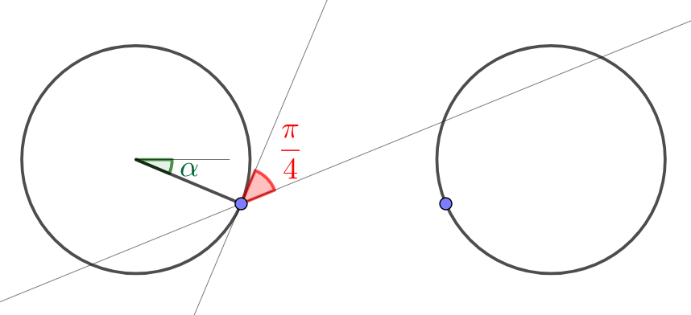
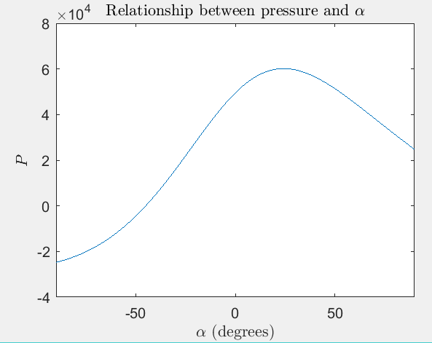
Contact angle:
Hydrophilic
Notes:
Huining

Slide 9
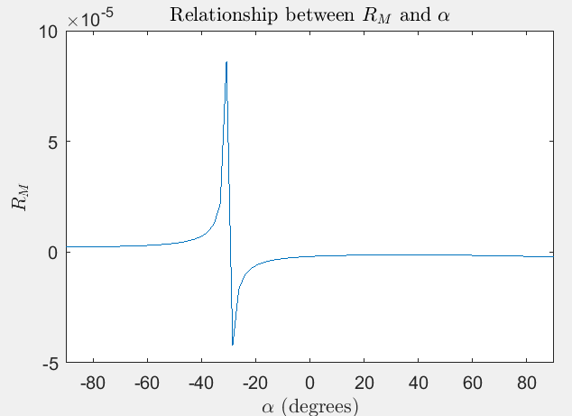
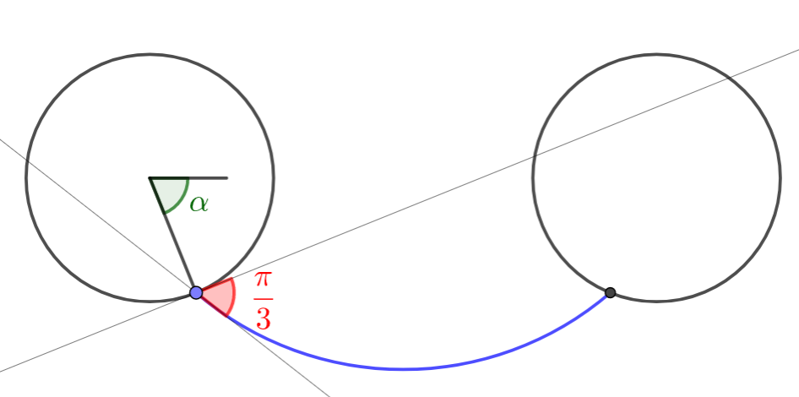
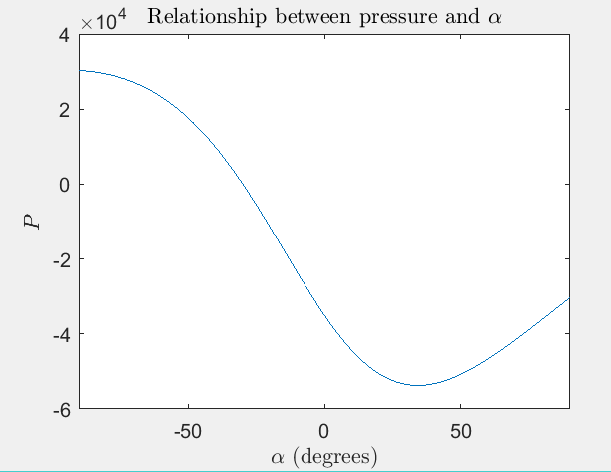
Contact angle:
Hydrophilic
Notes:
Huining

Slide 10
Conclusions
Bursting
Maximum pressure occurs at
For this maximum pressure, we get critical thickness
For any we have bursting – meniscus cannot support weight of water above it
Flooding
If
, then flooding occurs when
Notes:
Meredith

Slide 11
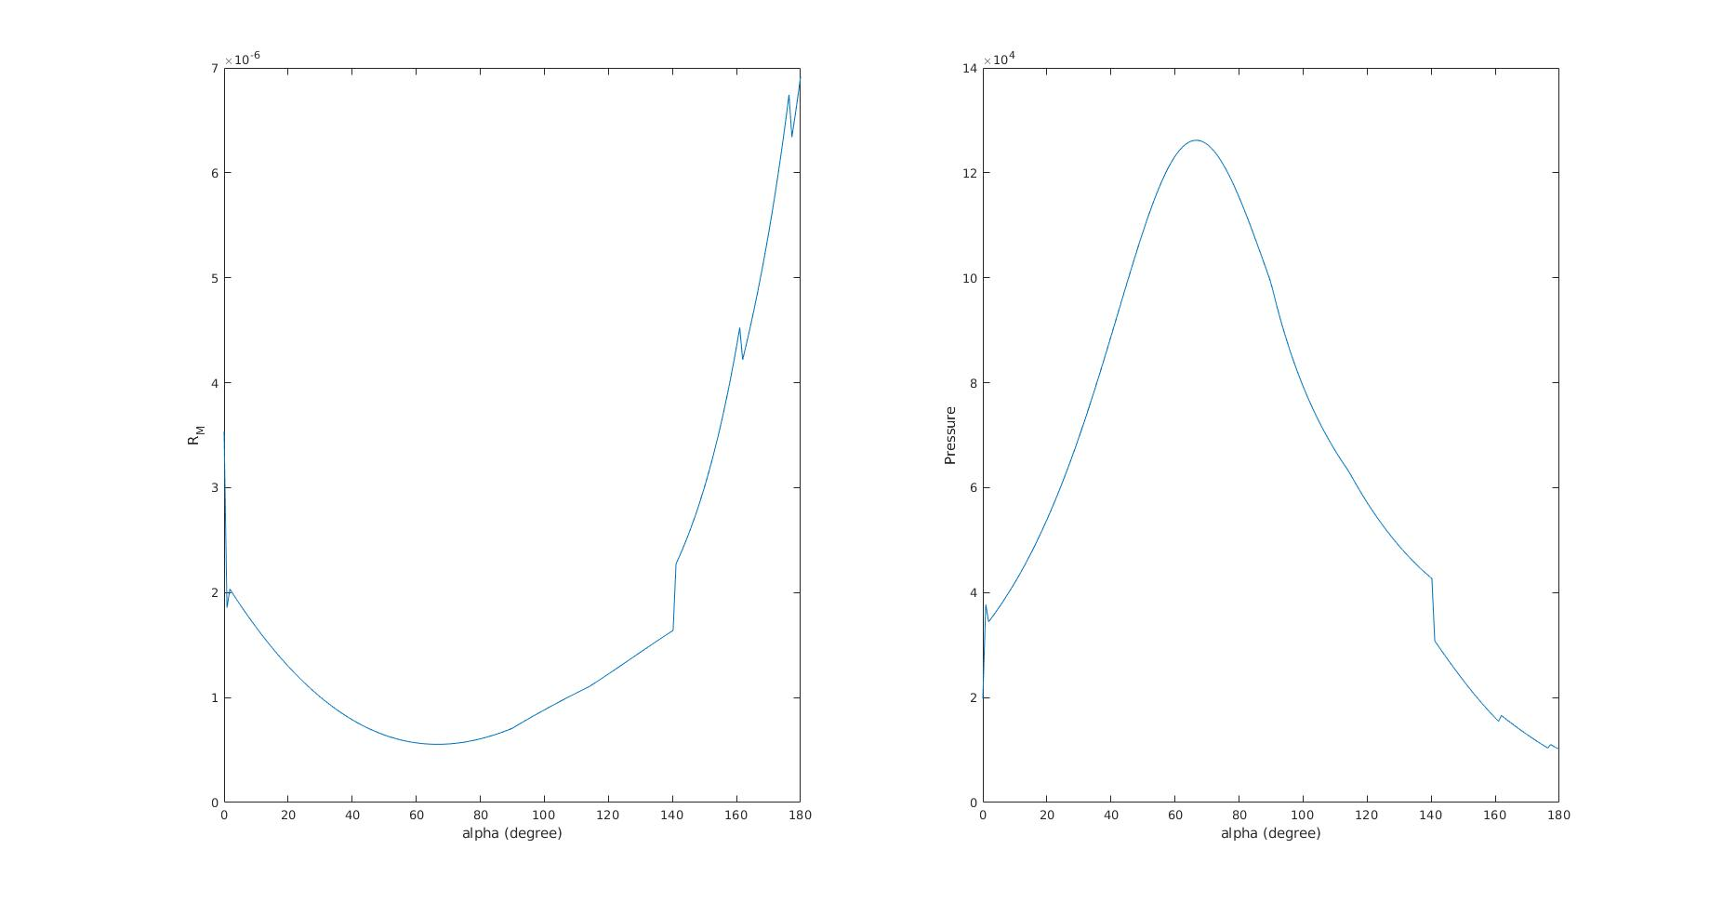
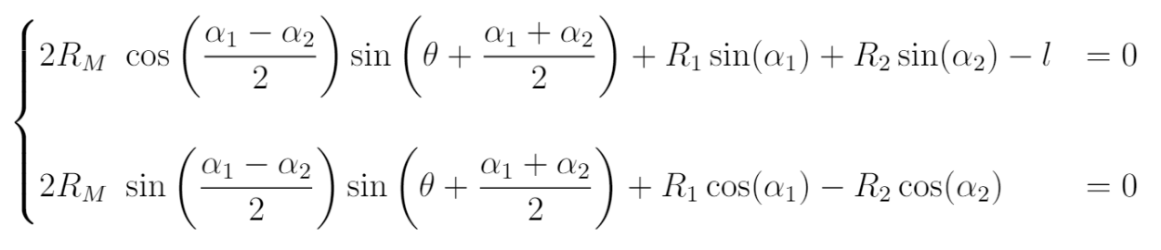
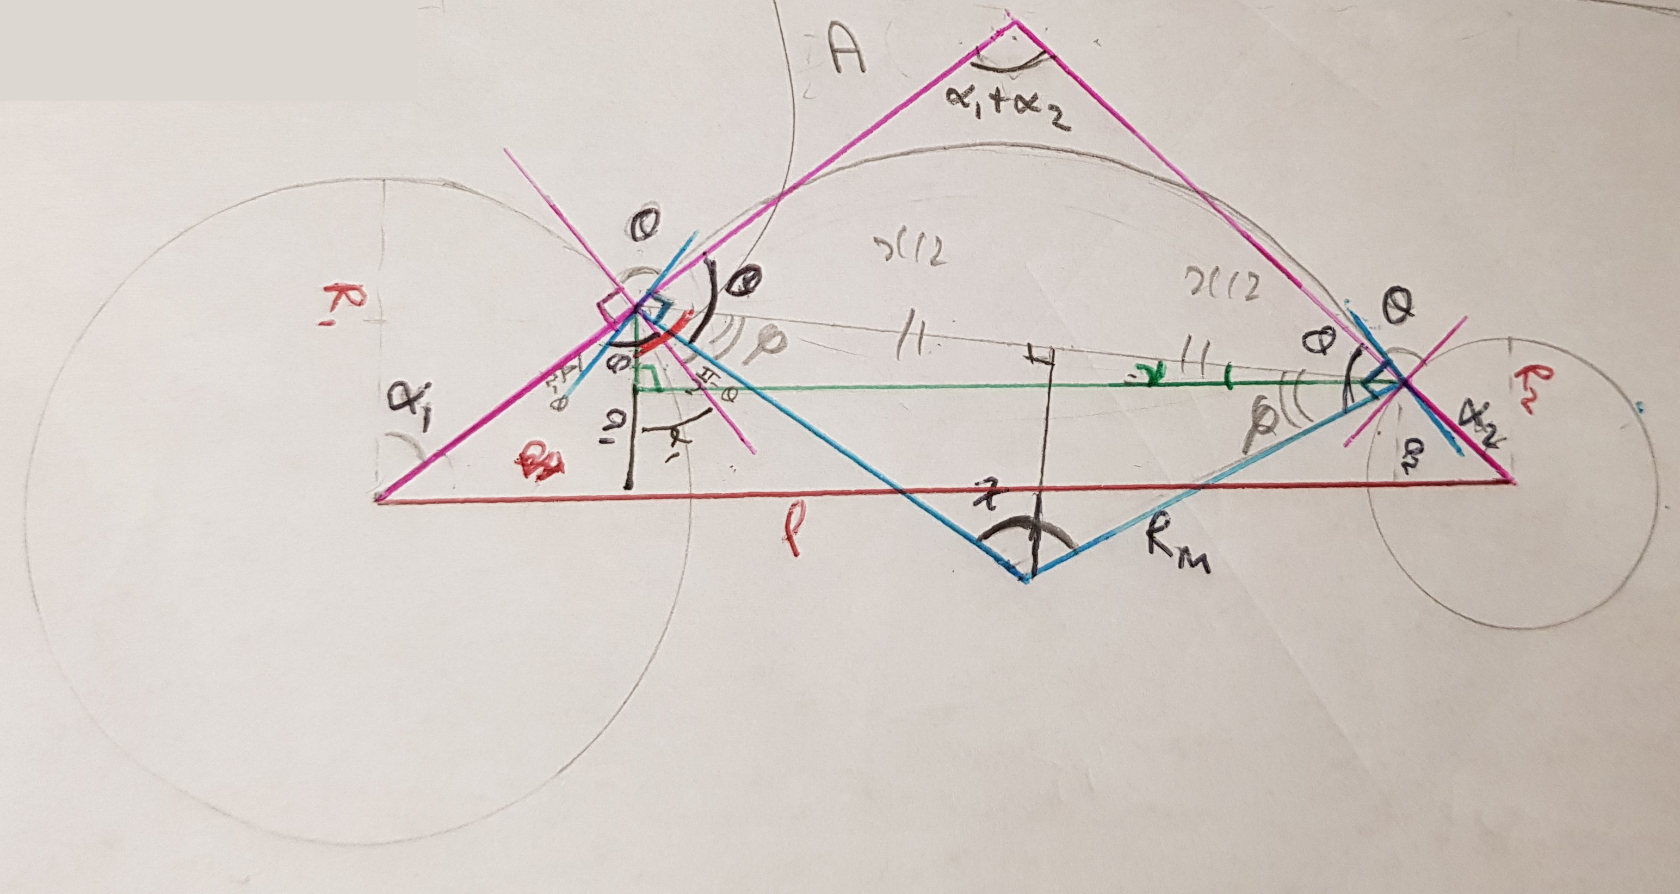
Further work – different radii
Notes:
Meredith

