Slide 1
Fluid breakthrough experiments
Oliver Bond, Meredith Ellis, Nicolas Boullé and Huining Yang

Slide 2
The problem
Suppose we have a small membrane in a container, made of some fibres. Liquid is slowly introduced on top of it until the membrane breaks.
Liquid
Membrane
Air

Slide 3
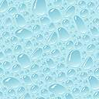
The problem
What is the shape of the meniscus between two fibres?
How does this depend on the physical parameters?
?

Slide 4
Assumptions
Fluid is static and incompressible.
The pressure due to the fluid is hydrostatic.
The upward force is due to the surface tension of the fluid.
The membrane does not bend.
The system is in its steady state.

Slide 5
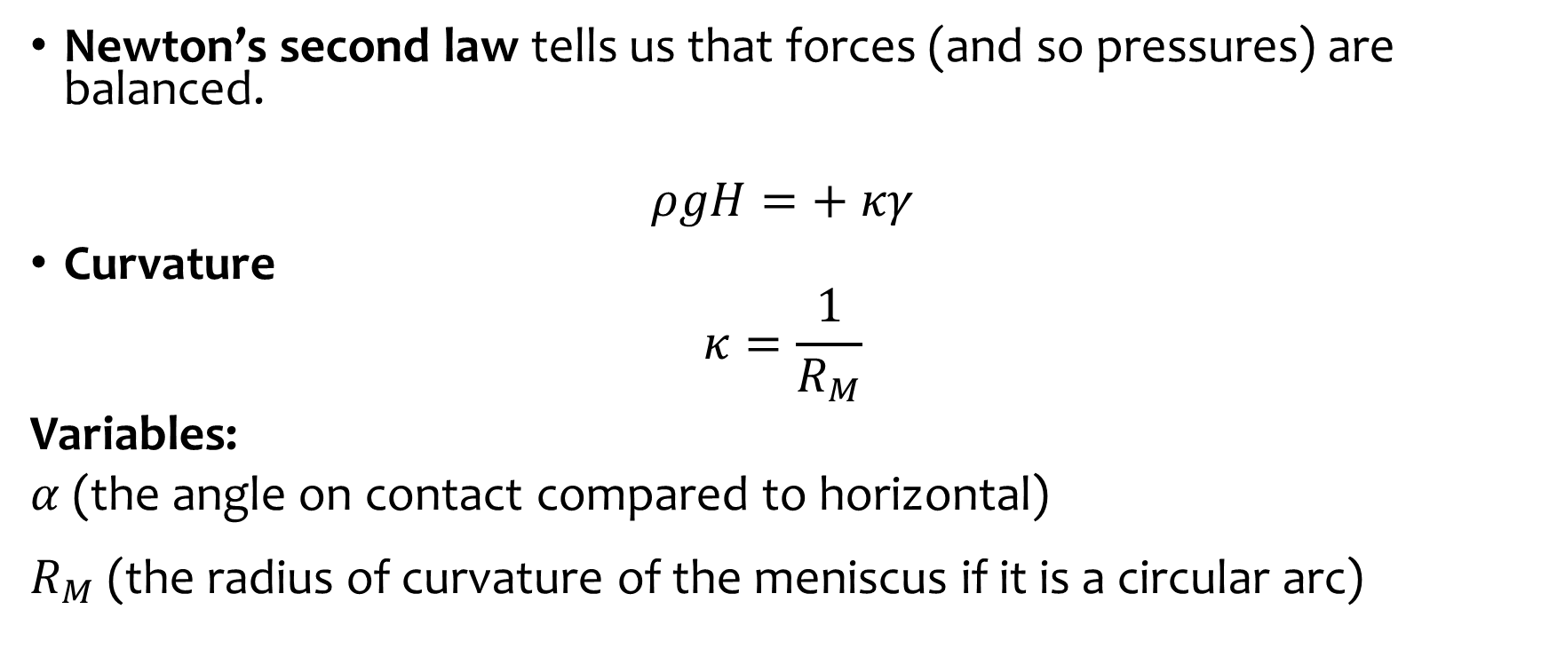
Physical principles
Newton’s second law tells us that forces (and so pressures) are balanced.
$$ρgH=+ κγ$$
Curvature
$$κ=\frac{1}{R_{M}}$$
Variables:
$α$ (the angle on contact compared to horizontal) $R_{M}$ (the radius of curvature of the meniscus if it is a circular arc)

Slide 6
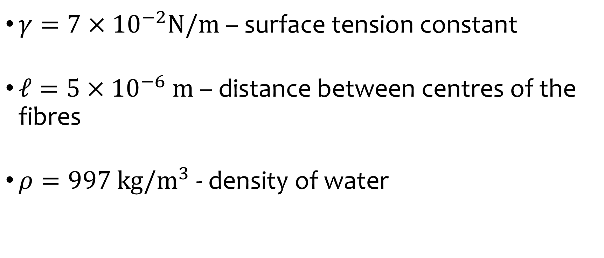
Main parameters
$γ=7×{10}^{−2}N/m$ – surface tension constant
$ℓ=5×{10}^{−6} m$ – distance between centres of the fibres
$ρ=997$ $kg/m^{3}$ - density of water

Slide 7
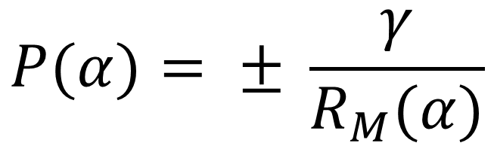

Governing equations
$$R_{M}\left(α\right)= \frac{R cos\left(α\right)− l/2}{cos⁡(θ−α)}$$
$$P(α)= ± \frac{γ}{R_{M}(α)}$$

Slide 8
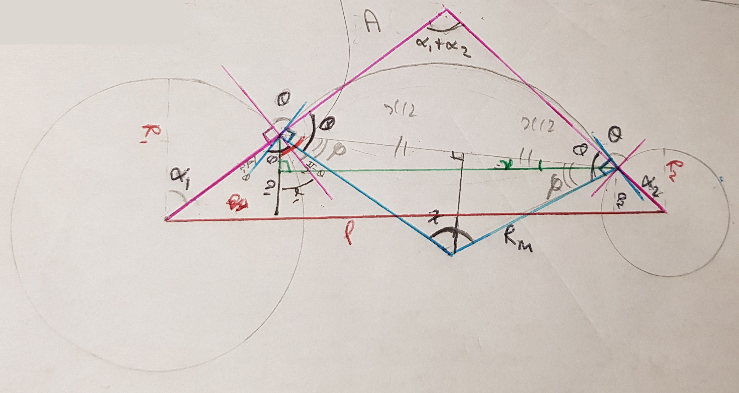

Slide 9
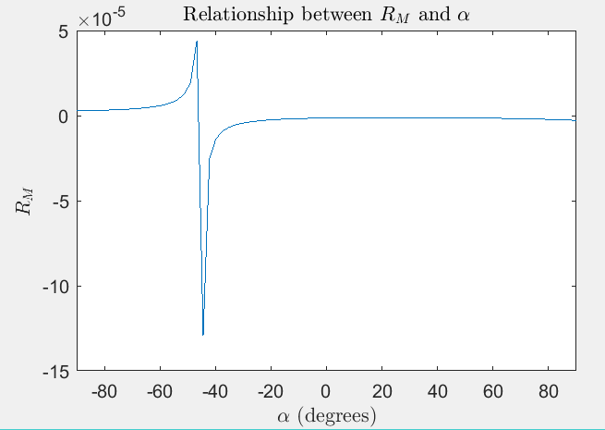
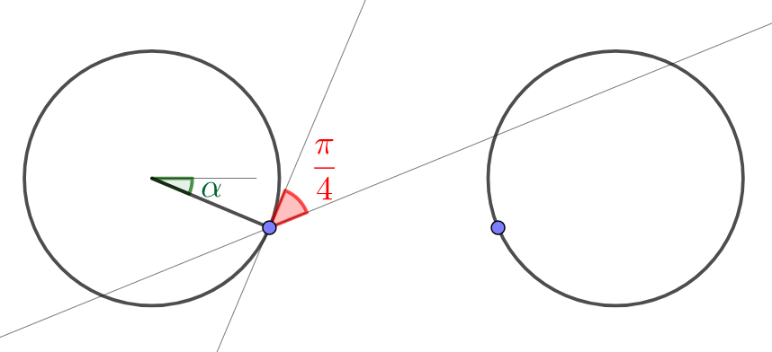
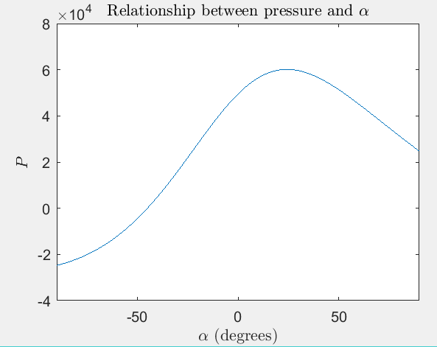


$$θ=\frac{π}{4}$$
$γ=−7×{10}^{−2}$ $N/m$

Slide 10
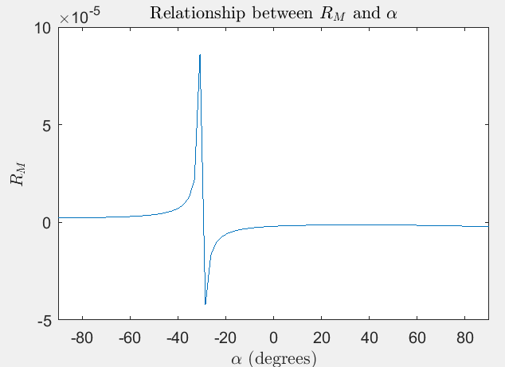
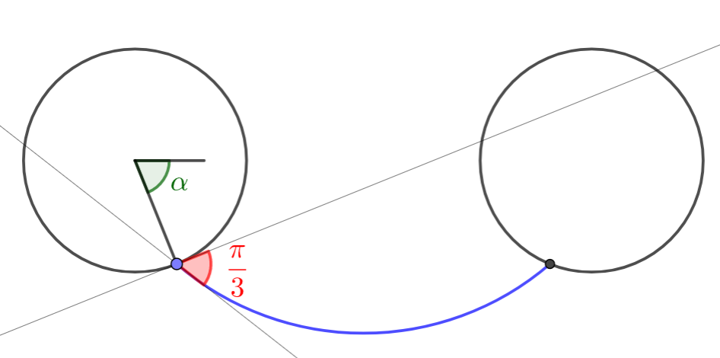
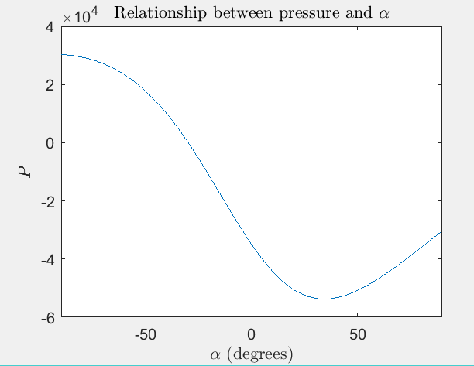
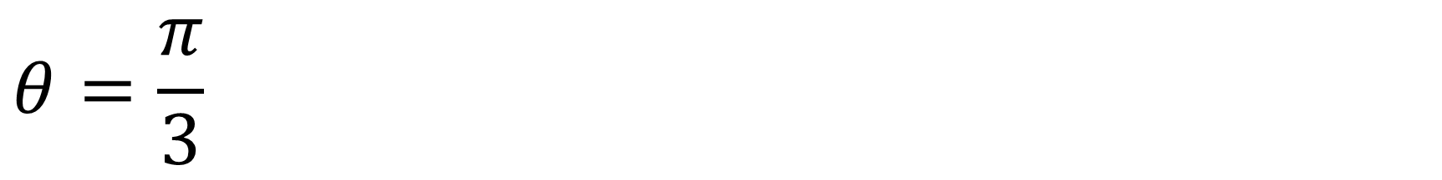

$$θ=\frac{π}{3}$$
$$γ=7×{10}^{−2} N/m$$

Slide 11
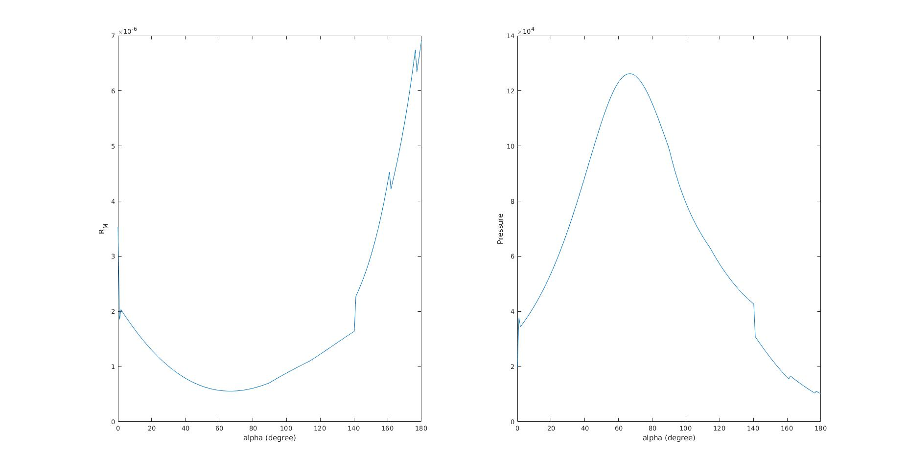
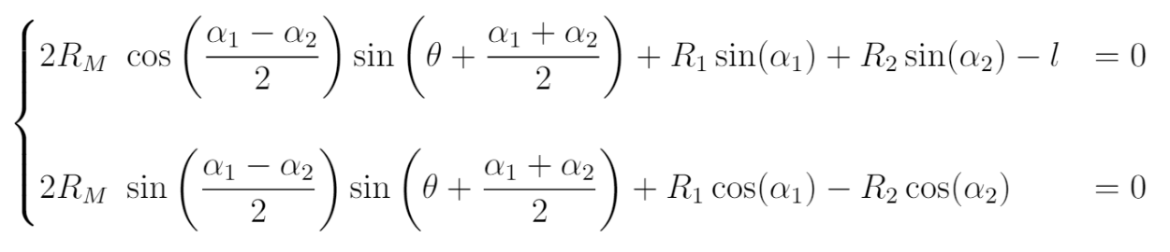
Further work

