Slide 1
Metadata Schema Conformity
Martin Seiler

Slide 2
Standards
Datamodel:
  ISO 19115:2003 (withdrawn)
  ISO 19115-1:2014 (published)
  ISO 19119:2005 (published)
Encoding:
  ISO 19139:2007 (published)
  ISO 19115-3:XXXX (under development)
  ISO 19139-1:XXXX (under development)

Slide 3
Schemata
ISO:2005 → Referece to GML 3.2.0
OGC:2006
  Adoption of ISO schemas
  additional namespace for service metadata („srv“)
  Publication of wrapper-schema apsio.xsd with CSW 2.0.2 ISO AP 1.0
ISO: update of schema → Referenz auf GML 3.2.1
OGC:2007
  Adaption of updated ISO-schema
  But: no update of apiso.xsd!

Slide 4
Schemata
  „CSW 2.0.2 ISO AP 1.0“ uses outdated ISO schema which can lead to unvalid metadata…

Slide 5
Problems: gmx:Anchor
  The element substitutes the CharacterString-element and allows an additional xlink:href-attribut
  Available since finalization of ISO 19139:2007
  ISO-schema used in apiso.xsd doesn‘t include the gmx-namespace (it uses ISO-schema from 2006!). Hence the element is not available
  Problem:
    The element becomes mandatory in some cases in new TG

Slide 6
Probleme: Use of GML v3.2.1
  The used version of the ISO-Schemas in apiso.xsd references GML-Version 3.2.0, which was never really implemented (NS: http://www.opengis.net/gml)
  Elements, that are part of GML v3.2.1, but not in v3.2.0 don‘t validate using the apiso.xsd-schema (NS: http://www.opengis.net/gml/3.2)

Slide 7
Probleme: Use of GML v3.2.1
  Problem:
  ... Element '{http://www.opengis.net/gml/3.2}TimePeriod': This element is not expected. Expected is one of ( {http://www.opengis.net/gml}AbstractTimePrimitive, {http://www.opengis.net/gml}TimeInstant, {http://www.opengis.net/gml}TimePeriod, {http://www.opengis.net/gml}TimeNode, {http://www.opengis.net/gml}TimeEdge ) ...

Slide 8
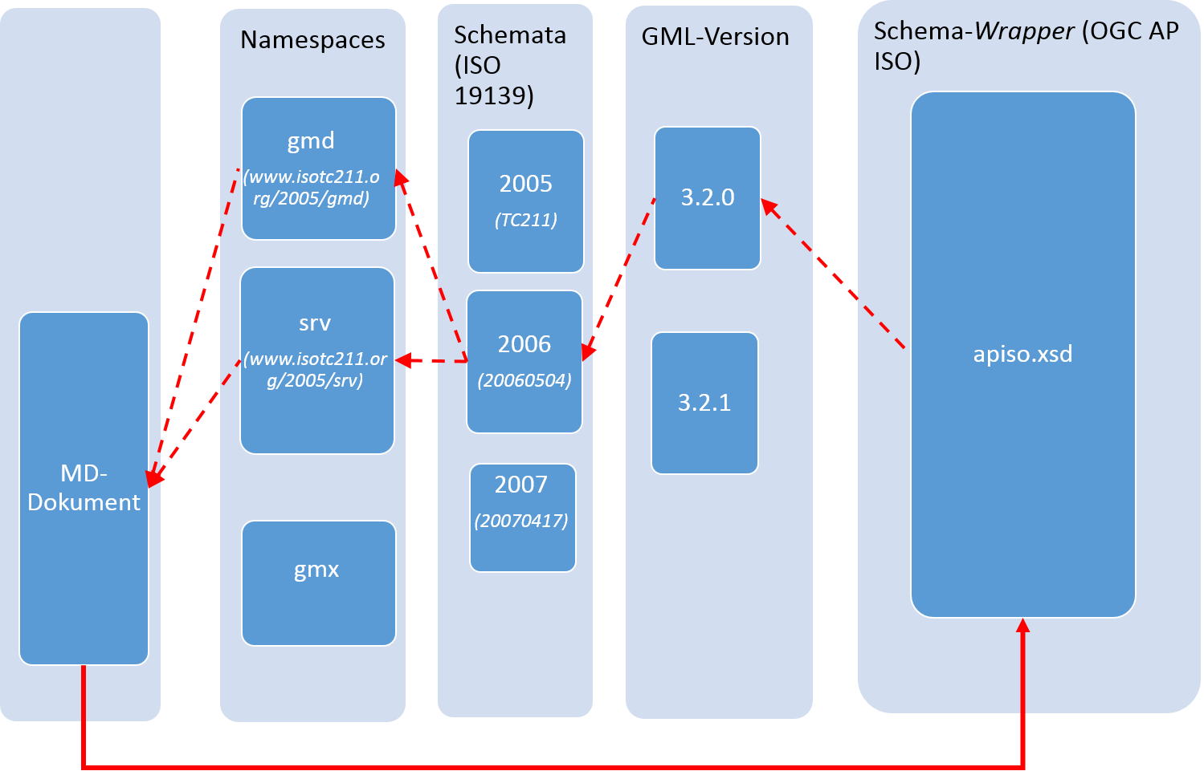
Summary

Slide 9
