Slide 1
Improvement of IndoorGML Core Module
Ki-Joune Li
29 May 2017

Slide 2
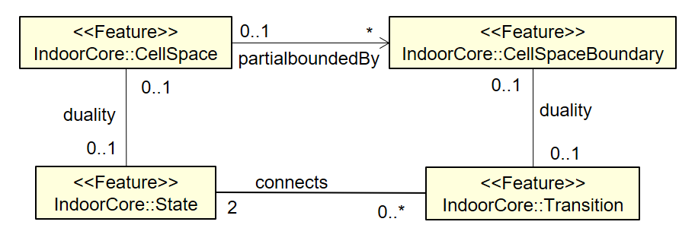
Improvement of Core Module (1) – CellSpaceBoundary in Thin Model
Two different interpretations on cell boundary surface
.

Slide 3
Improvement of Core Module (1) – CellSpaceBoundary in Thin Model
CB-1
Surface-1
C-1
Solid-1
Solid-2
C-2
partially bounded by
partially bounded by
C-1
CB-1
C-2
duality
duality
duality
State-1
connects
connects
State-2
Transition-1

Slide 4
Improvement of Core Module (1) – CellSpaceBoundary in Thin Model
Proposal:
Reflect it into v.1.1
Modify the cardinality from 0..1 to 0..2
OK with backward compatibility
Surface-2
Surface-1
CB-2
partially bounded by
partially bounded by
C-1
CB-1
C-2
duality
duality
duality
duality
State-1
connects
Transition-1
connects
State-2
Transition-2
0..2
CB-1
CB-2
C-1
C-2

Slide 5
Improvement of Core Module (1) – CellSpaceBoundary in Thin Model
Issue 1 – Geometry of Cell Boundary
Issue 2 – Backward compatibility with 1.0.2 ?
Yes since it is an extension from 0..1 to 0..2
the same geometry with reversed orientation?
Surface-2
Surface-1
Solid-1
Solid-2
CB-2
partially bounded by
partially bounded by
C-1
CB-1
C-2

Slide 6
Improvement of Core Module (2) - Storey
Background
Floor is an important information type by many applications but not included in IndoorGML.
Floor may be included as an attribute of each feature type
Proposal: Include it into IndoorGML 1.1
as an attribute of CellSpace
With an informative guideline on how to define storey
In Korea and Japan, it starts from 1, while it starts from 0 in Europe and North America.
Mezzanine or 7.5 floor (being John Malkovich)
Unclear cases like Guggenheim Museum in NY, Mercedes Benz Building in Stuttgart
OK with backward compatibility

Slide 7
Improvement of Core Module (2) - Storey
0..1
<<Feature>>
IndoorCore::PrimalSpaceFeatures
cellSpaceMember
cellSpaceBoundaryMember
0..*
0..*
<<Feature>>
IndoorCore::CellSpace
0..1
*
<<Feature>>
IndoorCore::CellSpaceBoundary
partialboundedBy
primalSpaceFeatures
0..1
0..1
duality
duality
<<Feature>>
IndoorCore::IndoorFeatures
0..1
0..1
<<Feature>>
IndoorCore::State
connects
<<Feature>>
IndoorCore::Transition
2
0..*
2
1..*
nodes
edges
multiLayeredGraph
interConnects
<<Feature>>
IndoorCore::InterLayerConnection
<<Feature>>
IndoorCore::SpaceLayer
0..*
interEdges
1..*
spaceLayers
<<Feature>>
IndoorCore::MultiLayeredGraph

