Slide 1

GRP Value in the Extended Attributes
Ryan Franz – FlightSafety International

Slide 2
Current Issues with the Extended Attributes
Extended Attribute Schema
Stored in: Geomatics_Attributes.xml or Vendor_Attributes.xml
Schema: Vector_Attributes.xsd
Current Issues
No GRP value appears in the Vector_Attributes.xsd schema
Unclear which attributes are associated with which GRP value
Very difficult to have a CDB with different GRP values
Currently, it would be required for each attribute code (across multiple standards or vendors) to be unique
Creating a new CDB or merging different CDBs that contain values from both DIGEST and DFDD requires renumbering EAC codes

Slide 3
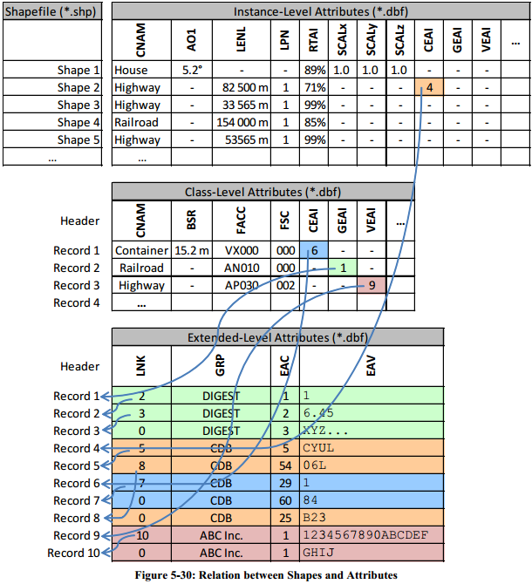
Extended Attribute Example (Figure 5-30, Volume 1)

Slide 4
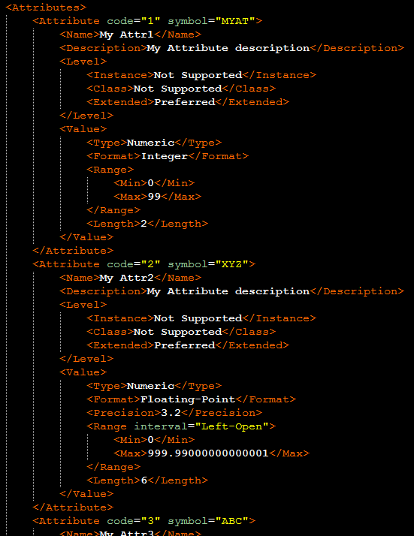
Extended Attribute Example (Figure 5-30, Volume 1)
?

Slide 5
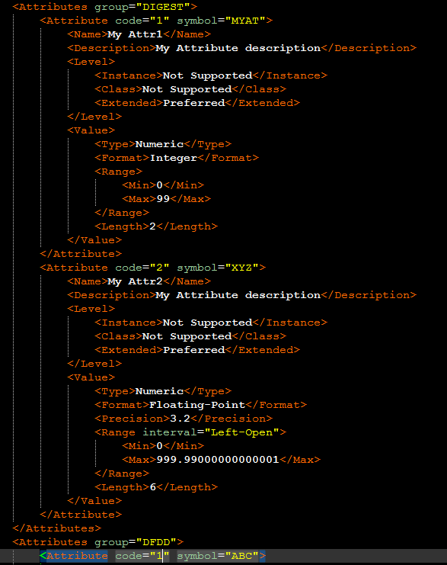
Extended Attribute Example (Figure 5-30, Volume 1)

