Slide 1

Change Request 499 – Datasets.xml updates
Ryan Franz – FlightSafety International

Slide 2
Current Issues with the Dataset.xml file
Old Data
The data contained by the file reflects CDB 3.0
Lack of Usefulness
It only contains the dataset codes associated with the dataset label
Together, they can be used to create one level of the directory structure, but not a full directory path
No mention of it in the specification

Slide 3
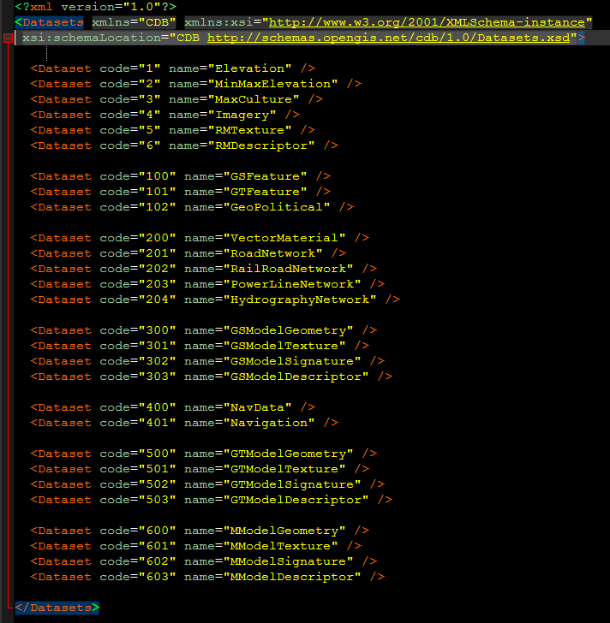
Current Dataset.xml file

Slide 4
Proposals
Update the file
Update with OGC CDB 1.0 dataset list
Add directory naming
Add enumerations for each directory naming type
Found in Volume 1 Section 3
7 unique types found, so far
Add file types
Should each dataset contain a default file type?
Should each dataset contain an enumeration for building a filename?
Modify the spec to mention what this file is and recommended uses of it

Slide 5
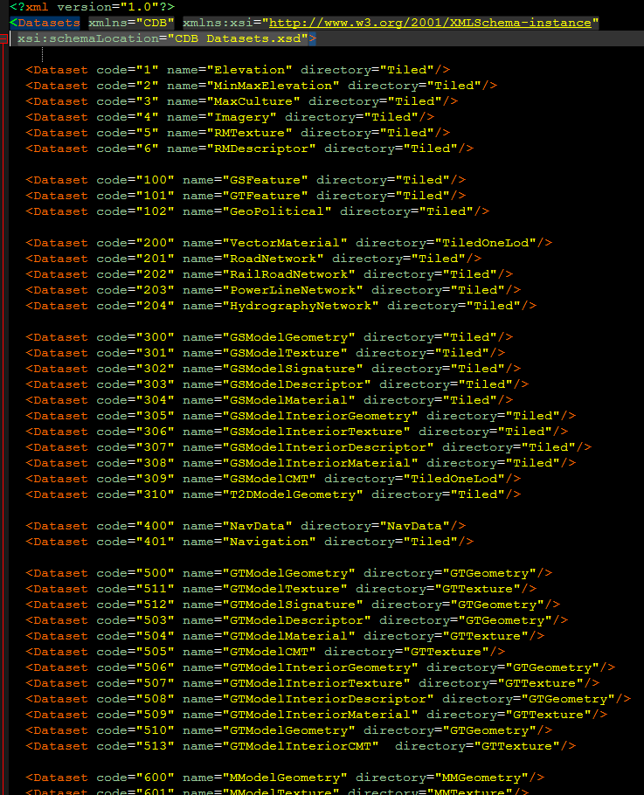
Proposed Dataset.xml file

Slide 6
How to use it
Directory naming
For example, dataset 001 is a Tiled dataset
Directory is CDB\Tiles\[NS]xx\[EW]xxx\001_Elevation\Lxx\Ux
For example, dataset 400 is a NavData dataset
Directory is CDB\Navigation\400_NavData
File type
Are the files tiff, or .dbf, or jp2?
File naming
Dataset 001 example:
[NS]xx[EW]xxx_D001_Sxxx_Txxx_Lxx_Ux_Rx.ext
Dataset 400 example:
D400_Sxxx_Txxx.ext

Slide 7
Open Questions
Is this proposal sufficient to create any CDB filepath and filename?
Do we want to replicate Datasets.xml at the Tile level (in case the Tile contains a different file type/extension?
Can we simplify Section 3 down to just the unique directory types and filename types?

