Slide 1
Database Design - Normalization

Slide 2
Recall: Database design lifecycle
Requirements analysis
  User needs; what must database do?
Conceptual design
  High-level description; often using E/R model
Logical design
  Translate E/R model into relational schema (tables)
Schema refinement
  Check schema for redundancies and anomalies
Physical design/tuning
  Consider typical workloads, and further optimise

Slide 3
Not all designs are equally good
Why is this design bad?
Data(sid,sname,address,cid,cname,grade)
Why is this one preferable?
Student(sid,sname,address)
Course(cid,cname)
Enrolled(sid,cid,grade)

Slide 4
An instance of our bad design
sid | sname | address | cid | cname | grade
124 | Britney | USA | 206 | Database | A++
204 | Victoria | Essex | 202 | Semantics | C
124 | Britney | USA | 201 | S/Eng I | A+
206 | Emma | London | 206 | Database | B-
124 | Britney | USA | 202 | Semantics | B+

Slide 5
Evils of redundancy
Redundancy is the root of many problems associated with relational schemas
  Redundant storage
  Update anomalies
  Insertion anomalies
  Deletion anomalies

Slide 6
Decomposition
We remove anomalies by replacing the schema
Data(sid,sname,address,cid,cname,grade)
with
Student(sid,sname,address)
Course(cid,cname)
Enrolled(sid,cid,grade)
Note the implicit extra cost here
Two immediate questions:
  Do we need to decompose a relation?
  What problems might result from a decomposition?

Slide 7
Functional dependencies
  We can say that sid determines address
  We’ll write this
  sid → address
  This is called a functional dependency (FD)
  If one set of attributes in a table determines another set of attributes in the table, then the second set of attributes is said to be functionally dependent on the first set of attributes.
    (Note: An FD is just another integrity constraint)

Slide 8
Functional dependencies
We’d expect the following functional dependencies to hold in our Student database
  sid → sname,address
  cid → cname
  sid,cid → grade
A functional dependency X → Y is simply a pair of sets (of field names)

Slide 9
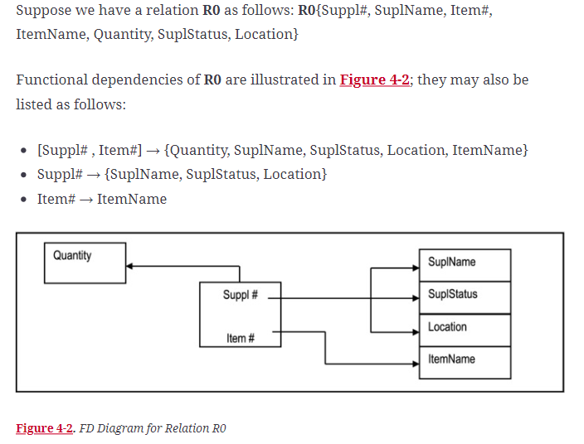
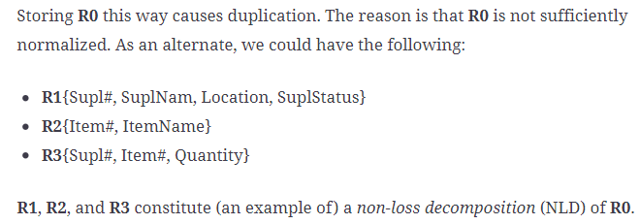
Non-loss Decomposition

Slide 10

A formal definition of a Non-loss Decomposition (NLD):
Here is a formal definition of an NLD:
a projection on a relation is an extraction (into a new relation) of some attributes of the relation;
a join requires at least two relations and may be construed as the opposite of a projection:
  If you can project R into P1 and P2, then you may be able to join P1 and P2 to yield R.

Slide 11
Goals of normalisation
Decide whether a relation is in “good form”
If it is not, then we will “decompose” it into a set of relations such that
  Each relation is in “good form”
  The decomposition has not lost any information that was present in the original relation
The theory of this process and the notion of “good form” is based on FDs.

Slide 12
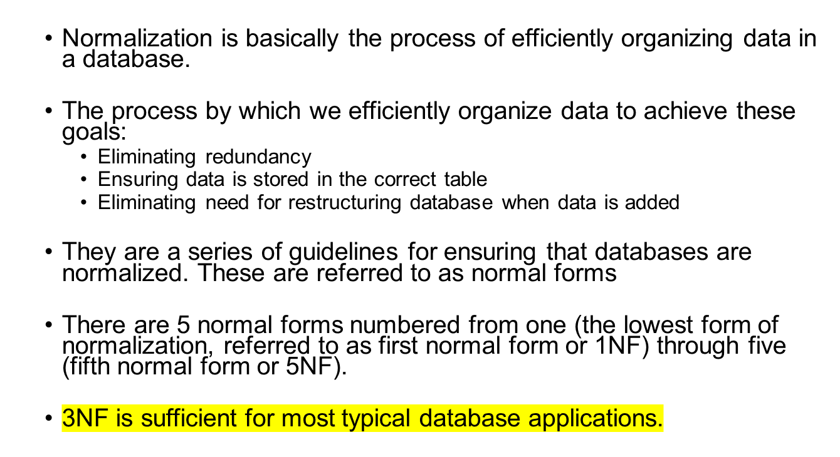
Normalization

Slide 13
Levels of Normalization
1NF
2NF
3NF
4NF
5NF
DKNF
Each higher level is a subset of the lower level

Slide 14
First Normal Form (1NF)
A table is in 1NF if all the fields contain only atomic values (as opposed to list of values).
Example (Not 1NF)
ISBN
Title
AuName
AuPhone
PubName
PubPhone
Price
0-321-32132-1
Balloon
Sleepy, Snoopy, Grumpy
321-321-1111, 232-234-1234, 665-235-6532
Small House
714-000-0000
$34.00
0-55-123456-9
Main Street
Jones, Smith
123-333-3333, 654-223-3455
Small House
714-000-0000
$22.95
0-123-45678-0
Ulysses
Joyce
666-666-6666
Alpha Press
999-999-9999
$34.00
1-22-233700-0
Visual Basic
Roman
444-444-4444
Big House
123-456-7890
$25.00
Author and AuPhone columns are not scalar
Notes:
A table not in first normal form is called un normalized

Slide 15
1NF - Decomposition
Place all items that appear in the repeating group in a new table
Designate a primary key for each new table produced.
Duplicate in the new table the primary key of the table from which the repeating group was extracted or vice versa.
Example (1NF)
ISBN
AuName
AuPhone
0-321-32132-1
Sleepy
321-321-1111
ISBN
Title
PubName
PubPhone
Price
0-321-32132-1
Snoopy
232-234-1234
0-321-32132-1
Balloon
Small House
714-000-0000
$34.00
0-321-32132-1
Grumpy
665-235-6532
0-55-123456-9
Main Street
Small House
714-000-0000
$22.95
0-55-123456-9
Jones
123-333-3333
0-123-45678-0
Ulysses
Alpha Press
999-999-9999
$34.00
0-55-123456-9
Smith
654-223-3455
1-22-233700-0
Visual Basic
Big House
123-456-7890
$25.00
0-123-45678-0
Joyce
666-666-6666
1-22-233700-0
Roman
444-444-4444
Notes:
1. The designated key will be the primary key of the original table concatenated with one or more data items from the new table.
For the first table the primary key is ISBN
For the second table the primary key is ISBN + Author Name

Slide 16
Second Normal Form (2NF)
For a table to be in 2NF, there are two requirements
  The database is in first normal form
  All nonkey attributes in the table must be functionally dependent on the entire primary key
  In other words: There are no partial key dependencies
Note: Remember that we are dealing with non-key attributes
Example 1 (Not 2NF)
Scheme → {Title, PubId, AuId, Price, AuAddress}
  Key → {Title, PubId, AuId}
  {Title, PubId, AuID} → {Price}
  {AuID} → {AuAddress}
  AuAddress does not belong to a key
  AuAddress functionally depends on AuId which is a subset of a key

Slide 17
Second Normal Form (2NF)
Example 2 (Not 2NF)
Scheme → {City, Street, HouseNumber, HouseColor, CityPopulation}
  key → {City, Street, HouseNumber}
  {City, Street, HouseNumber} → {HouseColor}
  {City} → {CityPopulation}
  CityPopulation does not belong to any key.
  CityPopulation is functionally dependent on the City which is a proper subset of the key
Example 3 (Not 2NF)
Scheme → {studio, movie, budget, studio_city}
  Key → {studio, movie}
  {studio, movie} → {budget}
  {studio} → {studio_city}
  studio_city is not a part of a key
  studio_city functionally depends on studio which is a proper subset of the key
Notes:
Let us consider the problems with the movie studio database:
Redundancy – City Population is repeated many times
Insertion anomaly – Whenever we add a new record we have to add unnecessary information. We can not add record until we know information about the city population
Deletion anomaly – Whenever we delete a record, useful information is deleted.
Update anomaly – The City Population needs to be updated in more than one location if it changes.

Slide 18
2NF - Decomposition
If a data item is fully functionally dependent on only a part of the primary key, move that data item and that part of the primary key to a new table.
If other data items are functionally dependent on the same part of the key, place them in the new table also
Make the partial primary key copied from the original table the primary key for the new table. Place all items that appear in the repeating group in a new table
Example 1 (Convert to 2NF)
  Old Scheme → {Title, PubId, AuId, Price, AuAddress}
  New Scheme → {Title, PubId, AuId, Price}
  New Scheme → {AuId, AuAddress}
Notes:
If there is a table with columns A,B,C,D with Primary Key (A,B) & D is dependant on A (alone) then to be 2NF, you should reduce (split) tables as:
Table with columns A,D with Primary Key (A)
Table with columns A,B,C with Primary Key (A,B)

Slide 19
2NF - Decomposition
Example 2 (Convert to 2NF)
  Old Scheme → {Studio, Movie, Budget, StudioCity}
  New Scheme → {Movie, Studio, Budget}
  New Scheme → {Studio, City}
Example 3 (Convert to 2NF)
  Old Scheme → {City, Street, HouseNumber, HouseColor, CityPopulation}
  New Scheme → {City, Street, HouseNumber, HouseColor}
  New Scheme → {City, CityPopulation}

Slide 20
Third Normal Form (3NF)
For a table to be in 3NF, there are two requirements
  The table should be second normal form
  No attribute is transitively dependent on the primary key
Example (Not in 3NF)
Scheme → {Title, PubID, PageCount, Price }
  Key → {Title, PubId}
  {Title, PubId} → {PageCount}
  {PageCount} → {Price}
  Both Price and PageCount depend on a key hence 2NF
  Transitively {Title, PubID} → {Price} hence not in 3NF
Notes:
In the Book Schema Third Normal Form is violated since a non-key field is dependent on another non-key field and is transitively dependent on the primary key.

Slide 21
Third Normal Form (3NF)
Example 2 (Not in 3NF)
Scheme → {Studio, StudioCity, CityTemp}
  Primary Key → {Studio}
  {Studio} → {StudioCity}
  {StudioCity} → {CityTemp}
  {Studio} → {CityTemp}
  Both StudioCity and CityTemp depend on the entire key hence 2NF
  CityTemp transitively depends on Studio hence violates 3NF
Example 3 (Not in 3NF)
Scheme → {BuildingID, Contractor, Fee}
  Primary Key → {BuildingID}
  {BuildingID} → {Contractor}
  {Contractor} → {Fee}
  {BuildingID} → {Fee}
  Fee transitively depends on the BuildingID
  Both Contractor and Fee depend on the entire key hence 2NF
BuildingID
Contractor
Fee
100
Randolph
1200
150
Ingersoll
1100
200
Randolph
1200
250
Pitkin
1100
300
Randolph
1200
Notes:
Let us consider the problems with the movie studio database:
Redundancy – City Population is repeated many times
Insertion anomaly – Whenever we add a new record we have to add unnecessary information. We can not add record until we know information about the city population
Deletion anomaly – Whenever we delete a record, useful information is deleted.
Update anomaly – The City Population needs to be updated in more than one location if it changes.

Slide 22
3NF - Decomposition
Move all items involved in transitive dependencies to a new entity.
Identify a primary key for the new entity.
Place the primary key for the new entity as a foreign key on the original entity.
Example 1 (Convert to 3NF)
  Old Scheme → {Title, PubID, PageCount, Price }
  New Scheme → {PubID, PageCount, Price}
  New Scheme → {Title, PubID, PageCount}
Notes:
If there is a table with columns A,B,C with Primary Key (A) and C is dependant on B (B → C) then to be 3NF, the tables become
Table with columns B,C with Primary Key (B)
Table with fields A,B with Primary Key ( A), and Foreign Key (B)

Slide 23
3NF - Decomposition
Example 2 (Convert to 3NF)
  Old Scheme → {Studio, StudioCity, CityTemp}
  New Scheme → {Studio, StudioCity}
  New Scheme → {StudioCity, CityTemp}
Example 3 (Convert to 3NF)
  Old Scheme → {BuildingID, Contractor, Fee}
  New Scheme → {BuildingID, Contractor}
  New Scheme → {Contractor, Fee}
BuildingID
Contractor
Contractor
Fee
100
Randolph
Randolph
1200
150
Ingersoll
Ingersoll
1100
200
Randolph
Pitkin
1100
250
Pitkin
300
Randolph

Slide 24
Normalization Case study

Slide 25
Normalization
  Let’s begin by looking at a table in 0NF
  A table is in 0NF if it has multivalued attributes

Slide 26

Normalization

Slide 27
Normalization
  Notice that Davis, Berger, Covino, Smith and Rogers are assigned to multiple projects.
  The following slide shows the repeated values highlighted in red.

Slide 28
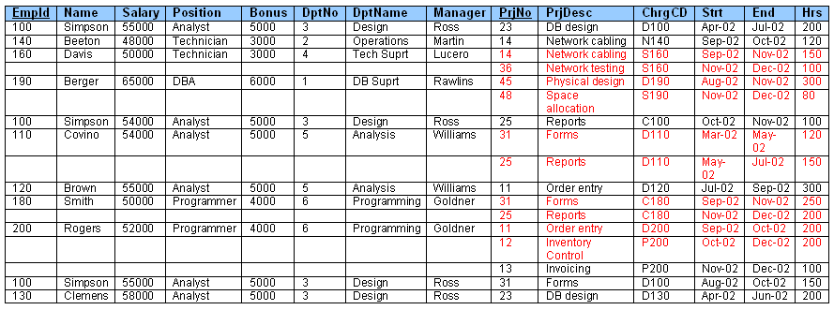
Normalization

Slide 29
Normalization
  Anomalies
  There are three types of anomalies we might encounter:
    Update Anomaly. Occurs when updating values of attributes in the database.
    Deletion Anomaly. Occurs when deleting rows from a relation.
    Addition Anomaly. Occurs while adding (inserting) new rows in a relation.

Slide 30
Normalization
  Sample anomalies in our example:
  Update Anomaly. Consider changing the name Simpson to Sampson.
    There are multiple rows with ‘Simpson’, and if we forget to update all of them, it will lead to inconsistencies in the data.
  Deletion Anomaly. Consider deleting all the information in the database about Beeton.
    We lose information about the ‘Operations‘ department entirely because there are no other employees in that department.
  Addition Anomaly. Consider trying to add a new employee Potter, who has not been assigned to a project yet.
    We will have an empty project information, which may not be desirable in the database design.

Slide 31
Normalization
  1NF
  A table is in 1NF if it has no multivalued attributes
  In other words: All columns must contain atomic attribute values.
  The simplest transformation to 1NF involves adding new rows to make sets atomic.
    Atomic: the table does not contain repeating groups or multivalued attributes.

Slide 32
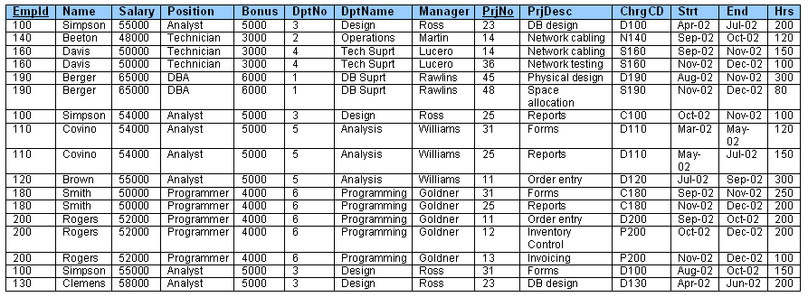
Normalization
Project-Assignment Table in 1NF

Slide 33
Normalization
  1NF
  We have solved the problem of multivalued attributes.
  All of our anomalies remain. We have to continue to 2NF.

Slide 34
Normalization
  2NF
  A table is in 2NF if non-key attributes are dependant on both parts of the primary key.
  In other words: There are no partial key dependencies
  The transformation to 2NF involves moving partial dependencies into their own tables.

Slide 35
Normalization
  2NF
  First we need to identify the dependencies in our example.
  PrjNo > PrjDesc
  EmpID > Name, Salary, Position, Bonus, DptNo, DptName, Manager
  {PrjNo, EmpID} > ChrgCD, Start, End, Hrs

Slide 36
Normalization
Project-Assignment Table in 1NF

Slide 37
Normalization
  2NF
  First we need to identify the dependencies in our example.
  PrjNo > PrjDesc
  EmpID > Name, Salary, Position, Bonus, DptNo, DptName, Manager
  {PrjNo, EmpID} > ChrgCD, Start, End, Hrs

Slide 38
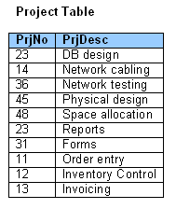
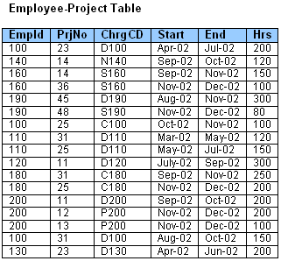
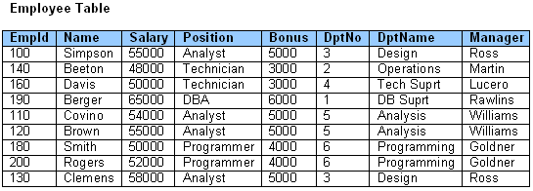
Normalization
  PrjNo > PrjDesc
  EmpID > Name, Salary, Position, Bonus, DptNo, DptName, Manager
  {PrjNo, EmpID} > ChrgCD, Start, End, Hrs

Slide 39
Normalization
  2NF
  This is starting to look more familiar to us.
  Let’s revisit our anomalies.

Slide 40
Normalization
  Sample anomalies in our example:
  Update Anomaly. Simpson now has a single point of change in the Employee Table. Resolved.
  Deletion Anomaly. Deleting information about Beeton will still delete all the information about his department. Anomaly persists.
  Addition Anomaly. Potter can now be added to the database without assigning him to a project. Resolved.

Slide 41
Normalization
  3NF
  A table is in 3NF if no non-key attributes are dependant on other non-key attributes.
  In other words: There are no transitive dependencies
  The transformation to 3NF involves moving transitive dependencies into their own tables.

Slide 42
Normalization
  3NF
  First we need to identify the transitive dependencies in our example.
  EmpId > Position
  Position > Bonus
  EmpId > DptNo
  DptNo > DptName, Manager
  So we are going to further decompose the Employee table.

Slide 43
Normalization

Slide 44
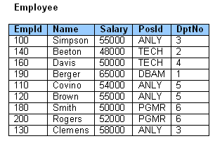
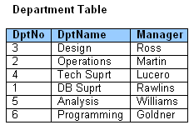
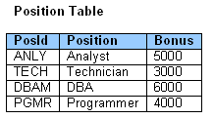
Normalization

Slide 45
Normalization
  3NF
  Let’s revisit our outstanding anomaly:
  Deletion Anomaly. Information about Beeton can be deleted from the employee table and still leave the department information in tact. Resolved.

Slide 46
Normalization
  We have eliminated our anomalies
  We have eliminated redundancies
  We have developed a more representative model or our business domain.

Slide 47
Normalization
Unnormalized Relations
First normal form
Functional dependencyof nonkey attributes on the primary key - Atomic values only
No transitive dependency between nonkey attributes
Second normal form
Third normal form
Boyce-
Codd and
Higher
All determinants are candidate keys - Single multivalued dependency
Full Functional dependencyof nonkey attributes on the primary key

