Slide 1
Skeletal Animations in
Ogre 2.x
by Matías Nazareth Goldberg

Slide 2
So... Ogre 1.x
  Very cache unfriendly
  Not SIMD
  Not threadable
  Too many issues with TagPoints
  Per-bone weights is slow and sluggish
  Bad IK integration
  Shares code with Node & Vertex animations

Slide 3
Ogre 2.x!
  Cache friendly
  SIMD
  Threadable
  TagPoints are being redesigned (implementation postponed to 2.1)
  Per-bone weights is natively supported
  Designed to integrate with 3rd party IK solutions (implementation postponed to 2.1)
  Does not share code with Node & Vertex animations and is incompatible with them! :(

Slide 4
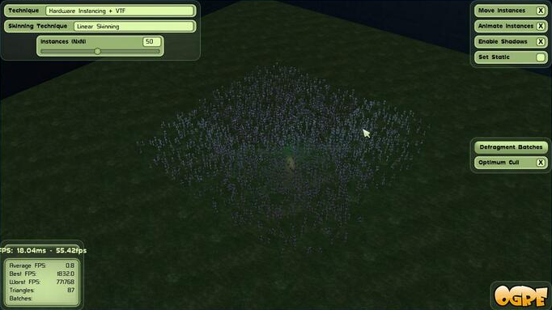
Hard numbers
2500 instances, 18 bones (robot.mesh)
Ogre 1.9:
38,46ms / 26 fps
Ogre 2.0:
14,80ms / 67 fps

Slide 5
2.6x Faster!
Ok, how did we achieve that again?

Slide 6
2.0 Breakdown
  Cache friendly
  SIMD
  Threadable
  TagPoints are being redesigned (implementation postponed to 2.1)
  Per-bone weights is natively supported
  Designed to integrate with 3rd party IK solutions (implementation postponed to 2.1)
  Does not share code with Node & Vertex animations and is incompatible with them! :(

Slide 7
Breakdown: Cache Friendly Part I
  Bones use ArrayMemoryManager
  See NodeMemoryManager slides [1]:
      SoA arrangement
      Transforms are all contiguous in memory
  Transforms are updated in bulk and from multiple threads
Restrictions:
  Bones from diferent hierarchy depth levels are not contiguous.
  Bones from different Skeletons are not contiguous
(Note: They can have different animations playing independently.)

Slide 8
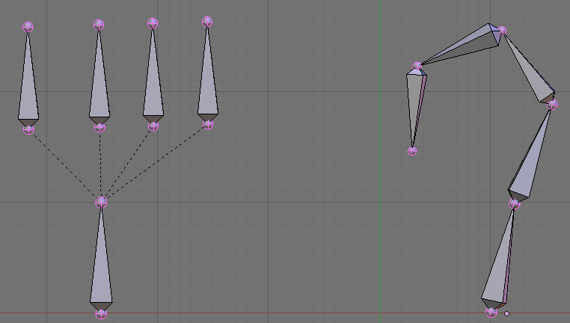
Breakdown: Cache Friendly Part I
Restrictions:
  Bones from diferent hierarchy depth levels are not contiguous in memory.
Level 1:
4 bones are contiguous
(also good for SIMD)
>
Level 0:
This bone is contiguous w/ the same bone of the next SkeletonInstance
5 levels, 1 bone per level
Each bone is contiguous with the ones from the next SkeletonInstance

Slide 9
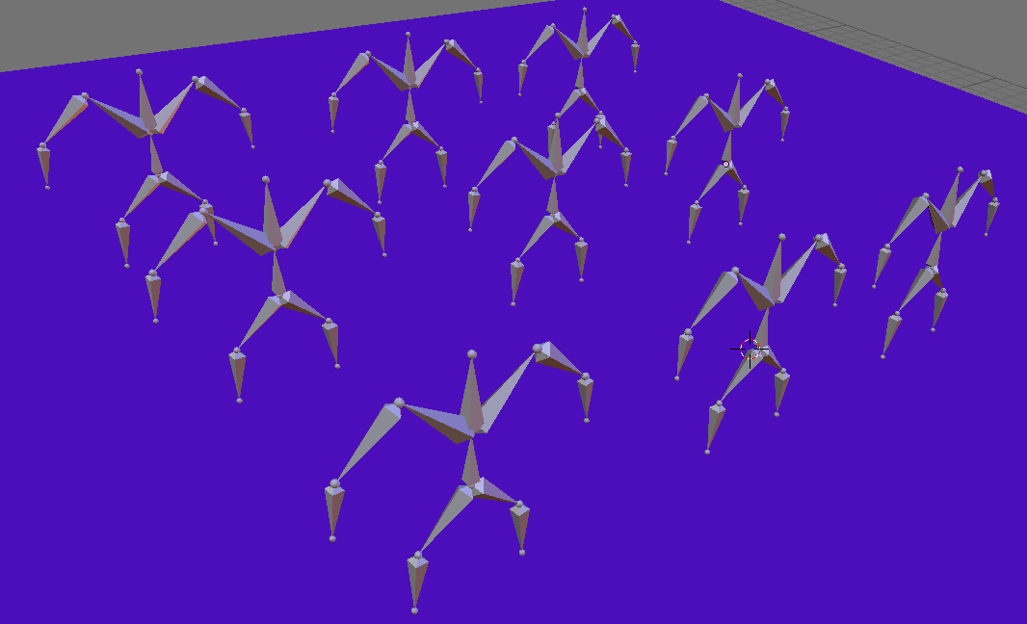
Breakdown: Cache Friendly Part I
Restrictions:
  Bones from different Skeletons are not contiguous.
GREAT!
Many instances of the same Skeleton have their bones contiguous in memory. (Also allows SIMD utilization)
(Note: They can have different animations playing independently.)

Slide 10
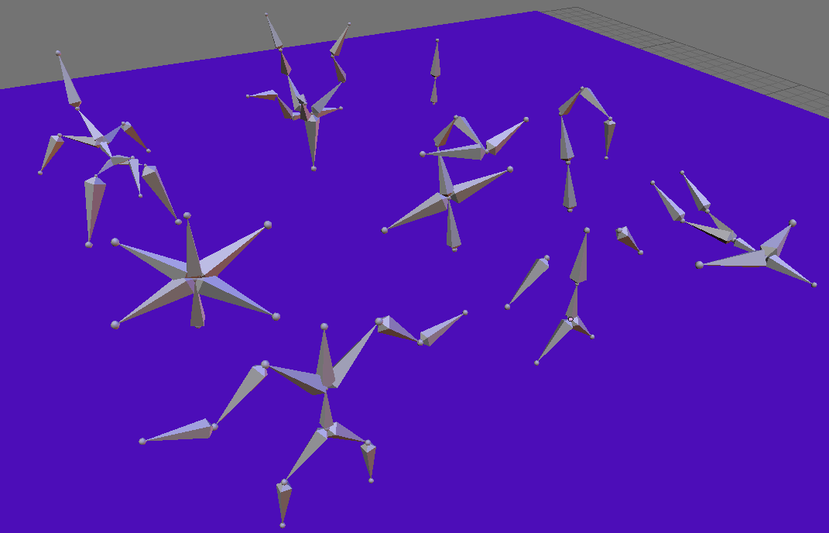
Breakdown: Cache Friendly Part I
Restrictions:
  Bones from different Skeletons are not contiguous.
BAD!
Many Skeletons, one instance for each. Prevents SIMD and cache coherency
(Pst, Ogre can handle 9 different Skeletons just fine, but don't use a hundreds of different skeletons at the same time.)

Slide 11
Breakdown: Cache Friendly Part II
  Key frames are arranged in memory by likehood of being used.
  That 'likehood' depends on which keyframes will be active at a given time

Slide 12
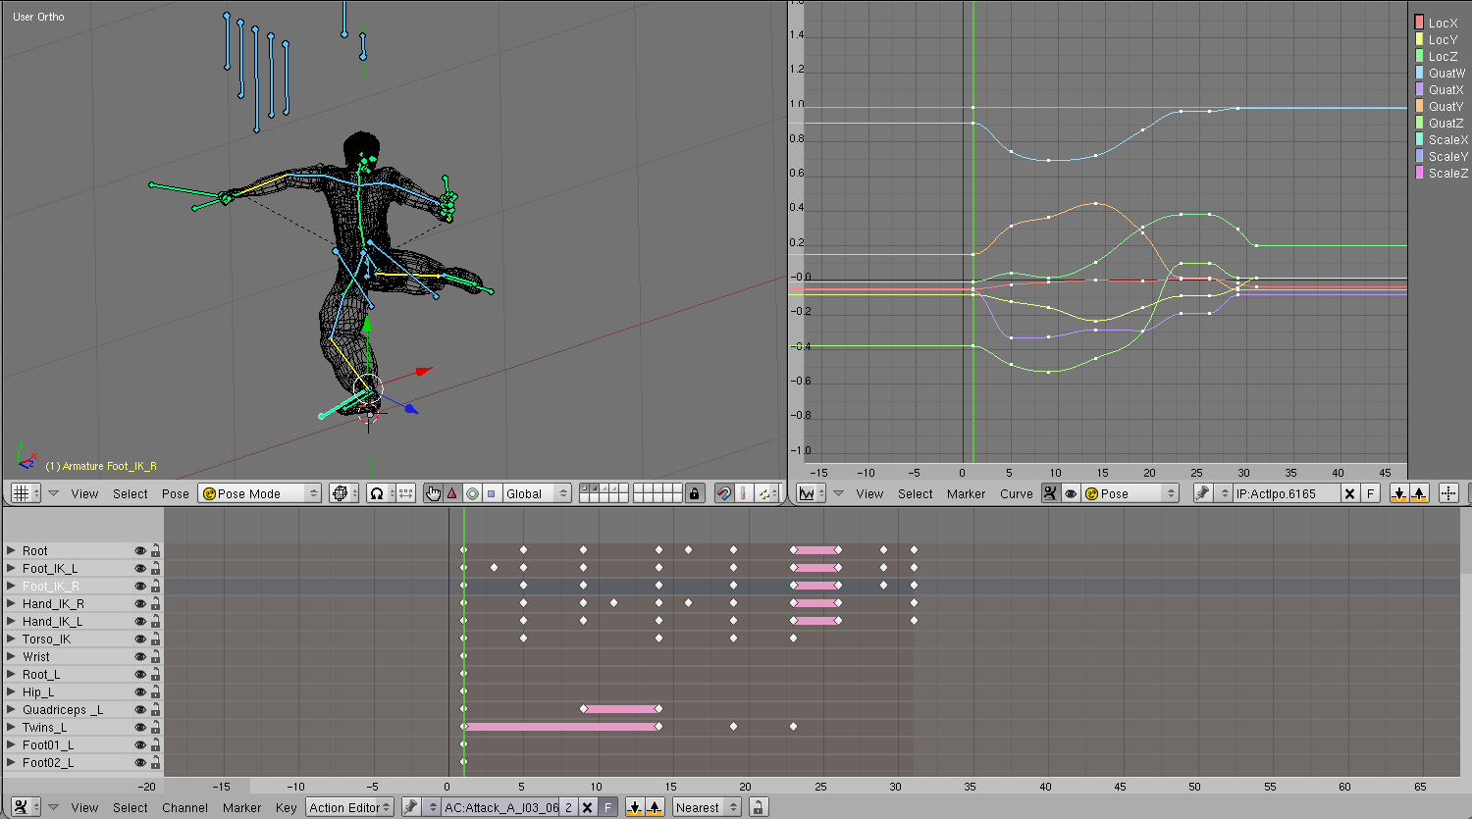
Breakdown: Cache Friendly Part II
The typical setup:
Each row is a 'track' in Ogre
Each dot is a keyframe

Slide 13
Breakdown: Cache Friendly Part II
We're going to represent the order in which keyframes are created for each Track. With a little of imagination, each row of keyframes belong to the same track

Slide 14
Breakdown: Cache Friendly Part II
This is how Ogre 1.9 allocates keyframes:

Slide 15
Breakdown: Cache Friendly Part II
This is how Ogre 1.9 allocates keyframes:

Slide 16
Breakdown: Cache Friendly Part II
This is how Ogre 1.9 allocates keyframes:

Slide 17
Breakdown: Cache Friendly Part II
This is how Ogre 1.9 allocates keyframes:

Slide 18
Breakdown: Cache Friendly Part II
This is how Ogre 1.9 allocates keyframes:

Slide 19
Breakdown: Cache Friendly Part II
This is how Ogre 1.9 allocates keyframes:

Slide 20
Breakdown: Cache Friendly Part II
This is how Ogre 1.9 allocates keyframes:

Slide 21
Breakdown: Cache Friendly Part II
This is how Ogre 1.9 allocates keyframes:

Slide 22
Breakdown: Cache Friendly Part II
This is how Ogre 1.9 allocates keyframes:

Slide 23
Breakdown: Cache Friendly Part II
What's the problem with this? When we're interpolating the animation, the keyframes from each track are too far apart (particularly important for long animations)

Slide 24
Breakdown: Cache Friendly Part II
What's the problem with this? When we're interpolating the animation, the keyframes from each track are too far apart (particularly important for long animations)
We're interpolating at this time

Slide 25
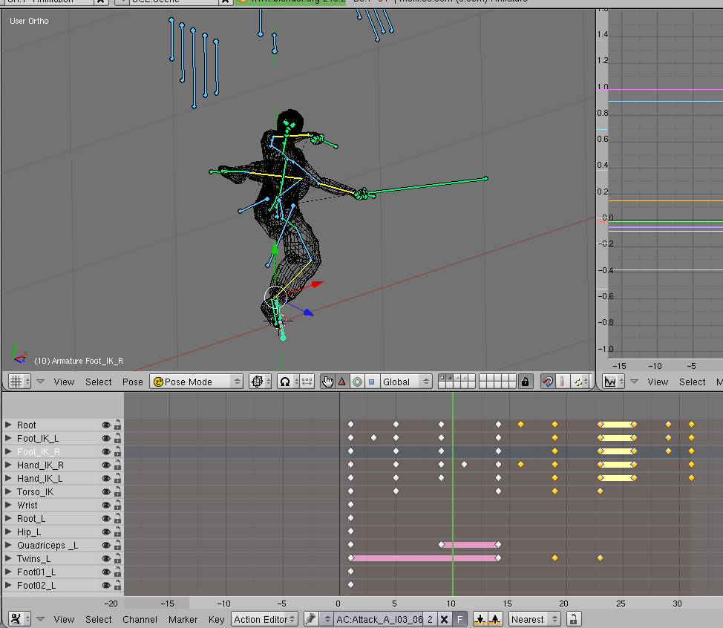
Breakdown: Cache Friendly Part II
All this data gets loaded into the cache!
  Potentially thrashing it.

Slide 26
Breakdown: Cache Friendly Part II
This is how Ogre 2.0 allocates keyframes:

Slide 27
Breakdown: Cache Friendly Part II
This is how Ogre 2.0 allocates keyframes:

Slide 28
Breakdown: Cache Friendly Part II
This is how Ogre 2.0 allocates keyframes:

Slide 29
Breakdown: Cache Friendly Part II
This is how Ogre 2.0 allocates keyframes:

Slide 30
Breakdown: Cache Friendly Part II
This is how Ogre 2.0 allocates keyframes:

Slide 31
Breakdown: Cache Friendly Part II
This is how Ogre 2.0 allocates keyframes:

Slide 32
Breakdown: Cache Friendly Part II
This is how Ogre 2.0 allocates keyframes:

Slide 33
Breakdown: Cache Friendly Part II
This is how Ogre 2.0 allocates keyframes:

Slide 34
Breakdown: Cache Friendly Part II
This is how Ogre 2.0 allocates keyframes:

Slide 35
Breakdown: Cache Friendly Part II
This is how Ogre 2.0 allocates keyframes:

Slide 36
Breakdown: Cache Friendly Part II
  Keyframes are allocate by column-order, rather than row order.
  Ideally all keyframes that are about to be used in the same frame are contiguous.

Slide 37
Breakdown: Cache Friendly Part II
  BUT THAT WAS AN EASY EXAMPLE!
      In practice, there's not always a right solution: Keyframes from different tracks aren't always aligned to a 'column' and its distribution can be very heterogenous.
      The algorithm's code is complex and can be confusing/counter-intuitive. See SkeletonAnimationDef::build in OgreSkeletonAnimationDef.cpp
      More examples in Appendix A

Slide 38
2.0 Breakdown
  Cache friendly
  SIMD
  Threadable
  TagPoints are being redesigned (implementation postponed to 2.1)
  Per-bone weights is natively supported
  Designed to integrate with 3rd party IK solutions (implementation postponed to 2.1)
  Does not share code with Node & Vertex animations and is incompatible with them! :(

Slide 39
Breakdown: SIMD
BoneMemoryManager
      Very similar to NodeMemoryManager
      See slides.
      Bone does not derive from Node.
      Cache friendly. SoA (Structure of Arrays) SIMD ready.
      Bone structure very heterogeneous: hard to SIMDify. But stable at the same time: same skeleton, same number of bones in each hierarchy level for each instance

Slide 40
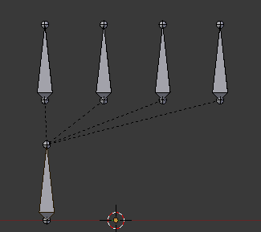
Breakdown: SIMD
First SIMD approach
      Group each bone hierarchy in the same SIMD block. SSE2: 4 bones per block.
4 bones per block
1 bone per block
This skeleton example needs 2 blocks.
      3 instances? We'll need 6 blocks
      Overhead is too high. Up to 300% waste.

Slide 41
Breakdown: SIMD
FINAL SIMD approach
      Number of bones per level known at beforehand
      1 bones → pack 4 instances in the same block!
      2 bones → pack 2 instances in the same block!
      3 bones → Cannot pack. 4 cannot divide by 3
      4 bones → 1 instance per block
      >4 bones → 1 instance consumes >1 block
      Overhead reduced: up to 60% waste

Slide 42
Breakdown: SIMD
Overhead summary
Overhead | Num. Bones in the same level
- | 1
- | 2
33,0% | 3 | (4 – 3) / 3
- | 4
60,0% | 5 | (8 – 5) / 5
33,3% | 6 | (8 – 6) / 6
14,3% | 7 | (8 – 7) / 7
- | 8
33,0% | 9 | (12 – 9) / 9
20,0% | 10 | (12 – 10) / 10
9,09% | 11 | (12 – 11) / 11
- | 12

Slide 43
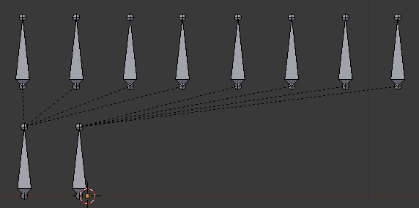
Breakdown: SIMD
FINAL SIMD approach
Instance 1
Instance 2

Slide 44
Breakdown: SIMD
FINAL SIMD approach
BLOCK 0
LEVEL 1
BLOCK 1
LEVEL 1
BLOCK 0
LEVEL 0
BoneMemoryManager

Slide 45
Breakdown: SIMD
Taking advantage of SIMD - Animation
      Ideal: Process 4 bones at the same time.
      Reality: Up to 4 bones at a time.
Animation
      Keyframes are applied per block.
      Use masking to prevent applying to bones in the block that aren't animated.
      Masking also prevents applying to bones that belong to a neighbour instance.

Slide 46
Breakdown: SIMD
Animation
      Keyframes are applied per block.
      Use masking to prevent applying to bones in the block that aren't animated.
      Masking also prevents applying to bones that belong to a neighbour instance.
Extra overhead in the keyframes if not all 4 bones have a track in that animation. Not really relevant.
Per-bone-per-animation weights for free!
Adds additional threading considerations

Slide 47
Breakdown: SIMD
Taking advantage of SIMD – Hierarchy update
      Ideal: Process 4 bones at the same time.
      Reality: Process 4 bones at a time!
Hierarchy update
      Not really novel. Similar system used for Nodes. Slightly different math, and supports non-uniform scaling.
      No need to worry about masking neighbours.

Slide 48
Breakdown: SIMD
FINAL SIMD approach
      One BoneMemoryManager per Skeleton definition
      This is why
          10 instances, 1 skeleton def > 10 skeleton defs

Slide 49
Breakdown: SIMD
Final SIMD approach: Advantages
      Processing multiple nodes at a time
      Cache friendly
Final SIMD approach: Disadvantages
      Update logic tied with memory management: Touch the wrong bone's slot in a block and an unrelated instance will be screwed.
      Cleaning the MemoryManager needs extra care: Order of releasing the slots is extremely important.
      Skeletons are inherently fat & bandwidth heavy. SIMD not always improves performance compared to scalar version due to CPU sitting idle waiting for data to arrive, gains vary per Skeleton and chipset architecture.
      Extra effort to setup the skeleton.

Slide 50
2.0 Breakdown
  Cache friendly
  SIMD
  Threadable
  TagPoints are being redesigned (implementation postponed to 2.1)
  Per-bone weights is natively supported
  Designed to integrate with 3rd party IK solutions (implementation postponed to 2.1)
  Does not share code with Node & Vertex animations and is incompatible with them! :(

Slide 51
APPENDIX A
More examples of Keyframe allocation order for different patterns
(note: the code may not fully 100% follow this order due to bugs or subtle implementation changes, but you'll get the idea)

Slide 95
References
[1] Ogre 2.0 Memory Manager slides uploaded (GSoC) http://yosoygames.com.ar/wp/2013/07/ogre-2-0-memory-manager-slides-uploaded-gsoc/
(slides are also included in the Docs folder of Ogre repo)

