Slide 1

TradeMind Academy
An intelligent tutoring system for trading education
Can a Bayesian student model run a real adaptive loop in a domain where the market itself teaches badly?
Ogechukwu Adama
Student number 10440379
QHO656 Dissertation Project · Supervisor: Prashant Bikram Shah
Southampton Solent University · September 2026
Live: tmacademyuk.vercel.app
Source: github.com/OGSOLENT/TradeMind_Academy
Notes:
My name's Ogechukwu Adama, and what I want to show you is TradeMind Academy. It's an intelligent tutoring system for trading education, and it's the artefact behind my dissertation. I'll start with why it exists, because that decides everything that comes after.

Slide 2
The market is a terrible teacher
And that makes this a pedagogy problem, not a finance one
< 1%
97%
0
80%
of day traders earn reliably positive returns after costs
(Barber et al., 2014)
of persistent traders lost money over 300+ days
(Chague et al., 2020)
measurable improvement with experience
(Chague et al., 2020)
of retail CFD customers lose money, says the regulator
(FCA, 2022)
Feedback from a live market arrives late, buried in variance, and often points the wrong way. A sound decision can lose money and a poor one can be paid. Deliberate practice needs structured tasks and immediate diagnostic feedback (Ericsson et al., 1993). Live markets supply neither, so unstructured exposure is a poor way to learn, whatever the content.
TradeMind Academy · QHO656 · Ogechukwu Adama
2
Notes:
If you go looking for trading education online right now, what you get is a pile of videos. Same videos, same order, for everybody. And the evidence on retail trading is pretty bleak. Most day traders lose money, and one large study found no sign that traders get better with experience at all. Which tells you something useful. The market is a terrible teacher. It pays you late, it buries the signal in noise, and quite often it rewards the wrong decision.

Slide 3
Two literatures that never meet
Where this project sits
Intelligent tutoring works
Financial education works too
0.76 against 0.79 for human tutors (VanLehn, 2011)
Median 0.66 across 50 evaluations (Kulik & Fletcher, 2016)
But 0.20 in the strongest trial (Pane et al., 2014)
76 randomised trials, 160,000 people, real effects (Kaiser et al., 2022)
Earlier null was about intervention quality, not education
But every trial measures budgeting, saving and credit
The gap
Knowledge tracing is built on mathematics, language and programming datasets. About 240 records screened across seven databases, and this survey found no tutoring system applying a formal student model to trading education. Peer-reviewed evaluation of instruction in chart-based trading skills is essentially absent, even though a large industry sells it.
TradeMind Academy · QHO656 · Ogechukwu Adama
3
Notes:
Existing trading courses don't fix this. Same content, same order, no model of the student. Intelligent tutoring systems were built for exactly this shape of problem and they have a mature evidence base. But the knowledge tracing literature is built almost entirely on mathematics, language and programming. I could find no published tutoring system applying a formal student model to trading education.

Slide 4
Four questions
Fixed at the progress report and not moved since
RQ1
Can a trading curriculum be decomposed into knowledge components clean enough for BKT to trace, and does the engine behave as the design requires?
Answered
RQ2
Can a BKT-driven routing policy run a complete adaptive loop end to end, while recording the data a learning-gain study would need?
Answered, narrowed
RQ3
Can the learner see and understand the model that is making decisions about them?
Answered on design
RQ4
What constraints does the regulatory and ethical context impose, and can they be built in without degrading the experience?
Answered
The learning-gain half of RQ2 needed participants. It is the one thing this project did not deliver, and slide 17 says exactly why.
Notes:
So my question was whether a Bayesian Knowledge Tracing model can run a real adaptive loop in this domain. And then, separately, whether the system can produce evidence good enough to say if that adaptation is worth anything. That second half is the part I'd ask you to hold on to. Building something that feels adaptive is easy. Showing it does something is not.

Slide 5
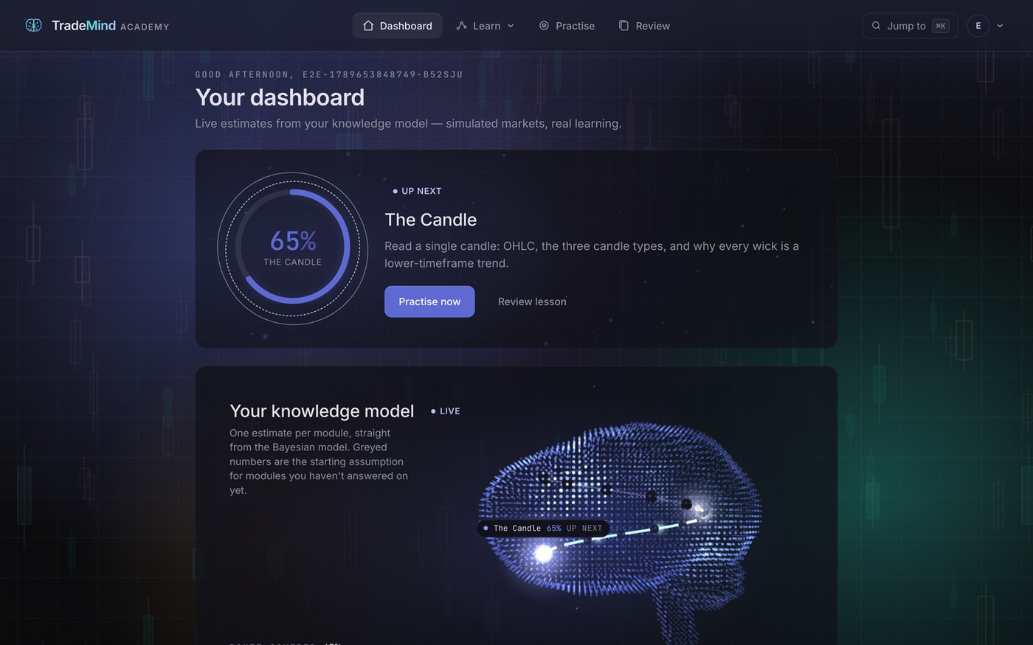
What was built
A deployed web application, not a prototype
16
66
116
modules in a strict
prerequisite chain
lessons, 33 with a
recorded walkthrough
assessment items across
six question types
48
16
19
stepped chart
walkthroughs
real historical case
studies, found by code
routes, 25,700 lines
of TypeScript
The dashboard: the routed next action, and the learner model as an object you can look at
Live at tmacademyuk.vercel.app, against the real database.
TradeMind Academy · QHO656 · Ogechukwu Adama
5
Notes:
TradeMind Academy is a deployed web application. Sixteen modules in a strict prerequisite chain, sixty-six lessons, a hundred and sixteen assessment items across six question types, a pure BKT engine, a rule-based router, and an append-only response log that records the model's estimate before and after every single answer.

Slide 6
Six components, one loop
Following the classic ITS architecture, with two hard boundaries
Content layer
Assessment engine
Student model
Control layer
Progress interface
Lessons and items
Serves and grades
BKT, per concept
Routing rules
Shows the model
Authentication and data layer · accounts, mastery, sessions, and the append-only response log
The engine and the router import nothing. No framework, no database. Trivially testable, and portable if the platform changes.
One writer. The logger is the only path an answer takes to the database, so there is exactly one place to get the research log right.
TradeMind Academy · QHO656 · Ogechukwu Adama
6
Notes:
Six components and one loop. A content layer, an assessment engine, a student model, a control layer of routing rules, a progress interface, and the data layer holding accounts and the research log. Two boundaries I treated as inviolable. The engine and the routing are pure TypeScript with no framework or database imports. And the logger is the only path by which an answer reaches the database.

Slide 7
The engine
Bayesian Knowledge Tracing (Corbett & Anderson, 1994)
The update
Parameters, all in one file
Correct: P(L)(1 − S) / [ P(L)(1 − S) + (1 − P(L))G ]
Wrong: P(L)S / [ P(L)S + (1 − P(L))(1 − G) ]
Learn: P(L′) = P(L|evidence) + (1 − P(L|evidence))T
Forecast: P(correct) = P(L)(1 − S) + (1 − P(L))G
Prior P(L0)
0.25
Learn P(T)
0.12
Guess P(G)
0.20
Slip P(S)
0.10
Mastery / remediate
0.8 / 0.4
A correct streak, computed by the shipped engine
0.25
0.648
0.905
0.980
0.996
Crosses the 0.8 mastery line on the second correct answer. These exact figures are the hand-computed unit-test fixtures, so a drifting implementation fails against the arithmetic rather than against its own opinion of itself.
start
answer 1
answer 2
answer 3
answer 4
TradeMind Academy · QHO656 · Ogechukwu Adama
7
Notes:
BKT comes from Corbett and Anderson in 1994. Each concept is a two-state hidden Markov model. Four parameters: the prior, the chance of learning on any attempt, the chance of guessing right when you don't know, and the chance of slipping when you do. Condition on the evidence, then apply the learning step. About fifteen lines of actual maths, and the tests assert against arithmetic I worked out by hand.

Slide 8
Rules a person can read
The pedagogical model is deliberately not learned
1
Unlock
2
Target
3
Action
4
Item
Every prerequisite
at or above 0.8
The lowest-mastery
unlocked module
Never practised → teach.
Otherwise the band decides
Difficulty ladder off
the same estimate
below 0.4
Remediate
0.4 to 0.8
Practise
Also: an easy item is forced after two consecutive wrongs, and no item repeats inside a session.
0.8 and above
Advance, unlock the next
TradeMind Academy · QHO656 · Ogechukwu Adama
8
Notes:
Routing is the pedagogical model, and it is deliberately a set of rules a person can read rather than a learned policy. A module unlocks when every prerequisite is at or above 0.8. The target is the weakest unlocked module. If it has never been practised the action is teach. Otherwise the band decides. And item selection follows a difficulty ladder off the same estimate.

Slide 9
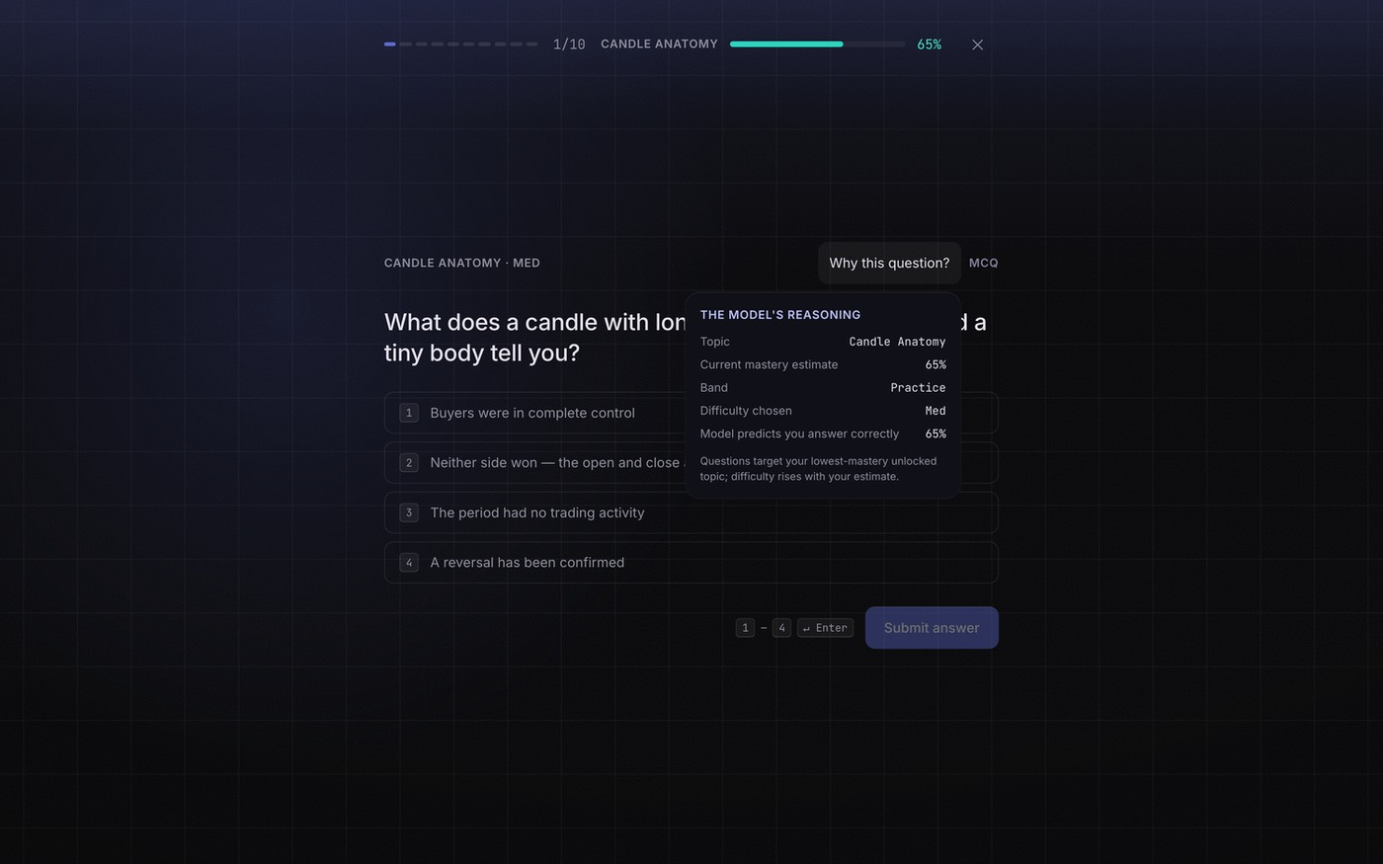
The model shows its working
The single most original thing in the build
Why this matters
The panel renders the routing engine's actual decision object, not a summary written for display.
Most self-explaining systems explain a reconstruction. A reconstruction can drift silently from the behaviour it claims to describe.
There is only one object here. So the explanation is structurally incapable of disagreeing with the decision.
Cheap to build in. Expensive to retrofit.
TradeMind Academy · QHO656 · Ogechukwu Adama
9
Notes:
The learner can just ask the system why. And these are the real values the router used. My current estimate, the band, the difficulty it picked because of that band, and how likely the model thought I was to get it right. None of that is written for display. It's the actual decision object the engine handed back. Which means the explanation can't disagree with the behaviour, because there isn't a second version of it to drift.

Slide 10
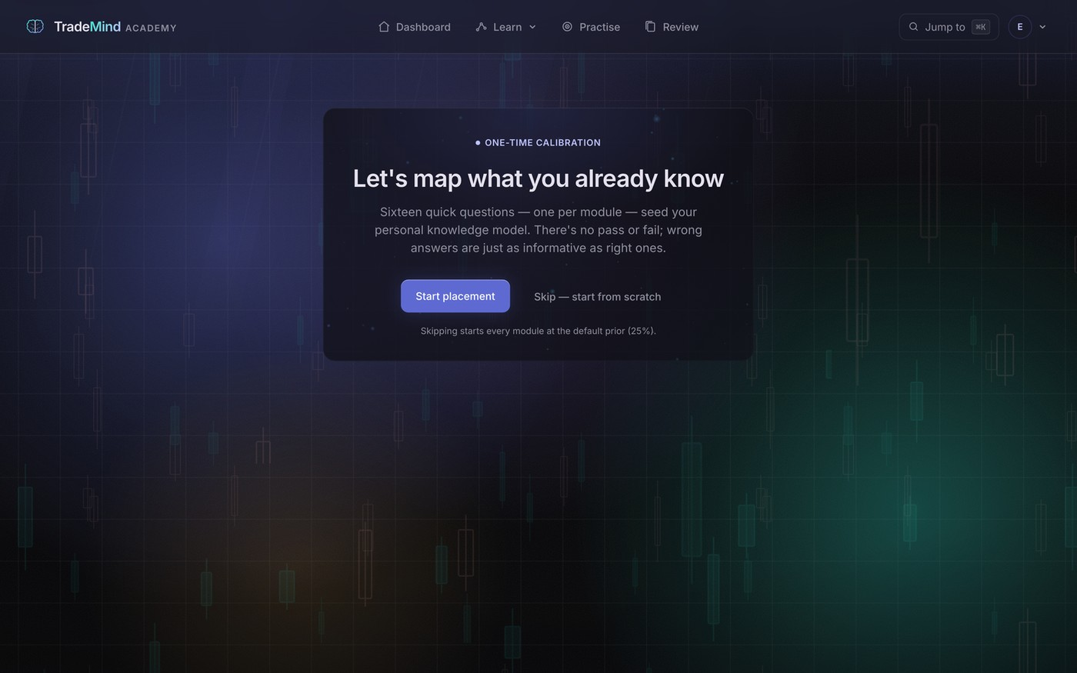
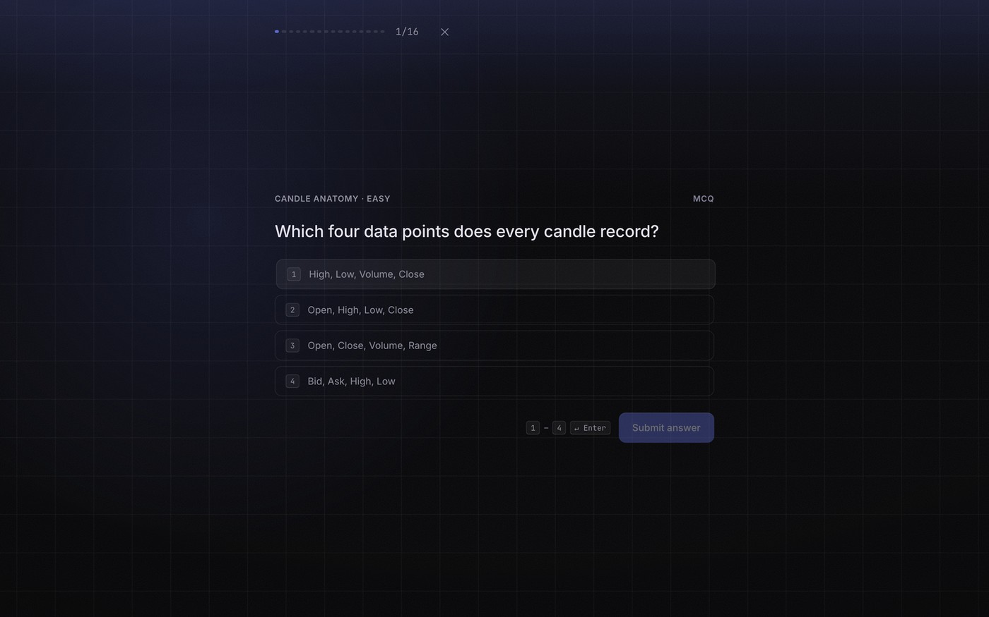
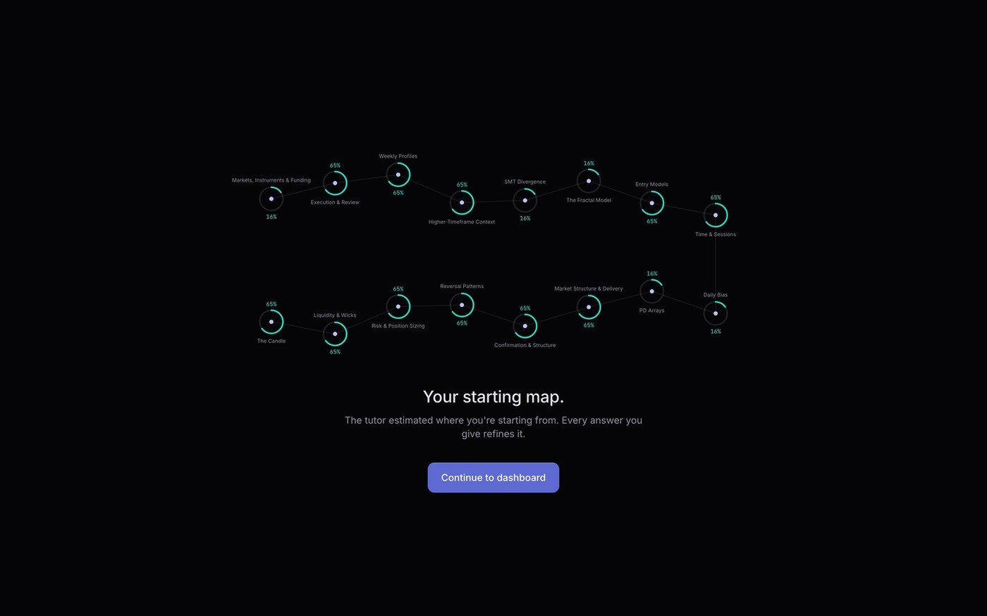
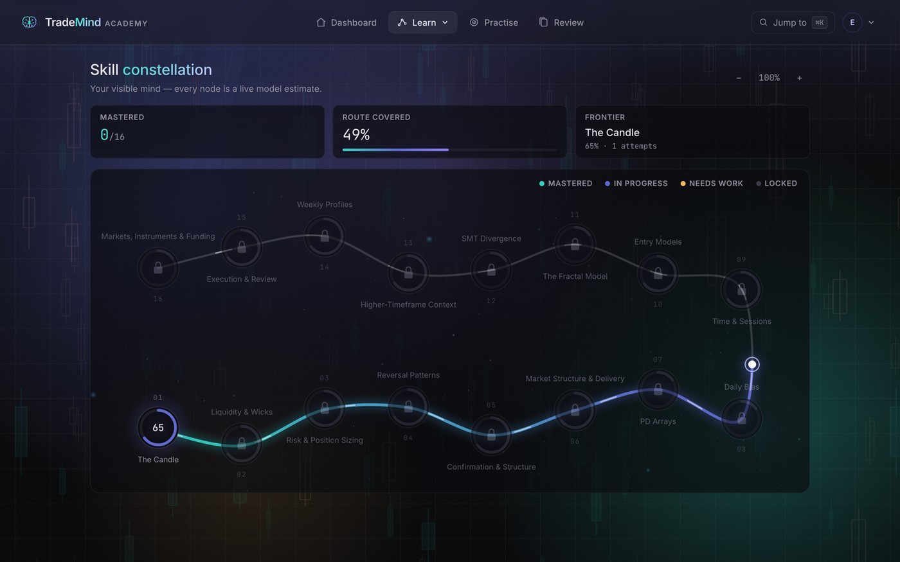
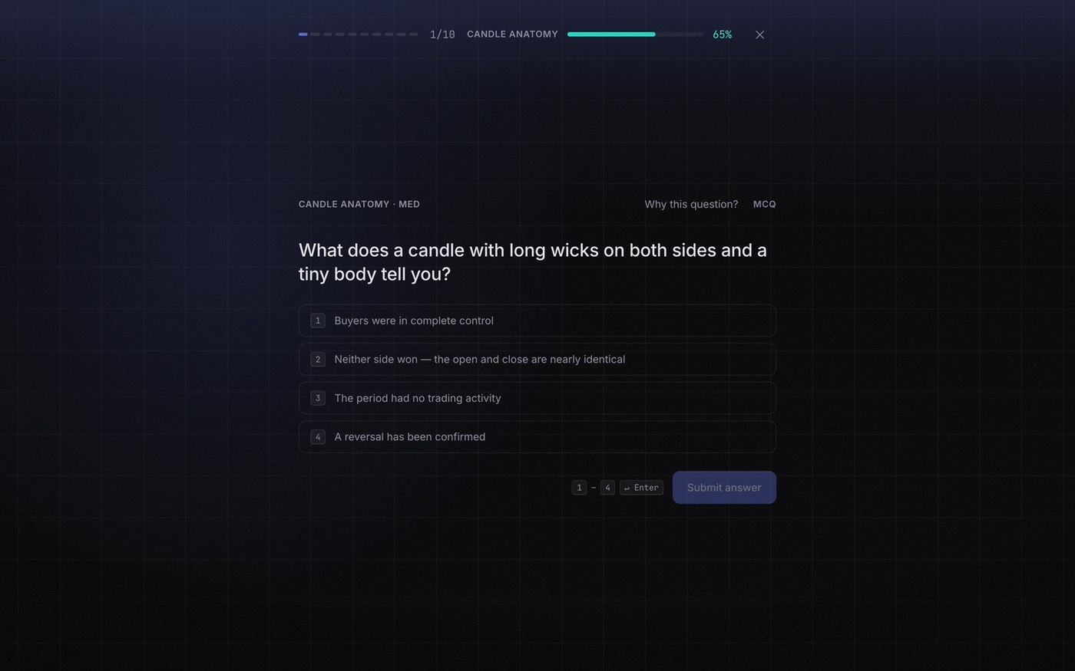
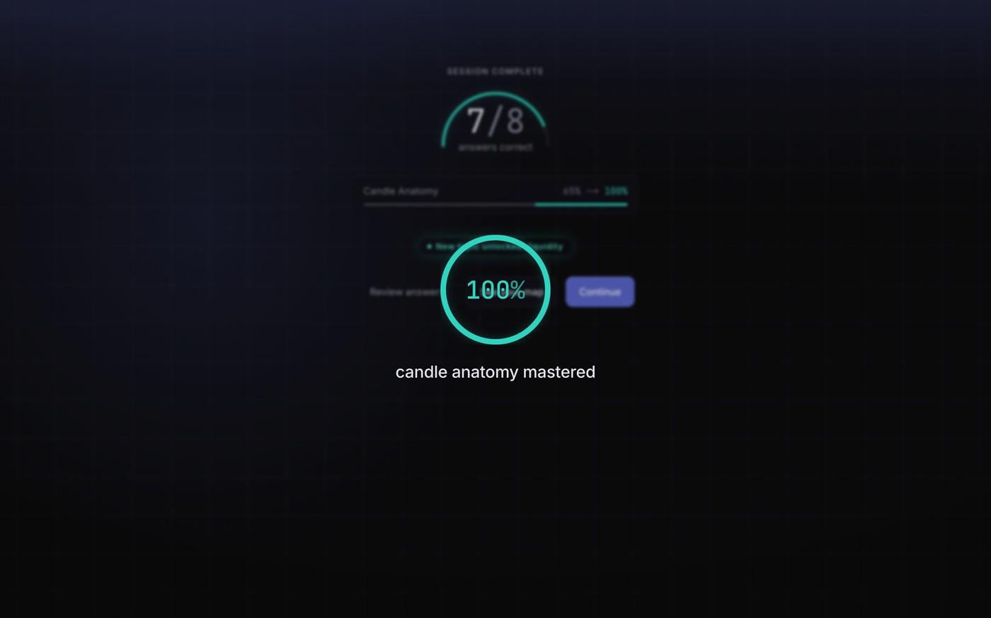
Live demonstration
The loop, end to end, on the real application
Consent, with a working decline
Placement, one item per module
The model initialising
The curriculum as one route
Practice, with live mastery
Before and after, per module
Notes:
Switch to the browser here. Run the loop live: sign-up and the ethics gate, placement, the model initialising, the dashboard, a practice session with the why-this-question panel, and the session summary. If anything fails, play the backup recording and narrate over it.

Slide 11
The content, and how it is evidenced
Constructed where precision matters, real where authenticity does
33
48
16
Recorded lessons
Stepped walkthroughs
Real case studies
Transcribed from four and a half hours of original video across 36 recordings, then rewritten as structured markdown.
A constructed price series, so the sweep, the break and the gap land on exactly the bars the caption names. Keyboard operable, announced to screen readers, with a full text description.
Historical ES and NASDAQ bars, dated and attributed. Found by a detector that encodes the lesson's own rule, not chosen by eye.
Why find the real examples by code? Because an example chosen by eye to flatter the concept is cherry-picked, and a reader has no way of telling. Finding them by rule makes the selection auditable. That is an evidence-integrity practice, not a technical one.
TradeMind Academy · QHO656 · Ogechukwu Adama
11
Notes:
Thirty-three of the sixty-six lessons have a recording. The other thirty-three open on a stepped chart walkthrough instead, and having built them I'd argue they're the better thing. The price series is constructed from control points, so the sweep and the break land on exactly the bars the caption says. And sixteen lessons carry a real historical case study, found by code rather than by me.

Slide 12
Ethics built in, not bolted on
The regulator draws a line this artefact must never approach
Approval condition
Where it is enforced
Verified by
Participants are 18 or over
Required at profile creation in the database rules, not only the interface
Rules test: create rejected without the flag
Informed consent first
GDPR consent screen with the lawful basis stated and a working Decline
Browser test: Decline signs out and bounces
No financial promotion
Simulated or labelled historical only. No broker link, no signal, no profitability language
Guardrail sweep of every string in the interface
Research data protected
Responses are create-only in the rules, even for their owner
Rules tests: update and delete both denied
Development cannot touch live
Emulator by configuration after test accounts once reached the live project
Enforced by construction, not by discipline
TradeMind Academy · QHO656 · Ogechukwu Adama
12
Notes:
Because this is a research artefact in a regulated space, the constraints shaped the build more than anything else did. Every chart is simulated or a labelled historical case study. No broker connection, no signals, no live prices, eighteen plus. And that's blocked in the database rules, not just the interface, which matters because someone signing in with Google never sees the sign-up form at all.

Slide 13
Verified at four levels
Each layer catches a class of defect the others structurally cannot
138
16
32
4
unit tests
database rule tests
browser journeys
audit passes
BKT maths against hand-computed fixtures, routing decisions, grading, the logger's queue and backoff
Every forbidden operation attempted against the emulator and asserted to fail
16 journeys across desktop and Pixel 7, including axe-core on twelve pages
Lighthouse, axe, keyboard and reduced motion, and a manual guardrail sweep
Coverage where the claims live
100%
100%
94%
90%
46%
The test that earns its keep cuts the network halfway through a session, then reads the database directly and counts the rows against the answers given.
BKT engine
Assessment, grading
Routing
Logger
All of lib
TradeMind Academy · QHO656 · Ogechukwu Adama
13
Notes:
A hundred and thirty-eight unit tests, sixteen on the database rules, and thirty-two end-to-end runs across desktop and mobile profiles. Coverage on the modules the claims actually rest on is a hundred per cent. Across all of lib it's forty-six, because the Firebase adapters are covered by browser journeys instead. I'd rather tell you that than pad the number.

Slide 14
Are the numbers honest?
Calibration: do the forecasts come true at the rate they claim?
0.43 pp
expected calibration error across 8,000 simulated answers
26.0%
Brier skill against a base-rate baseline over the full sequences
The result that went against me
Fitting the prior and learn rate per learner is the step everyone assumes you should take. On held-out data it makes the forecasts slightly worse and nearly doubles the calibration error, because twenty answers cannot identify a prior. So the defaults stay, and that is now an evidence-based decision.
TradeMind Academy · QHO656 · Ogechukwu Adama
14
Notes:
Every logged answer carries the estimate from just before it. Push that through the emission model and it becomes a forecast. And a calibrated model's forecasts come true at the rate they claim. Across eight thousand simulated answers the expected calibration error is 0.43 of a percentage point. Then a result I genuinely didn't expect. Fitting the parameters per learner, which is the step everyone assumes you should take, makes it slightly worse on held-out data.

Slide 15
Does the adapting actually buy anything?
300 synthetic learners, three policies, one item budget of 160
46%
of the syllabus's items, for the same true knowledge. And 44% of the engine's budget goes on modules already known, against 76% for the syllabus.
And the cost
About one module in sixteen is called mastered that the learner does not know, because the engine stops asking once the estimate crosses 0.8 and a lucky guess can carry it there. The syllabus makes the opposite error and pays double the items to avoid it. Neither is free, and mine is the one that shows on the learner's dashboard.
Modules the learner truly knows at the end, of 16
14.97
Adaptive
14.77
Fixed syllabus
8.50
Random unlocked
Answers come from the learner's hidden true state and the item's difficulty, never from the engine's estimate. And the generative model is deliberately not BKT's own, so the engine is tested against a world it did not assume.
TradeMind Academy · QHO656 · Ogechukwu Adama
15
Notes:
Calibration tells you the estimates are honest. It doesn't tell you the adapting is worth doing. So I built a second simulation. Three hundred synthetic learners, three policies, same item budget. And the important bit, answers come from the learner's true state, never from the engine's estimate, so the engine is allowed to be wrong and gets punished when it is. It reaches the same true knowledge as a fixed syllabus on forty-six per cent of the items.

Slide 16
Measured, not assumed
Accessibility as a gate, and performance findings that were invisible on a fast laptop
Accessibility
Performance
100
Lighthouse accessibility, best practices and SEO on every public page, on both mobile and desktop presets
77 → 91
Sign-in on a simulated slow phone, after the entrance animations were rebuilt in CSS
axe-core now runs inside the browser suite against twelve pages on two device profiles, failing the build on any serious or critical WCAG 2.1 AA violation. Before it went green it found three real defects a manual pass had missed:
The animation library was server-rendering every entrance block with an inline opacity of zero. So pages stayed blank until 940 kilobytes of JavaScript had hydrated, and a throttled phone saw the sign-in form 6.6 seconds after the HTML arrived.
A muted colour token at 3.0:1 on every small label in the app
Unearned profile badges whose dimming took their text to 1.9:1
A scrolling lesson table with no keyboard route to scroll it
An entrance animation that hides server-rendered content behind JavaScript is a performance and an accessibility defect, not a polish choice. And it was completely invisible on a fast laptop.
TradeMind Academy · QHO656 · Ogechukwu Adama
16
Notes:
Accessibility was a gate from the first phase rather than a final pass. And it's automated now, with axe running over twelve pages including the signed-in ones on two device profiles. It found three real defects a Lighthouse pass had missed. On performance, the finding that mattered was that the animation library was server-rendering every block at opacity zero, so pages were blank until 940 kilobytes of JavaScript had hydrated.

Slide 17
The study is built
Which changes what the limitation of this project actually is
Post-test
Placement's twin on form B, so fifteen of sixteen items differ. It never updates the learner model, and logs the model's current estimate against every answer, which makes it a held-out check that practice answers structurally cannot give you.
/post-test
Questionnaire
The ten System Usability Scale statements against the published average of 68, plus three open questions. Owner-only in the security rules, with a test proving a stranger is denied.
/survey
Analysis
Reads the database and writes the results document. Per-learner placement, post-test, Hake's normalised gain, time on task, modules mastered, usability score. Pseudonymised, test accounts dropped.
scripts/analyse.ts
It runs clean against the empty live database and reports n = 0 rather than falling over. So the limitation is not that I could not build the study. It is that I have not recruited anyone yet.
TradeMind Academy · QHO656 · Ogechukwu Adama
17
Notes:
The human study is built. Not planned, built and tested. A post-test that's placement's twin on form B, so fifteen of the sixteen questions are different. It never touches the learner model, and every answer is logged with the model's current estimate. So the limitation isn't that I couldn't build the study. It's that I haven't recruited anybody yet. Those are two different sentences, and the second one is the true one.

Slide 18
What the project contributes
Each stated at the strength the evidence supports
1
The application
2
A design pattern
An existence proof that a contested, ill-structured practitioner domain decomposes into components a four-parameter model can trace without misbehaving.
An explanation that renders the router's real decision object rather than a reconstruction, so it is structurally incapable of drifting from the behaviour.
3
A method
4
A practice
A way to answer whether adaptation is worth anything when you cannot recruit participants. The most transferable of the four.
Reporting what went the wrong way. Fitting made the forecasts worse, the prior is barely identifiable, and the router over-calls mastery.
Section 7.5 of the report states each of these with the evidence behind it, and Appendix J traces every design decision in chapters three to five back to its source.
Notes:
Four things offered as contributions, each stated at the strength the evidence supports. The application as an existence proof. The open learner model pattern. The routing simulation as a method. And reporting the findings that went the wrong way.

Slide 19
What this does not show
Stated before anyone has to ask
No human learners
The model evidence is simulated
Parameters are defaults
Everything demonstrated is about correctness, behaviour, calibration and policy efficiency. Nothing is about whether anyone learns.
And the simulated learners share the engine's guess and slip values, so it tests wrong priors rather than the emission model itself.
Justified by the fitting result, but it is a finding about this data volume rather than a principle.
Seven items a module
No forgetting term
A contested methodology
Enough to demonstrate the loop and thin for repeated practice and for two assessment forms drawn from one pool.
Plainly false for human learners. The review queue flags fading skills by heuristic, which is a stand-in for a modelled term.
The interface says so clearly, but it limits how far any learning-gain result would generalise beyond this content.
A system that shows learners its own uncertainty ought to be described by a report willing to show its own.
Notes:
The weaknesses are real. No human participants, so nothing here is about whether anyone learns. The parameters are defaults rather than fitted. The item bank is thin at seven items a module. The model assumes no forgetting. And the curriculum teaches a contested methodology, which limits how far any result would generalise.

Slide 20
What happens next
In priority order, and the first one matters most
Run the study
Everything it needs is deployed. Five to eight participants over one session each would give feasibility evidence for learning gain, calibration and usability. The first number to look at is how often the model calls a module mastered that the post-test says is not.
1
Fit the learn rate, leave the prior to placement
The simulation showed which parameter is identifiable from short sequences and which is not. Fitting per-module learn rates and checking them against degeneracy bounds would replace the defaults with something defensible.
2
Deepen the item bank
Sixteen items a module, more annotation items, and at least three pre-test-eligible items each, so the two assessment forms share nothing at all.
3
Add forgetting and spacing
A BKT variant with a forgetting transition would put the review queue on a modelled footing rather than a heuristic one.
4
A constrained generative tutor
Scoped to the concept being studied, grounded in that lesson's text, with the BKT model unchanged as the sole authority over progression.
5
TradeMind Academy · QHO656 · Ogechukwu Adama
20
Notes:
In priority order, and the first is the one that matters. Run the study, because it's the only thing that turns the artefact into an answered research question. Then fit the learn rate on real responses while leaving the prior to placement. Then deepen the item bank, add a forgetting term, and only then a constrained generative tutor.

Slide 21

Thank you
The loop works end to end, tested at four levels with the engine at full coverage.
The model is calibrated, and reported honestly, including the result that went against me.
The adaptation is measurably more efficient than a syllabus, with its cost stated next to its benefit.
The study instruments exist and they run. And it is live.
What I have not shown you is that anybody learns from it, because that needs participants and I have not had any. That is the boundary, and it is the next thing.
Live: tmacademyuk.vercel.app
Source: github.com/OGSOLENT/TradeMind_Academy
Ogechukwu Adama · 10440379
Notes:
So, to close. The loop works end to end. It's tested at four levels with the engine at full coverage. The model is calibrated, and I've reported that calibration honestly, including the result that went against me. The adaptation is measurably more efficient than a syllabus, and I've put its cost next to its benefit. The study instruments exist and they run. And the whole thing is live. What I haven't shown you is that anybody learns from it, because that needs participants and I haven't had any. That's the boundary, and it's the next thing I'd do. Thanks for listening. Happy to take questions.

