Slide 1
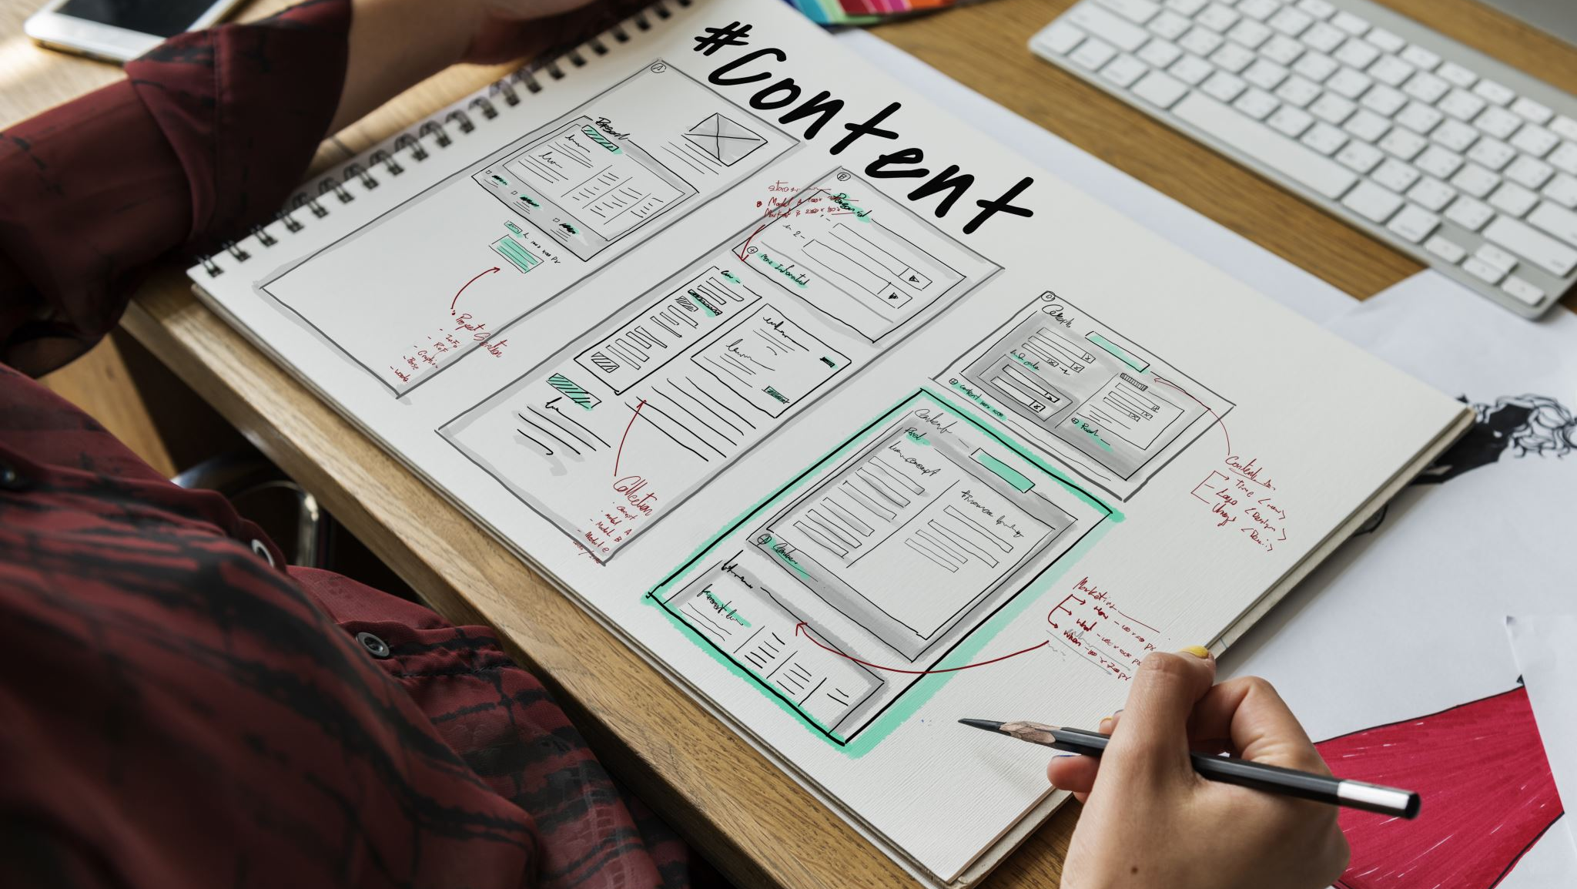
Academic and Personal Task Management App For Students
By
Gurudev Ongole
Akhil Reddy Patpi

Slide 2
Introduction:
This Mobile App helps students efficiently manage and organize their academic and personal tasks, projects and schedules.
It has personal task management and academic task management features in one comprehensive solution.
This App mainly helps masters students in US pursuing higher education. This includes students from various academic disciplines such as Engineering, Sciences and Business.
This App does not limit itself to masters students but also educators, academic advisors and anyone looking to orgainize their academic and personal life.

Slide 3
We have utilized Google Firebase's Authentication system both for registering new users and for verifying the identity of registered users.
We have employed a firestore database to store all the data related to this application.

Slide 4
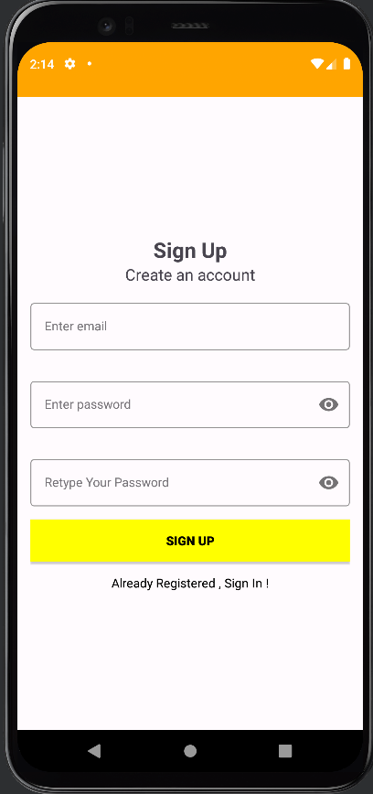
Login Screen(Signup)
The signup screen is designed for user registration where individuals can create their accounts by providing email address, and password.

Slide 5
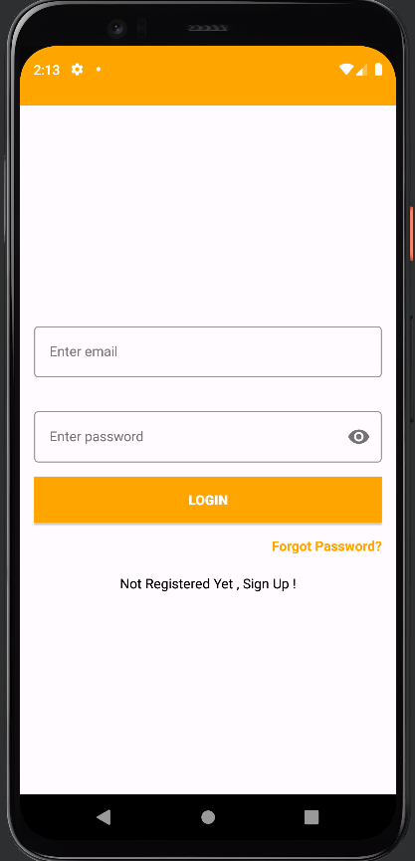
Login Screen(Signin)
Through signin screen, registered users can access the application. It consists of input fields for users to enter their credentials. This screen also has options for password recovery or reset. Upon successful authentication, users gain access to their accounts.

Slide 6
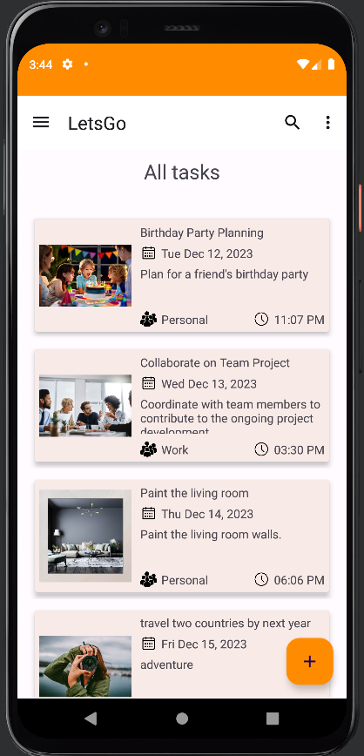
Dashboard
The dashboard screen offers users a quick and convenient way to access essential features and information.
On this screen, users can access their profiles, The main screen shows the user all the tasks. It provides an option to search and sort the tasks.

Slide 7
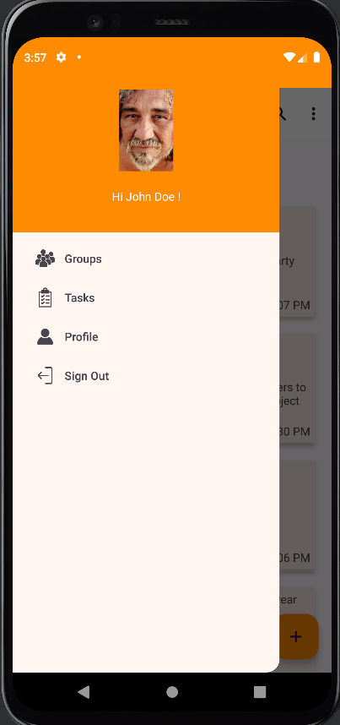
Menu Bar
There is a Menu Bar on the dashboard screen which provides easy access across the application features. We can access groups, tasks, profile and it provides an option to signout.

Slide 8
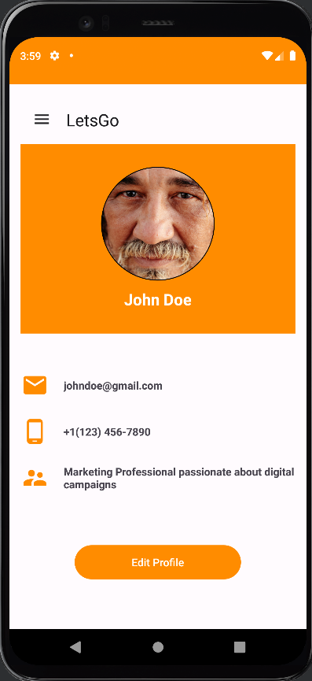
Profile
This screen serves as a user profile page, where the user's image, personal information are prominently displayed.
Users have the ability to make edits to this information and save any modifications they make.

Slide 9
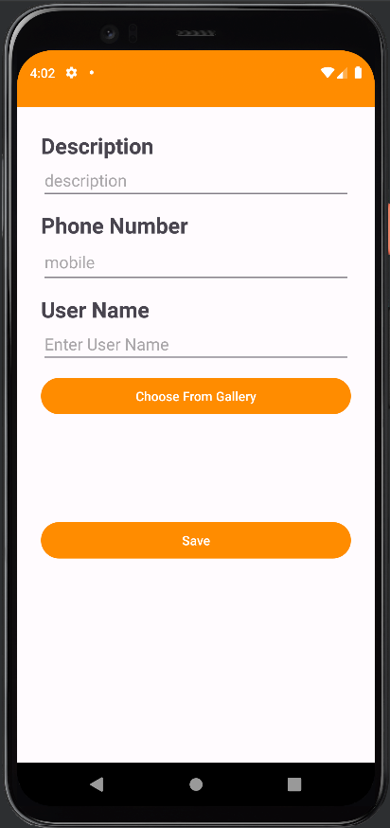
Edit Profile
This screen allows the user to make modifications to their profile and save the changes once done.

Slide 10
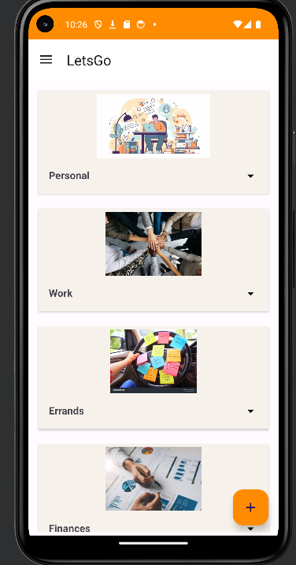
Groups
This screen is accessible from the dashboard menu and serves as a comprehensive directory of all the groups within the platform.
Users have the ability to view and access information about these groups.
It also provides an option to exit a particular group.

Slide 11
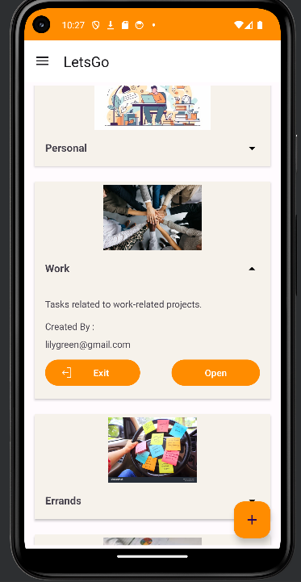
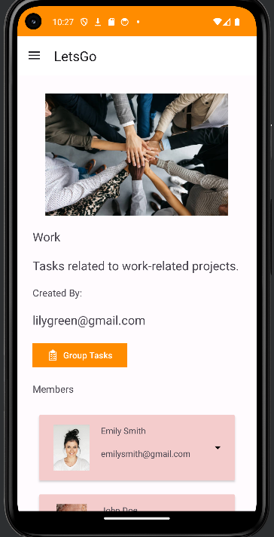
Group View
Upon clicking on a group, this screen provides a detailed view of the group's information, including its name, description, and who created it.
In addition to the group details, the screen also presents a list of group members, allowing users to see who else is part of the group.
It also has an option to check the tasks present in that group.

Slide 12
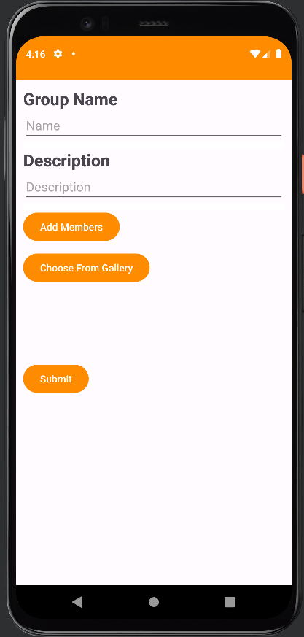
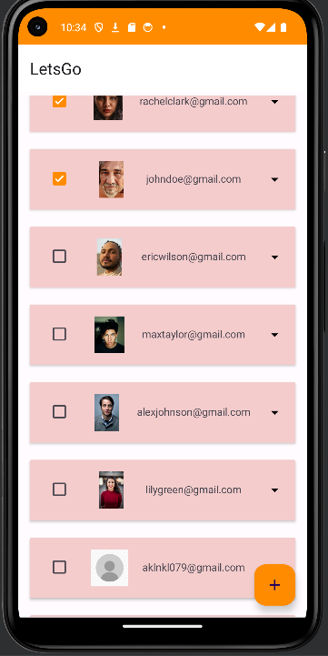
Add Group
Users can create a new group by entering key information, which includes specifying the group's name, providing a description, and selecting a group picture.
Users can also add members to the group.

Slide 13
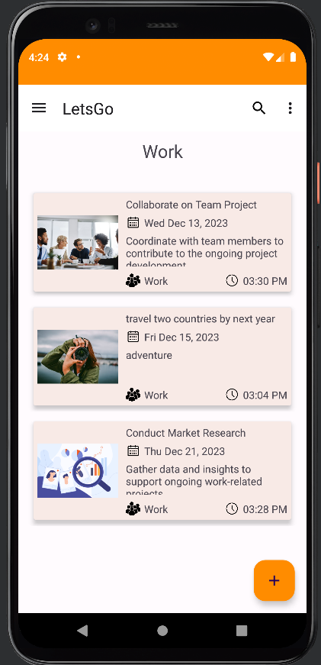
Tasks
This screen displays all the tasks in order according to the calendar related to that group.
We can also search for tasks and add a group task.

Slide 14
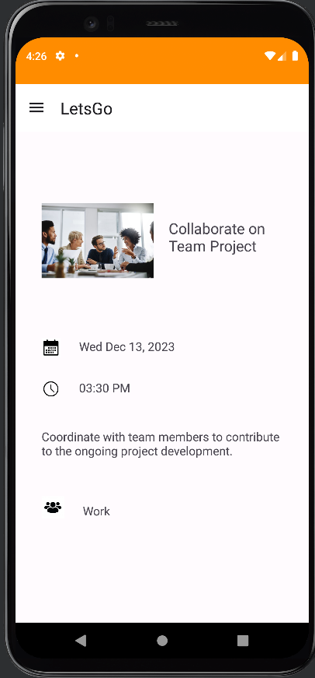
Task View
Upon clicking on a task , this screen is opened.
The displayed task details have information such as the task's date and time, title, description and the group it belongs to.

Slide 15
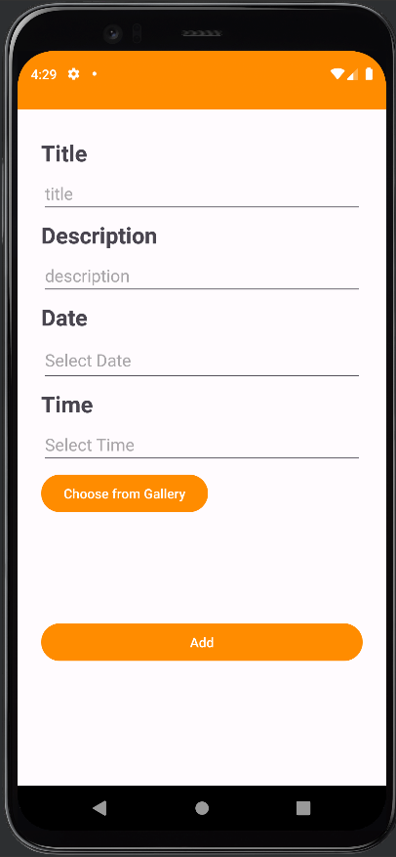
Add Task
Users can create a new task by entering necessary information such as title, description, date, time and uploading task picture.

Slide 16
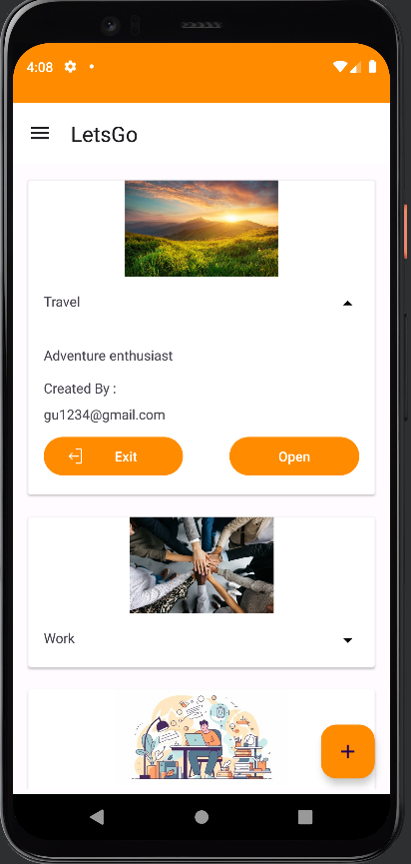
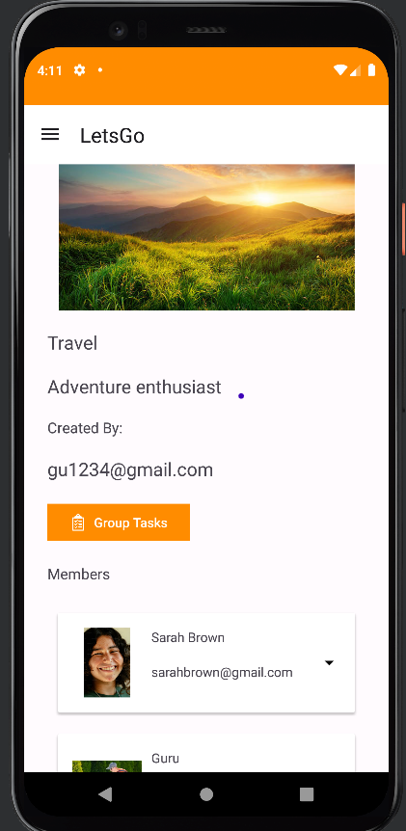
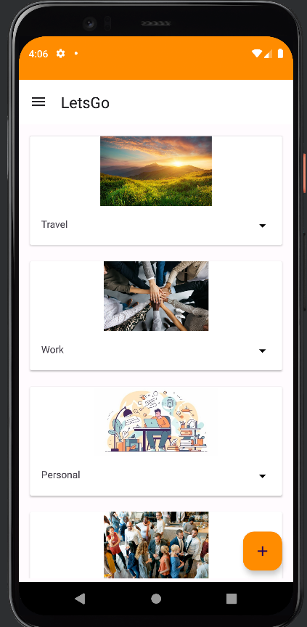
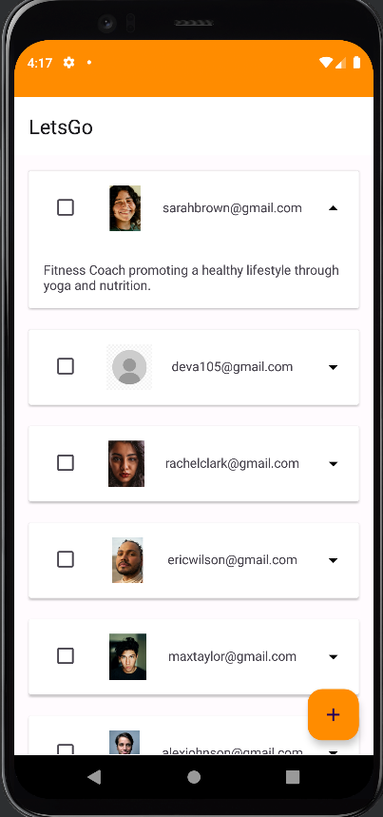

Slide 17
Thank You

