Slide 1
Chest X-ray Abnormalities Detection
수학과 오서영

Slide 2
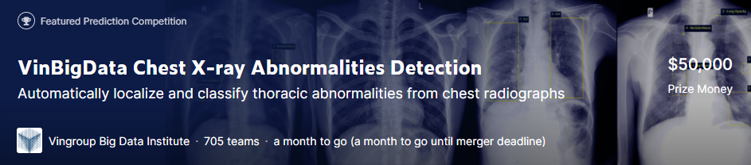
Overview
Introduction
Chest radiograph is difficult task for radiologist.
The interpretation of chest X-rays can lead to medical misdiagnosis, even for the best practicing doctor.
Computer-aided detection and diagnosis systems would help reduce the pressure on doctors at metropolitan hospitals and improve diagnostic quality in rural areas.

Slide 3
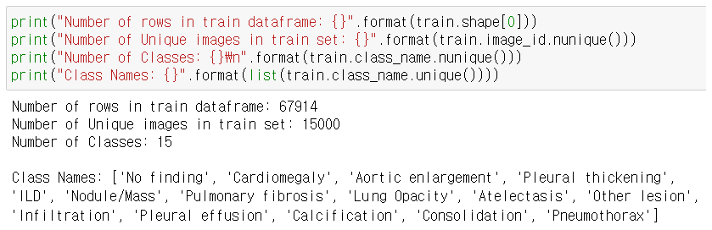
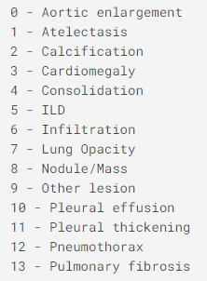
1. Data Exploration and Visualization
14 critical radiographic findings
+
‘No finding’

Slide 4
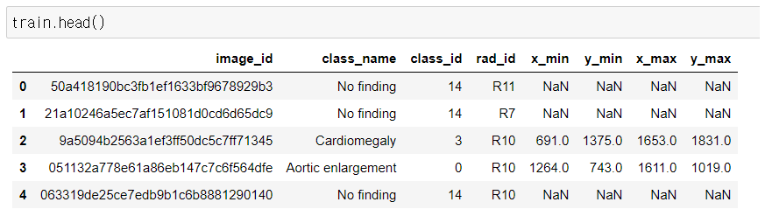
1. Data Exploration and Visualization
(x_min, y_min, x_max, y_max) : bounding box
We have to predict (class, confidence, x_min, y_min, x_max, y_max)

Slide 5
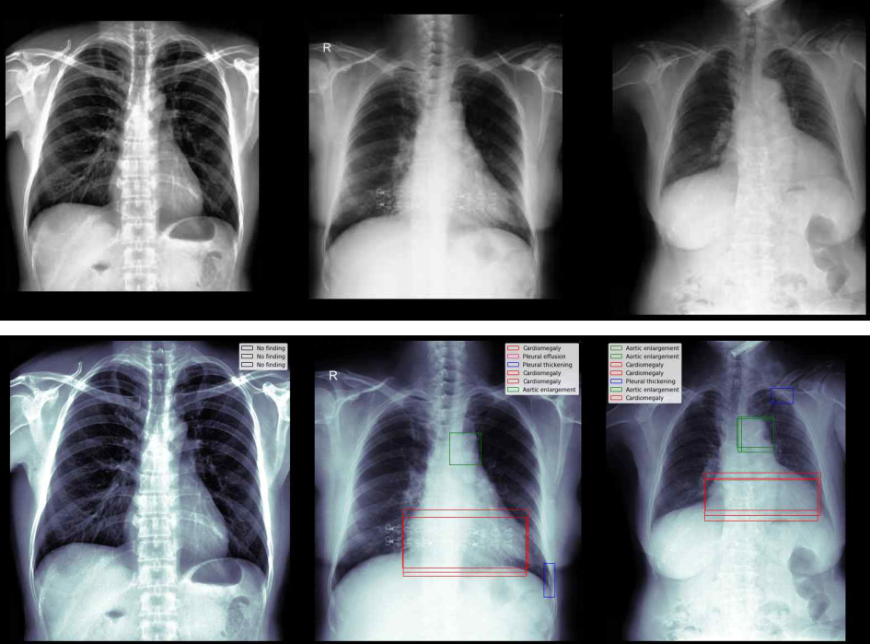
1. Data Exploration and Visualization
Original
Bounding Box

Slide 6
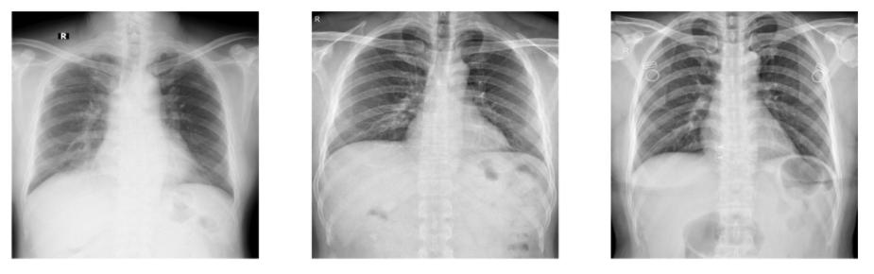
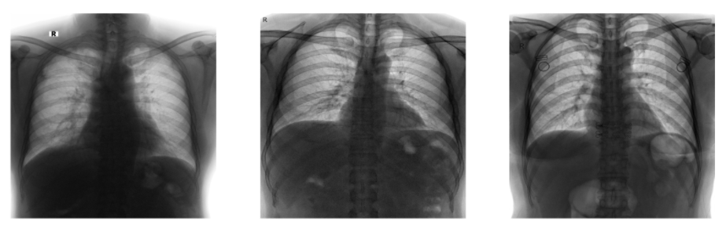
2. Data Preprocessing
Original
Invert : 255 - img

Slide 7
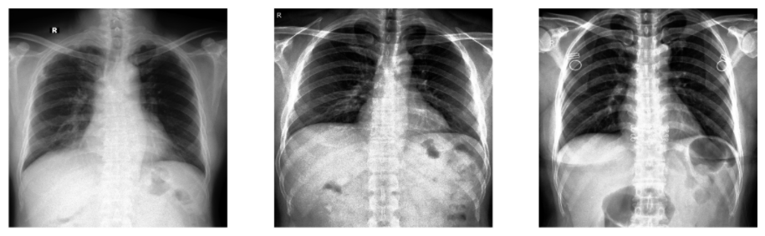

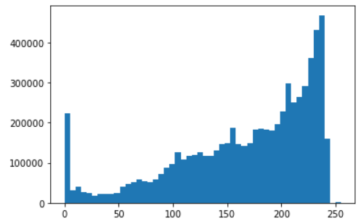
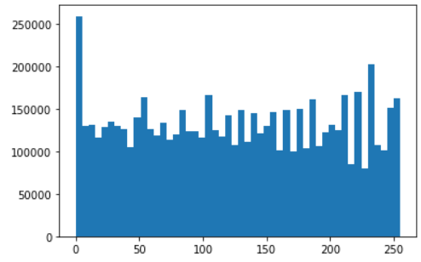
2. Data Preprocessing
Histogram Equalization
The contrast increases.
Details of the dark regions
appear clearly.
intensity

Slide 8
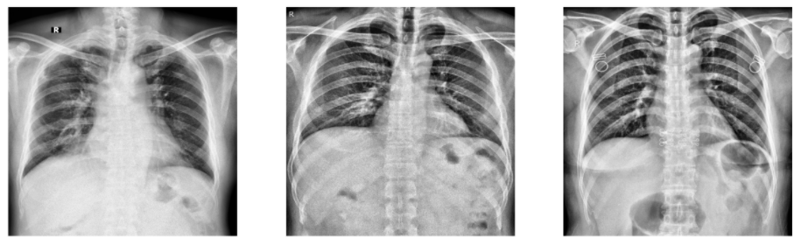
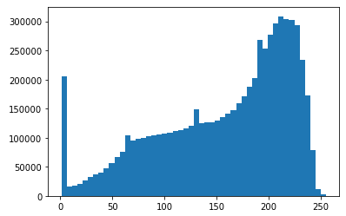
2. Data Preprocessing
Contrast Limited Adaptive Histogram Equalization
Image is divided into
small blocks called "tiles"

Slide 9
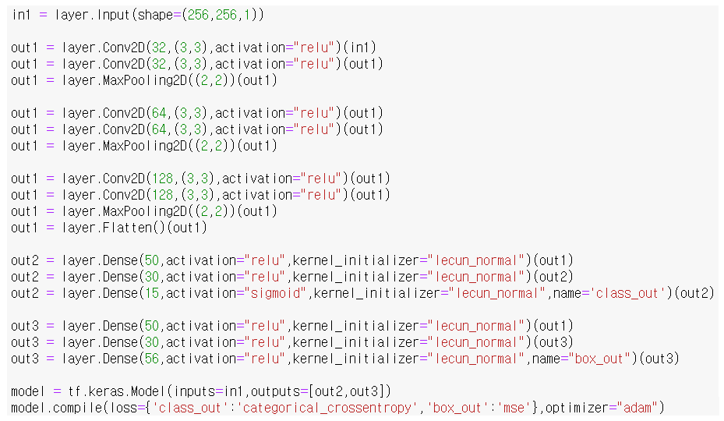
3. Modeling – Baseline CNN
Class, Confidence
Bounding Box
mean average precision
0.05

Slide 10
Infographic

Slide 11
Kaggle Competition
[1] VinBigData Chest X-ray Abnormalities Detection,
https://www.kaggle.com/c/vinbigdata-chest-xray-abnormalities-detection/data
References
[1] Chest X-ray abnormalities: Baseline[TF.Keras],
https://www.kaggle.com/bibhash123/chest-x-ray-abnormalities-baseline-tf-keras/comments
[2] x-ray image Enhancement test,
https://www.kaggle.com/kuuuuub/x-ray-image-enhancement-test

