Slide 1
Predict
Future Sales
최연석, 오서영

Slide 2
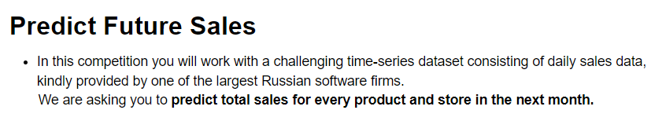
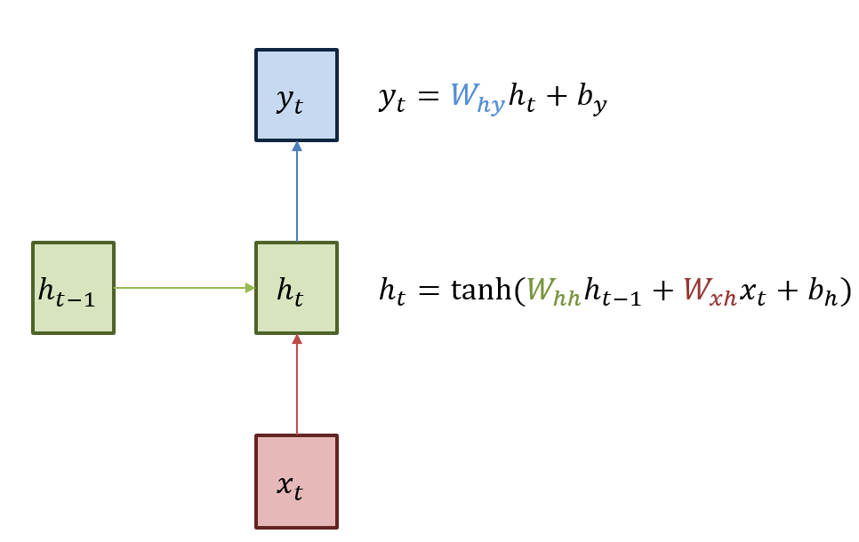
1. LSTM
LSTM (Long Short Term Memory)
: 순차적으로 등장하는 데이터 처리에 적합한 모델

Slide 3
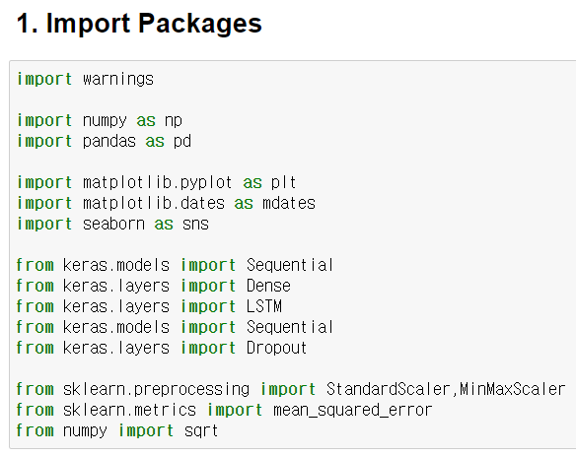
1. LSTM

Slide 4
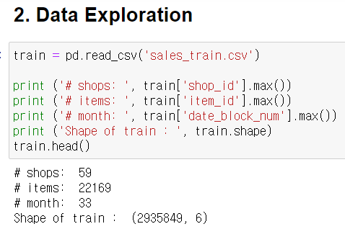
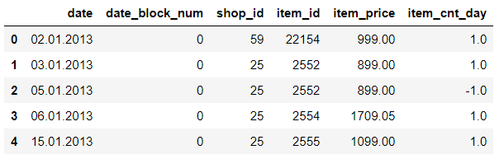
1. LSTM

Slide 5
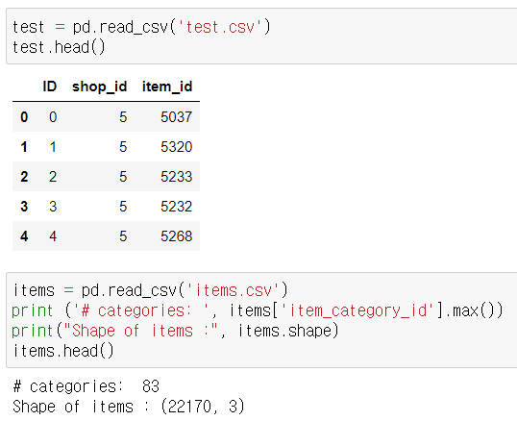
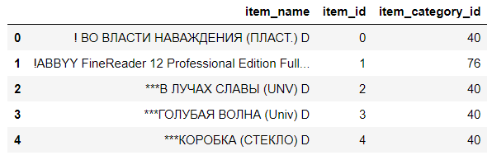
1. LSTM

Slide 6
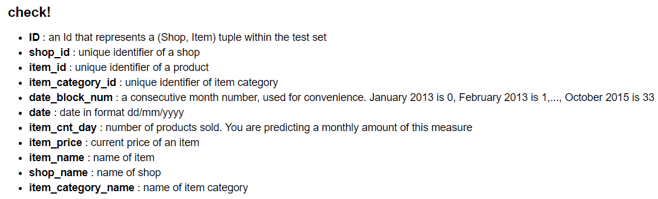
1. LSTM

Slide 7
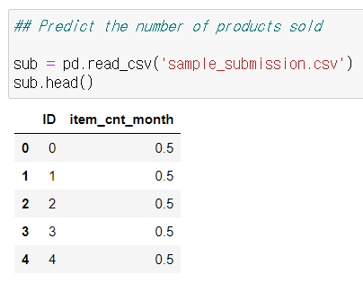
1. LSTM

Slide 8
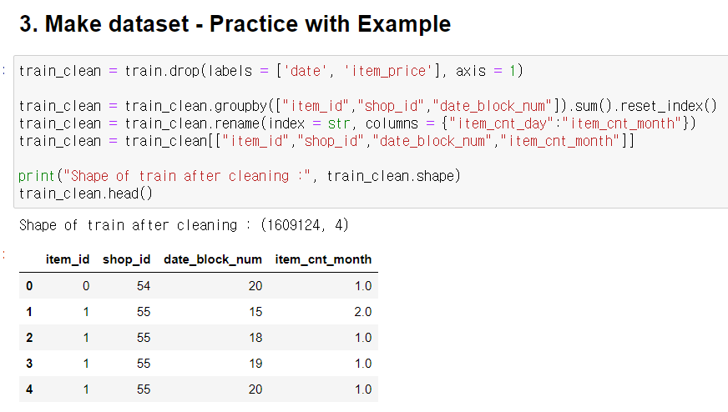
1. LSTM

Slide 9
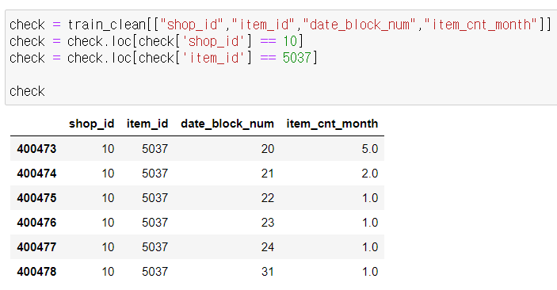
1. LSTM

Slide 10
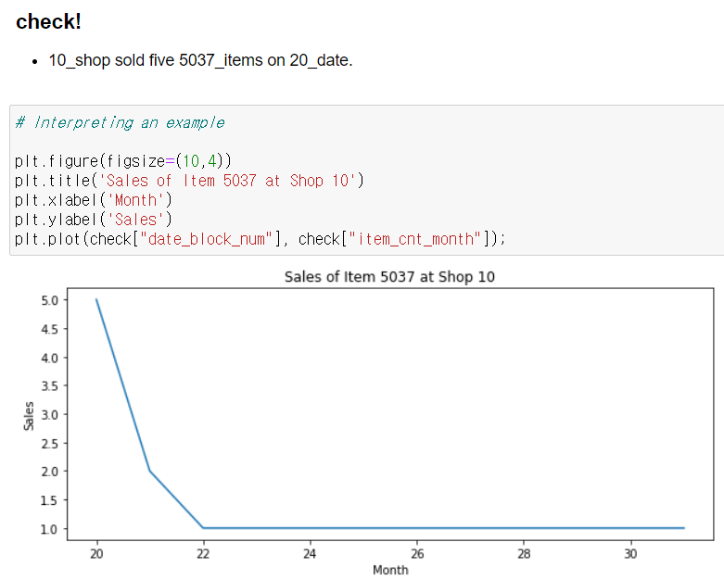
1. LSTM

Slide 11
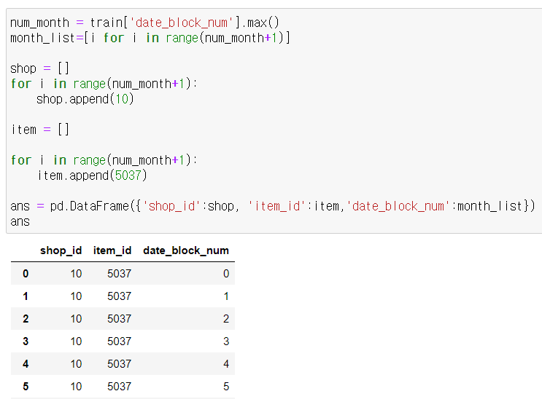
1. LSTM

Slide 12
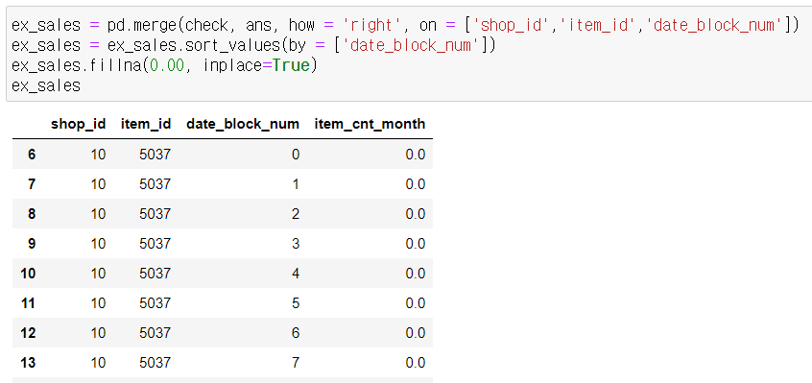
1. LSTM

Slide 13
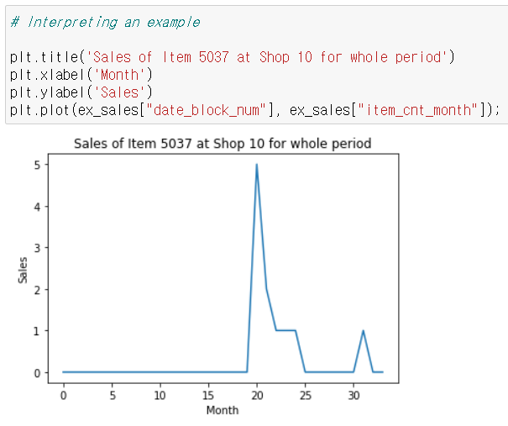
1. LSTM

Slide 14
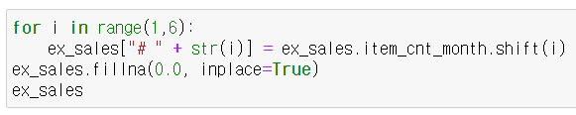
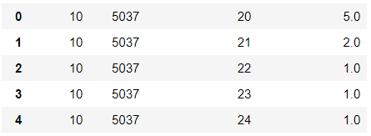
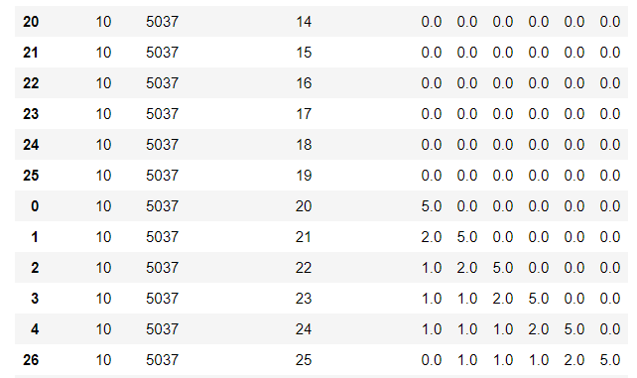
1. LSTM

Slide 15
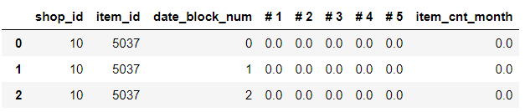
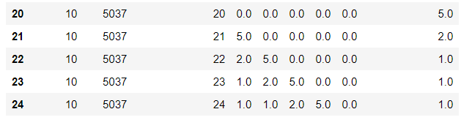
1. LSTM

Slide 16
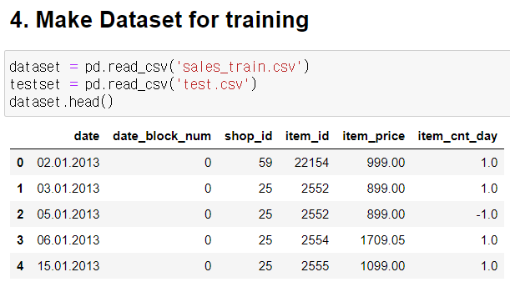
1. LSTM

Slide 17
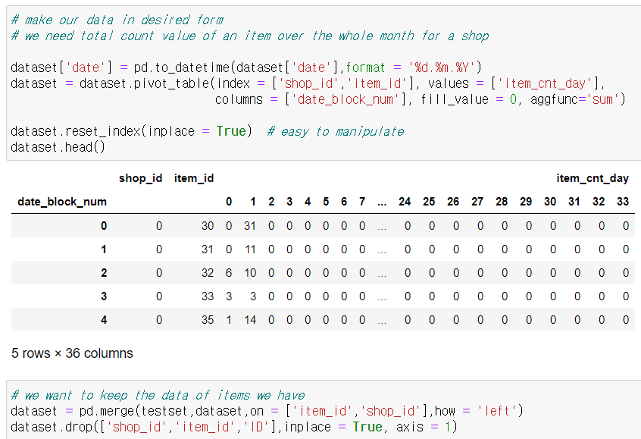
1. LSTM

Slide 18
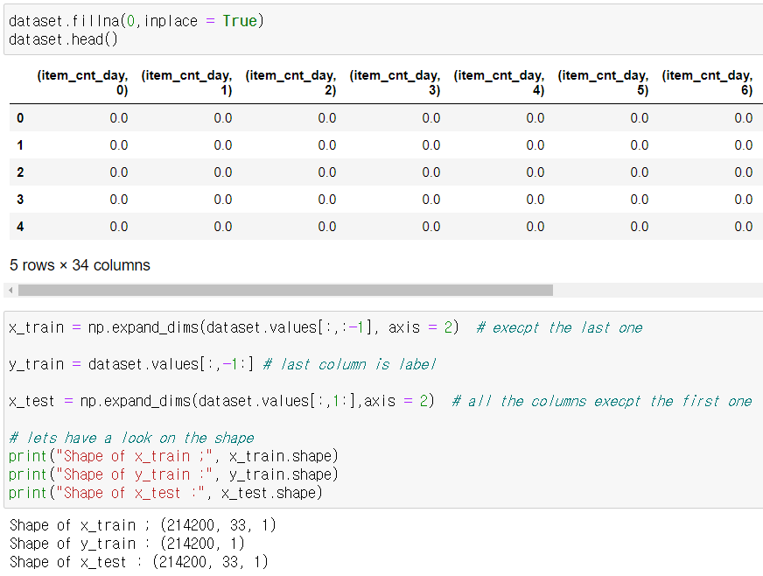
1. LSTM

Slide 19
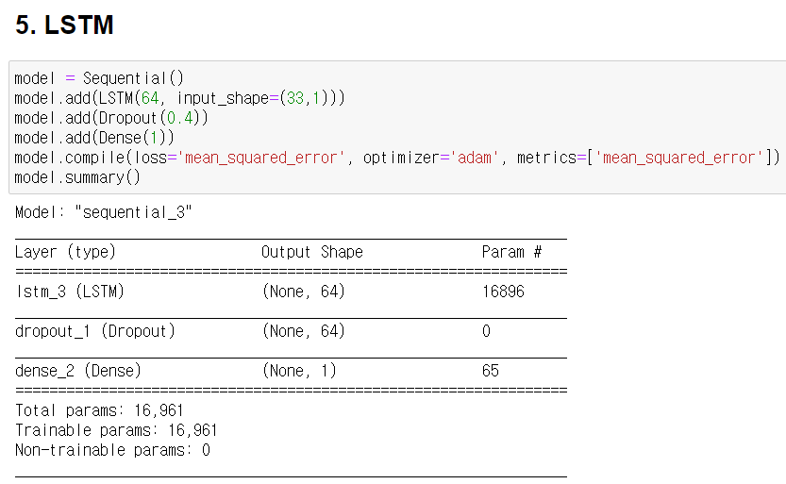
1. LSTM

Slide 20
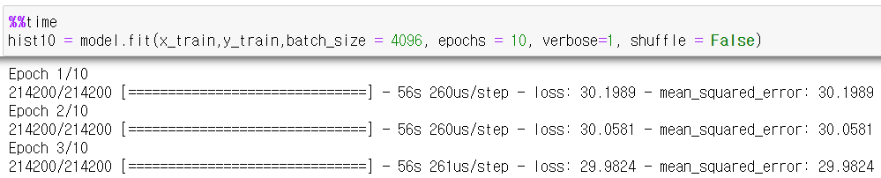
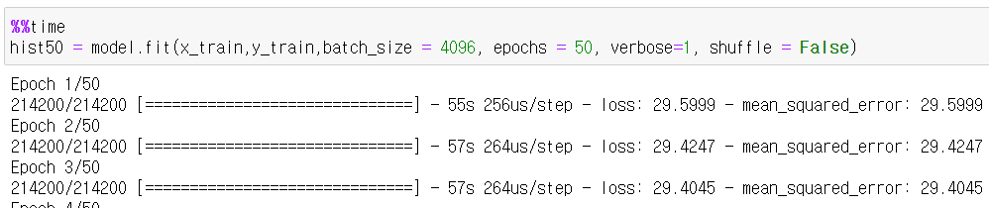
1. LSTM

Slide 21
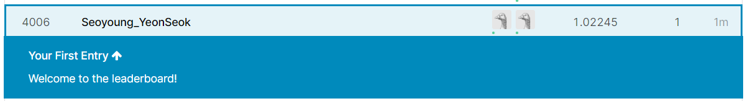
1. LSTM - Submit
10 iterations
RMSE error :
1.02245
60 iterations
RMSE error :
1.02711
4006등

Slide 22
2. XGBregressor
XGB Regressor (Extreme Gradient Boosting)
: 트리 기반의 앙상블 학습법
-> Kaggle Competition에서 주로 상위를 차지
-> 빠르고 성능이 좋아 자주 사용됨

Slide 23
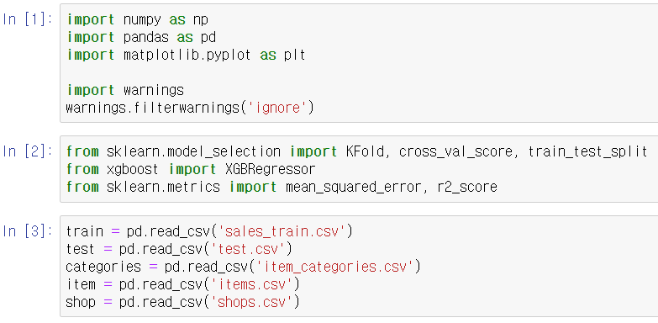
2. XGBregressor

Slide 24
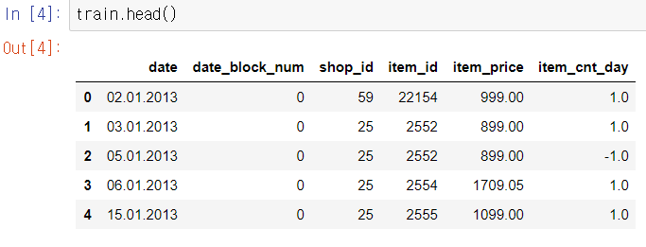
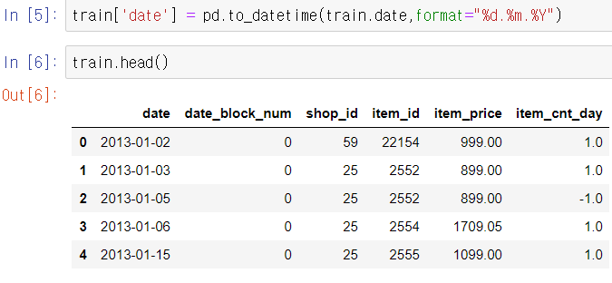
2. XGBregressor

Slide 25
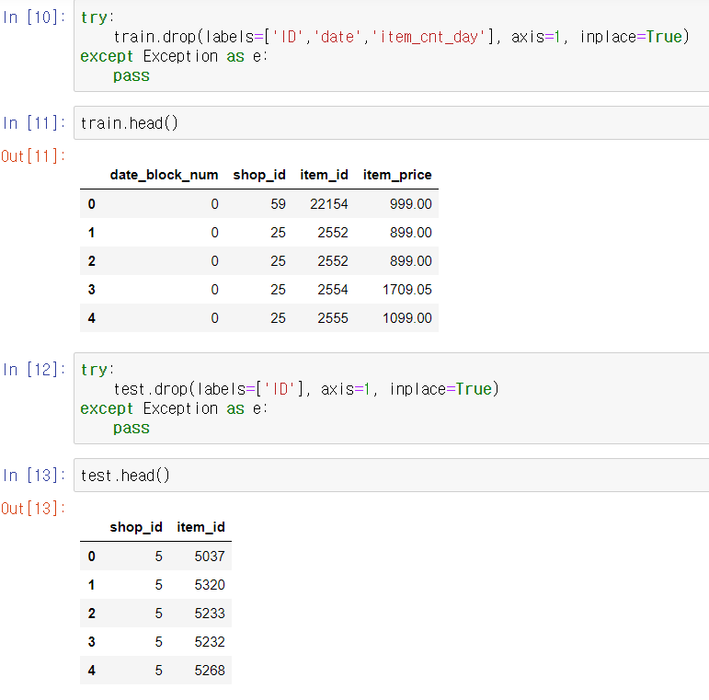
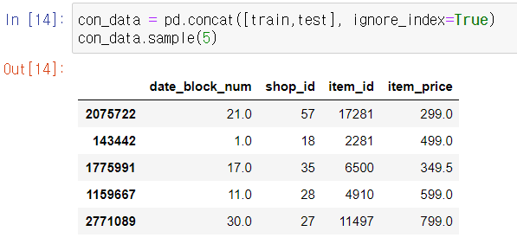
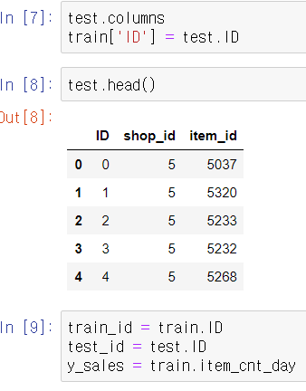
2. XGBregressor

Slide 26
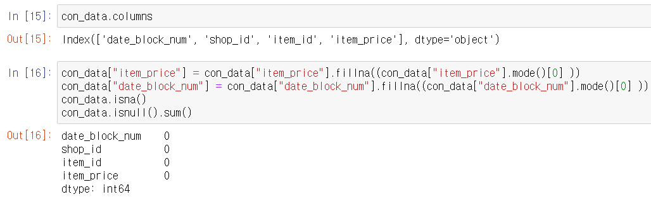
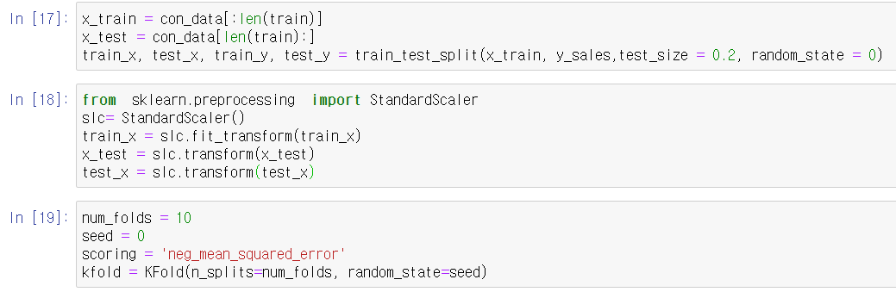
2. XGBregressor

Slide 27
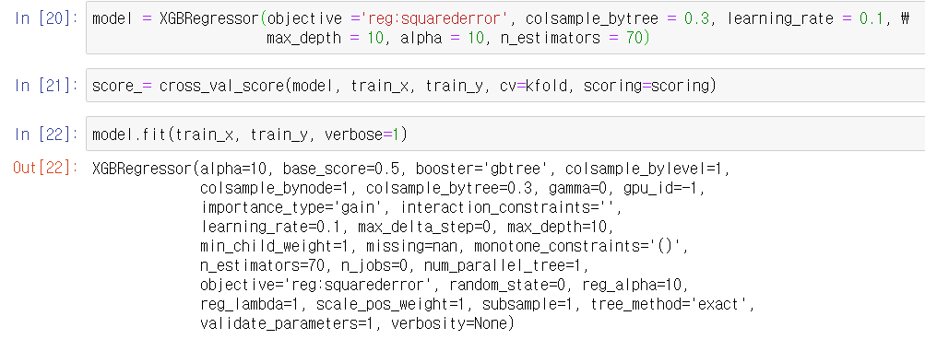
2. XGBregressor

Slide 28
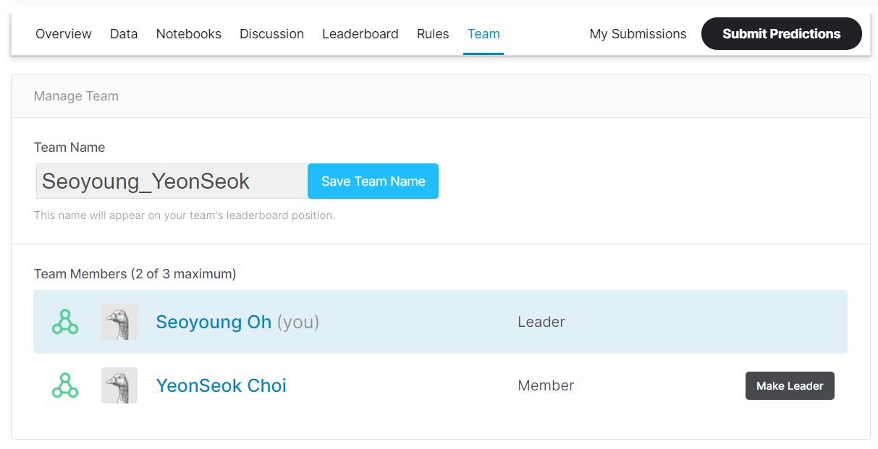
2. XGBregressor - Submit
RMSE error
: 1.43635
-> 7100 등

Slide 29
Conclusion
Feature Engineering !

Slide 30
Reference
[1] Simple Predict with Xgboost,
https://www.kaggle.com/doukanberkberber/simple-predict-with-xgboost
[2] Sales Forecast LSTM - 67% (Beginner-Friendly),
https://www.kaggle.com/carmnejsu/sales-forecast-lstm-67-beginner-friendly
[3] Simple and Easy Aprroach using LSTM,
https://www.kaggle.com/karanjakhar/simple-and-easy-aprroach-using-lstm

