Slide 1
Learning representations by back-propagating errors
Rumelhart, David E., Geoffrey E. Hinton,
and Ronald J. Williams.
수학과 오서영

Slide 2
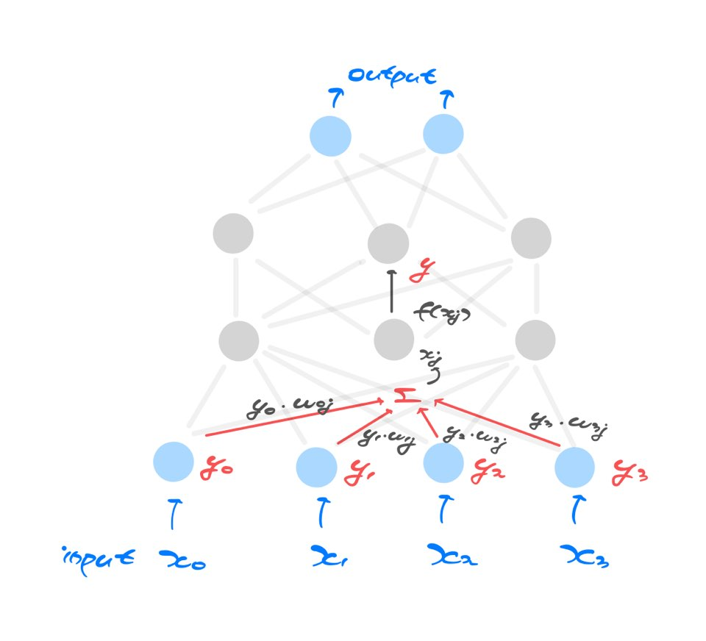
Neural Network

Slide 3
Back-propagation
If input units are directly connected to the output units
-> easy to find learning rules
(iteratively adjust the relative strengths)
-> progressively reduce the difference
between the actual and desired output
Hidden units
-> Learning procedure decides under what
circumstances the hidden units should be active in order to achieve the desired input-output
-> Hidden units are going to learn to represent some features of input domain
-> Back propagation

Slide 4


Feed Forward
Input${ x}_{j}$
-> input of higher layer will be a weighted sum of the outputs of all of the lower layer units that feed into it
-> i feeds into j
Output $y_{i}$
Adjusted by a weight on the link between i and j $w_{ij}$
$$x_{j}= \sum{y_{i}w_{ij}}$$

Slide 5

Feed Forward
Output $y_{j}$
-> Activation function in this paper is the sigmoid function
$$y_{j}= \frac{1}{1+e^{−x_{j}}}$$
-> By repeating this procedure, starting with the input layer,
we can feed-forward through the network layers and arrive at a set of outputs for the output layer

Slide 6

Error Function
The aim is to find a set of weights that ensure that
the output vector is the same as the desired output vector
-> computed output value of j in output layer $y_{j}$
-> its desired state $d_{j}$
$$E= \frac{1}{2}\sum_{j}{(}{y_{j}−d_{j})}^{2}$$
-> minimize
-> need to adjust the weights

Slide 7

Error Function
To minimize E by gradient descent it is necessary to compute the partial derivative of E with respect to each weight in the network
-> $\frac{∂E}{∂w}$-> $\frac{∂E}{∂y_{j}}$ (E and y are directly related) -> $\frac{∂y_{j}}{∂x_{j}}$
$\frac{∂}{∂y_{j}}\frac{1}{2}\sum_{j}{(}{y_{j}−d_{j})}^{2}$ = $y_{j}−d_{j}$ $y_{j}$ = sigmoid${(x}_{j})$
$\frac{∂y_{j}}{∂x_{j}}$ = sigmoid${(x}_{j})$ * ($1−\text{sigmoid}{(x}_{j})$)

Slide 8


Error Function
$$x_{j}= \sum{y_{i}w_{ij}}$$
-> $\frac{∂x_{j}}{∂w_{ij}}$ = $y_{i}$
We can chain them together to figure out how the error changes with the weights
$$\frac{∂E}{∂w}= \frac{∂E}{∂y}∗\frac{∂y}{∂x}∗\frac{∂x}{∂w}$$

Slide 9
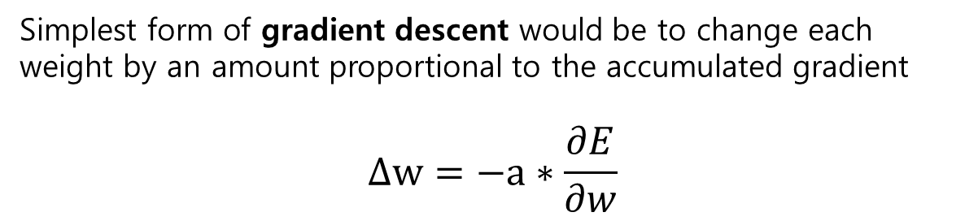
Gradient Descent
Simplest form of gradient descent would be to change each weight by an amount proportional to the accumulated gradient
$$Δw=−a∗\frac{∂E}{∂w}$$

Slide 10
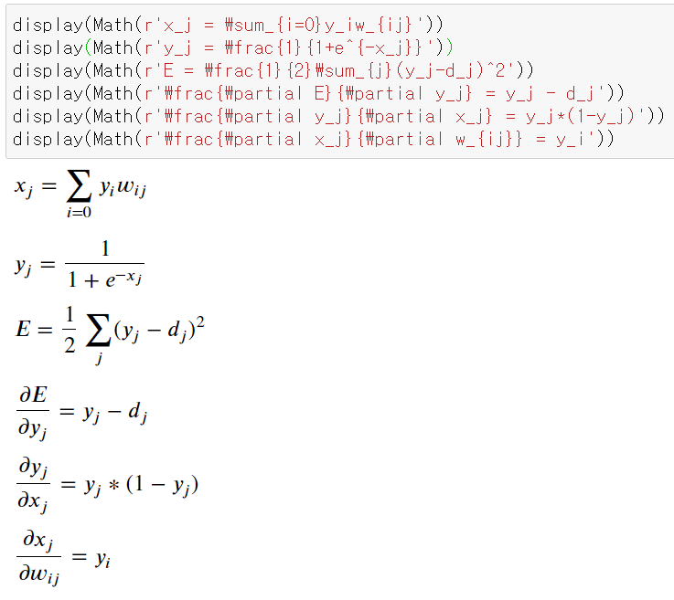
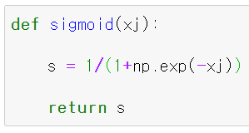
Code implementation

Slide 11
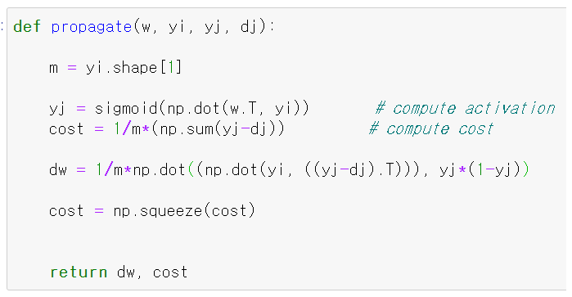
Code implementation

Slide 12
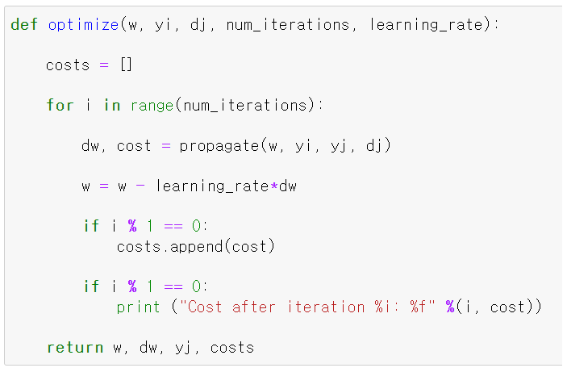
Code implementation

Slide 13
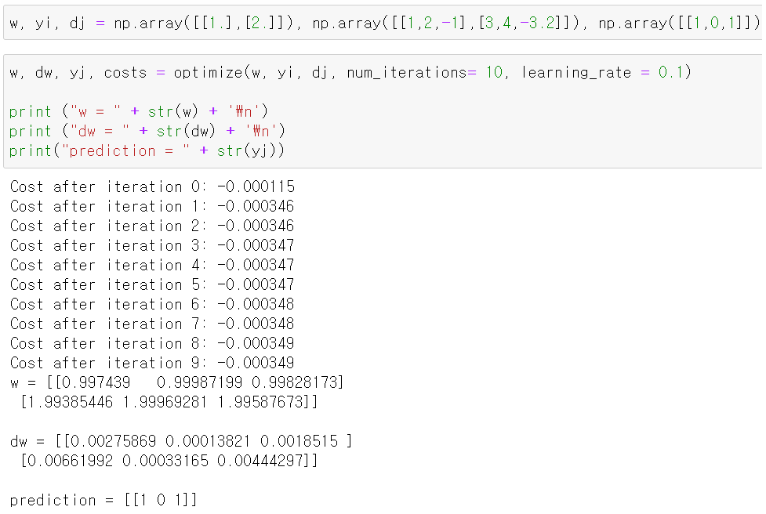
Code implementation

