Slide 1
Learning representations by back-propagating errors
Rumelhart, David E., Geoffrey E. Hinton,
and Ronald J. Williams.
수학과 오서영

Slide 2
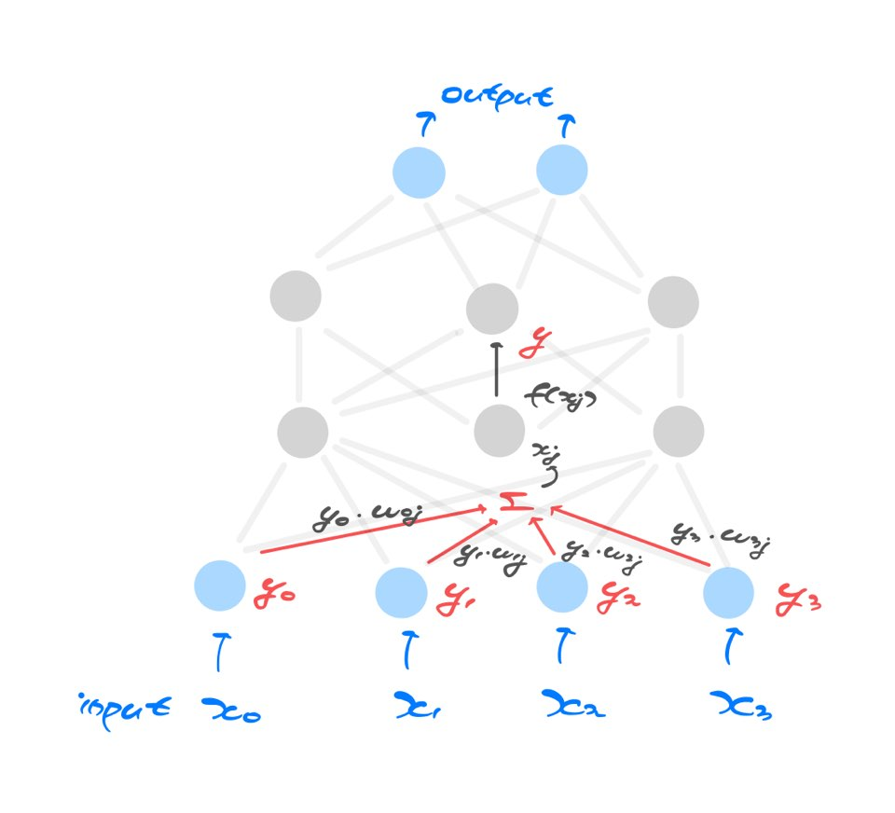
Neural Network

Slide 3
Back-propagation
If input units are directly connected to the output units
-> easy to find learning rules
(iteratively adjust the relative strengths)
-> progressively reduce the difference
between the actual and desired output
Hidden units
-> Learning procedure decides under what
circumstances the hidden units should be active in order to achieve the desired input-output
-> Hidden units are going to learn to represent some features of input domain
-> Back propagation

Slide 4







Feed Forward
Input
-> input of higher layer will be a weighted sum of the outputs of all of the lower layer units that feed into it
-> i feeds into j
Output
Adjusted by a weight on the link between i and j

Slide 5

Feed Forward
Output yj
-> Activation function in this paper is the sigmoid function
-> By repeating this procedure, starting with the input layer,
we can feed-forward through the network layers and arrive at a set of outputs for the output layer

Slide 6

Error Function
The aim is to find a set of weights that ensure that
the output vector is the same as the desired output vector
-> computed output value of j in output layer yj
-> its desired state dj
-> minimize
-> need to adjust the weights

Slide 7


Error Function
To minimize E by gradient descent it is necessary to compute the partial derivative of E with respect to each weight in the network
-> dE/dw
-> dE/dyj (E and y are directly related)
-> dyj/dxj

Slide 8



Error Function
-> dxj/dwij
We can chain them together to figure out how the error changes with the weights

Slide 9

Gradient Descent
Simplest form of gradient descent would be to change each weight by an amount proportional to the accumulated gradient

Slide 10
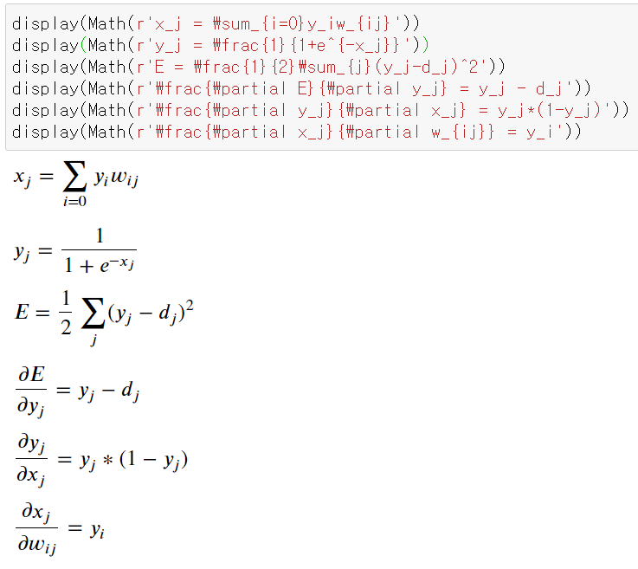
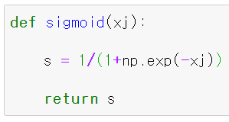
Code implementation

Slide 11
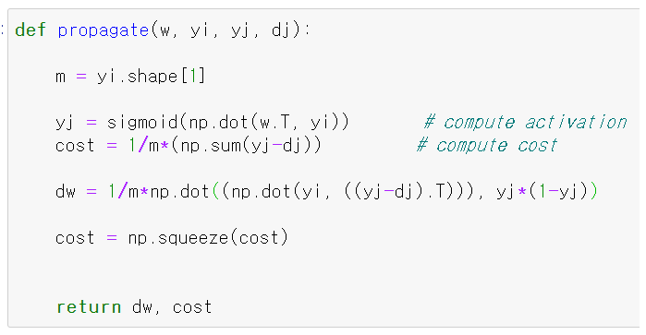
Code implementation

Slide 12
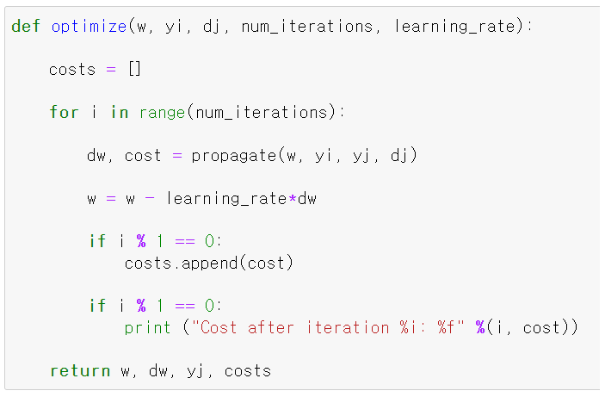
Code implementation

Slide 13
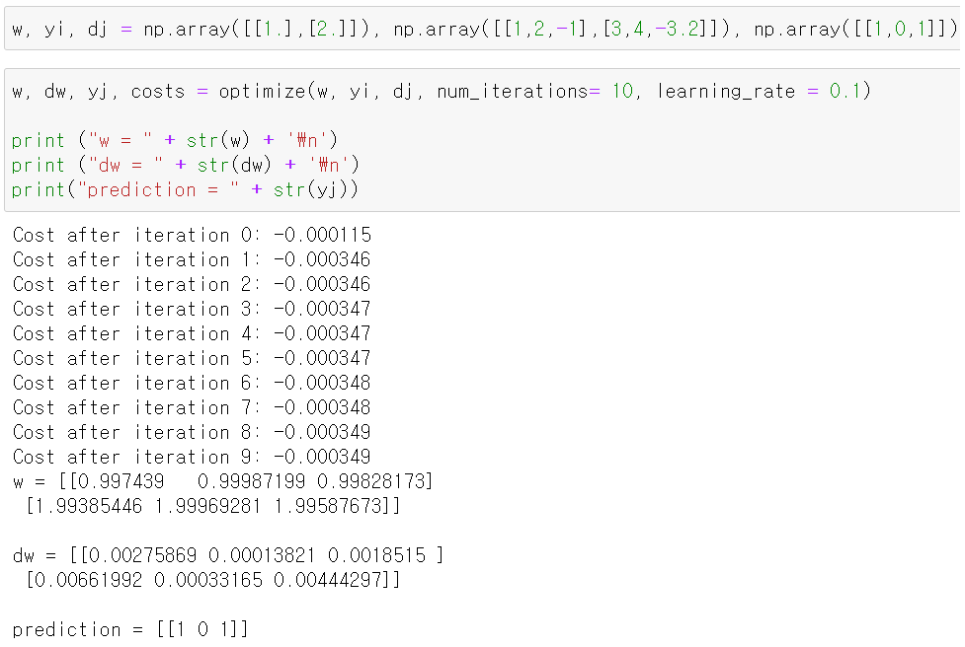
Code implementation

