Slide 1
Gradient-based learning applied to document recognition
By LeCun, Yann, et al
2017010698 수학과 오서영

Slide 2
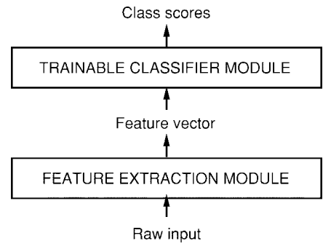
1. Introduction
Machine Learning with Neural Network
-> important role in pattern recognition
-> hand-designed heuristics + automatic learning
Pattern Recognition
First module : feature extractor
Input patterns -> low dimensional vectors
Distortions of the input -> do not change their nature
Hand-craft feature extractor -> prior knowledge
2. Second module : Classifier
general-purpose and trainable
-> problem
: accuracy is largely determined
by the ability of the feature extractor

Slide 3







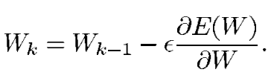
2. Learning from Data
Gradient-based learning
Learning machine computation
p-th input patttern
collection of adjustable parameters
class label (output)
Loss function
desired output
-> finding the value of W that minimize
-> W is updated

Slide 4
3. Gradient Back-Propagation
Usefulness of Gradient-based learning
was not widely realized until the following three events occurred.
The presence of local minima in the loss function does not seem to be a major problem in practice
Efficient procedure = Back-propagation
to compute the gradient in a non-linear system composed of several layers of processing
3. Back-prop applied to multi-layer neural networks can solve complicated learning tasks

Slide 5





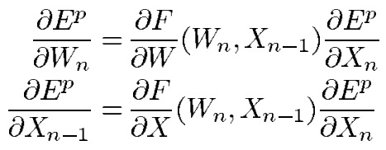
4. Globally Trainable Systems
Most practical pattern recognition systems are composed of multiple modules
Each module must be continuous and differentiable almost everywhere with respect to the internal parameters of the module
input vector representing the output of the module
Vector of tunable parameters
Module’s input vector
Partial derivatives of with respect to and

Slide 6
5. Convolutional Networks
Traditional model of pattern recognition,
Hand-designed feature extractor gathers relevant information from input
And eliminates irrelevant information
Trainable classifier then categorized the resulting feature vector into classes
Network could be fed with almost raw inputs
-> fully connected feed-forward network -> problems

Slide 7
5. Convolutional Networks
1. Typical images are large, often with several hundred variables (pixels) -> large number of parameters increases the capacity of the system and therefore requires a larger training set
2. Handwriting ~ size, slant, position variations
for individual characters
3. Variables are spatially or temporally nearby are highly correlated
-> Deficiency of fully connected architectures is that the topology of the input is entirely ignored.

Slide 8
5. Convolutional Networks
CNN
- Local receptive fields, shared weights, sub-sampling
1. Local receptive fields
Neurons can extract elementary visual features such as oriented edges, end-points, corners
-> These features are combined by the subsequent layers in order to detect higher-order features
2. shared weights
Units in a layer shares the same set of weights.
The set of outputs of the units in such a plane is called a
feature map. Units in a feature map are all constrained to
perform the same operation on different parts of the image.
A complete convolutional layer is composed of several feature
maps, so that multiple features can be extracted at each location

Slide 9
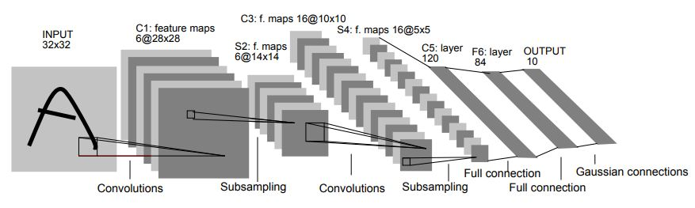
5. Convolutional Networks
3. sub-sampling
A simple way to reduce the precision with which the
position of distinctive features are encoded in a feature
map is to reduce the spatial resolution of the feature map.
-> thereby reducing the resolution of the feature map and
reducing the sensitivity of the output to shifts and distortions

