Slide 1
Reducing the Dimensionality of Data with Neural Networks
Hinton, Geoffrey E.,
and Ruslan R. Salakhutdinov.

Slide 2
Overview
Dimensionality reduction
- classification, visualization, communication, storage of high-dimensional data
Goal : use a deep neural to reduce the dimensionality of an input.
-> the reduction techniques described are compared to principal component analysis (PCA) and logistic PCA
PCA
: Find the directions of greatest variance in the data set and
Represent each data point by its coordinates along each of these directions.

Slide 3
Overview
Autoencoder
Nonlinear generalization of PCA
Encoder transform the high-dimensional data into a low-dimensional code
Decoder recover the data from the code
Starts with random weights in the two networks
Trained by minimizing the discrepancy between the original data and its reconstruction.
Gradients are obtained by the chain rule to back-propagate error from the decoder network to encoder network.

Slide 4
Overview
It is difficult to optimize multilayer autoencoder
1. With large initial weights
: autoencoders typically find poor local minima
2. With small initial weights
: the gradients in the early layers are tiny, making it infeasible to train autoencoders with many hidden layers
3. If initial weights are close to a good solution
: gradient descent works well
-> But finding such initial weights is very difficult
Pretraining procedure for binary data, generalize it to real-valued data, and show that it works well for a variety of data sets.
-> based on Restricted Boltzmann Machine (RBM)

Slide 5
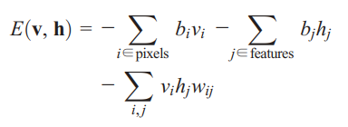
Methods
Restricted Boltzmann Machine (RBM)
The input data correspond to visible units of the RBM and the feature detectors correspond to hidden units.
A joint configuration (w, h) of the visible and hidden units has an energy
The network assigns a probability to every possible data via this energy function

Slide 6
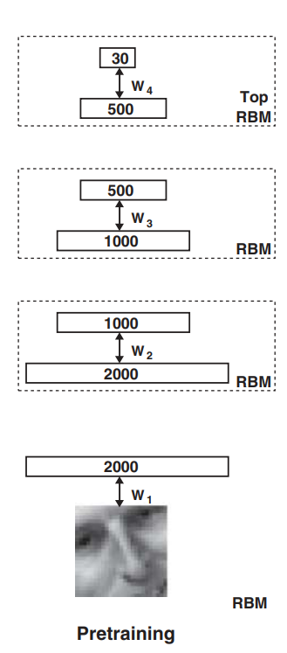
Methods
Training a large neural network through greedy layer-wise pretraining
He took an input (50*50 images), and trained a RBM to reduce the feature space of the image.
Each set of weights are learned individually, so in the first step, W1 is learned and once W1 is learned,
the data is then all restored as the result of the first transfer and W2 is learned, and so on.

Slide 7
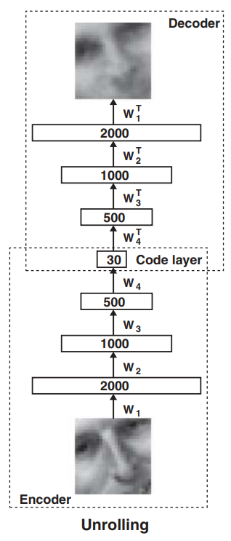
Methods
RBM is generative models, so the weights are bidirectional.
-> activation in layer two can be used to generate a corresponding set of activations in layer one.
The weights between the layers are effectively re-used to map the data back to its original dimensionality.
-> the input weights for a NN that can be trained with backpropagation to fine-tune the weights using the input weights as the outputs to the network
Code layer : used for classification, regression, clustering, etc.

