Slide 1
Gradient-based learning applied to document recognition
By LeCun, Yann, et al
2017010698 수학과 오서영

Slide 2
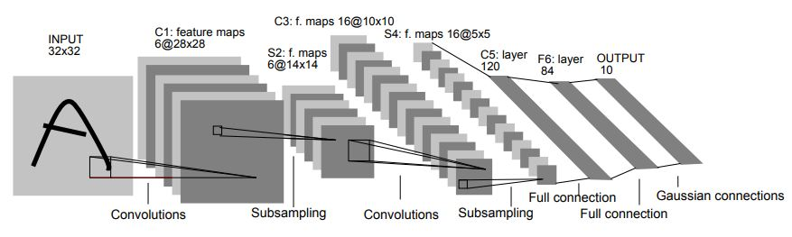
5. Convolutional Networks

Slide 3
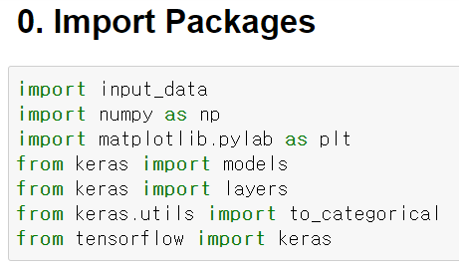
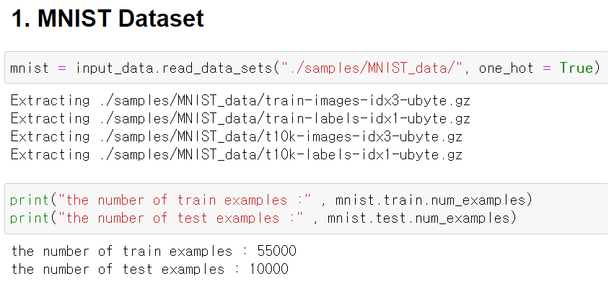
5. Convolutional Networks

Slide 4
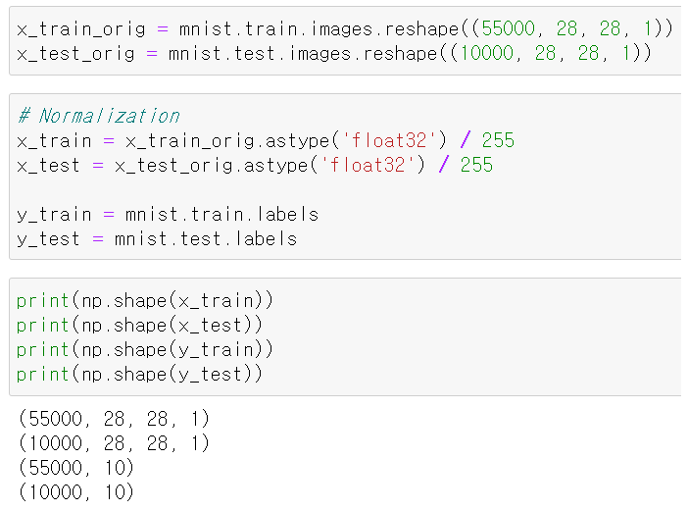
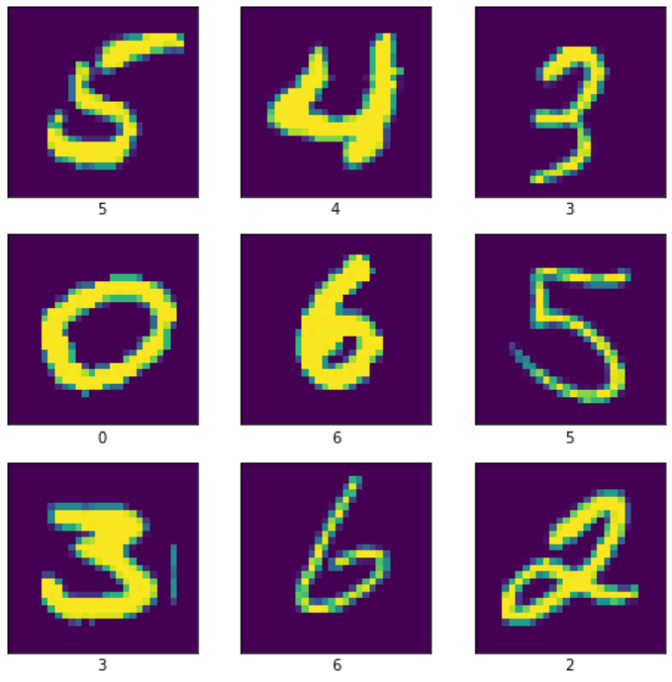
5. Convolutional Networks

Slide 5
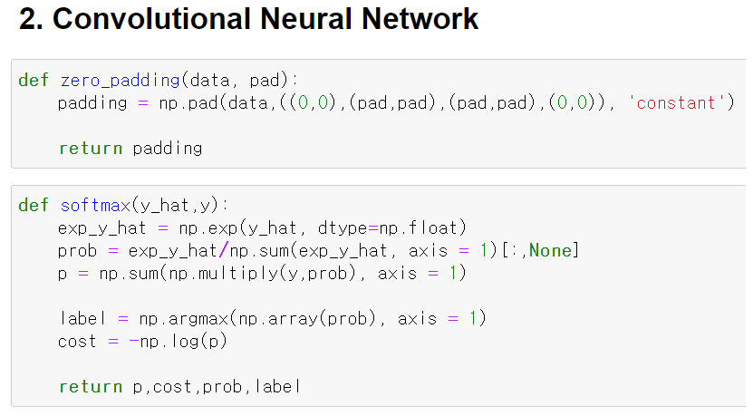
5. Convolutional Networks

Slide 6
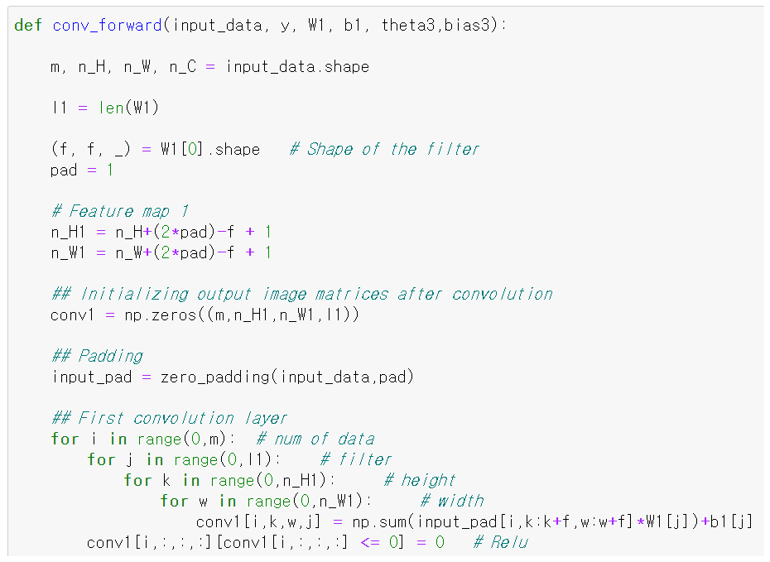
5. Convolutional Networks

Slide 7
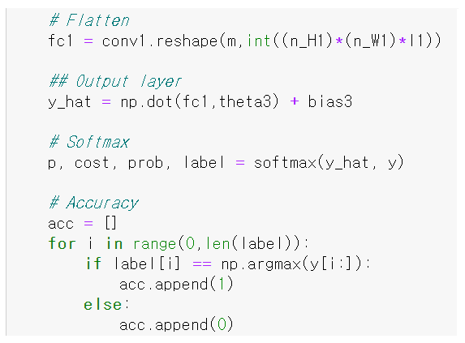
5. Convolutional Networks

Slide 8
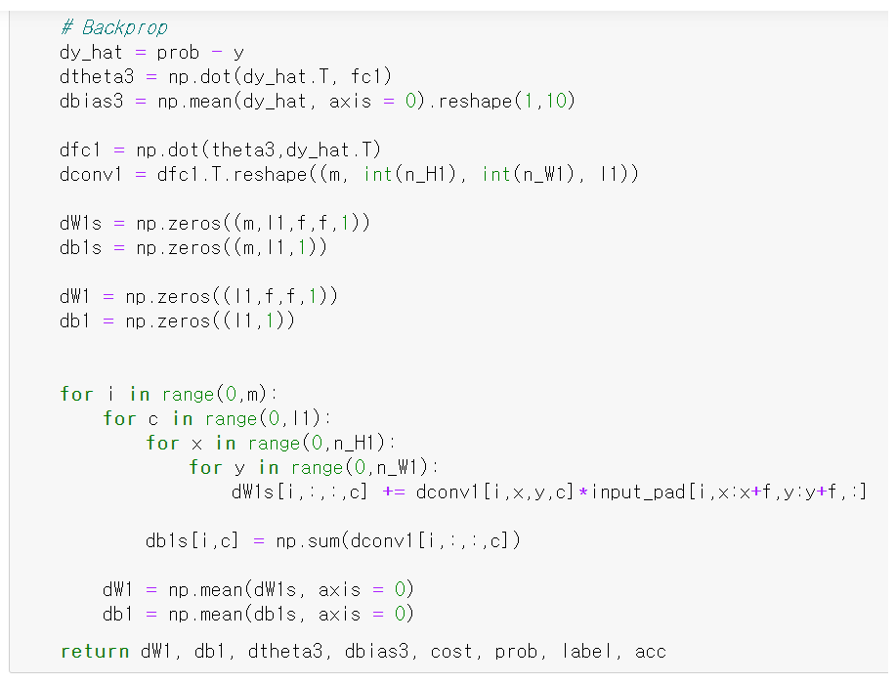
5. Convolutional Networks

Slide 9
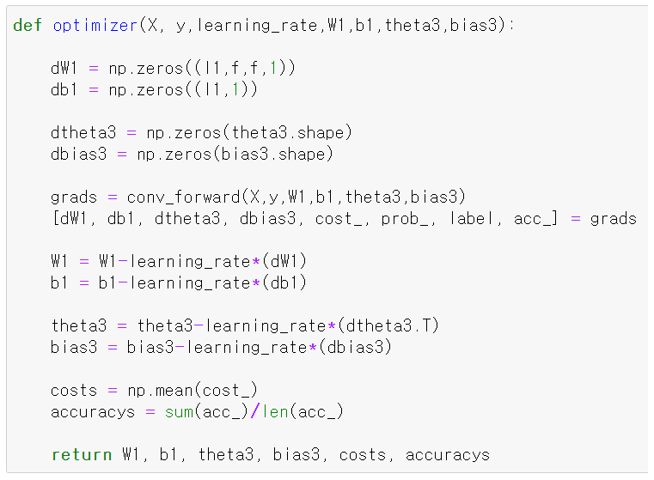
5. Convolutional Networks

Slide 10
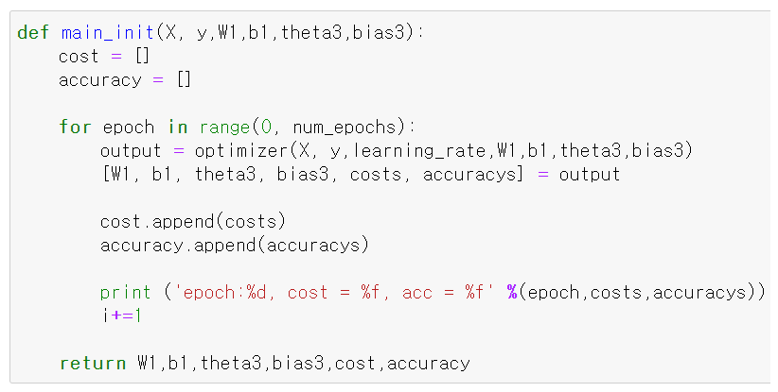
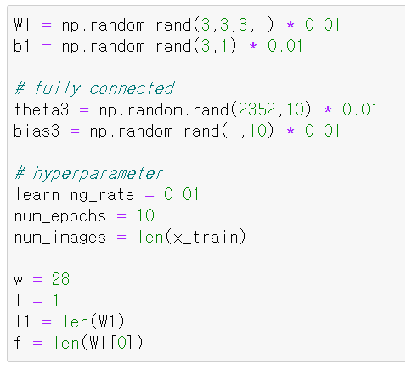
5. Convolutional Networks

Slide 11
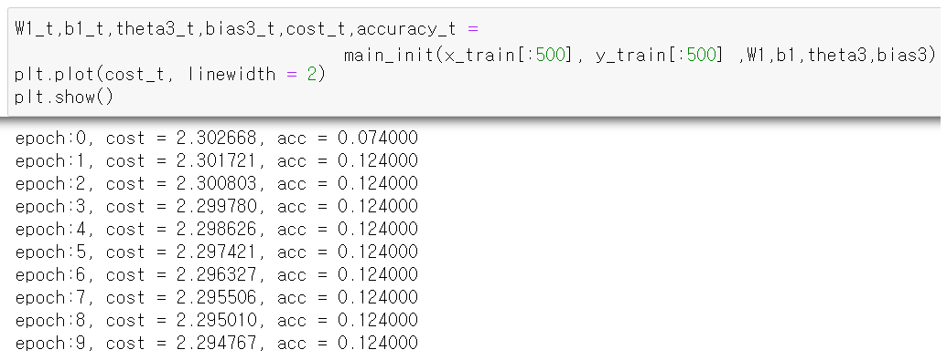
5. Convolutional Networks

