Slide 1

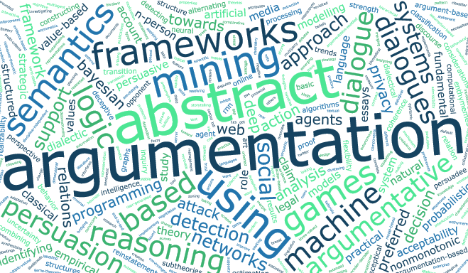


Online Handbook
of Argumentation for AI
OHAAI aims to provide an open access and curated platform for the argumentation research community to keep track of the latest PhD work on the theory and application of argumentation in AI.
OHAAI seeks short papers (extended abstracts) that present emerging research in argumentation. We encourage submissions describing work-in-progress or recently completed work during PhD studies.
OHAAI will publish the peer reviewed papers on ArXiv.
The authors will have the opportunity to update their contribution through the duration of their PhDs.
Important Dates:
Expression of interest
31/10/2019, 23:59 GMT
Paper submission
31/01/2020, 23:59 GMT
Notification of acceptance
Within 30 days from submission
For further information contact: argumentation@kcl.ac.uk
Visit our website!
https://ohaai.github.io

Slide 2

Online Handbook
of Argumentation for AI
OHAAI aims to provide an open access and curated platform for the argumentation research community to keep track of the latest and upcoming topics and applications of argumentation in AI.
OHAAI seeks short papers (extended abstracts) that present emerging research in argumentation. We encourage submissions describing work-in-progress or recently completed work during PhD studies.
OHAAI will publish the peer reviewed papers on ArXiv.
The authors will have the opportunity to update their contribution through the duration of their PhDs.
Important Dates:
Expression of interest
31/10/2019, 23:59 GMT
Paper submission
31/01/2020, 23:59 GMT
Notification of acceptance
Within 30 days from submission
For further information contact: argumentation@kcl.ac.uk
Visit our website!
QR code
Website address

