Slide 1
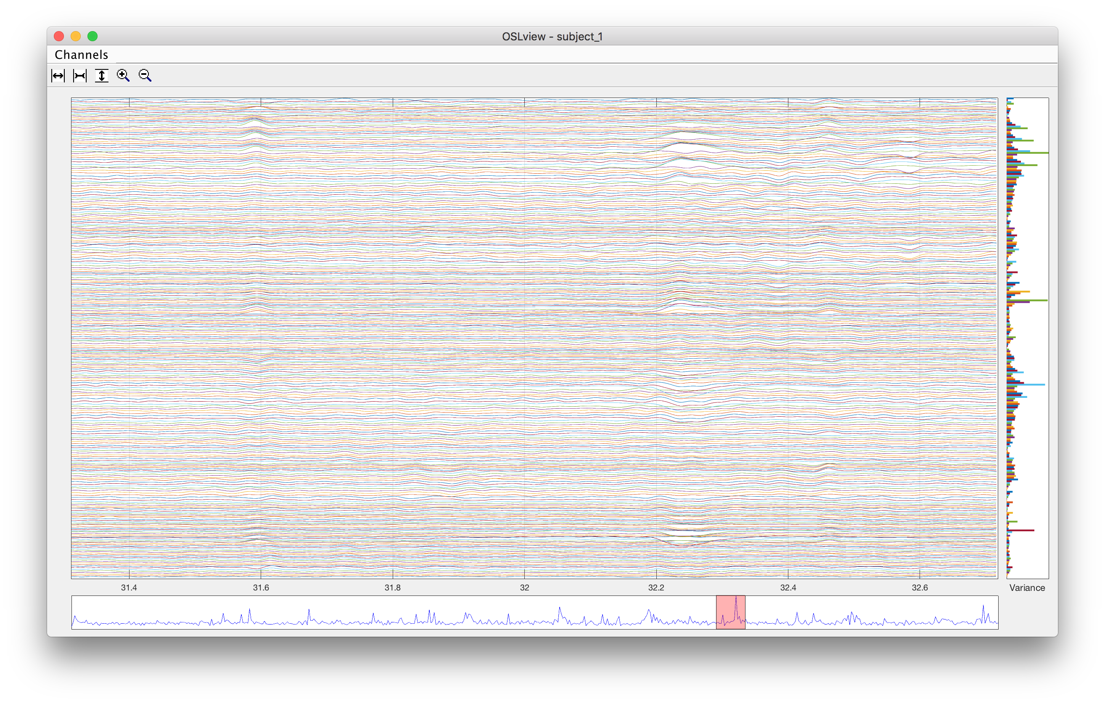
Channel menu
Mouse zoom
Increase/decrease amplitude
Increase/
decrease time
Side
window
Main window
Current time window
Pan window

