Slide 1


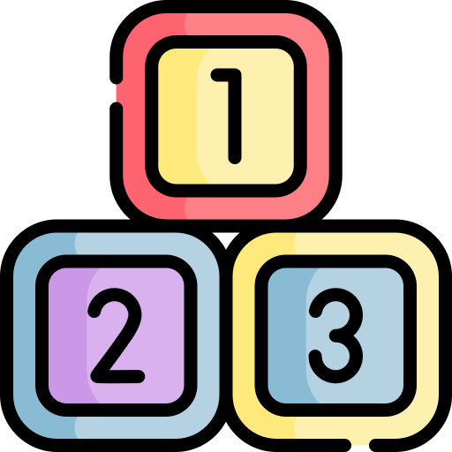
Deploying C2Q: Step-by-Step Overview
System Requirements
Java 8+, Apache Maven 3, Apache Tomcat
Python 3.7.6+
PostgreSQL (optional for queries)
Key Dependencies
Usagi for concept mapping (from OHDSI)
Negation Detection model (from the shared Google Drive)
OMOP CDM v5.2.2 datasets (e.g., SynPUF_1K / 5%)
OMOP CDM Vocabulary (from Athena)
Setup Process
Clone Repository
Set up Python venv & install packages
Download & place the Negation Detection model in NegationDetection/
Download Usagi & implement the Concept Hub POST API
Configure paths in GlobalSetting.java: Negation model path, Python virtualenv path, Concept Hub POST API endpoint (Usagi)
Load OMOP datasets into PostgreSQL
Update DB config in GlobalSetting.java (URLs, credentials)
Build and deploy on Apache Tomcat
Access C2Q via browser

Slide 2
Integrating Clinical Notes into the C2Q Pipeline
Pre-filter Clinical Notes
Extract & Structure Info
Generate Cohort Using C2Q
Create a targeted data mart by filtering clinical notes using major eligibility criteria (e.g., conditions, or clinical departments).
Apply NLP tools to extract clinical entities from free-text notes
Use concept mapping tools to map extracted entities to standardized OMOP CDM concepts
Store the structured outputs as augmented data within the OMOP CDM structured database.
Enter free-text eligibility criteria via the C2Q interface.
C2Q converts criteria into SQL queries executed against the augmented OMOP CDM database.
Retrieve a patient cohort informed by both structured data and unstructured notes.

